Slide 1
CoroPrevention EDC - Training Master Deck
v0.1
edc.coroprevention.eu

Slide 2
Agenda
Enter and Edit Data
Reports
Monitor Data
Manage DCRs
CoroPrevention: Laboratory Data
CoroPrevention: Randomise / Allocate Treatment
CoroPrevention: SAE / SADE Form
CoroPrevention: Import Data from Tool Suite
CoroPrevention: Generate ePRO Link
CoroPrevention: Protocol Deviations
CoroPrevention: Laboratory Data
CoroPrevention: Protocol Deviations

Slide 3
Training Topics per User Type
Training Topic | User Types
Login | All
Training | All
Navigation | All
Add Subject | Investigator, Site Nurse
Enter and Edit Data | Investigator, Site Nurse, (Lead) CRA, Data Manager, Project Manager
Apply Signature on eCRFs | Investigator
Reports | All
Monitor Data | (Lead) CRA
Manage DCRs | (Lead) CRA, Data Manager

Slide 4
Training Topics per User Type (2)
Training Topic | User Types
Forgot Password | All
Reset 2FA | All
CoroPrevention - Laboratory Data | All
CoroPrevention - Randomise / Allocate Treatment | Investigator, Site Nurse
CoroPrevention - SAE / SADE Form | Investigator, Site Nurse
CoroPrevention - Import Data from Tool Suite | Investigator, Site Nurse
Generate ePRO Link | Investigator, Site Nurse
Protocol Deviations | (Lead) CRA, Data Manager, Project Manager, Investigator, Site Nurse
Endpoint Adjudication | CEC User, CEC Chair

Slide 5
Enter and Edit Data

Slide 6
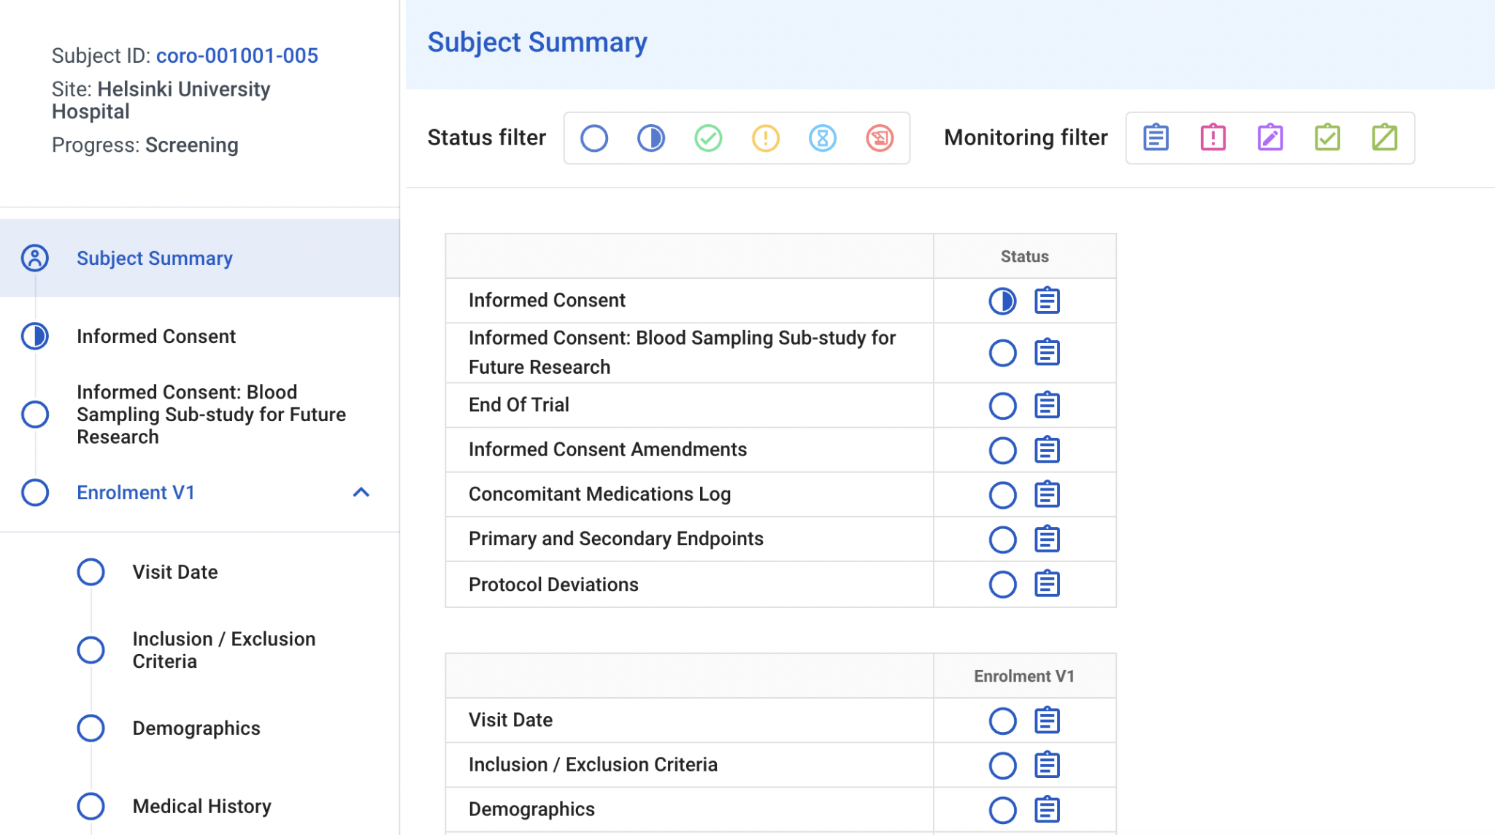
Enter/Edit Data - Flow
Use the subject flow to navigate to a form:
Some forms are not part of a visit (e.g. Informed Consent)
Click a visit to view its forms

Slide 7
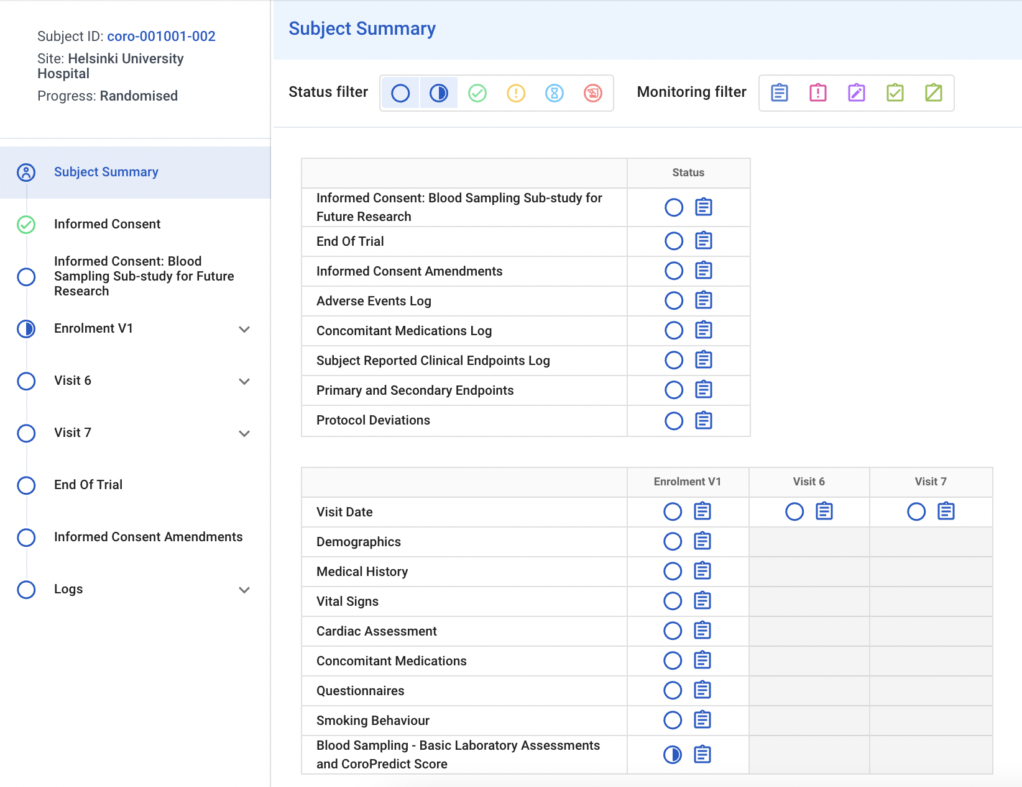
Enter/Edit Data - Subject Summary
Or use the subject summary to navigate to a form:
Optionally click a status filter to only view forms for a given data entry status
Click the status icon for the form to access it
In the example given, the subject summary is filtered on entry status “Empty” and “Incomplete”.
The summary now shows all forms where data is still expected.

Slide 8
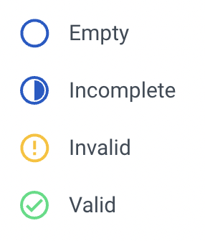
Enter/Edit Data - Status Icons
Status Icons indicate the data entry status of a subject/visit/form/block:
 | No data is present.
 | Data is present, but data entry is not complete.
 | Invalid data is present: at least one DCR (query) is raised.
 | All data is present and valid.
 | At least one DCR (query) has been answered.
 | Data has been signed.

Slide 9
Enter/Edit Data - Data Saving
Data entered is automatically validated and saved in-real time:
No Save button
Instant feedback in form of automatic DCRs (queries) on the entered data
Dynamic fields or forms depending on the entered data appear immediately
In this example, a DCR is raised as the day contains a non-numeric character

Slide 10
Enter/Edit Data - Open DCR
Hover over the DCR icon next to the field label to view the DCR message
Or open the DCR by clicking the DCR icon or the DCR button

Slide 11
Enter/Edit Data - Edit
Update the entered data accordingly if applicable:
Change the entered data
Provide a reason for change
Click Save to confirm or cancel to return to the form without making the update
Choose ‘Data changed because’ to provide a custom reason for making the data update

Slide 12
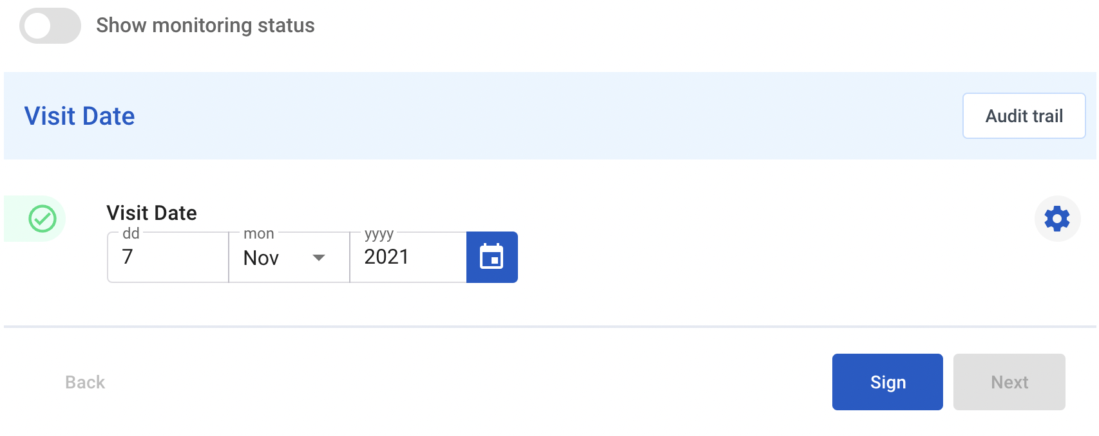
Enter/Edit Data - Edit (2)
The updated data is saved and validated in-real time:
Automatic DCRs are closed automatically if they are no longer applicable

Slide 13
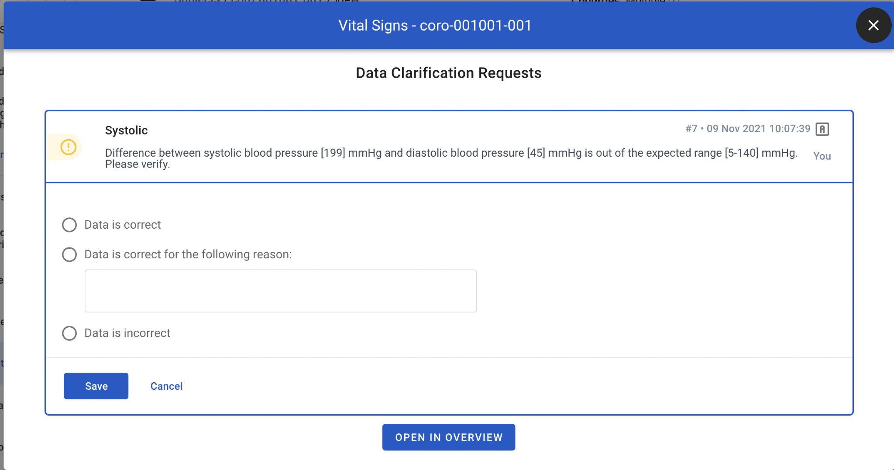
Enter/Edit Data - Answer DCR
Provide an answer to a DCR if applicable:
Open the DCR by clicking the icon on the left or the button on top
Select or provide a custom answer and click Save

Slide 14
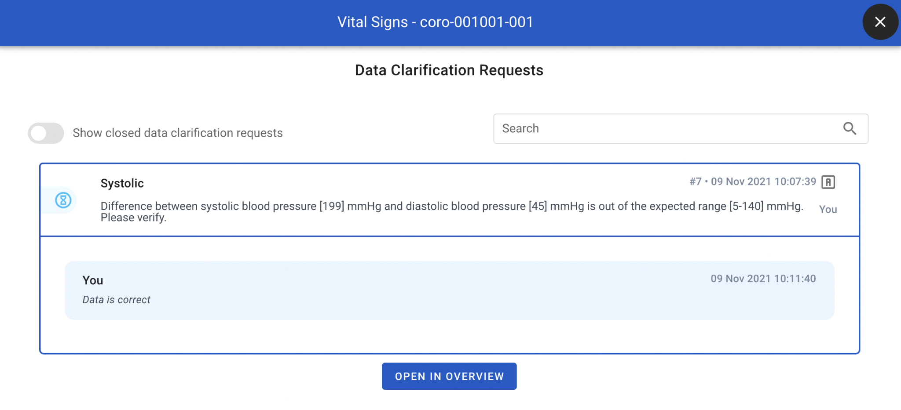
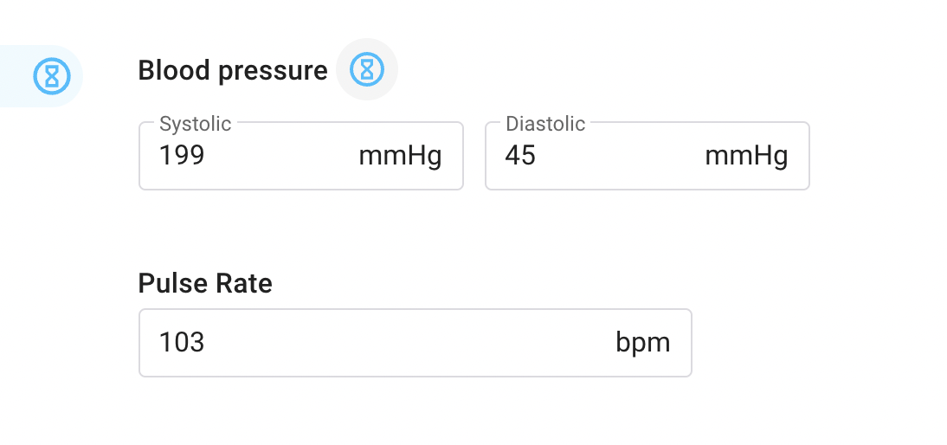
Enter/Edit Data - Answer DCR (2)
The Data Manager / CRA can subsequently:
Close the DCR if the provided answer is satisfactory
Reopen the DCR to require an additional response from the site (additional clarification or data update)

Slide 15
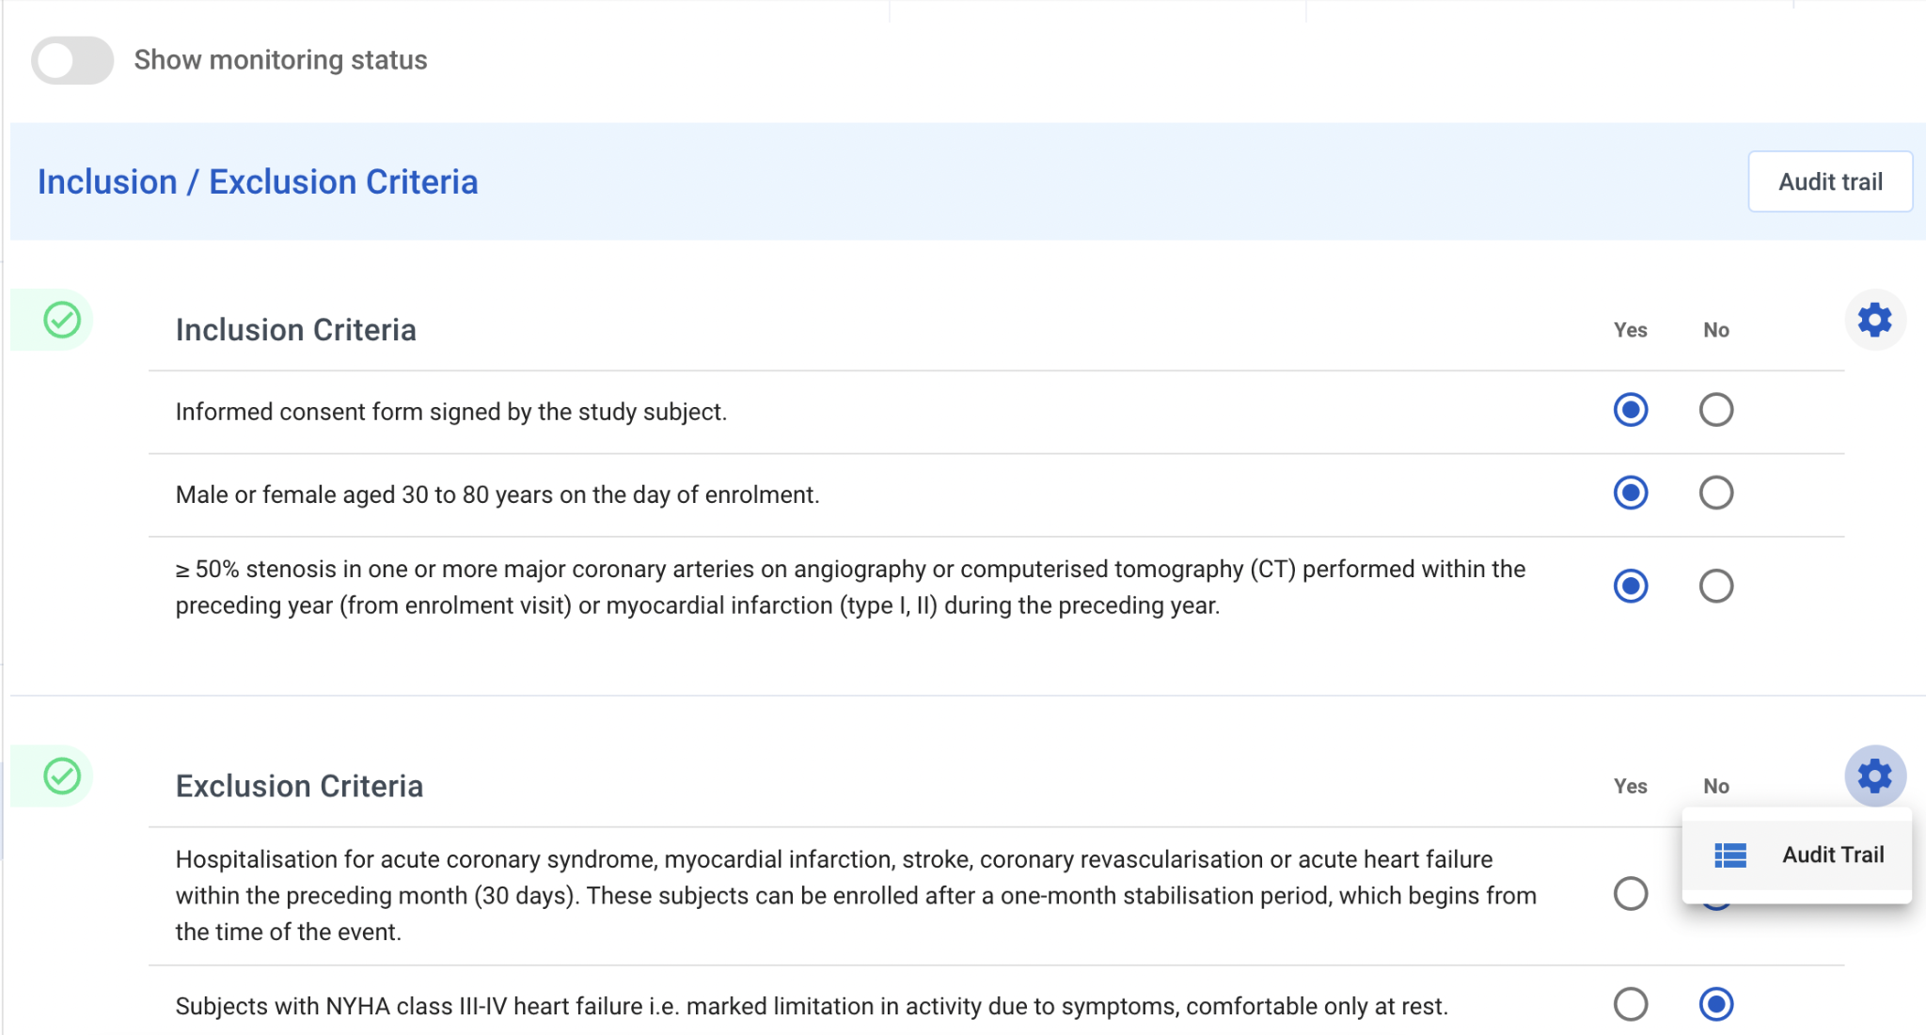
Enter/Edit Data - Audit Trail
All data entry is logged in the audit trail
Click the “Audit trail” button to view the audit trail for the entire form
Click the cog wheel and then “Audit Trail” to view the audit trail for the block of fields

Slide 16
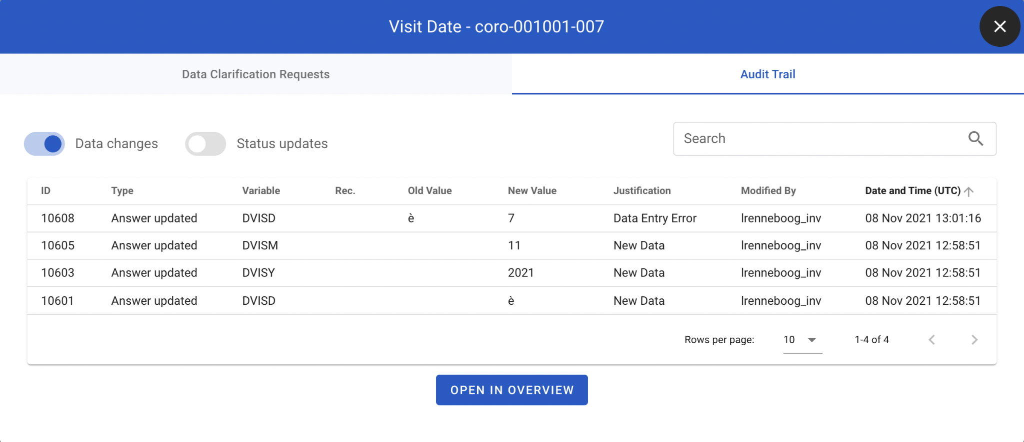
Enter/Edit Data - Audit Trail (2)
The data audit trail is toggled by default (‘Data changes’)
For initial data entry, the justification shows “New Data”
For data edits, the justification shows “Data Entry Error” if this was the provided reason or it will show the custom reason provided by the user

Slide 17
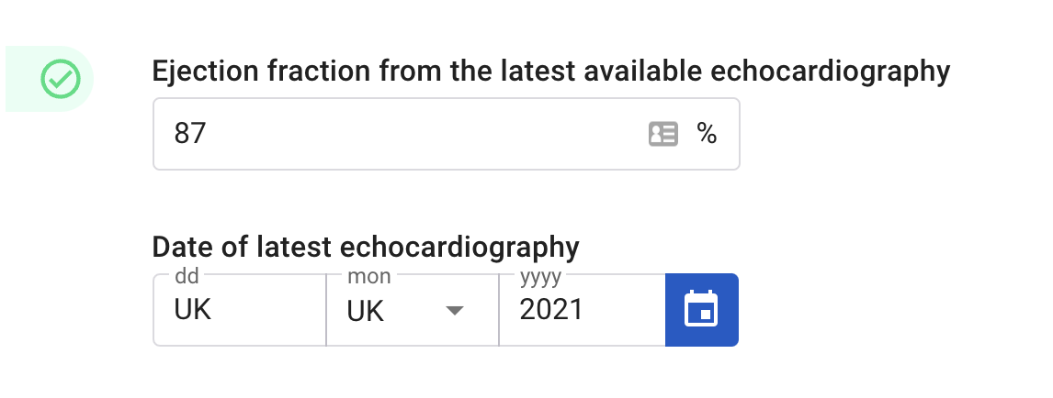
Enter/Edit Data - Required Data
Almost all data fields in the CoroPrevention trial are required (= must be completed) and mandatory (= cannot be completed as UK, NA or ND).
Notable exceptions:
Day and month for “Date of latest echocardiography”
Day for Date on Subject Reported Clinical Endpoints Log
In case this information is unknown, this can be entered as “UK” or “NA” or “ND” and will be considered valid and complete by the system.

Slide 18
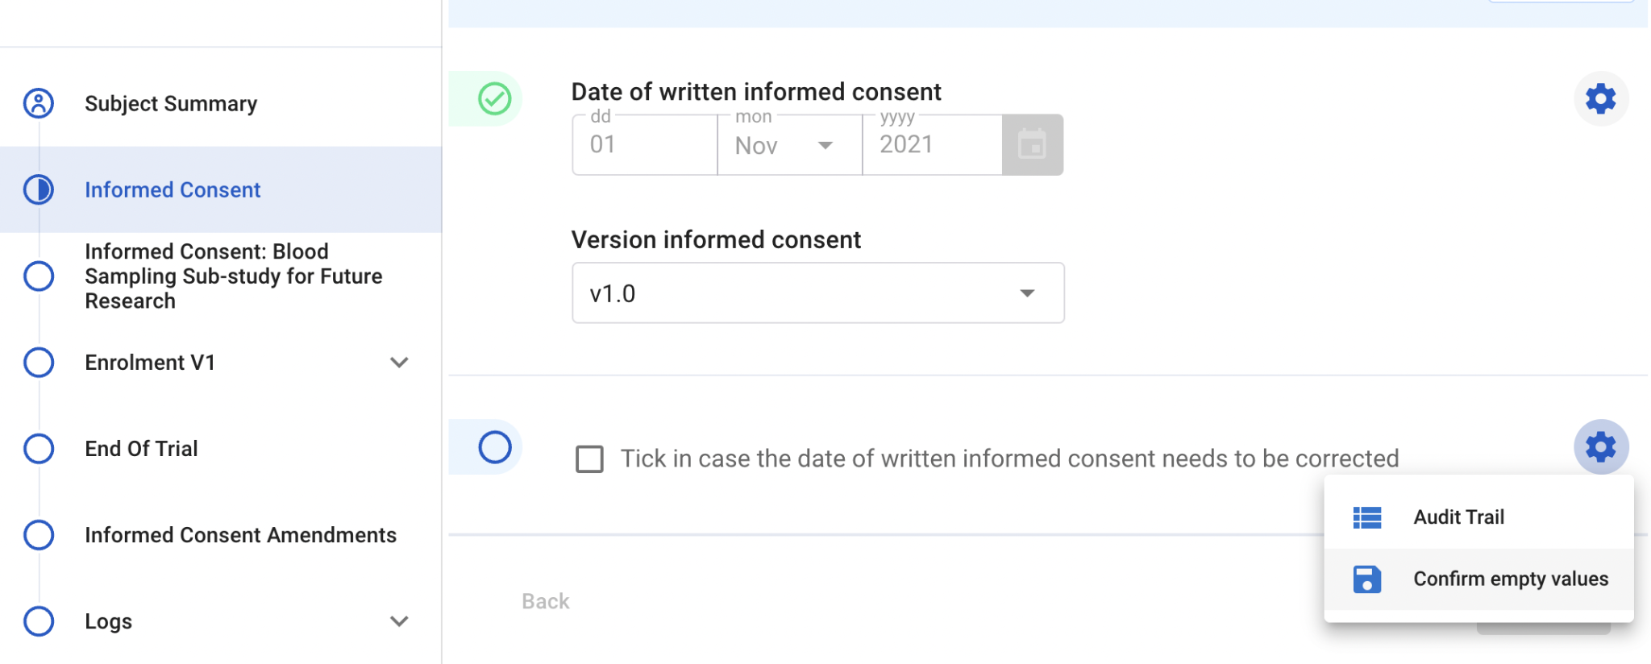
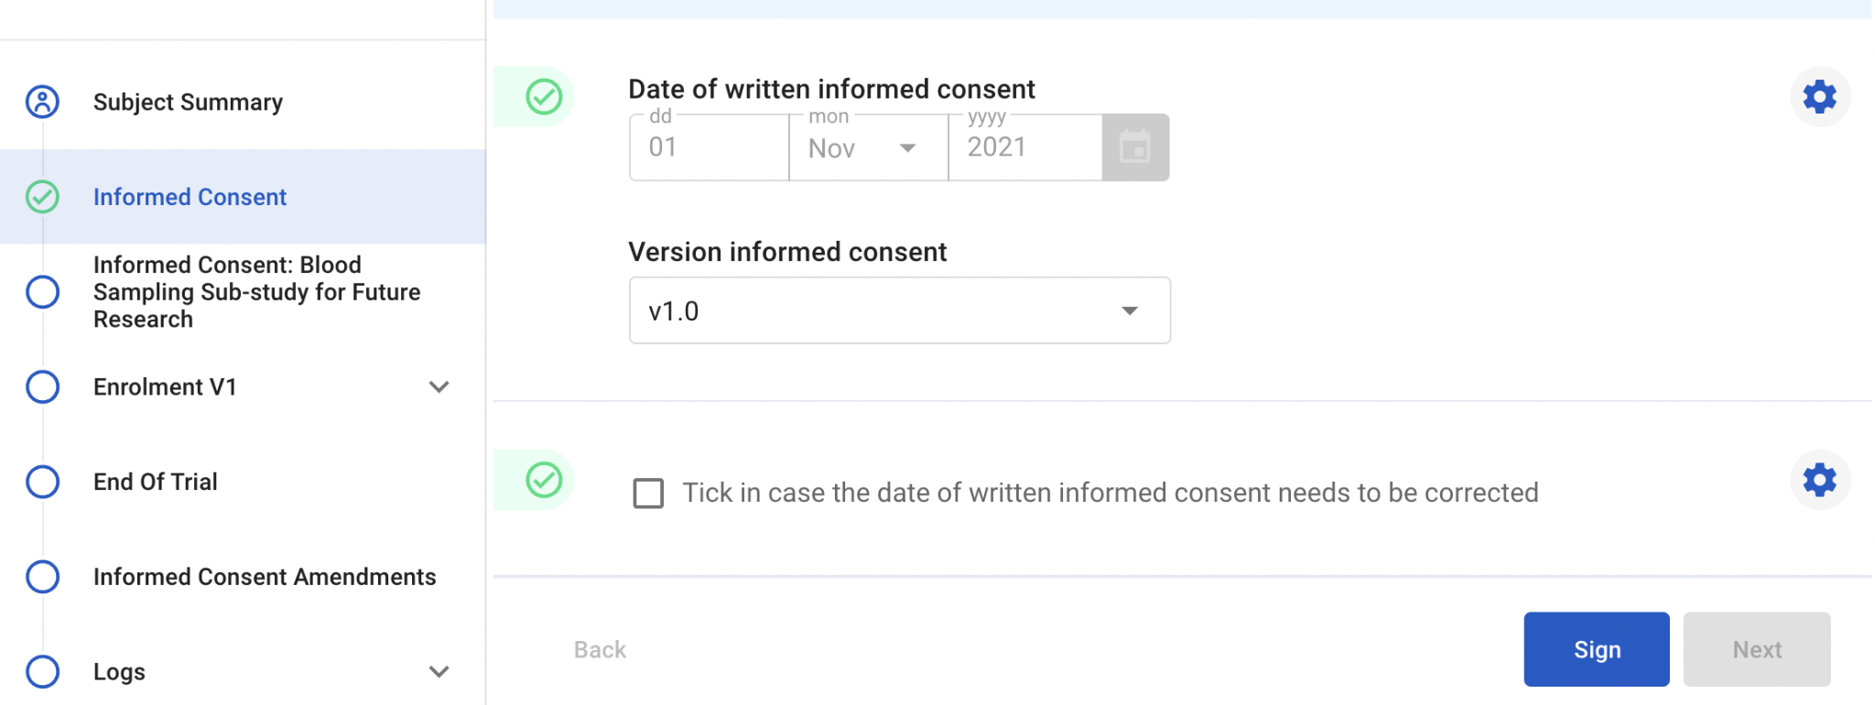
Enter/Edit Data - Confirm Empty Values
Notable exception (2): - check box fields with only one option e.g. ‘Tick in case the date of written informed consent needs to be corrected’
Should only be completed (ticked) in case applicable.
If not applicable, click the cog wheel and select ‘Confirm empty values’ to validate this field:
=>
Use “Confirm empty values” to confirm any other data that is not available.

Slide 19
Enter/Edit Data - Calculated Fields
It is not possible to enter/edit data for calculated fields:
System will calculate the value
All parameters need to be entered, the system will not calculate the value if data is missing E.g.: eligibility of a subject will only be calculated once all inclusion and exclusion criteria questions have been filled in

Slide 20
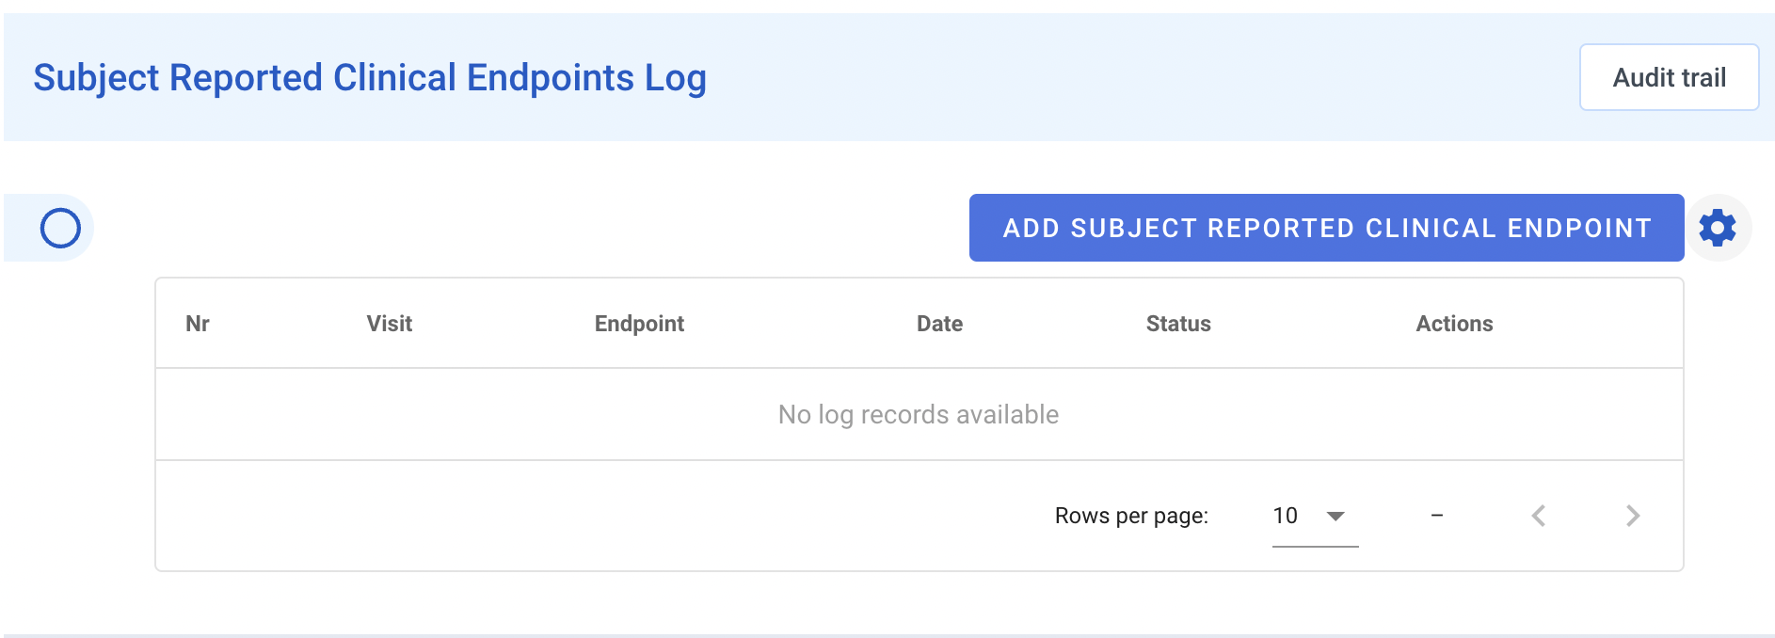
Enter/Edit Data - Log Forms
Log forms are forms that are repeating in nature
To add a new record, click the “Add” button
There is no limit on the number of records that can be added

Slide 21
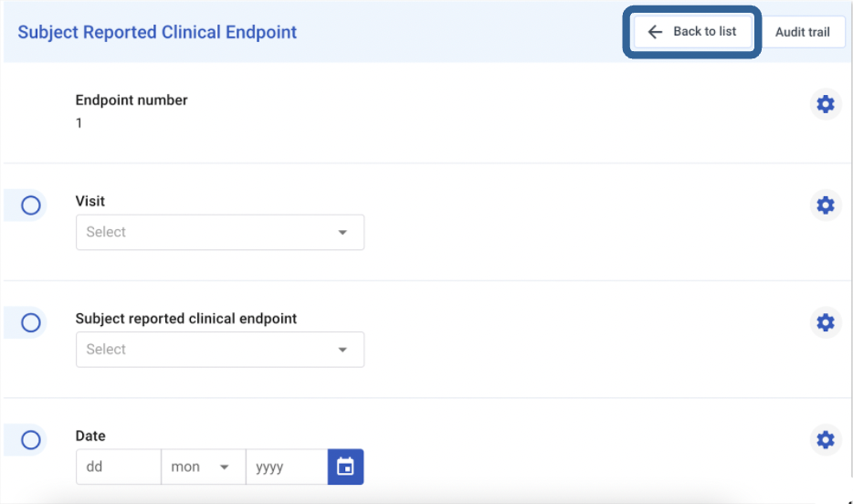
Enter/Edit Data - Log Forms (2)
The record will open in portrait mode allowing you to enter the data
The system will automatically determine a log number for the record
After data entry, click “Back to list” to return to the list of records for the form
Use the “Back” or “Next” buttons to navigate to the previous or next record

Slide 22
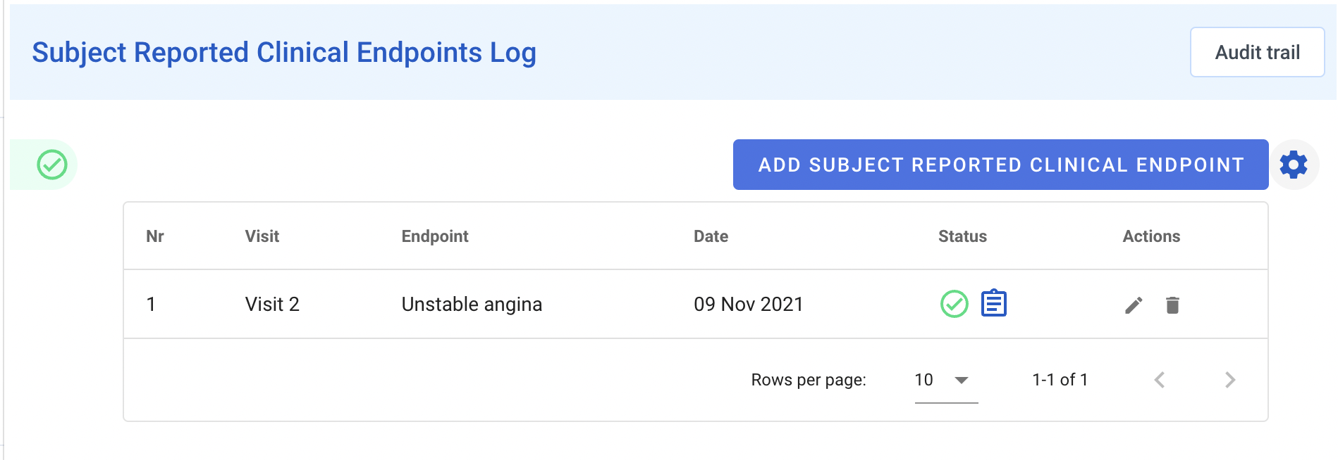
Enter/Edit Data - Log Forms (3)
Click the pencil icon to edit the record, the record will open in portrait mode
Click the trash can icon to delete the record

Slide 23
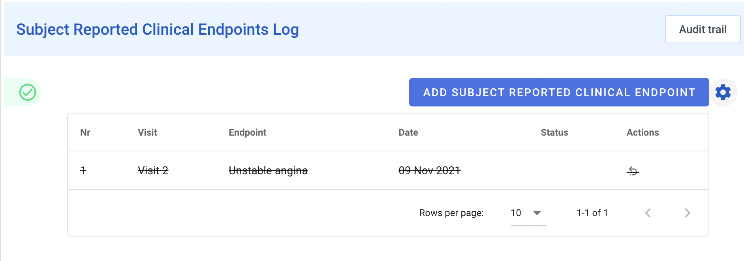
Enter/Edit Data - Log Forms (4)
Click the arrow to reactivate the deleted record
Editing data on a record, deleting and reactivating a record will require a reason for change to be provided

Slide 24
Reports

Slide 25
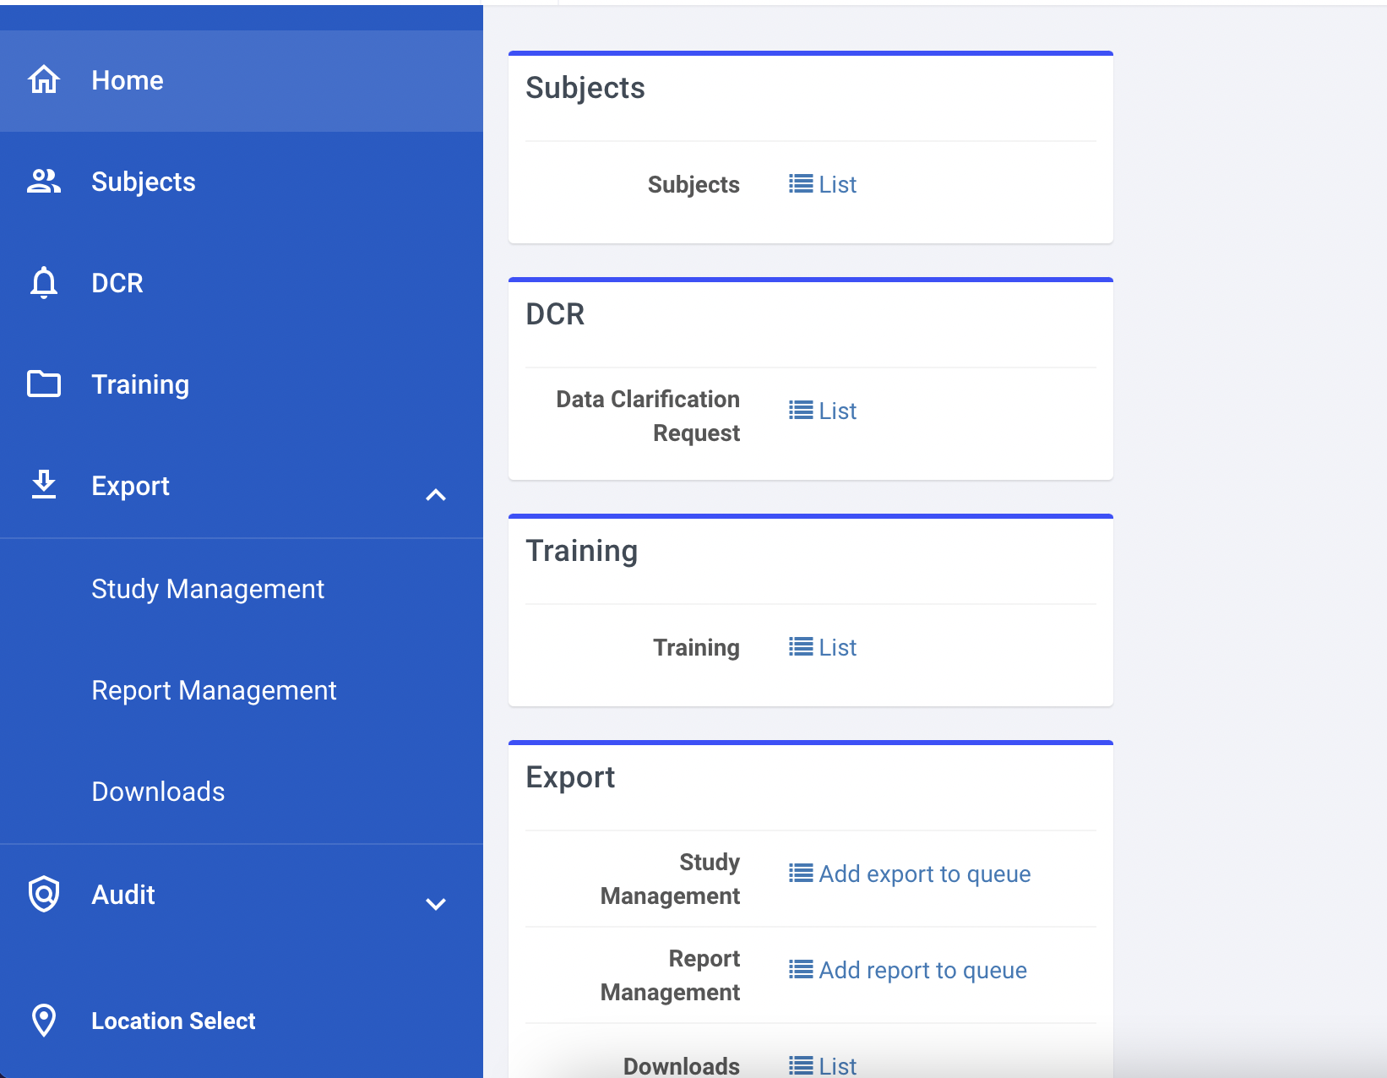
Reports - General
All reports and/or exports available to you can be found:
By clicking Export in the navigation bar
Or through the dashboard
Click the desired type of report or export
The reports and exports are categorized in three categories:
Study Management
Study Execution
Reports
Which reports and exports are available to you are depending on your user type.

Slide 26
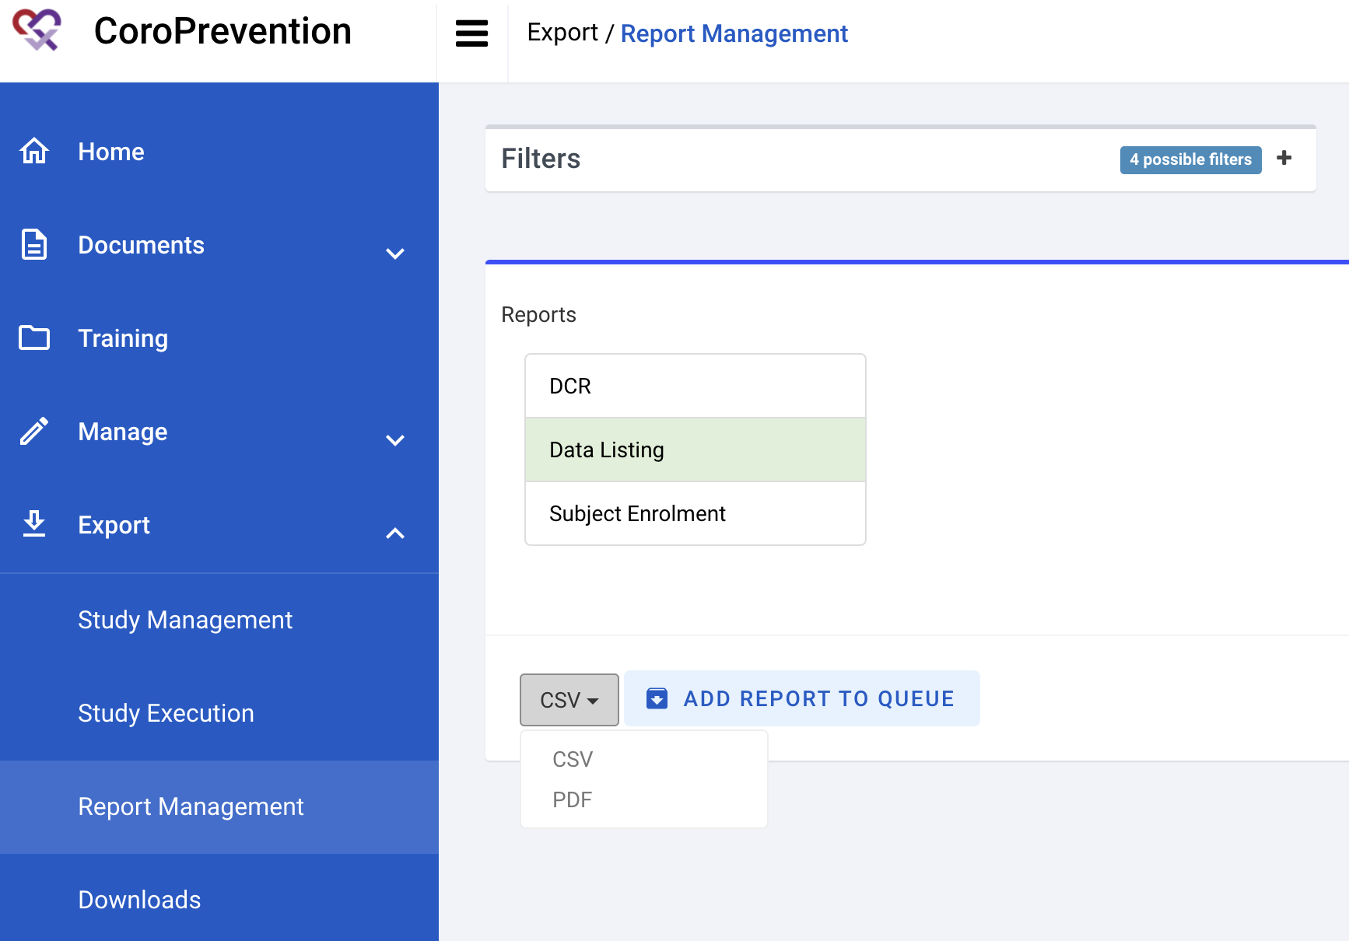
Reports - Generation
Select the desired export / report
Specify the filters if applicable
Select the desired format from the dropdown of available formats
Click Add Export / Report To Queue to start the creation of the export / report

Slide 27
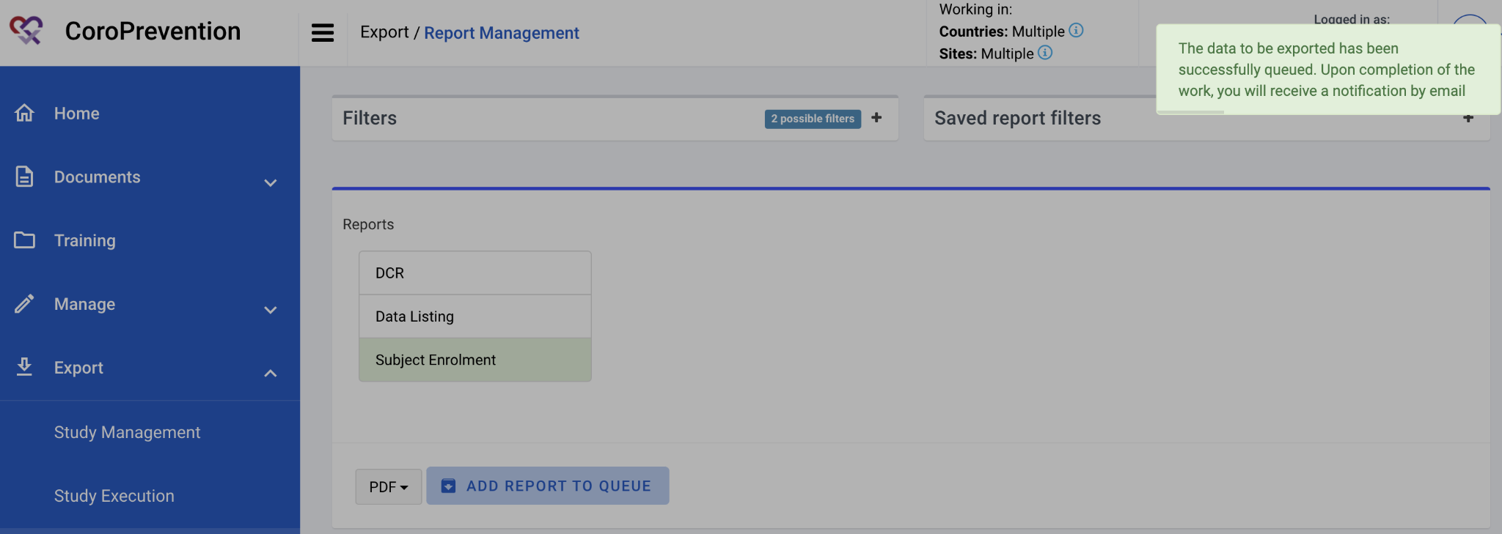
Reports - Generation (2)
A success message pop-up is shown
You will receive an email when the export / report has finished and is available for you to download

Slide 28
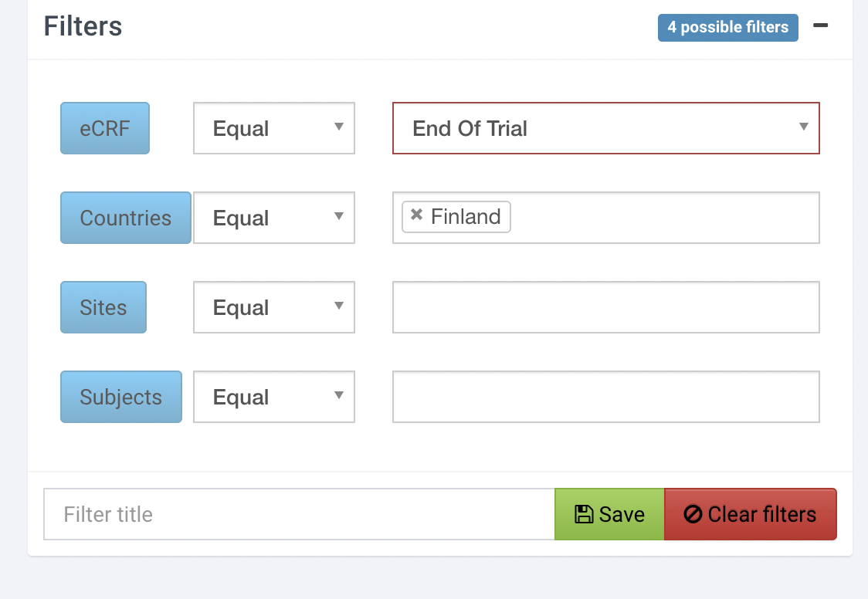
Reports - Filters
Before generating the report it is possible to use filters, this will limit the data of your export / report
For most reports and exports, the filters are optional
For some reports a filter is required: e.g. the Data Listing report requires an eCRF to be selected
The system will warn you in case a filter needs to be specified
You can save your filter combinations for future use by providing a title for the filter and clicking “Save”

Slide 29
Reports - Download
Requested reports / exports are listed in the Downloads section
Navigate through the blue bar or via the dashboard to Downloads

Slide 30
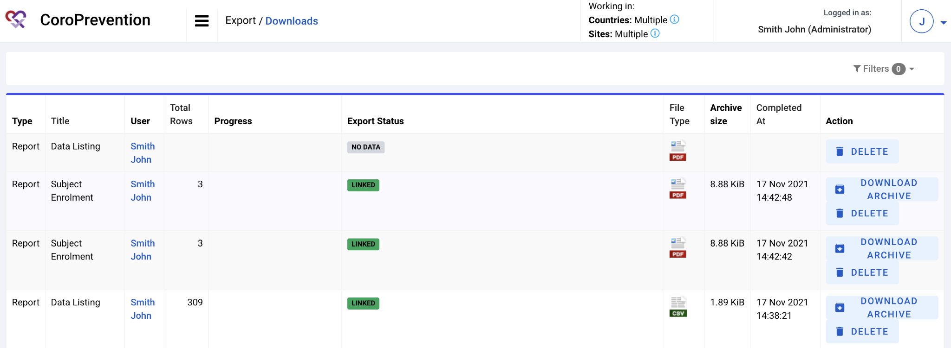
Reports - Download (2)
Download the desired report / export by clicking the ‘Download Archive’ button
A .zip file containing the report / export is saved on your device
Use the ‘Delete’ button to delete requests you no longer need
If the request returned no data, the export status will show ‘No Data’. It is not possible to download this empty file.

Slide 31
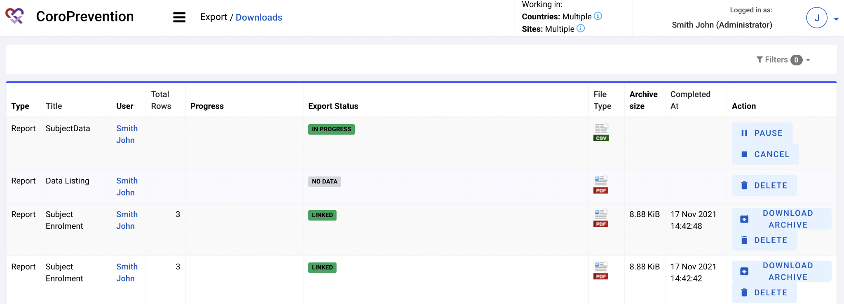
Reports - Download (3)
Any requests still being processed by the system will also show up in the list
You can track the progress in the Progress column
If applicable, you can pause or cancel the request in this stage

Slide 32
Monitor Data

Slide 33
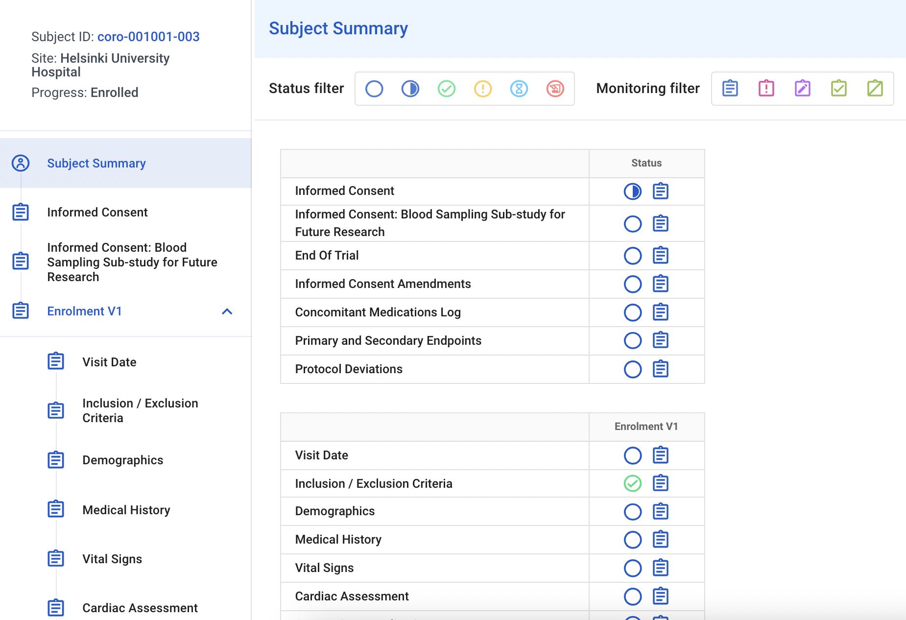
Monitor Data - Flow
Use the subject flow to navigate to a form:
Some forms are not part of a visit (e.g. Informed Consent)
Click a visit to view its forms

Slide 34
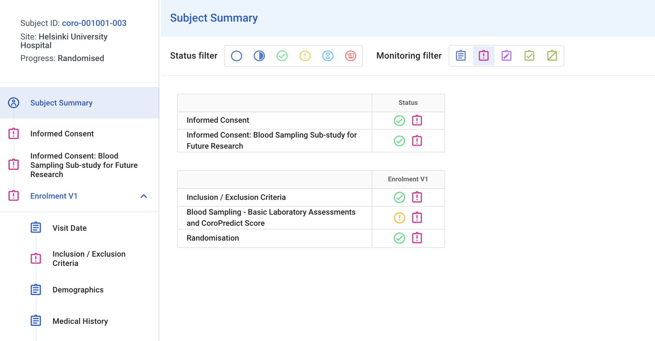
Monitor Data - Subject Summary
Or use the subject summary to navigate to a form:
Optionally click a status filter to only view forms for a given data entry status or monitoring status
Click the status icon for the form to access it
In the example given, the subject summary is filtered on monitoring status “Requiring monitoring”.
It’s possible to combine the Status and Monitoring filters.

Slide 35
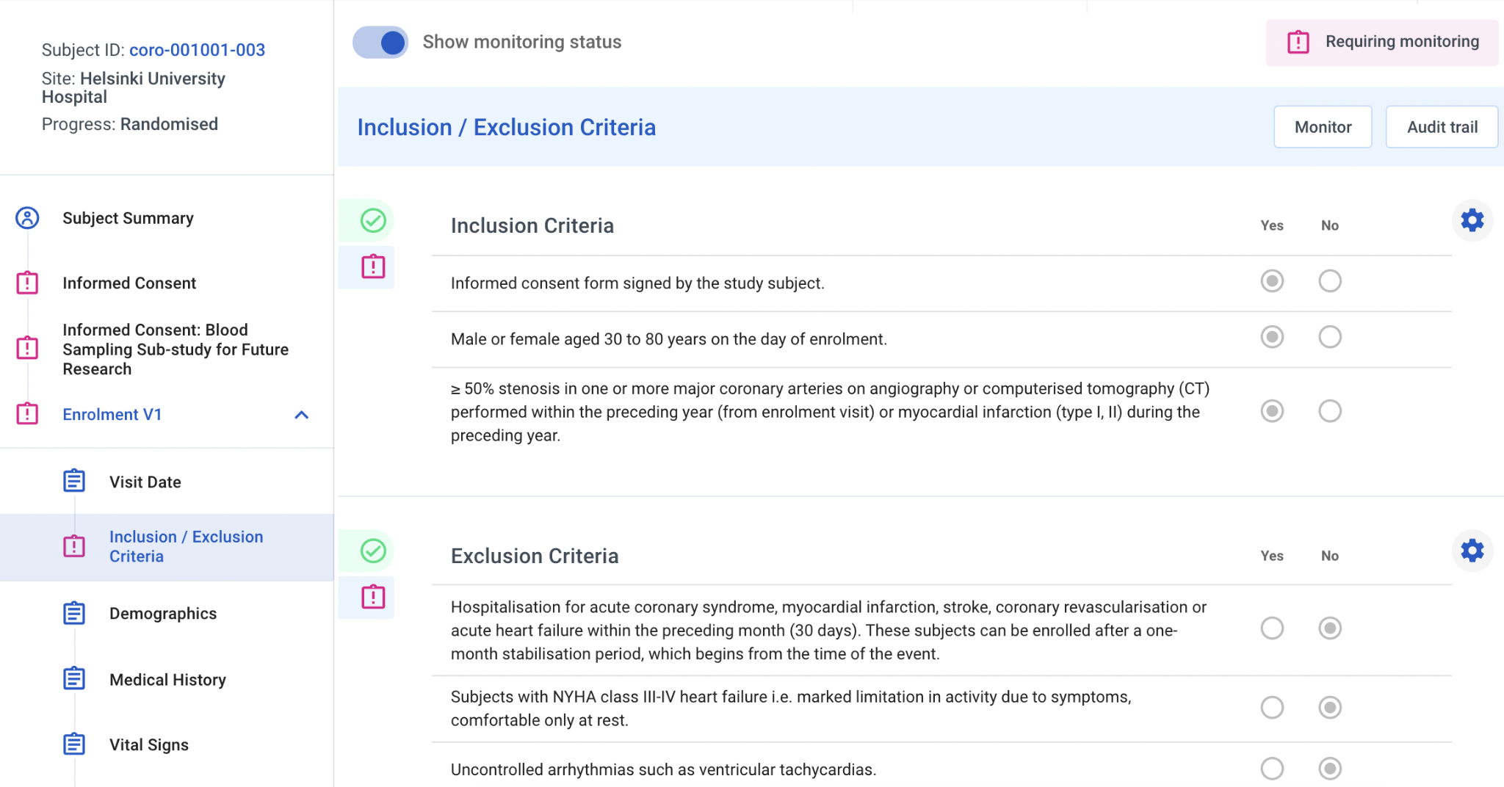
Monitor Data - Monitor Toggle
By default, users with monitoring permissions will see Monitoring status in the subject’s flow
Click the toggle button on any form to switch to data entry view

Slide 36
Monitor Data - Entry Status Icons
Entry Status Icons indicate the data entry status of a subject/visit/form/block:
 | No data is present.
 | Data is present, but data entry is not complete.
 | Invalid data is present: at least one DCR (query) is raised.
 | All data is present and valid.
 | At least one DCR (query) has been answered.
 | Data has been signed.

Slide 37
Monitor Data - Monitoring Status Icons
Monitoring Status Icons indicate the data entry status of a subject/visit/form/block:
 | Not monitored
 | Requiring monitoring
 | Modified after monitoring (the data was updated after monitoring)
 | Monitored
 | Closed (data manager closed the eCRF for monitoring)

Slide 38
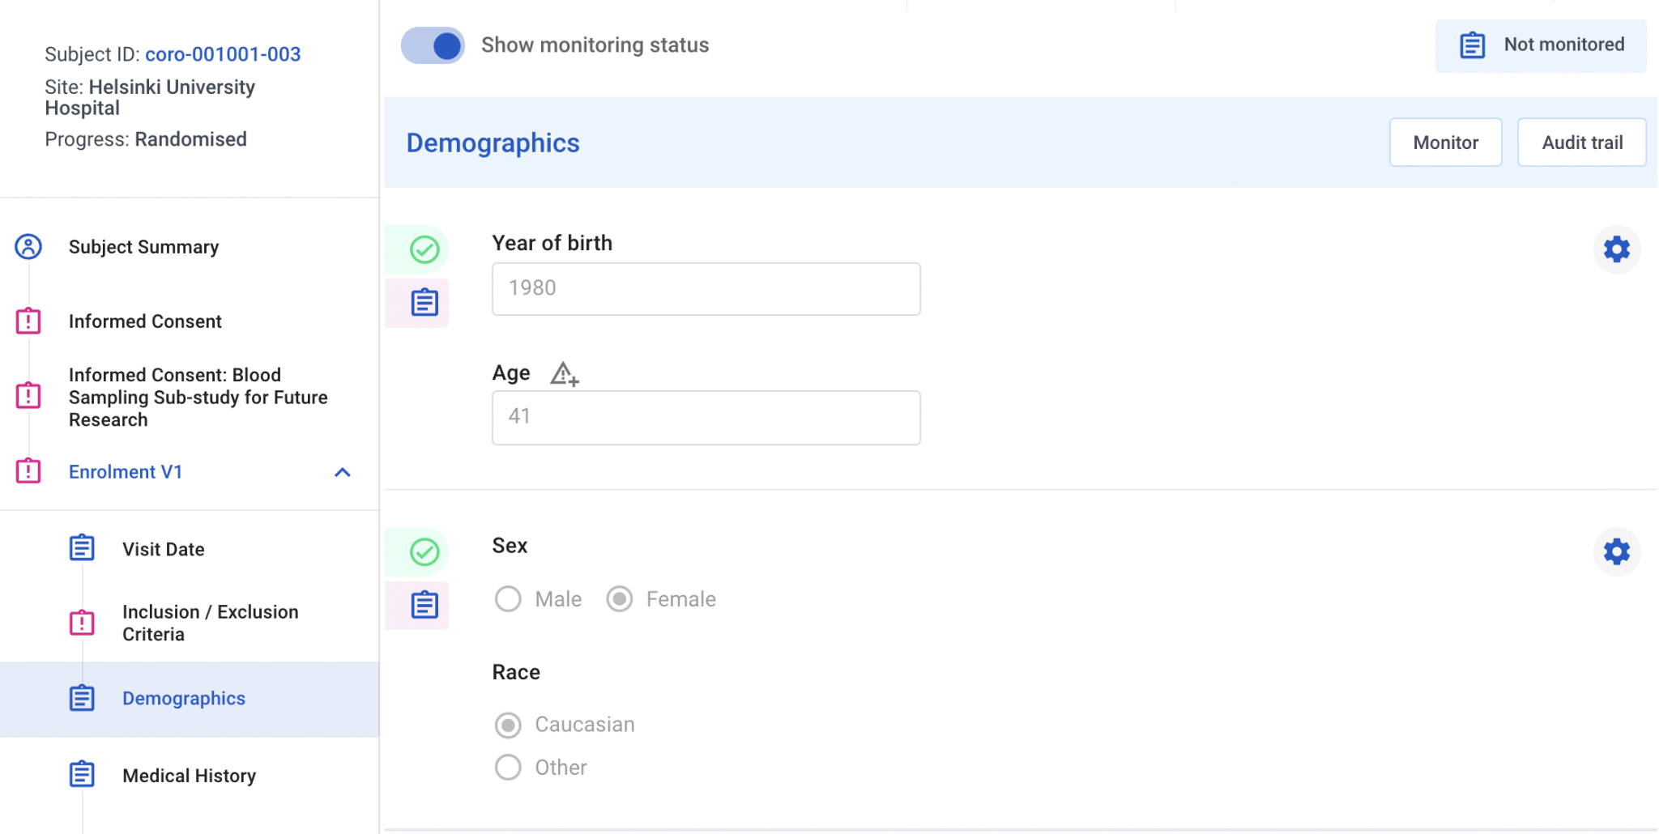
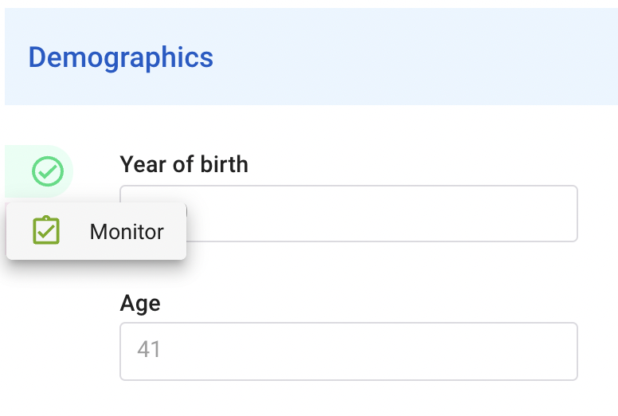
Monitor Data - Monitor Block
To perform data verification (monitoring), the Show monitoring status toggle needs to be on
Click the monitoring status icon of the block you want to monitor
Click Monitor

Slide 39
Monitor Data - Monitor Block (2)
The status of the block changes to “Monitored”

Slide 40
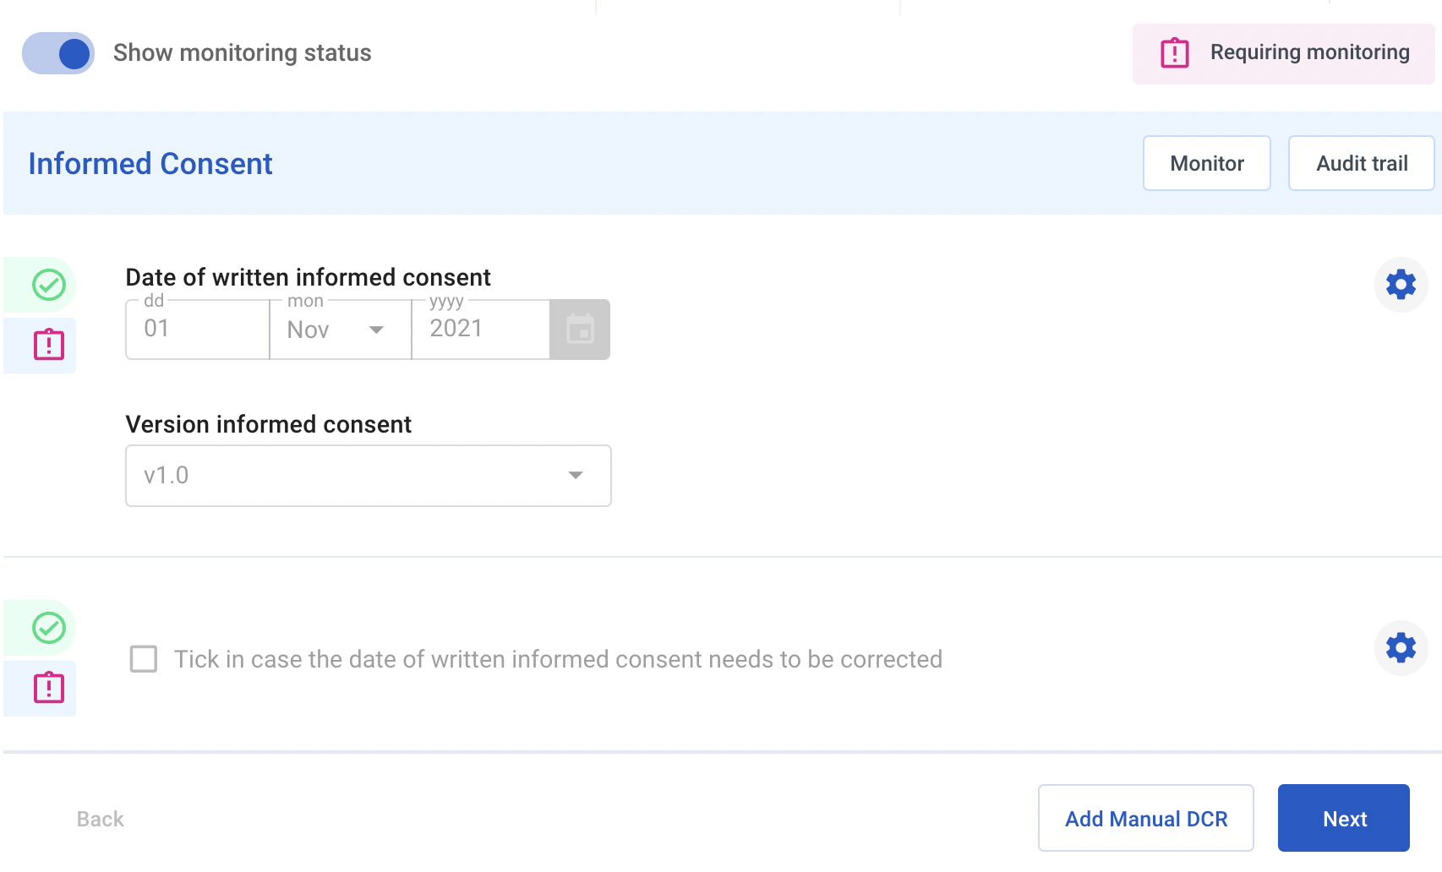
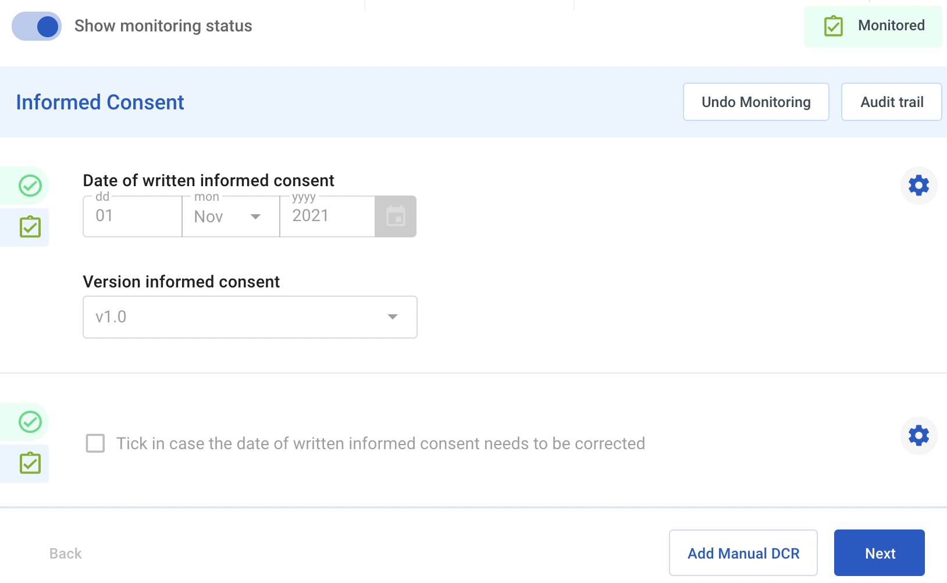
Monitor Data - Monitor eCRF
To monitor all fields on an eCRF at once, click the Monitor button

Slide 41
Monitor Data - General
Monitoring is possible for all blocks/eCRFs with one of following statuses:
Not monitored
Requiring monitoring
Modified after monitoring
As a monitor you are expected to monitor the blocks/eCRFs with status Requiring monitoring

Slide 42
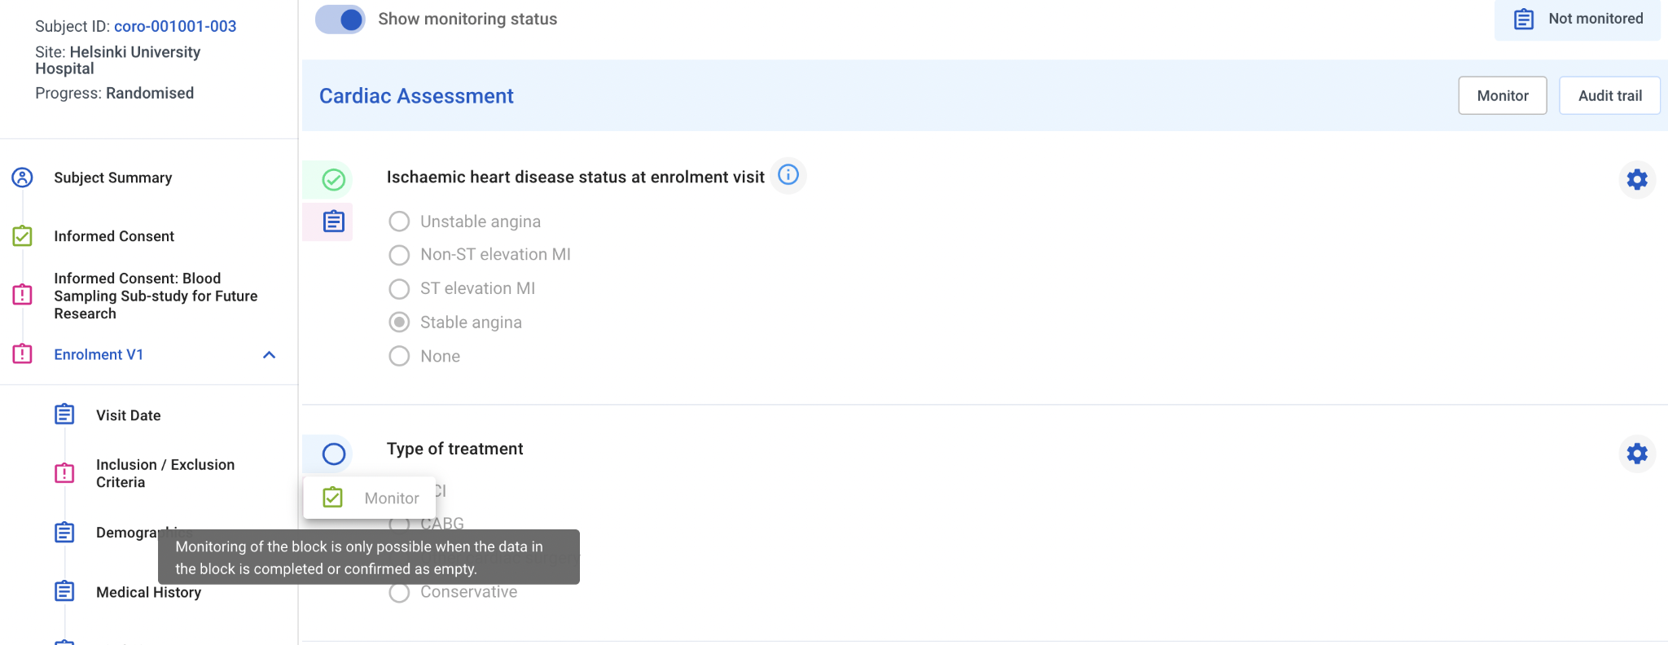
Monitor Data - Preconditions
A block can only be monitored if no data is missing:
Blocks that have been confirmed as empty can also be monitored

Slide 43
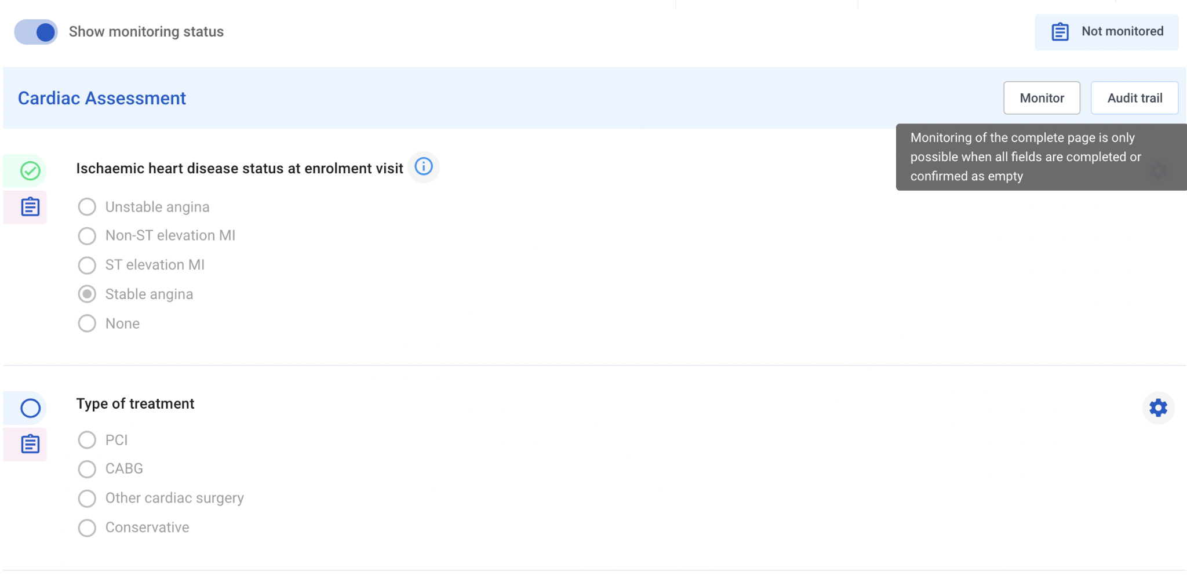
Monitor Data - Preconditions (2)
An entire eCRF can only be monitored if no data is missing in any of its blocks:
Blocks that have been confirmed as empty can also be monitored

Slide 44
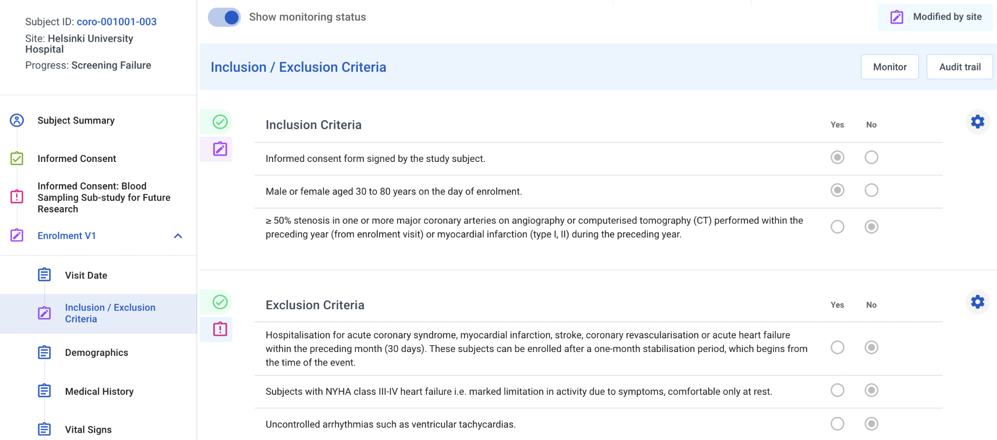
Monitor Data - Updates After Monitoring
Site can make modifications to monitored data
The block, eCRF and subject receive status “Modified after monitoring”
When these modifications are monitored again, status will change to “Monitored”

Slide 45
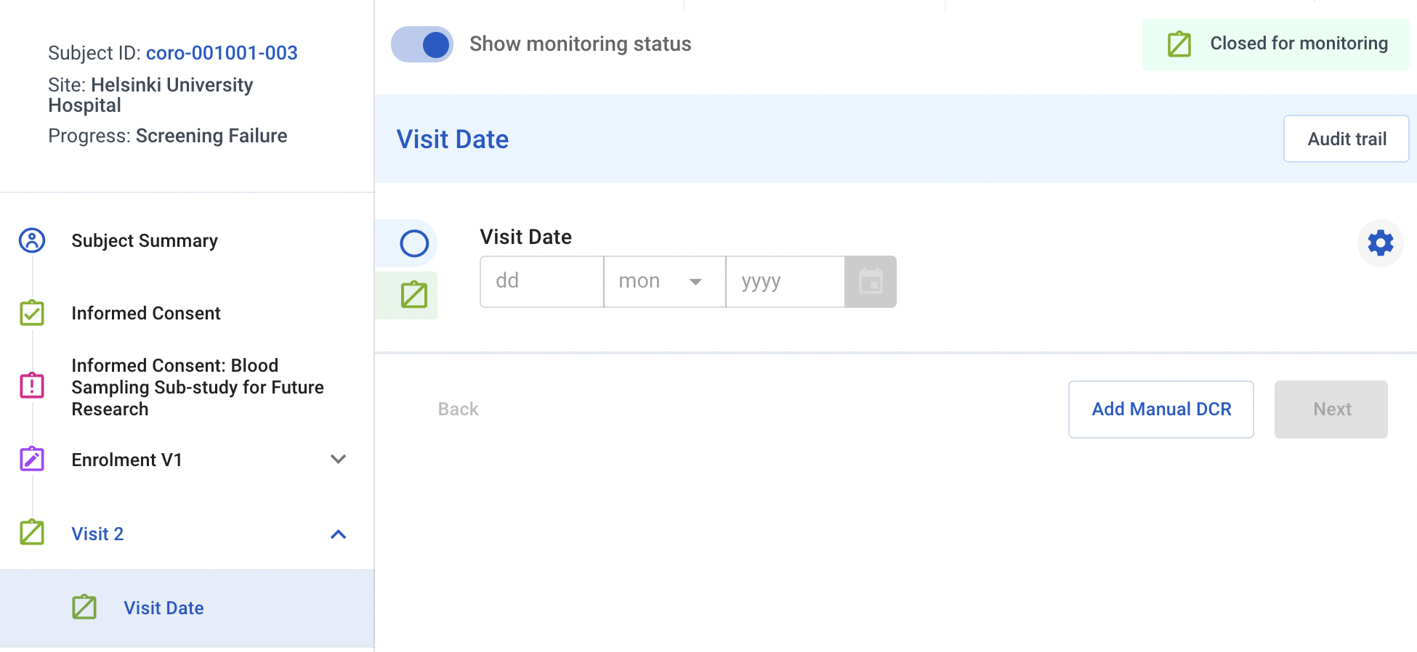
Monitor Data - Closed for Monitoring
Data Manager can close eCRFs for monitoring e.g. if no data is expected
Monitoring is not possible in this case

Slide 46
Manage DCRs

Slide 47
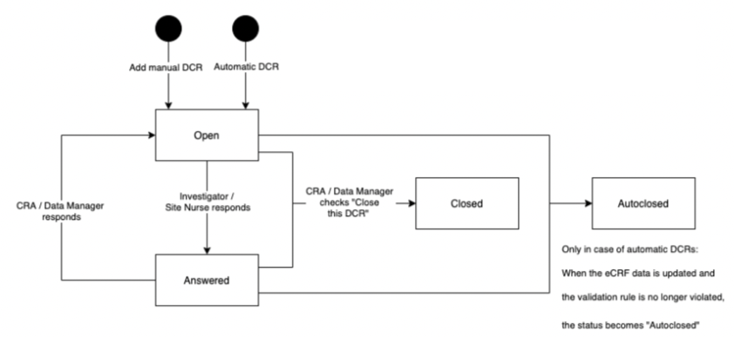
Manage DCRs - DCR Workflow
CRA, Lead CRA and Data Manager can manually create a DCR (query) on a data field or eCRF
CRA and Lead CRA can only provide a response to or close a DCR that was raised by a CRA or Lead CRA
Data Manager can only provide a response to or close a DCR that was raised by a Data Manager
Auto-DCRs can only be closed by the system (when conditions are satisfied) or manually by a Data Manager

Slide 48
Manage DCRs - Create DCR on block
CRA, Lead CRA and Data Manager can manually create a DCR (query) on a data field:
Hover over the field, appears
Click to add a DCR

Slide 49
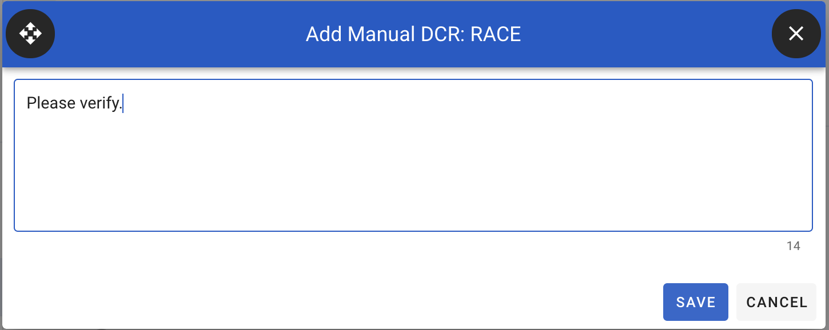
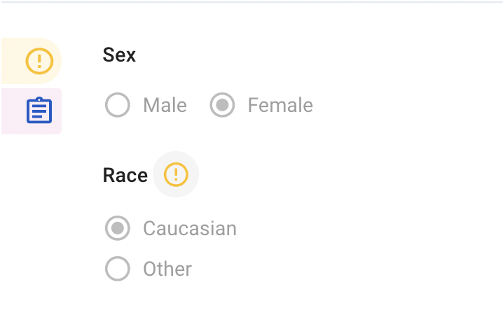
Manage DCRs - Create DCR on block (2)
Enter the data clarification request and click Save to confirm or Cancel to return to the form

Slide 50
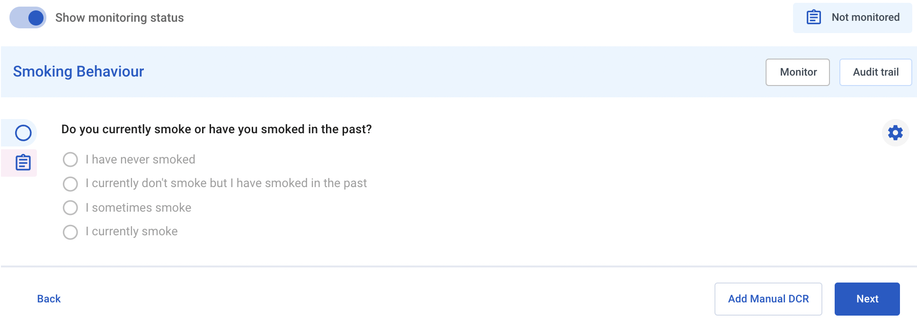
Manage DCRs - Create DCR on eCRF
CRA, Lead CRA and Data Manager can manually create a DCR (query) on an entire eCRF:
Click the “Add Manual DCR” button

Slide 51
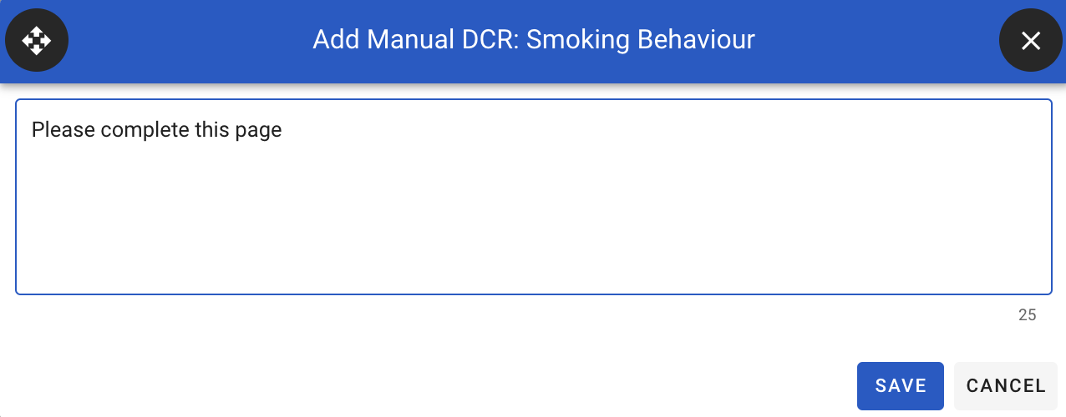
Manage DCRs - Create DCR on eCRF (2)
Enter the data clarification request and click Save to confirm or Cancel to return to the form
eCRF DCRs are shown by clicking the DCR button
These do not appear on a field itself

Slide 52
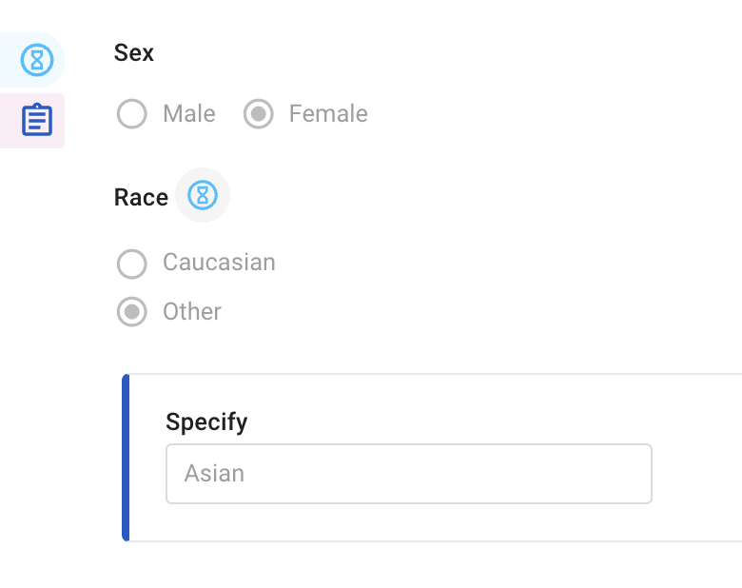
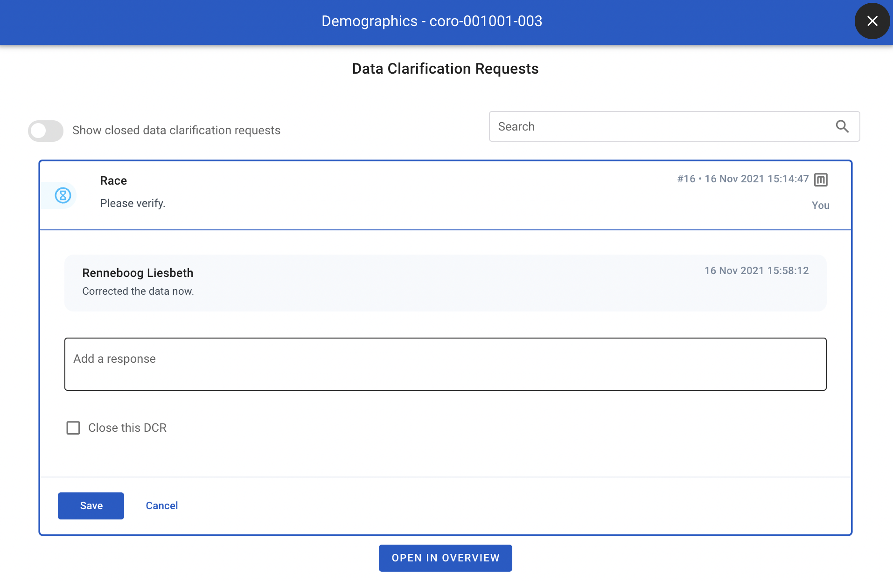
Manage DCRs - Answered DCR
The site (Study Nurse, Investigator) can provide an answer to a DCR:
Indicated by the Answered DCR icon
Click the icon to open the DCR and view the response

Slide 53
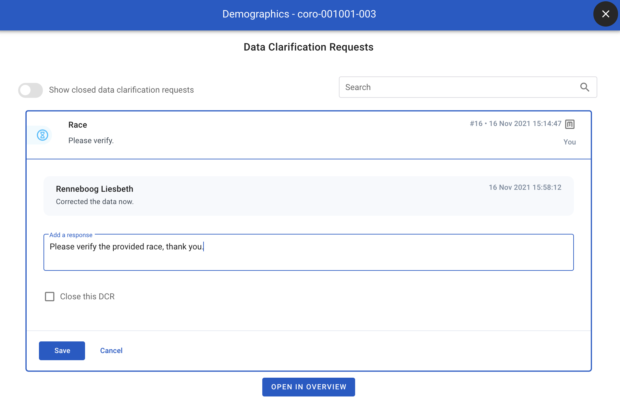
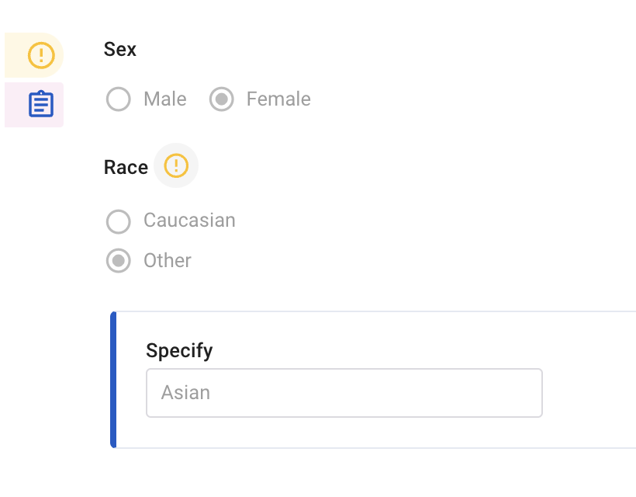
Manage DCRs - Re-open a DCR
To re-open the DCR to the site, provide a response and click Save

Slide 54
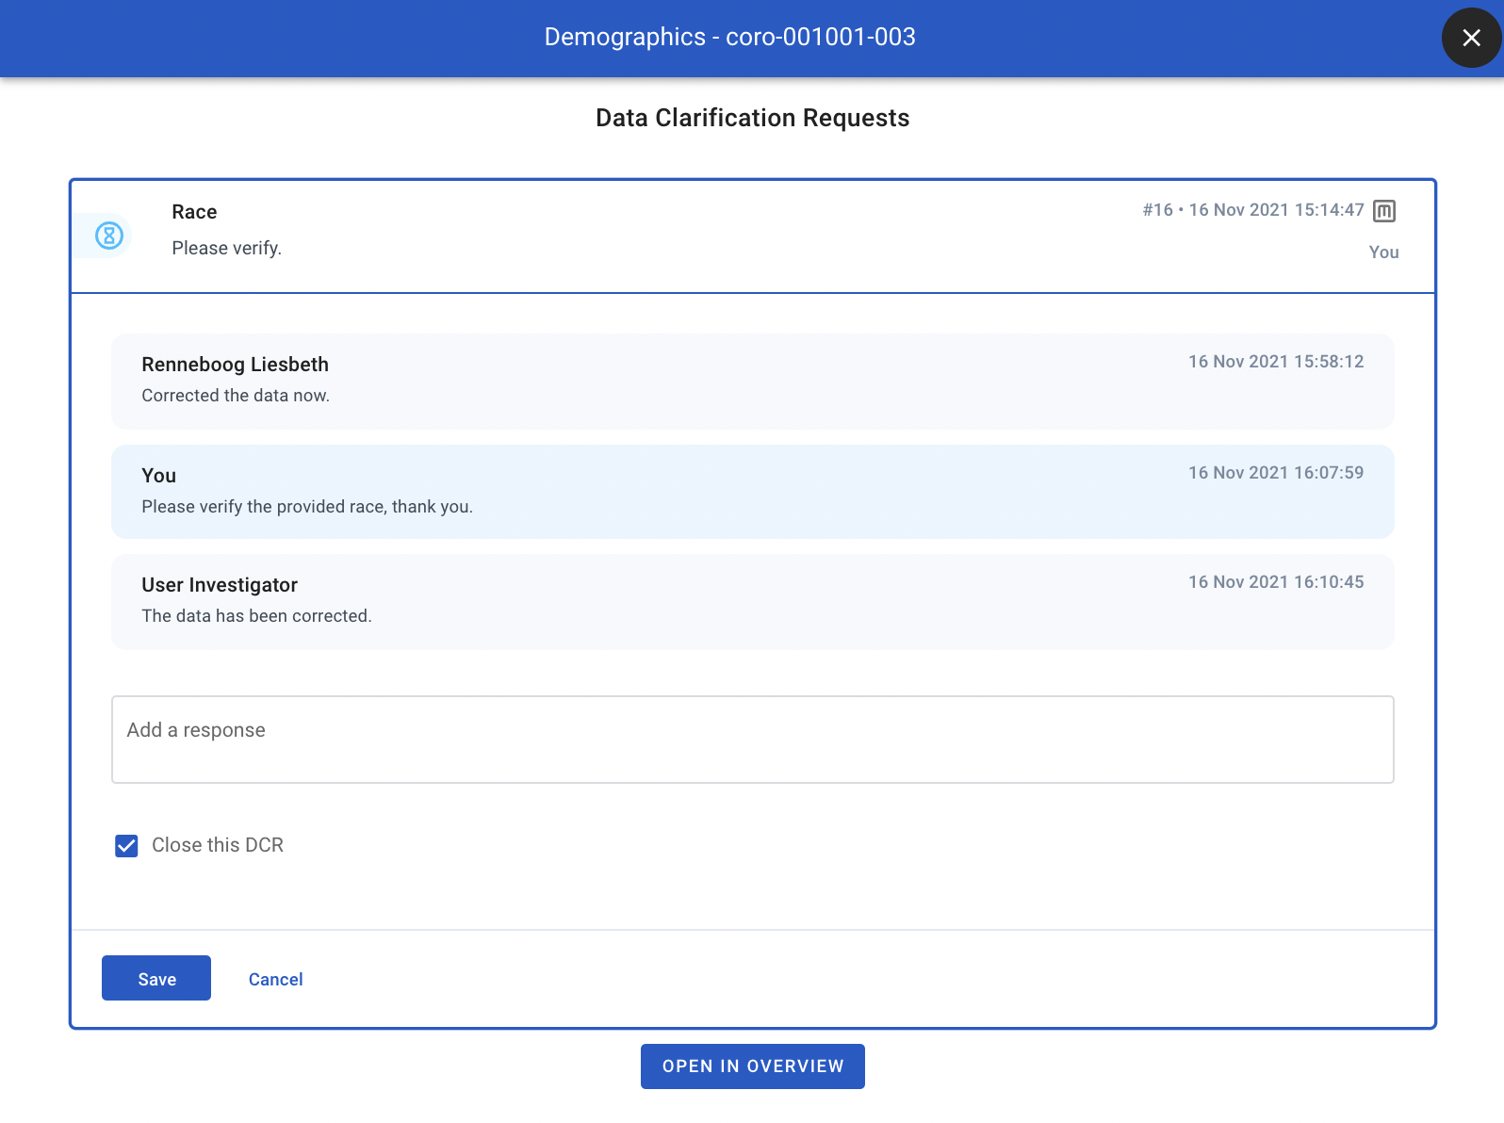
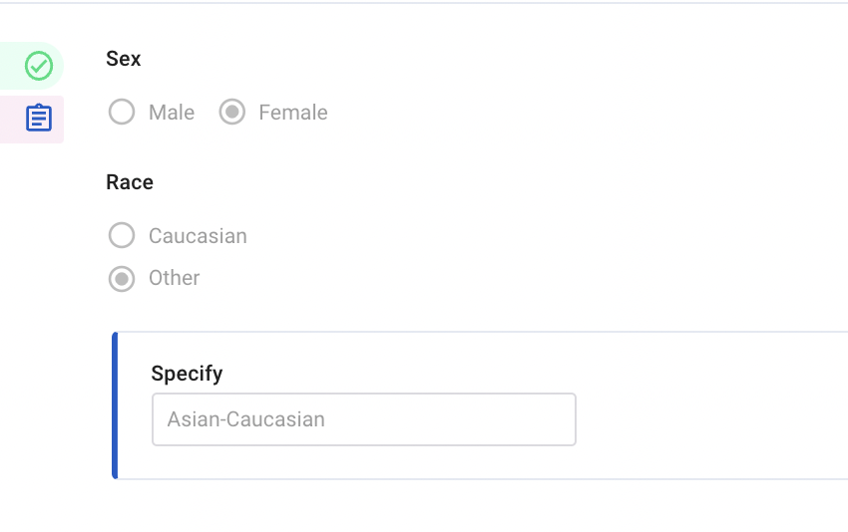
Manage DCRs - Close a DCR
If the DCR is resolved, tick Close this DCR and click Save.
It is possible to provide a response when closing a DCR, this is not required.

Slide 55
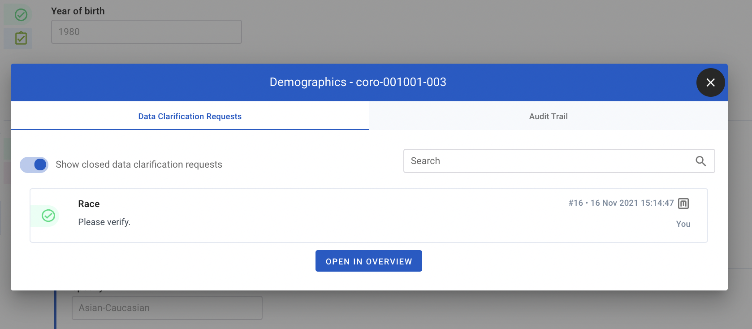
Manage DCRs - View DCRs
Click the DCR button on top of the page or the data entry status icon of a block to open the DCRs for the page/block
Toggle Show closed data clarification requests to include closed DCRs

Slide 56
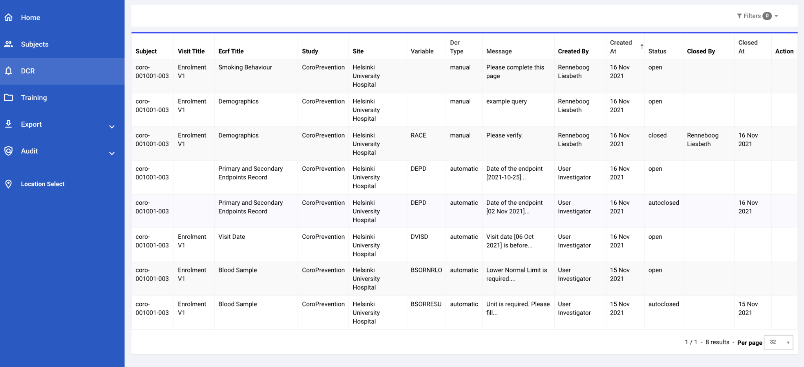
Manage DCRs - DCRs Overview
To see all DCRs for the location you’re working in, click DCR in the navigation bar
Use the filters to search for specific DCRs

Slide 57
Manage DCRs - DCRs Overview (2)
This includes system-generated DCRs and manual DCRs
Closed and autoclosed DCRs are also listed here
Download this list through Export > Study Management Data Export > DCRs

Slide 58
Laboratory Data

Slide 59
Laboratory Data - General
The trial contains two types of laboratory data forms
Blood Sampling - Basic Laboratory Assessments and CoroPredict Score
Blood Sampling: Sub-study for Future Research
Only if Informed Consent for Blood Sampling Sub-study for Future Research is given
Compliance Assessments results are not collected in EDC

Slide 60
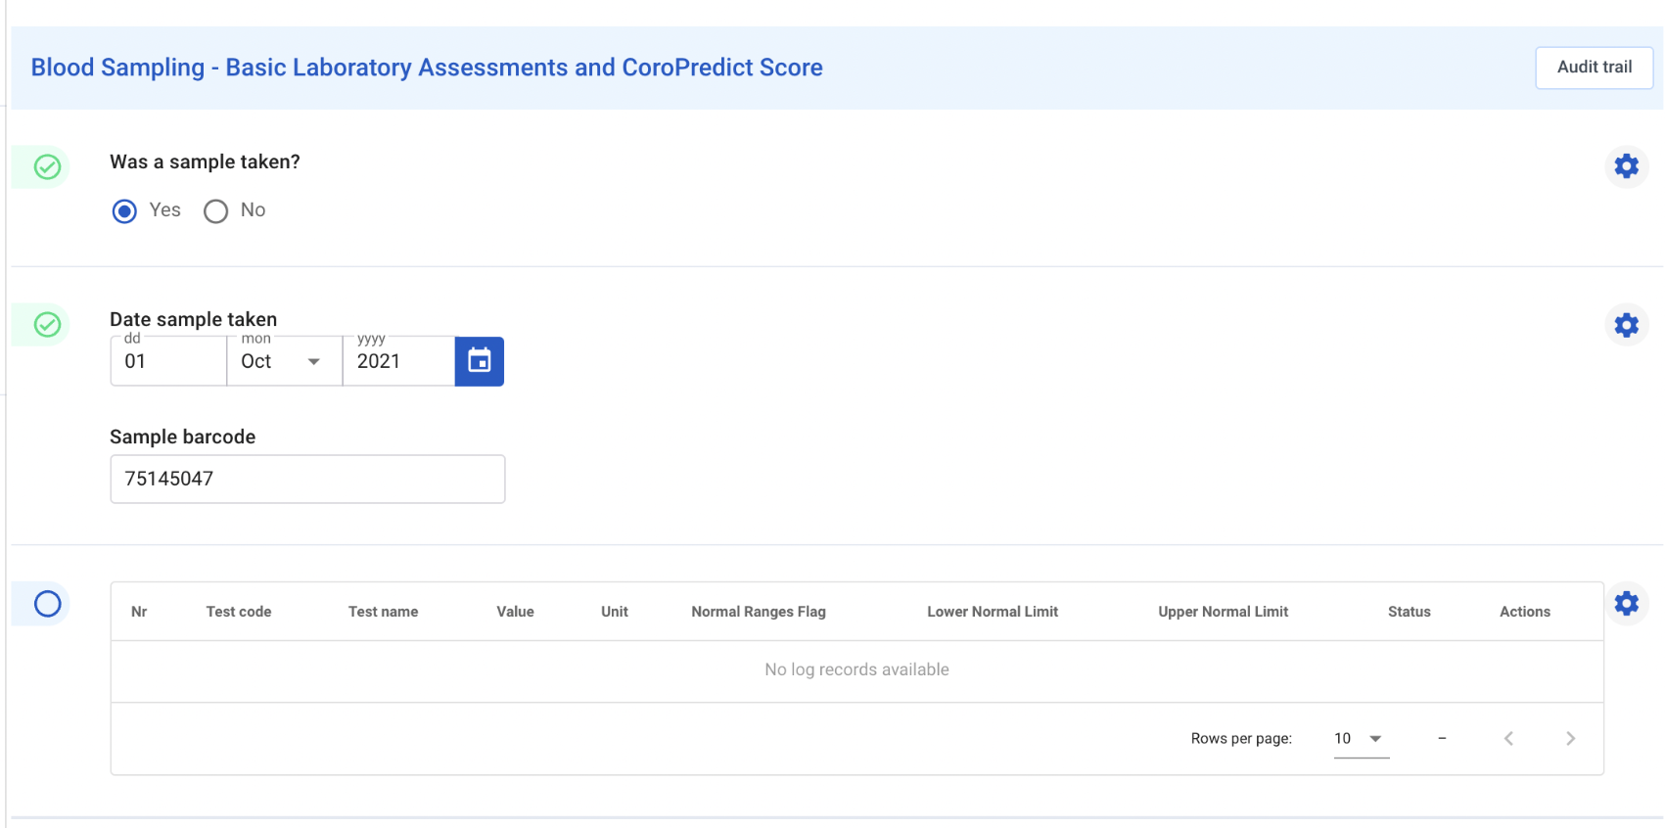
Blood Sampling - Basic Laboratory Assessments and CoroPredict Score
Blood Sampling results are provided by the central lab and uploaded automatically to the eCRF within the subject’s visit
At least the following data should be entered into EDC to enable this:
Subject needs to be created
Year of birth and Sex on Demographics form
Visit Date (visits except Enrolment V1)
Was a sample taken?
Sample barcode
The laboratory assessments details for a subject-visit can only be uploaded if the above data has been completed in EDC.
The lab results will appear automatically once they’ve been made available.

Slide 61
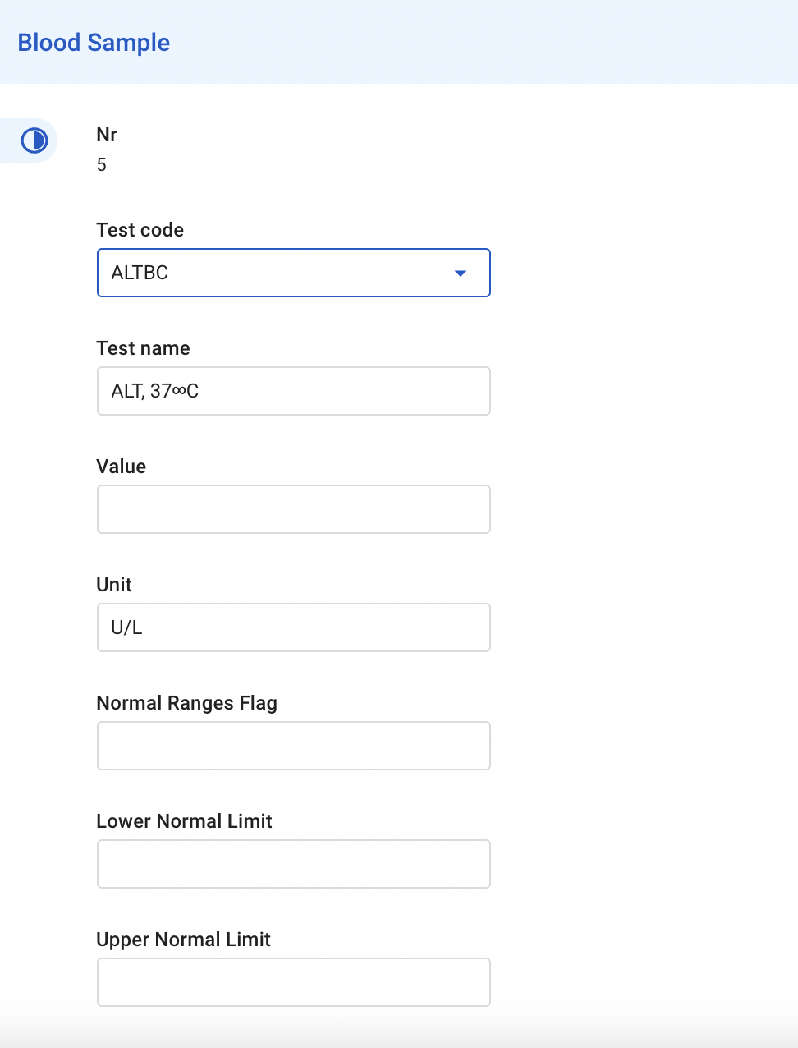
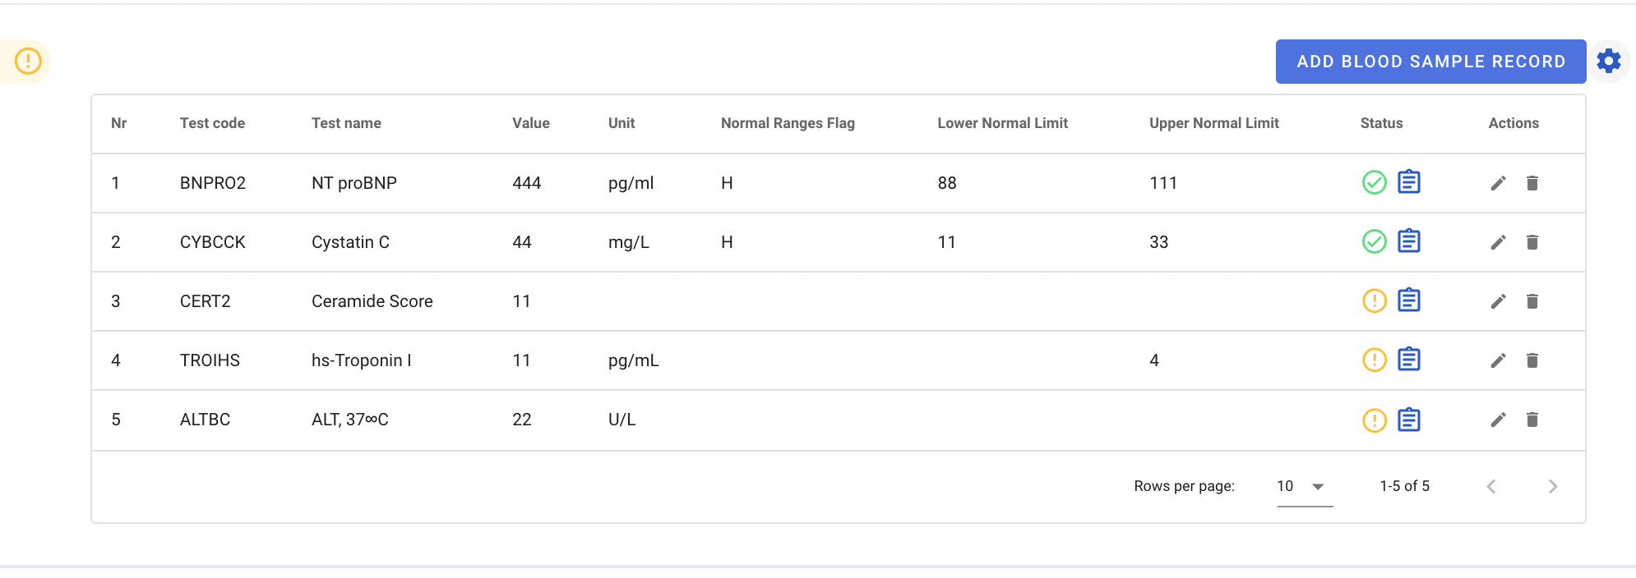
Blood Sampling - Basic Laboratory Assessments and CoroPredict Score - Biobank Subjects
Only applicable for Finnish sites - Biobank subjects in Enrolment V1
Indicate in the subject’s eCRF that the subject is a biobank subject
An “Add Blood Sample Record” button appears, click the button to add a laboratory assessment
Complete the available details for the assessment
Test name and Unit appear automatically when a Test code is selected
Repeat for each available assessment

Slide 62
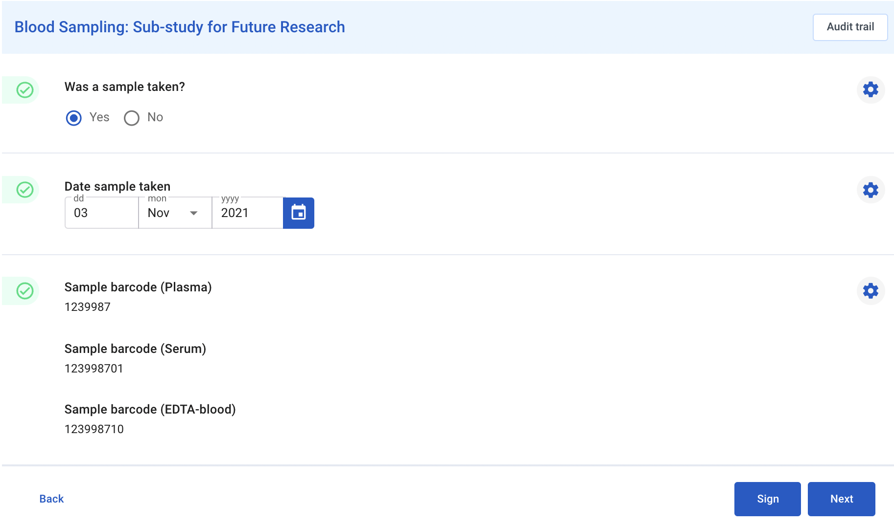
Blood Sampling: Sub-study for Future Research
Only if Informed Consent for Blood Sampling Sub-study for Future Research is given
Complete whether the sample was taken and if so, the date
Sample barcodes will be derived from the Blood Sampling - Basic Laboratory Assessments and CoroPredict Score form within the same visit
The Visit Date needs to be completed to trigger this form for the visit.
The Visit Date needs to be after or equal to the date of informed consent for the sub-study.

Slide 63
Protocol Deviations

Slide 64
Protocol Deviations - Log
Any protocol deviations (PDs) on subject are to be collected on the Protocol Deviations Log.
PDs can be manually created or automatically generated based on predefined conditions. Automatic PDs have “System” as reporter.

Slide 65
Protocol Deviations - Create
Click Add Protocol Deviation to create a new PD for a subject
The PD number and Date reported will be set by the system
Complete fields Reporter, Category, Description, Action Taken
If the PD is ready to be submitted, tick Submit to sponsor?
Ticking Submit to sponsor? triggers an email notification to the sponsor.
The sponsor will complete the other fields of this PD record.

Slide 66
Protocol Deviations - Automatic PDs
Created by the system based on predefined data conditions
Fields PD number, Date reported, Reporter, Category, Description and Sponsor Classification are automatically set
Complete Action taken and if the PD is ready to be submitted, tick Submit to sponsor?
Ticking Submit to sponsor? triggers an email notification to the sponsor.
The sponsor will complete the other fields of this PD record.

Slide 67
Protocol Deviations - Sponsor Evaluation
A PD that is submitted will be evaluated by the sponsor
The evaluation is final when fields Discarded by sponsor? and Closed by sponsor? have been completed
A closed PD can no longer be edited
If Sponsor classification = Important, additional sponsor fields will be displayed:
Sponsor description
Root cause and impact assessment
Corrective action
Preventative action

