Slide 1
CoroPrevention Tool Suite Caregiver dashboard User guide V4
V.4; 17.08.2023

Slide 2
Table of contents
Information exchanged between different systems
How to enroll a patient in the Tool Suite
General module
Journey module
Education module
Medication adherence module
Physical activity (EXPERT tool) module
Patient records view

Slide 3
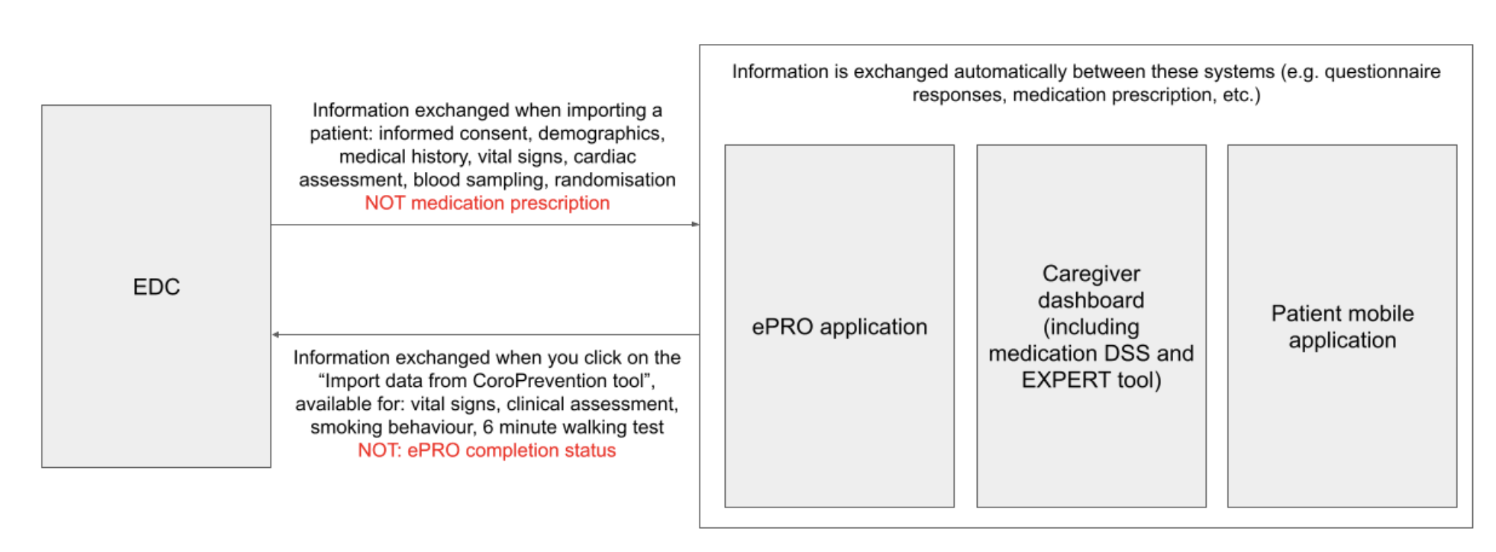
Which information is exchanged between different systems?

Slide 4
Case nurse manual caregiver dashboard – how to enroll a patient in the Tool Suite
V.4; 17.08.2023

Slide 5
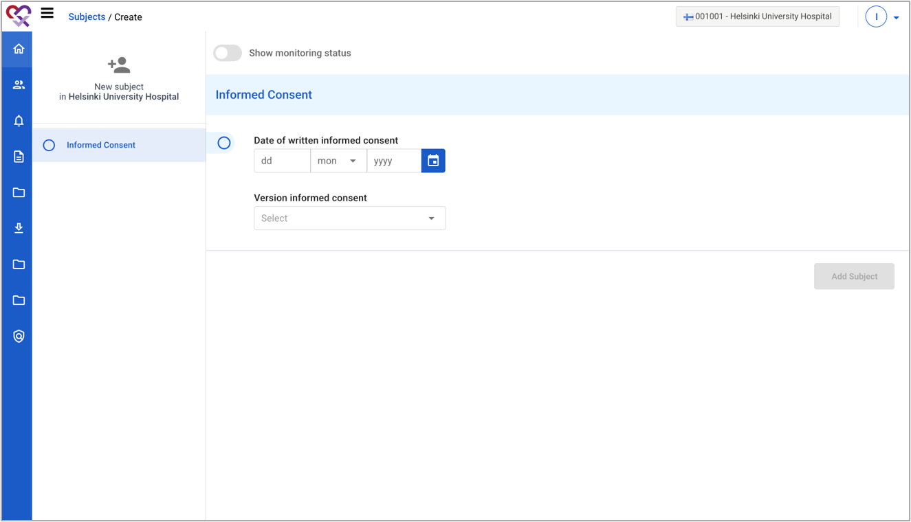
Prepare for visit 1 (EDC)
1 | When a subject enrolls in the study, you start in the EDC system.
2 | To create the patient, you have to fill in the date and version of the informed consent.
1
2

Slide 6
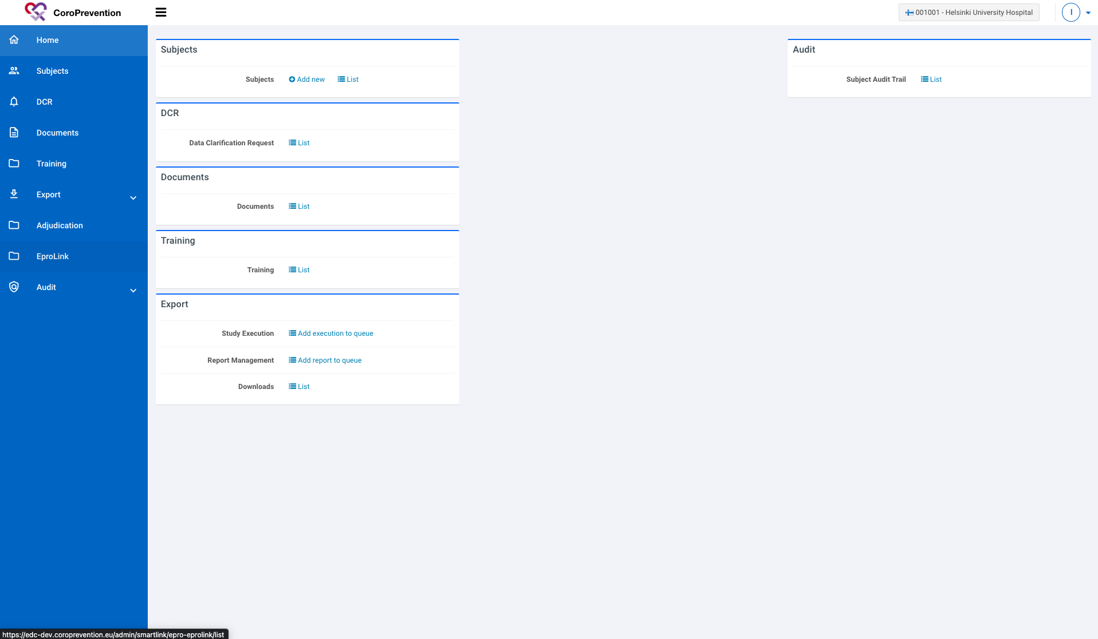
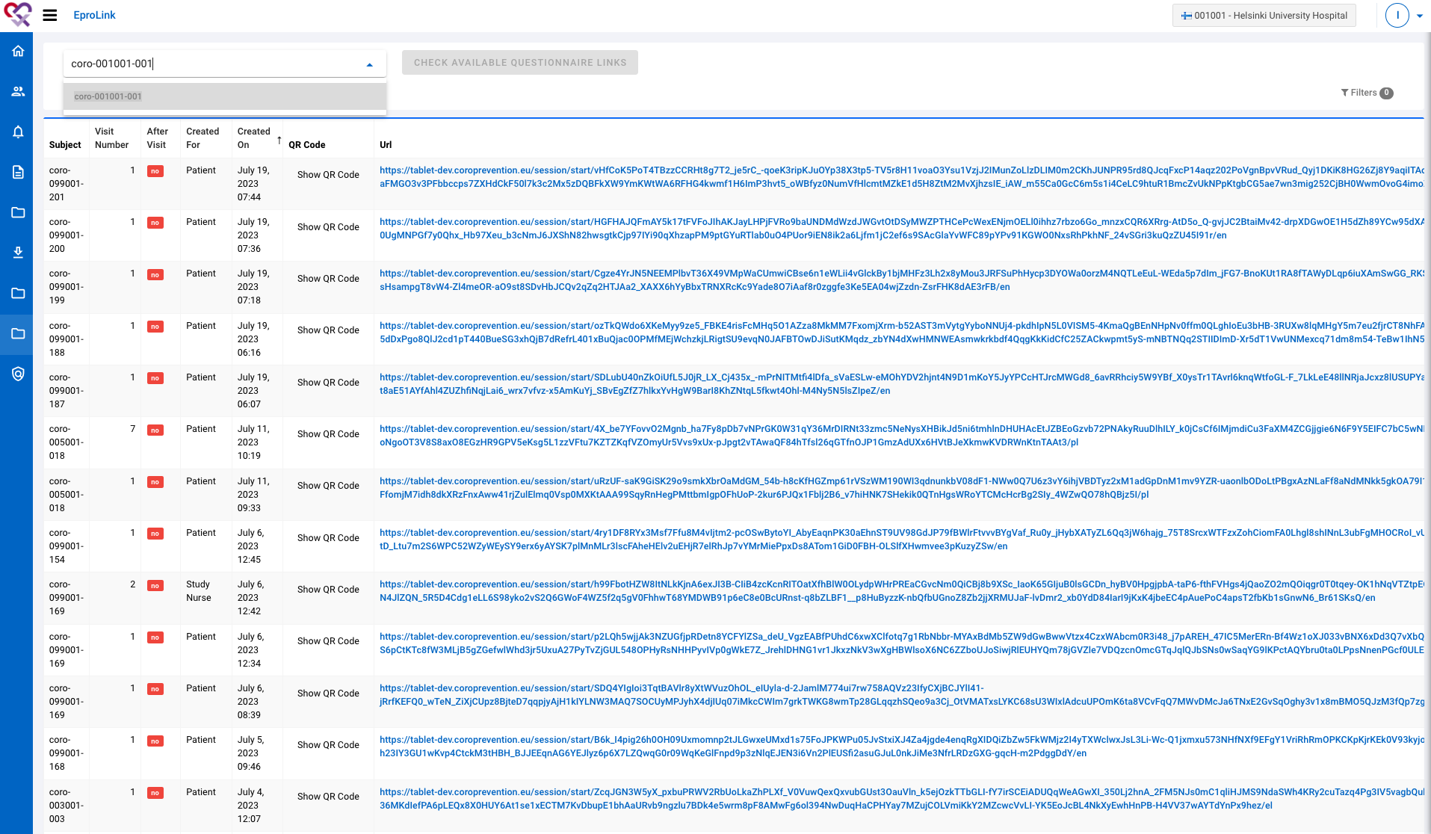
Have visit 1 with the patient (EDC)
1 | First, the patient has to complete the ePROs for visit 1. You can open the ePROs by navigating to “EproLink”.
2 | Look up the patient by entering the subject ID.
3 | Click the button “Check available questionnaire links” to open the links for the ePROs.
1
2
3

Slide 7
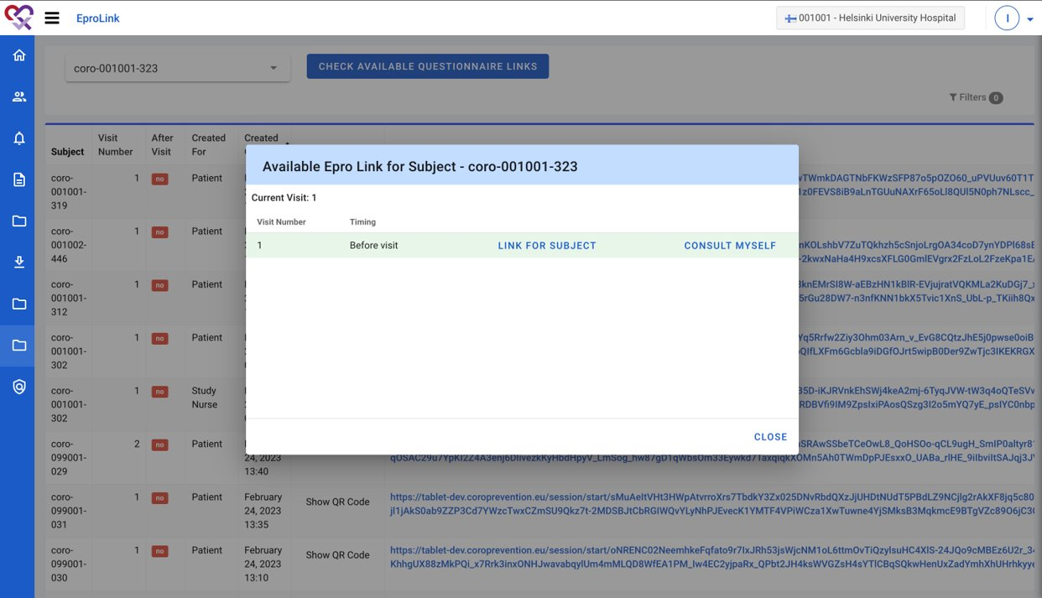
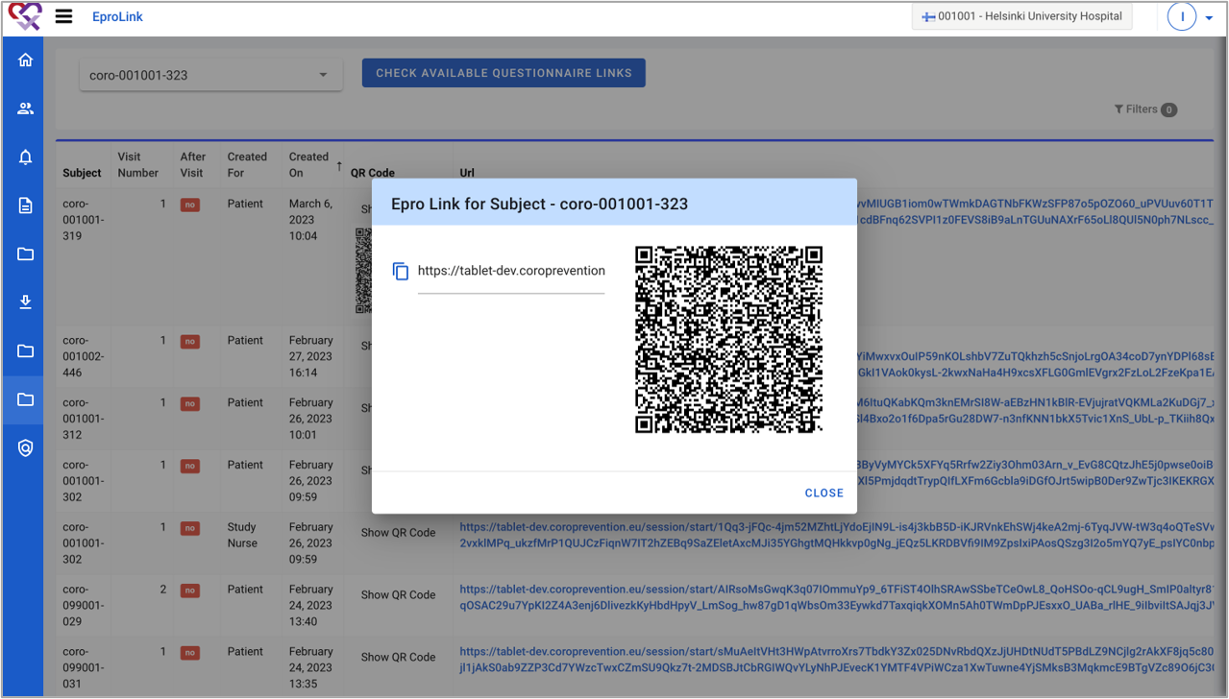
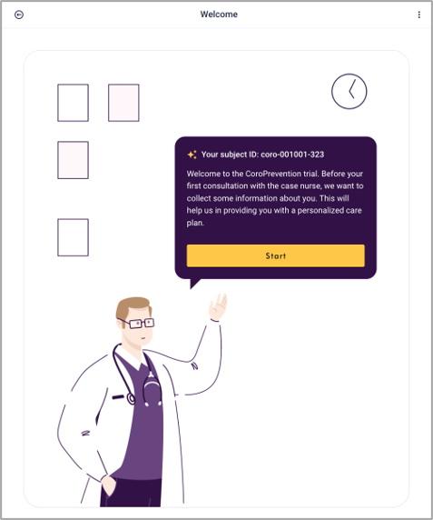
Have visit 1 with the patient (EDC)
1 | First, the patient has to complete the ePROs for visit 1. You can open the ePROs by navigating to “EproLink”.
2 | Look up the patient by entering the subject ID.
3 | Click the button “Check available questionnaire links” to open the links for the ePROs.
4 | Click on the “Link for subject” link to generate the QR code for the ePROs for visit 1.
5 | Scan the QR code with the tablet and hand the tablet over to the patient, so the patient can complete the ePROs.
4
5
5

Slide 8
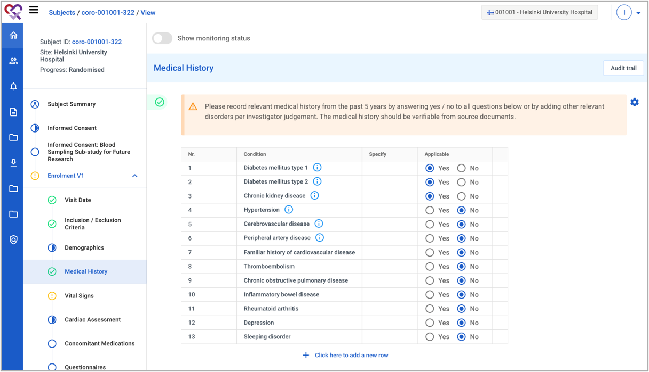
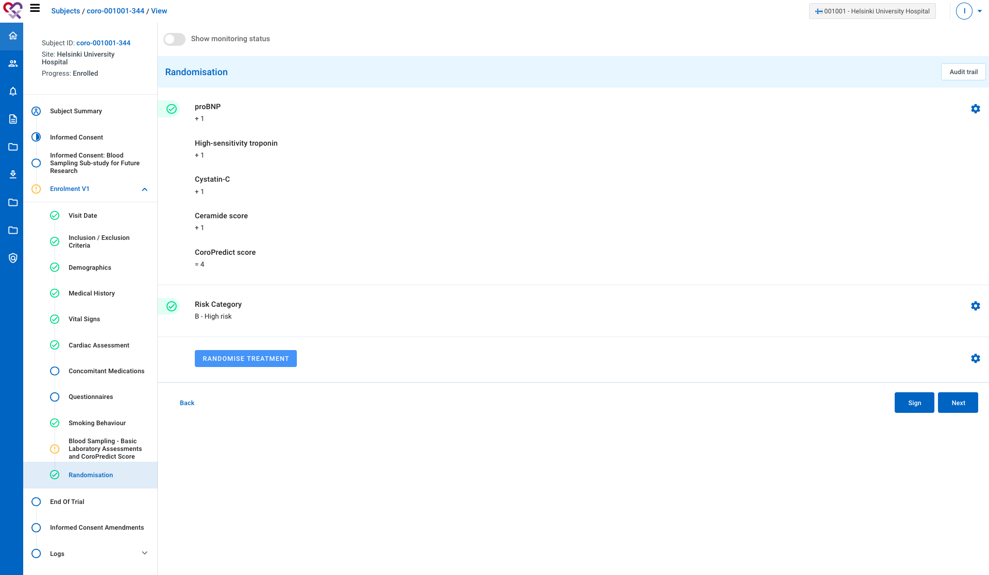
Prepare for visit 2 (EDC)
1 | In the EDC, complete the information of visit 1. The following information has to be completed to be able to import the patient into the Tool Suite: Demographics: year of birth, sex Medical History: Diabetes mellitus type 1, Diabetes mellitus type 2 Vital Signs: Body height, Body weight, Blood pressure (Systolic and Diastolic), Pulse rate Cardiac Assessment: Type of ischemic heart disease during index cardiovascular event, Type of treatment, History of MI?, History of HF?, History of stroke?, History of arterial fibrillation?, CHA2DS2-VASC score Blood sampling: Date sample taken, BNPRO2, TROIHS, CYBCCK, CERT2, an eGRF value e.g. CKDCY3, LDLBC, HDLS, CHOLBC, HBA1CH
2 | Randomize the patient.
1
2

Slide 9
Prepare for visit 2 (EDC)
When completing the information in the EDC, make sure the data satisfies the following criteria (to be able to import the patient into the Tool Suite later).
Parameter | Allowed ranges
Body weight | BMI: 12 kg/m^2 – 60 kg/m^2 Body weight: using the formula and range for BMI and the patient’s height
Blood pressure | Systolic: 40 mmHg – 280 mmHg Diastolic: 30 mmHg – 160 mmHg
Pulse rate | Pulse rate: 35 – 140 bpm
HBA1CH | HbA1c: 2.15% - 20%
CHOLBC | Total cholesterol: 50 mg/dl– 500 mg/dl
LDLBC | LDL: 10 mg/dl – 450 mg/dl
HDLS | HDL: 10 mg/dl – 200 mg/dl.

Slide 10
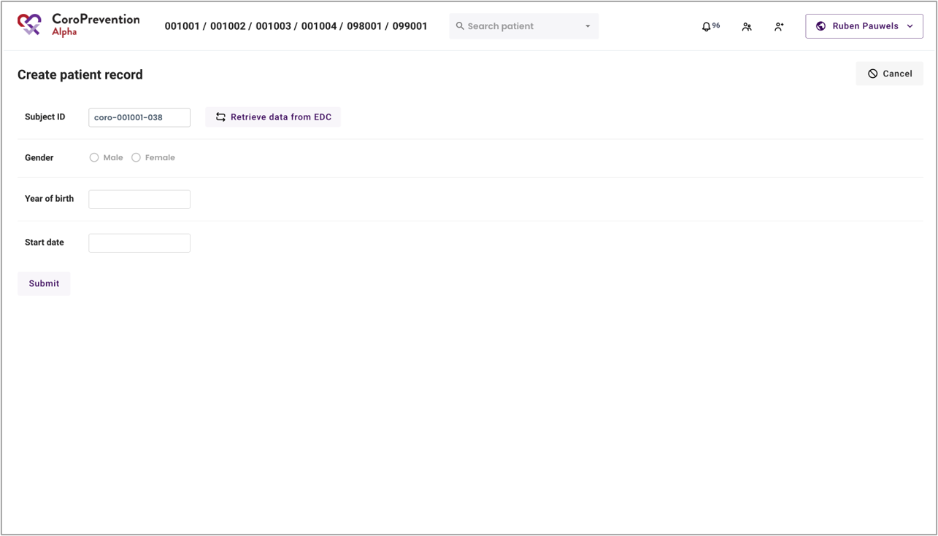
Prepare for visit 2 (caregiver dashboard)
1 | If the patient is randomized into the PPP group, the patient has to be imported into the Tool Suite. This can be done in the caregiver dashboard. Login to the caregiver dashboard and navigate to the “Create patient record” screen. Note: patients that are not in the PPP group cannot be imported into the Tool Suite.
2 | Fill in the subject ID.
3 | Click the button ”Retrieve data from EDC” to fetch the data from the EDC.
4 | Check if the data shown in the screen is correct for the patient.
5 | If the data is not correct, go to the EDC to change the data and repeat the steps above. If the data is correct, click the “Submit” button to initiate the actual import of the patient from the EDC. Note: each patient can only be imported once into the Tool Suite.
1
2
3
4
5

Slide 11
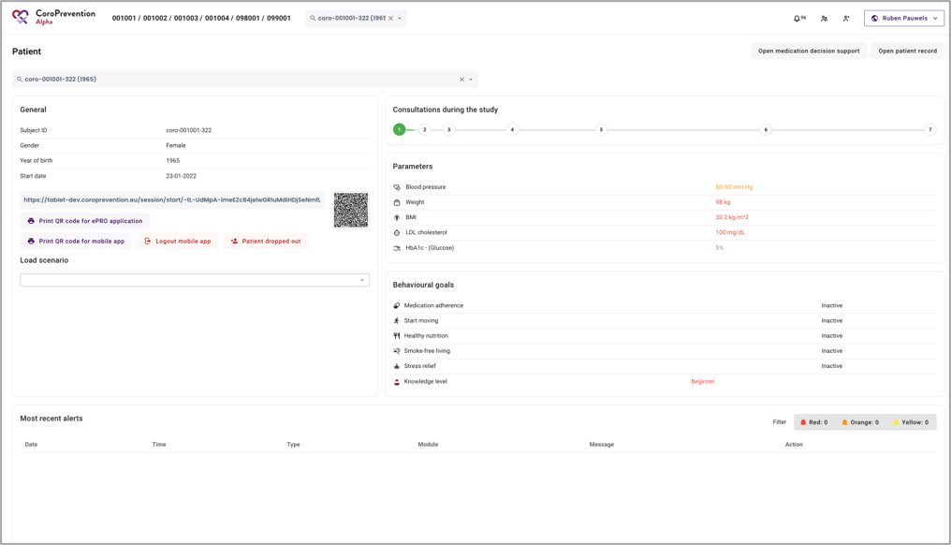
Prepare for visit 2 (caregiver dashboard)
1 | Patient record succesfully imported into the Tool Suite.
1

Slide 12
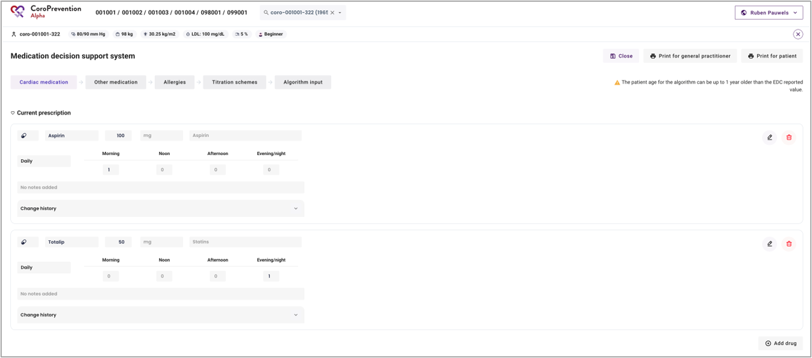
Prepare for visit 2 (caregiver dashboard)
1 | The medication prescription of the patient is not automatically imported from the EDC to the Tool Suite (caregiver dashboard). Therefore, you have to manually register the patient’s medication prescription. Click the “Open medication decision support” button to open the medication DSS in which you can modify the patient’s medication prescription.
2 | Register the patient’s medication prescription. This is the same prescription as the one that was entered in EDC for visit 1.
1
2

Slide 13
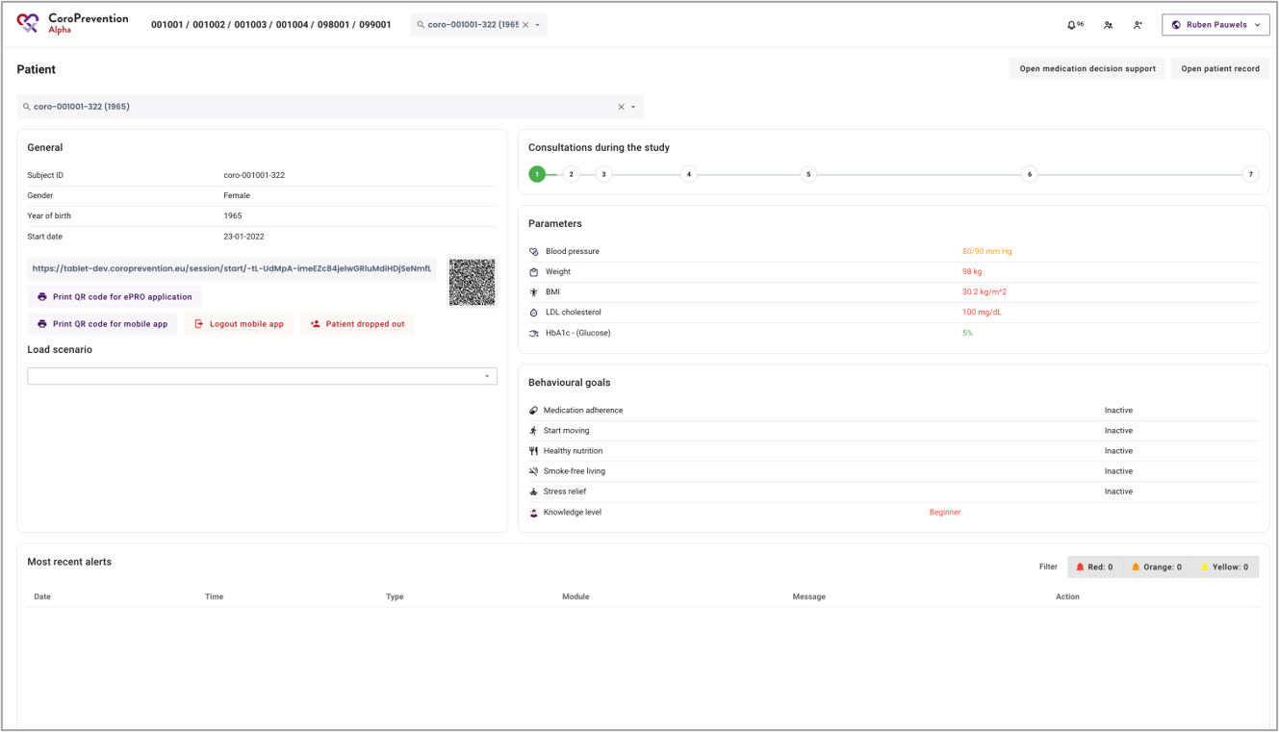
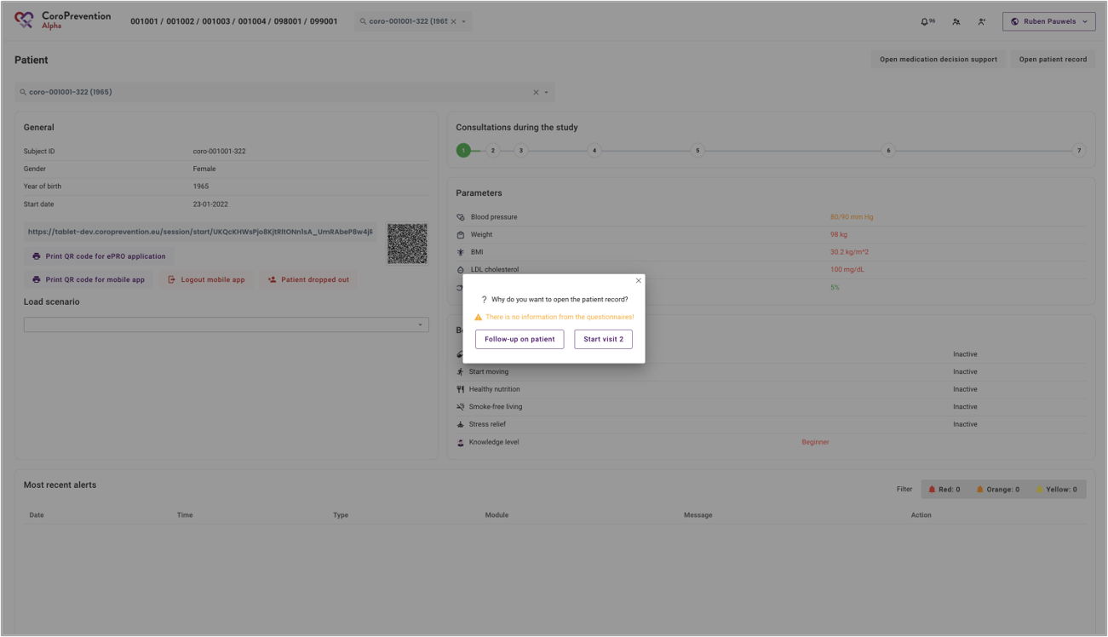
Prepare for visit 2 (caregiver dashboard)
1 | During the visit, you will also discuss with the patient his/her exercise goals. To set a weekly sports goal (exercise prescription) for the patient, open the patient record by clicking the button “Open patient record” Note: alternatively, you can also set the weekly sports goal during the visit with the patient.
2 | Open the patient record by clicking on the “Follow-up on patient” button.
1
2

Slide 14
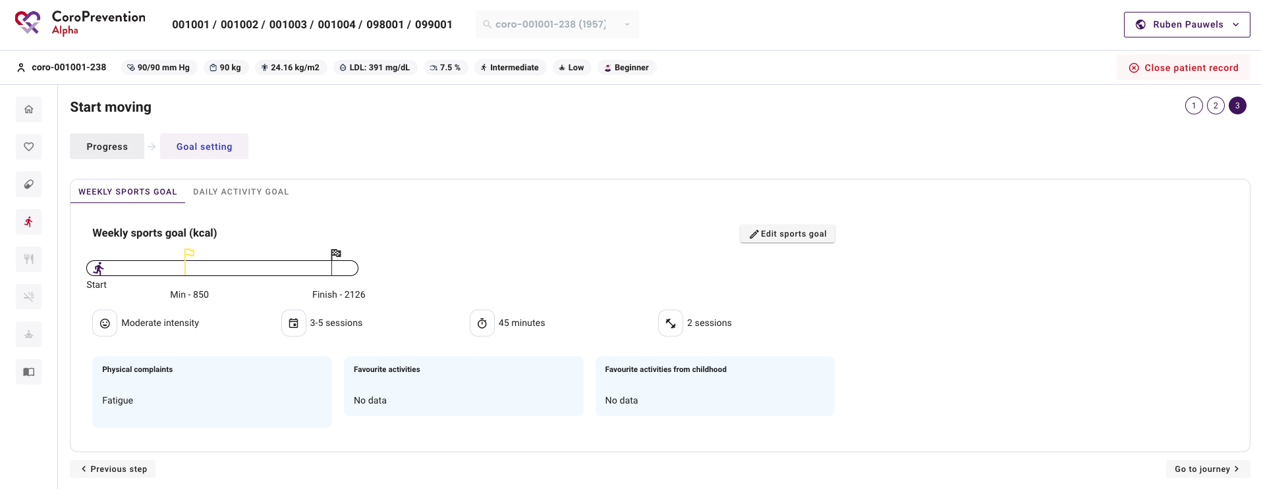
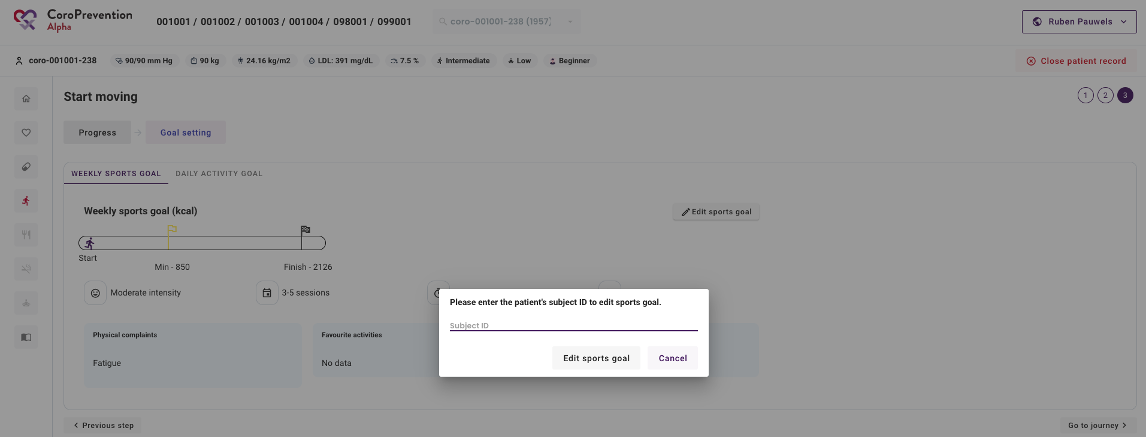
Prepare for visit 2 (caregiver dashboard)
3 | Navigate to the “Start moving” module by clicking the icon of the running man.
4 | Click on the ”Goal setting” tab.
5 | In the “Weekly sports goal” tab, click on the “Edit sports goal” button.
6 | Enter the patient’s subject ID and click the “Edit sports goal” button to open the EXPERT tool.
4
3
5
6

Slide 15
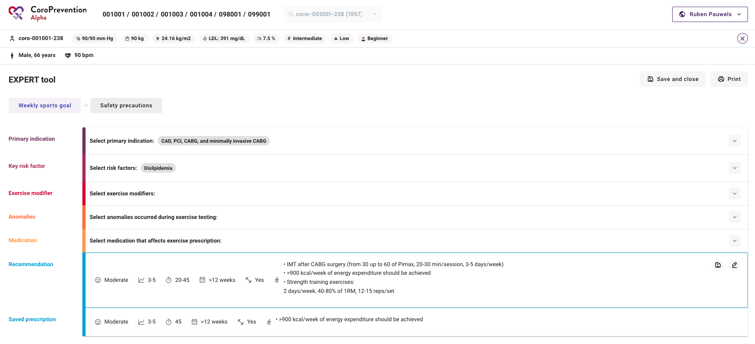
Prepare for visit 2 (caregiver dashboard)
7 | Set a weekly sports goal (exercise prescription) for the patient by selecting the relevant primary indications, key risk factors, exercise modifiers, anomalies and medication. Note: filling in this information might require you to look at the patient’s electronic health record.
8 | When you have created the weekly sports goal for the patient, you can close the EXPERT tool by clicking the “Save and close” button.
8
7

Slide 16
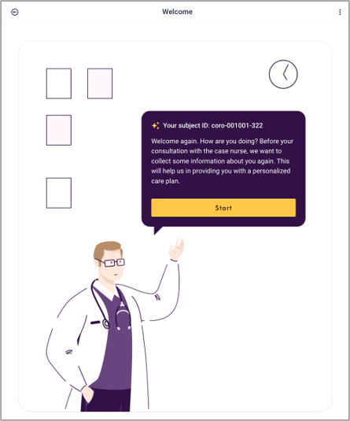
Have visit 2 with the patient (caregiver dashboard)
1 | Use the search function to find the patient record.
2 | Take the tablet and scan the QR code (or copy the link) to open the ePRO for the patient.
3 | Give the tablet to the patient so he/she can complete the questionnaires.
1
2
3

Slide 17
Have visit 2 with the patient (caregiver dashboard)
4
4 | Click the button “Open patient record” to open the patient record for a visit.
5 | In the pop-up, click the button "Start visit 2” to start the visit. Note: only use "Start visit X" when patient is sitting with you.
5

Slide 18
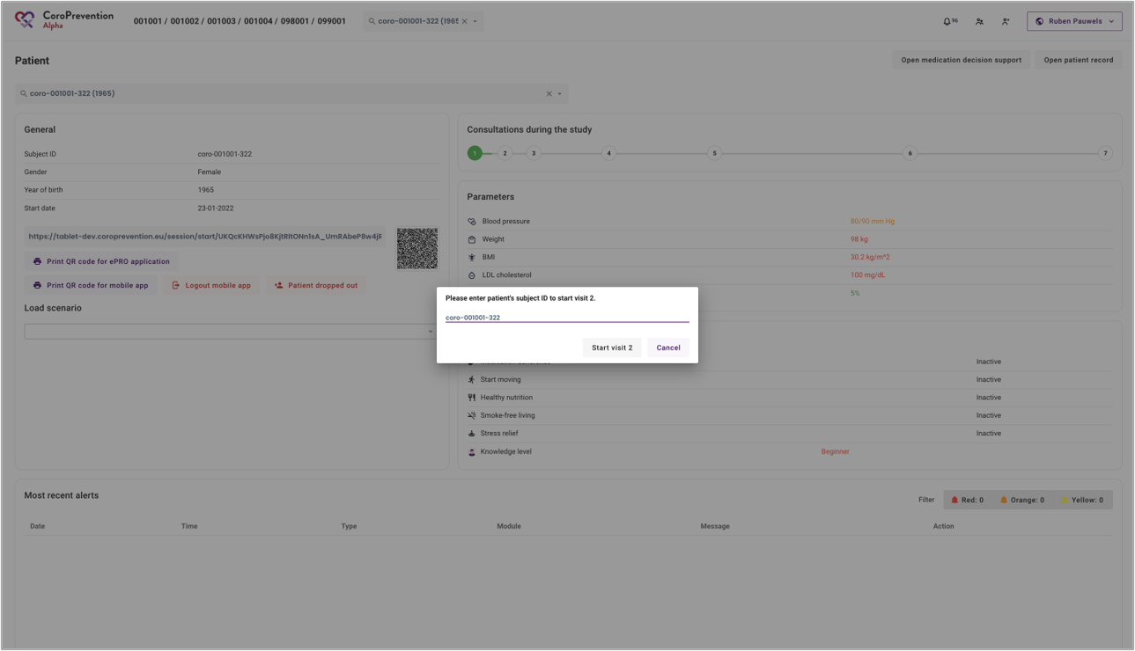
Have visit 2 with the patient (caregiver dashboard)
6 | Fill in the subject ID to make sure you are opening the patient record of the correct patient.
7 | Click the “Start visit 2” button to start the visit.
6
7

Slide 19
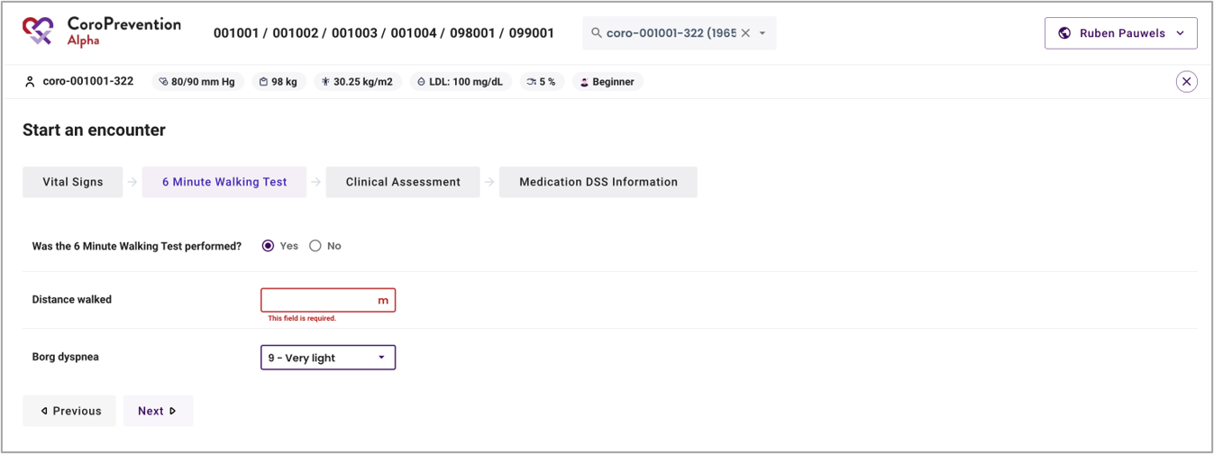
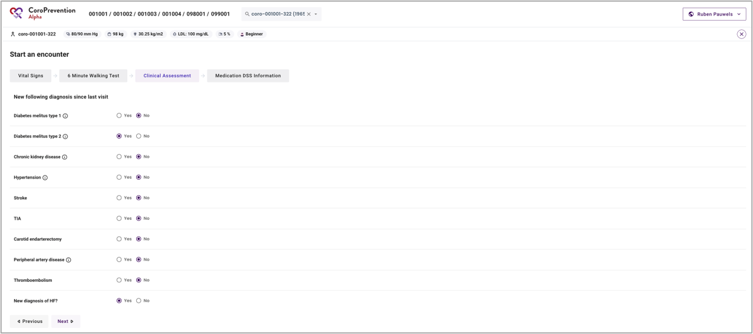
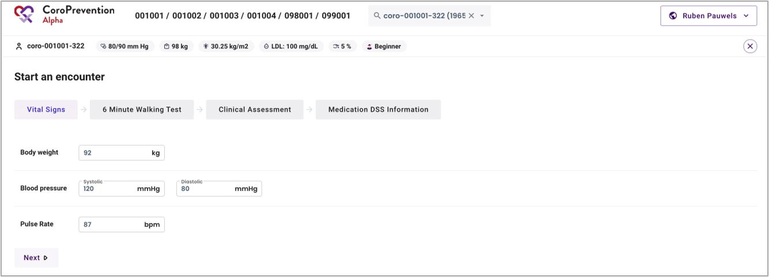
Have visit 2 with the patient (caregiver dashboard)
1 | When you start the visit, you have to measure and fill in the vital signs information in the caregiver dashboard. Note: after the visit, you can import this information in the EDC.
2 | During some visits, the patient has to perform the 6 Minute Walking Test. You have to record the results in the caregiver dashboard. Note: after the visit, you can import this information in the EDC.
3 | Fill in the information regarding the clinical assessment (based on information in the hospital system or questions asked to the patient). Indicate only NEW diagnosis since last visit. Note: after the visit, you can import this information in the EDC.
2
3
1

Slide 20
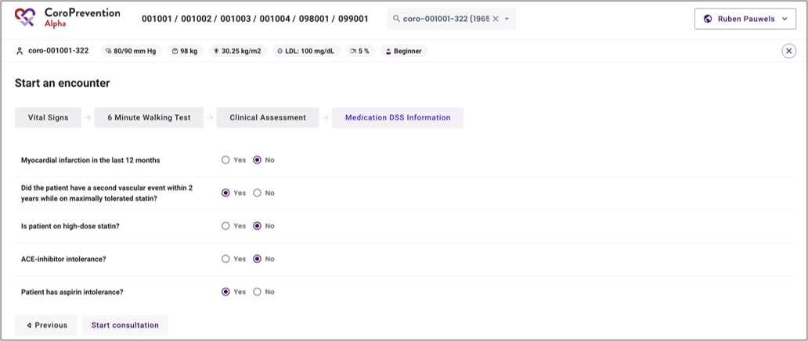
Have visit 2 with the patient (caregiver dashboard)
4 | Fill in the information that is required for the algorithm of the medication DSS to make personalized medication recommendations for the patient. This information can be filled in based on information that you can find in your hospital system (medical records).
4

Slide 21
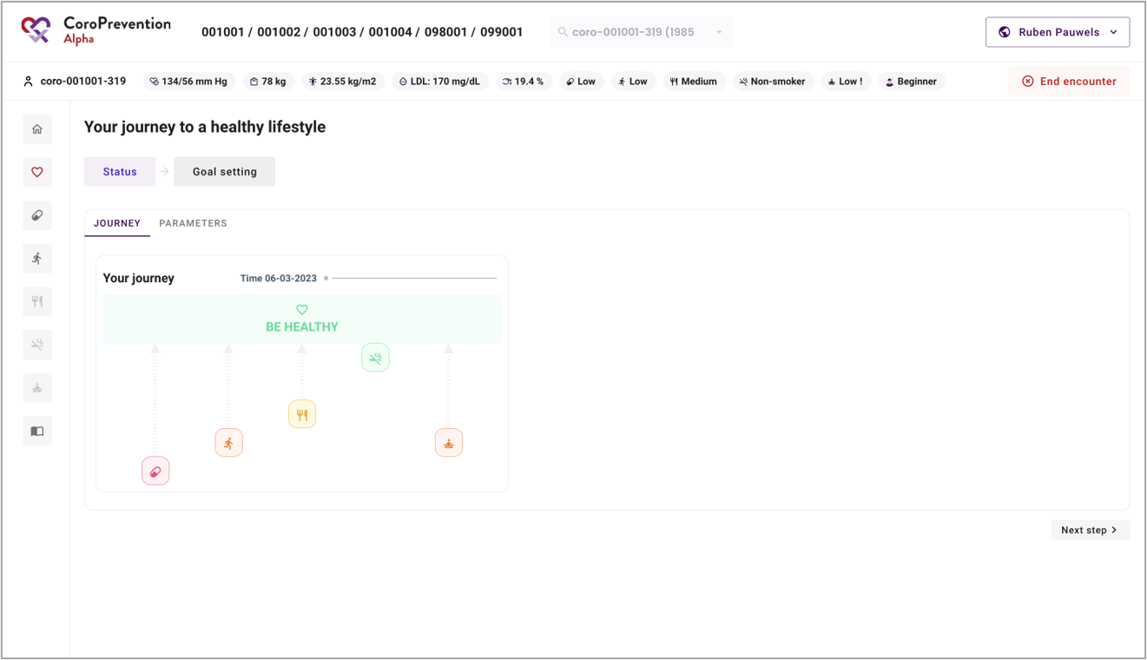
Have visit 2 with the patient (caregiver dashboard)
1 | The patient record is open for visit. From now on, you can have the shared decision making discussion with the patient about his/her status and goals.
2 | During visit 2, you will also install the CoroPrevention mobile application on the patient’s smartphone.
1

Slide 22
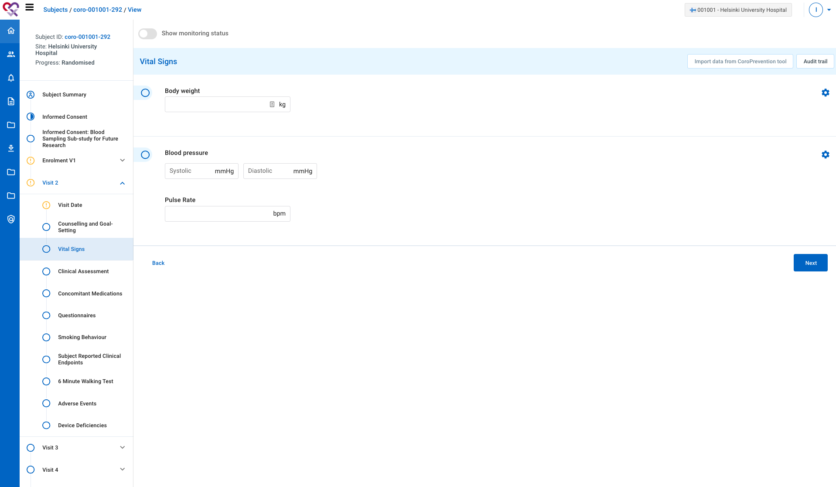
After visit 2 with the patient (EDC)
1 | During or short after visit 2, all missing information for visit 2 has to be completed in the EDC.
2 | You can also use the “Import data from CoroPrevention tool” to import data that you already registered in the caregiver dashboard.
2
1

Slide 23
Preparing and having visit 3 - 7
Visit 3: ePRO questionnaires + shared decision making conversation with case nurse (slide 13 – 19)
Visit 4: ePRO questionnaires + shared decision making conversation with case nurse (slide 13 – 19)
Visit 5: ePRO questionnaires + shared decision making conversation with case nurse (slide 13 – 19)
Visit 6: ePRO questionnaires + shared decision making conversation with case nurse (slide 13 – 19) + appointment with investigator
Visit 7: ePRO questionnaires + shared decision making conversation with case nurse (slide 13 – 19) + uninstall patient mobile app

Slide 24
Remote follow-up on patient between visits (caregiver dashboard)
1
1 | Click the button “Open patient record” to open the patient record for a follow-up.
2 | In the pop-up, click the button ”Follow-up on patient” to start the follow-up. Note: use “Follow-up on patient” to view the patient record when the patient is not with you e.g. to view the patient’s progress or to prepare for the visit.
2

Slide 25
Remote follow-up on patient between visits (caregiver dashboard)
1 | The patient record is open for follow-up.
1

Slide 26
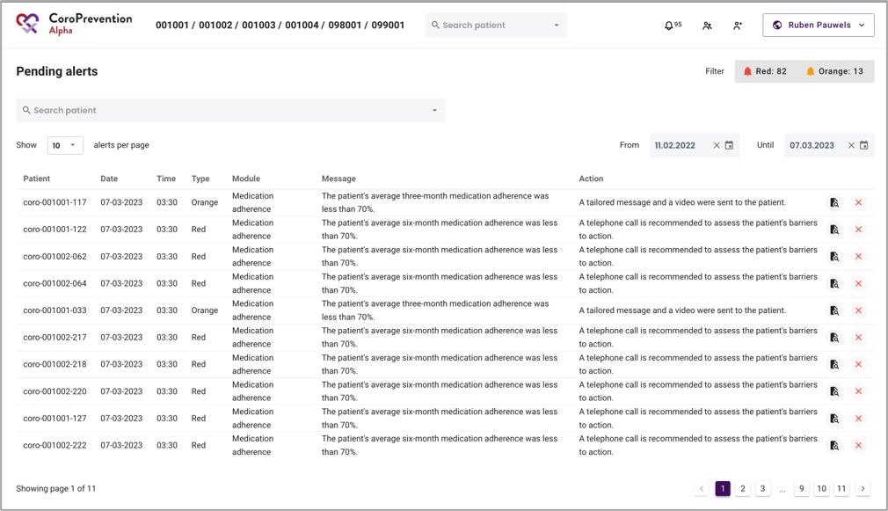
Alerts between visits (caregiver dashboard)
1 | Click the “Bell” icon to view the list of pending alerts. Alerts get triggered based on the patient’s reported behaviour (from the mobile app)​. Note: alerts are shared between all nurses of a site​.
2 | The required action is described in the alert.
3 | Click the “File lookup” icon to open the patient record​.
4 | Click the “Cross” icon to dismiss the alert​.
1
2
3
4

Slide 27
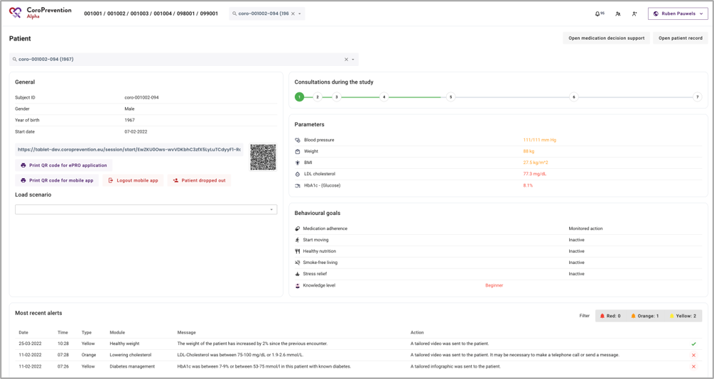
Alerts between visits (caregiver dashboard)
1 | In the patient overview, there is a section “Most recent alerts”. This section shows all alerts (handled and unhandled) that were triggered for the patient since last. Note: yellow alerts are handled automatically by the system (e.g. tailored education sent to the patient)​.
1

Slide 28
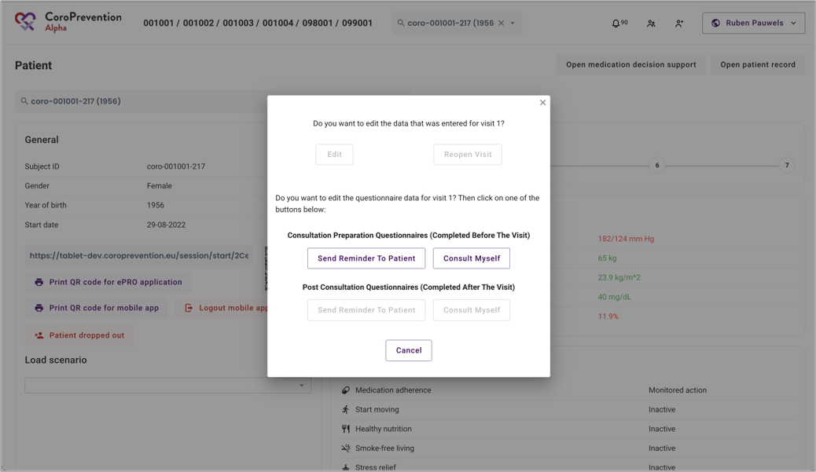
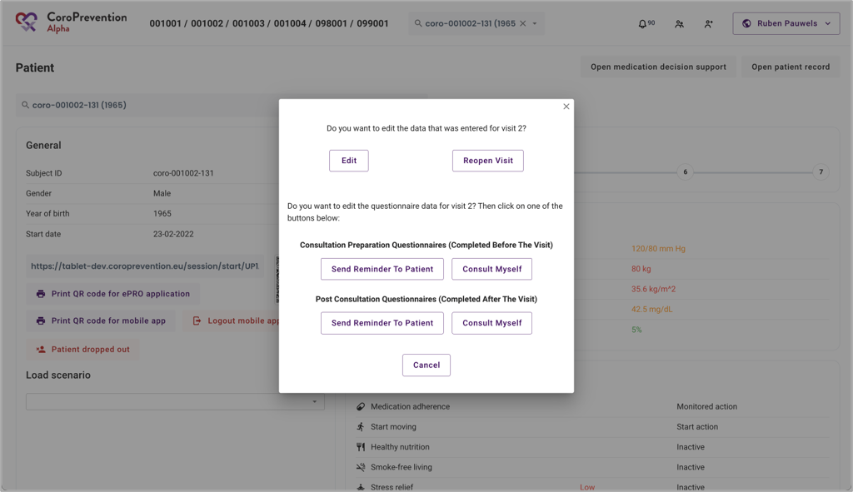
Troubleshooting – Mistake in data entry (caregiver dashboard)
1 | Visit 1 data can be edited in the EDC.​ Visit 1 data cannot be edited in the Tool Suite after import. Therefore it is important to check the data thoroughly before importing!​
2 | Visit 2-7 data of “Start an encounter” screens can be edited​ in the caregiver dashboard and in the EDC. A visit can also be reopened​ and links for questionnaires can be resent to the patient.
1
2

Slide 29
Case nurse manual caregiver dashboard - general module
V.4; 17.08.2023

Slide 30
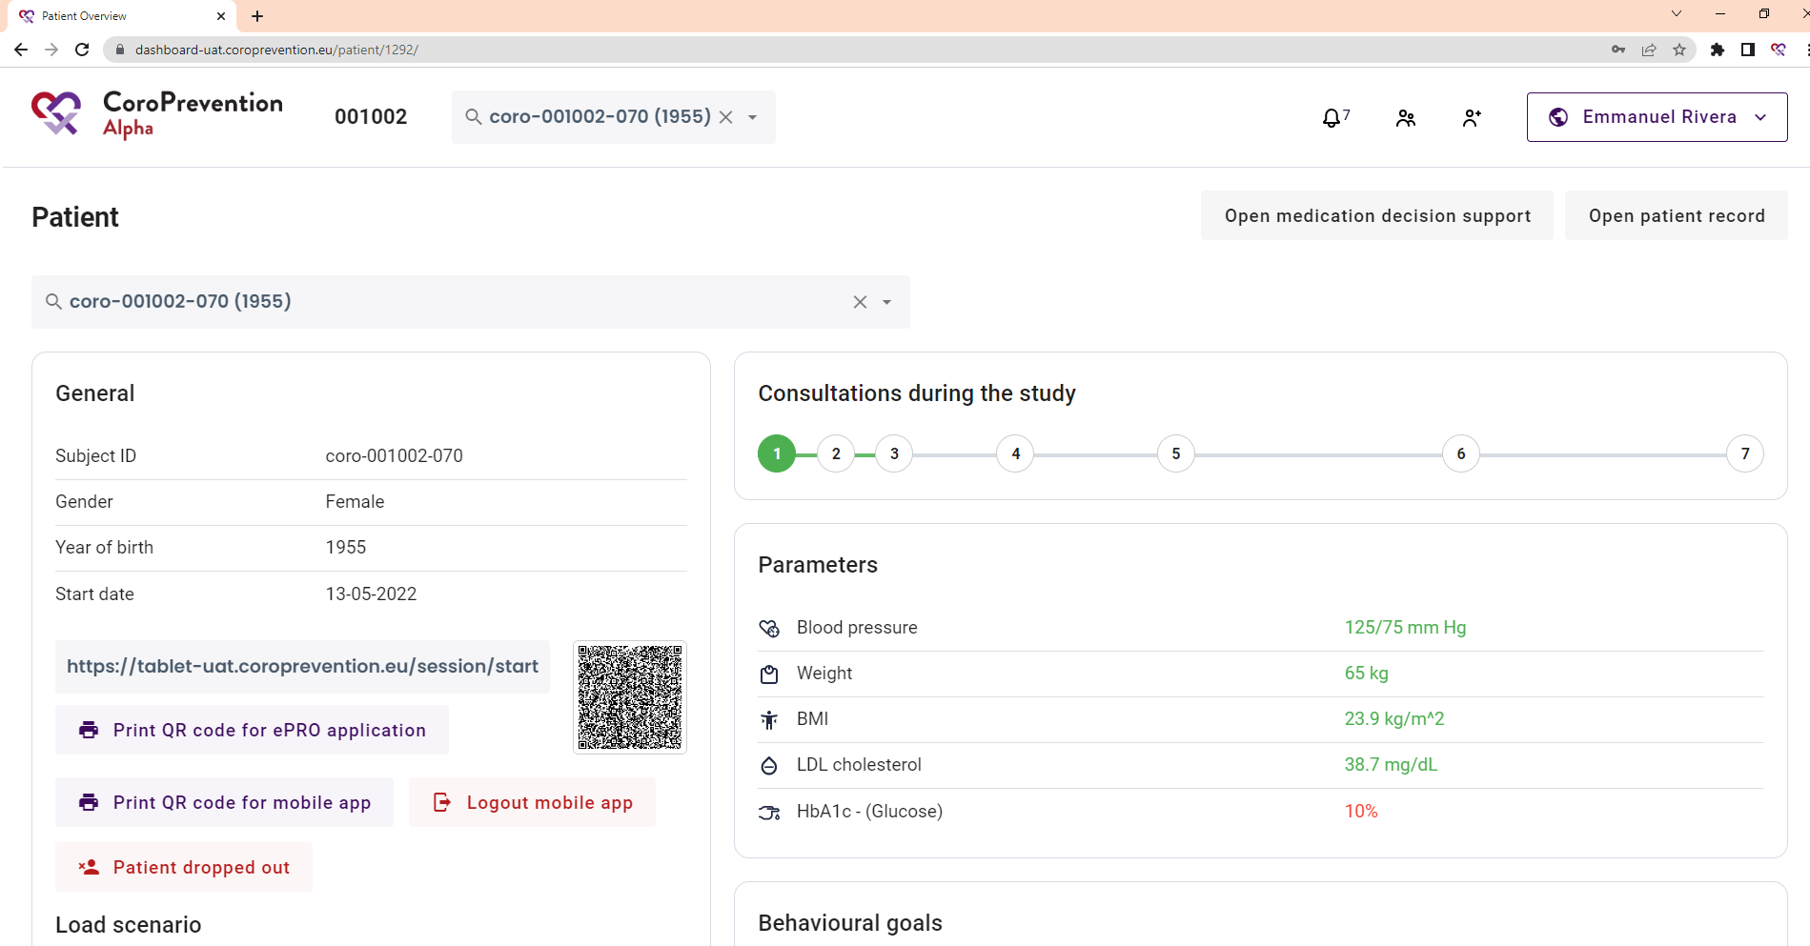
What can I find in the top navigation bar?
1 | At the top of the screen, you can find the top navigation bar.
2 | In the search bar, you can type the subject ID of a patient. The system gives suggestions for patients that match with your search criteria. You can click on a suggestion to open the patient record of that patient.
3 | You can view the alerts by clicking this button. There is an indication of how many pending alerts you have.
4 | You can open the screen to search a patient in your trial centre by clicking this button.
5 | You can create a patient record by clicking this button.
6 | You can view who is logged in in the caregiver dashboard. In the account menu, open the about page, access settings and log out of the caregiver dashboard.
3
4
5
1
2
6

Slide 31
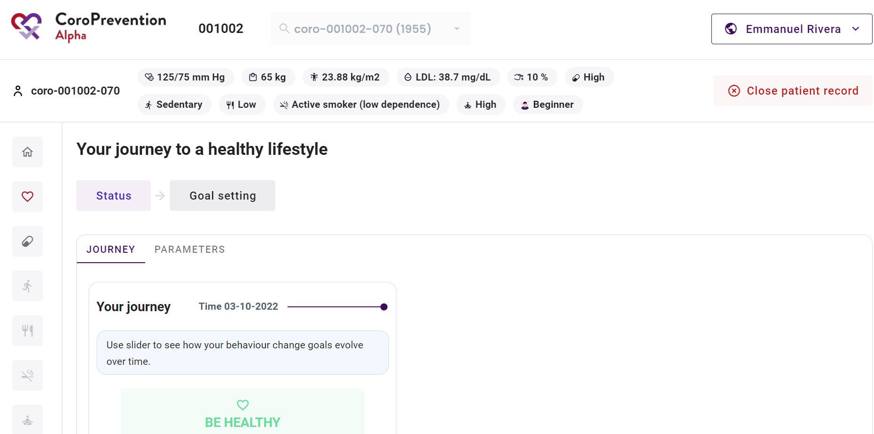
Where can I see the patient's risk profile?
1
2
3
5
6
7
8
9
10
4
11
12
13
14
15
16

Slide 32
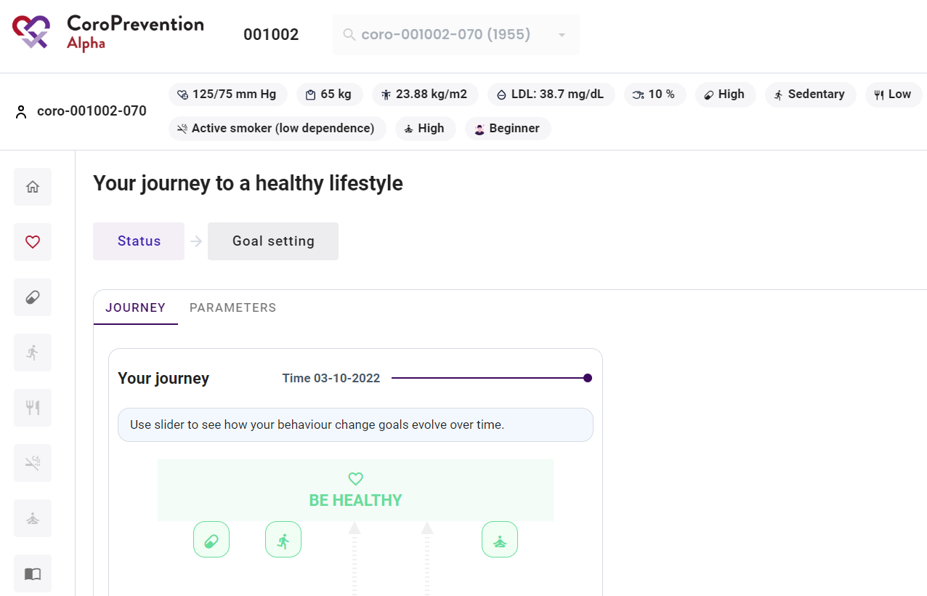
What can I do in the menu on the left?
1 | The navigation menu on the left allows you to switch for the patient between different modules or behavioural goals. The currently selected item is highlighted. The house icon takes you back to the main page of the patient profile.
2 | In this menu item, you can view the patient's progress for parameters and his/her journey to a healthy lifestyle. Also, you can select the outcome and behavioural goals for the patient.
3 | In this menu item, you can view the patient's progress and set goals for "Medication adherence".
4 | In this menu item, you can view the patient's progress and set goals for "Start moving".
5 | In this menu item, you can view the patient's progress and set goals for "Healthy nutrition". This feature is not available in release 2.
6 | In this menu item, you can view the patient's progress and set goals for "Smoke-free living". This feature is not available in release 2.
7 | In this menu item, you can view the patient's progress and set goals for "Stress relief". This feature is not available in release 2.
8 | In this menu item, you can view the patient's disease related knowledge, review the patient's usage of the educational module, and configure the relevant educational content for the patient. We recommend to do this as the last step in the encounter with the patient.
1
2
3
4
5
6
7
8

Slide 33
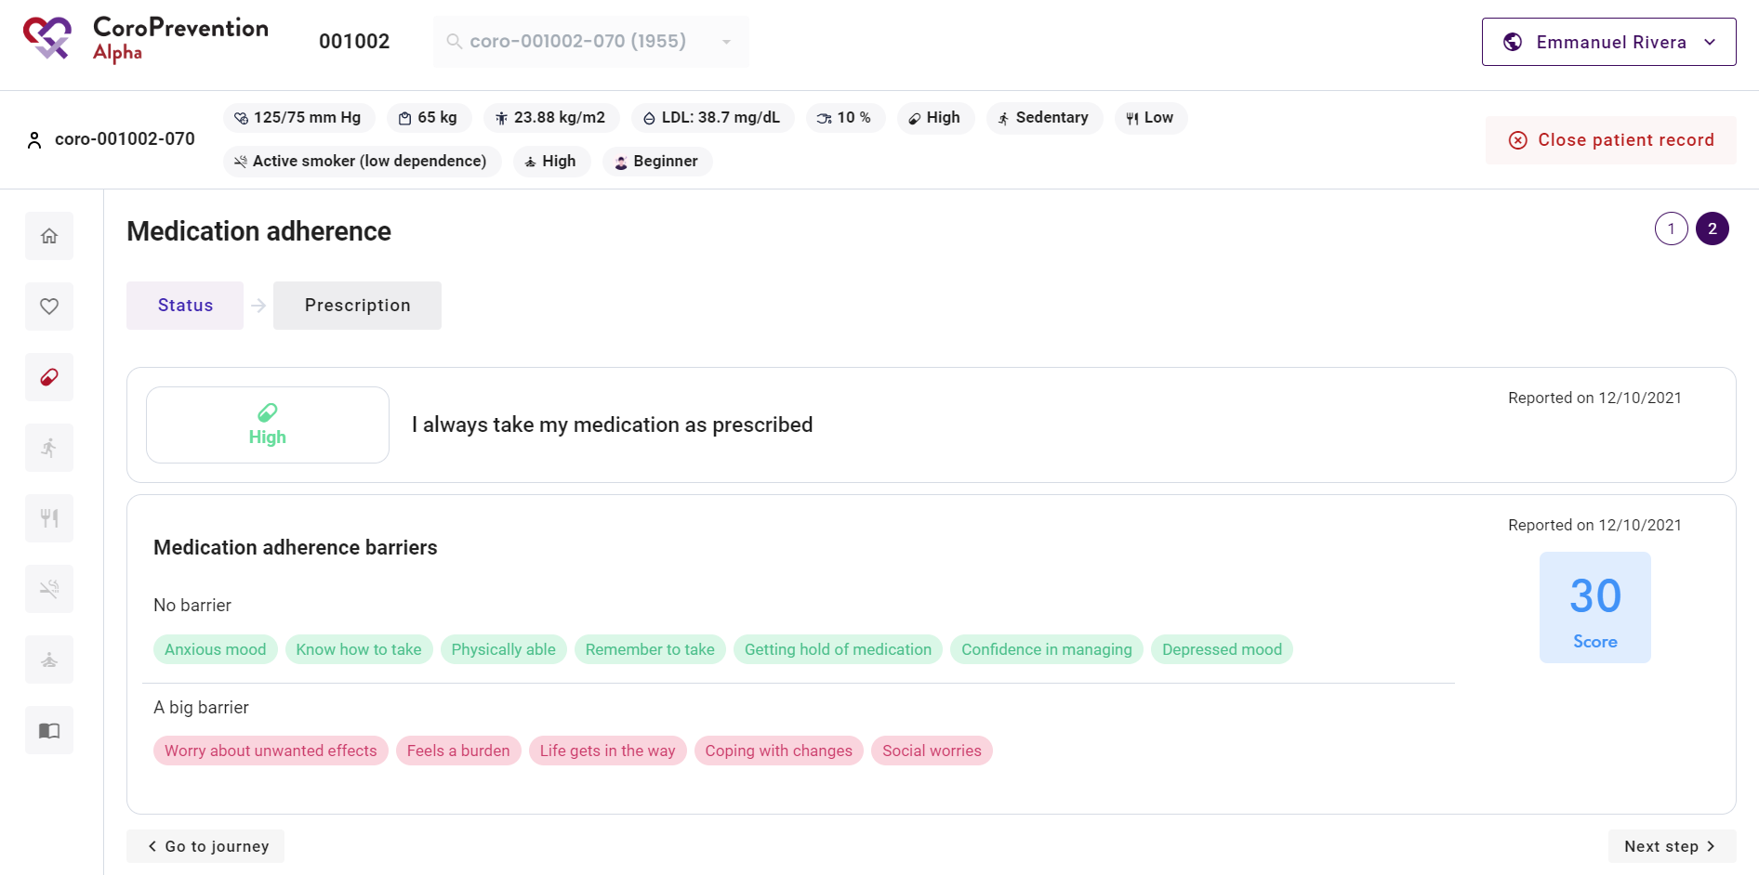
How to know the patient's level of guidance for a behavioural goal?
1 When you have opened the details about a behavioural goal, you can view the patient's level of guidance for the behavioural goal by looking at the circles. Each circle represents one level of guidance for the behavioural goal. The circle of the patient's current level of guidance for the behavioural goal is highlighted. If there is no circle highlighted, the patient is in inactive mode (level of guidance 0) for the behavioural goal.
1

Slide 34
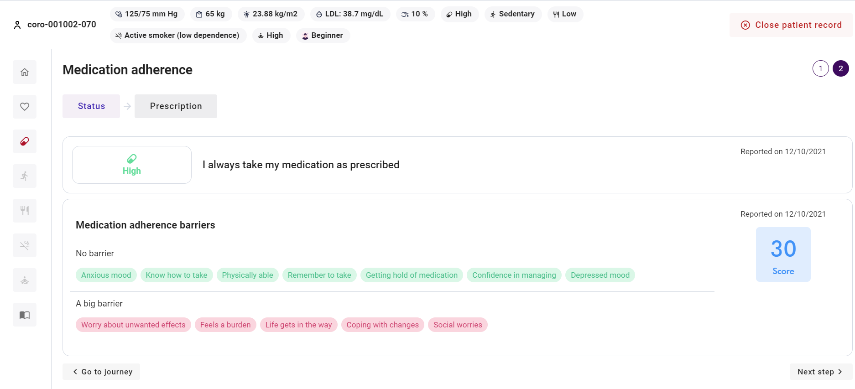
How to structure the conversation about a behavioural goal?
1 | For each menu item on the left (i.e. module or behavioural goal), there are several discussion steps. These refer to the different topics that you can discuss with the patient. The currently selected discussion step is highlighted. You can click on a discussion step to view the related screen.
2 | You can go to the next discussion step by clicking this button.
1
2

Slide 35
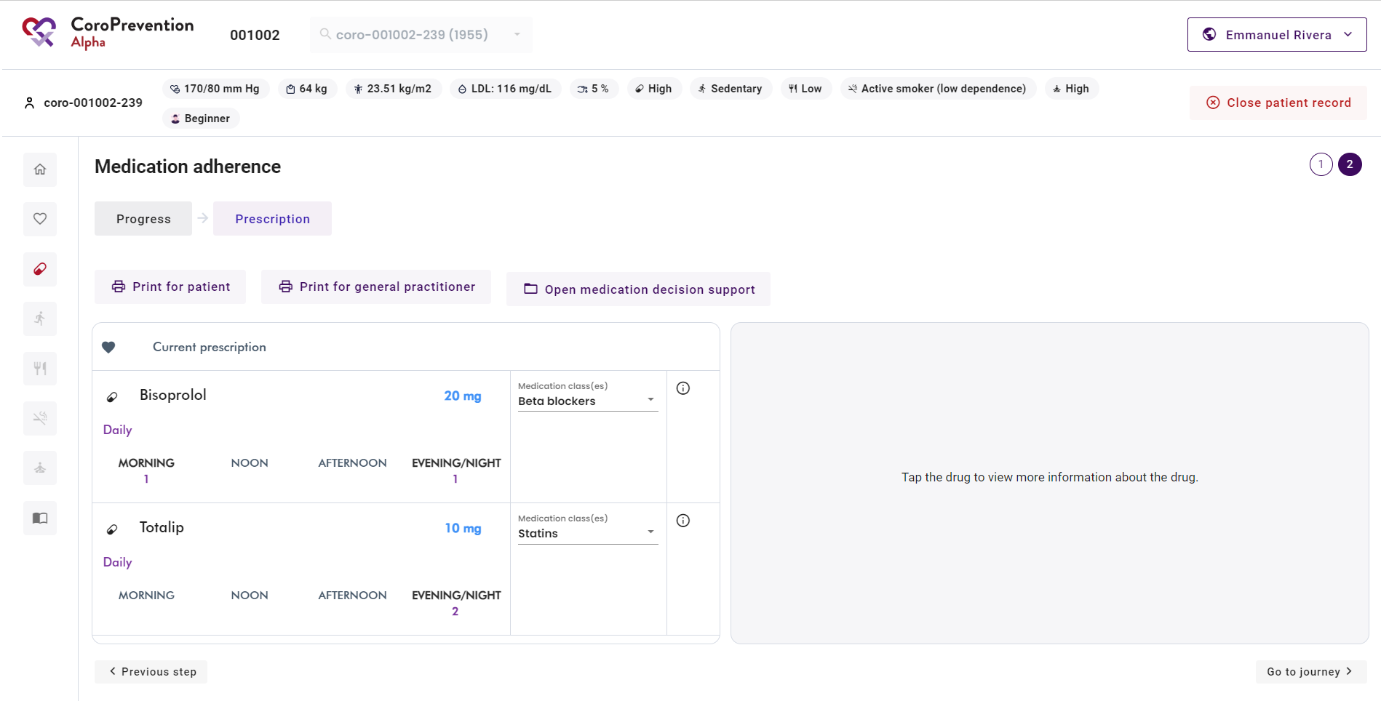
How to structure the conversation about a behavioural goal?
3 | You can go to the previous discussion step by clicking this button.
4 | After going through all discussion steps for a module or behavioural goal, you can return to the patient's journey by clicking this button.
3
4

Slide 36
Case nurse manual caregiver dashboard - journey module
V.4; 17.08.2023

Slide 37
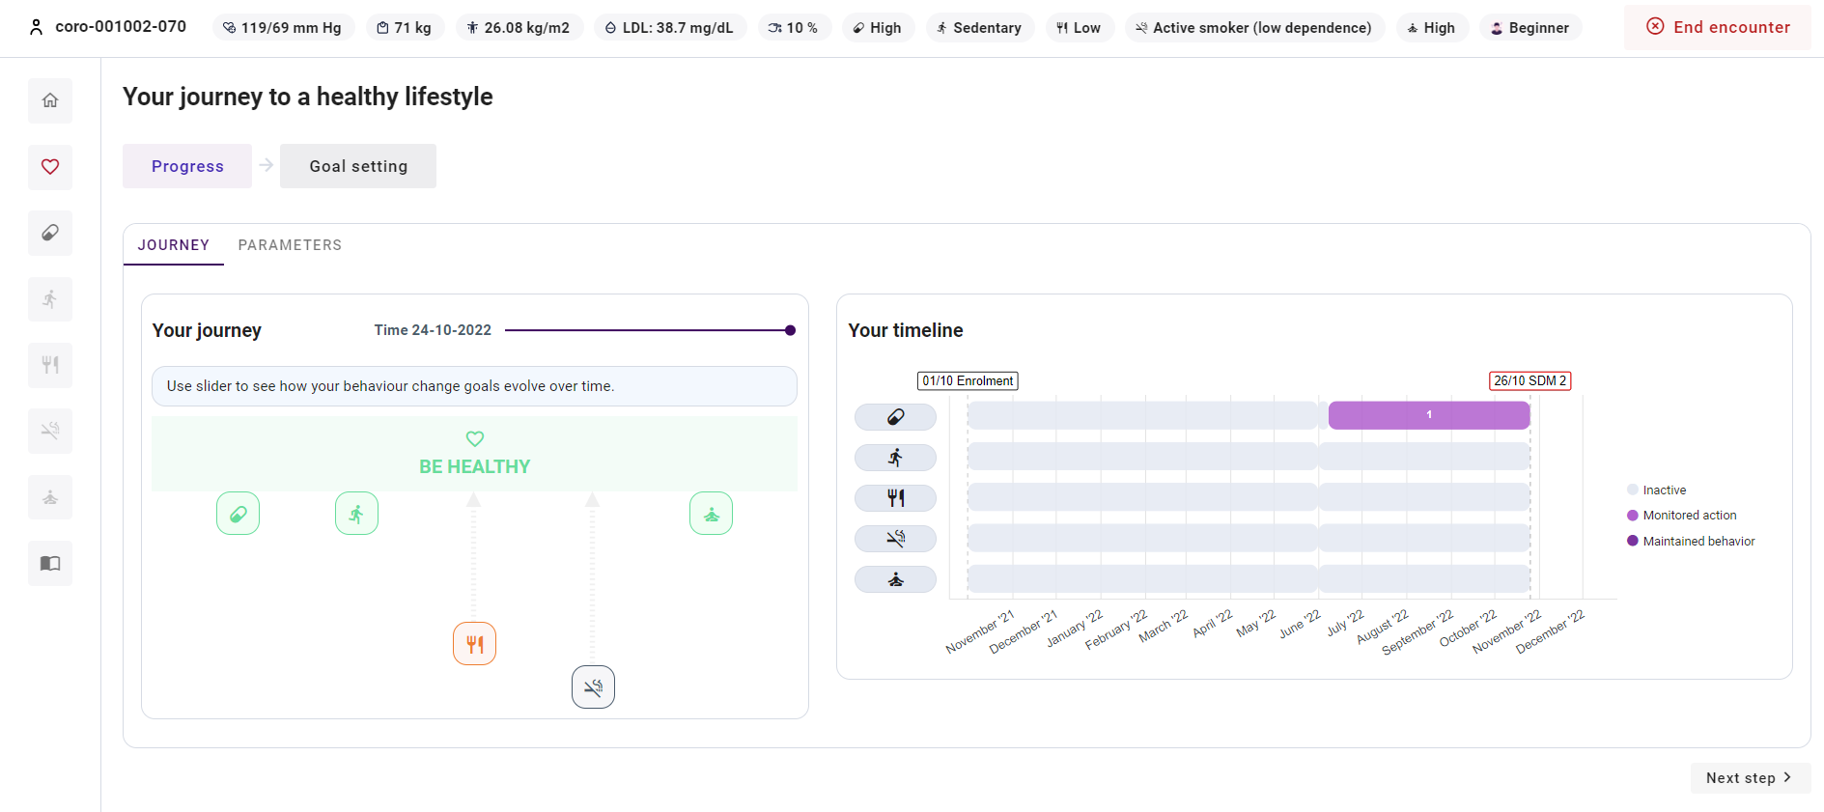
How to follow up on the patient's progress for the journey?
1
1 | In "Progress", you can view the patient's progress for his/her journey towards a healthy lifestyle. You can view the patient's progress for a) the behavioural goals and b) the parameters.
a
b

Slide 38
How to follow up on the patient's progress for the behavioral goals?
1 | In the "Journey" tab in "Progress", you have an overview of the patient's progress for the five behavioural goals.
2 | You can see how close the patient is to being healthy for each behavioural goal. The closer the behavioural goal is to the "Be healthy", the better the related risk factor is under control. In the example, you can see that "Healthy nutrition" and "Smoke-free living" are far from the "Be healthy", so these risk factors need most improvement. "Medication adherence”, “Start moving” and "Stress relief" are near to the "Be healthy", so these risk factors are well under control.
3 | You can explore the patient's progress towards a healthy lifestyle over time by moving the slider.
1
3
2
5

Slide 39
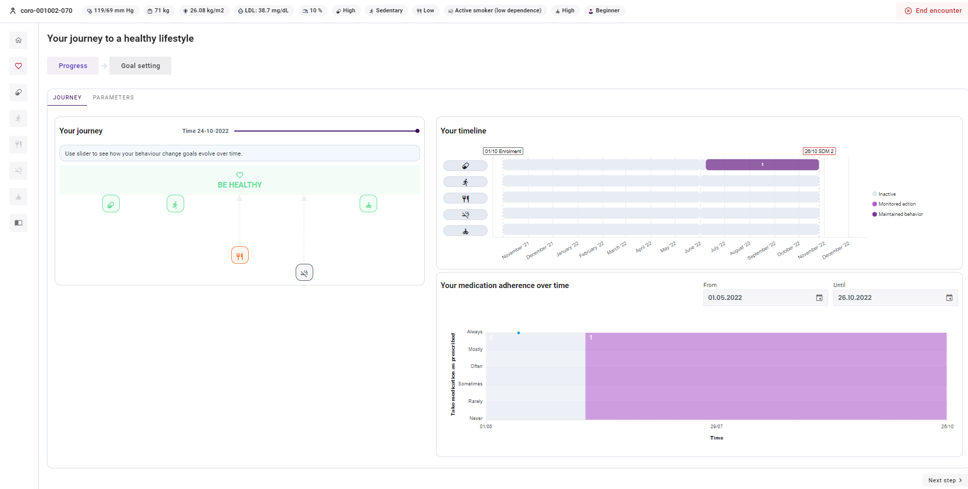
How to follow up on the patient's progress for the behavioral goals?
4 | In the timeline, you can view when the patient was in which level of guidance for the different behavioural goals. The numbers indicate in which level of guidance the patient was for the behavioural goal in the specified period. When there is no level of guidance indicated, the patient was in inactive mode for the behavioural goal.
5 | If you click on an icon of one of the behavioural goals or a period in the timeline, you get a detailed overview of the patient's self-reported behaviour for that behavioural goal (reported in the ePRO application or in the mobile app). In the upper right corner, you can adjust the period that is shown in the chart(s).
6 | The numbers in the chart indicate the level of guidance that the patient was in at that moment for the behavioural goal.
4
5
6

Slide 40
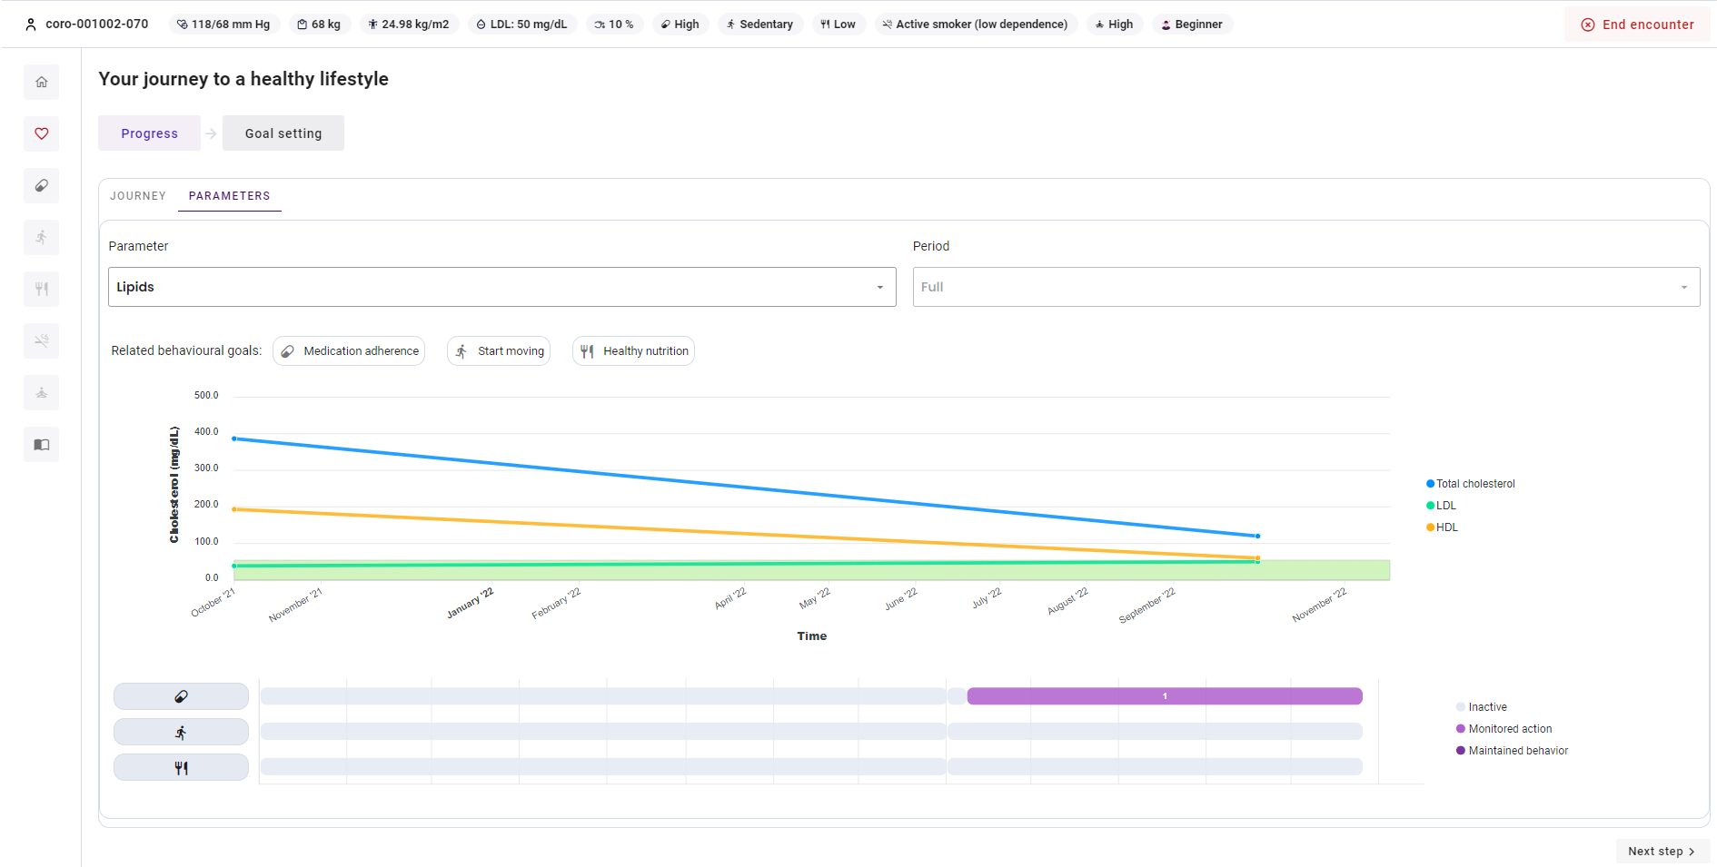
How to follow up on the patient's progress for parameters?
1 | In the "Parameters" tab in "Progress", you have an overview of the patient's progress for his/her parameters. The available parameters are blood pressure, weight, lipids, and glucose.
2 | The chart depicts the evolution of the parameter over time. You can hover over a dot to see the exact value for a certain date or the average for a certain period.
3 | The green area is the personalized target zone that the patient should strive to achieve.
4 | You can choose which parameter you want to visualise.
5 | You can choose the timeframe that you want to visualise.
6 | There is an overview of the behavioural goals that are related to the selected parameter.
7 | For each related behavioural goal, you can view in which level of guidance the patient was for that behavioural goal over time.
1
5
4
6
2
3
7

Slide 41
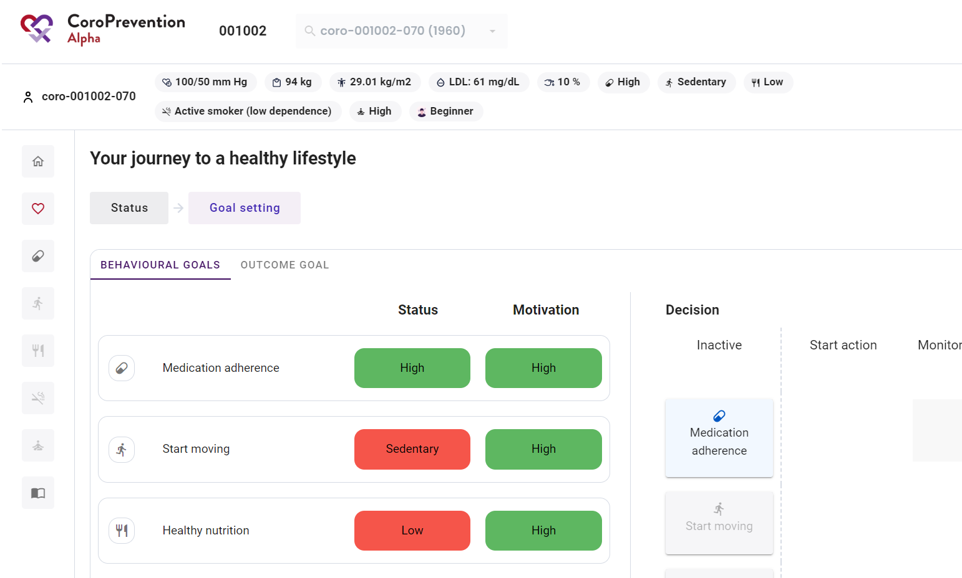
How to set the patient's behavioural and outcome goals?
1 In "Goal setting", you can set the patient's a) behavioural goals and b) outcome goals. The patient should aim to achieve the outcome goals by working on the behavioural goals.
1
a
b

Slide 42
How to change the configuration of the levels of guidance for the patient's behavioural goals?
1 | In the "Behavioural goals" tab in "Goal setting", you can select together with the patient for each behavioural goal its level of guidance. In Release 1, this is only available for “Medication adherence”.
2 | You can view the patient's current status, i.e. how well the patient is doing in terms of outcomes. This is the same as the information depicted in the risk profile bar (at the top in the caregiver dashboard). You can use this information when determining the patient's level of guidance for a behavioural goal.
3 | You can view how motivated the patient is to work on the behavioural goal. You can use this information when determining the patient's level of guidance for a behavioural goal.
4 | For each behavioural goal, the goal is to discuss and decide together with the patient in which level of guidance the patient will be. There are three levels of guidance: "start action", "monitored action", and "maintained behavior". You can change the level of guidance of a behavioural goal by dragging the behavioural goal to the desired level of guidance. If the patient doesn't want to work on a behavioural goal, you can drag that behavioural goal to inactive. When the level of guidance for a behavioural goal is changed in the caregiver dashboard, this change will be automatically applied in the patient mobile application. Note that not every level of guidance is available for each behavioural goal. For the behavioural goal "Medication adherence", only "inactive", "monitored action" and "maintained behaviour" are possible. For the behavioural goal ”Start moving", "inactive", “start action”, "monitored action" and "maintained behaviour" are possible. At this moment, there is no application support yet for the behavioural goals "Healthy nutrition", "Smoke-free living" and "Stress relief", so these can only be in "inactive".
1
2
3
4

Slide 43
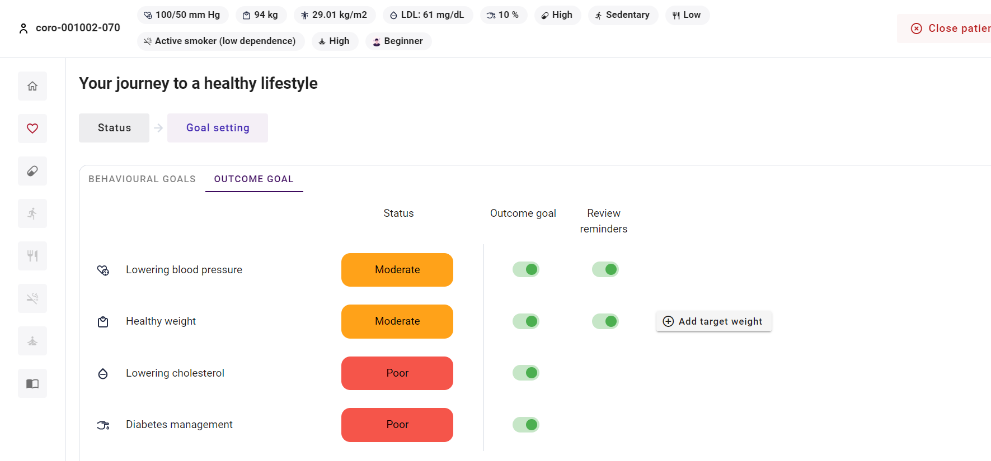
How to set the patient's outcome goals?
1 | In the "Outcome goals" tab in "Goal setting", you can select the outcome goals for the patient. In contrast to the behavioural goals, here direct measured outcomes are given.
2 | You can view how well the patient is doing for each outcome goal. This is directly linked to the patient's current parameter values.
3 | You can select for each outcome goal if you think it is an outcome goal that the patient should work on. The outcome goals are automatically updated by the system based on the patient's reported parameter values. However, if desired, you can adjust this. Be aware that very time that the patient or the case nurse reports a parameter that is associated to an outcome goal, the outcome goal is updated.
1
2
3
5

Slide 44
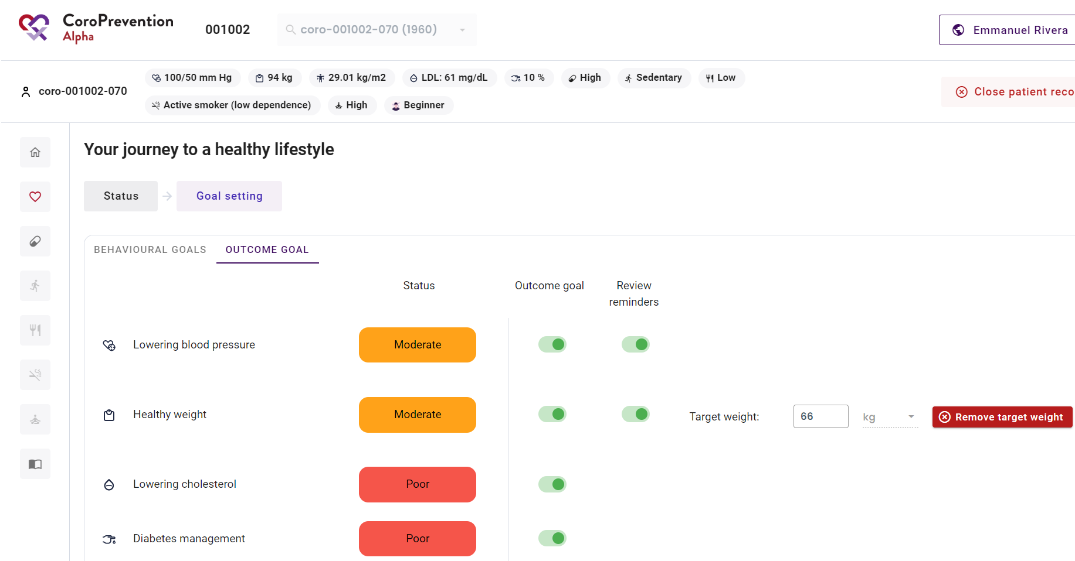
How to set the patient's outcome goals?
4 | You can, together with the patient, set a target weight. When you add a target weight and the patient’s current BMI is more than 25 kg/m^2, the recommended target weight is set automatically to a 5 percent weight reduction. If the patient's BMI is already 25 kg/m^2 or lower, it is recommended to maintain the same weight. If desired, you can adjust the recommended target weight.
5 | You can, together with the patient, remove the target weight.
4
5

Slide 45
Case nurse manual caregiver dashboard - education module
V.4; 17.08.2023

Slide 46
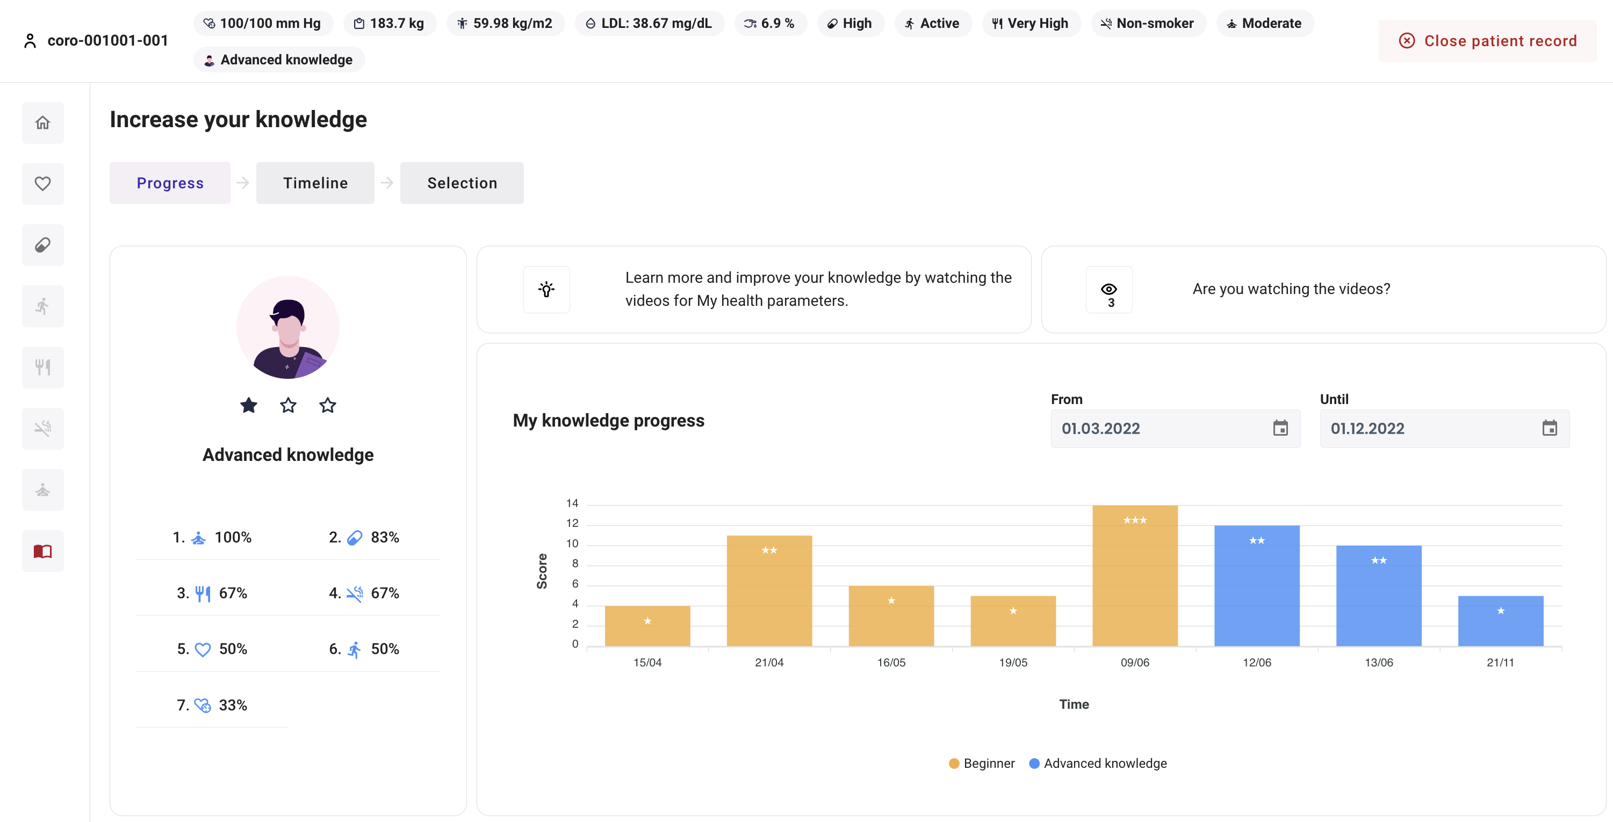
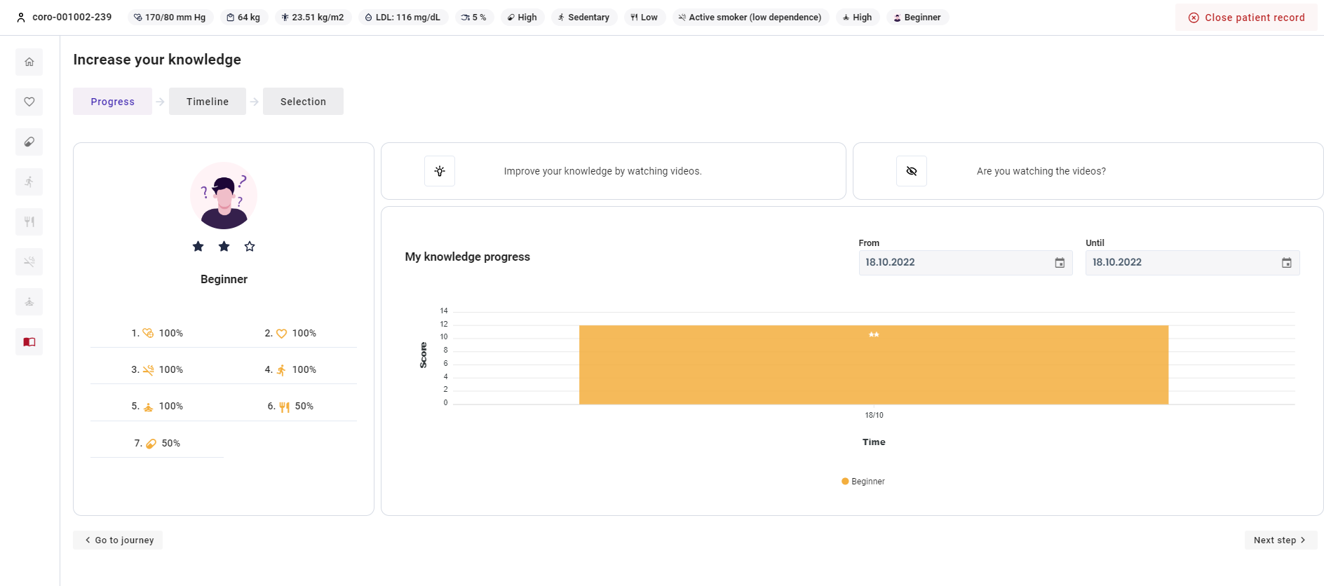
How to follow up on the patient's disease-related knowledge?
1
4
5
2
There is an overview of how well the patient’s knowledge is for different categories. The categories are respectively: stress relief, medication adherence, healthy nutrition, smoke-free living, my heart, start moving, and health parameters. The percentage indicates how well the patient scored on this category in his/her current knowledge level.
6
3
The graph depicts the evolution of the patient’s score on the knowledge challenge over time. The different colors indicate the patient’s knowledge level at that moment. The stars in the bar depict the patient’s score on the knowledge challenge. In the upper right corner, you can adjust the time period shown in the chart.

Slide 47
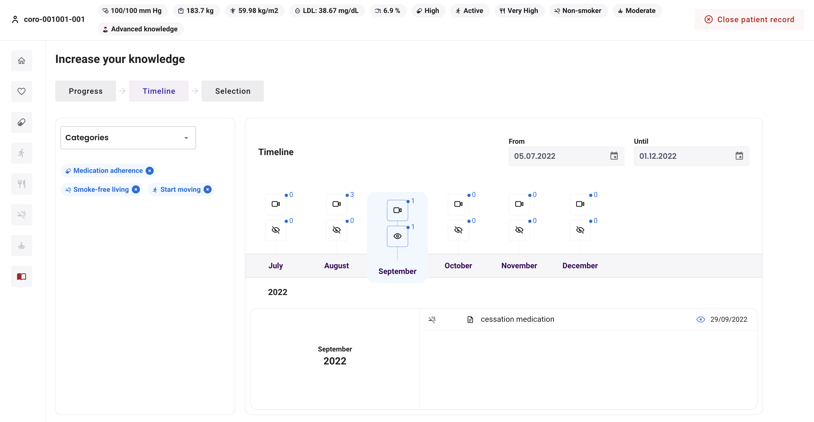
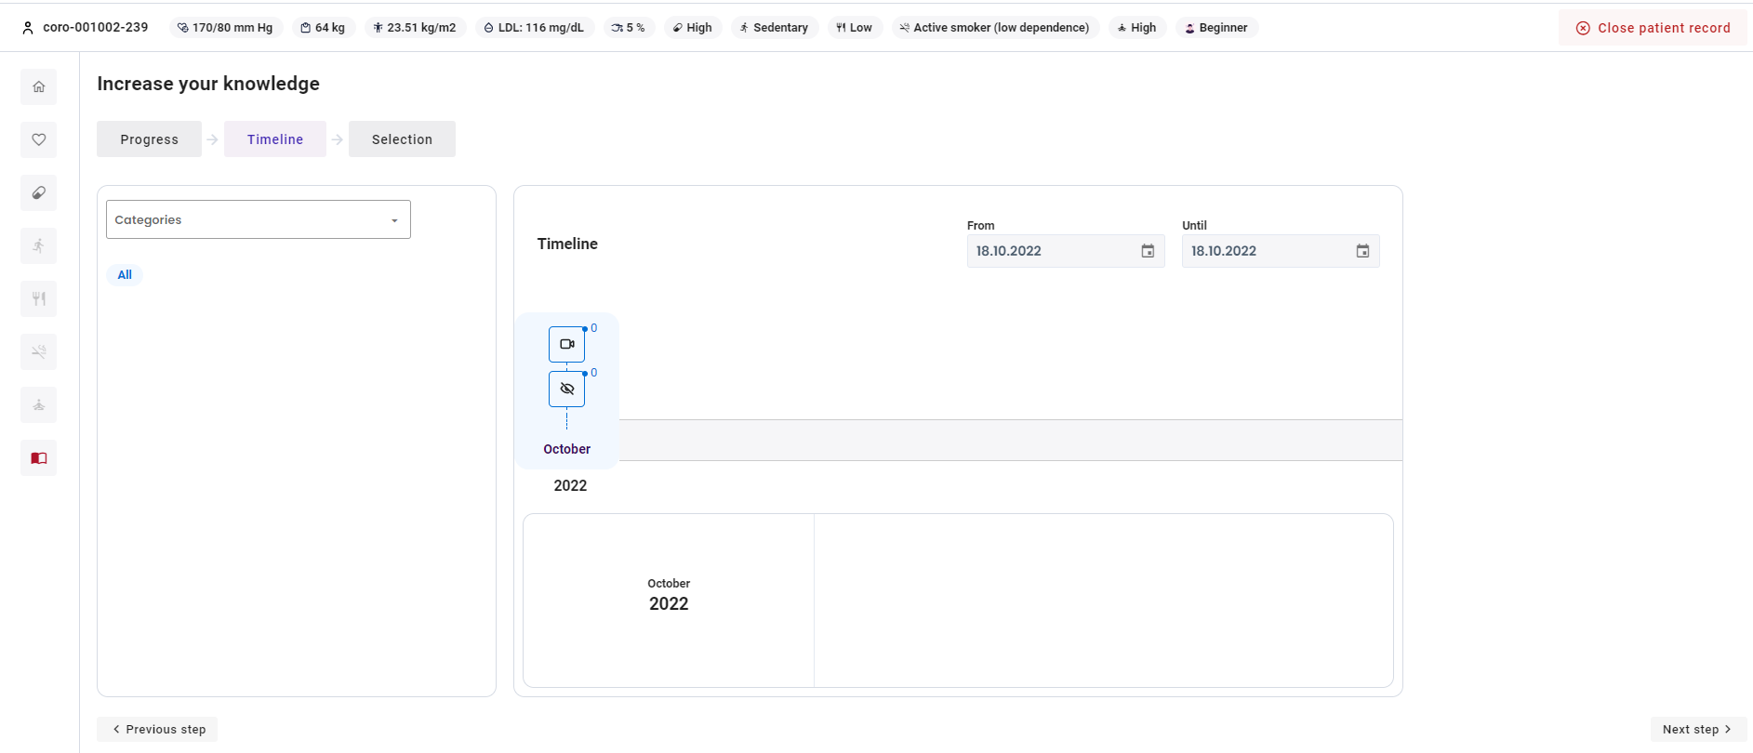
How to follow up on the personalized educational material sent to the patient?
1 | In "Timeline", you can follow up on how many of the personalized educational items (e.g. video, article, image) that you sent to the patient were viewed by the patient.
2 | You can select the categories that you want to include in the timeline.
3 | Categories that are currently selected are displayed. These can be removed by clicking on the "cross" icon.
4 | You can change the time period that you want to see in the timeline.
5 | The timeline shows per month how many educational items were sent to the patient ("camera" symbol) and how many of these items were viewed by the patient ("eye" symbol).
6 | You can click on a month to view more detailed information about the educational items that were sent to the patient.
1
2
4
3
5
6

Slide 48
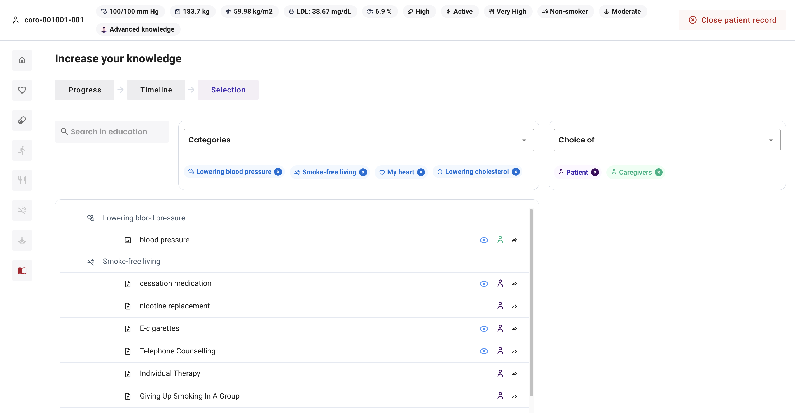
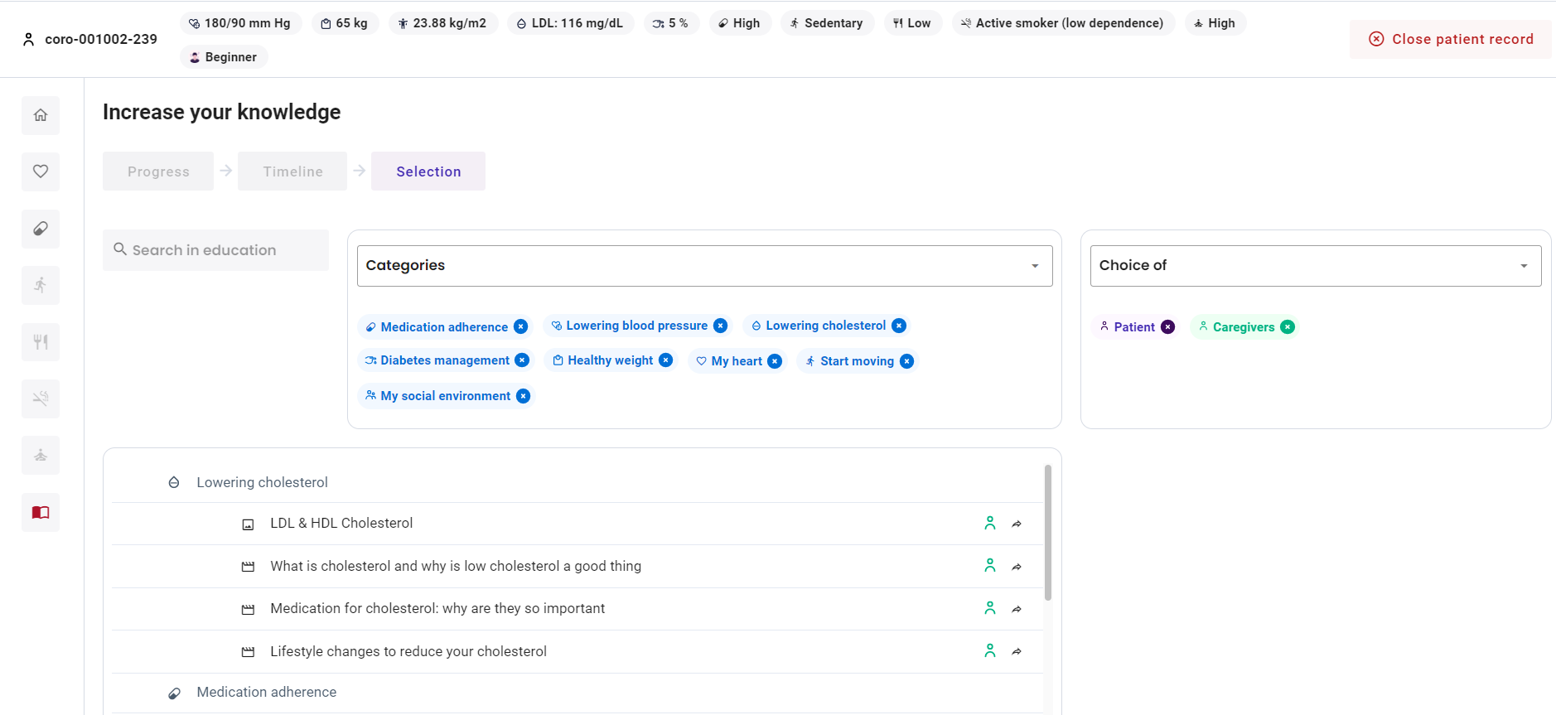
How to select personalized educational material for the patient?
1 | In "Selection", you can select the educational content that is relevant for the patient.
2 | You have an overview of action related educational material that is available in the CoroPrevention Tool Suite. For each educational item, there is an icon representing the type of education (i.e. text, image or video), the category and if the patient already viewed this educational item or not.
3 | You can search educational content by using the search function. You can also apply filters to look for specific educational content based on the category or who selected the educational content.
4 | You can view the filters for the category and choice of that are currently applied. You can remove any of these filters by clicking on the "cross" icon.
5 | Based on the patient's current outcome and behavioural goals, a set of recommended educational content is automatically selected for the patient. As a caregiver, you can also update this set of recommended educational content. Educational content that is selected by the algorithm or by you, has a "caregiver" symbol.
6 | Educational content that is selected by the patient has a "patient" symbol.
1
3
3
3
4
4
5
2
6

Slide 49
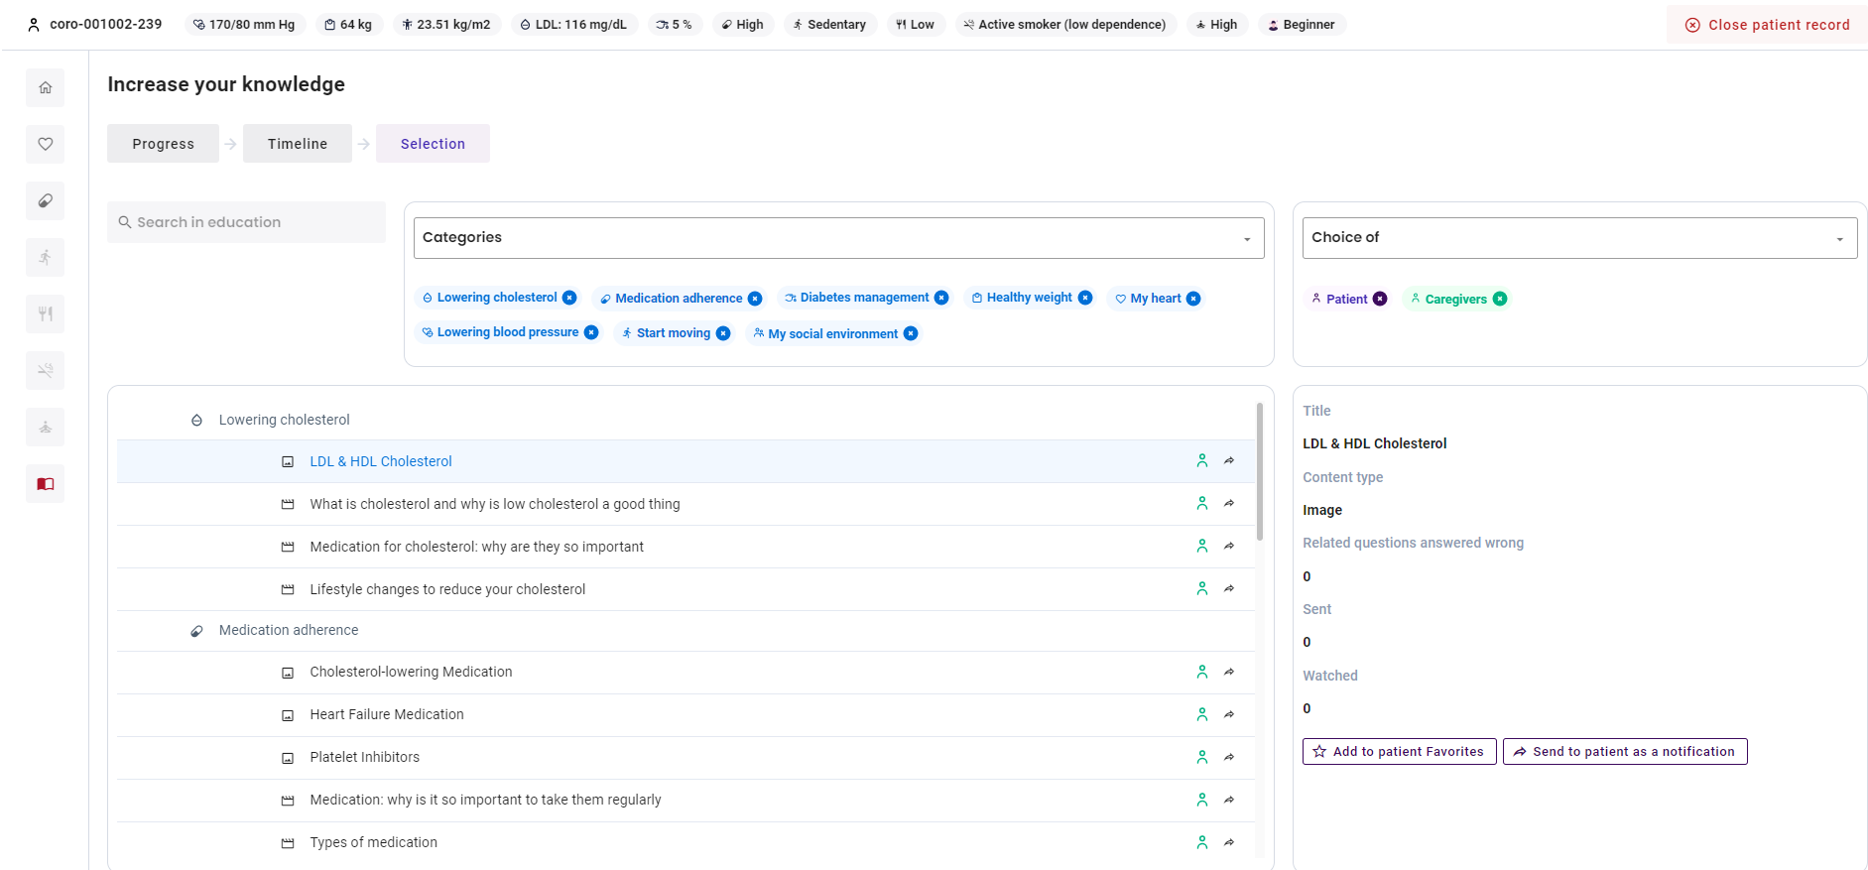
How to select personalized educational material for the patient?
7 | You can remove an educational item from the patient's or caregiver's choice by clicking on the "patient" or "caregiver" symbol respectively.
8 | If you found the educational material that you were looking for, you can click on the educational item to view more information (i.e. title, content type, number of related questions of the knowledge challenge that the patient answered wrong, how many times the educational item was sent to the patient, and how many times the educational item was viewed by the patient).
9 | You can add the educational item to the patient's favourites by clicking this button.
10 | You can send the educational item to the patient as a notification (i.e. in an application reminder) by clicking this button.
11 | You can also send the educational item to the patient (i.e. in an application reminder) by clicking on the “share" icon.
7
4
11
8
8
7
9
10

Slide 50
How to send personalized educational content to the patient?
1 | In "Selection", you can send personalized educational content to the patient.
2 | You have an overview of action related educational material that is available in the CoroPrevention Tool Suite. For each educational item, there is an icon representing the type of education (i.e. text, image or video), the category and if the patient already viewed this educational item or not.
3 | You can search educational content by using the search function. You can also apply filters to look for specific educational content based on the category or who selected the educational content.
4 | You can view the filters for the category and choice of that are currently applied. You can remove any of these filters by clicking on the "cross" icon.
1
3
3
3
4
4
2

Slide 51
How to send personalized educational content to the patient?
5 | If you found the educational material that you were looking for, you can click on the educational item to view more information (i.e. title, content type, number of related questions of the knowledge challenge that the patient answered wrong, how many times the educational item was sent to the patient, and how many times the educational item was viewed by the patient).
6 | You can send the educational item to the patient as a notification (i.e. in an application reminder) by clicking this button.
7 | You can also send the educational item to the patient (i.e. in an application reminder) by clicking on the “share" icon.
7
5
5
6

Slide 52
Case nurse manual caregiver dashboard - medication adherence module
V.4; 17.08.2023

Slide 53
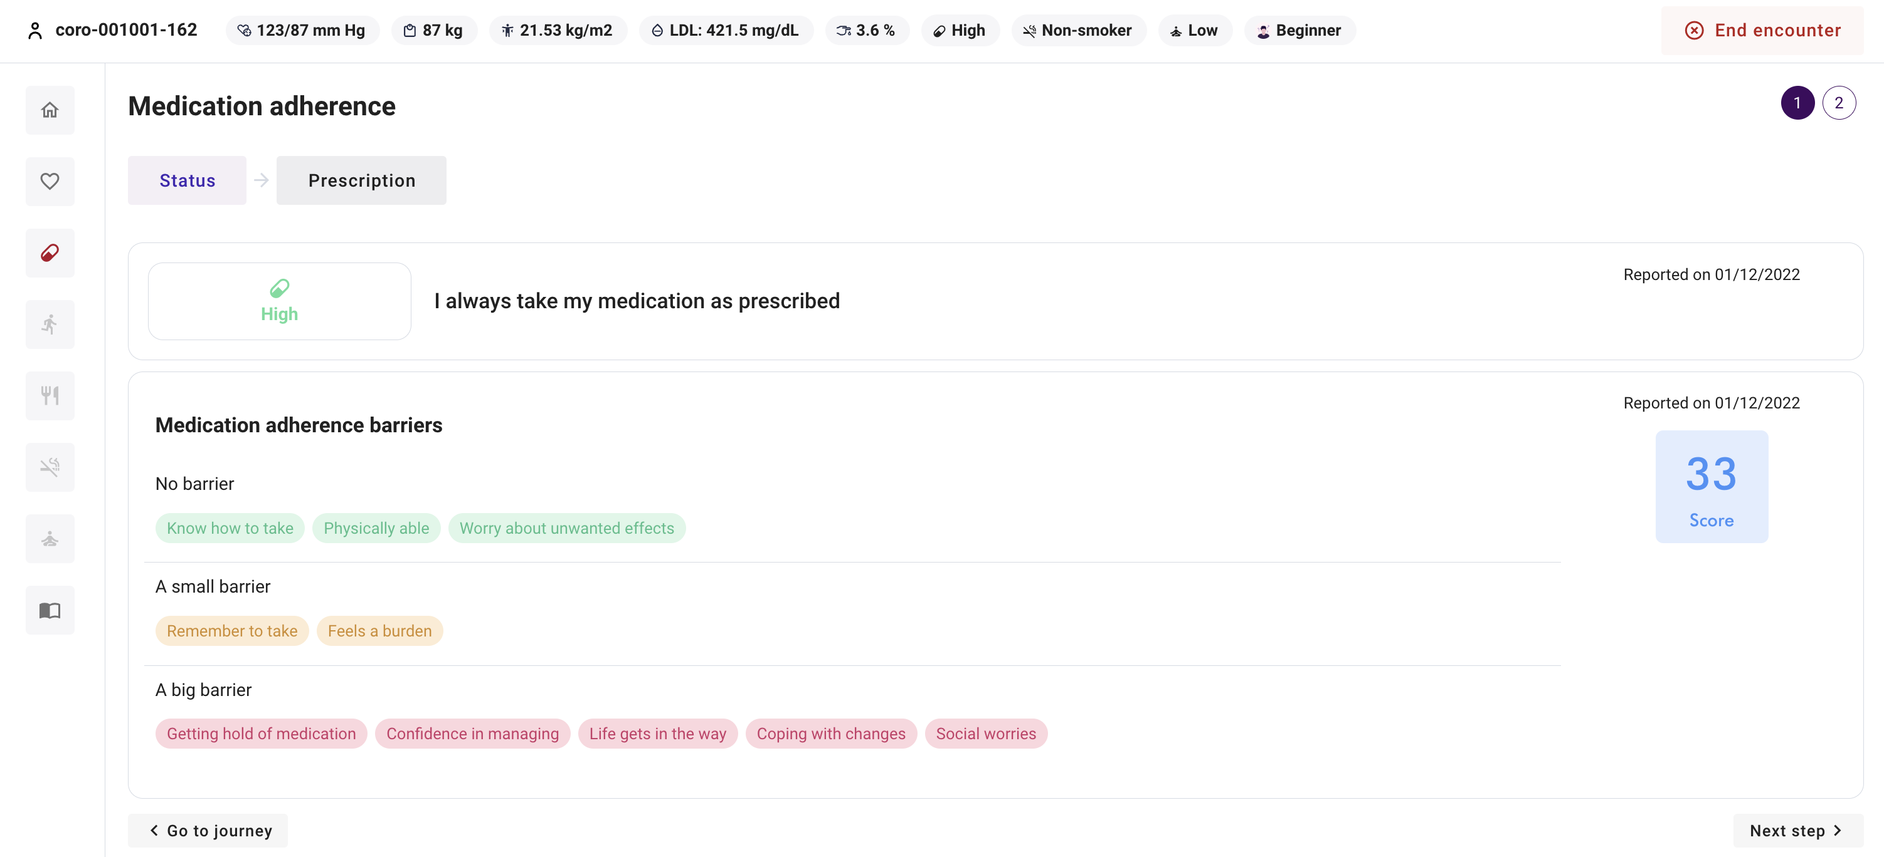
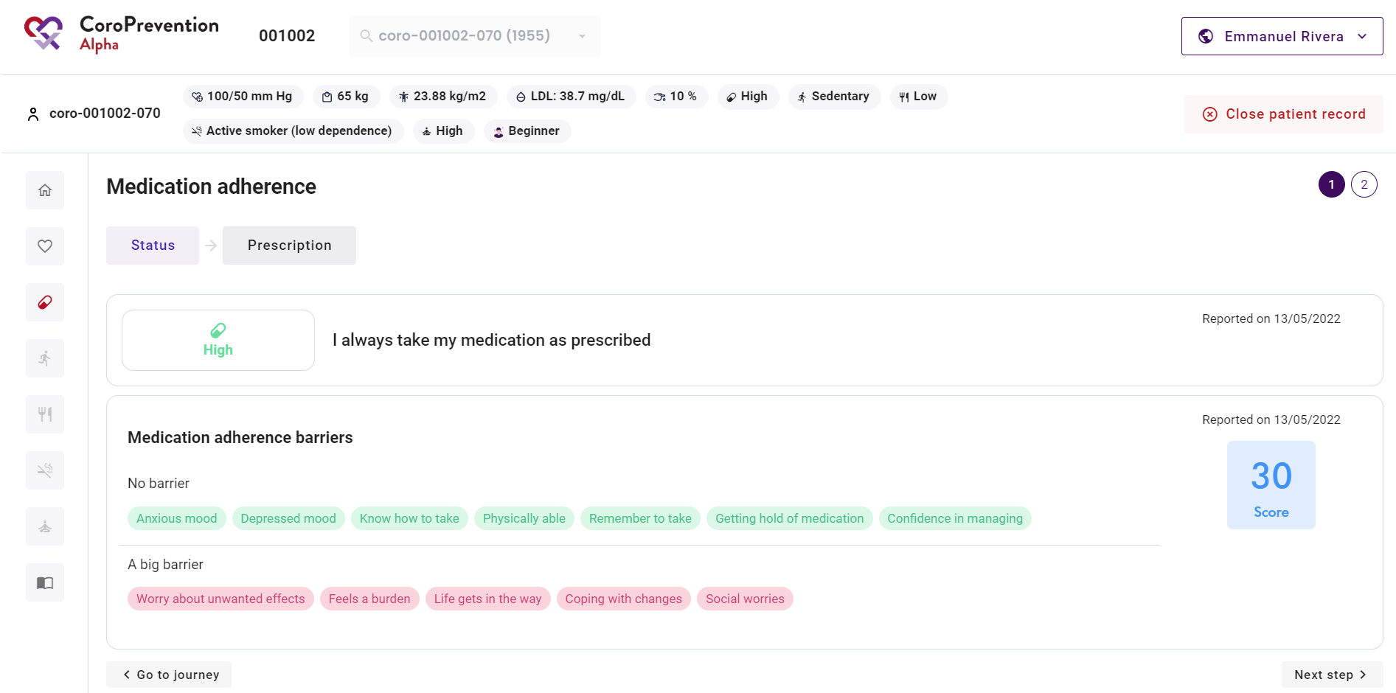
How to view the patient's status for medication adherence during the first shared decision making consultation?
1 | In "Status", you have an overview of the patient's status for medication adherence.
2 | You can see how the patient describes his/her medication adherence in general.
3 | There is an overview of the patient's barriers for medication adherence. The barriers are based on the patient's answers on the Identification of Medication Adherence Barriers (IMAB) questionnaire that was completed in the ePRO application. The IMAB questionnaire assesses the patient's difficulties with taking medication. Higher IMAB scores are indicateive of the greater strength of one or more barrriers for medication adherence.
4 | The elements indicated in green are no barriers for the patient.
5 | The elements indicated in orange are small barriers for the patient.
6 | The elements indicated in red are major barriers for the patient. These are the elements that the patient has limited knowledge about, or that go wrong on a regular basis. These are the patient's main points for improvement and should be the focus of the shared decision making discussion.
1
2
3
4
5
6

Slide 54
How to follow up on the patient's progress for medication adherence?
1 | In "Progress", you have an overview of the patient's progress for medication adherence.
2 | You can see how the patient describes his/her medication adherence in general.
3 | The patient's small (orange) and major (red) barriers for medication adherence are depicted. The barriers are based on the patient's answers on the Identification of Medication Adherence Barriers (IMAB) questionnaire that was completed in the ePRO application. The IMAB questionnaire assesses the patient's difficulties with taking medication.
4 | The chart depicts how the patient's medication adherence evolved over time. The medication adherence was reported by the patient in the mobile application or the ePRO application. Above the chart, you can adjust the time period shown in the chart.
5 | The numbers in the chart indicate the level of guidance for "Medication adherence" that the patient was in at that moment. You can click on a period in a level of guidance to view more details about this period.
1
2
3
4
5

Slide 55
How to follow up on the patient's progress for medication adherence?
6 | There is more detailed information about the patient's medication adherence when he/she was in level of guidance 1 for "Medication adherence".
7 | You can view the medication adherence percentage over this entire period in level of guidance 1 for "Medication adherence".
8 | You can view the best month of this period in level of guidance 1 for "Medication adherence".
9 | You can view the medication adherence percentage of the last 30 days in this period in level of guidance 1 for "Medication adherence".
10 | In the calendar overview, you can view on which days the patient's medication adherence was good (green), moderate (orange), or bad (red). Above the calendar overview, you can select the month for which you want to view the medication adherence.
6
7
10
8
9

Slide 56
How to view the patient’s medication prescription?
1 | In "Prescription", you have an overview of the patient's medication prescription.
2 | The patient's current medication prescription is depicted. There is also an indication of the changes that were made since last encounter. These changes are especially relevant to discuss with the patient.
3 | Drugs that were added since last visit are indicated by a "plus" icon.
4 | Drugs that were edited since last visit are indicated by a "pencil" icon.
5 | Drugs that were deleted since last visit are scratched through.
6 | Pills are indicated by a "pill" icon, while injections are indicated by a "syringe" icon.
7 | You can click on a row in the medication prescription to view more information about the drug.
8 | You can view the parameters that the medication is related to, the reason why the patient has to take the medication, the date that it was prescribed and by whom it was prescribed, and which changes were made to this drug over time. There is also an infographic that you can use in the discussion with the patient to explain the mechanisms that the drug works on and the reason why the patient has to take the drug.
9 | To be able to view the additional information about a drug, the medication class of the drug should be selected.
10 | You can record additional notes for the drug.
11 | If you are allowed to prescribe medication, you can open the medication decision support system by clicking this button.
12 | You can print the medication prescription for the patient and the recommendations for the patient's general practitioner by clicking these buttons.
1
12
11
2
3
9
8
7
5
6
4
10

Slide 57
Case nurse manual caregiver dashboard - medication DSS
V.4; 17.08.2023

Slide 58
How to open the medication decision support system (i.e. medication DSS)?
1
 | There are three ways to open the medication DSS.
1 2 | In the patient summary, you can open the medication DSS by clicking this button. In the “House” menu item, you can open the medication DSS by clicking the “Open medication decision support” button.
3 | In the "Medication adherence" module, you can go to "Prescription" and click on this button to open the medication DSS.
2

Slide 59
How to navigate in the medication DSS?
1 | There are four tabs in the medication DSS: a) cardiac medication, b) other medication, c) allergies, and d) titration schemes.
2 | You can save the medication prescription by clicking this button. After saving the medication prescription, the changes are automatically made to the patient's medication prescription on his/her smartphone.
3 | You can print the medication prescription by clicking any of these buttons.
4 | If the patient has a low renal function, there is a warning indicating this.
5 | You can close the medication DSS by clicking this button. You cannot leave the medication DSS when the medication prescription is incomplete.
5
1
2
3
a
b
c
d
4

Slide 60
How to prescribe cardiac medication following the guidelines using the medication DSS?
1 | In the "Cardiac medication" tab, you can find an overview of all cardiac medication that the patient has to take.
2 | The background color of each drug indicates if it is recommended according to the guidelines or not. If the drug has a green background color, it means that the drug is already correctly prescribed, as recommended by the guidelines. If the drug has a yellow background color, it means that the drug was added by the algorithm of the medication DSS because it is recommended according to the guidelines. You have to check if you want to follow this recommendation and if that is the case, complete the missing information for the drug. As such, yellow indicates drugs for which action is required for a correct prescription. After completing the missing information, the background color for the drug changes from yellow to green. If the drug has a white background color, it means that the drug is not recommended according to the guidelines. It is also possible that a drug is a combination drug of which some components are recommended by the guidelines and some others are not. This is indicated by a white row with a recommendation icon for the recommended medication classes.
3 | You can view the way of administration (i.e. oral/pill or injection medication) of the drug.
4 | You can view the name of the drug.
5 | You can view the dosage of the drug (dose and unit).
6 | You can view the medication class(es) of the drug. If it is a combination drug, multiple medication classes are indicated.
7 | You can view the frequency that the patient has to take the drug.
8 | You can view at what time(s) the patient has to take the drug.
9 | You can view the notes about the drug.
10 | If the drug was added to the medication prescription by the patient since last encounter, there is an icon indicating this.
11 | You can edit the drug by clicking this button.
12 | You can delete the drug from the medication prescription by clicking this button. If you delete a drug that is recommended according to the guidelines, you will be asked to state the reason why you rejected the recommendation. Immediately after deleting one of the drugs the action can be undone by clicking the "Undo" button in the confirmation message. If you delete a recommended drug, it is only deleted from the prescription but still shown in the recommendations.
13 | You can view more information about the drug by clicking this button. The detailed information includes: the class of recommendation, the level of evidence, the guideline information, the guideline source, and the changes that were made to this drug in the past.
14 | You can add a drug to the patient's medication prescription by clicking this button. When prescribing the same medication class twice, a warning will be displayed.
15 | You can view the change history for the drug.
1
5
6
3
10
7
4
8
2
11
12
9
13
15
14

Slide 61
How to prescribe cardiac medication following the guidelines using the medication DSS?
10 If the drug was added to the medication prescription by the patient since last encounter, there is an icon indicating this.
10

Slide 62
How to view the patient's allergies in the medication DSS?
1 In the "Allergies" tab, the medication allergies for the patient are shown. This includes aspirin and ACE inhibitor intolerance.
1

Slide 63
How to view the patient's other (non-cardiac) drugs in the medication DSS?
1 | In the "Other medication" tab, you can view the drugs that the patient has to take that are not related to his/her cardiac condition.
2 | You can view the way of administration (i.e. oral/pill or injection medication) of the drug.
3 | You can view the name of the drug.
4 | You can view the dosage of the drug (dose and unit).
5 | You can view the frequency that the patient has to take the drug.
6 | You can view at what time(s) the patient has to take the drug.
1
3
4
2
5
6

Slide 64
How to view and edit the patient's titration schemes in the medication DSS?
1 | In the tab "Titration schemes", you can define the titration schemes for medication that should be uptitrated. You can create two types of titration schemes: dosage titration schemes and drug addition titration schemes.
2 | You can create a new dosage titration scheme by clicking this button. A dosage titration scheme defines for a certain drug the start and target dosage.
3 | You can create a new drug addition titration scheme by clicking this button. A drug addition titration scheme defines a start medication class and medication classes that should be added based on the patient's parameter values.
4 | You can edit the titration scheme by clicking this button.
5 | You can delete the titration scheme by clicking this button.
1
4
5
2
3

Slide 65
How to save the changes to the patient's medication prescription?
1
1 | You can save the changes to the patient's medication prescription by clicking this button.
2 | After you clicked the "Save and close" button, you have an overview of the patient's medication prescription (cardiac and other medication) and the titration schemes.
3 | You can return to the medication DSS to edit the patient's prescription by clicking this button.
3
2

Slide 66
How to save the changes to the patient's medication prescription?
4 You can return to the CoroPrevention caregiver dashboard by clicking this button.
4

Slide 67
Case nurse manual caregiver dashboard – start moving module
V.4; 17.08.2023

Slide 68
How to follow up on the patient's progress for physical activity?
1
In “Status” / "Progress", you have an overview of the patient’s current physical activity, as reported in the ePRO application.
1

Slide 69
How to view the patient's current status for physical activity?
1
In “Status” / “Progress”, you can see if the patient is currently doing a sufficient amount of physical activity. This mainly consists of the information that is reported by the patient in the ePRO application.
You can view how much the patient is moving globally.
You have an overview of the results of the Rapid Assessment of Physical Activity (RAPA) questionnaire. This includes how active the patient is, if the patient performs strength exercises, and if the patient performs flexibility exercises.
1
2
2
3
3

Slide 70
Which types of physical activity goals can be set for the patient?
1
In "Goal setting", you can set the patient's goals for physical activity. Two types of physical activity goals can be set: a) a weekly sports goal and b) a daily activity goal.
Note:
- When you edit the physical activity goals for the patient and the patient did not yet have a goal in “monitored action” for “Start moving”, the goal becomes applicable from the moment that you save the goal.
- When you edit the physical activity goals for the patient and the patient already has a goal for the ongoing week, the updated goal becomes applicable as of Monday (i.e. start of the new week).
1
a
b

Slide 71
How to set the patient’s weekly sports goal?
1 | In the "Weekly sports goal" tab in "Goal setting", you can view the patient's weekly sports goal for next week.
2 | There is an overview of the patient's weekly sports goal, expressed in kcal. The flags denote the minimal and optimal goal for the weekly sports goal. The patient should strive to achieve at least the yellow flag, but aim for the finish flag.
3 | There is an overview of the exercise prescription, consisting of: the recommended exercise intensity, the recommended number of exercise sessions, the recommended session duration, and the recommended number of strength training sessions.
4 | The physical complaints that the patient indicated (in the ePRO application) that he/she suffers from are depicted. This information can be taken into account when setting the weekly sports goal.
5 | The patient's current favourite activities are depicted. This information can be taken into account when discussing how to achieve the weekly sports goal.
6 | The patient's favourite activities from childhood are depicted. These can be used to motivate the patient to possibly restart this activity.
7 | You can edit the patient's weekly sports goal (i.e., exercise prescription) in the EXPERT tool. You can open the EXPERT tool by clicking this button.
1
2
7
3
4
5
6

Slide 72
How to set the patient's daily activity goal?
1 | In the "Daily activity goal" tab in "Goal setting", you can set the patient's personalized daily activity goal for next week. The daily activity goal is expressed in steps.
2 | You can view the patient's current level for the daily activity goal. There are four levels of step goals: inactive (< 2500 steps), beginner (2500-4999 steps), intermediate (5000-7500 steps) and advanced (> 7500 steps).
3 | You can edit the patient's level for the daily activity goal by clicking this button.
4 | Based on the patient's achievement of the daily activity goal last week, there is a proposed daily activity goal no sport for next week. If the patient achieved the daily activity goal for that day on at least 5 out of the 7 days and the daily activity goal is not yet at least 7500 steps, the system proposes to increase the daily activity goal no sport by 10 percent. Otherwise, the system recommends that you keep the daily activity goal no sport the same as last week. You can discuss this proposal with the patient.
5 | You can edit the patient's daily activity goal no sport for next week.
6 | The patient's daily activity goal is different depending on whether the patient performs sports or not. When the patient performs a sports activity, the patient has to do fewer steps during the day. Therefore, the patient's daily activity goal is lowered automatically on days that he/she reports sports.
1
2
3
4
5
6

Slide 73
Case nurse manual caregiver dashboard – Physical activity module (EXPERT tool)
V.4; 17.08.2023

Slide 74
How to open the EXPERT tool to edit the patient's weekly sports goal (or exercise prescription)?
1
In the "Start moving" module, you can go to "Goal setting". You can click on this button to edit the patient's weekly sports goal (or exercise prescription). When you click this button, the Exercise Prescription in Everyday practice & Rehabilitation Training (EXPERT) tool is opened.
1

Slide 75
How to navigate in the EXPERT tool?
1 | There are two tabs in the EXPERT tool: a) weekly sports goal and b) safety precautions.
2 | You can save the weekly sports goal and close the EXPERT tool by clicking this button. After saving the weekly sports goal, the changes are automatically made to the patient's weekly sports goal on his/her smartphone. You cannot leave the EXPERT tool when the weekly sports goal is incomplete or when you did not save the exercise prescription (i.e., accept/reject/change the recommendation).
3 | You can print the weekly sports goal or safety precautions by clicking this button. Depending on the tab where you click this button, the weekly sports goal (i.e., exercise prescription) or safety precautions are printed.
4 | You can view the patient's gender and age.
5 | You can view the patient's pulse rate in rest.
6 | You can view the distance that the patient walked in his/her most recent Six-Minute Walk Test.
4
5
6
1
2
3
a
b

Slide 76
How to define the patient's weekly sports goal (or exercise prescription)?
1
1 | In the "Weekly sports goal" tab, you can view and edit the patient's weekly sports goal. The patient's weekly sports goal is represented as the exercise prescription.
2 | You can view the boxes with all the parameters related to cardiovascular diseases. There are five boxes, one for each of the categories included in the EXPERT tool algorithm: primary indications, key risk factors, exercise modifier, anomalies, and medication. You can open each box by clicking on the box.
2
2
2
2
2

Slide 77
How to define the patient's weekly sports goal (or exercise prescription)?
3 | Within each category, you should select all the conditions that are applicable for the patient by clicking on the corresponding checkmark. The EXPERT tool also automatically selects some risk factors based on the patient’s information, e.g., when the patient’s BMI is too high, the system will select obesity. Anomalies and medication do not have an individual exercise recommendation, but choices made in these two lists are considered in the final exercise recommendation. For some cases in the "Anomalies" category, you have to define the heart rate at which the patient experienced the anomaly.
3

Slide 78
How to define the patient's weekly sports goal (or exercise prescription)?
4 | When you open the EXPERT tool, it automatically suggests a recommendation (indicated by a thick border around the box). Every time you change the disease-related selections, the recommendation is updated automatically. The suggestion is based on all the selected diseases and the patient’s information. Make sure you check that this recommendation is suited for the patient.
5 | If you agree with the automatically generated recommendation, you can accept the recommendation and save it to the patient record by clicking this button.
6 | If you wish to modify the generated recommendation, you can click this button. You may choose to modify either some or all the fields in the generated recommendation. We advise you to formulate the reason why you have changed the recommendation. This extra information can serve as a future reference when analysing the data of the patient or for other members of the team when accessing the patient’s record.
4
5
6

Slide 79
How to define the patient's weekly sports goal (or exercise prescription)?
6 | You may choose to modify either some or all the fields in the generated recommendation. We advise you to formulate the reason why you have changed the recommendation. This extra information can serve as a future reference when analysing the data of the patient or for other members of the team when accessing the patient’s record.
7 | You can click the undo button if you want to undo your changes in the recommendation.
8 | You can save the modified recommendation by clicking this button. From the second time onwards, when you save a recommendation for a certain patient, you will have to choose between starting a new training program or a follow up recommendation that is considered part of the last (ongoing) training program. This decision will not have any influence on the exercise training recommendation as such. Considering a recommendation as the beginning of a training program or not has only informative purposes.
9 | You can go back to the initial recommendation and collapse the recommendation box by clicking this button.
7
8
9
6

Slide 80
How to define the patient's weekly sports goal (or exercise prescription)?
10 | From the second time onwards, when you open the EXPERT tool you will see the recommendation and the saved recommendation for the patient (i.e., the recommendation that you saved last time).
10°
10°

Slide 81
How to view the safety precautions for the patient?
1 | In the "Safety precautions" tab, you can consult the list of safety precautions according to the patient’s most recently saved exercise recommendation.
2 | You can click on each of the boxes to read more information on each one of the categories.
1
2
2
2

Slide 82
Case nurse manual caregiver dashboard - patient records view
V.4; 17.08.2023

Slide 83
How to create a patient record?
1
1 | You can navigate to the screen to create a patient record by clicking this button. This button is only available when currently no patient record is opened.
2 | You can only create a patient record for a patient who has already been registered in the EDC system and who has been randomized into the PPP intervention group. You have to fill in the subject ID of the patient to import the patient information from the EDC system to the CoroPrevention Tool Suite.
3 | When you click this button, the patient information is retrieved from the EDC system, imported to the CoroPrevention Tool Suite, and shown below.
2
3

Slide 84
How to view a short summary about a patient?
1 | When you look up a patient using the search function or if you click in an alert on the button to view the patient record, you first see this screen. This screen gives you a general overview of the most important information about the patient. The patient record is at this moment not open yet.
2 | You can view the general information about the patient, including the patient's subject ID, gender, year of birth and date of enrolment in the CoroPrevention study.
3 | You can scan the QR code with the tablet to open the consultation preparation questionnaire for the patient. Alternatively, you can type the URL in the browser of the tablet. You can also print this code to give it to the patient on paper.
4 | To login to the patient mobile application, the patient can also use a QR code, instead of his/her login credentials. You can print the QR code by clicking this button. When you print a new QR code for the patient, the patient's login credentials are reset.
5 | If the patient drops out of the study, you have to register this in the EDC system and in the CoroPrevention caregiver dashboard. In the caregiver dashboard, you can indicate that the patient dropped out of the study by clicking this button.
6 | If the patient lost his/her smartphone (e.g. the smartphone is stolen), you can remotely log out the patient mobile application on the patient's smartphone. This ensures that the person that finds the patient's smartphone cannot view the personal, medical information about the patient.
7 | In the timeline in the study, you can view the visits that are planned for this patient. When the visit was already completed, the circle is green. When the visit was skipped/cancelled, the circle is red. When the visit is not yet completed, the circle is white.
8 | You can indicate that a visit was skipped by clicking on the circle of a not yet completed visit.
9 | You can view or edit the data that was entered before the encounter, consult or edit the questionnaire results (e.g. if the patient filled in the questionnaire on paper), and send the patient a reminder in the mobile app to fill in the questionnaires, by clicking on the circle of an already completed visit.
10 | You can view the patient's most recently reported parameter values. The color-coding indicates if the patient's parameters are in the target ranges.
11 | For each behavioural goal, you can view how the patient is doing and in which level of guidance the patient is currently. The color-coding indicates how good the patient is doing for the behavioural goal. This is based on the same information as in the risk profile bar. Furthermore, you can view the patient's current knowledge level. The color-coding indicates the patient's performance on his/her most recent knowledge challenge.
12 | You have an overview of all alerts that were triggered for this patient since last visit.
13 | There is a filter for each type of alert. You can click on a filter to enable or disable it.
14 | You can mark an alert as handled by clicking on the "cross" icon. The cross will then be updated to a checkmark.
1
2
7
8
9
10
3
4
6
5
11
13
12
14

Slide 85
How to open the patient record?
1
1 | When you want to see more information about the patient then what is shown in the summary, you can open the patient record by clicking this button.
2 | You can open the patient record for follow-up or for a patient visit. Here it is important to choose the correct option. This way, the system keeps track of how far the patient is in his/her timeline in the study.
3 | If the patient is sitting in front of you and this is a scheduled study visit, choose "Start visit". The number of the visit is indicated on the button.
4 | If you are following up on the patient in between visits, for example because of alerts or because the patient has called you, you should choose "Follow-up on patient".
2
4
3

Slide 86
How to start a visit with the patient?
1
2
1 | If you start a visit with the patient, you first have to complete some information about the patient. The system will guide you through the different steps.
2 | First, you have to measure the patient's vital signs and record these. You can later import this information into the EDC system.
3 | In some visits, the patient has to perform the Six-Minute Walk Test. You have to record the results in this screen. You can later import this information into the EDC system.
3

Slide 87
How to start a visit with the patient?
4 | Next, you have to complete the clinical assessment. You can later import this information into the EDC system.
5 | In visit 2 and visit 6, the cardiologist will use the medication decision support system to update the patient's medication prescription. To be able to make a correct recommendation for the patient's medication prescription, you have to fill in some additional information in this screen. Since this information will be later used to guide the therapy on the patient (by you or automatically by the system), it is important that the information is as complete as possible.
6 | After completing the questions, you can start the visit by clicking this button. The patient record will then be opened for the study visit.
4
5
6

Slide 88
How to end a visit and close the patient record?
1
1 When you want to end the patient visit, you can close the patient record by clicking this button in the risk profile bar.

