Slide 1
General introduction to the CoroPrevention Tool Suite
Version March 2024

Slide 2
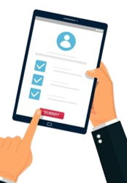
Components of the CoroPrevention Tool Suite
Caregiver dashboard to support shared decision making during encounters
ePRO application to collect patient preferences
Decision Support Systems to support caregivers in prescribing for their patients
Mobile application to support the PPP of the patient

Slide 3
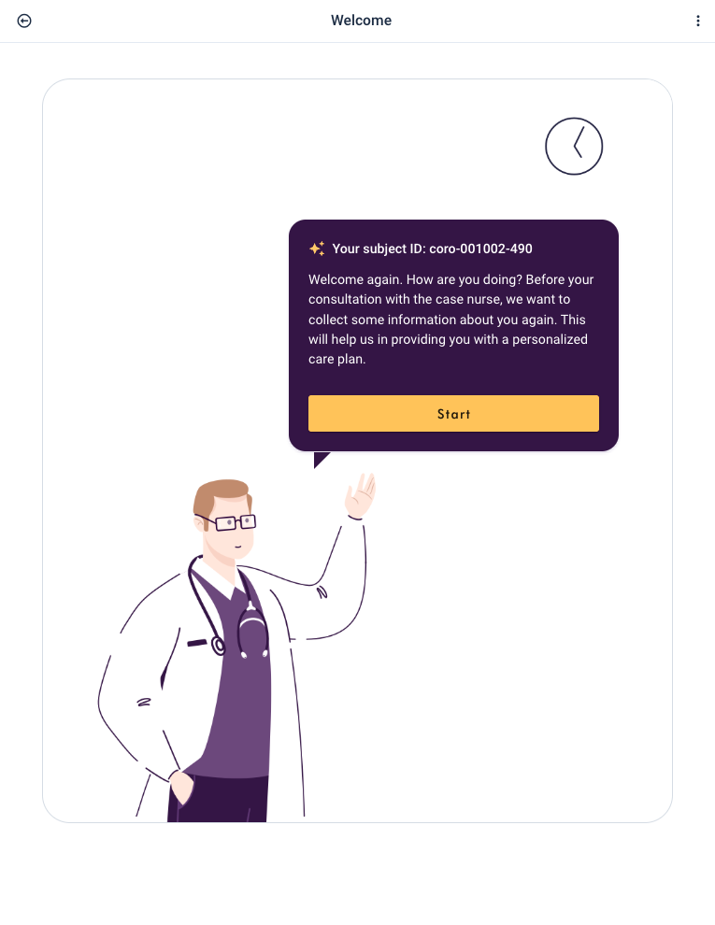
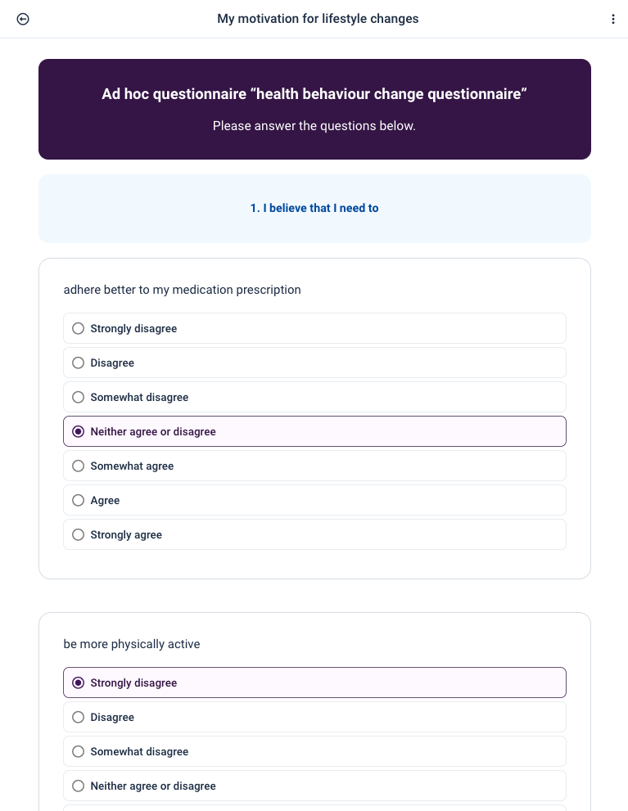
ePRO application
Target users: Patients
PPP group
Preparation for the encounter
Part of the shared decision making process
Administration of questionnaires
Traditional care group
Administration of questionnaires

Slide 4
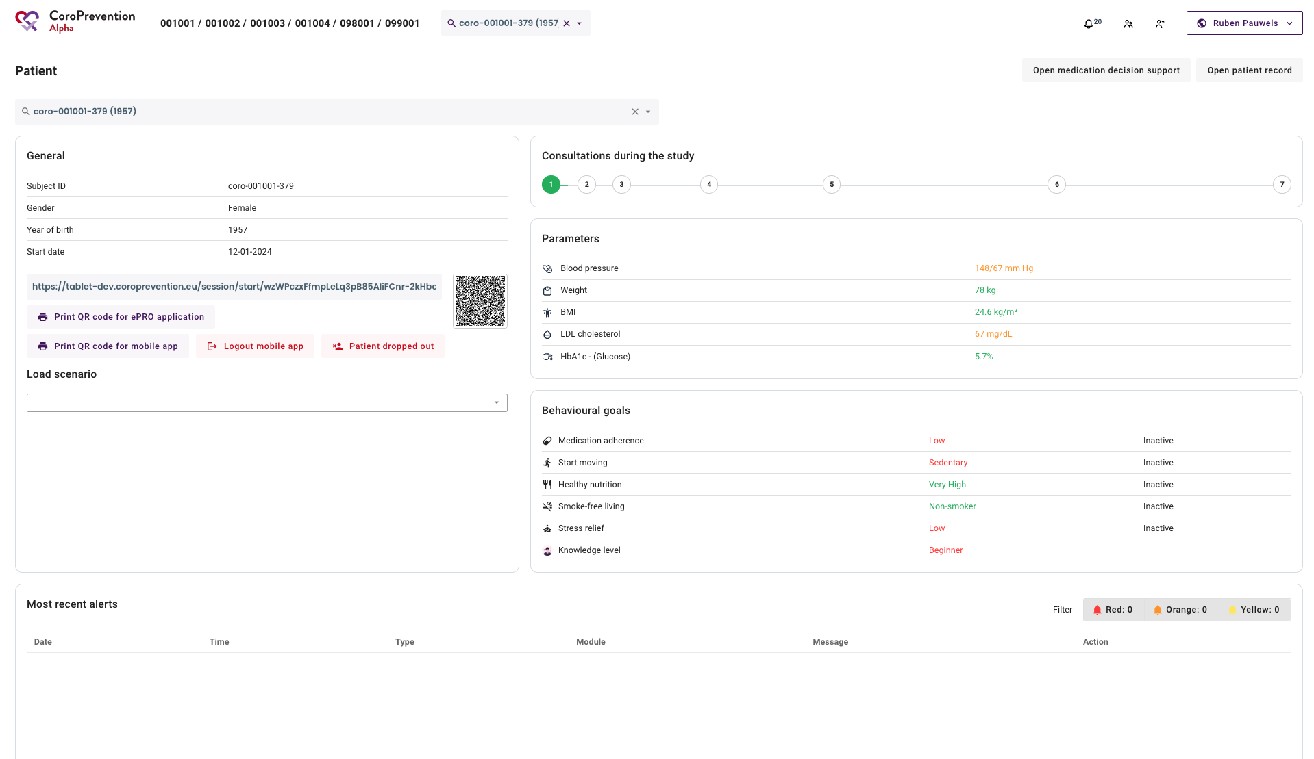
Caregiver dashboard
Target users: mostly Caregivers, but Patients also view the caregiver dashboard during the encounters
Get

Slide 5
Caregiver dashboard
Caregivers
Preparation of the patient record for PPP patients (integration with EDC system)
Recommendations for exercise (EXPERT tool) and medication (medication DSS) according to ESC guidelines, evidence, expert opinions
Follow-up patient progress and alerts
Visual tool to support motivational talk and shared decision making

Slide 6
Caregiver dashboard
Patients
See their progress as part of the SDM encounter with their case nurse
Visual tool to support motivational talk and shared decision making

Slide 7
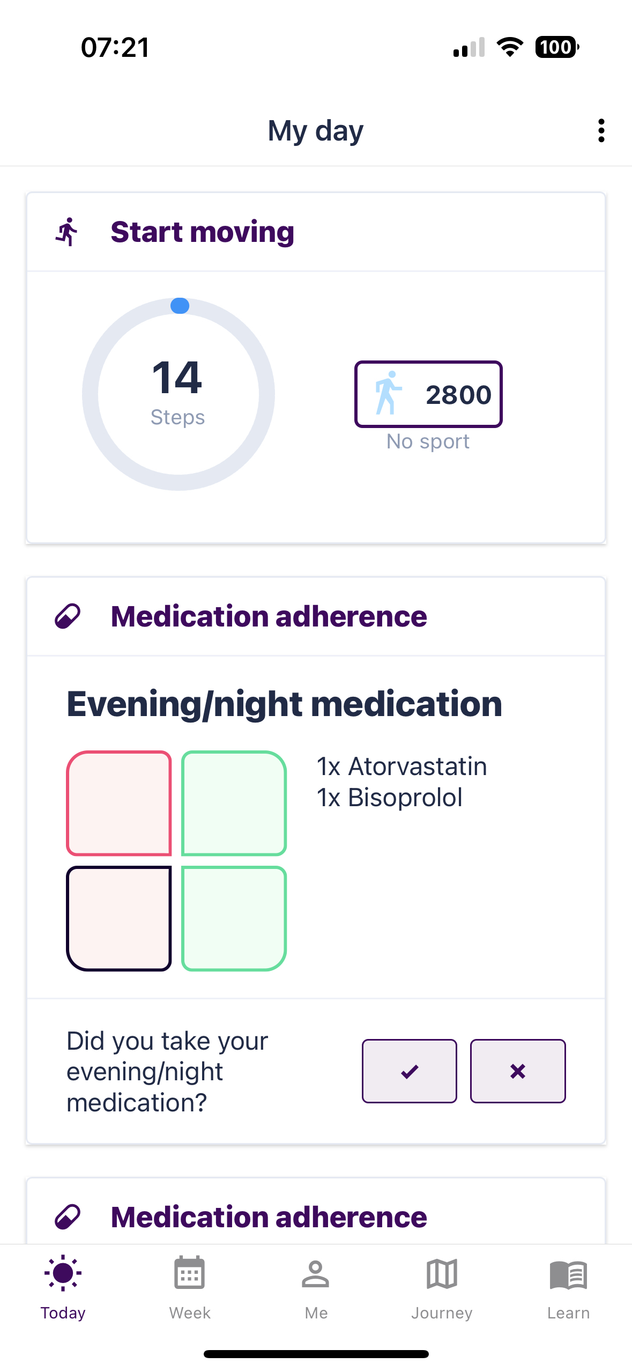
Patient mobile application
Target users: Patients
Support adherence to their PPP
Reporting and follow up of their progress while achieving their health goals
Educational content to increase their disease- and lifestyle-related knowledge

Slide 8
Modules of the CoroPrevention Tool Suite
Monitor your parameters
Medication adherence
Increase your knowledge
Smoke-free living
Start moving
Stress relief
Healthy nutrition
Notes:
Audio fragment to be updated

Slide 9
Tailoring to the patient - ensuring Personalised PP
Evolutionary approach adapts the modules depending on patient preferences and expert opinion (shared decision making)
Each module can be inactive or in one of the four levels of guidance:
Lifestyle / behavior change
Inactive
Start
action
Monitored
action
Maintained behavior
Levels of guidance

Slide 10
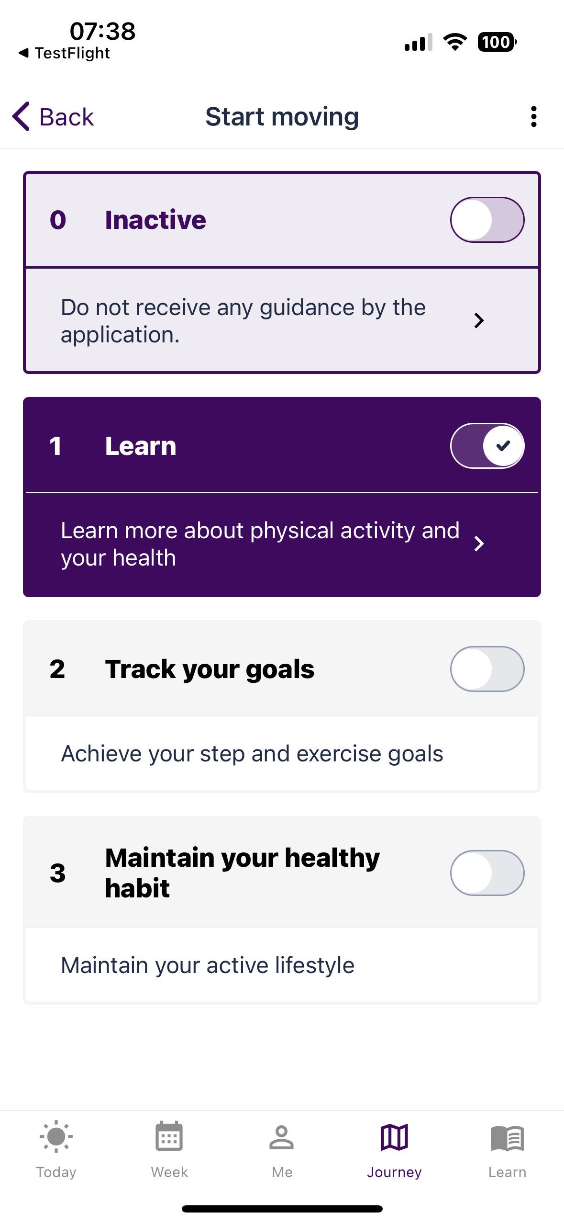
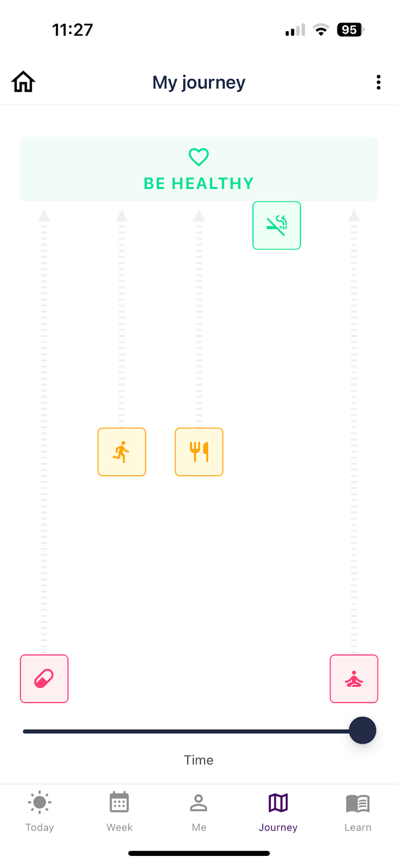
Tailoring to the patient - a PPP journey

Slide 11
Good luck!

