Slide 1
Part E: Medication prescription and medication DSS

Slide 2
Content
Medication prescription
Smartphone application
Caregiver dashboard
Medication decision support system (DSS)
EDC (see other training)
Decision tree
Caregiver dashboard
Tips and pitfalls

Slide 3
Medication prescription
Smartphone application

Slide 4
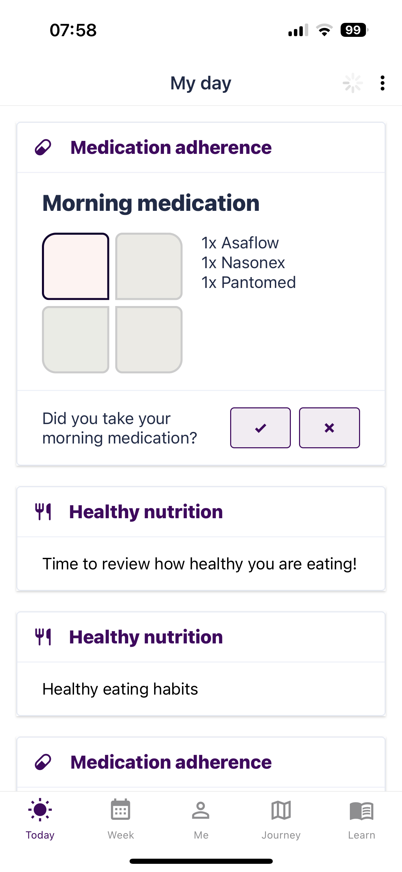

Slide 5
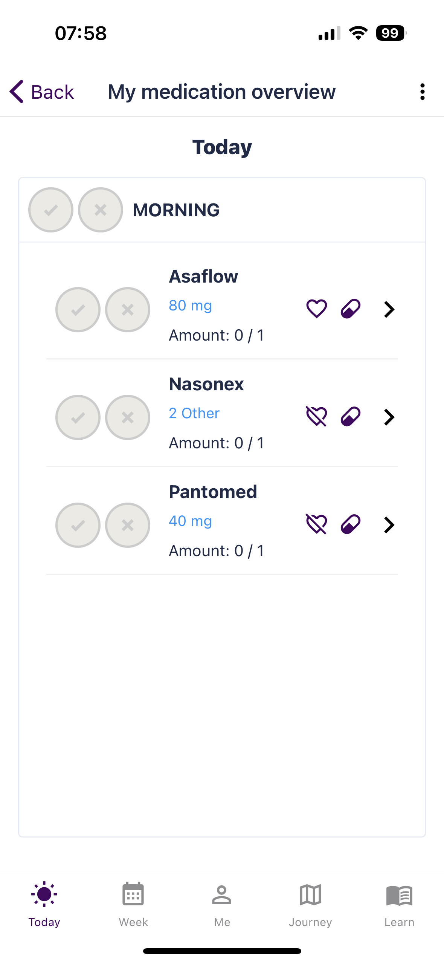

Slide 6
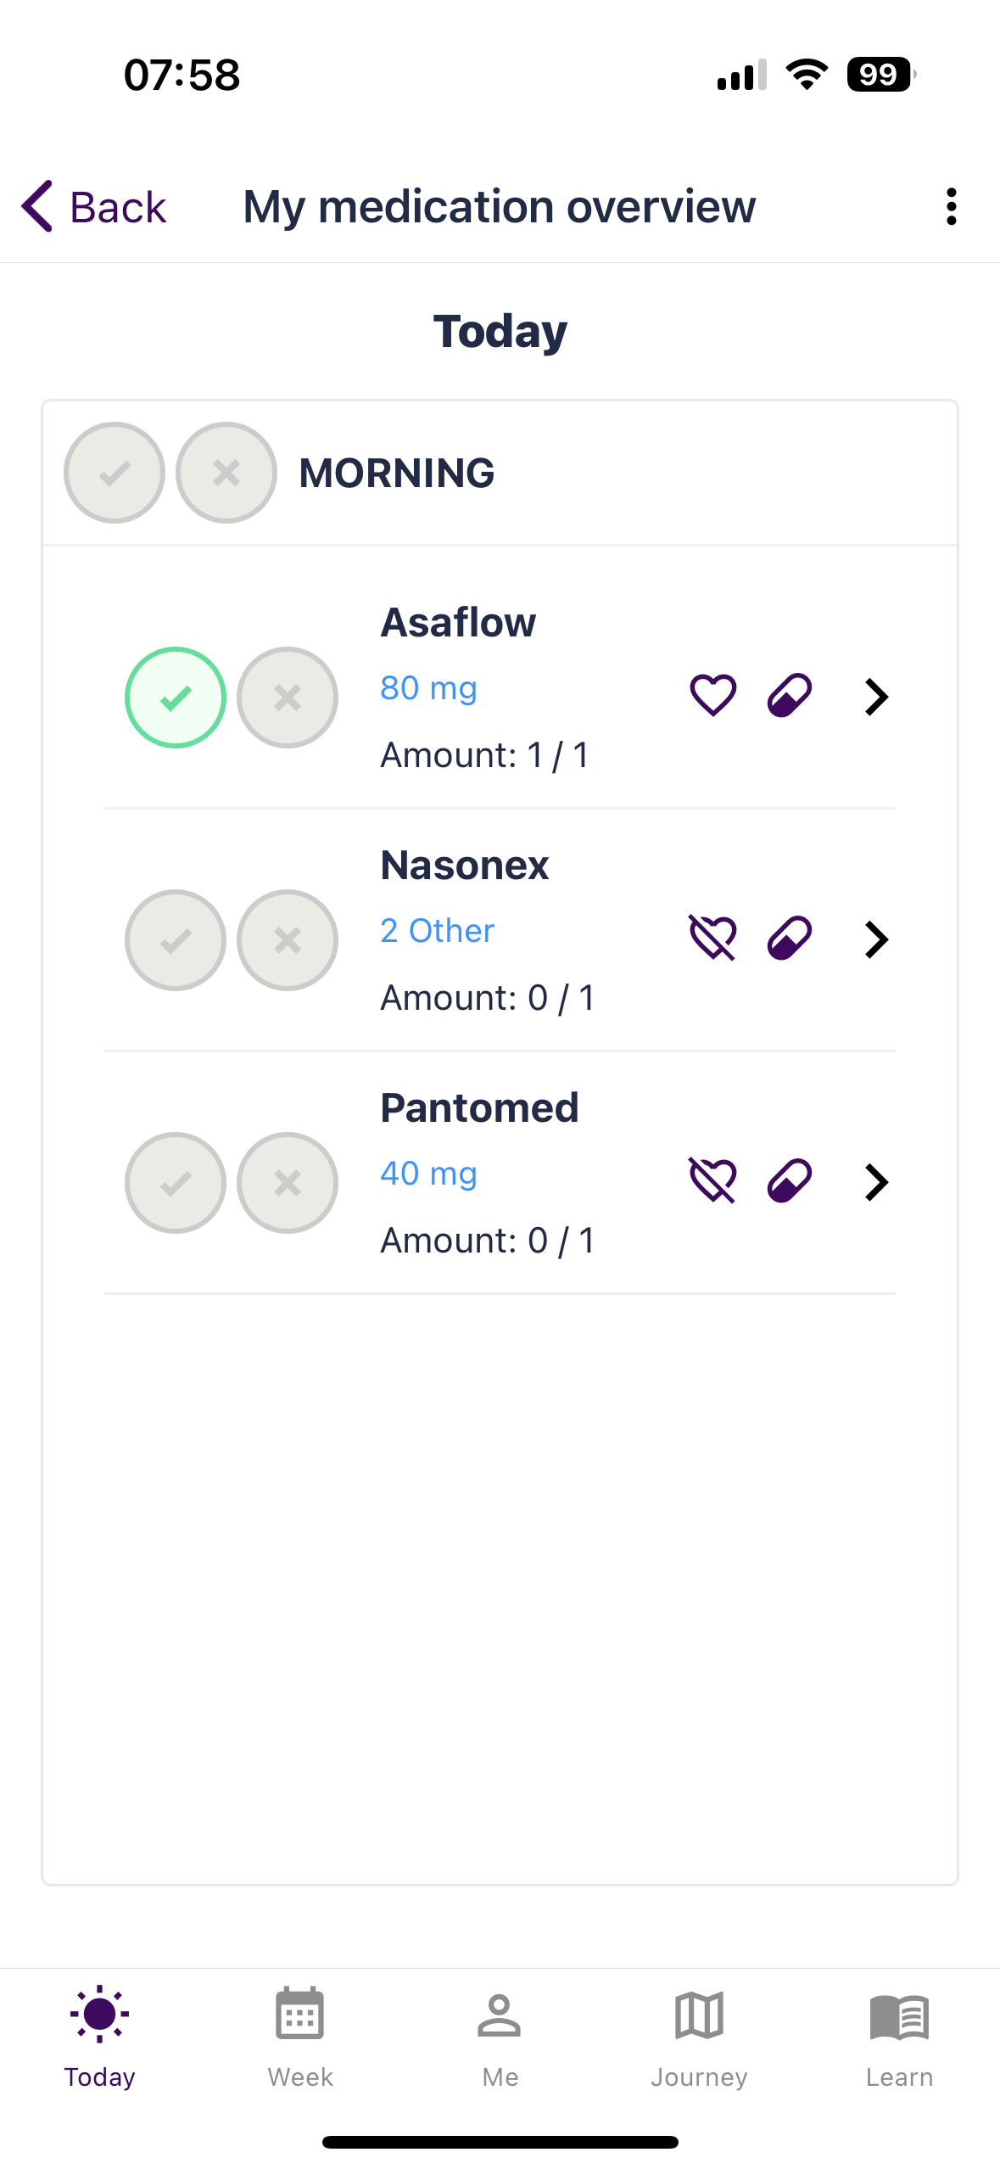

Slide 7
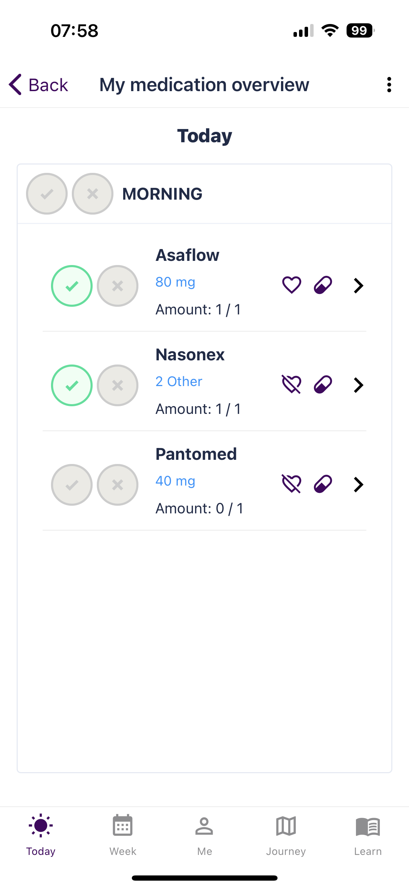

Slide 8
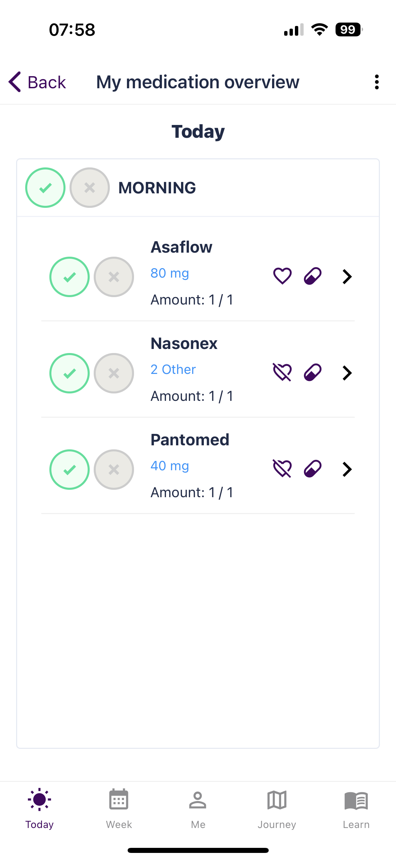

Slide 9
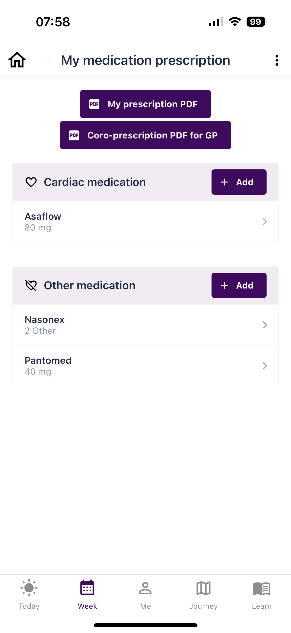

Slide 10
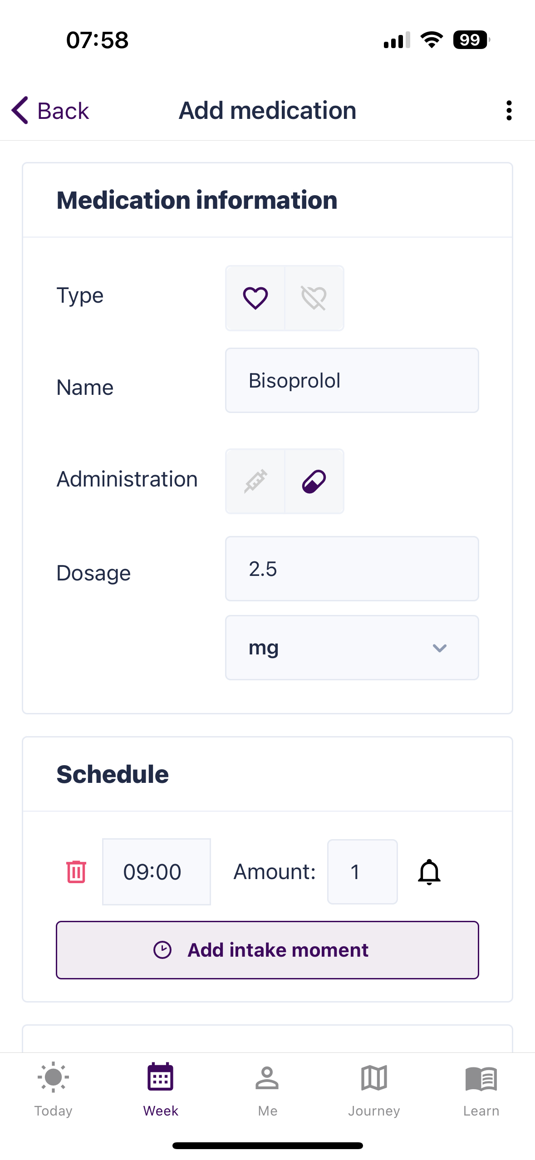
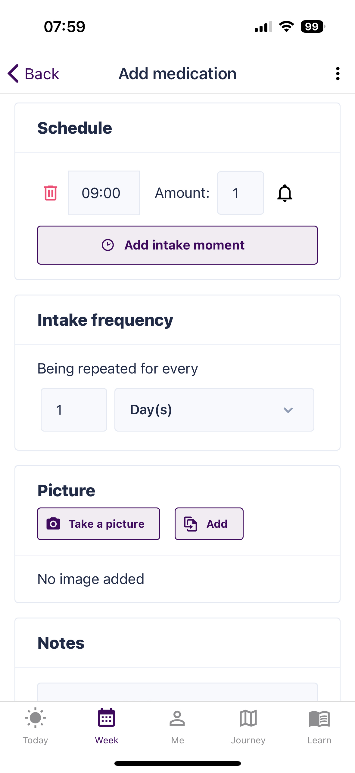
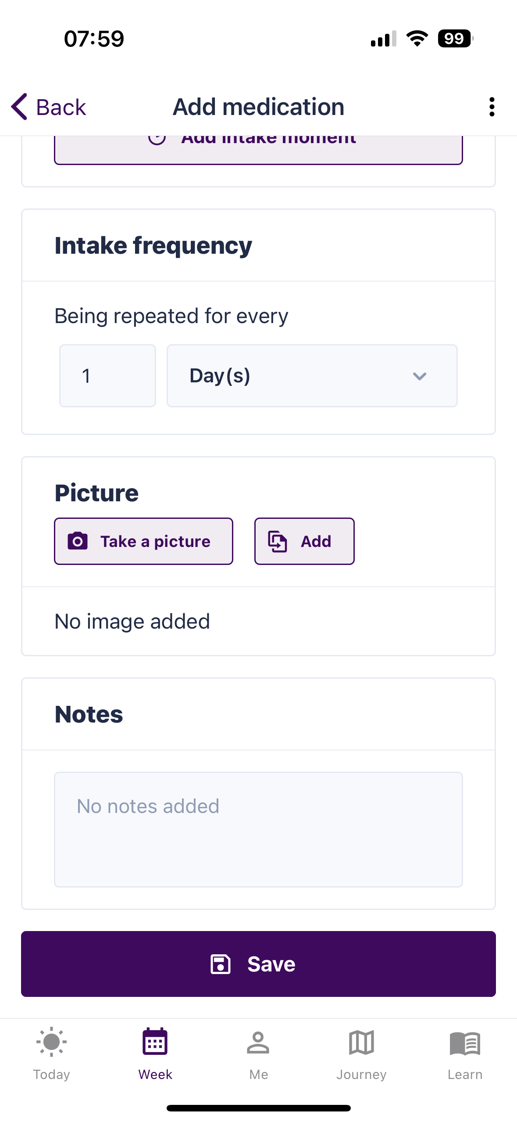

Slide 11
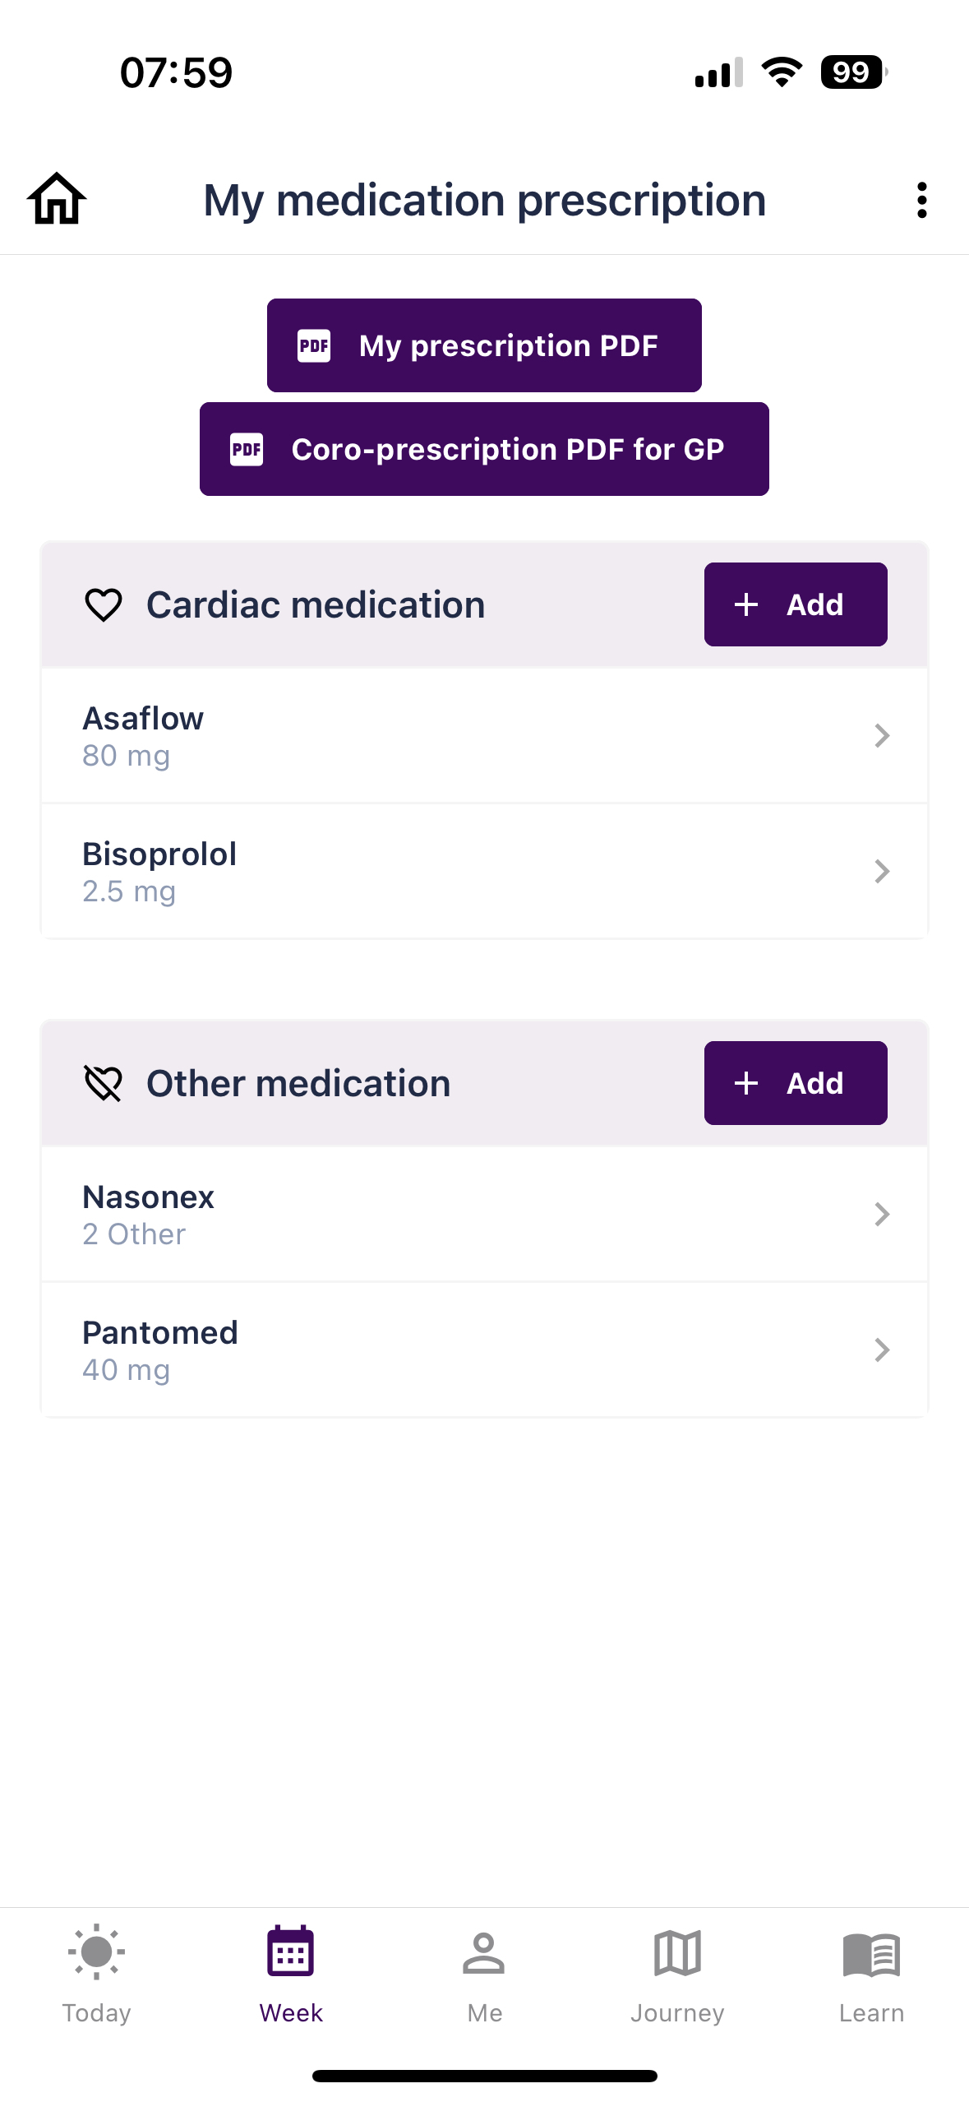

Slide 12
Medication prescription
Caregiver dashboard (without medication DSS)

Slide 13
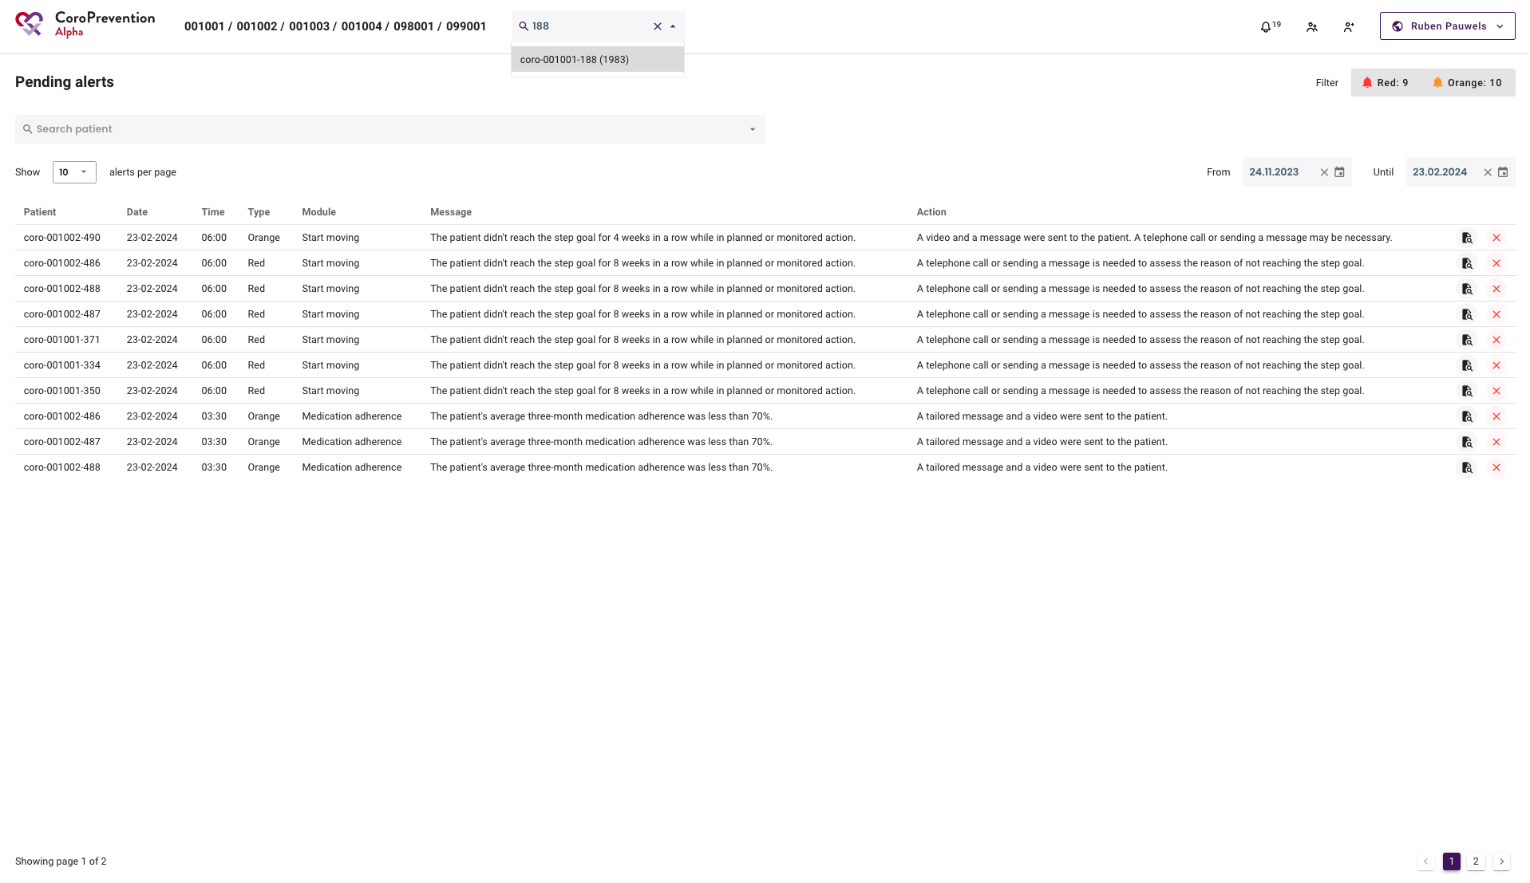

Slide 14
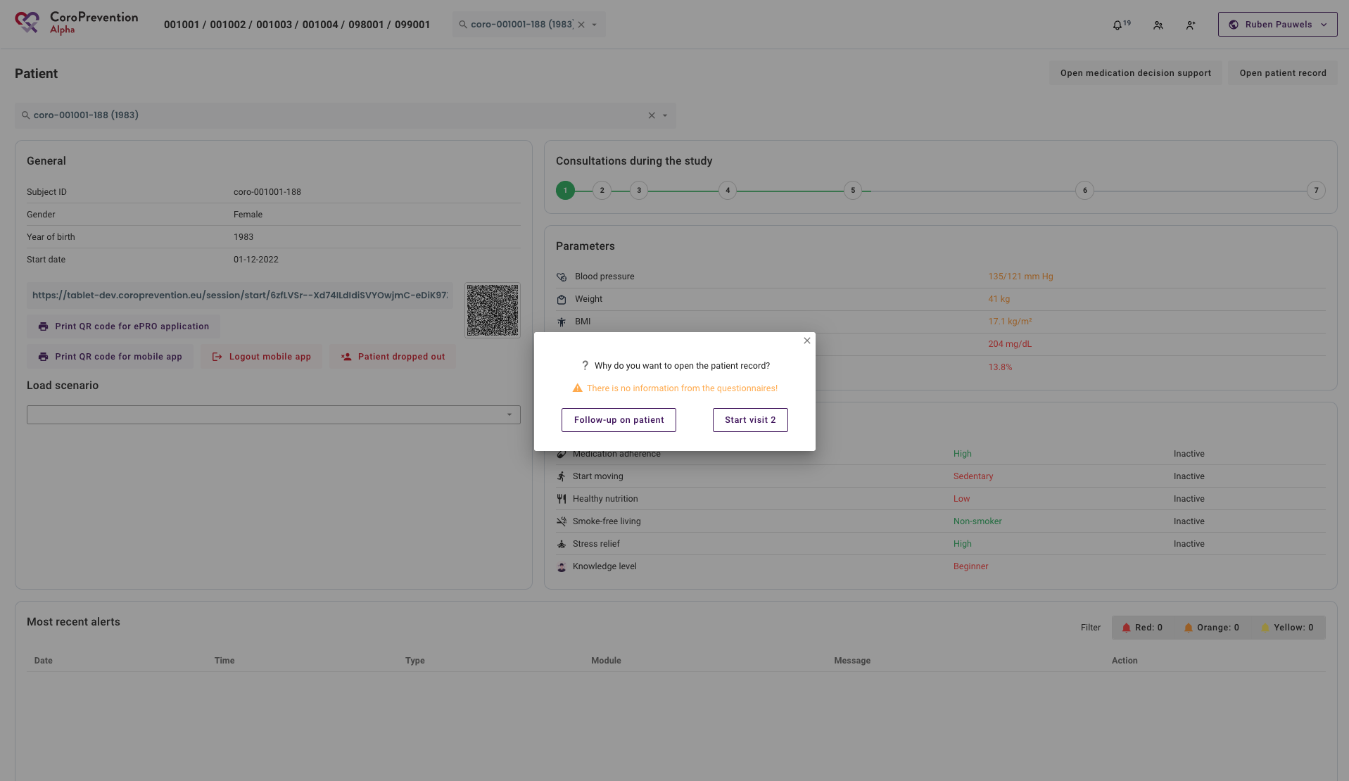

Slide 15
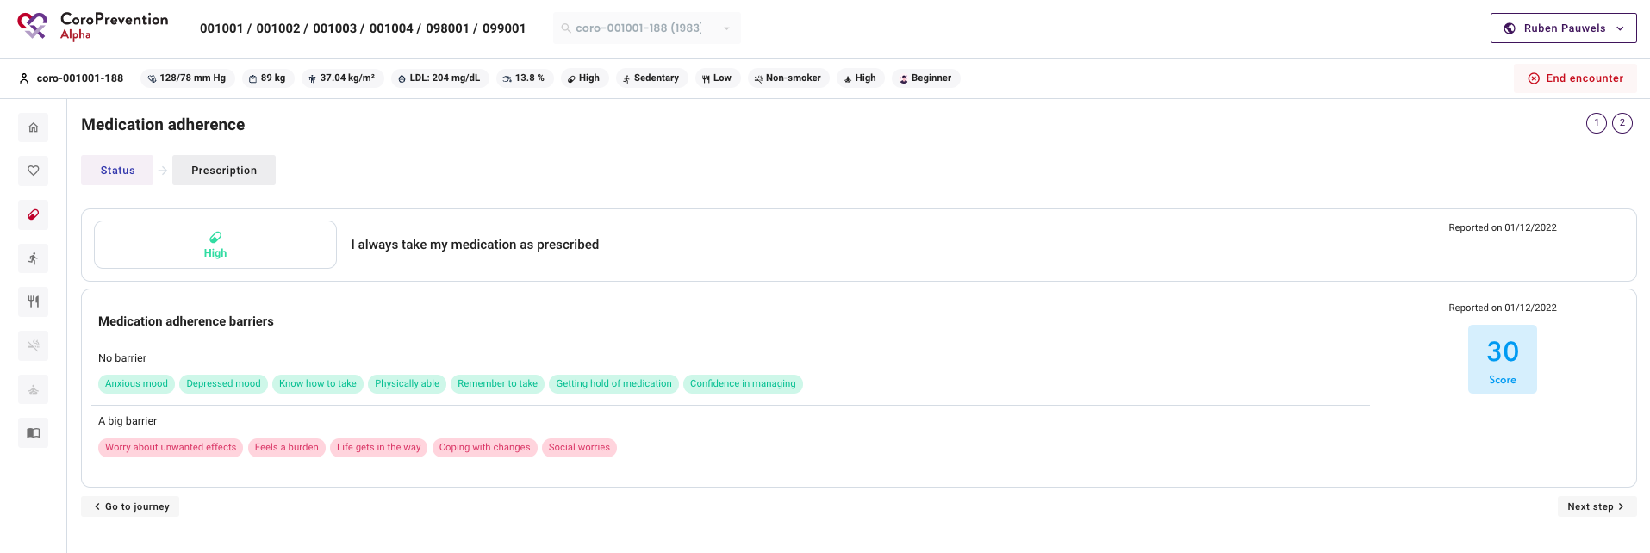

Slide 16
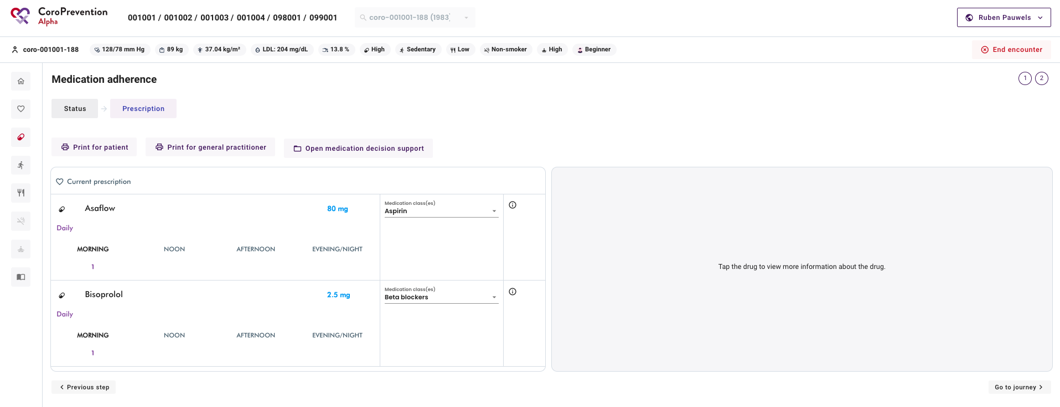

Slide 17
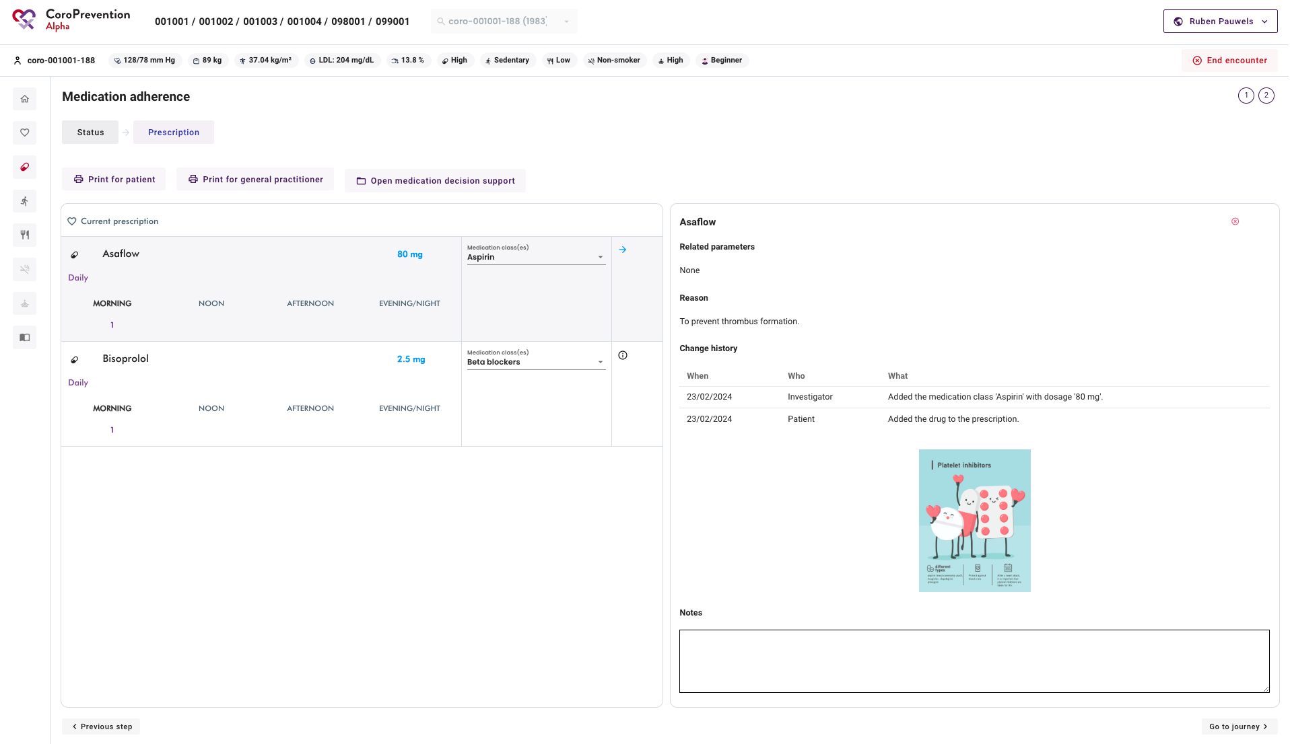

Slide 18
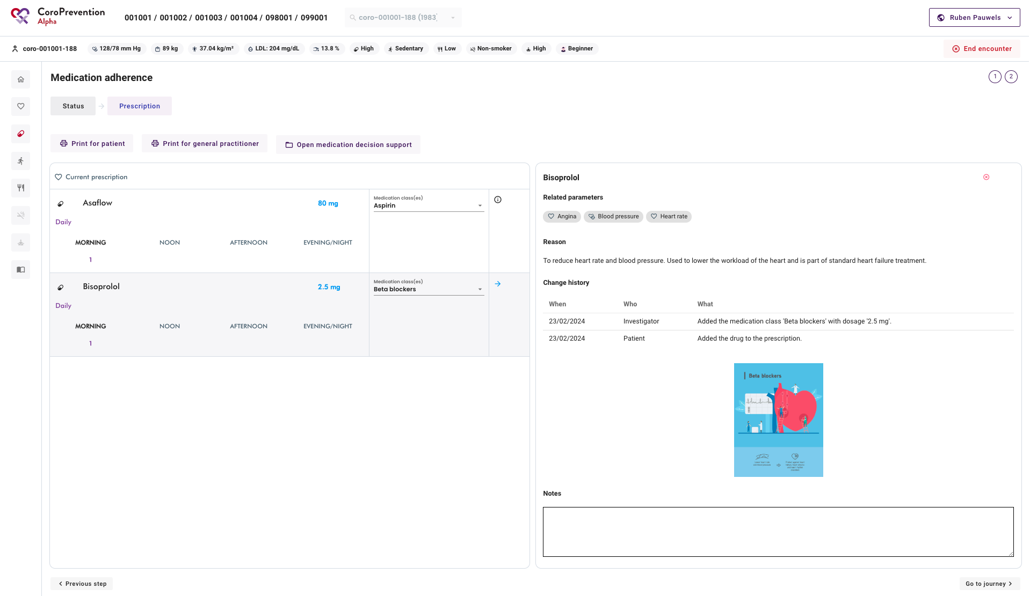

Slide 19
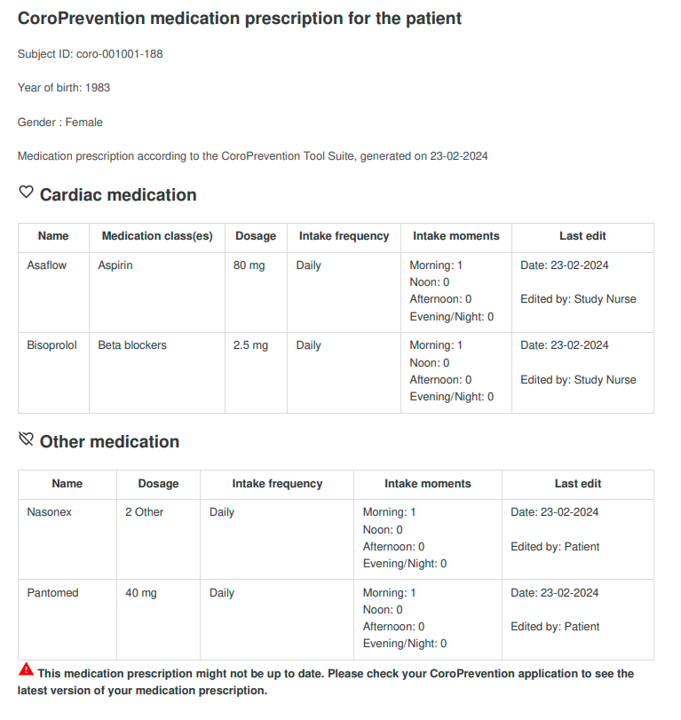

Slide 20
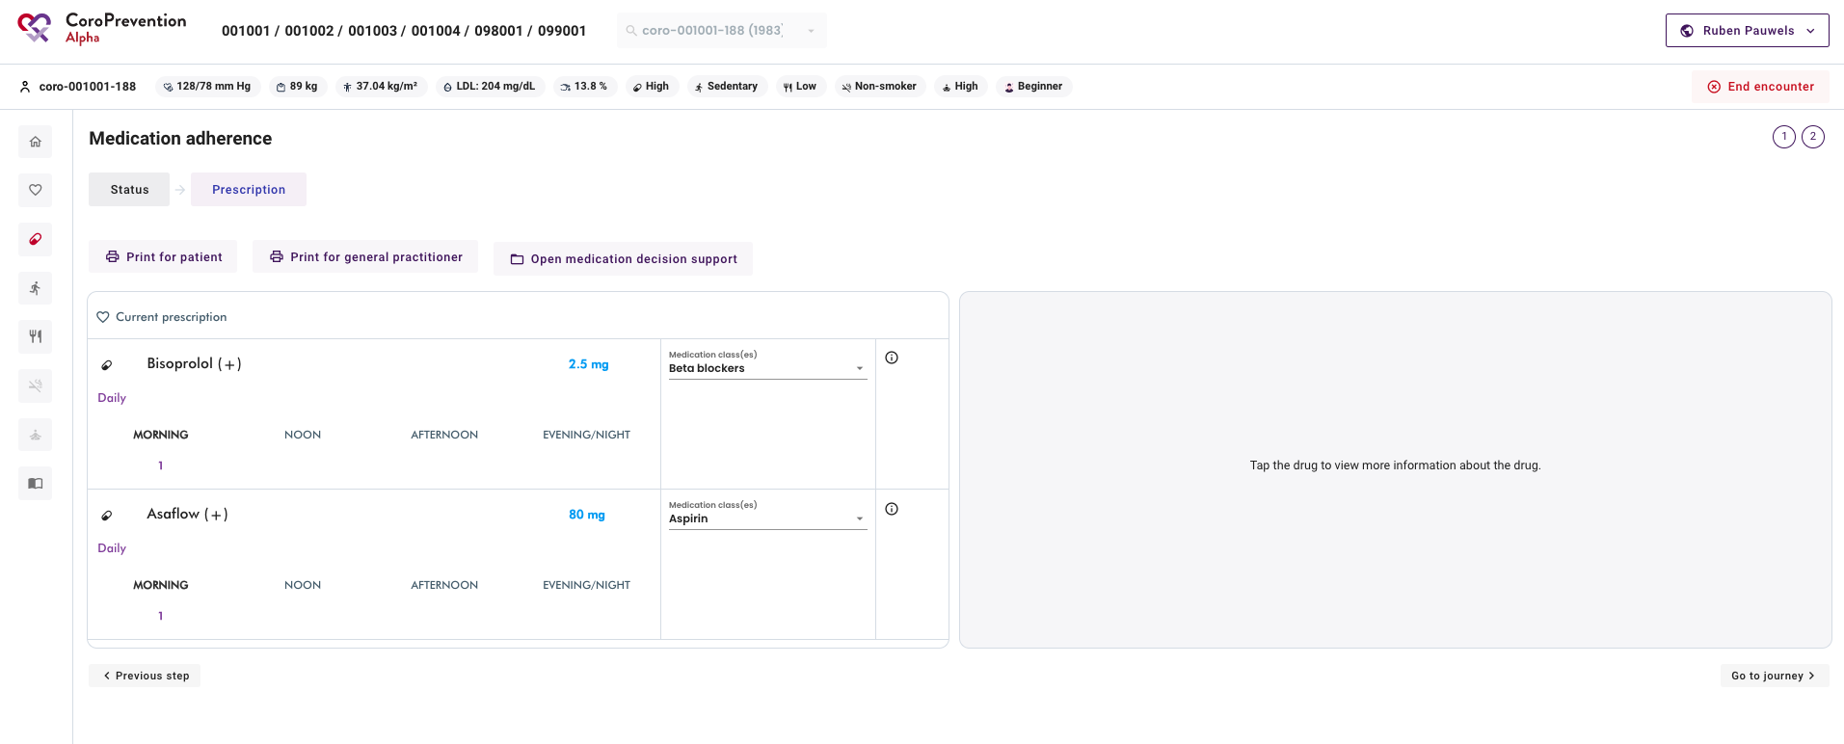

Slide 21
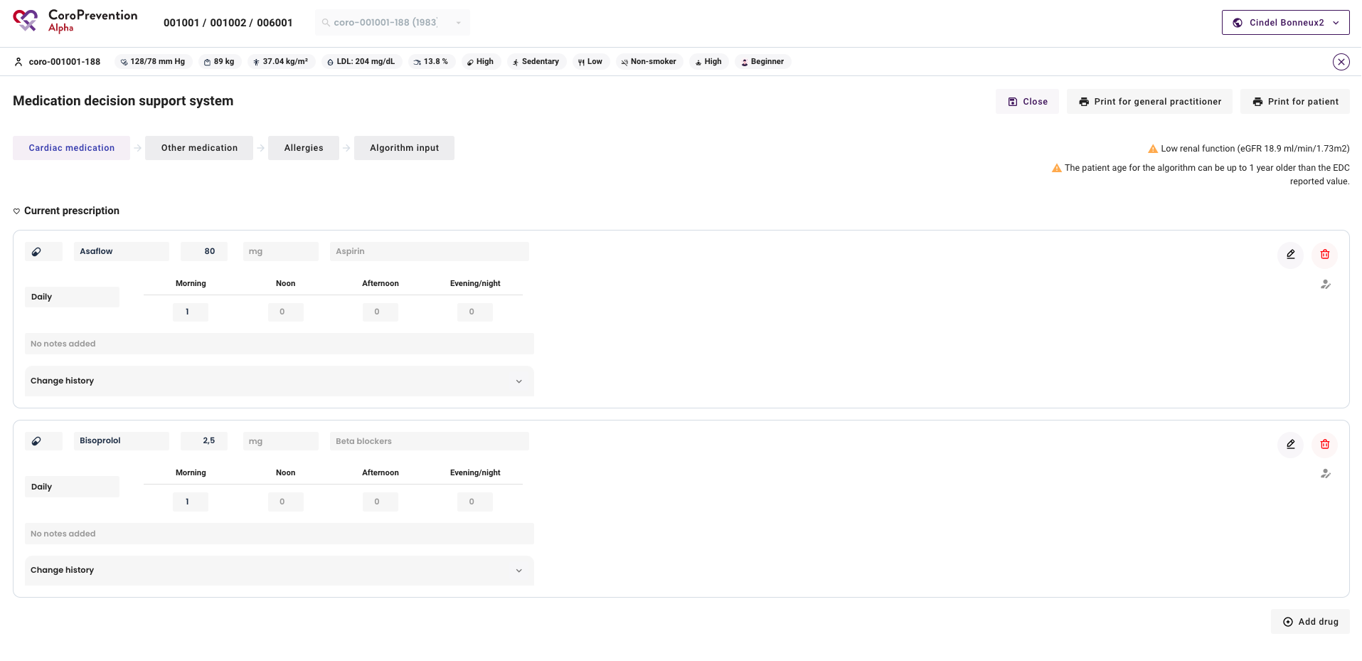

Slide 22
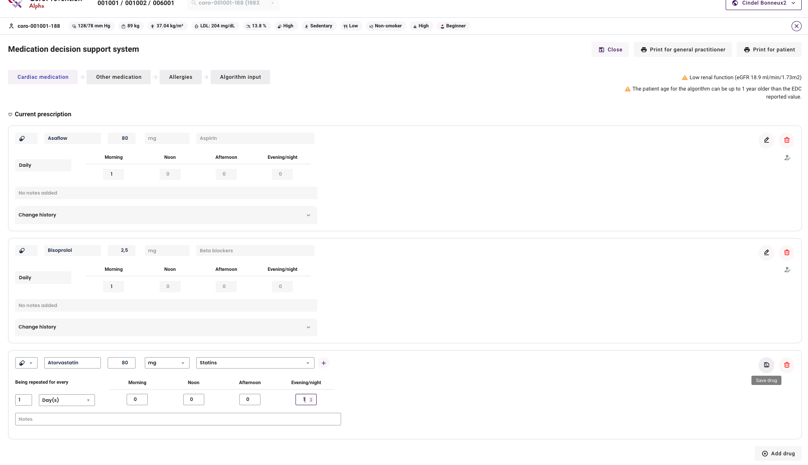

Slide 23
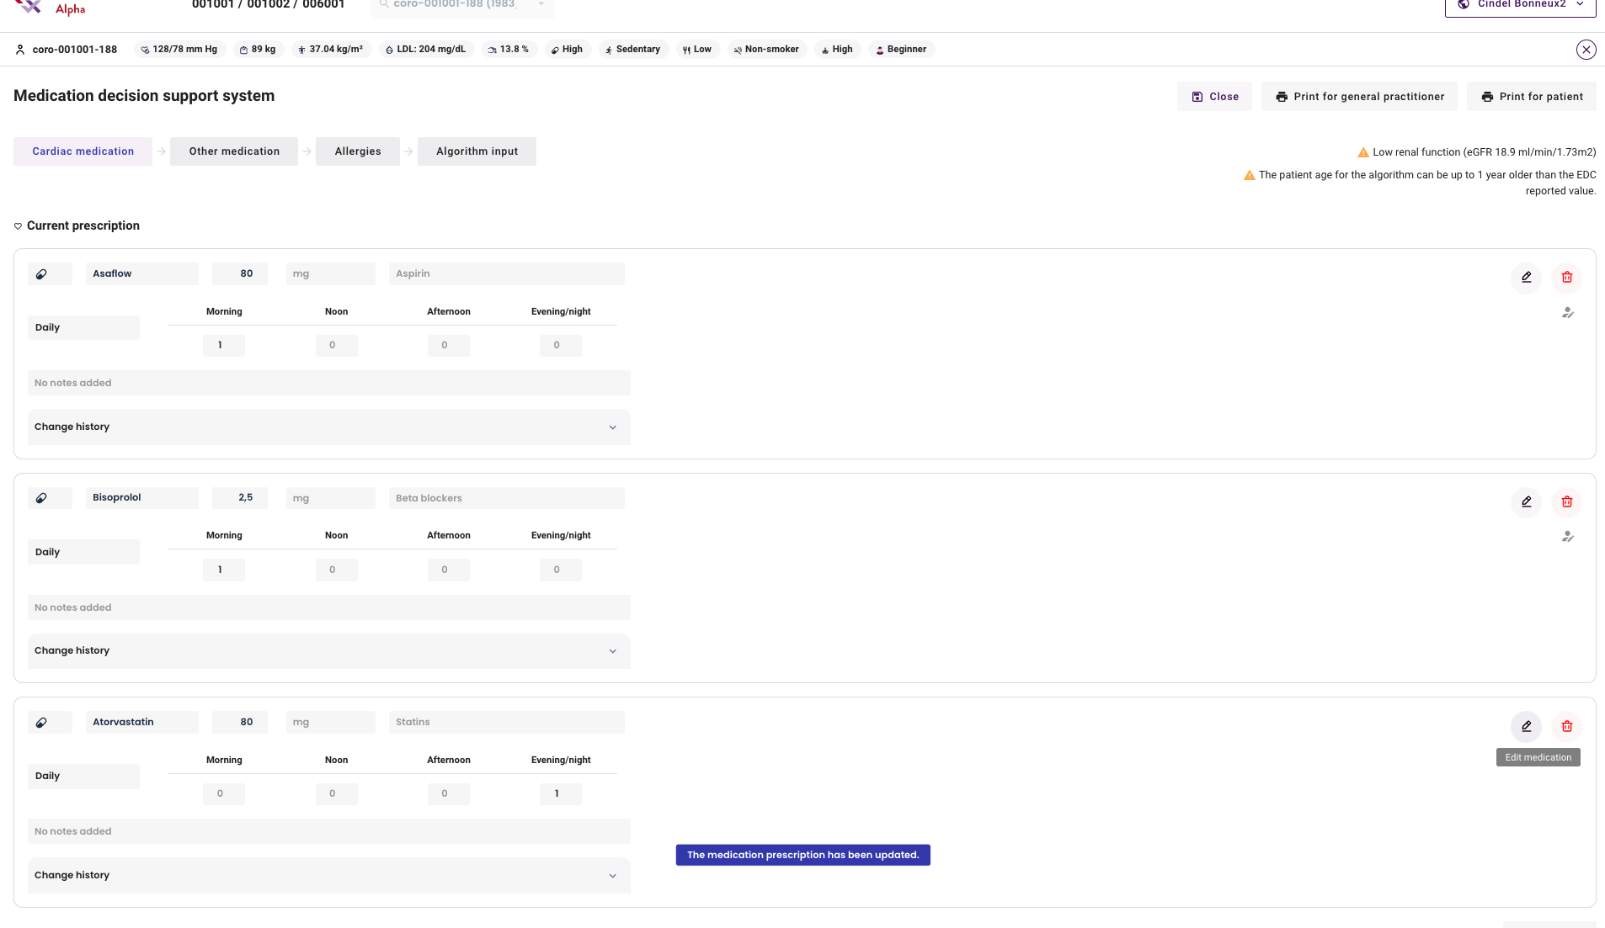

Slide 24
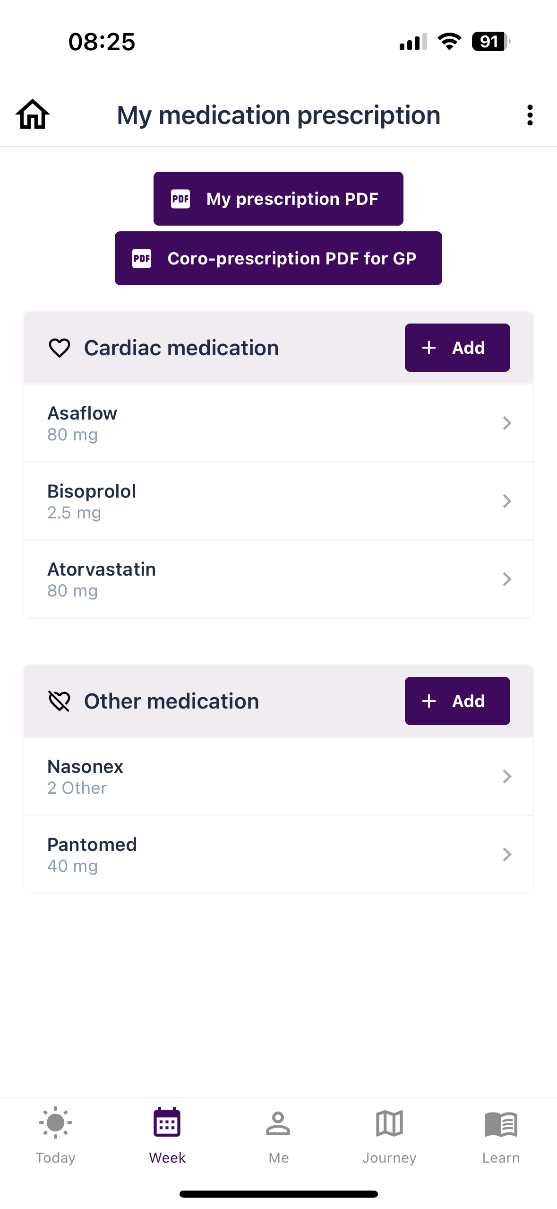

Slide 25
Medication decision support system
EDC
Notes:
Medication DSS: Only visit 2 + visit 6

Slide 26
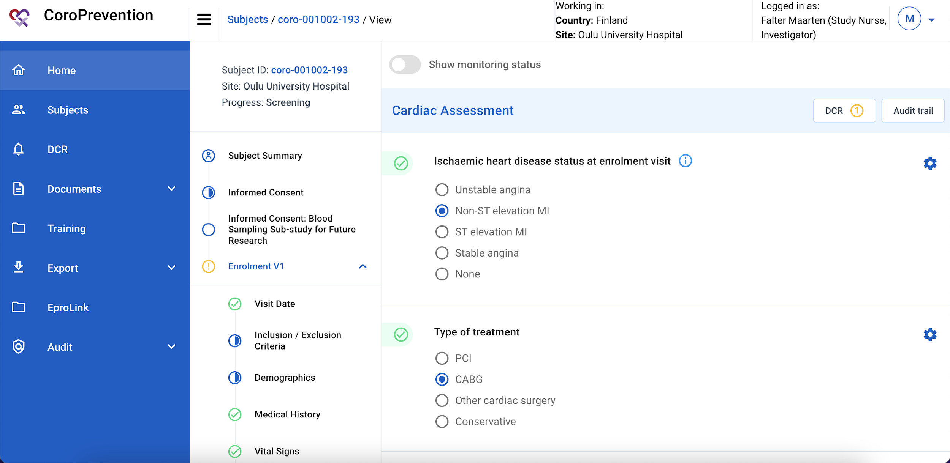

Slide 27
Medication decision support system
Caregiver dashboard

Slide 29
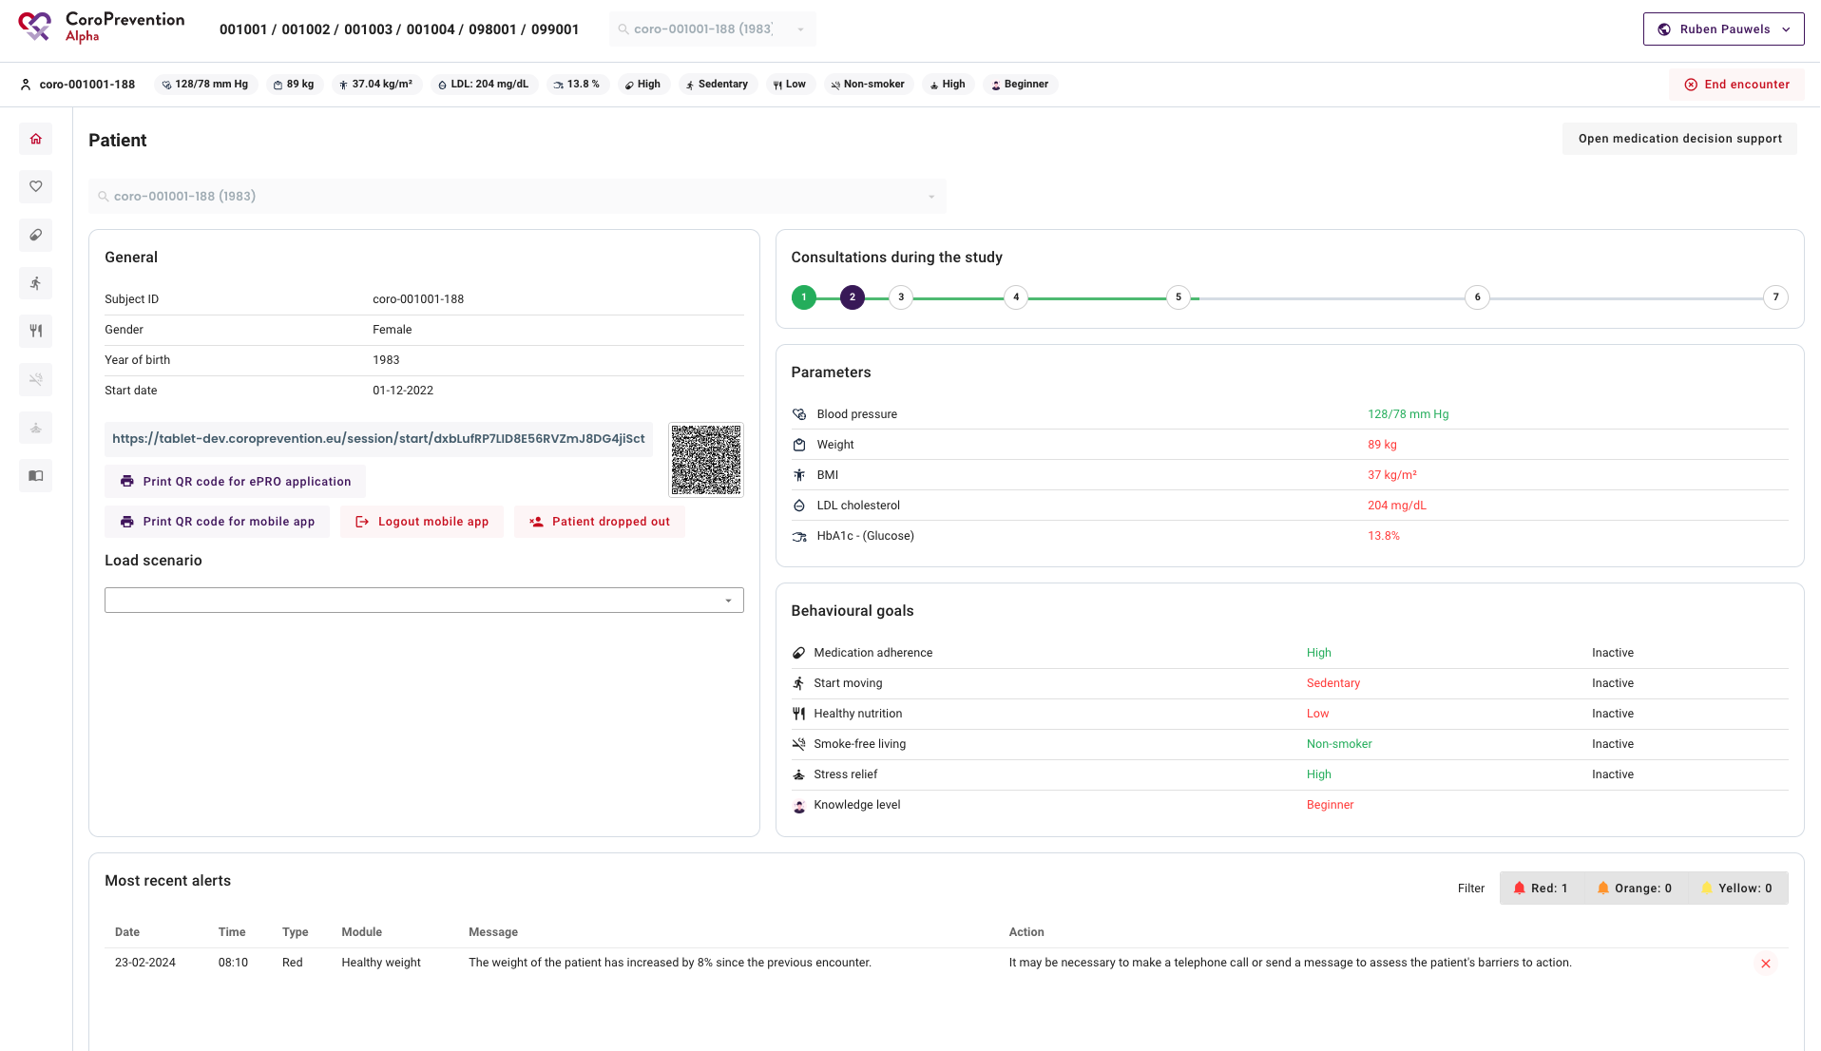

Slide 30
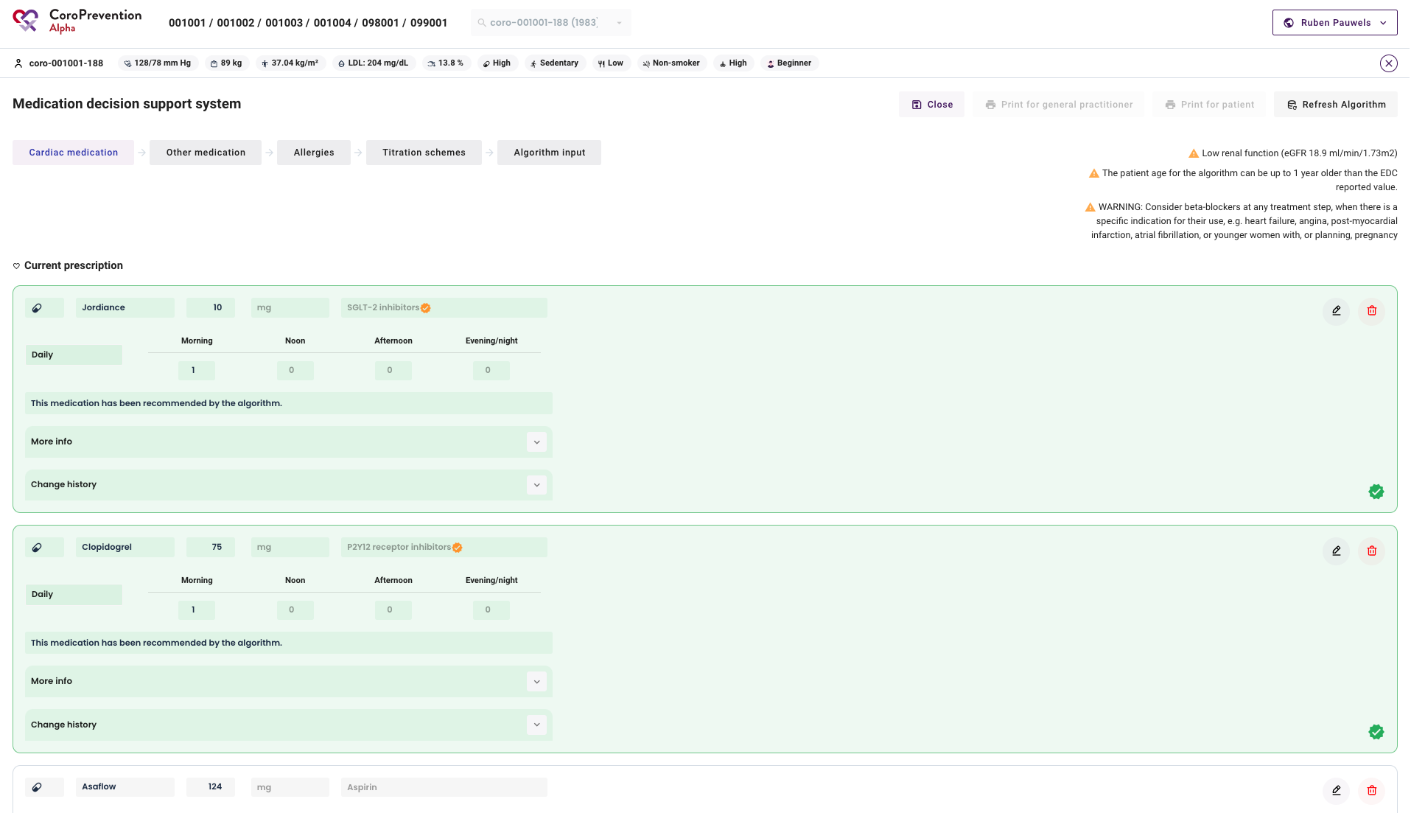

Slide 31
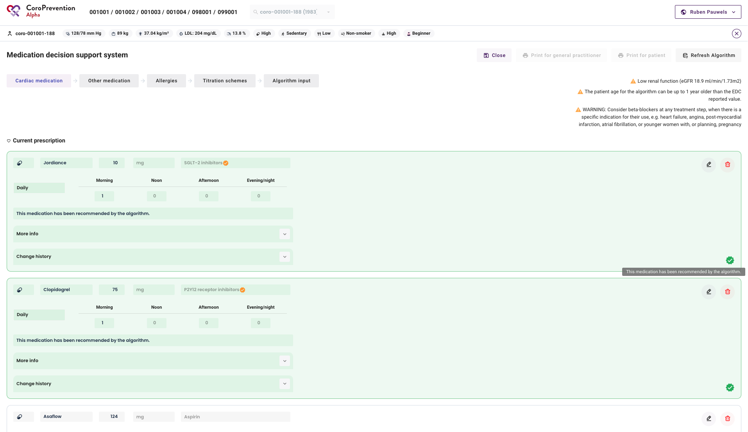

Slide 32
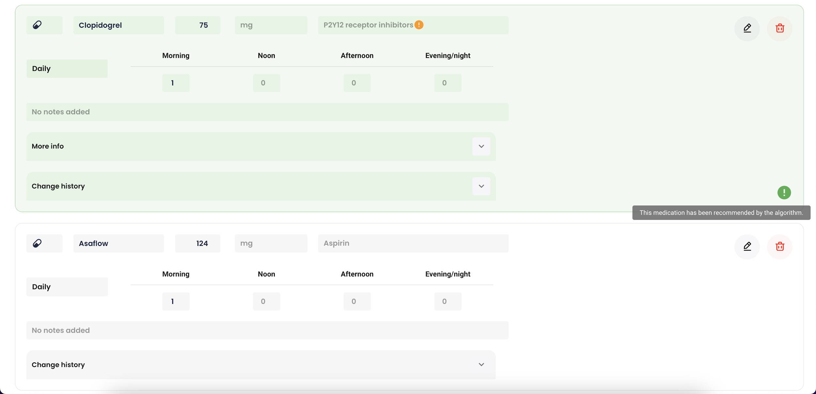

Slide 33
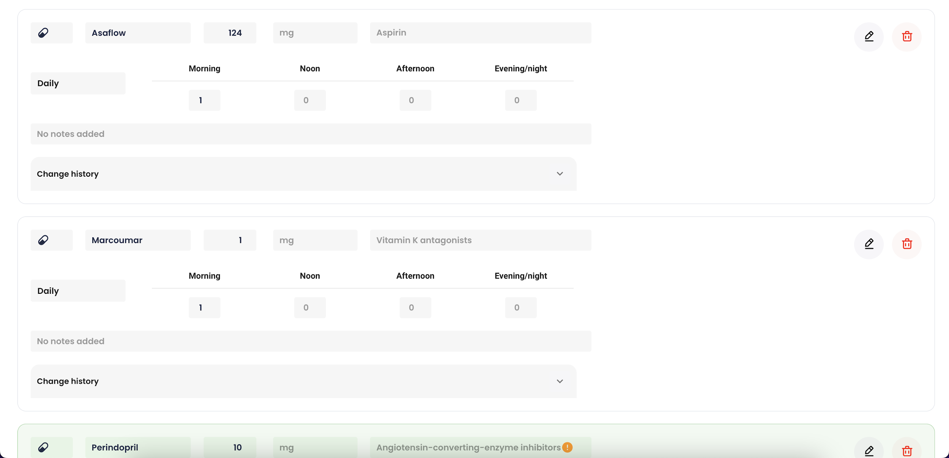

Slide 34
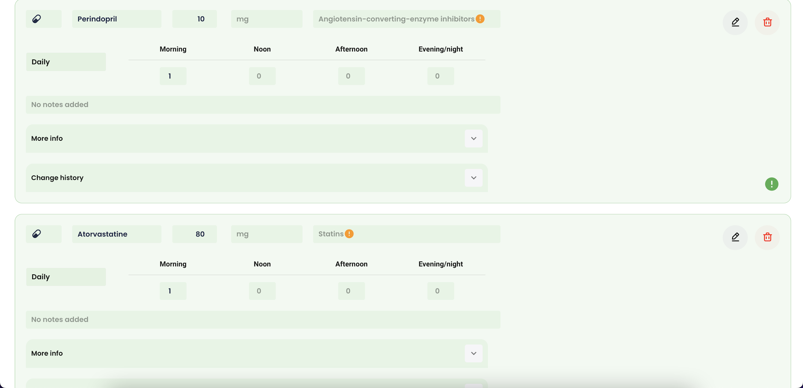

Slide 35
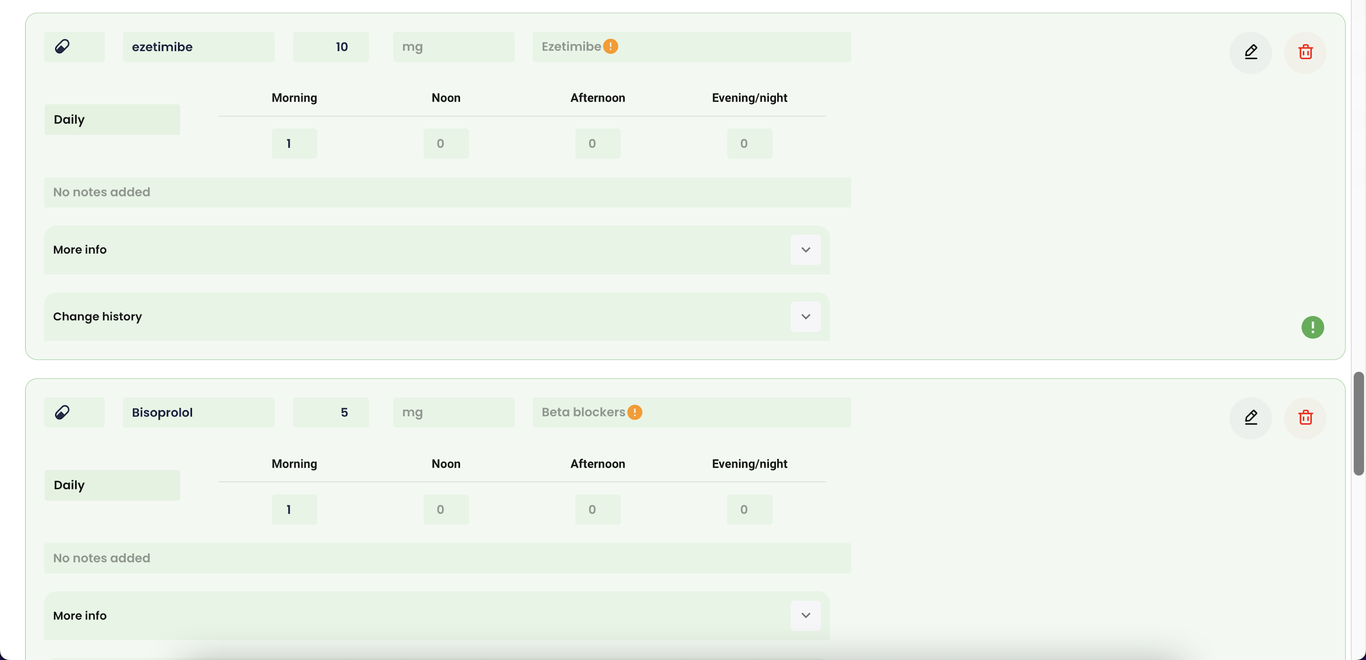

Slide 36
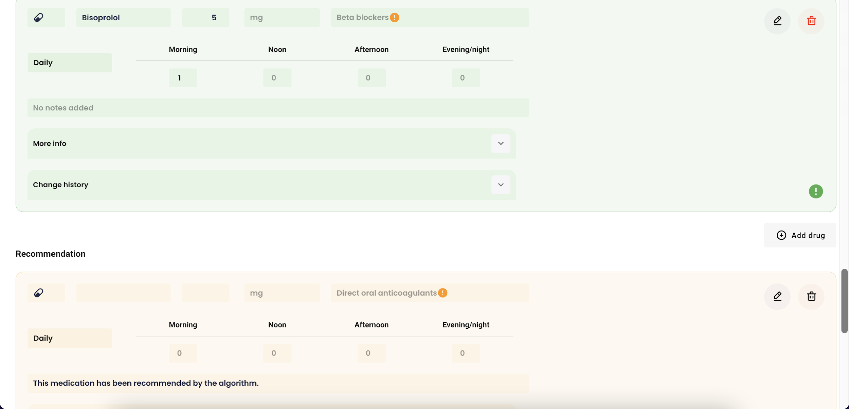

Slide 37
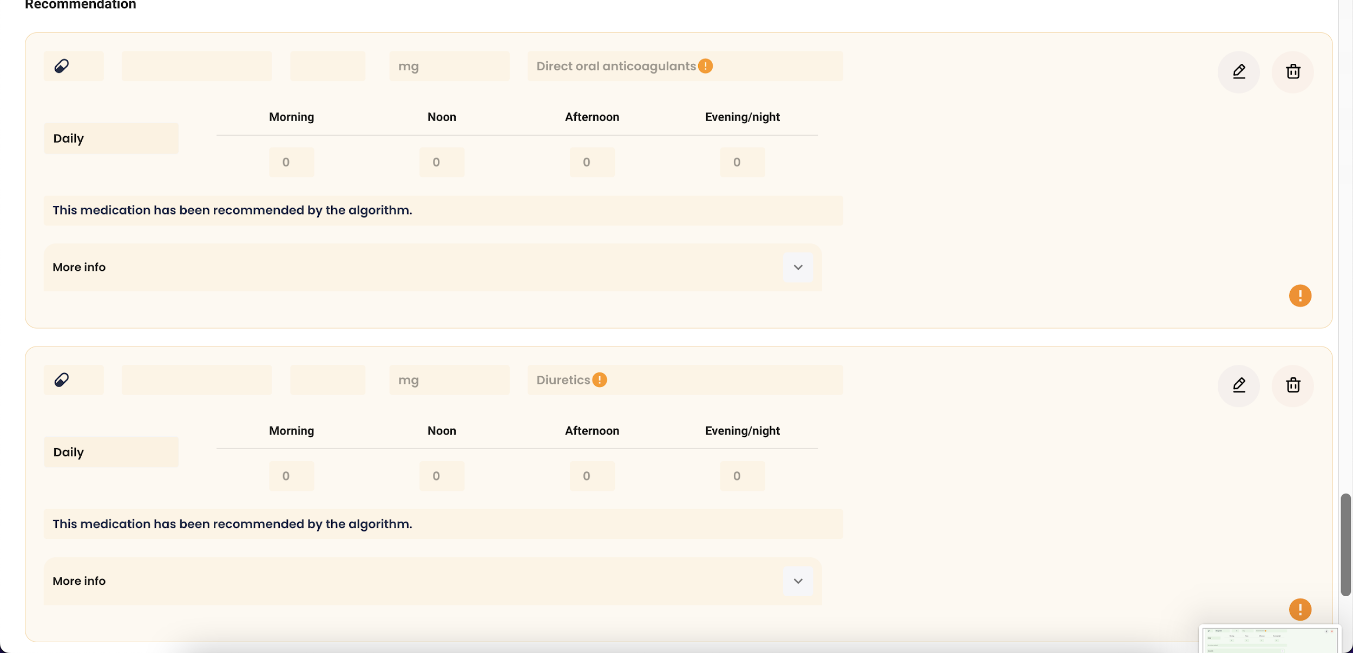

Slide 38
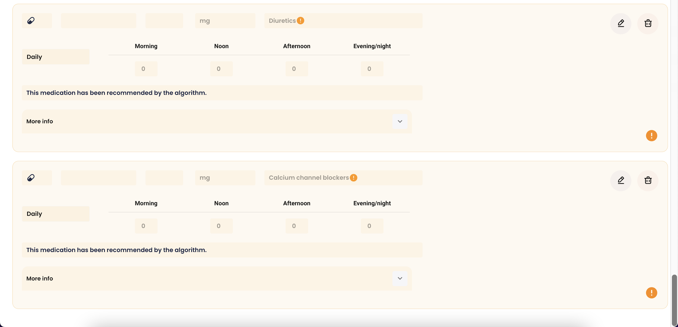

Slide 39
Add drug without recommendation

Slide 40
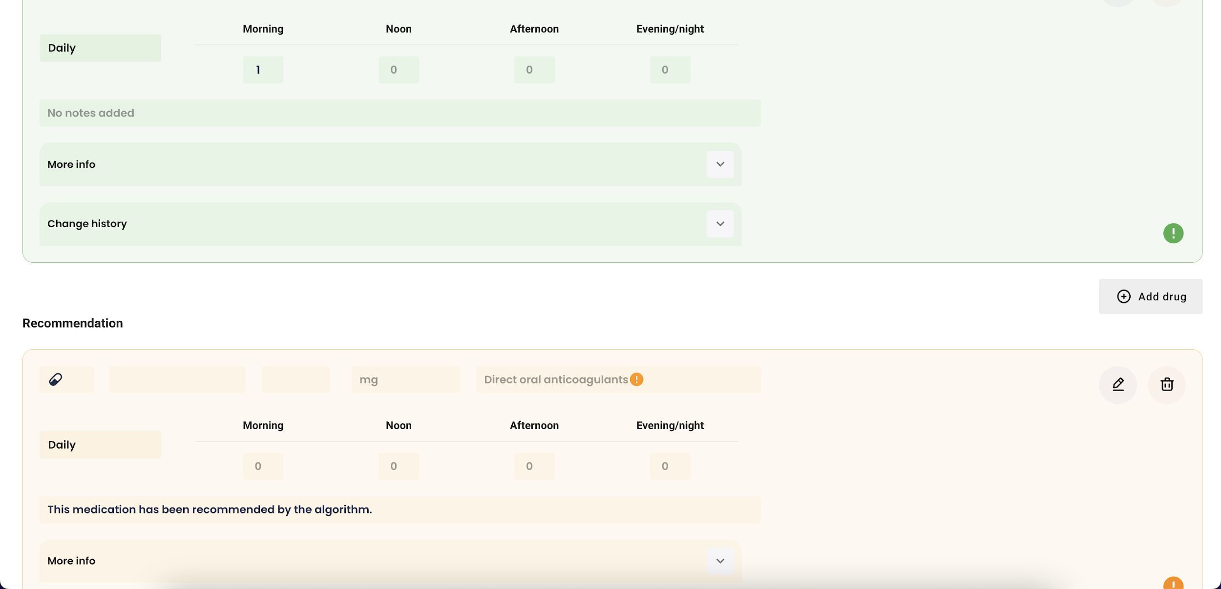

Slide 41
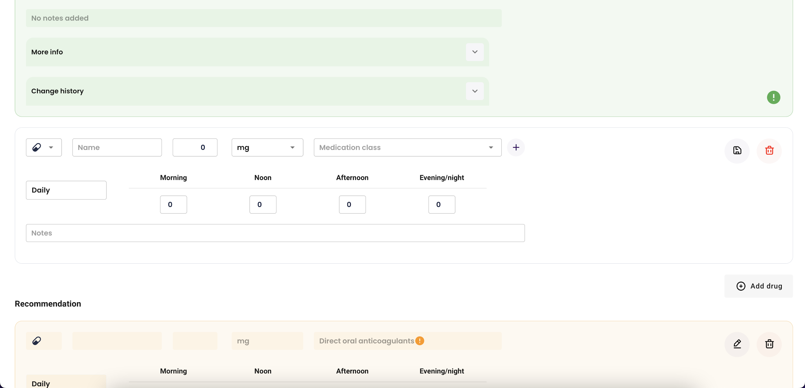

Slide 42
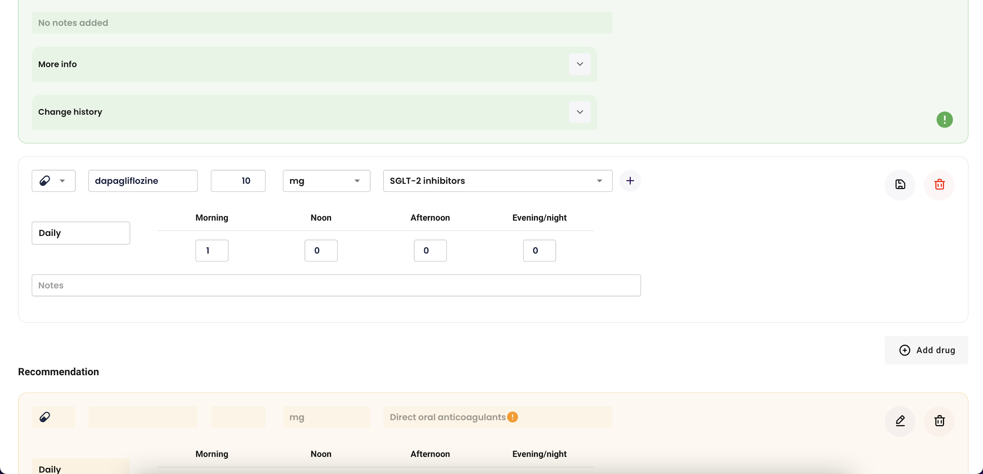

Slide 43
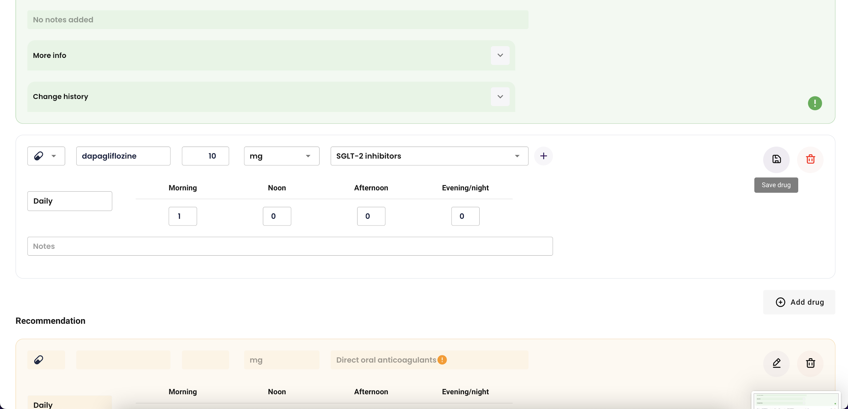

Slide 44
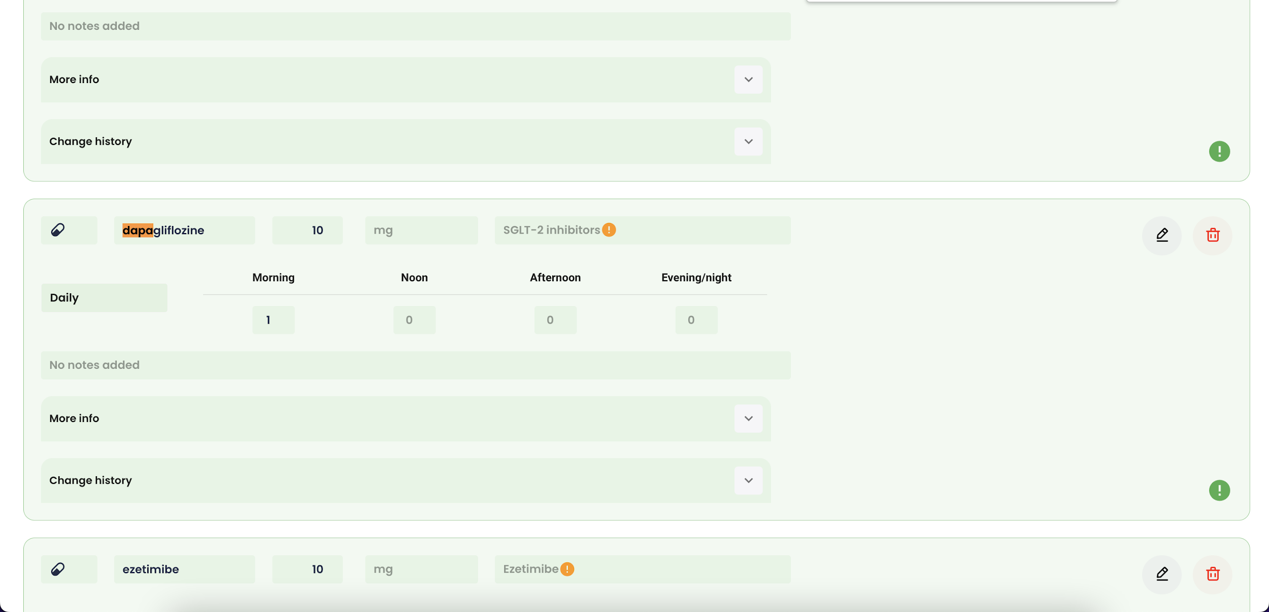

Slide 45
Add drug with recommendation

Slide 46
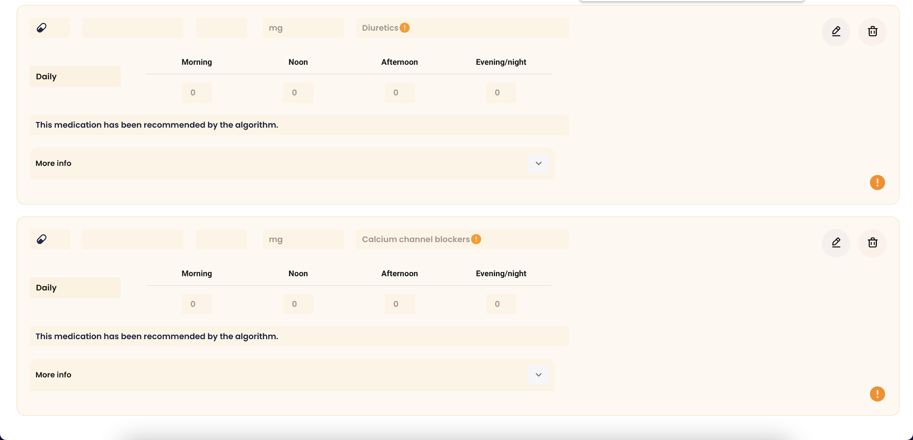

Slide 47
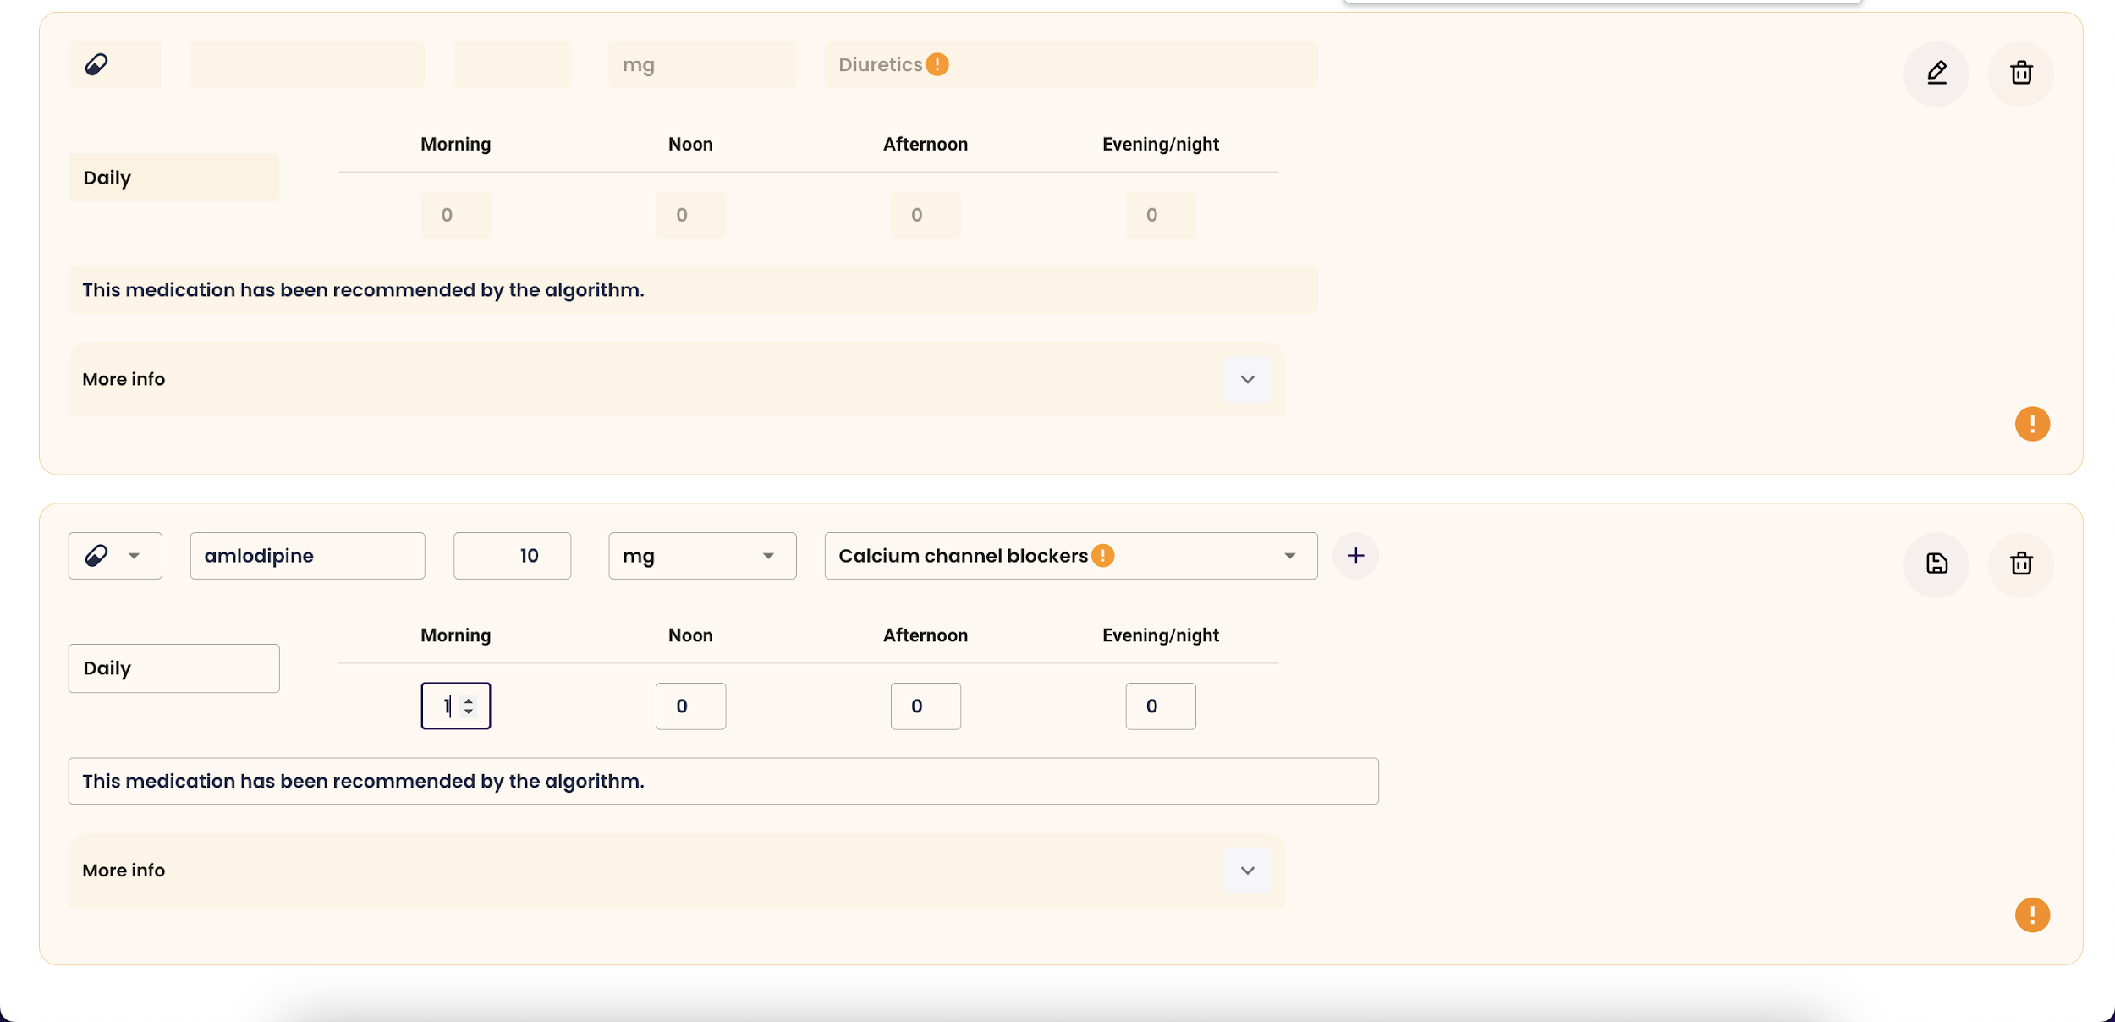

Slide 48
Tips and pitfalls

Slide 49
Tips and pitfalls
Medication adherence: will be monitored by the case nurse
Medication prescription and medication DSS: will be mainly the physician (cardiologist/internist/other)
In first versions: consider it a recommendation, but please consider in each patient if the automatic recommendation is appropriate.

Slide 50
Note
In the first visit (V2), the medication schedule will not be automatically transferred from the EDC to the Tool Suite.
Make sure to re-enter the current medication schedule for this patient in the Tool Suite.

