Slide 1
Introduction to the EXPERT tool
Notes:
Welcome in this webinar, we will have a look at the CoroPrevention EXPERT tool.

Slide 2
What is the EXPERT tool?
Developed according to EAPC and ESC position statements/guidelines and the expert opinions of the EAPC EXPERT group members
To select maximally clinically effective and medically safe training modalities for patients with cardiovascular disease
Recommendation System to support prescription of personalized exercise training
Notes:
In the CoroPrevention project, the EXPERT tool is integrated into the caregiver dashboard to support you with exercise prescription.
What is the EXPERT tool?
- The EXPERT tool is developed according to the EAPC and ESC guidelines and the expert opinions of the EAPC EXPERT group members.
- The aim is to select maximally clinically effective and medically safe training modalities for patients with cardiovascular disease.
- It is a recommendation system (or decision support system) designed to support you in the prescription of personalized exercise training.

Slide 3
How to apply the EXPERT tool in CoroPrevention? Case description
64-year old male
Medical history:
Arterial hypertension, obesity, hypercholesterolaemia, diabetes mellitus
Shoulder operation in 2015
Elective coronary angiography demonstrating severe 3-vessel disease in 2021
Elective CABG was performed
Risk factors:
Obesity, diabetes, arterial hypertension, hypercholesterolaemia
Prior smoker, currently non-smoker
Low physical activity
Notes:
We will start this introduction with a case to show you how to use the EXPERT tool in the caregiver dashboard.
Our example patient is a 64-year old man with a medical history of:
Arterial hypertension, obesity, hypercholesterolaemia, diabetes mellitus
Shoulder operation in 2015
Elective coronary angiography demonstrating severe 3-vessel disease in 2021
Elective CABG was performed
He has the following risk factors:
Obesity, diabetes, arterial hypertension, hypercholesterolaemia
Prior smoker, currently non-smoker
Low physical activity

Slide 4
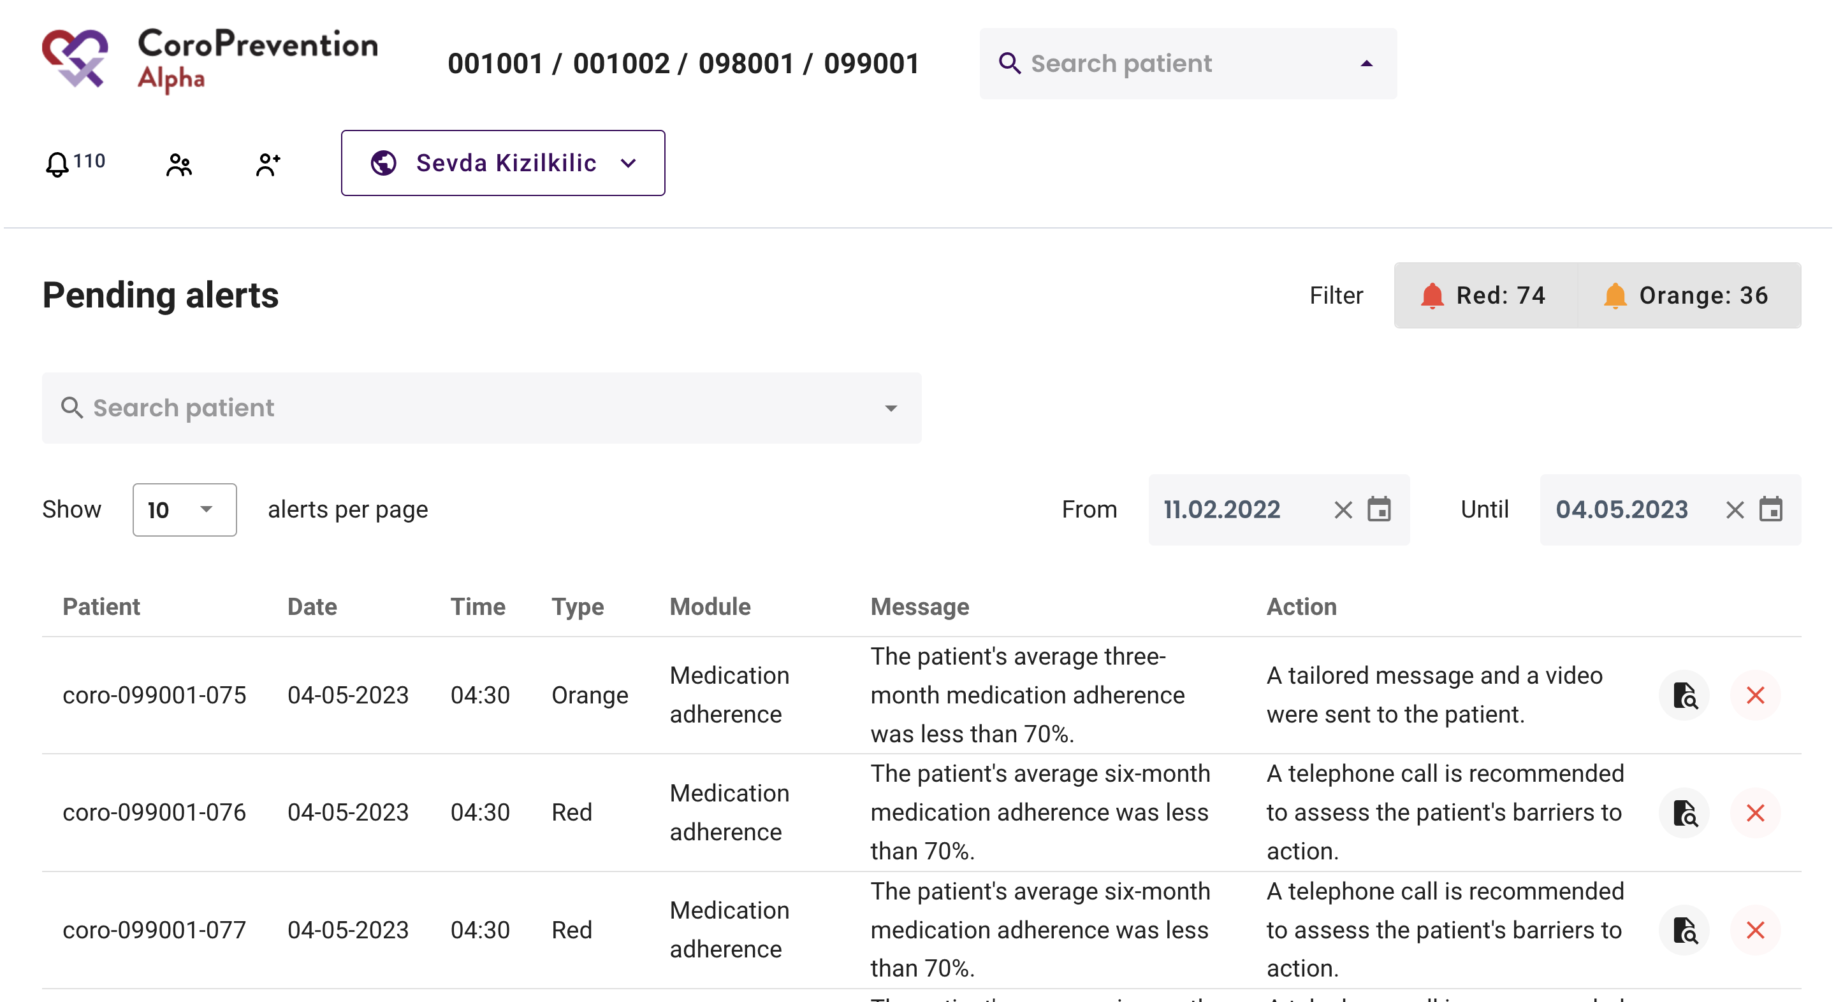
Open the EXPERT tool
Notes:
The EXPERT tool is integrated in the caregiver dashboard.
First you have to find the patient for whom you want to make an exercise prescription. To achive this, you have to enter the patient’s subject ID in the search bar and select the correct patient.

Slide 5
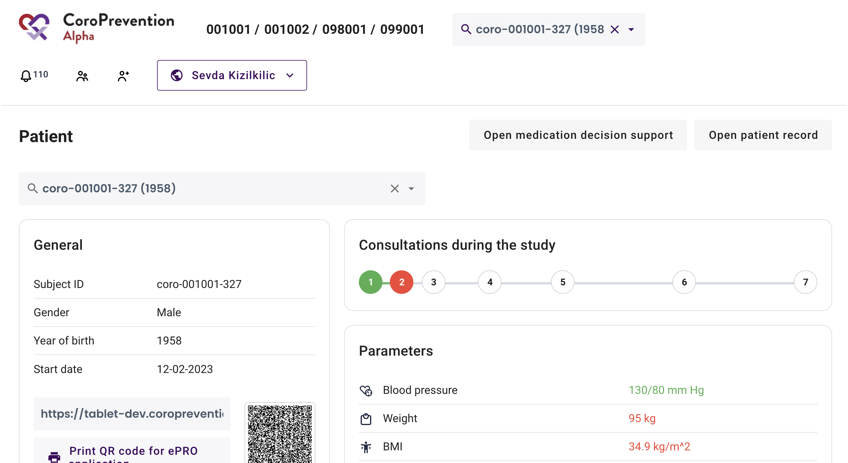
Open the EXPERT tool
Notes:
This shows the patient overview page.
Click here on “Open patient record”.

Slide 6
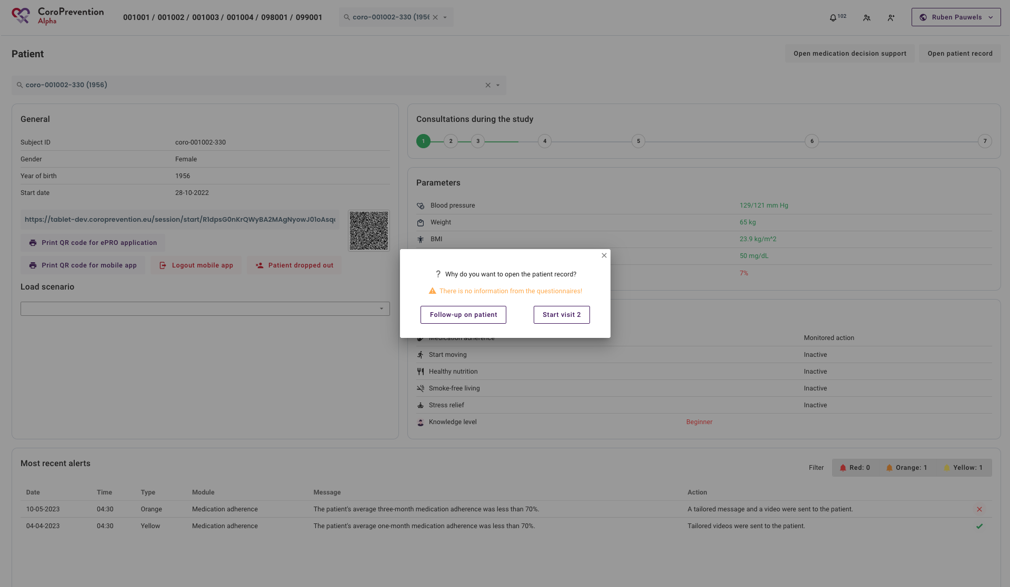
Open the EXPERT tool
Notes:
Click in the pop-up dialog on the correct button.
If you want to open the patient record when the patient is not with you for an encounter, you should click the “Follow-up on patient” button. In this manner, you can open the patient reocrd to prepare the exercise prescription prior to visit 2.
If the patient is currently with you for a visit, you should click the “Start visit” button.

Slide 7
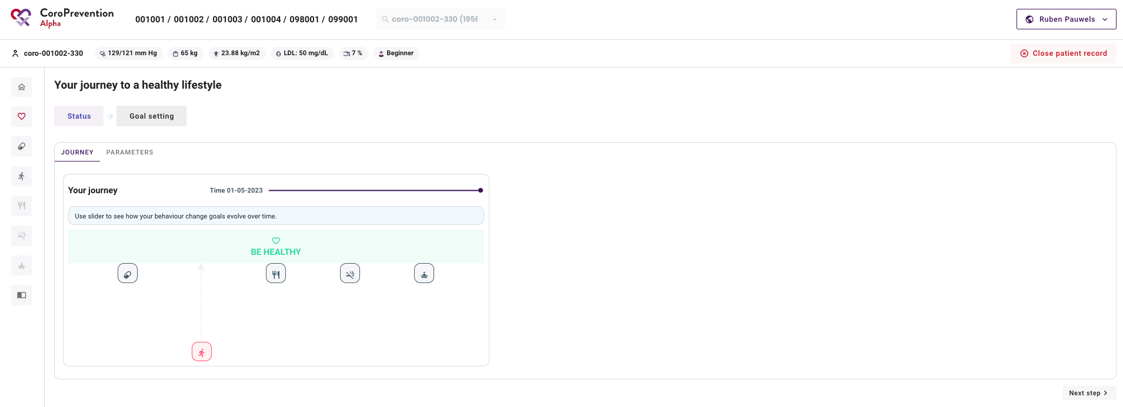
Open the EXPERT tool
Notes:
The patient record is now open. You can find the EXPERT tool in the “Start moving” module. You can open this module by clicking on the ”running man” icon on the left side of the screen.

Slide 8
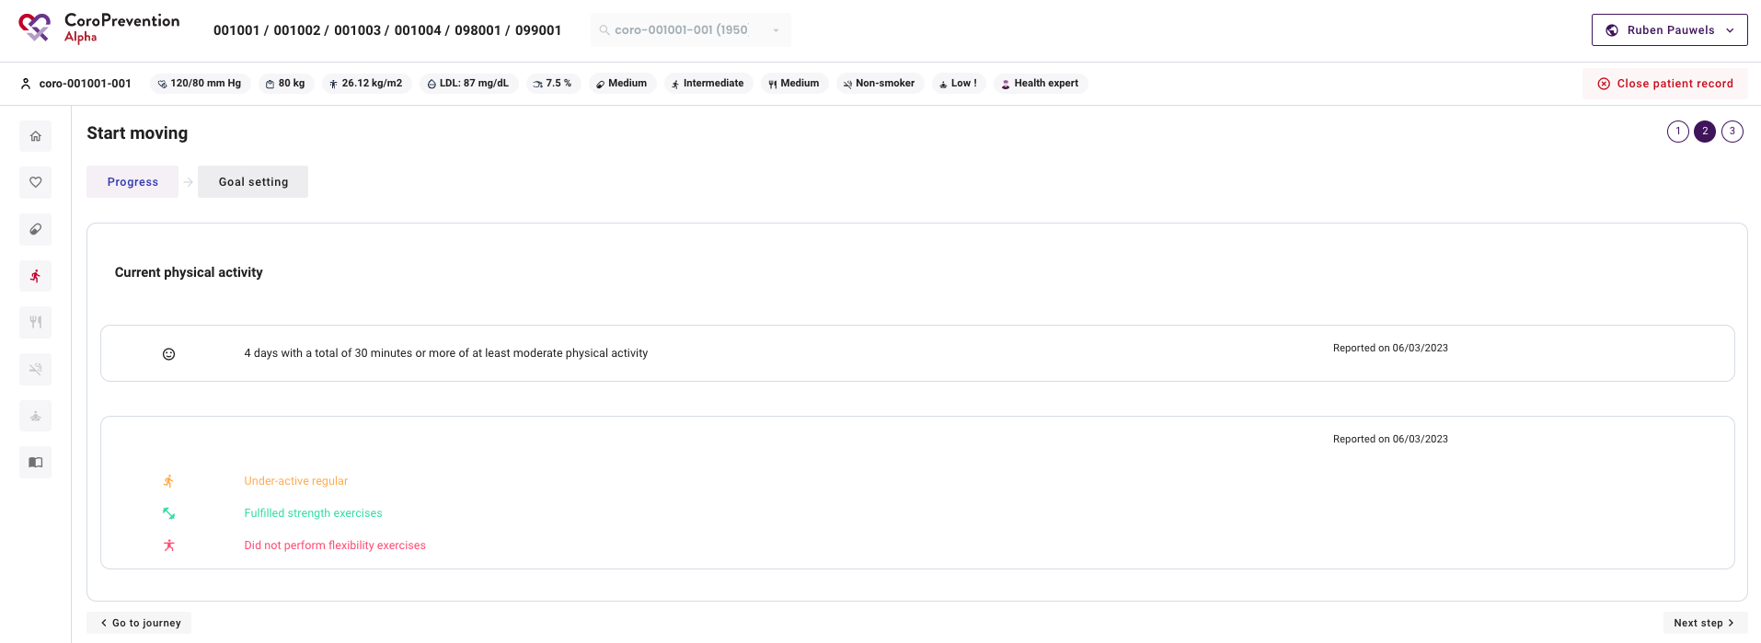
Open the EXPERT tool
Notes:
Next, go to the “Goal setting” discussion step.

Slide 9
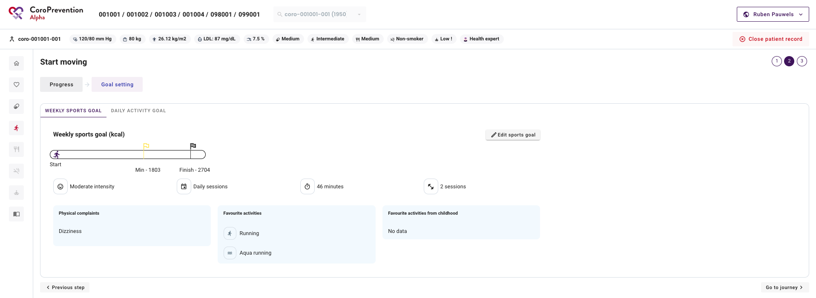
Open the EXPERT tool
Notes:
And click there on the “Edit sports goal” button.

Slide 10
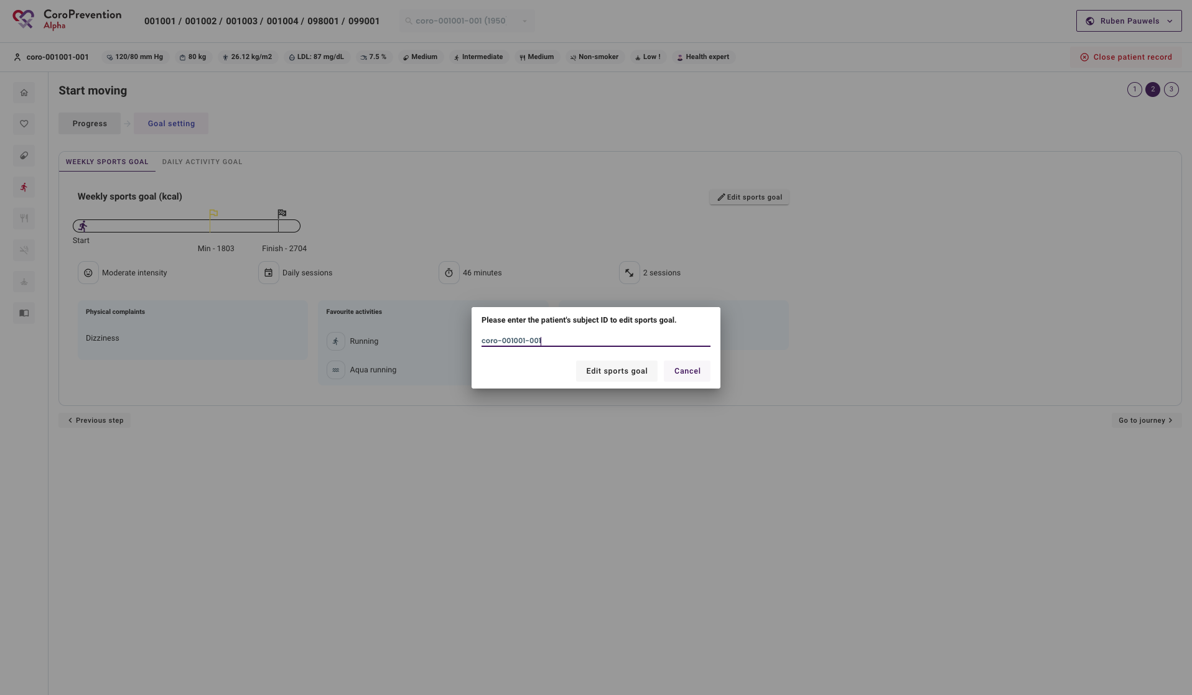
Open the EXPERT tool
Notes:
To avoid that you open the EXPERT tool for the wrong patient, you will be asked to enter the patient’s subject ID again. You can submit the subject ID by clicking on the “Edit sports goal” button.

Slide 11
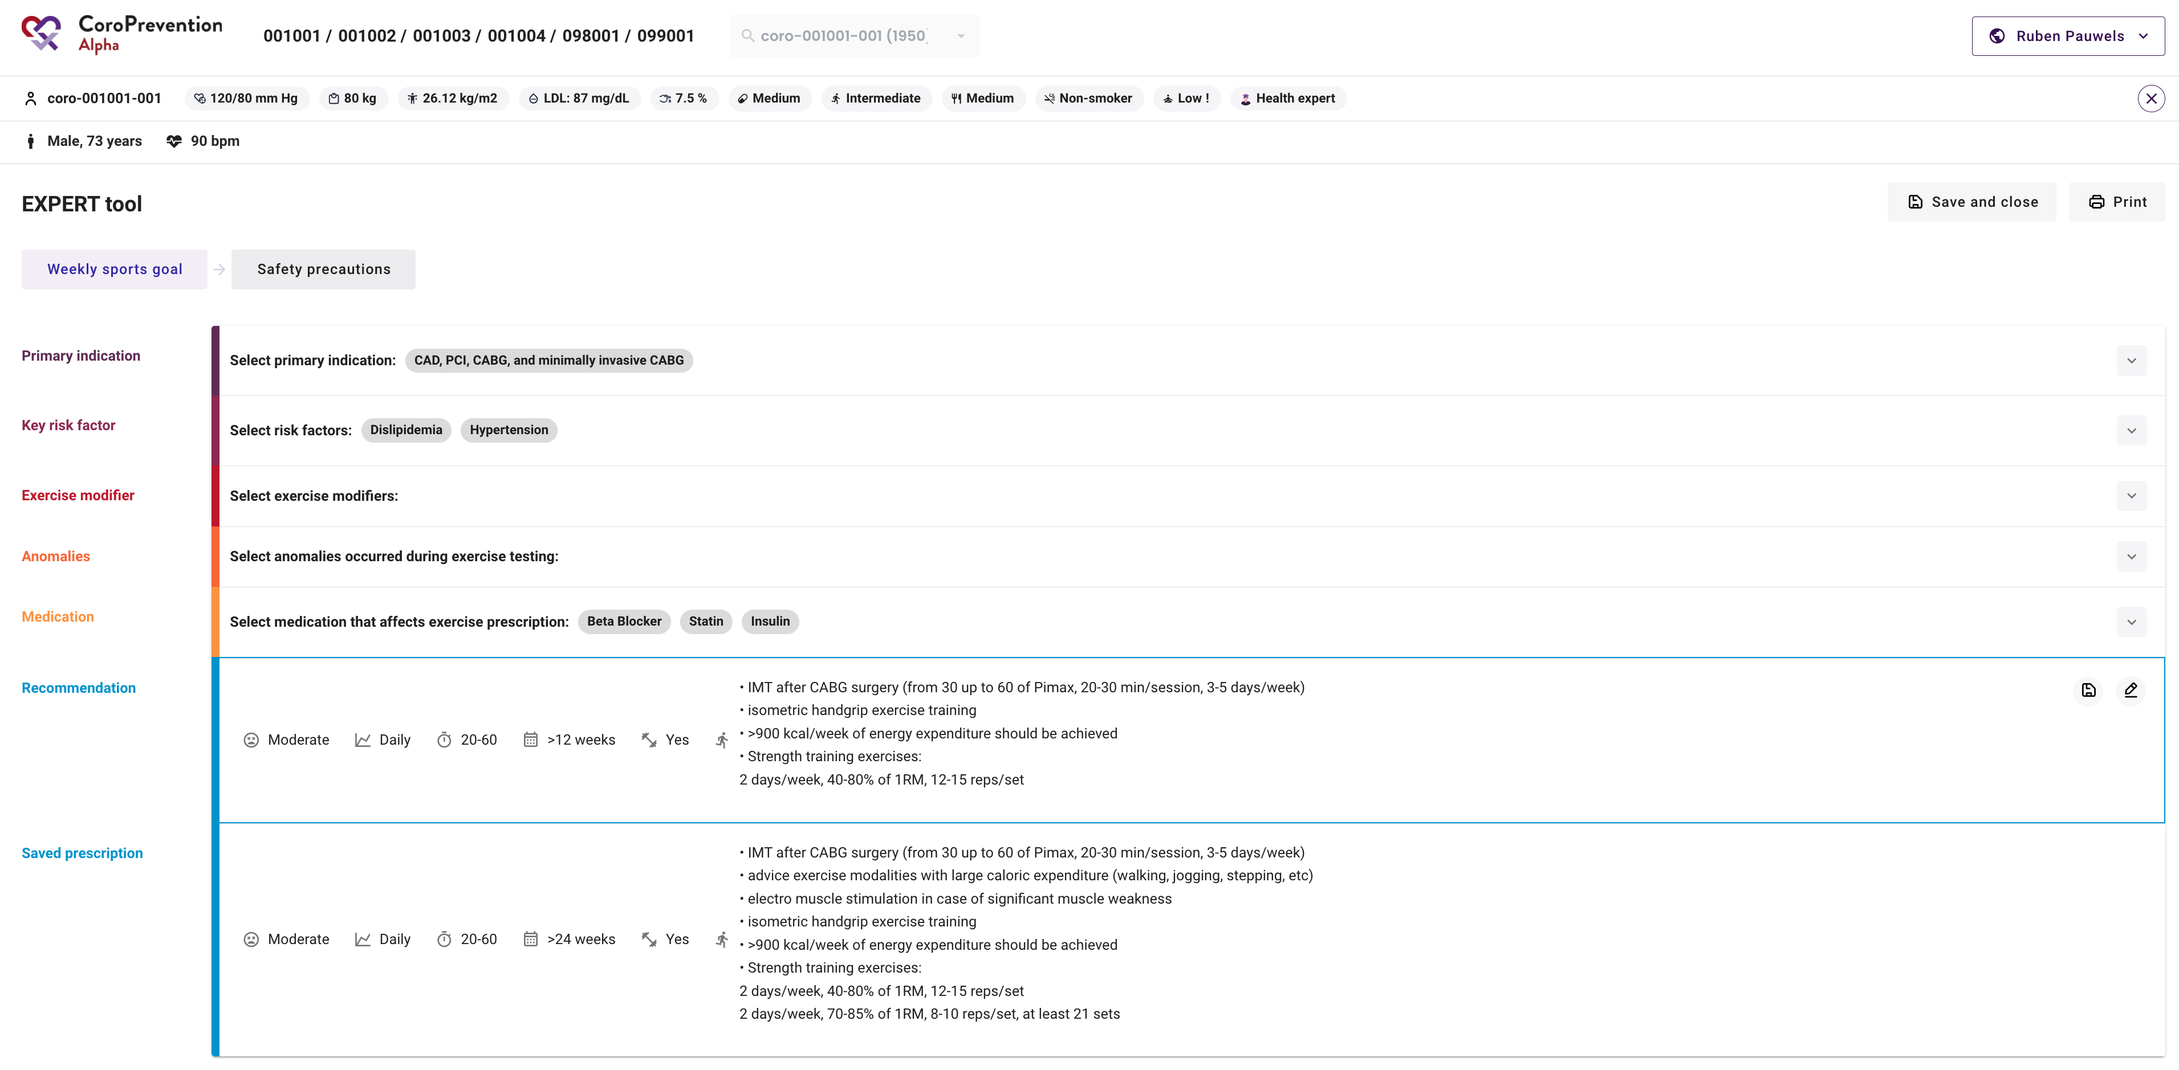
EXPERT tool – Weekly sports goal
Notes:
When you open the EXPERT tool, by default, the “Weekly sports goal” discussion step is shown.
Here you can create a personalized exercise prescription for the patient, which will be transformed for the patient into a weekly sports goal, expressed in calories, in the patient mobile application.

Slide 12
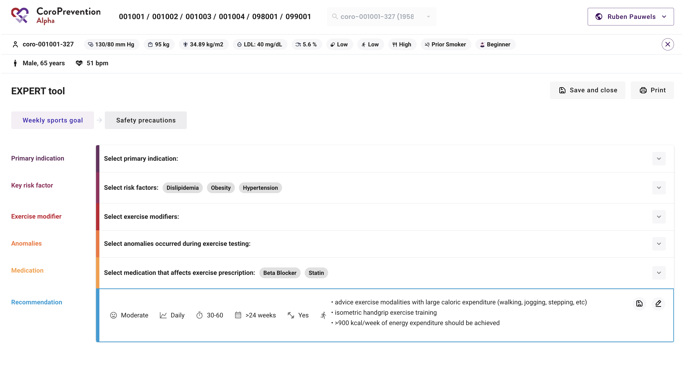
EXPERT tool – Exercise prescription
Select applicable items
Notes:
Let’s see how we can make an exercise prescription for the patient.
First, you will select all the applicable items for the patient.
You will see that some items have already been selected for risk factors and medications. This is because the data from the EDC (at visit 1), the caregiver dashboard and ePRO questionnaires is automatically used.
However, it is important that you always check every selected and unselected item again.
You can start with the primary indication, next the key risk factor, the exercise modifier(s), the anomalies and medication.

Slide 13
EXPERT tool – Primary indication
Medical history:
Arterial hypertension, obesity, hypercholesterolaemia, diabetes mellitus
Shoulder operation in 2015
Elective coronary angiography demonstrating severe 3-vessel disease in 2021
Elective CABG was performed
Notes:
For filling in the primary indication, you have to look at the medical history of the patient.
When we look at the medical history of our example patient, we see that he had an elective angiography in 2021 and subsequently underwent a CABG.
If we then look at the items that we can select as a primary indication, we see that we can select the first item for this patient, namely “CAD, PCI, CABG, and minimally invasive CABG”.
Note that it is allowed to select more than 1 “primary indication”. For example, if this patient also had heart failure, we would select the item “Heart failure (with lowered LVEF) and CMP” as well.
For each primary indication, we can see the recommendation.

Slide 14
EXPERT tool – Primary indication
Intensity
Frequency
Session duration
Programme duration
Strength training
Notes:
For the primary indication “CAD, PCI, CABG, and minimally invasive CABG”, we see that the patient has to train at moderate intensity, for 3 to 5 times a week, each time for 20 to 45 minutes.
The program would last a total of at least 6 to 8 weeks and strength training is recommended.

Slide 15
EXPERT tool – Key risk factor
Risk factors:
Obesity, diabetes, arterial hypertension, hypercholesterolaemia
Prior smoker, currently non-smoker
Low physical activity
Notes:
Next, we move on to the key risk factors.
As mentioned earlier, some of these have already been filled in automatically based on the information already known in the system. Still, you have to look at all the risk factors in the medical history and recheck which ones need to be selected, because sometimes it may be that some risk factors are not automatically selected by the system.
In the case of our example patient, we don’t have to select any additional risk factors.

Slide 16
EXPERT tool – Exercise modifier
Medical history:
Arterial hypertension, obesity, hypercholesterolaemia, diabetes mellitus
Shoulder operation in 2015
Elective coronary angiography demonstrating severe 3-vessel disease in 2021
Elective CABG was performed
Notes:
Then, we move on to the exercise modifier(s).
For this section, we also have to look at the medical history of the patient.
For our example patient, no exercise modifiers are present, so we don’t need to select any item.

Slide 17
EXPERT tool – Anomalies
Notes:
Within the “Anomalies” section, we don’t have to select any items, since these anomalies occur during exercise testing and the patients that participate in the CoroPrevention study do not undergo exercise testing as part of the study.

Slide 18
EXPERT tool – Medication
Notes:
Some of medications that affect exercise prescription are already automatically selected based on the collected in the system. However, not all medications that affect exercise prescription will be known by the system. Therefore, it is important to recheck the selected items by looking at the medication list of the patient (e.g. in the medical records).

Slide 19
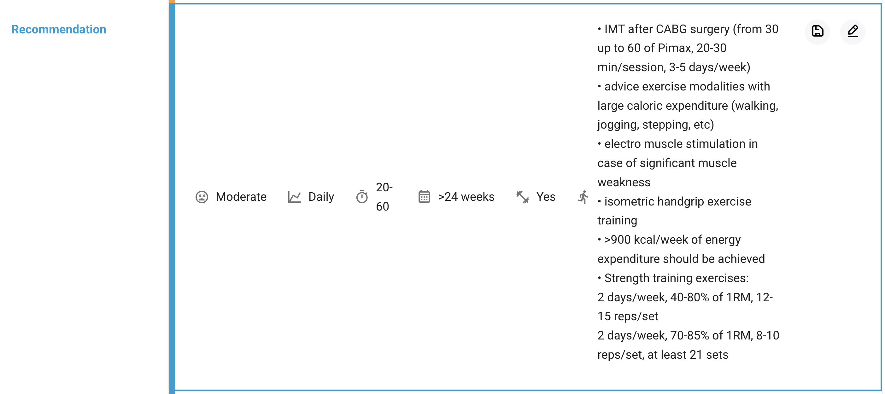
EXPERT tool – Recommendation
Notes:
After selecting all relevant items for the patient in the sections primary indication, key risk factors, exercise modifiers, anomalies and medication, the EXPERT tool generates a personalized recommendation for the exercise prescription for this patient. When you update the selected items in any of the sections, the recommendation is updated automatically.
As we can see here, this patient would have to train at moderate intensity, every day, for 20 to 60 minutes for at least 24 weeks. Furthermore, strength training is recommended. There is also some additional advice for exercise training. During the visit, you can discuss this exercise prescription with the patient.

Slide 20
EXPERT tool – Intensity
Light activity | Feels like you can maintain it for a long time. Easy to breathe and carry on a conversation.
Moderate activity | Feels like you can exercise for a long period, but probably not for hours. Your breathing is somewhat heavier but you are still able to speak in full sentences.
Vigorous activity | Feels like you cannot exercise very long, your breathing is heavy and you are not able to say a full sentence without gasping for extra air.
Notes:
It is important to explain to the patient what light, moderate or vigorous intensity means. For this, you can use the descriptions depicted on this slide.

Slide 21
EXPERT tool – Recommendation
Notes:
Based on your knowledge about the patient or by discussing the exercise prescription with the patient, it might turn out that the exercise prescription is not suited for the patient. In such cases, you can edit the exercise prescription by clicking on the pencil button.

Slide 22
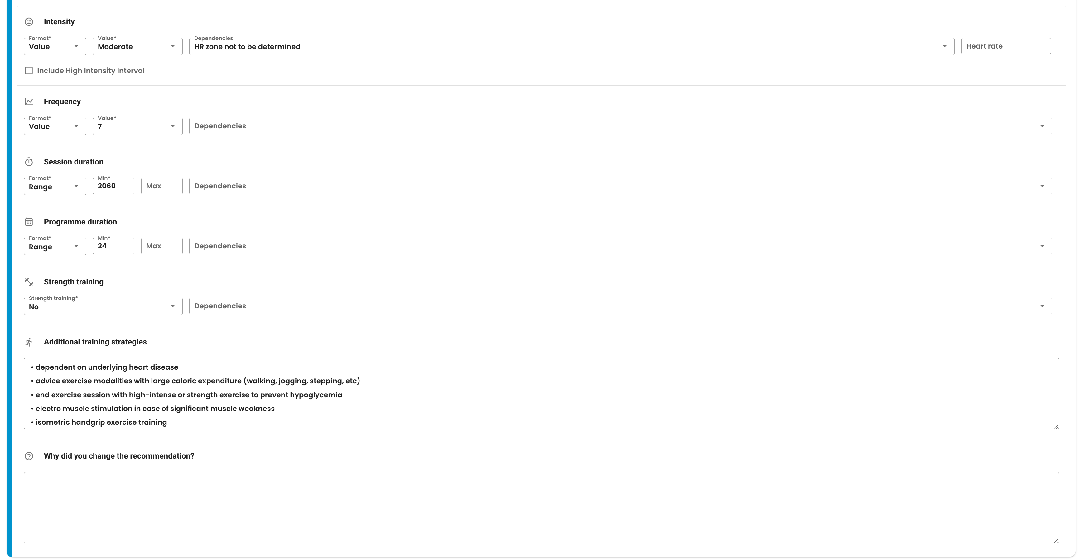
EXPERT tool – Recommendation
Remember to record reason why you made the change
Notes:
You can modify any of the components of the exercise prescription, thus the intensity, frequency, session duration, programme duration, strength training recommendation and additional training strategies.
If you change any of these items, you have to record the reason for the change e.g. because you think the patient is not able to achieve this goal or because the patient mentioned that doing sports daily is not feasible for him.

Slide 23
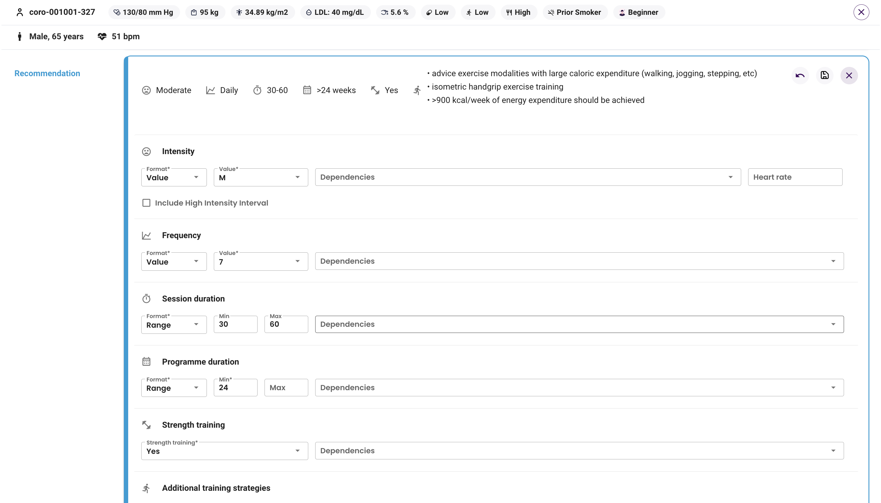
EXPERT tool – Recommendation
At the top, view the recommended prescription
At the bottom, edit the prescription
Notes:
While editing the exercise prescription, you can always compare your edited prescription with the original recommendation that is shown at the top.
You can revert your changes and go back to the original exercise prescription by clicking the “Revert” / “Undo” button. You will be asked to confirm this action.

Slide 24
EXPERT tool – Save exercise prescription
At the top, view the recommended prescription
At the bottom, edit the prescription
Notes:
When you are done updating the exercise prescription, you can click on the “Save” button.

Slide 25
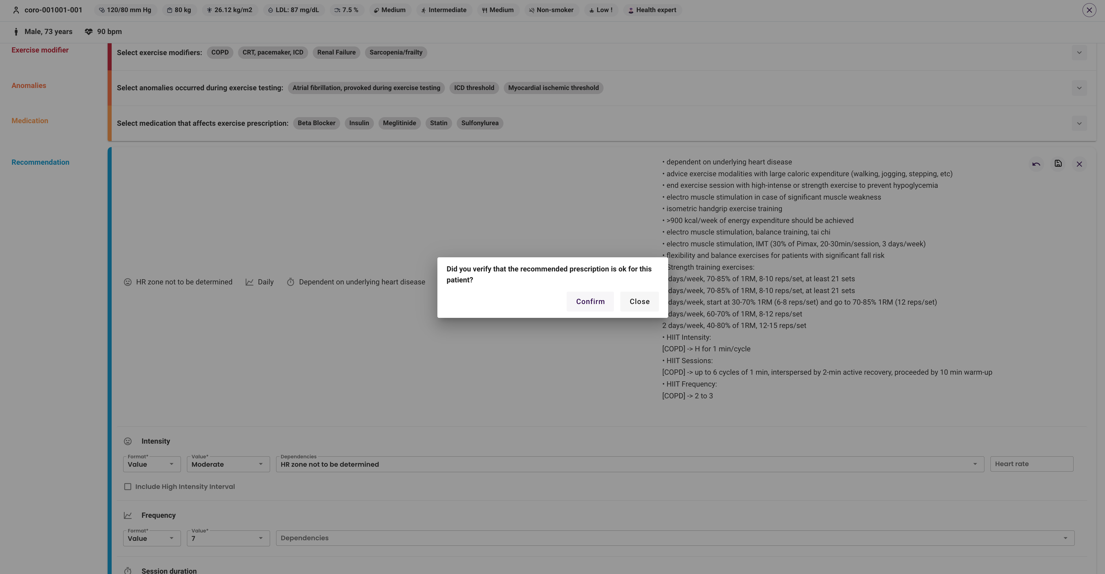
EXPERT tool – Save exercise prescription
Notes:
You will be asked to confirm the changes that you made to the exercise prescription.

Slide 26
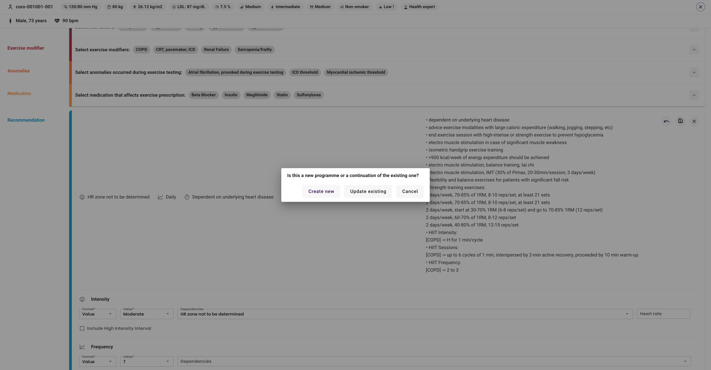
EXPERT tool – Save exercise prescription
Notes:
From the second time onwards, when you save a recommendation for a patient, you will have to choose between starting a new training program or a follow up recommendation that is considered part of the last (ongoing) training program. This decision will not have any influence on the exercise training recommendation as such. Considering a recommendation as the beginning of a training program or not has only informative purposes.

Slide 27
EXPERT tool – Saved prescription
Notes:
When you saved an exercise prescription at least once, you will always see the “Recommendation” and the “Saved prescription”.

Slide 28
EXPERT tool – Print
Notes:
You can print the “Saved prescription” by clicking the ”Print” button. Any changes that you made to the exercise prescription but that were not yet saved will not yet appear in the printed PDF.

Slide 29
EXPERT tool – Save and close
Notes:
When you are done updating the exercise prescription and want to save the edits and leave the EXPERT tool, you can click the “Save and close” button.
Alternatively, you can also close the EXPERT tool (with or without saving the exercise prescription) by clicking on the cross icon.

Slide 30
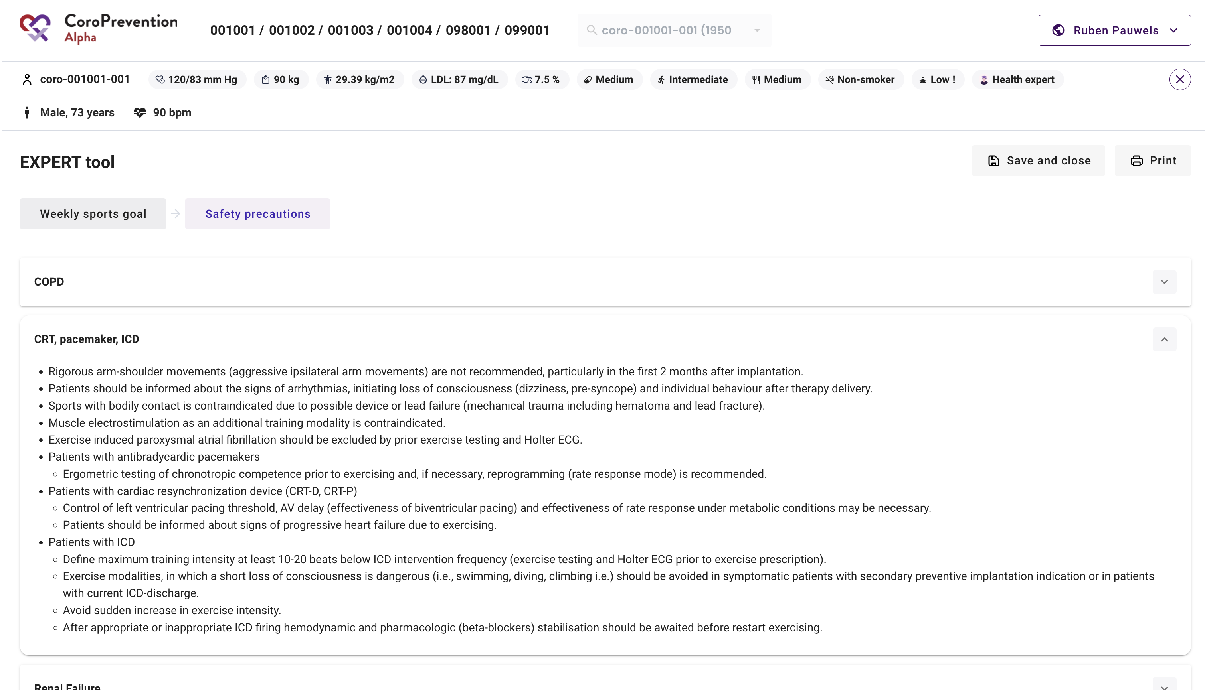
EXPERT tool – Safety precautions
Notes:
So far, we have focused on the “Weekly sports goal” discussion step.
Now we will have a brief look at the “Safety precautions” discussion step.
During the visit, you can briefly go over the safety precautions with the patient. The safety precautions contain quite some abbreviations, which might not be immediately clear to you. To help you with this, you will receive a list that explains these abbreviations, so it is easier to convey the relevant information to the patient.
Note that the safety precautions depicted in this screen are based on the latest saved exercise prescription. Make sure to always save the edits to the exercise prescription before discussing the relevant safety precautions with the patient.

