Slide 1
Introduction to the Healthy Nutrition module: smartphone application and caregiver dashboard
Notes:
Welcome in this webinar, we will have a look at the CoroPrevention healthy nutrition module in the smartphone application and the caregiver dashboard.

Slide 2
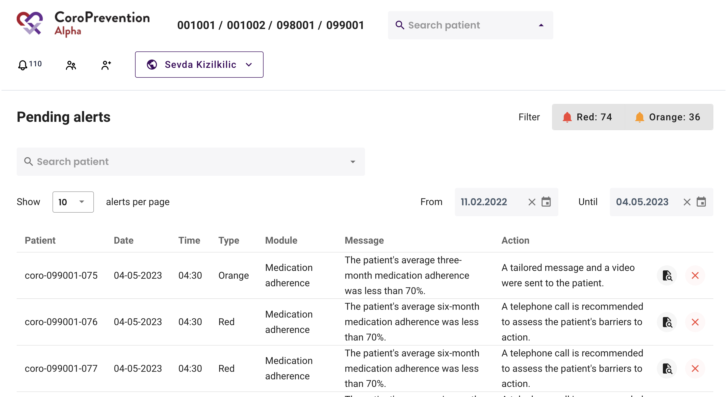
Open the Healthy Nutrition module
Notes:
How to open the healthy nutrition module in the caregiver dashboard?
- what you have to do first is enter the patient's subject id in the 'search patient' field.

Slide 3
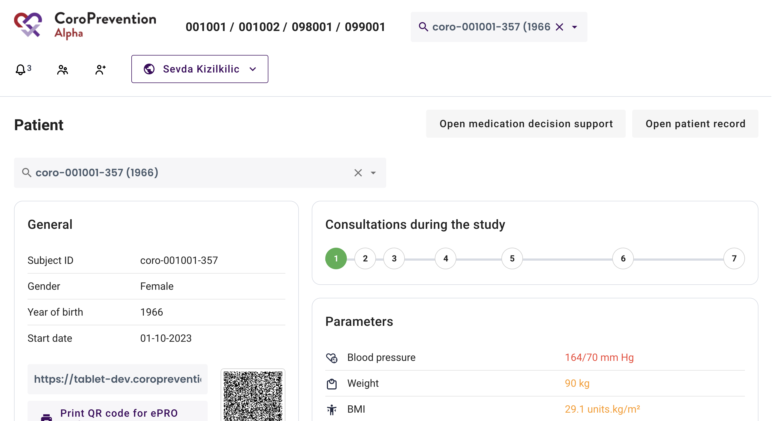
Open the Healthy Nutrition module
Notes:
Thereafter, click on ‘Open patient record’

Slide 4
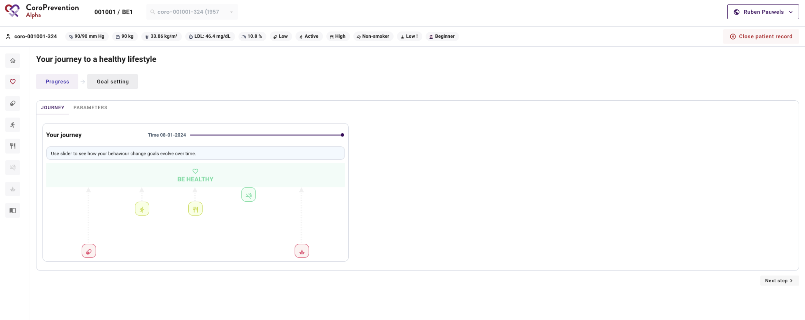
Open the Healthy Nutrition module
Notes:
In this tab, you can find the journey to a healthy lifestyle.
The behavioural goal ‘healthy nutrition’ is shown by a spoon and fork in this screenshot. The higher this icon and the greener it is, the better the healthy nutrition is and the better the healthy nutrition goal is achieved. The lower this icon and the more red it is, the less the healthy nutrition goal is achieved.

Slide 5
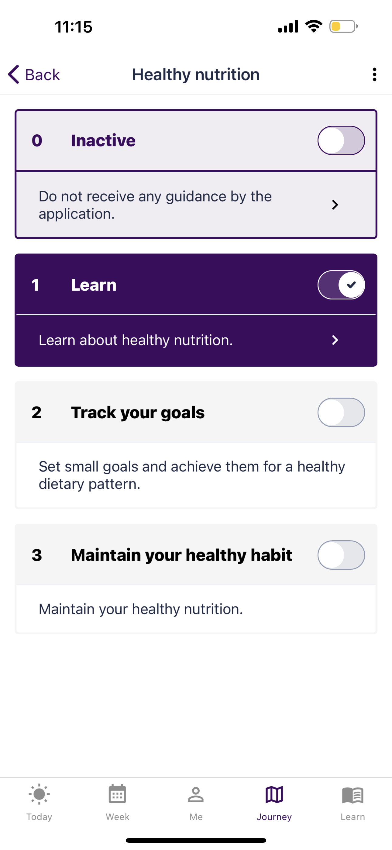
Journey
Learn: The application encourages the patient to eat healthy through several features
Track your goals: getting support to improve the nutrition
Maintain your healthy habits: maintain the healthy nutrition
Notes:
Here, we are looking at the smartphone application.
If the patient goes to the journey tab, he/she will see 4 levels of guidance for healthy nutrition.
If the patients is on level of guidance ’inactive’, he/she will not receive any guidance by the application for healthy nutrition.
If the patient is on level of guidance ’learn’, the application will encourage the patient to eat more healthy.
If the patient is on level of guidance 'track your goals', the patient will get support to improve his/her nutrition.
And last, if the patient is on level of guidance 'maintain your healthy habits', he/she will get support to maintain healthy nutrition by general features and reporting the healthy nutrition, similar to the "Track your goals" level.
Which level of guidance the patient has chosen can be found in the journey goal-setting tab of the caregiver dashboard.

Slide 6
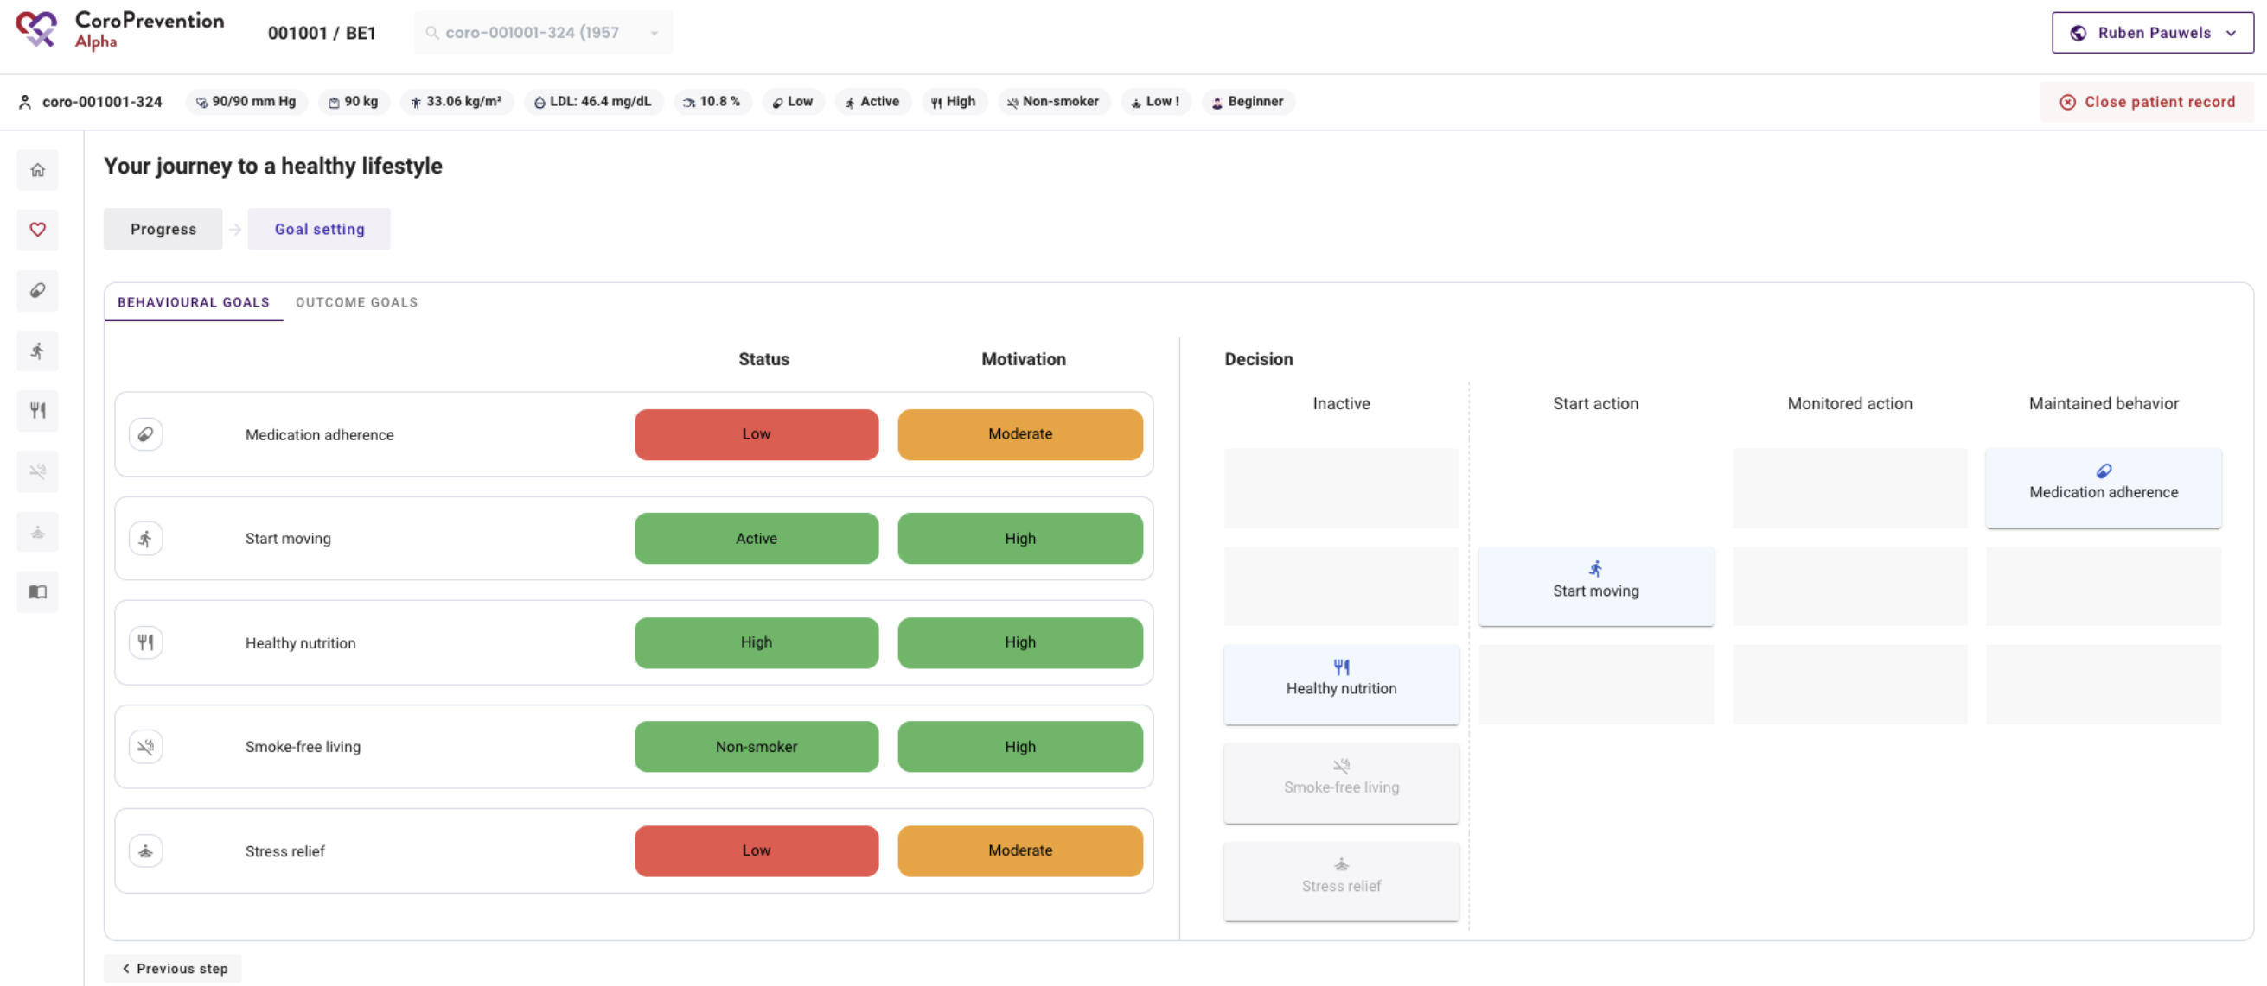
Notes:
If you go to the journey tab --> goal setting --> behavioural goals in the caregiver dashbord, you will see the different levels of guidance for the different modules.
In this case, the patient is for the healthy nutrition module on the level of guidance 'inactive’.
Furthermore, you can see how the patient's status and motivation is for this goal. Since the patient is highly motivated, we could consider moving the patient to another level of guidance.

Slide 7
Journey: Learn
Start action: Learn
The application encourages the patient to eat healthy through several features
General features
Notes:
If the patient goes to the journey tab and he/she is in level of guidance ’learn’, the application will encourage the patient to eat healthy through several general features.
The general features are the same as in start moving level of guidance 1. The patient focuses than on educational content, reflective tasks and quizzes to increase his/her knowledge and prepare to eat more healthy

Slide 8
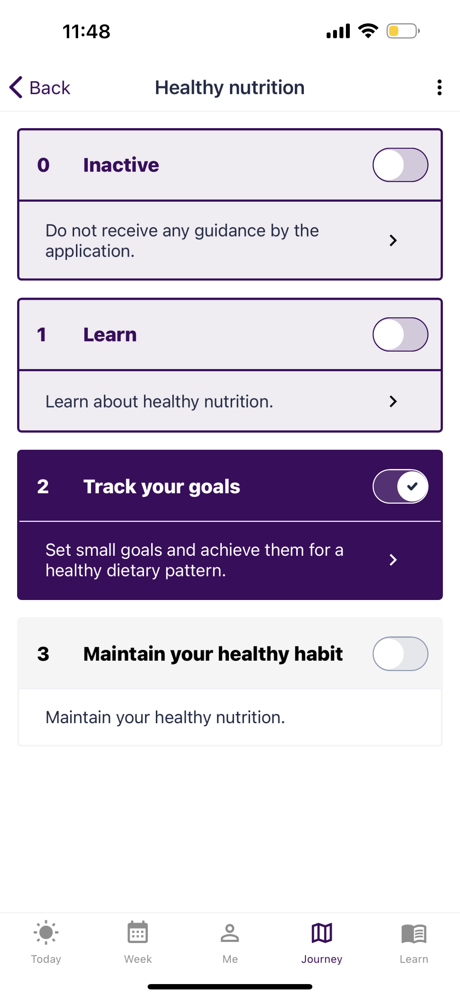
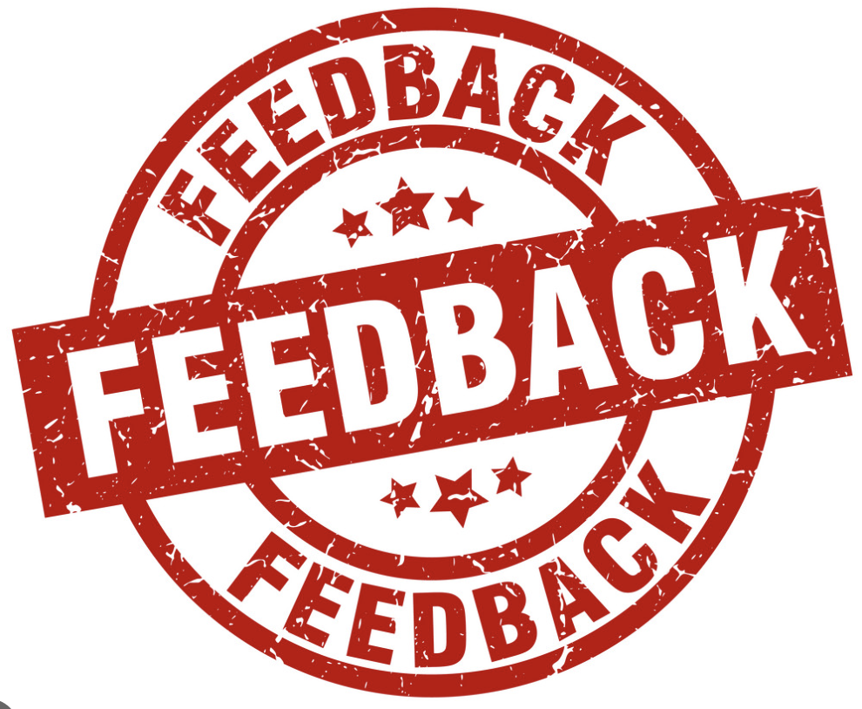
Journey: Track your goals
Monitored action: Track your goals
The patient will get support to improve his/her nutrition by:
Reporting the Nutrition- score
Feedback on the Nutrition- score
Goal-setting for healthy nutrition
Notes:
If the patient wants to go further to the next level of guidance, he/she has to slide the button next to 'track your goals' to the right. The patient is now at the level of guidance ’track your goals’.
Now he/she will get support to improve his/her nutrition by: reporting the Nutrition score, Feedback on the nutrition score and goal-setting for healthy nutrition.
The explanation of the nutrition score will be provided on the next slide.

Slide 9
What is the Nutrition-score?
The MedDietScore: how adherent is a person to the Mediterranean dietary pattern (11 food groups: non-refined cereals, fruit, vegetables, legumes, potatoes, fish, meat and meat products, poultry, full fat dairy products, olive oil and alcohol intake)
Nutrition-score: how heart-healthy is a person eating. Calculated by looking at how much the person consumes of each of the food groups.​
Based on MedDietScore with key updates:
→ MedDietScore: drinking no alcohol is same as drinking over 700ml; Nutrition-score: drinking no alcohol is good and contributes to better
→ Update of the food groups (Nordic diet)
→ Addition of salt and sugar as two additional food groups
Nutrition-score of 100%: best a person can achieve (but.. this is hard to achieve) → patient is to aim to get as close as possible to 100%.
3
Notes:
Before we go over the details of the healthy nutrition, I will give a brief explanation of the MedDietScore and Nutrition-score.
The MedDietScore assesses how adherent a person is to the Mediterranean dietary pattern. It assesses the person’s nutrition intake for 11 food groups: non-refined cereals, fruit, vegetables, legumes, potatoes, fish, meat and meat products, poultry, full fat dairy products, olive oil and alcohol intake.
For CoroPrevention, we developed the Nutrition-score (based on the MedDietScore). The Nutrition-score indicates how heart-healthy a person is eating. The key updates made to the MedDietScore to arrive at the Nutrition-score are the following:
Update of the scoring protocol for alcohol intake. In the MedDietScore calculation, drinking no alcohol gives the same score as drinking over 700ml alcohol. In the Nutrition-score drinking no alcohol is considered good and contributes to better (higher score).
Update of the food groups to also cover alternatives that are more available in Nordic countries (ref. Nordic diet).
Addition of salt and sugar as two additional food groups.
The Nutrition-score is calculated by looking at how much the person consumes of each of the food groups.​
A Nutrition-score of 100% is the best a person can achieve. However, it is hard to achieve to get to this 100%. The patient is to aim to get as close as possible to 100%.​
Note that at the visits with the case nurse, the patient completes the MedDietScore questionnaire and two extra questions for sugar and salt in the ePRO application. The scoring protocol from the MedDietScore is used there. Whereas, in the mobile app, the patient completes the Nutrition-score questionnaire, which is a similar questionnaire as in the ePRO but the phrasing is adapted so it is easier for the patient to fill in the questions and the scoring protocol is updated.

Slide 10
Open the Healthy Nutrition module
Notes:
In the next step in the caregiver dashboard, you have to open the healthy nutrition module by clicking on the healthy nutrition icon, shown on the left by a spoon and fork.

Slide 11
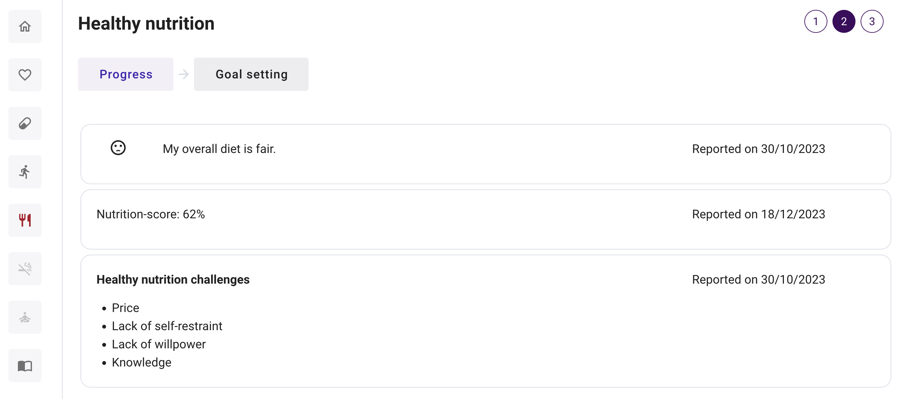
Open the healthy nutrition module
Notes:
As a key part of healthy nutrition, we have the ‘progress’
In ”Progress", there is an overview of the patient’s current nutrition, as reported in the ePRO application and in the patient mobile app.
On the right you can see when these were reported.
In this case:
- The overall rating of the patient’s diet is fair.
- The Nutrition-score, as explained in the previous slide, is expressed as a percentage and is in this case 62%. It is important that you draw attention towards possible discongruencies between self-rated diet and the nutrition-score.
- And last, you can see which challenges the patient reported as hindering him/her in eating healthy: the challenges for this patient are: price, lack of self-restraint, lack of willpower and knowledge. It is important to discuss these challenges with the patient.

Slide 12
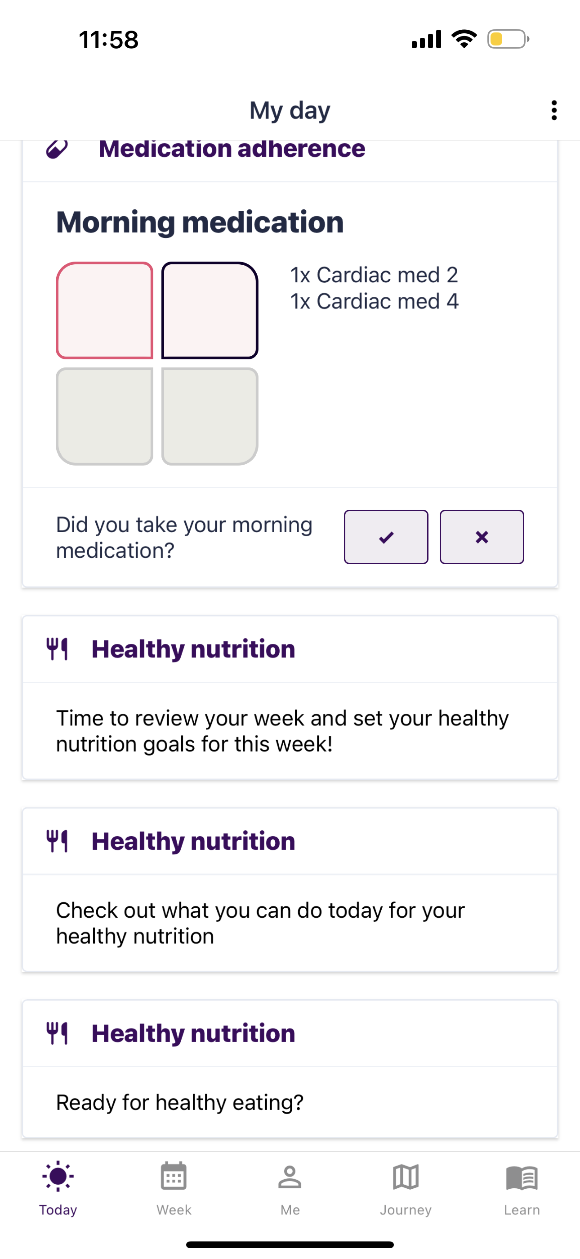
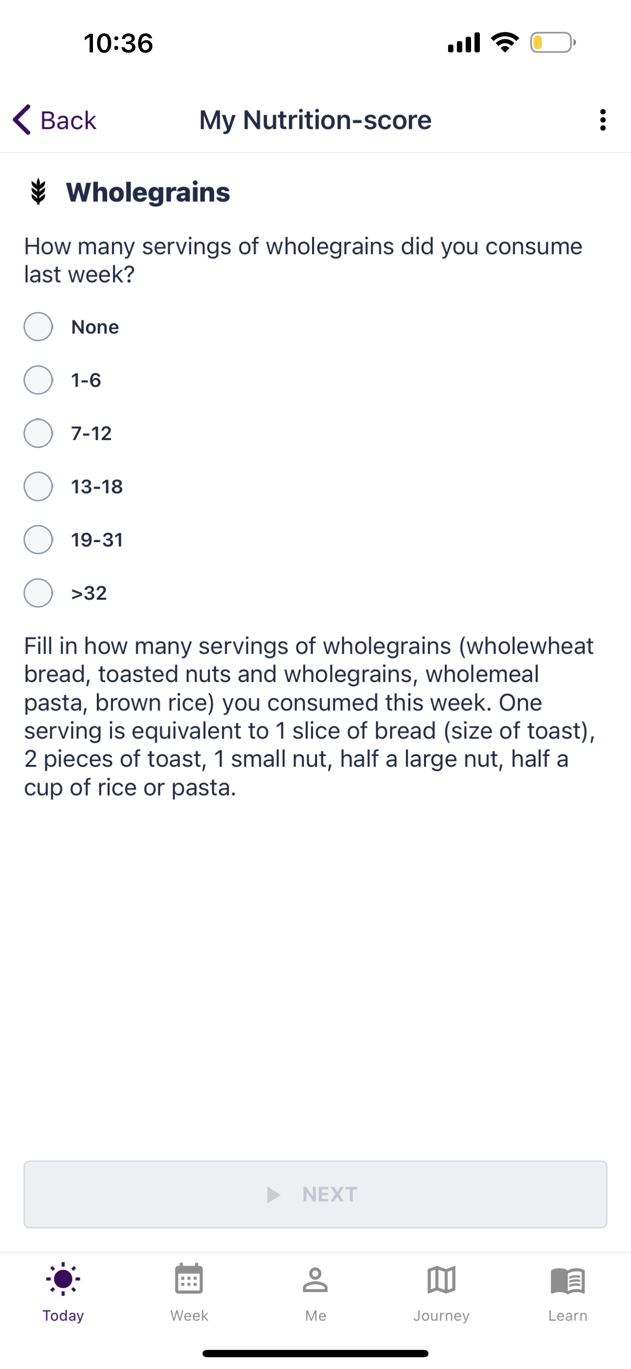
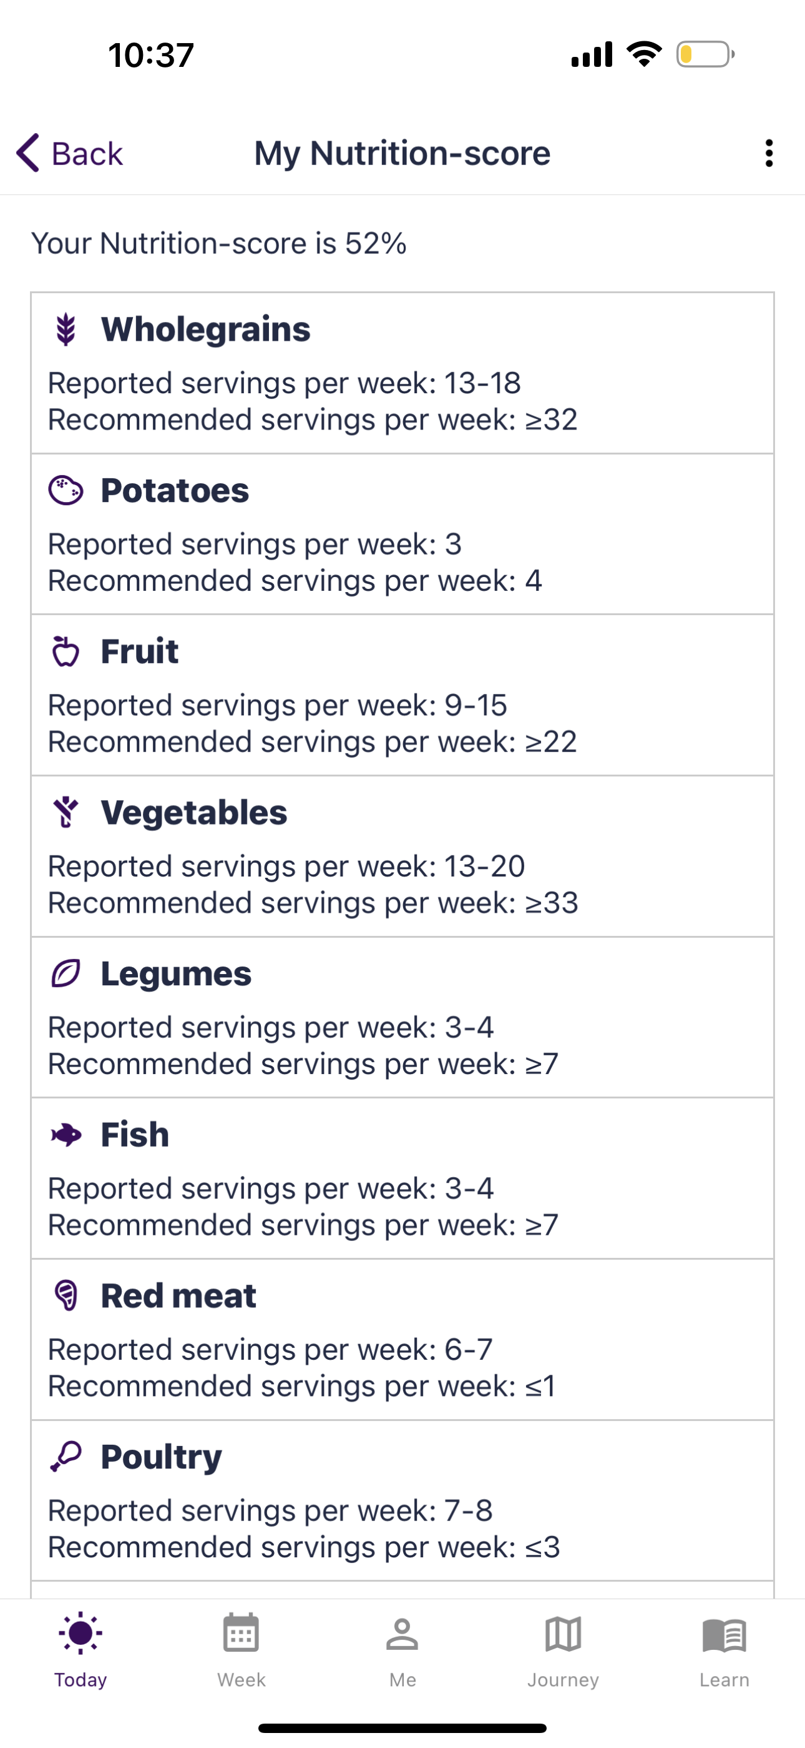
Reporting the Nutrition-score
Notes:
The patient is able to fill in the Nutrition-score in the mobile application by clicking on the reminder in the ‘My day’ screen, namely “Time to review your week and set your healthy nutrition goals for this week”, as shown by the arrow pointing on the left of the side.
Note that this reminder will only appear if the patient is in level of guidance ‘track your goals’.
Note also that at the visits with the case nurse, the patient completed a similar questionnaire on the tablet. However, in the mobile app, the phrasing is adapted so it is easier for the patient to fill in the questions.
Each week, the patient will report on your Nutrition-score (i.e. what he/she ate last week). This information will be used to give the patient feedback on the eating habits.
When filling in the questions, the patient has to think about last week as starting on Monday and ending on Sunday.
There is some additional information available on how to fill in the questions.

Slide 13
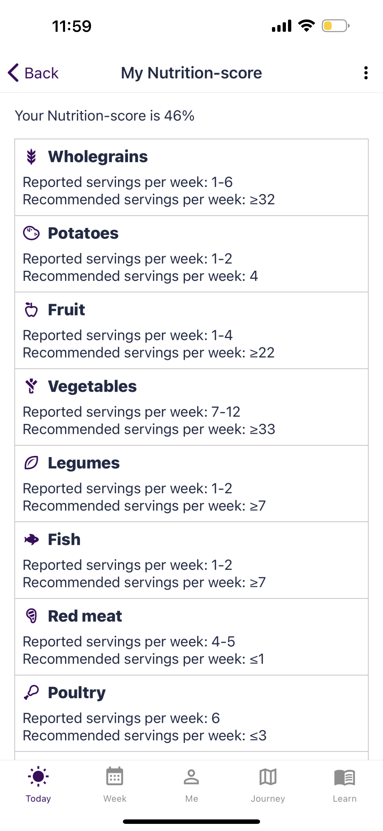
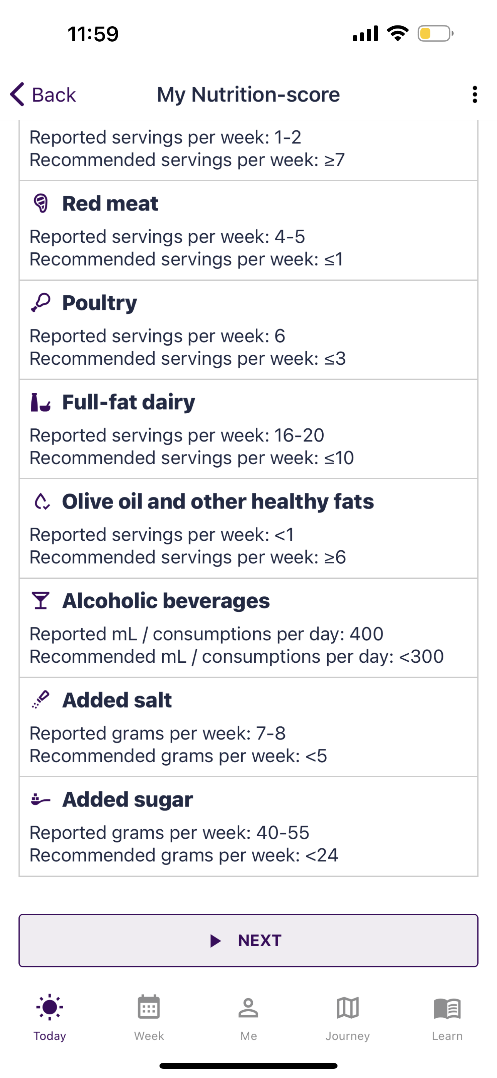
Feedback on the Nutrition-score
Nutrition-score: expressed as a percentage
Nutrition-score of 100%: best a person can achieve (but.. This is hard to achieve) → patient is to aim to get as close as possible to 100%.
For each food group, the patient can compare his/her reported value with the recommended value.
The patient should aim to get to the recommended ranges for all food groups.
Food groups for which the patient does not achieve the recommended range yet are good candidates for goals for next week.
Notes:
After filling in the questions, the patient will get a Nutrition-score. In this case, we have a Nutrition-score of 46%. As mentioned in the previous slide: A Nutrition-score of 100% is the best a person can achieve. However, it is hard to achieve to get to this 100%. The patient is to aim to get as close as possible to 100%.​
For each food group, the patient can compare the reported value with the recommended value.
You should aim to get to the recommended ranges for all food groups.
Food groups for which the patient does not achieve the recommended range yet are good candidates for the goals for next week.

Slide 14
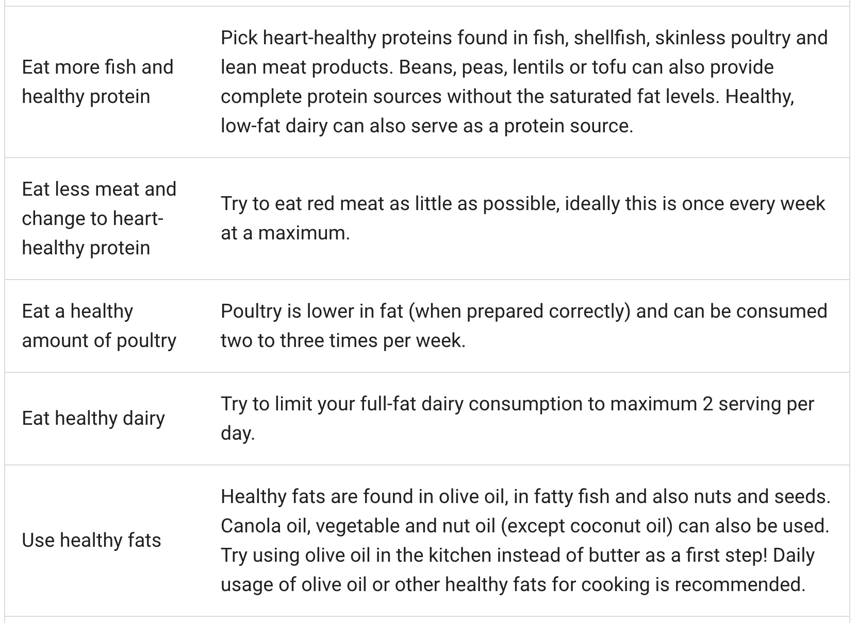
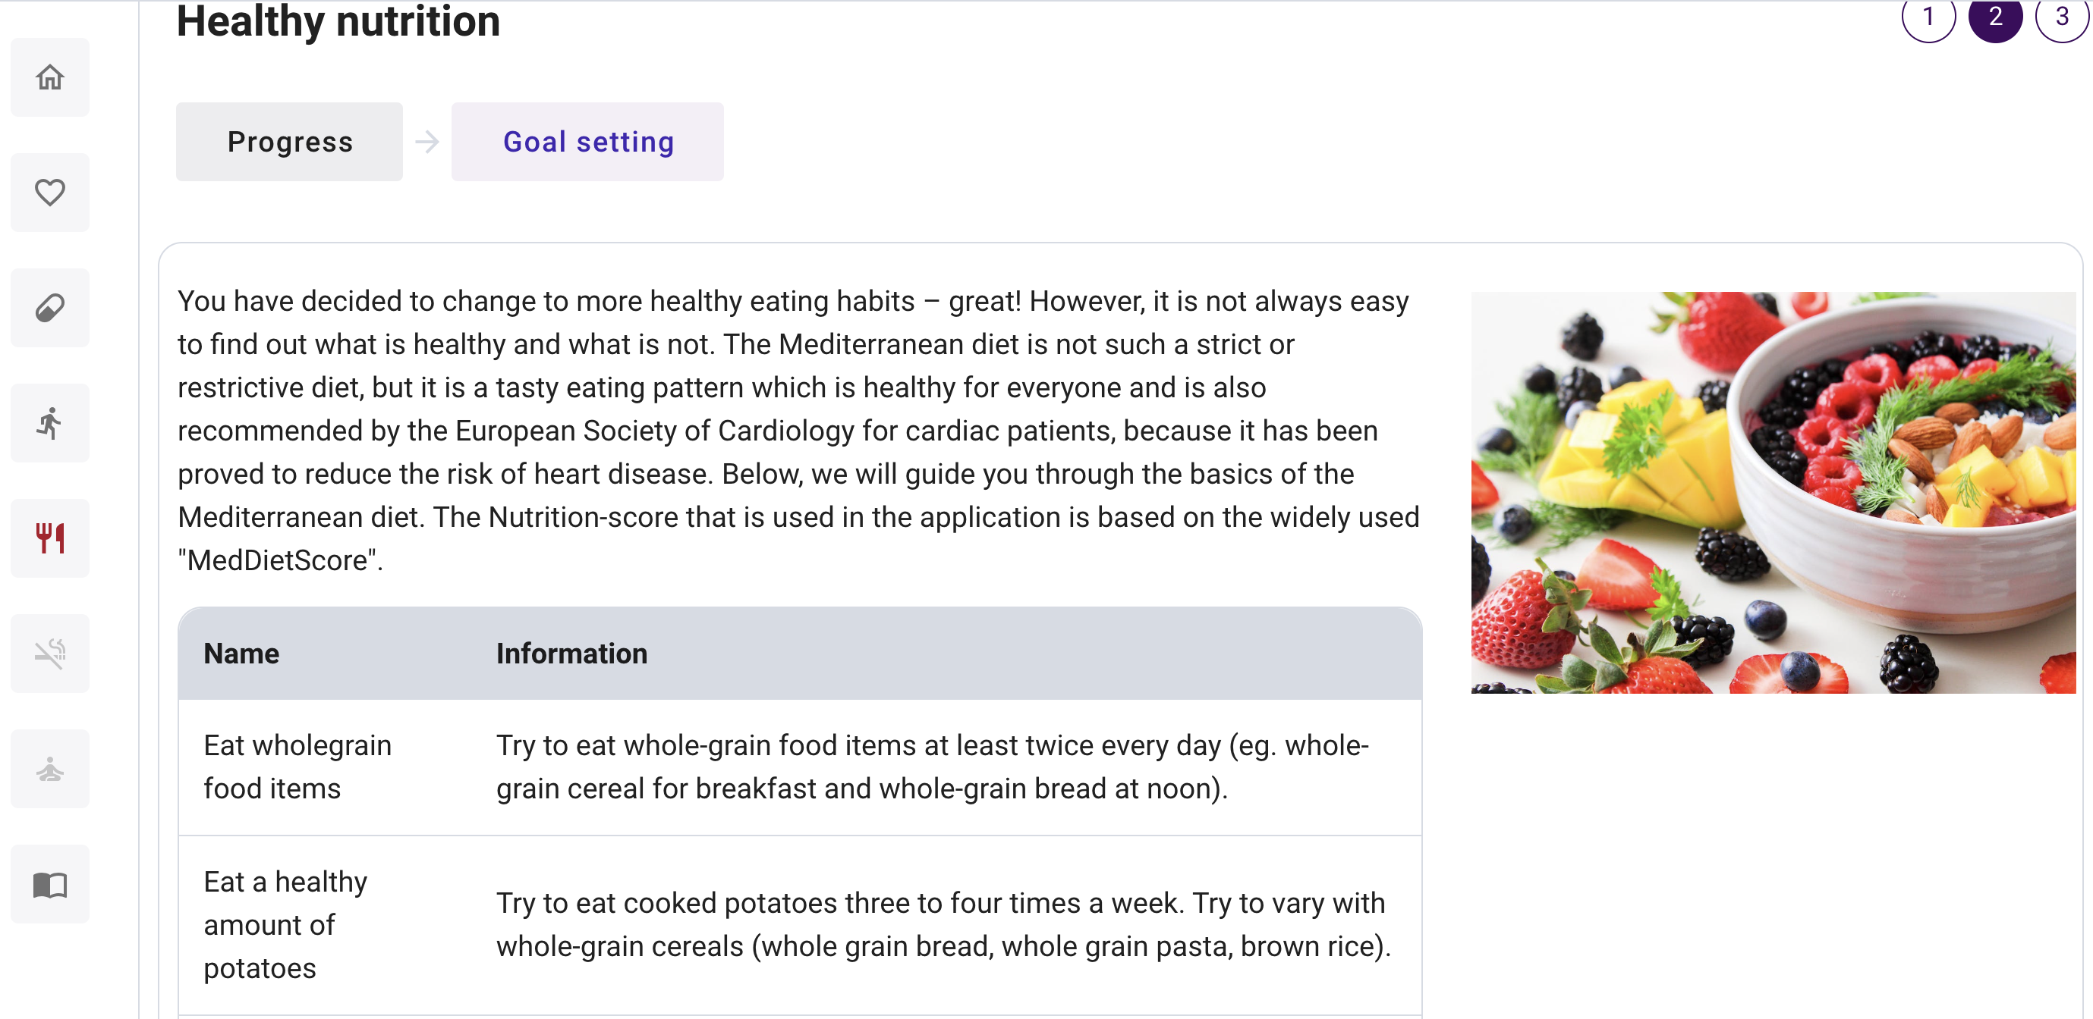
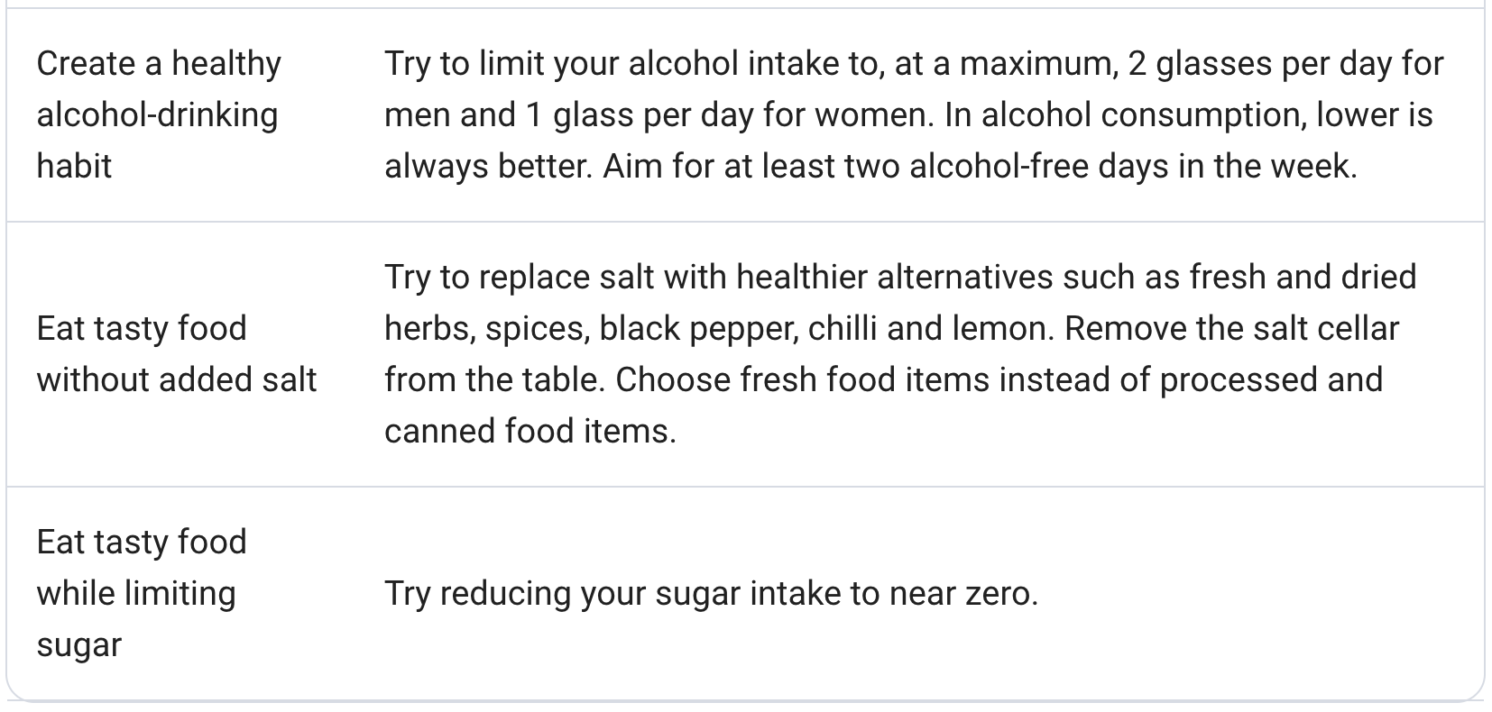
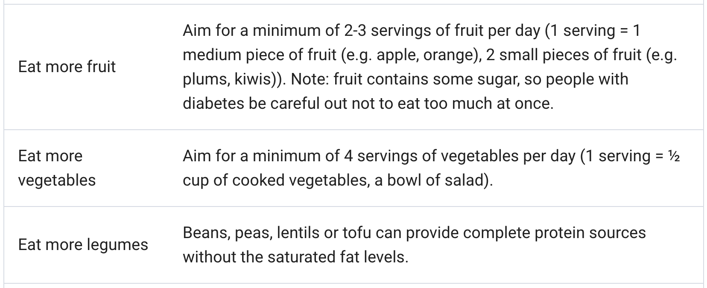
Goal setting
Notes:
Further, go to the ‘goal setting’ discussion step in the caregiver dashboard.
In "Goal setting", you can discuss the patient's goals for a healthy nutrition. Instruct the patient to update the goals in the mobile app on a weekly basis when actively working on healthy nutrition. To instruct the patient, go to ‘progress’ on the caregiver dashboard (shown in the previous slide) and discuss the challenges that were shown and give some tips on how to set good goals for it. Also, you can ask the patient what he/she eats and then suggest some suiting goals.
The text in this screenshot gives a brief explanation of the Mediterranean diet.
The table provides detailed information about the goals to adhere to the Mediterranean or Nordic diet, where the focus is on eating more wholegrain food items, a healthy amount of potatoes, more fruit, more vegetables, more legumes, more fish and healthy protein, less meat and change to heart-healthy protein, a healthy amount of poultry, healthy diary, healthy fats, healthy alcohol drinking habit, tasty food without added salt and tasty food while limiting sugar.

Slide 15
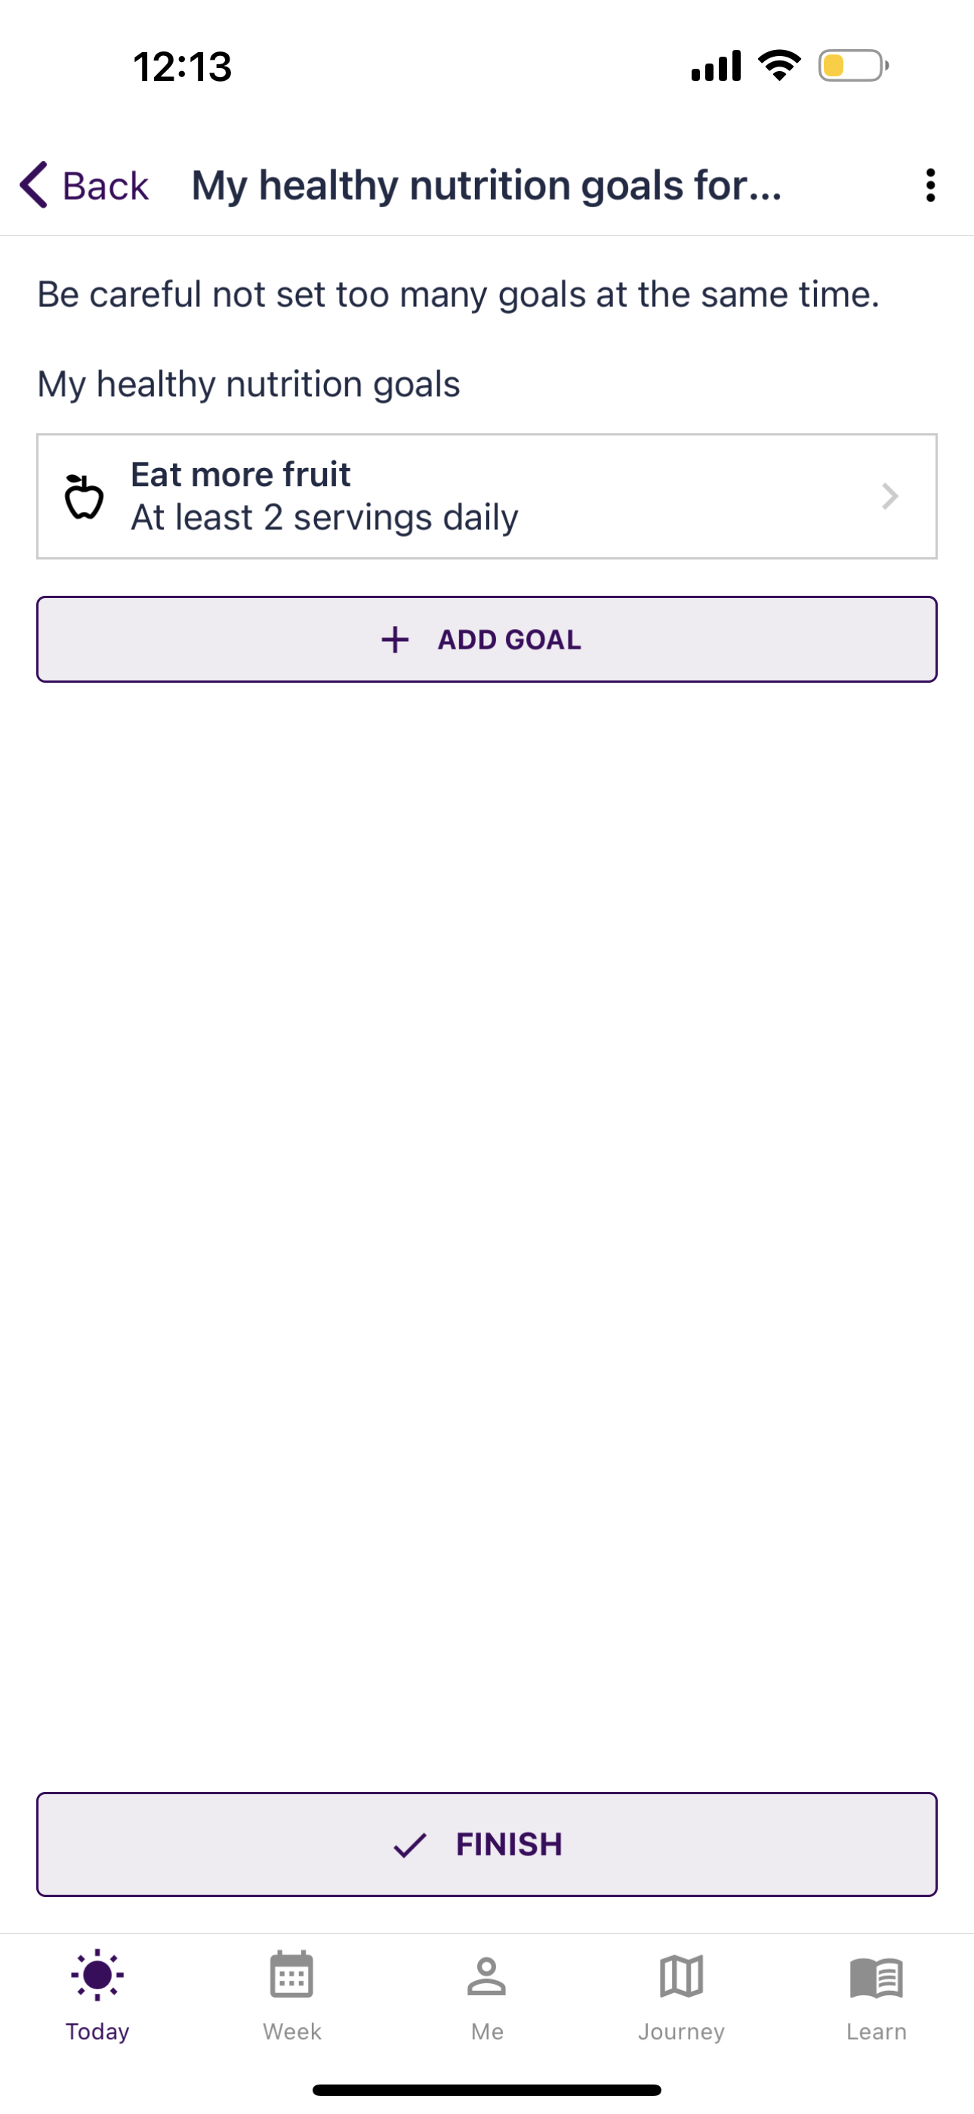
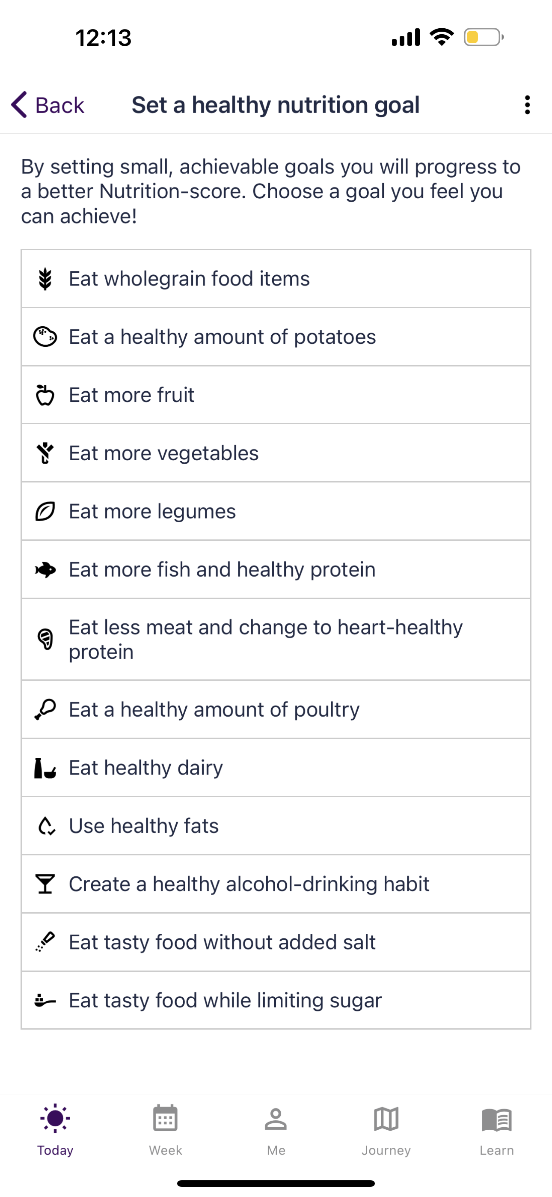
Goal-setting for healthy nutrition
Every Monday morning, the patient gets a reminder to review the past week and set his/her goals for the upcoming week.
Each week, the patient can set one or multiple healthy nutrition goals by choosing from the pre-defined goals.
Each goal is related to a Nutrition-score food group.
The patient can set as many healthy nutrition goals as he/she wants, but at least one goal needs to be defined.
Each week, the patient starts from the goals of last week.
Notes:
Every Monday morning, the patient gets a reminder to review the past week and set the goals for the upcoming week.
Each week, the patient can set one or multiple healthy nutrition goals by choosing from the pre-defined goals.
Each goal is related to a Nutrition-score food group.
The patient can set as many healthy nutrition goals as you want, but at least one goal needs to be defined.
Each week, the patient starts from the goals of last week.

Slide 16
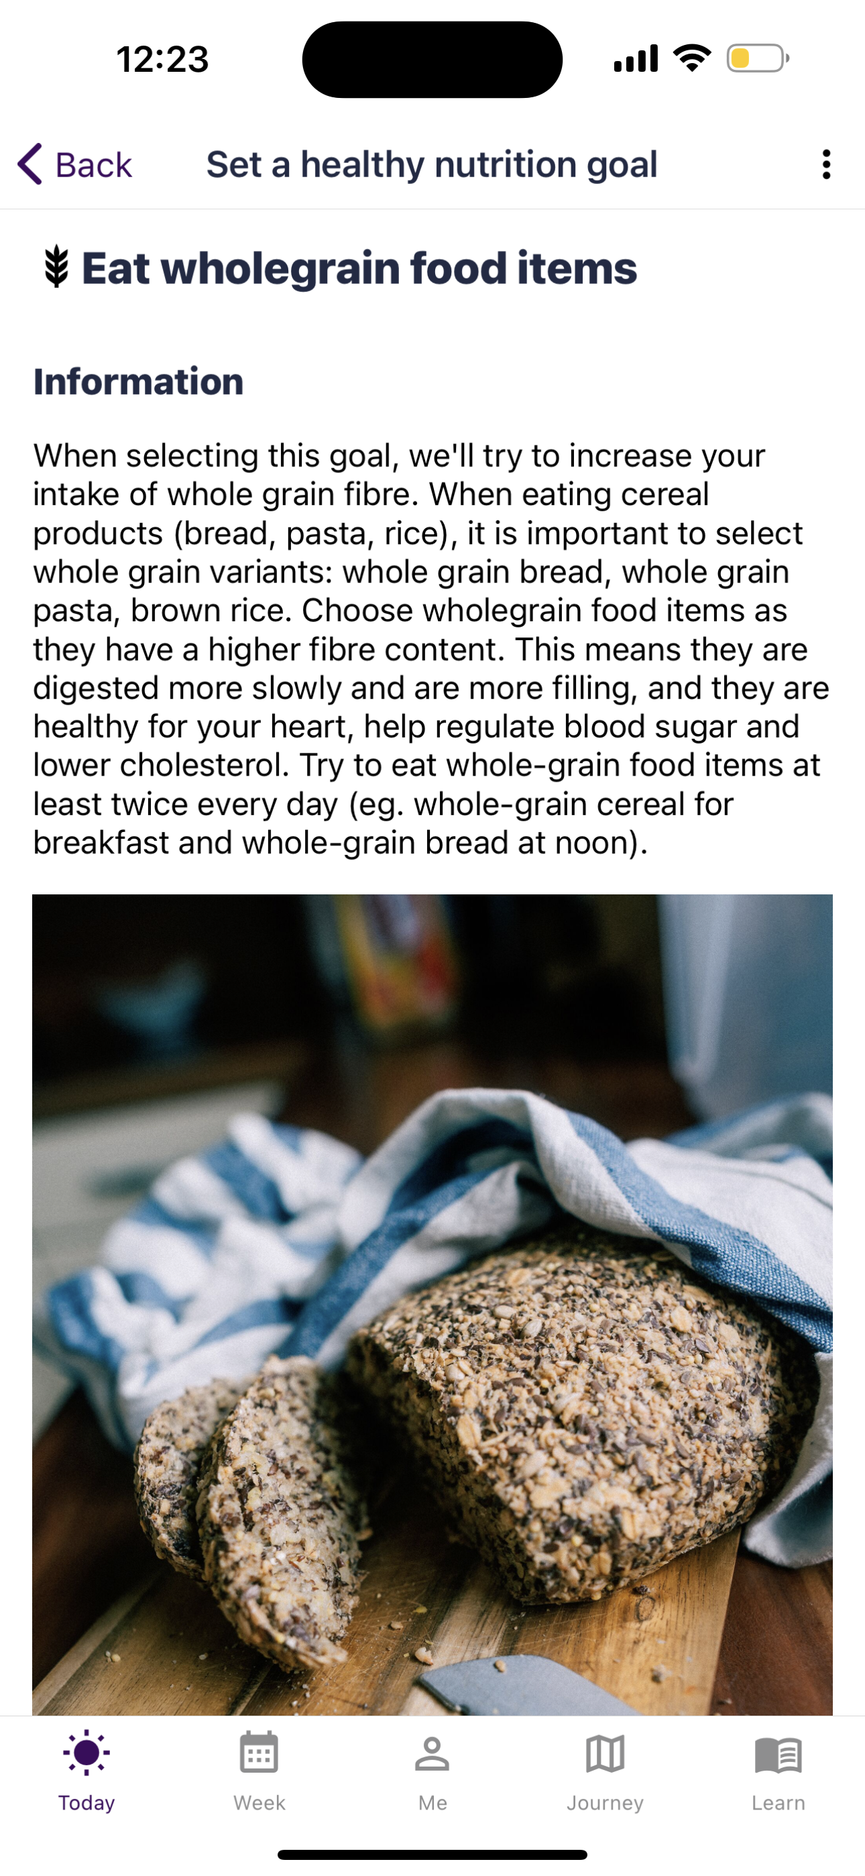
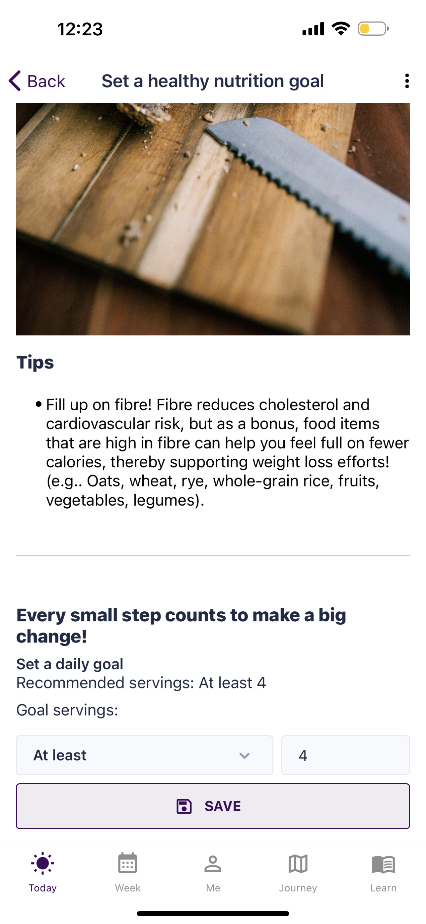
Goal-setting for healthy nutrition
The patient can add, edit and delete goals as he/she wants.
Mention to the patient that it is important to eat food products that are suitable for him/her. In case of doubt about nutritional advice or quantities of food, the patient should talk about this with his/her doctor or case nurse.
!
Notes:
If the patient clicks on one of the goals that are mentioned in the previous slide, he/she will get these screens in the app.
This is an example by clicking on the goal ‘eat wholegrain food items’.
Atthe top, the patient will get more information and tips about the goal, by scrolling down, he/she can easily add, edit and delete goals as wanted.
At last, click on ‘save’.
NB: Eat food products that are suitable for you. In case of doubt about nutritional advice or quantities of food, talk about this with your doctor or case nurse.

Slide 17
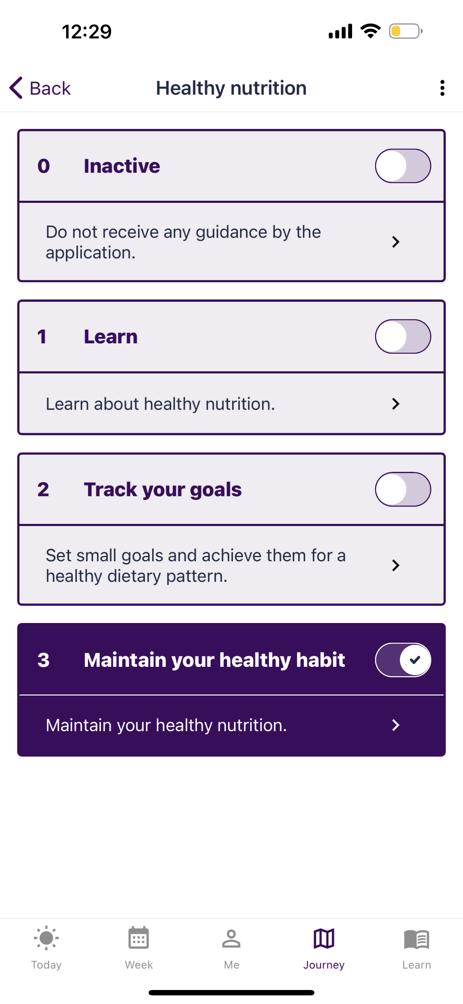
Journey: Maintain your healthy habit
Monitored action: Maintain your healthy habits.
The patient will get support to maintain healthy nutrition by:
General features
Monitoring the Nutrition-score
Notes:
At last, if the patient wants to go further to the next level of guidance, he/she has to slide the button next to ’maintain your healthy habits' to the right. The patient is now in the level of guidance to ’maintain your healthy habits’.
After that, the patient will get support to maintain your healthy nutrition by general features and monitoring the healthy nutrition, similar to the other level of guidances.
Regarding the general features: The patients focuses than on educational content, reflective tasks and quizzes to increase the knowledge and maintain a healthy nutrition.
Regarding the monitoring of the nutrition-score, this is done on monthly basis

