Slide 1

General introduction to the CoroPrevention Tool Suite
Version December 2024

Slide 2




Components of the CoroPrevention Tool Suite
Caregiver dashboard to support shared decision making during encounters
ePRO application to collect patient preferences
Decision Support Systems to support caregivers in prescribing for their patients
Mobile application to support the PPP of the patient

Slide 3
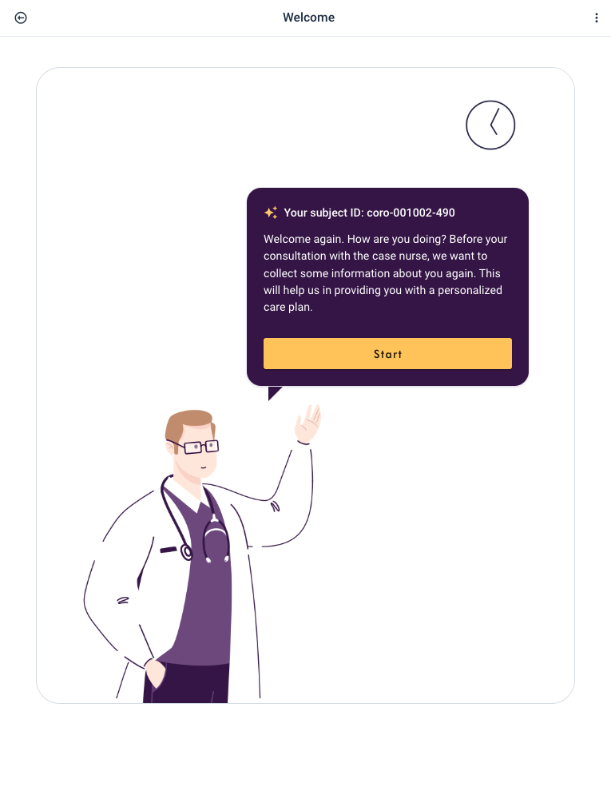
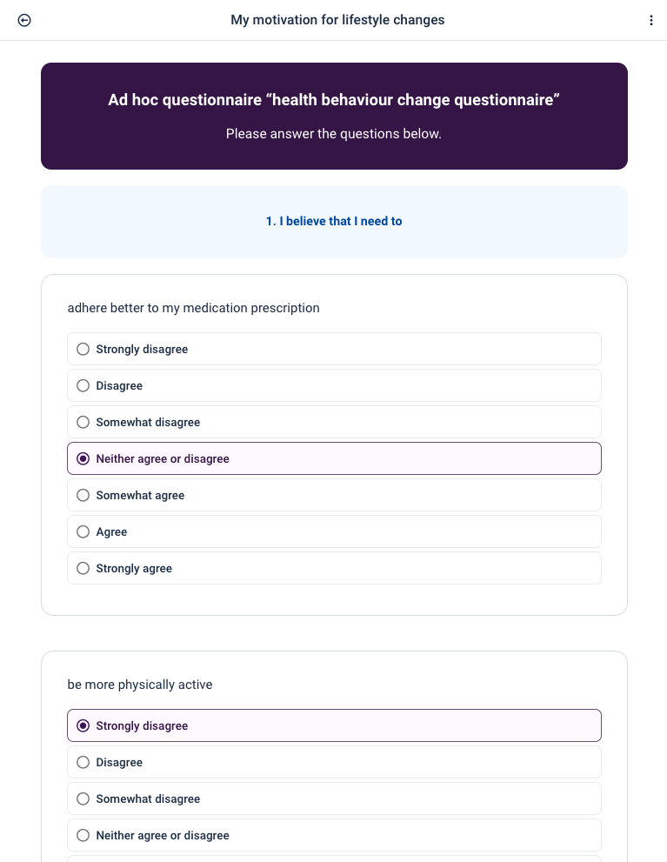
ePRO application
Target users: Patients
  PPP group
    Preparation for the encounter
    Part of the shared decision making process
    Administration of questionnaires
  Traditional care group
    Administration of questionnaires

Slide 4
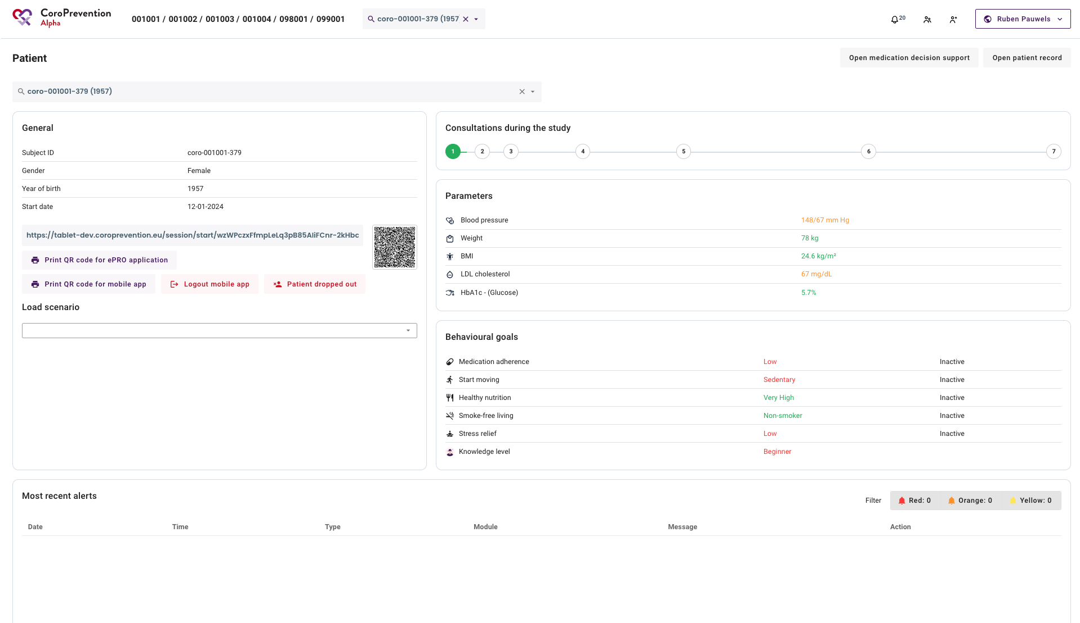
Caregiver dashboard
Target users: mostly Caregivers, but Patients also view the caregiver dashboard during the encounters
  Get

Slide 5
Caregiver dashboard
Caregivers
  Preparation of the patient record for PPP patients (integration with EDC system)
  Recommendations for exercise (EXPERT tool) and medication (medication DSS) according to ESC guidelines, evidence, expert opinions
  Follow-up patient progress and alerts
  Visual tool to support motivational talk and shared decision making

Slide 6
Caregiver dashboard
Patients
  See their progress as part of the SDM encounter with their case nurse
  Visual tool to support motivational talk and shared decision making

Slide 7
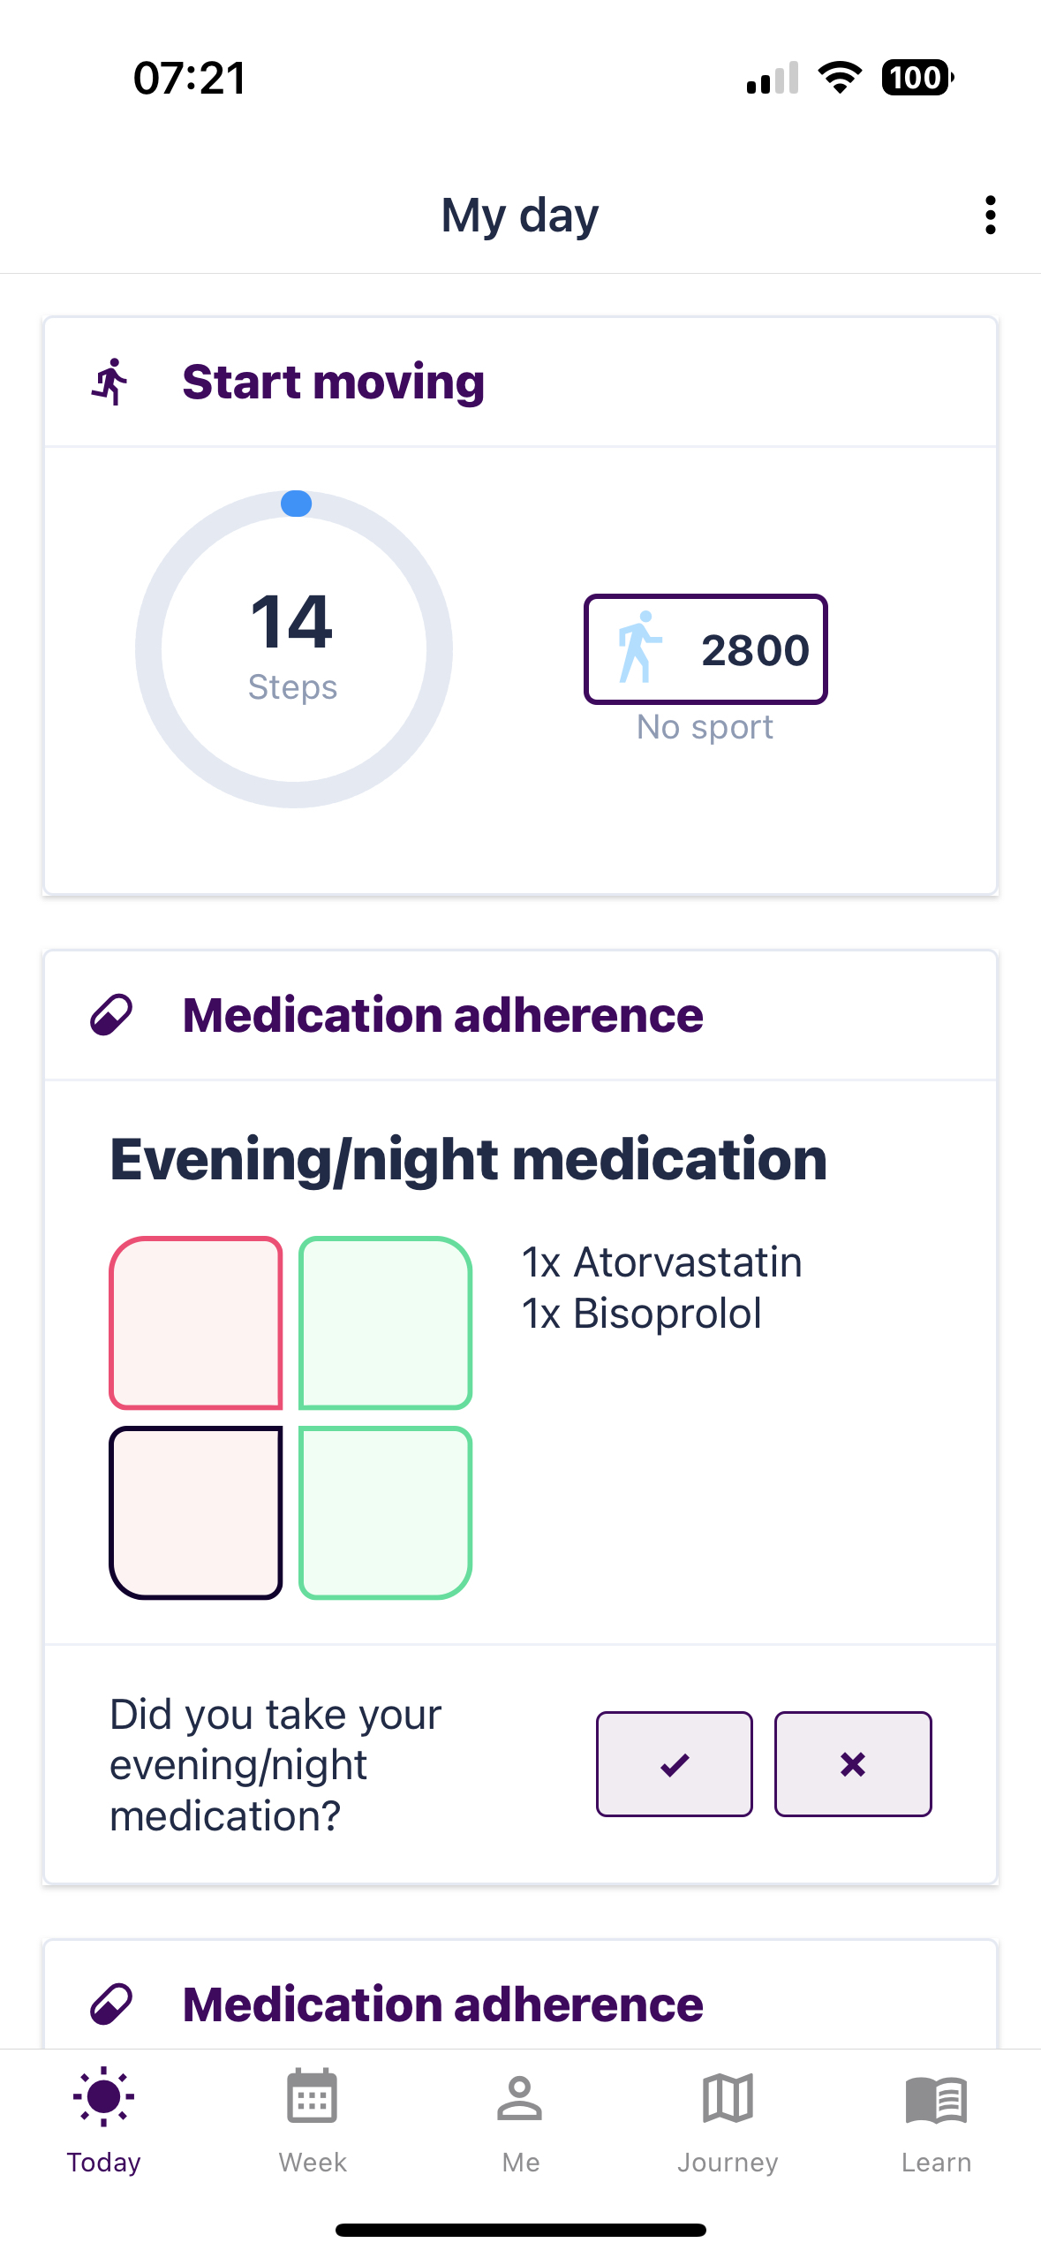
Patient mobile application
Target users: Patients
  Support adherence to their PPP
  Reporting and follow up of their progress while achieving their health goals
  Educational content to increase their disease- and lifestyle-related knowledge

Slide 8
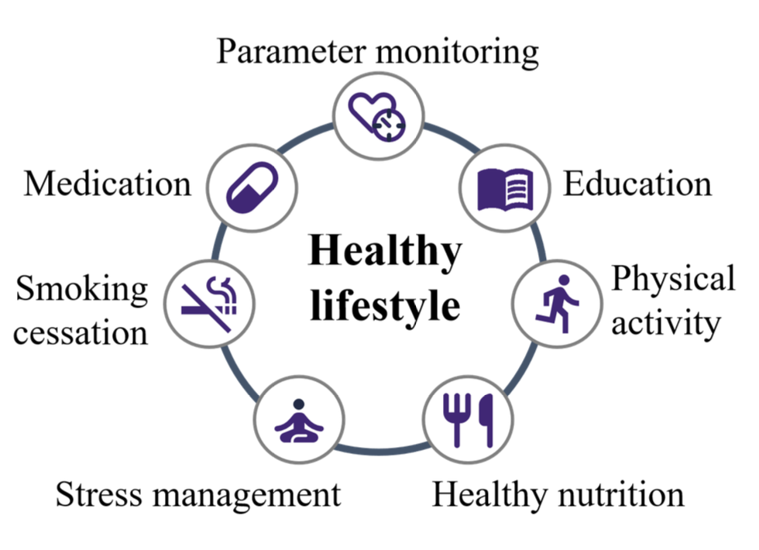
Modules of the CoroPrevention Tool Suite
Monitor your parameters
Medication adherence
Increase your knowledge
Smoke-free living
Start moving
Stress relief
Healthy nutrition
Notes:
Audio fragment to be updated

Slide 9
Tailoring to the patient - ensuring Personalised PP
Evolutionary approach adapts the modules depending on patient preferences and expert opinion (shared decision making)
Each module can be inactive or in one of the four levels of guidance:
Lifestyle / behavior change
Inactive
Start
action
Monitored
action
Maintained behavior
Levels of guidance

Slide 10
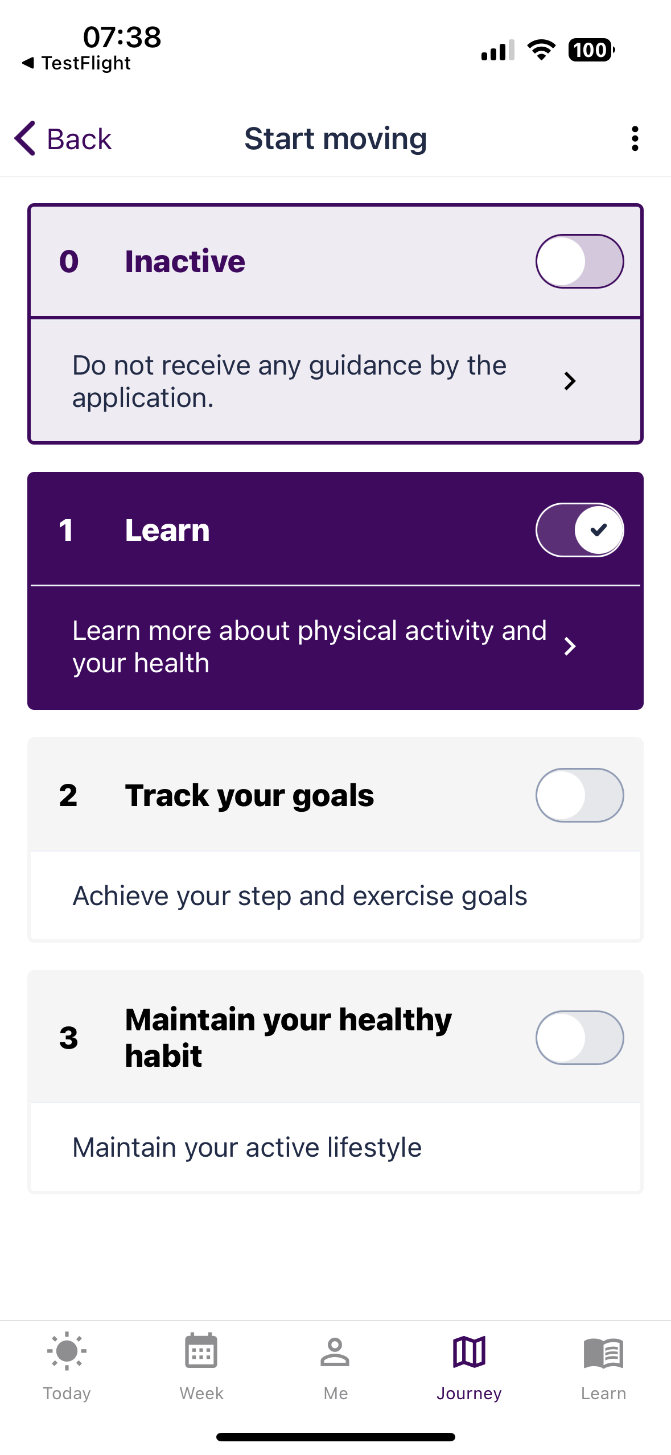
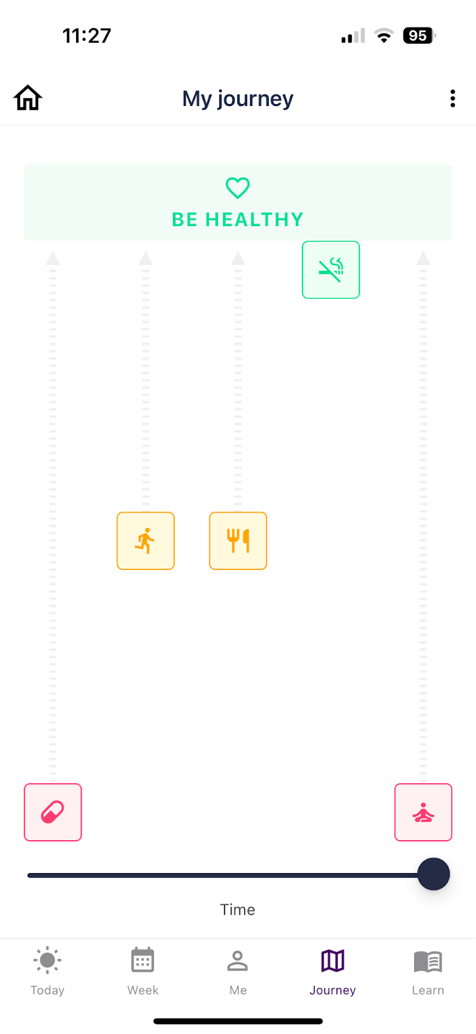
Tailoring to the patient - a PPP journey

Slide 11


Good luck!

