Slide 1
Introduction
Cindel Bonneux, UniWeb

Slide 2
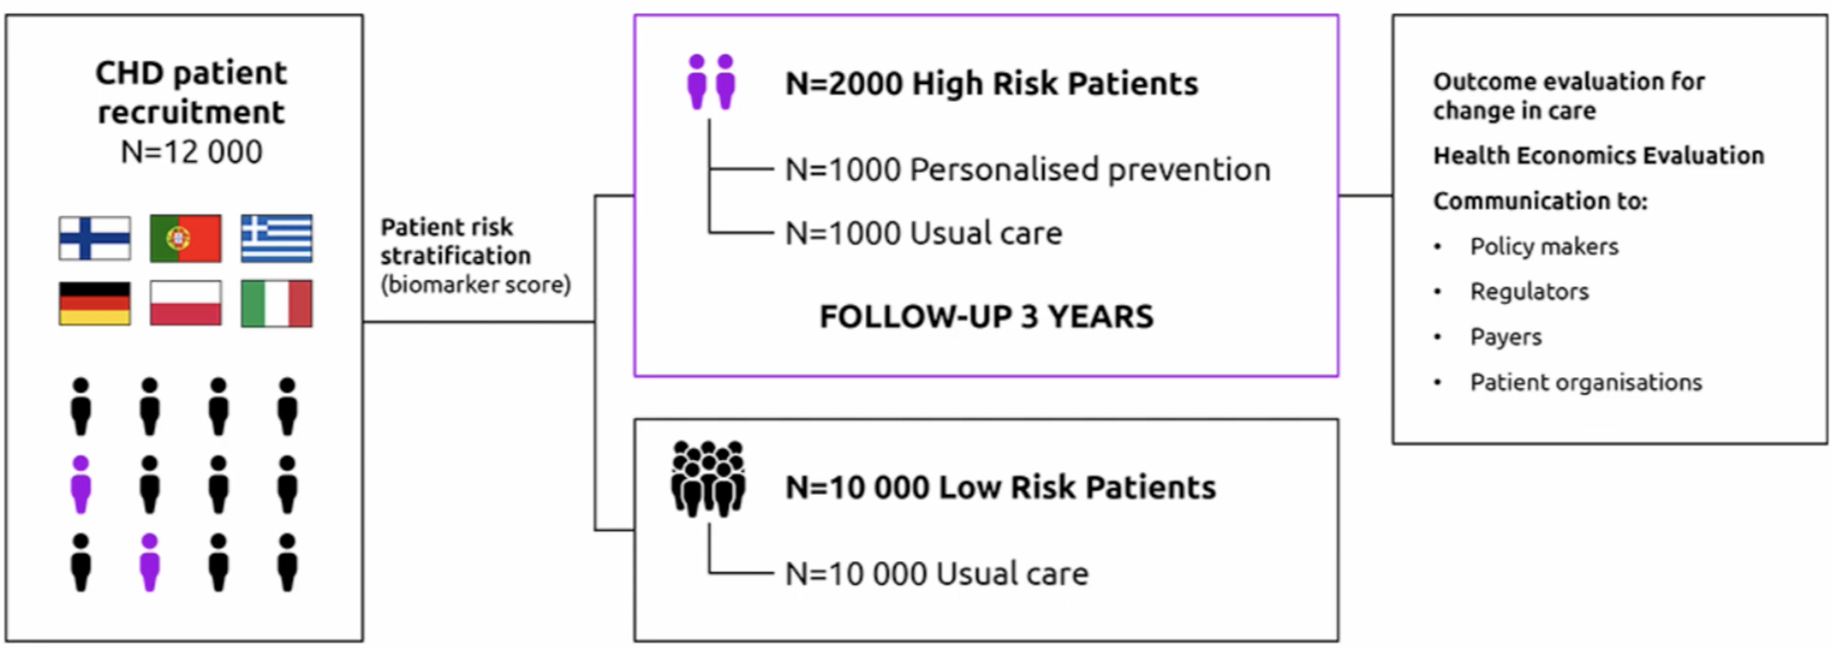
Trial setup

Slide 3
Trial setup

Slide 4
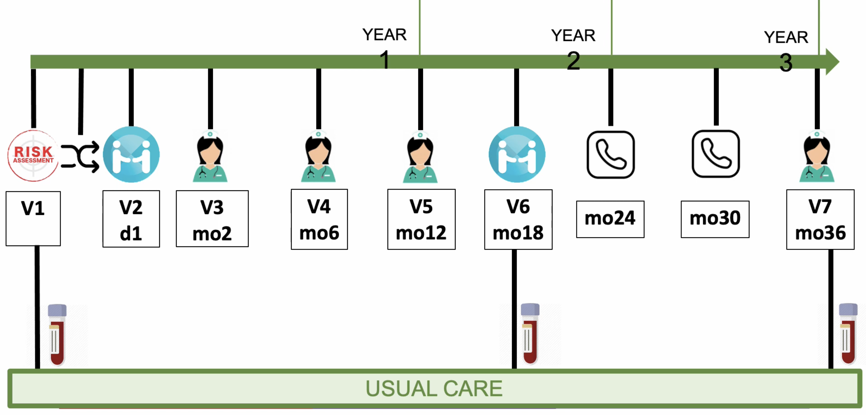
Study protocol

Slide 5
Study protocol

Slide 6
Visit 1
Target group: all 12.000 patients
Steps:
Enrolment procedure, e.g. informed consent, patient information

Slide 7
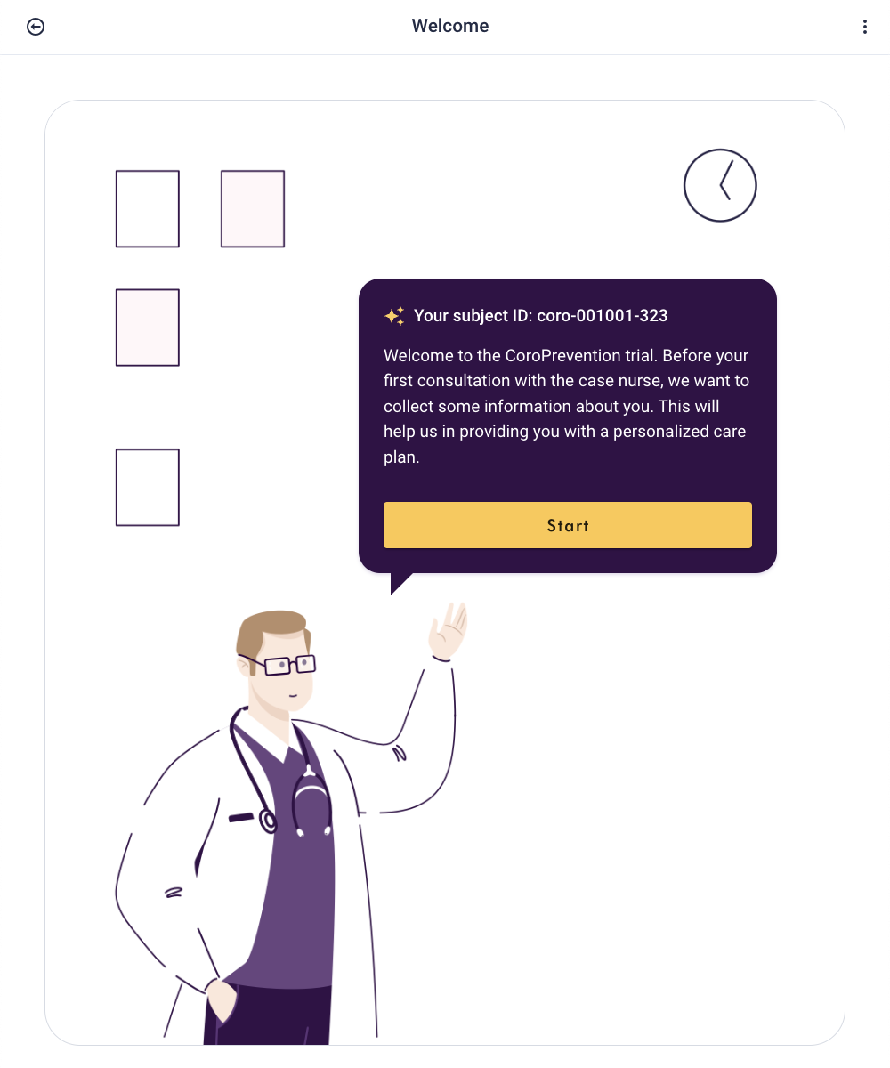
Visit 1
Target group: all 12.000 patients
Steps:
Enrolment procedure, e.g. informed consent, patient information
EPro questionnaires

Slide 8
Visit 1
Target group: all 12.000 patients
Steps:
Enrolment procedure, e.g. informed consent, patient information
EPro questionnaires
Blood sample

Slide 9
Study protocol

Slide 10
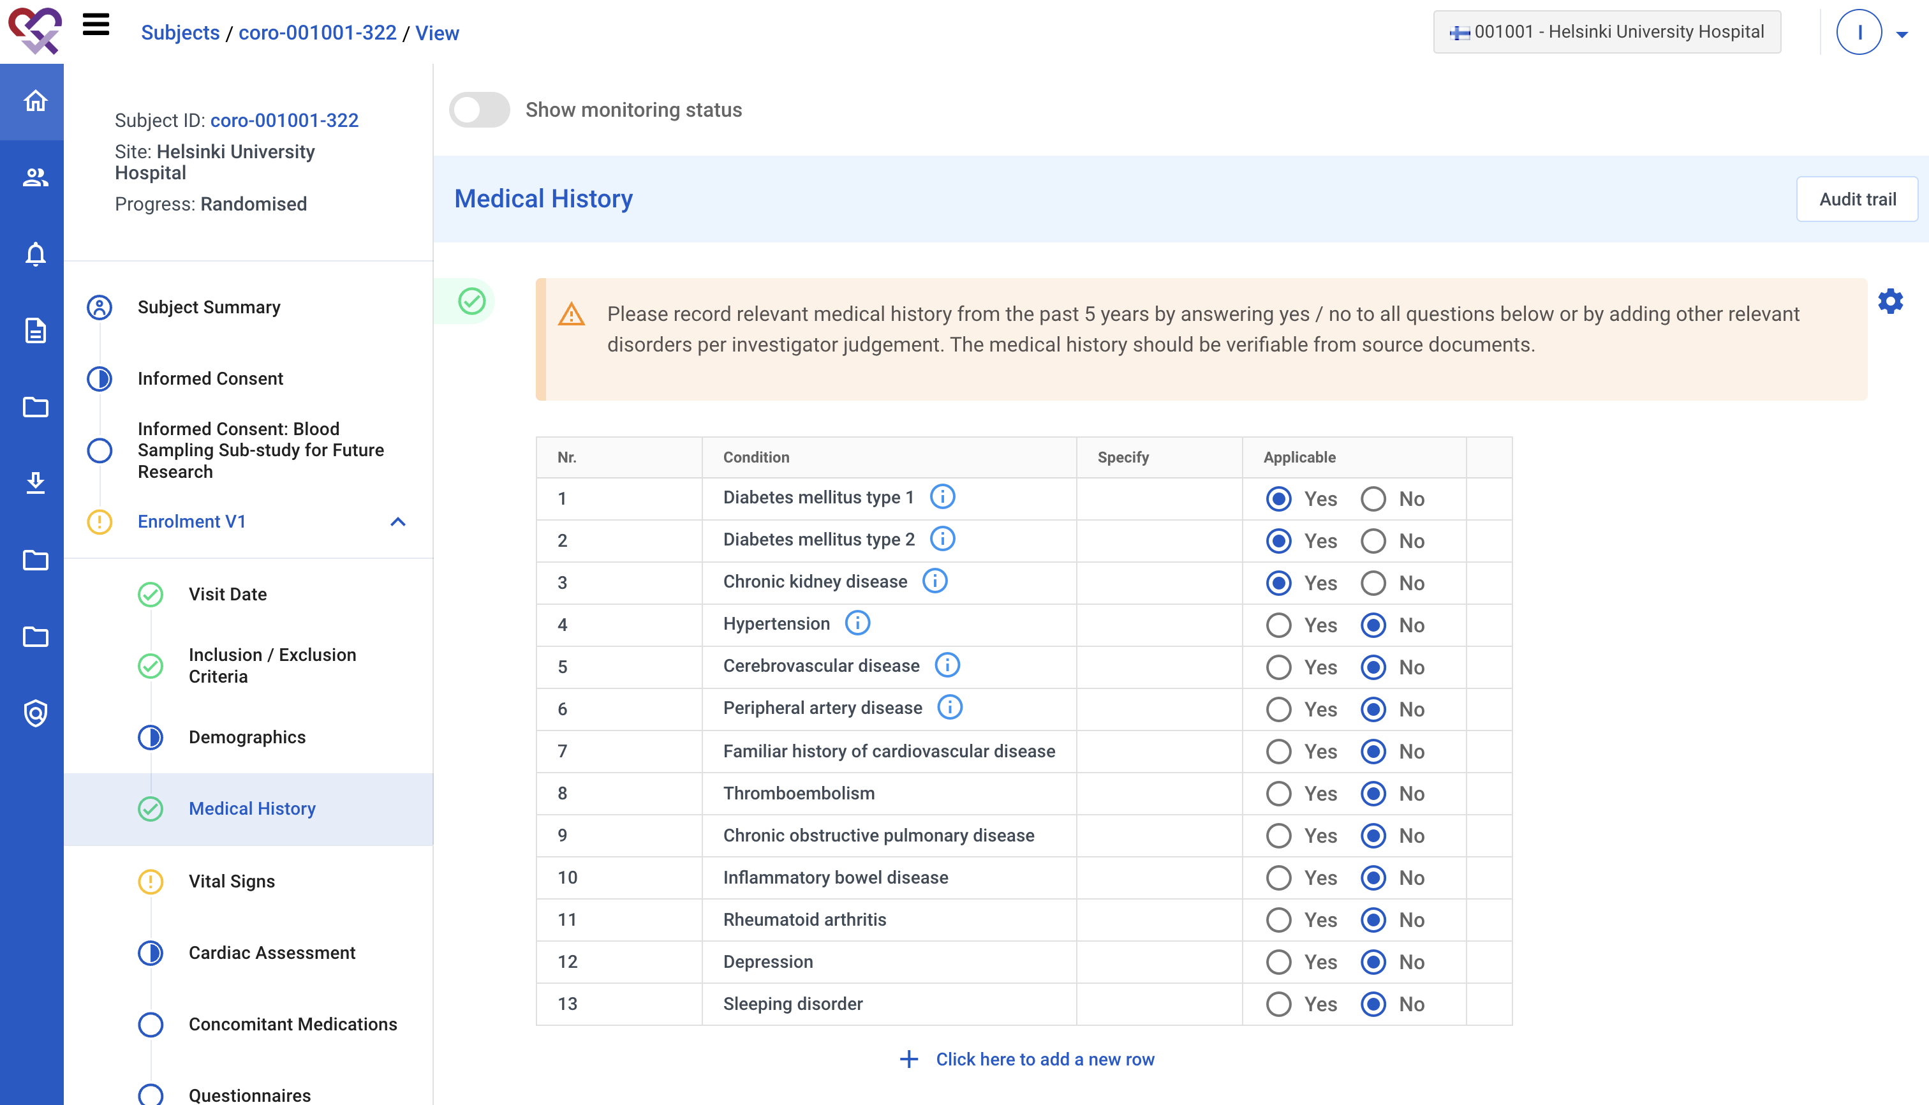
After visit 1
Target group: all 12.000 patients
Steps:
Complete the information in the EDC

Slide 11
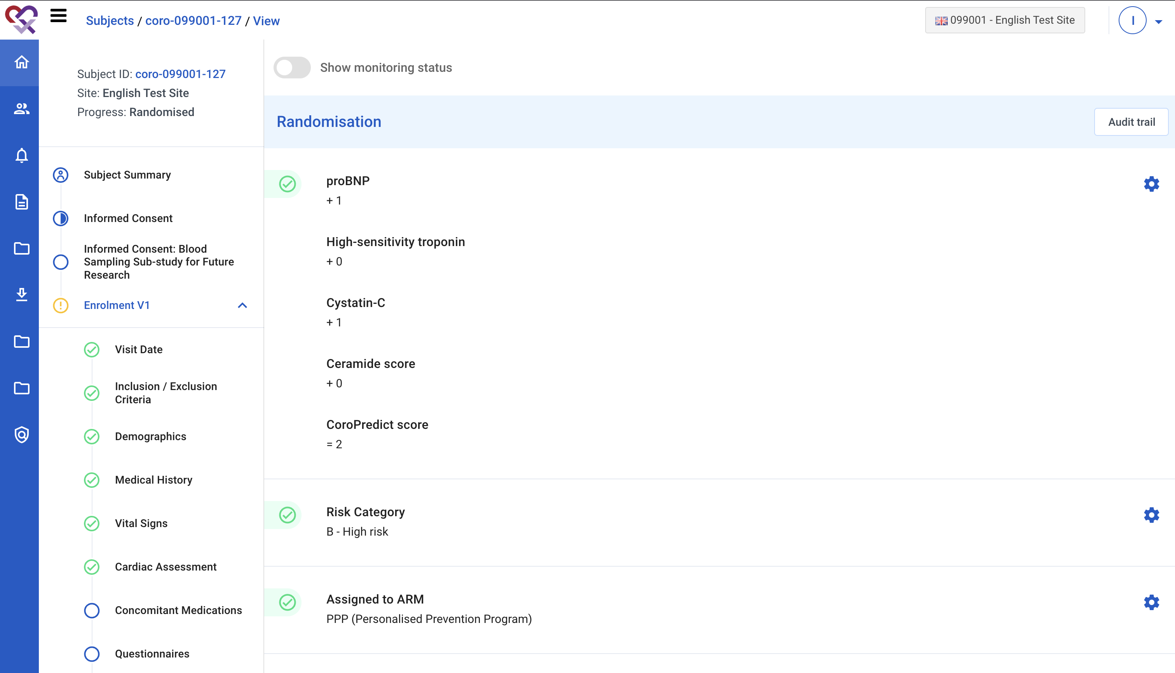
After visit 1
Target group: all 12.000 patients
Steps:
Complete the information in the EDC
Randomize the patient

Slide 12
After visit 1
Target group: all 12.000 patients
Steps:
Complete the information in the EDC
Randomize the patient
Plan next consultation

Slide 13
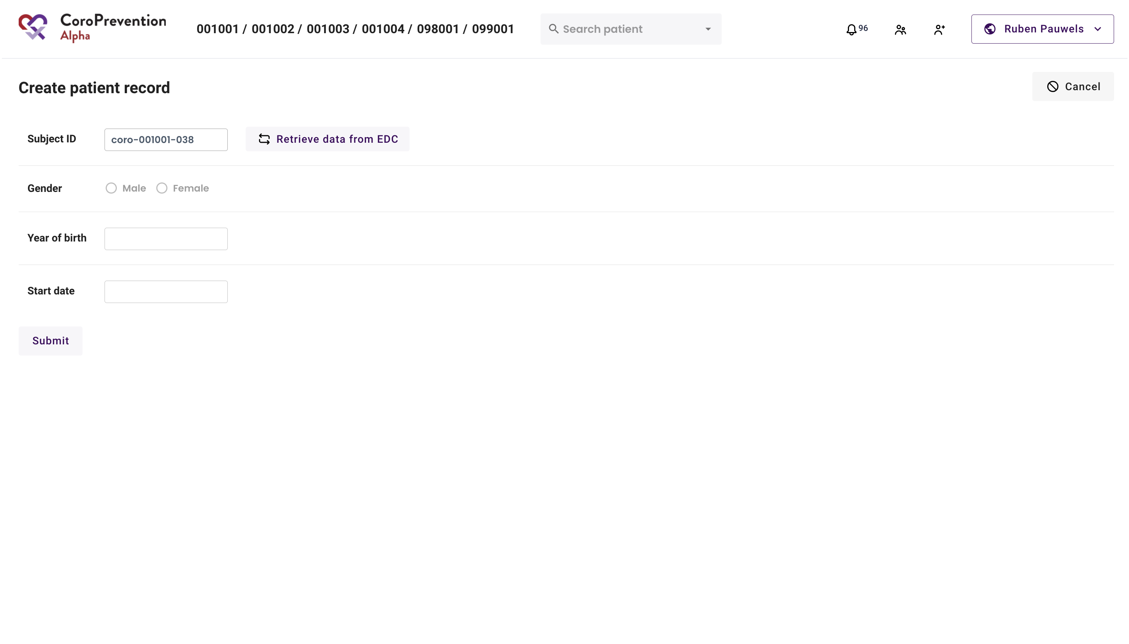
After visit 1
Target group: all 12.000 patients
Steps:
Complete the information in the EDC
Randomize the patient
Plan next consultation
If needed, prepare Tool Suite for visit 2

Slide 14
Study protocol

Slide 15
Visit 2
Target group: 1.000 PPP patients
Steps:
EPro questionnaires

Slide 16
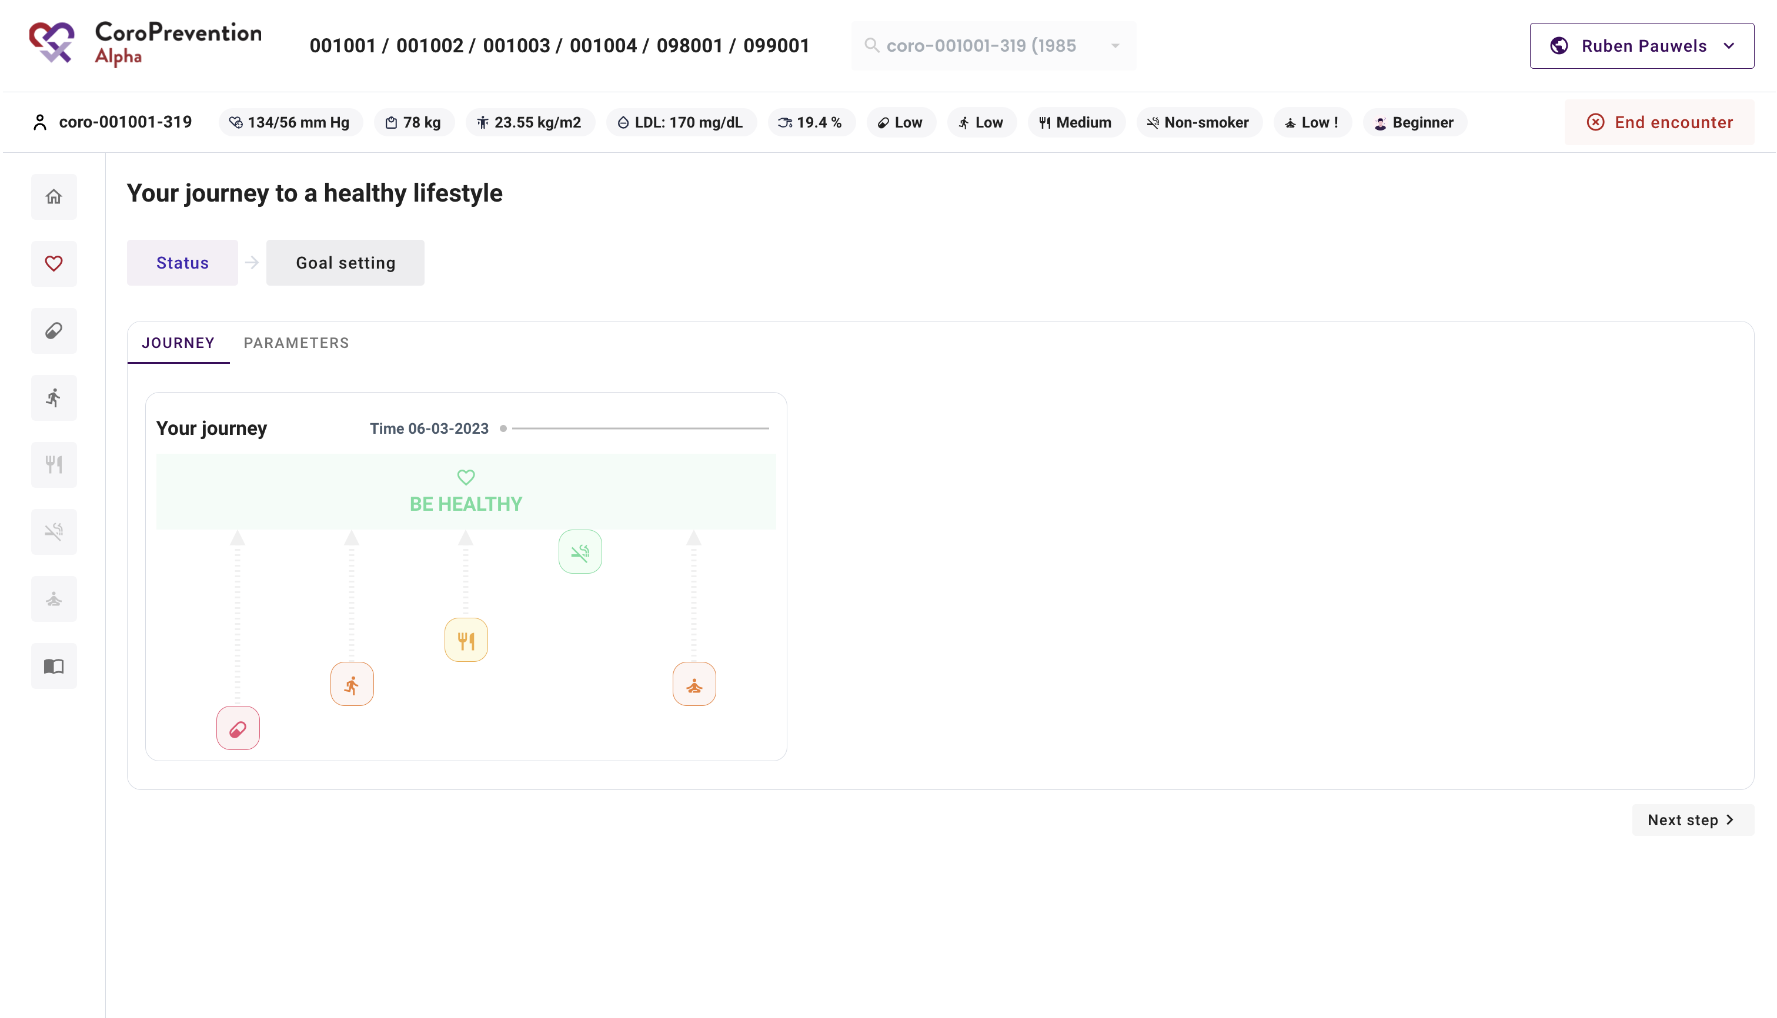
Visit 2
Target group: 1.000 PPP patients
Steps:
EPro questionnaires
Shared decision making conversation with case nurse

Slide 17
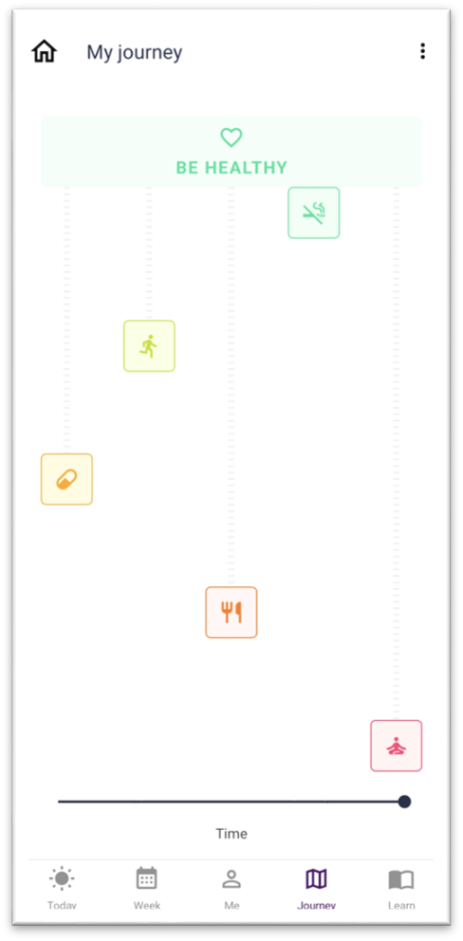
Visit 2
Target group: 1.000 PPP patients
Steps:
EPro questionnaires
Shared decision making conversation with case nurse
Installation of the patient mobile app

Slide 18
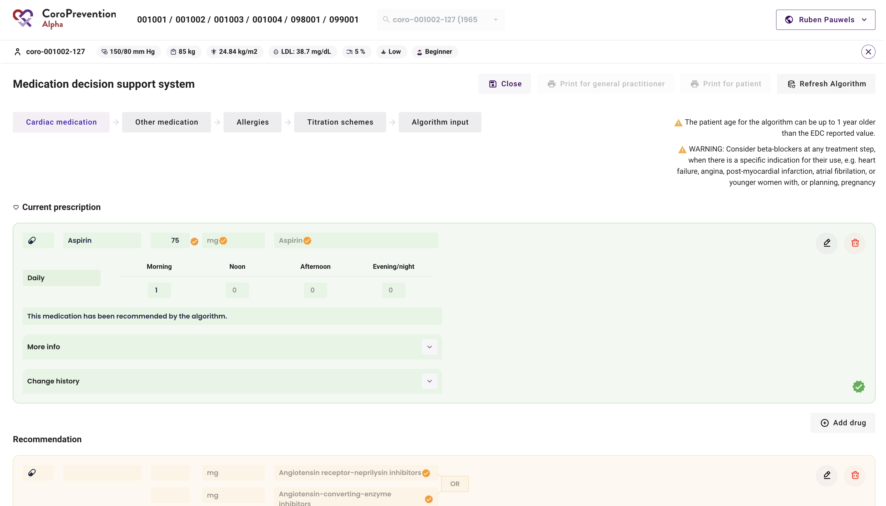
Visit 2
Target group: 1.000 PPP patients
Steps:
EPro questionnaires
Shared decision making conversation with case nurse
Installation of the patient mobile app
Consultation with investigator

Slide 19
Study protocol

Slide 20
After visit 2
Target group: 1.000 PPP patients
Steps:
Complete the information in the EDC

Slide 21
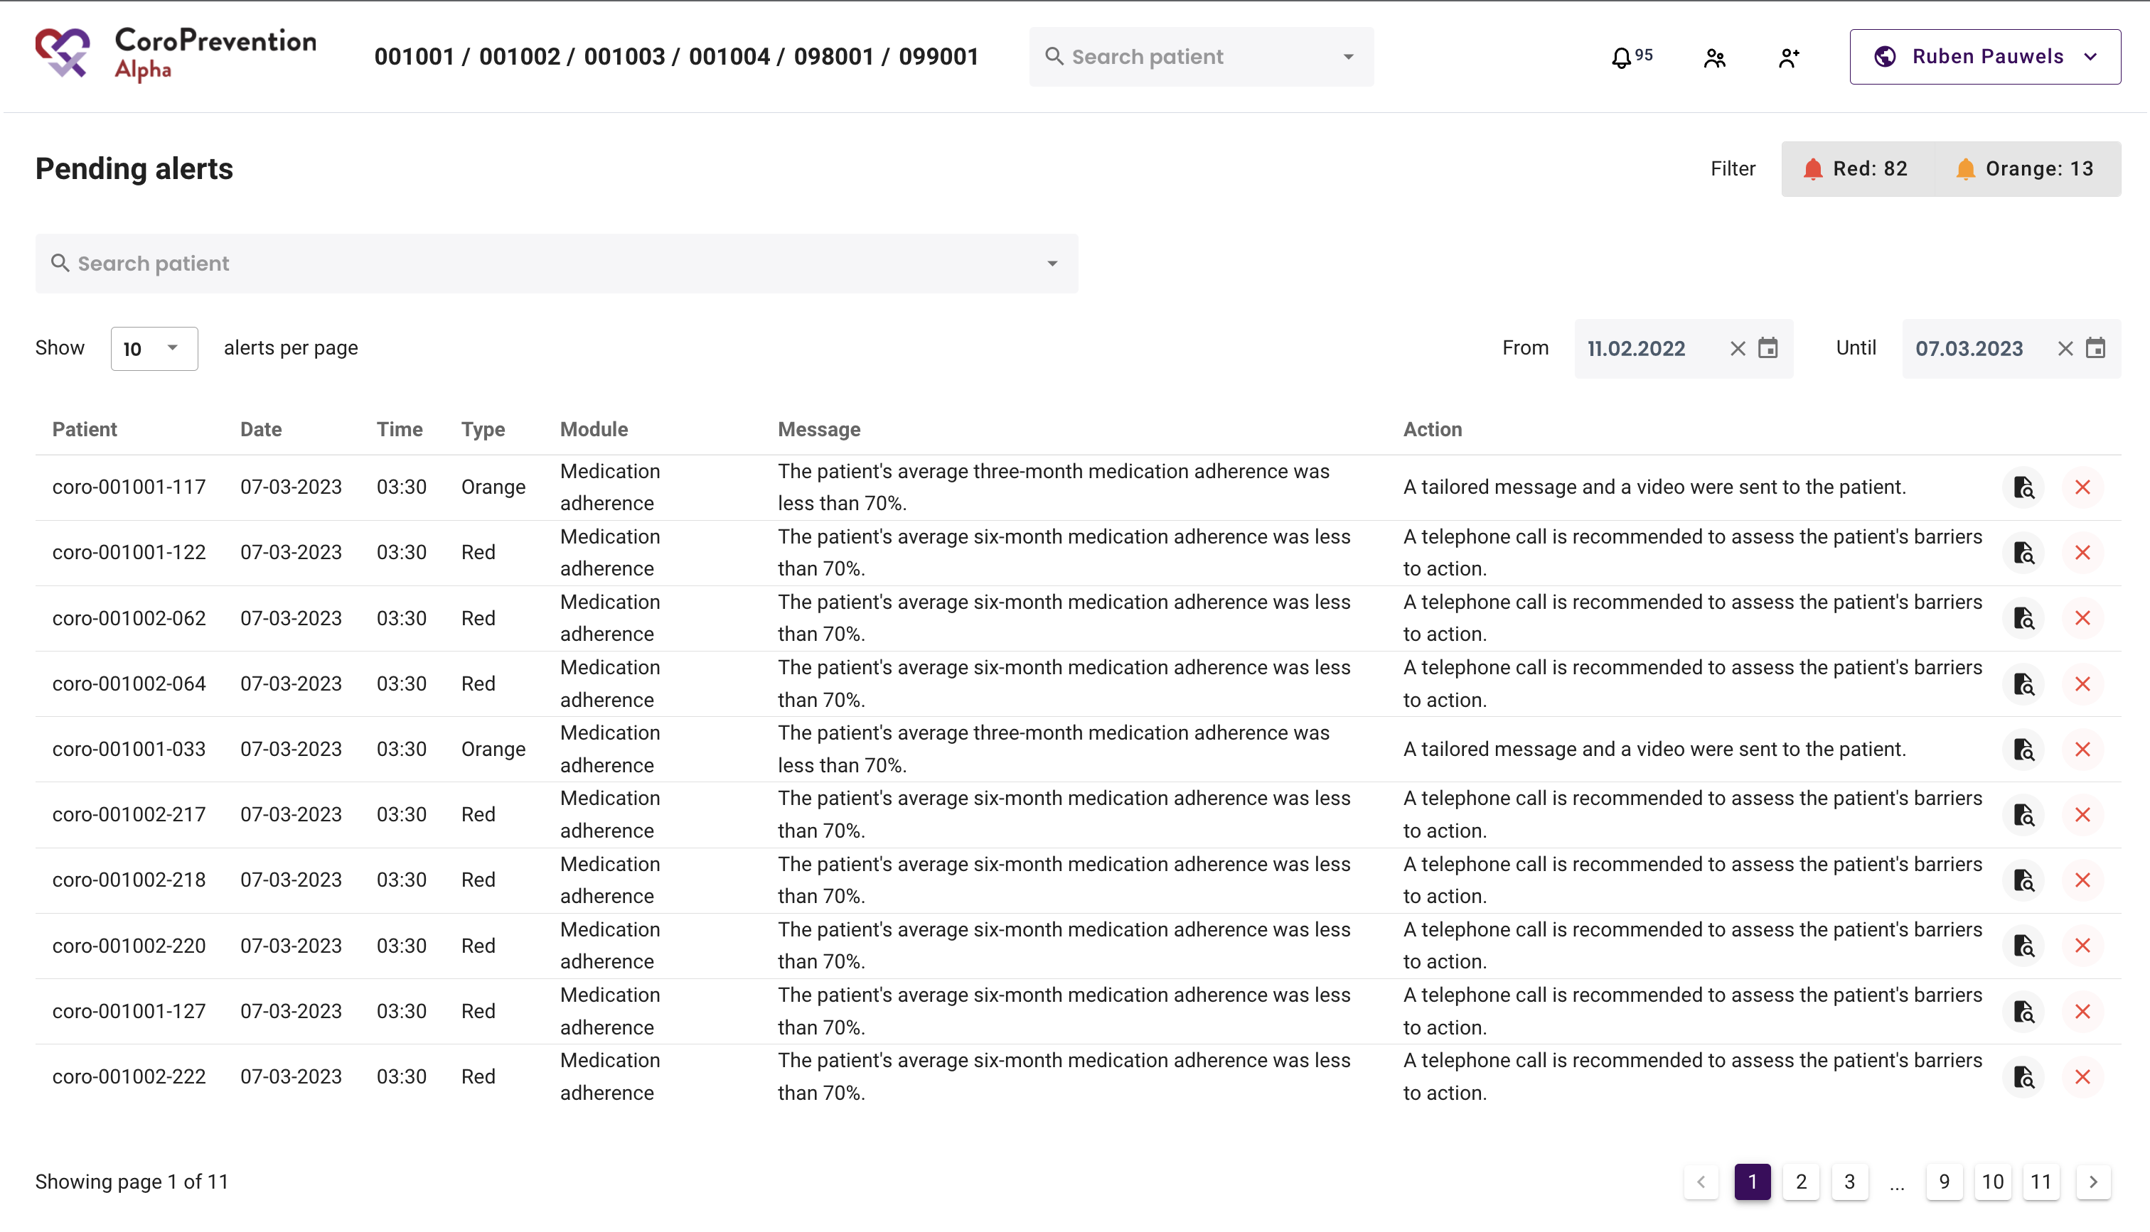
Between visit 2 and visit 3
Target group: 1.000 PPP patients
Steps:
Review alerts and call the patient when intervention is needed

Slide 22
Study protocol

Slide 23
Visit 3
Target group: 1.000 PPP patients
Steps:
EPro questionnaires

Slide 24
Visit 3
Target group: 1.000 PPP patients
Steps:
EPro questionnaires
Shared decision making conversation with case nurse

Slide 25
Study protocol

Slide 26
Next visits
Visit 4, 5 = similar to visit 3
After/between visits 3 – 5 = similar to after/between visits 2 – 3

Slide 27
Study protocol

Slide 28
Visit 6
Target group: 1.000 PPP + 1.000 UC patients
Steps:
EPro questionnaires

Slide 29
Visit 6
Target group: 1.000 PPP patients
Steps:
EPro questionnaires
Shared decision making conversation with case nurse

Slide 30
Visit 6
Target group: 1.000 PPP + 1.000 UC patients
Steps:
EPro questionnaires
Shared decision making conversation with case nurse
Blood sample

Slide 31
Visit 6
Target group: 1.000 PPP patients
Steps:
EPro questionnaires
Shared decision making conversation with case nurse
Blood sample
Consultation with investigator

Slide 32
Study protocol

Slide 33
Between visit 6 and visit 7
Target group: 1.000 PPP patients
Steps:
Review alerts and call the patient when intervention is needed
Obligatory phone calls at m24 and m30

Slide 34
Study protocol

Slide 35
Visit 7
Target group: 1.000 PPP + 1.000 UC patients
Steps:
EPro questionnaires

Slide 36
Visit 7
Target group: 1.000 PPP patients
Steps:
EPro questionnaires
Shared decision making conversation with case nurse on final outcomes

Slide 37
Visit 7
Target group: Target group: 1.000 PPP + 1.000 UC patients
Steps:
EPro questionnaires
Shared decision making conversation with case nurse
Uninstall patient mobile app

Slide 38
Visit 7
Target group: Target group: 1.000 PPP + 1.000 UC patients
Steps:
EPro questionnaires
Shared decision making conversation with case nurse
Uninstall patient mobile app
Blood sample

