Slide 1
Introduction to the EXPERT tool
Prof. Reijo Laaksonen, TAU; MD Ece Kizilkilic, UHasselt; Cindel Bonneux, UniWeb

Slide 2
Case description
64-year old male
Medical history:
Arterial hypertension, obesity, hypercholesterolaemia, diabetes mellitus
Shoulder operation 2015
2021: elective coronary angiography demonstrating severe 3-vessel disease.
Elective CABG was performed.
Risk factors:
Obesity, diabetes, arterial hypertension, hypercholesterolaemia
Previous smoker, currently non-smoker
Low physical activity

Slide 3
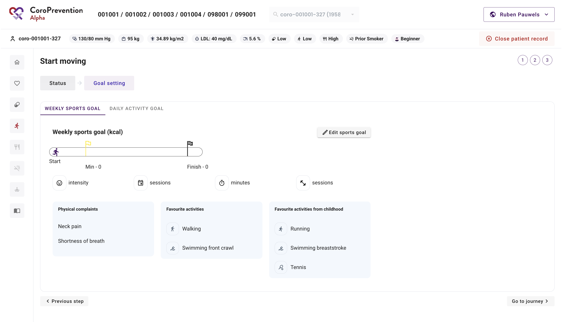
Open the EXPERT tool
Click the “Edit sports goal” button to open the EXPERT tool

Slide 4
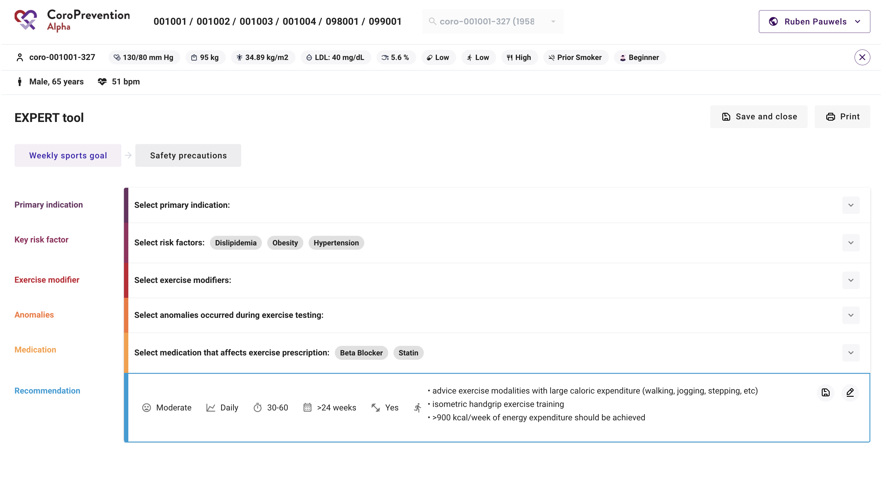
EXPERT tool – Exercise prescription
Select applicable items

Slide 5
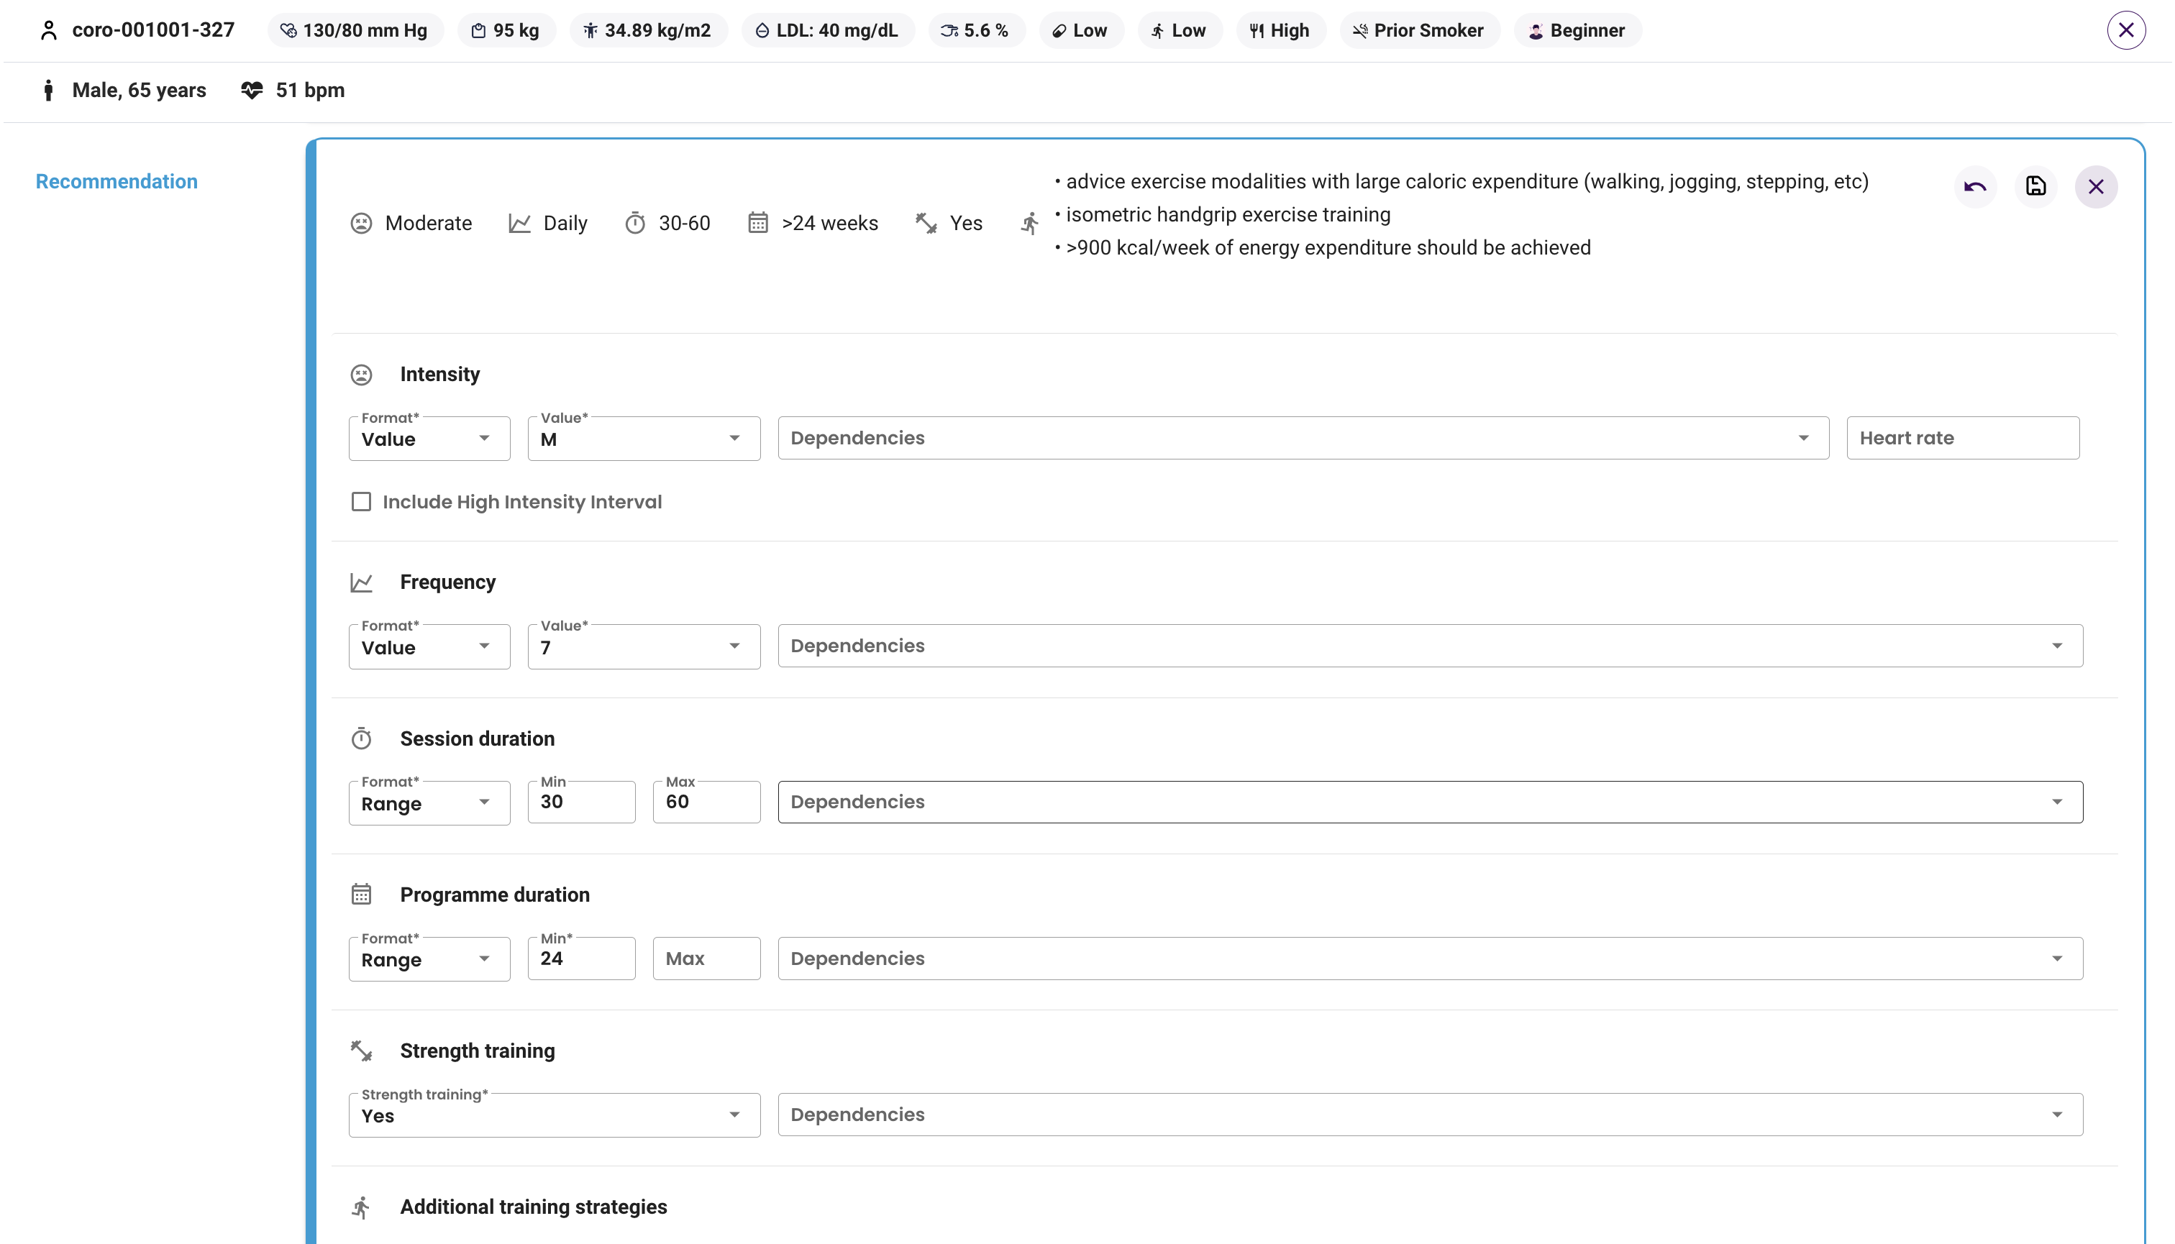
EXPERT tool – Exercise prescription
At the top, view the recommended prescription
At the bottom, edit the prescription

Slide 6
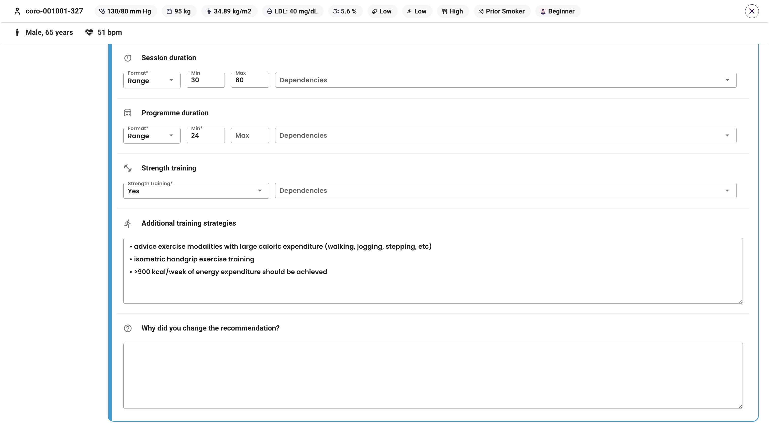
EXPERT tool – Exercise prescription
Remember to record reason why you made the change

Slide 7
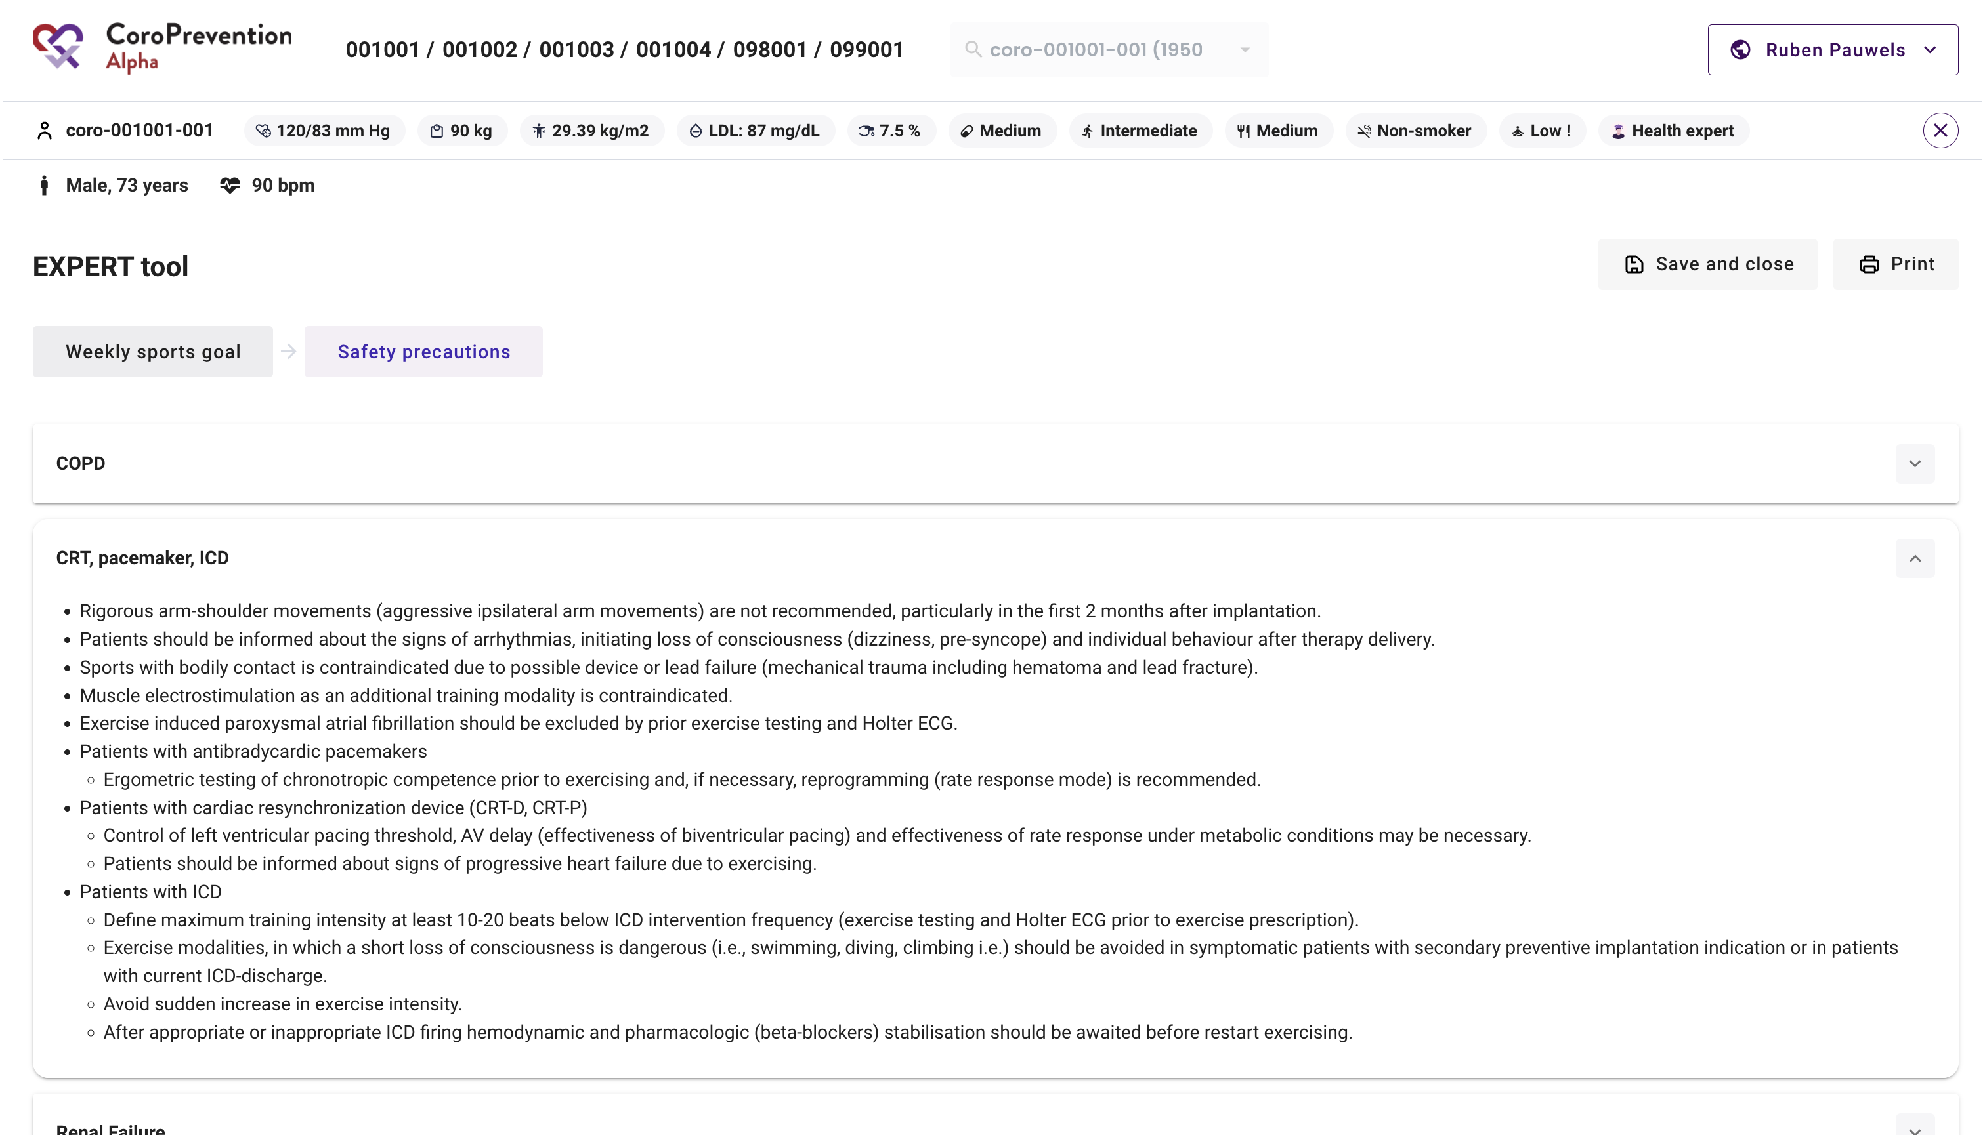
EXPERT tool – Safety precautions
Read safety precautions for the patient

Slide 8
Introduction to the EXPERT tool
Prof. Reijo Laaksonen, TAU; MD Ece Kizilkilic, UHasselt; Cindel Bonneux, UniWeb

