Slide 1
How can you use the Tool Suite during encounters with the patient
Cindel Bonneux, UniWeb and prof. dr. Hanne Kindermans, UHasselt

Slide 2
Visit 2

Slide 3
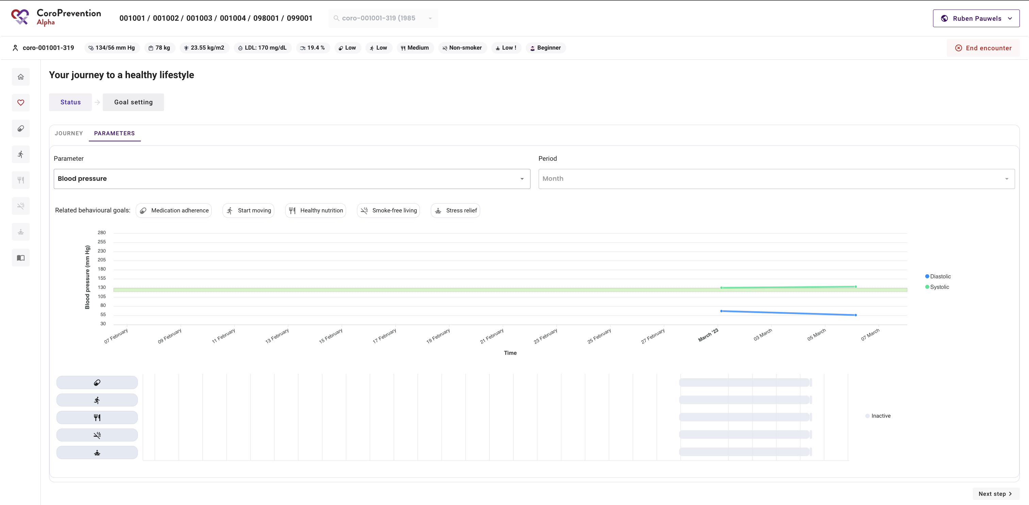
Parameters – Status
View the patient’s current parameter values
View which behavioural goals are related to the parameters

Slide 4
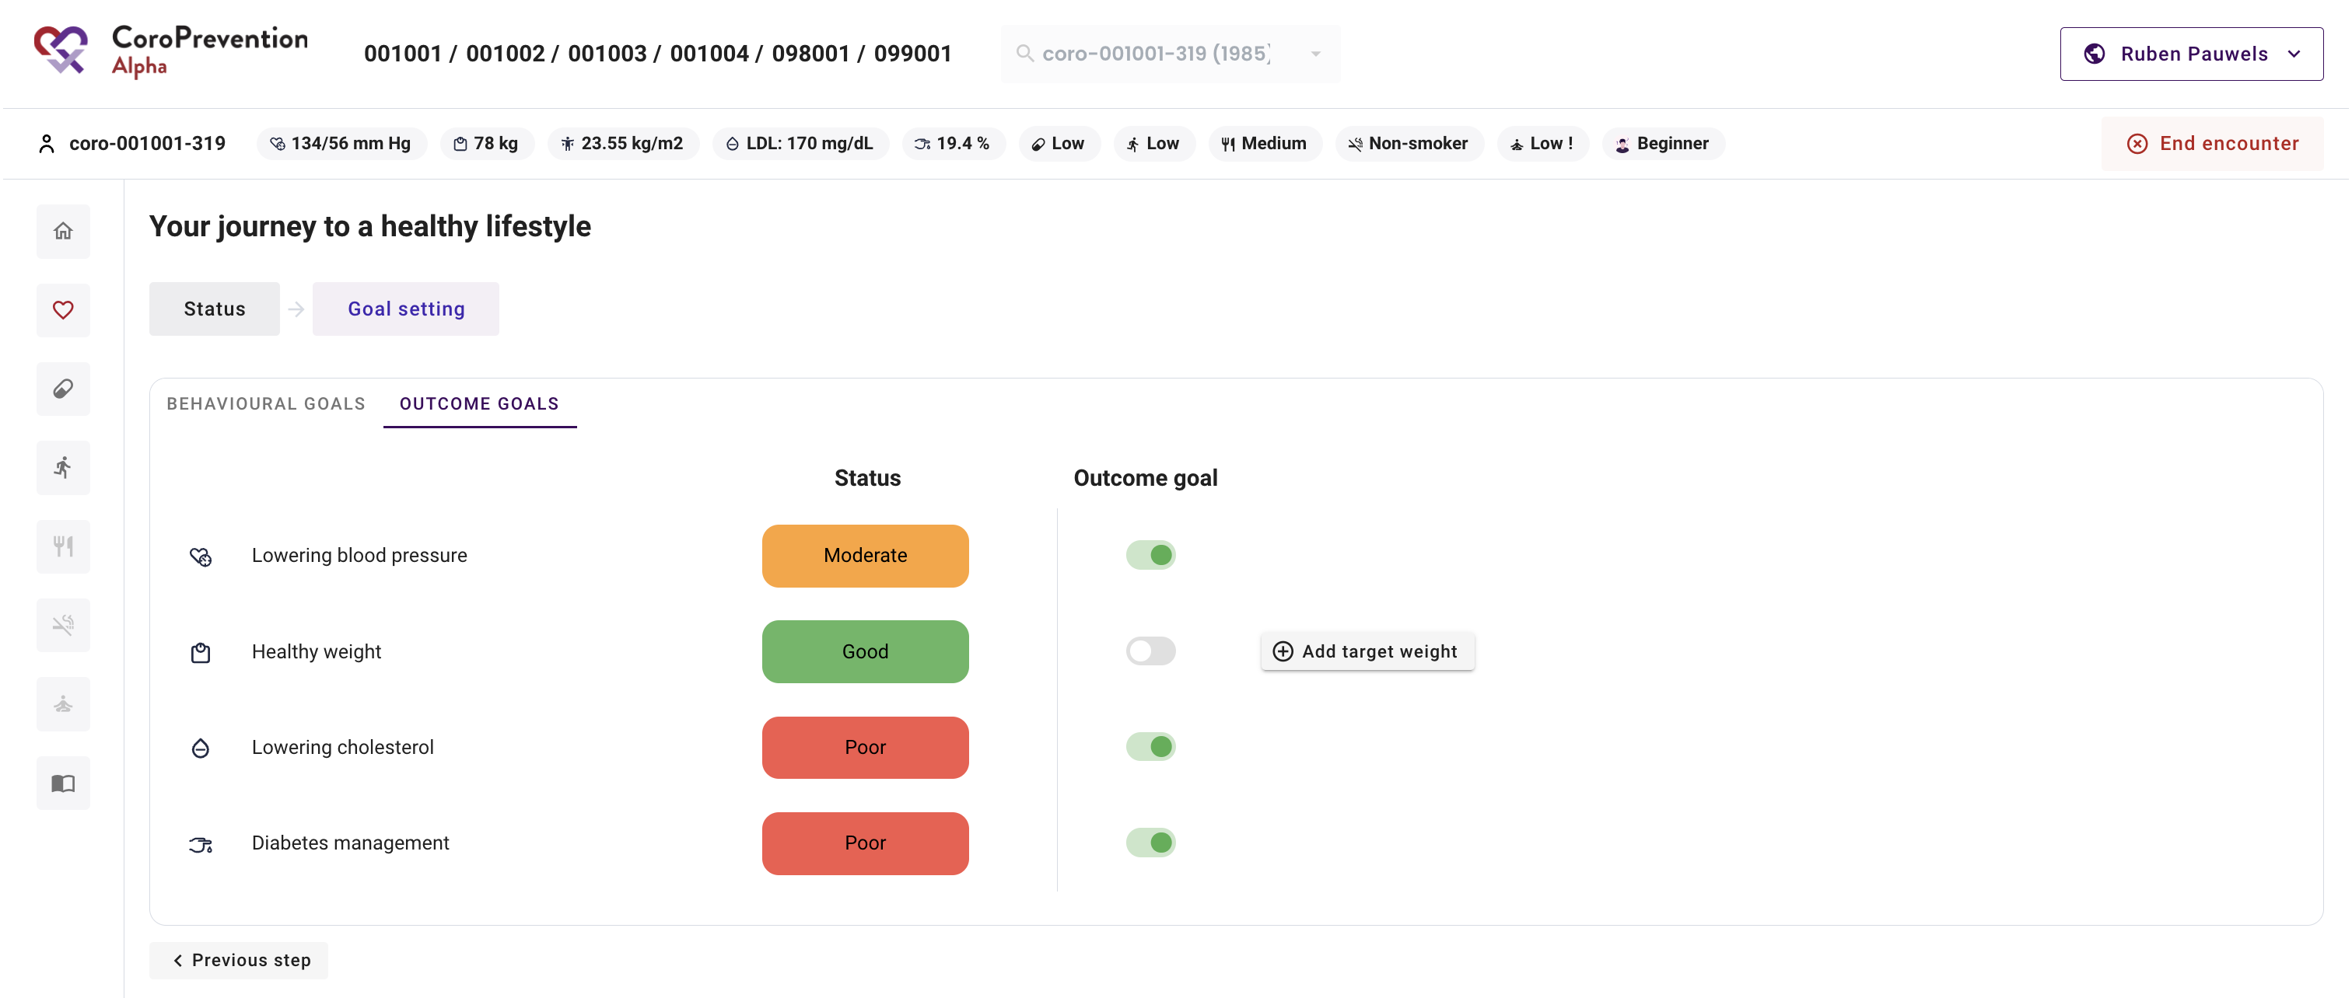
Parameters – Goal setting
View the patient’s status for the outcome goals
View the recommended outcome goals based on the patient’s parameter values
Activate/Deactivate outcome goals
Set a target weight

Slide 5
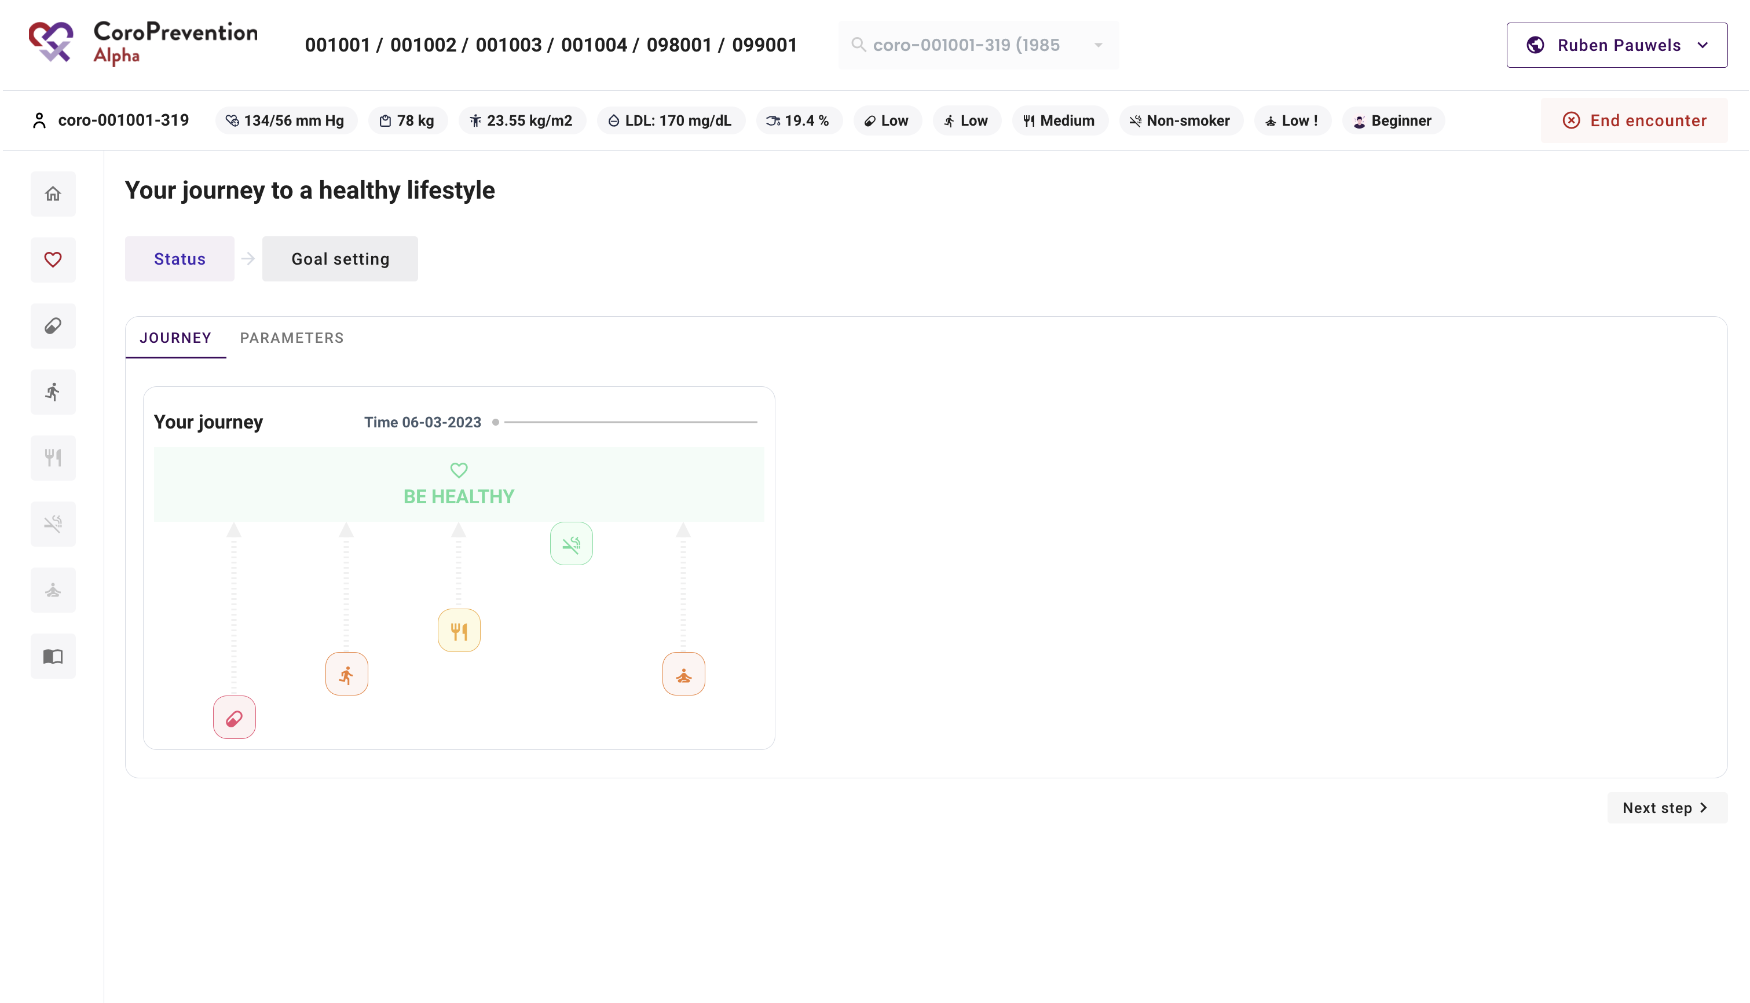
Journey – Status
View the patient’s current status for the behavioural goals
Close to “Be healthy” = green = good
Far from “Be healthy” = red = bad

Slide 6
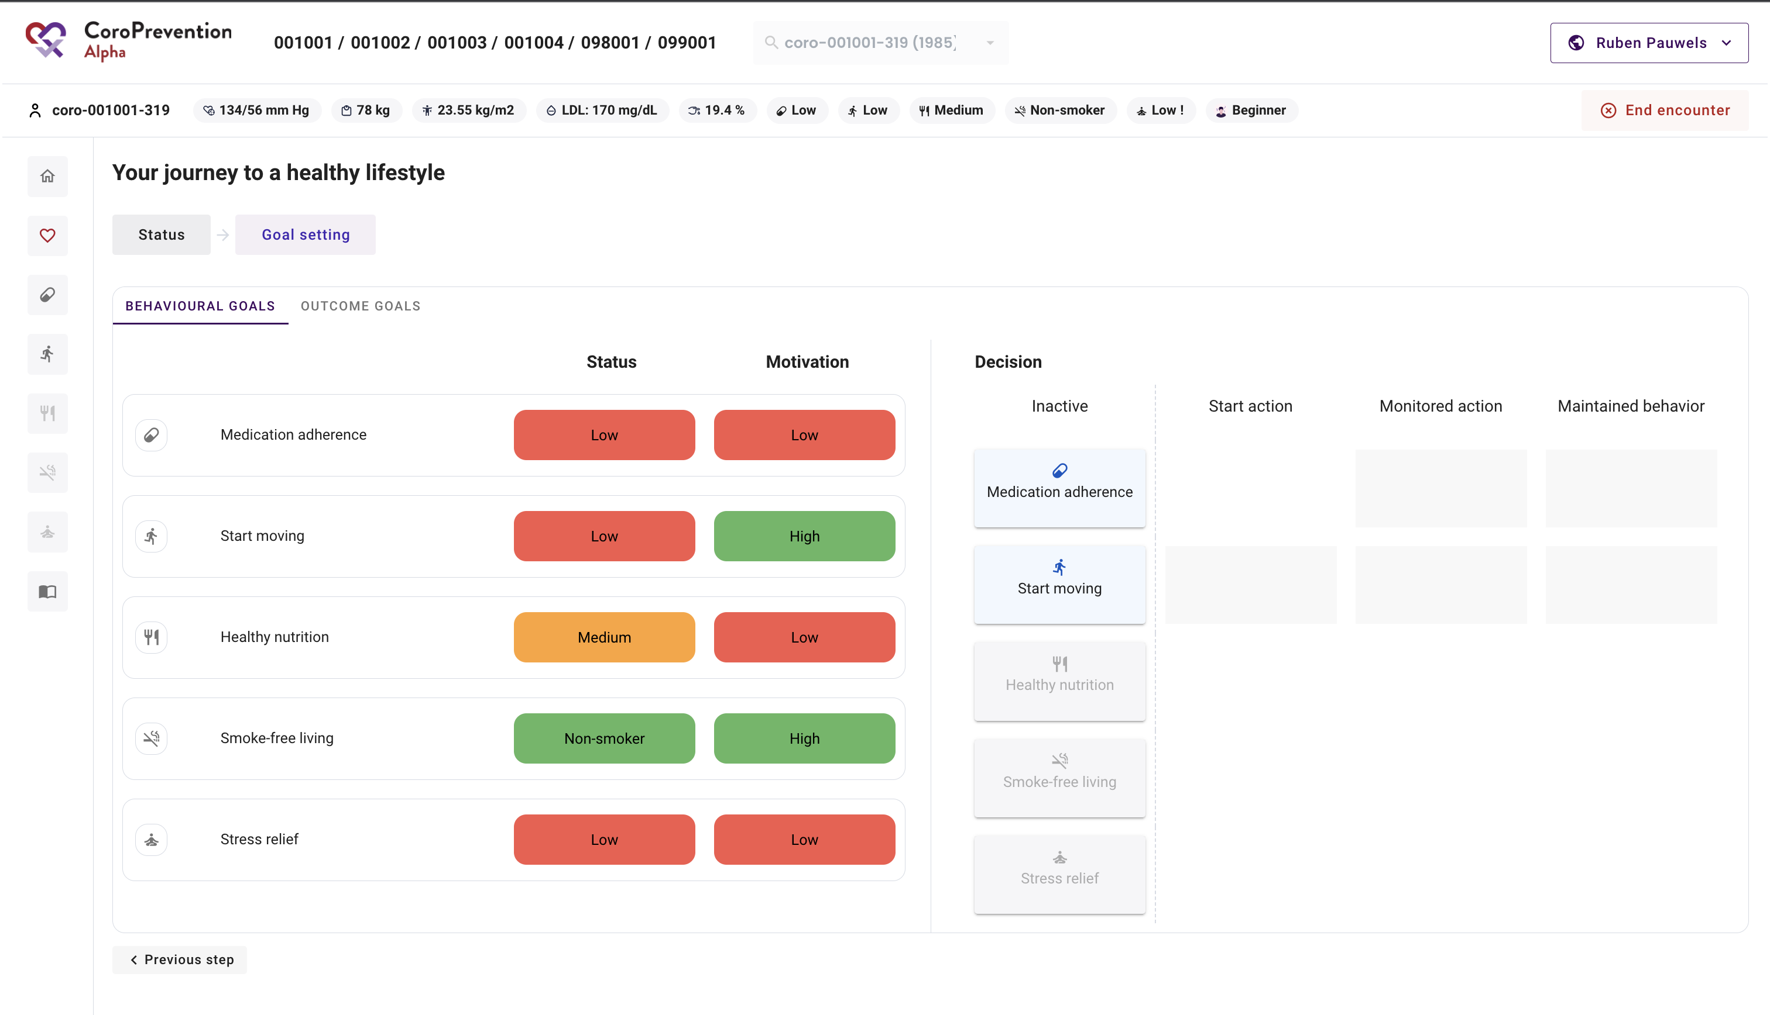
Journey – Goal setting
View the patient’s status for the behavioural goals
View the patient’s motivation for the behavioural goals
Start with discussing “Medication adherence”

Slide 7
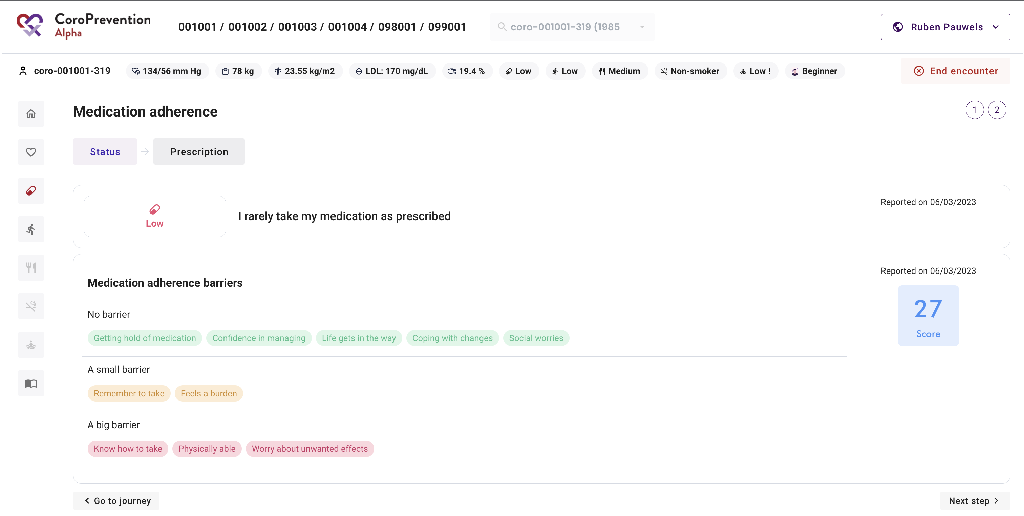
Medication adherence – Status
View the patient’s current medication adherence
View the patient’s score on the Identification of Medication Adherence Barriers (IMAB) Questionnaire
View the patient’s barriers for taking medication as prescribed

Slide 8
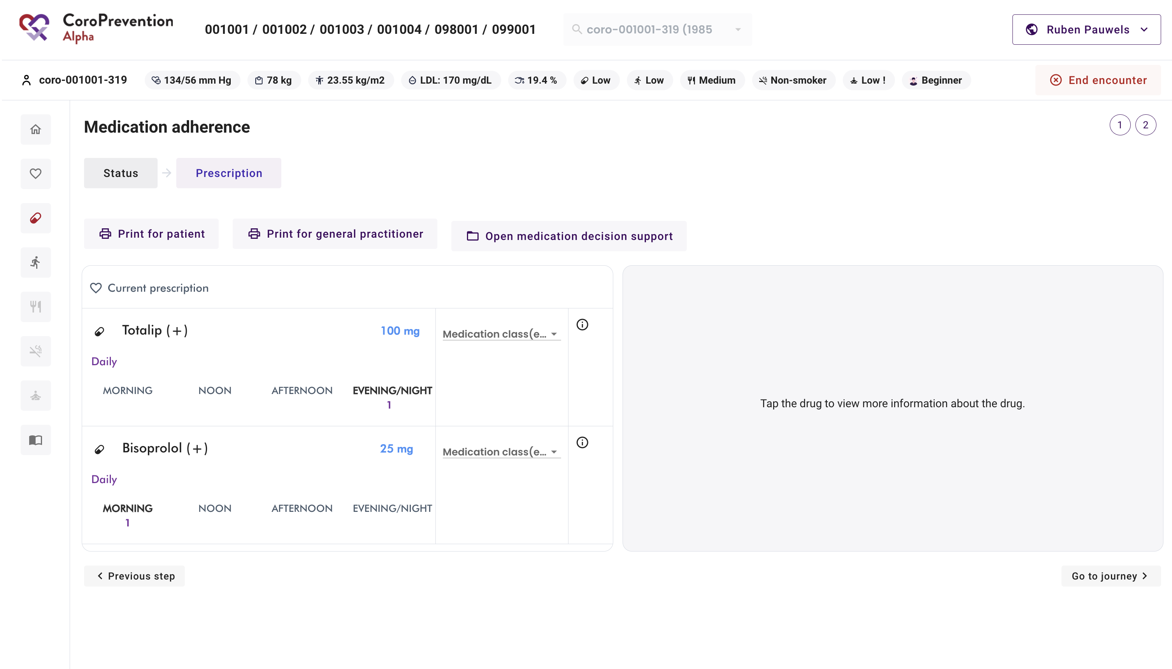
Medication adherence – Prescription
View the patient’s current medication prescription
Select for each drug the medication class
Print medication prescription for patient and GP

Slide 9
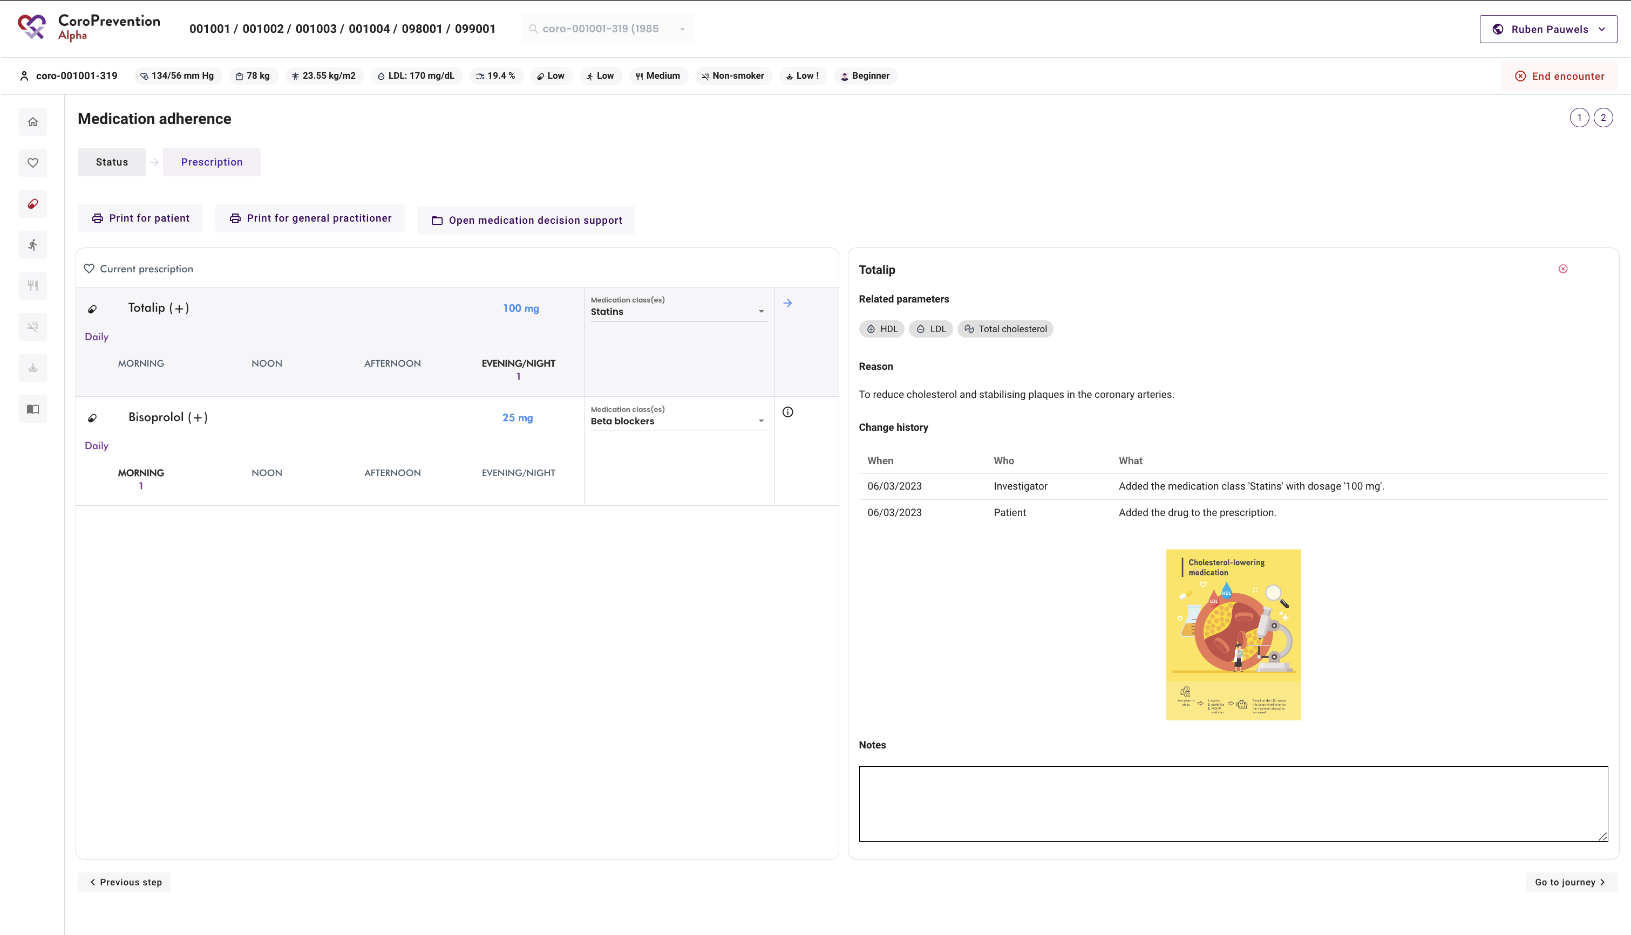
Medication adherence – Prescription
View the details about a drug
View infographics to discuss the importance of the drugs
Read and take notes

Slide 10
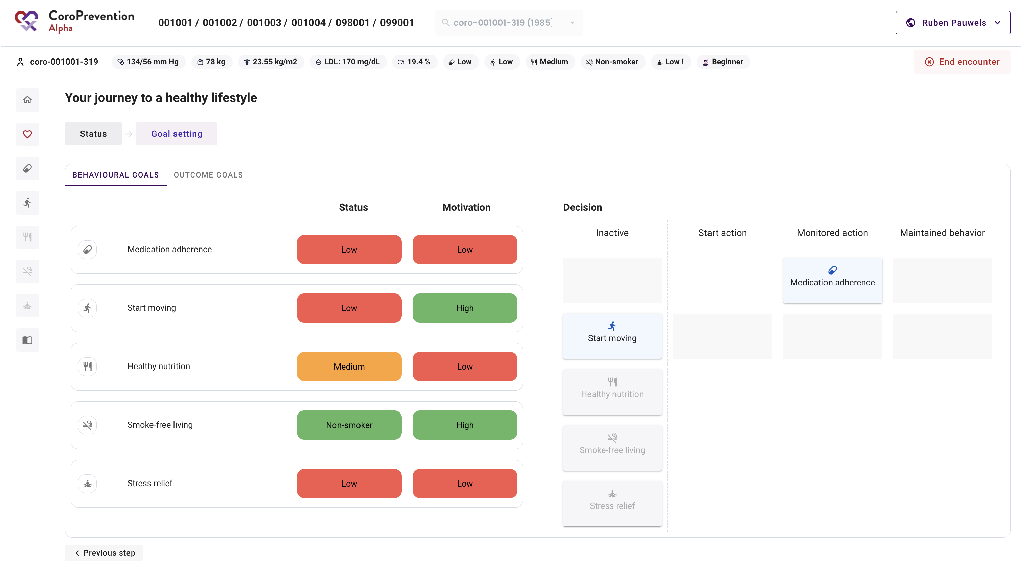
Journey – Goal-setting
After discussion, agreed to start working on “Medication adherence” so moved to “Monitored action”

Slide 11
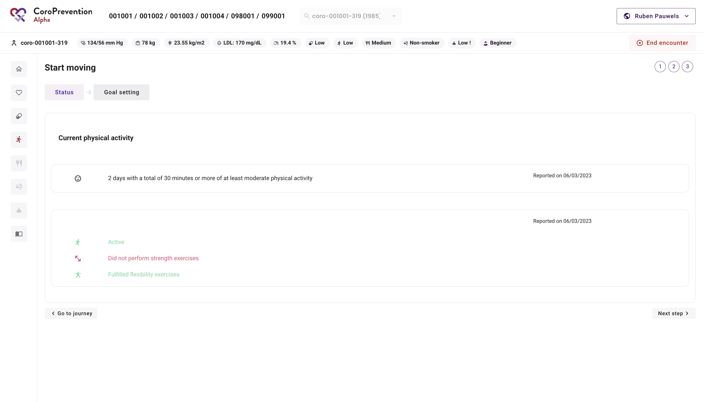
Start moving – Status
View how many days per week the patient is physically active
View the results of the Rapid Assessment of Physical Activity (RAPA) questionnaire

Slide 12
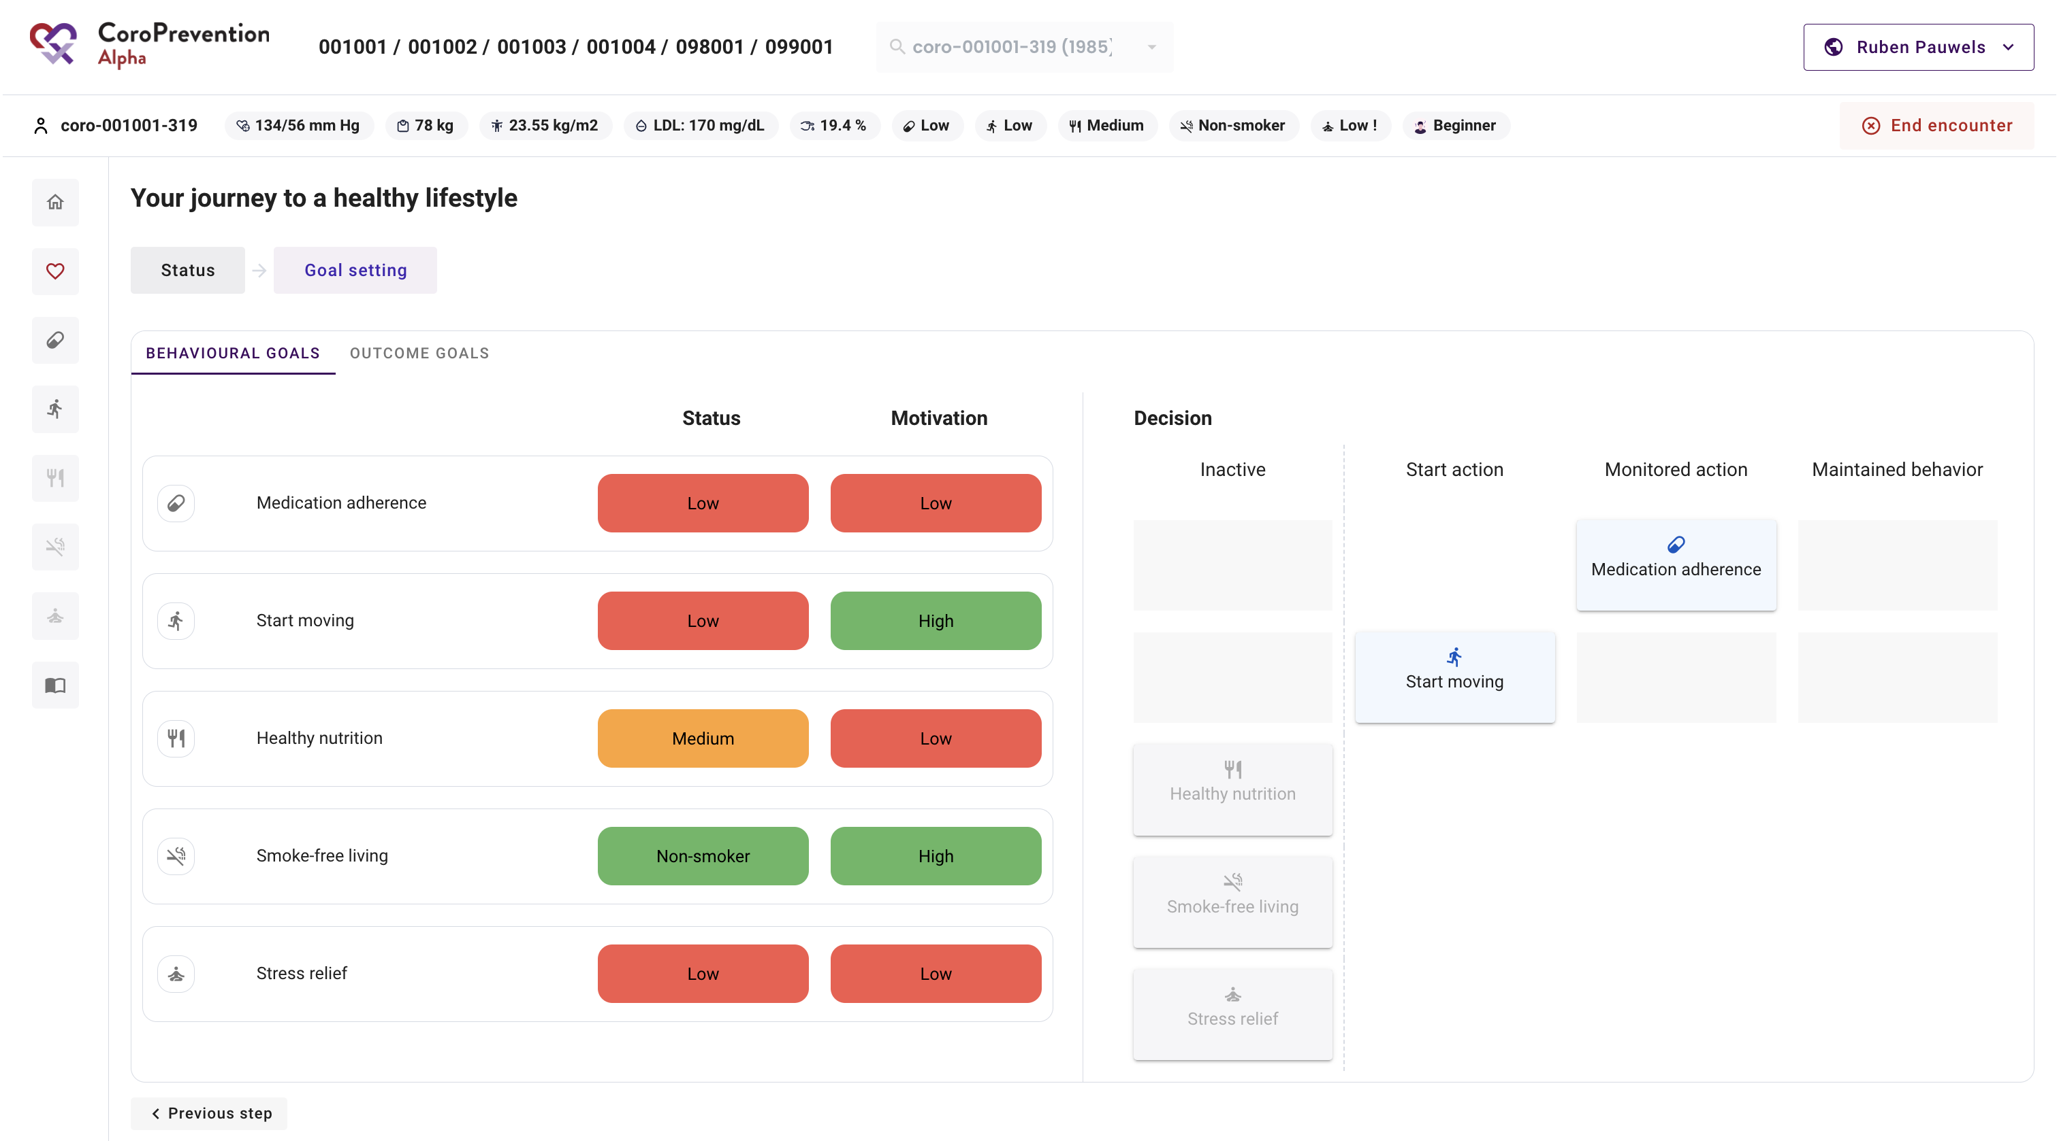
Journey – Goal-setting
Patient has high motivation to work on “Start moving”, so go to “Start action” to prepare to be active or “Monitored action”
Patient cannot change everything at once, so decided to go for “Start action”

Slide 13
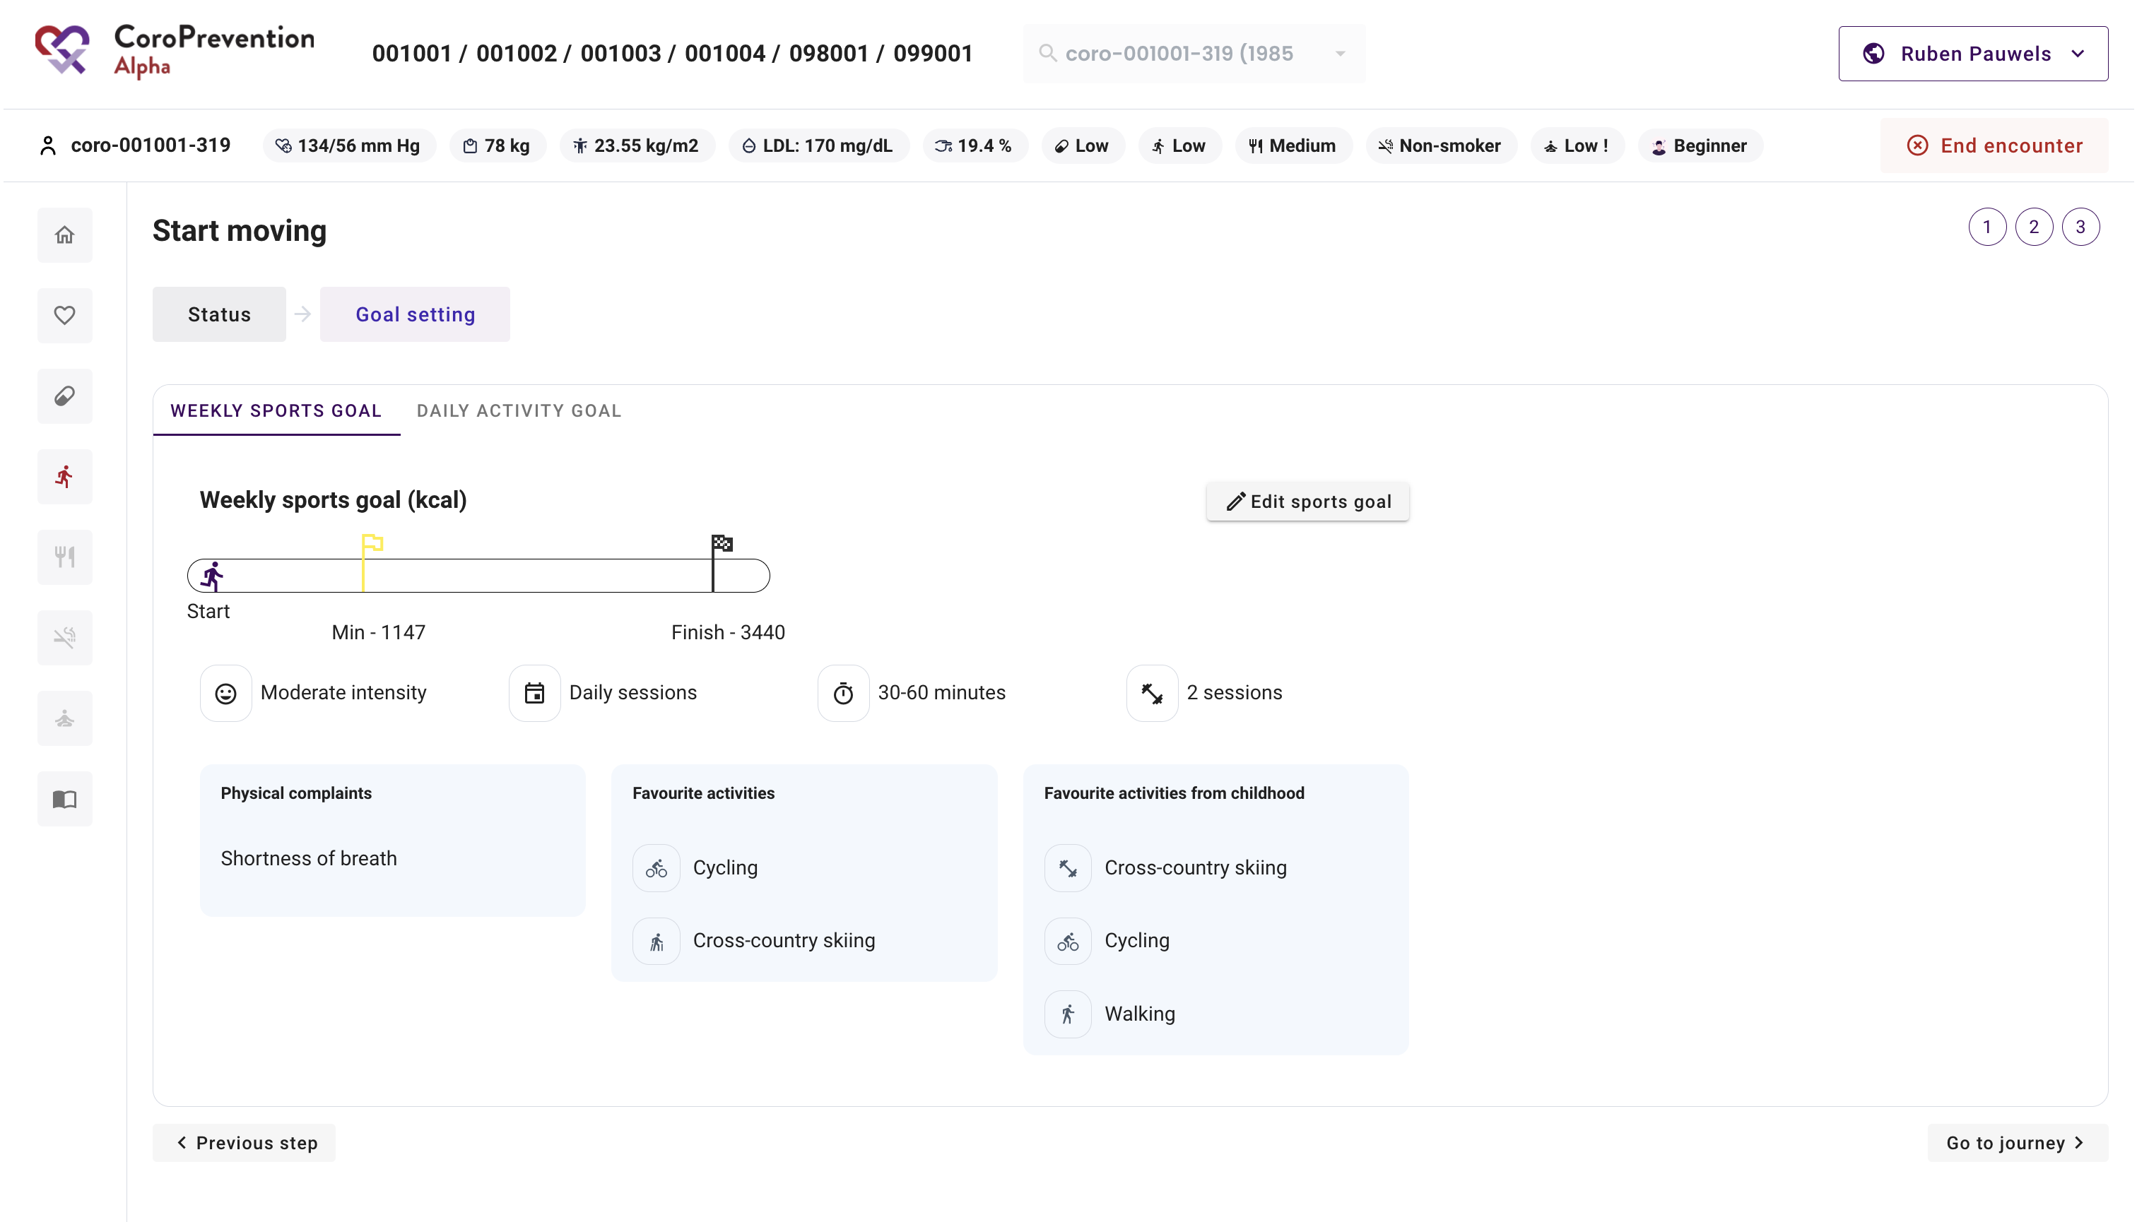
Start moving – Goal setting
View the patient’s weekly sports goal
View which physical complaints the patient experiences while exercising
View the patient’s favourites activites from childhood and currently

Slide 14
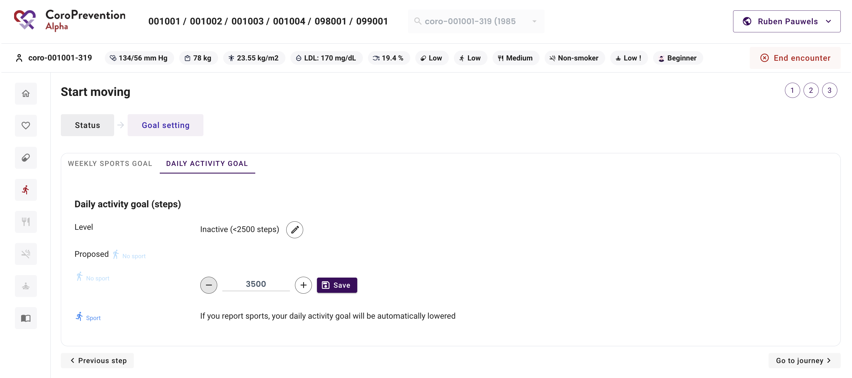
Start moving – Goal setting
View and edit the step goal class
Set the patient’s daily activity goal no sport
Daily activity goal sport = automatically calculated

Slide 15
Healthy nutrition – Status
Risk profile bar and journey status
No application module yet

Slide 16
Smoke-free living – Status
Risk profile bar and journey status
No application module yet

Slide 17
Stress relief – Status
Risk profile bar and journey status
Exclamation mark if there is special attention required
No application module yet

Slide 18
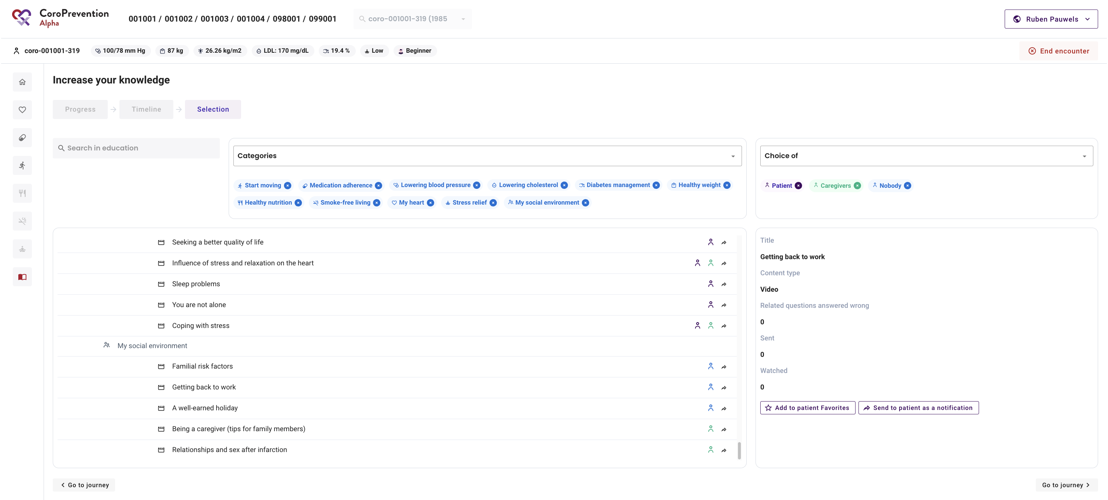
Increase your knowledge - Selection
View the patient’s preferred educational content
View the patient’s recommended educational content
Sent educational content to the patient
Add educational content to the patient’s favourites

Slide 19
Visit 3-7

Slide 20
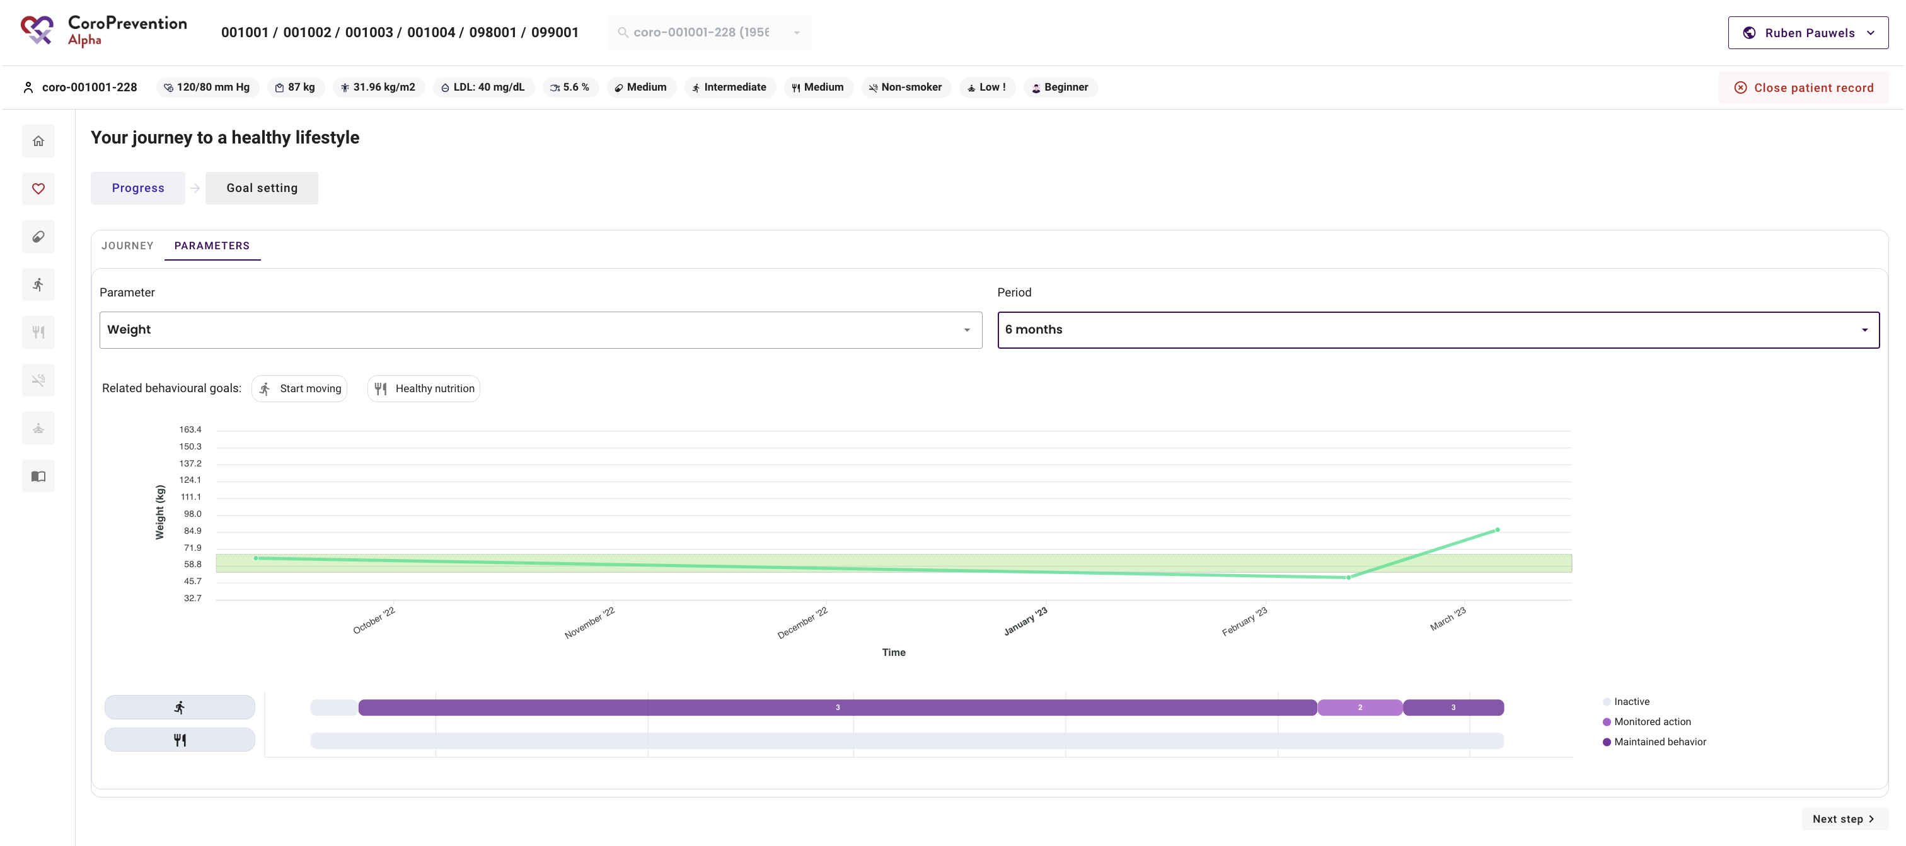
Parameters – Progress
View the patient’s evolution in parameter values
View which behavioural goals are related to the parameters

Slide 21
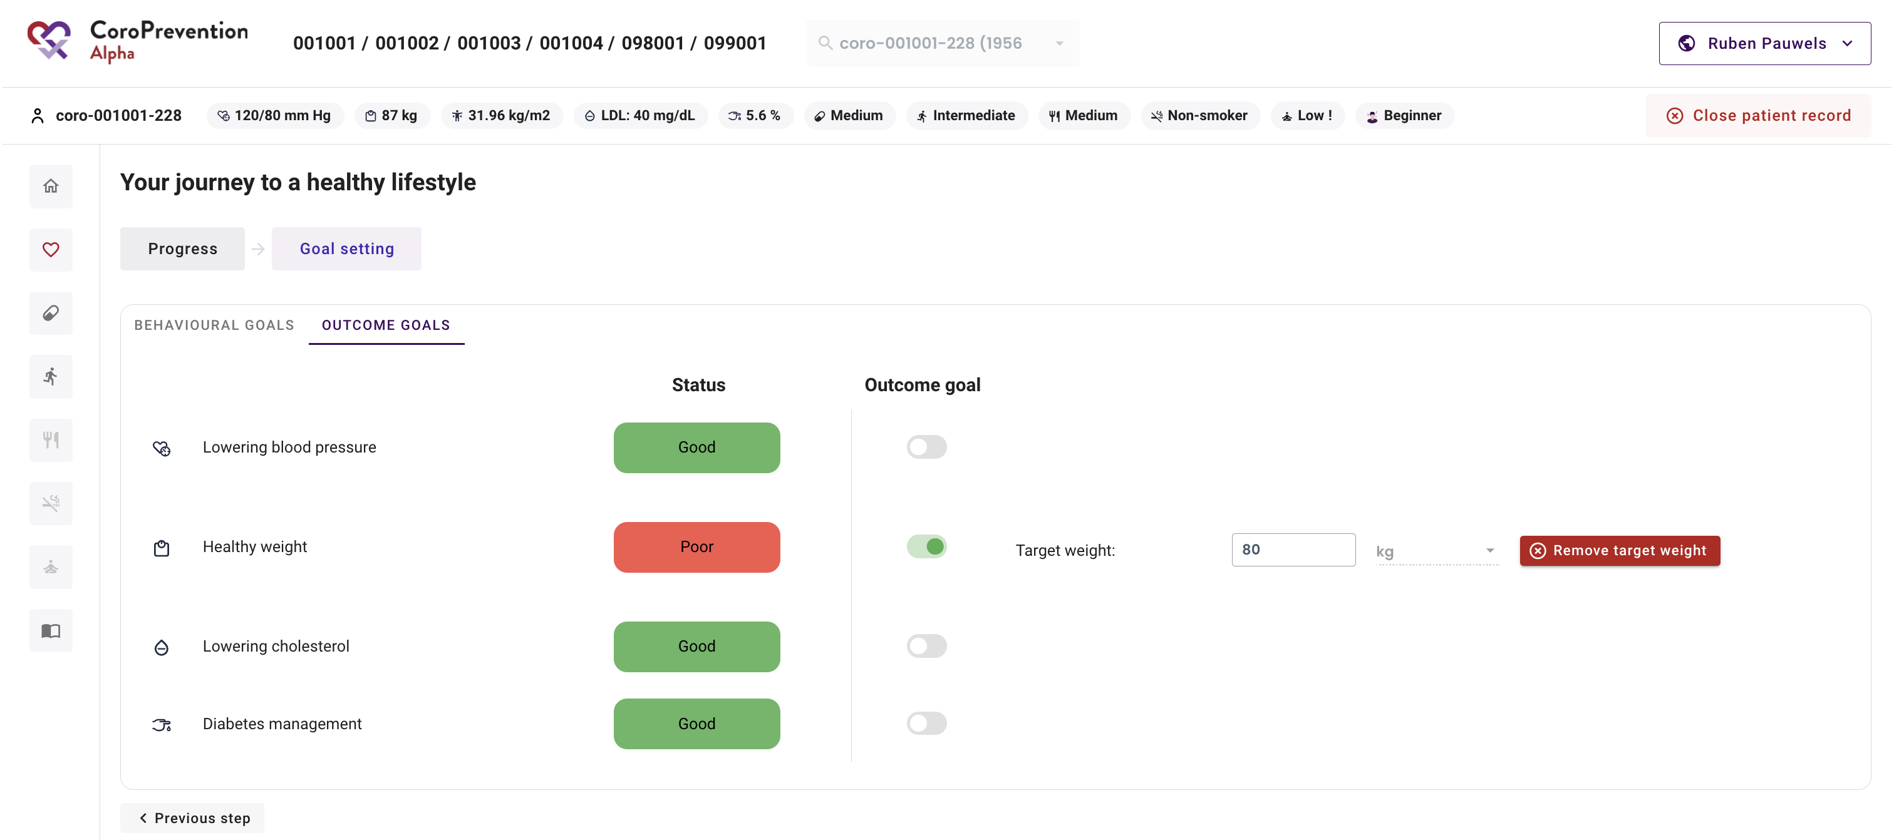
Parameters – Goal setting
View the patient’s status for the outcome goals
View the recommended outcome goals based on the patient’s parameter values
Activate/Deactivate outcome goals
Set a target weight

Slide 22
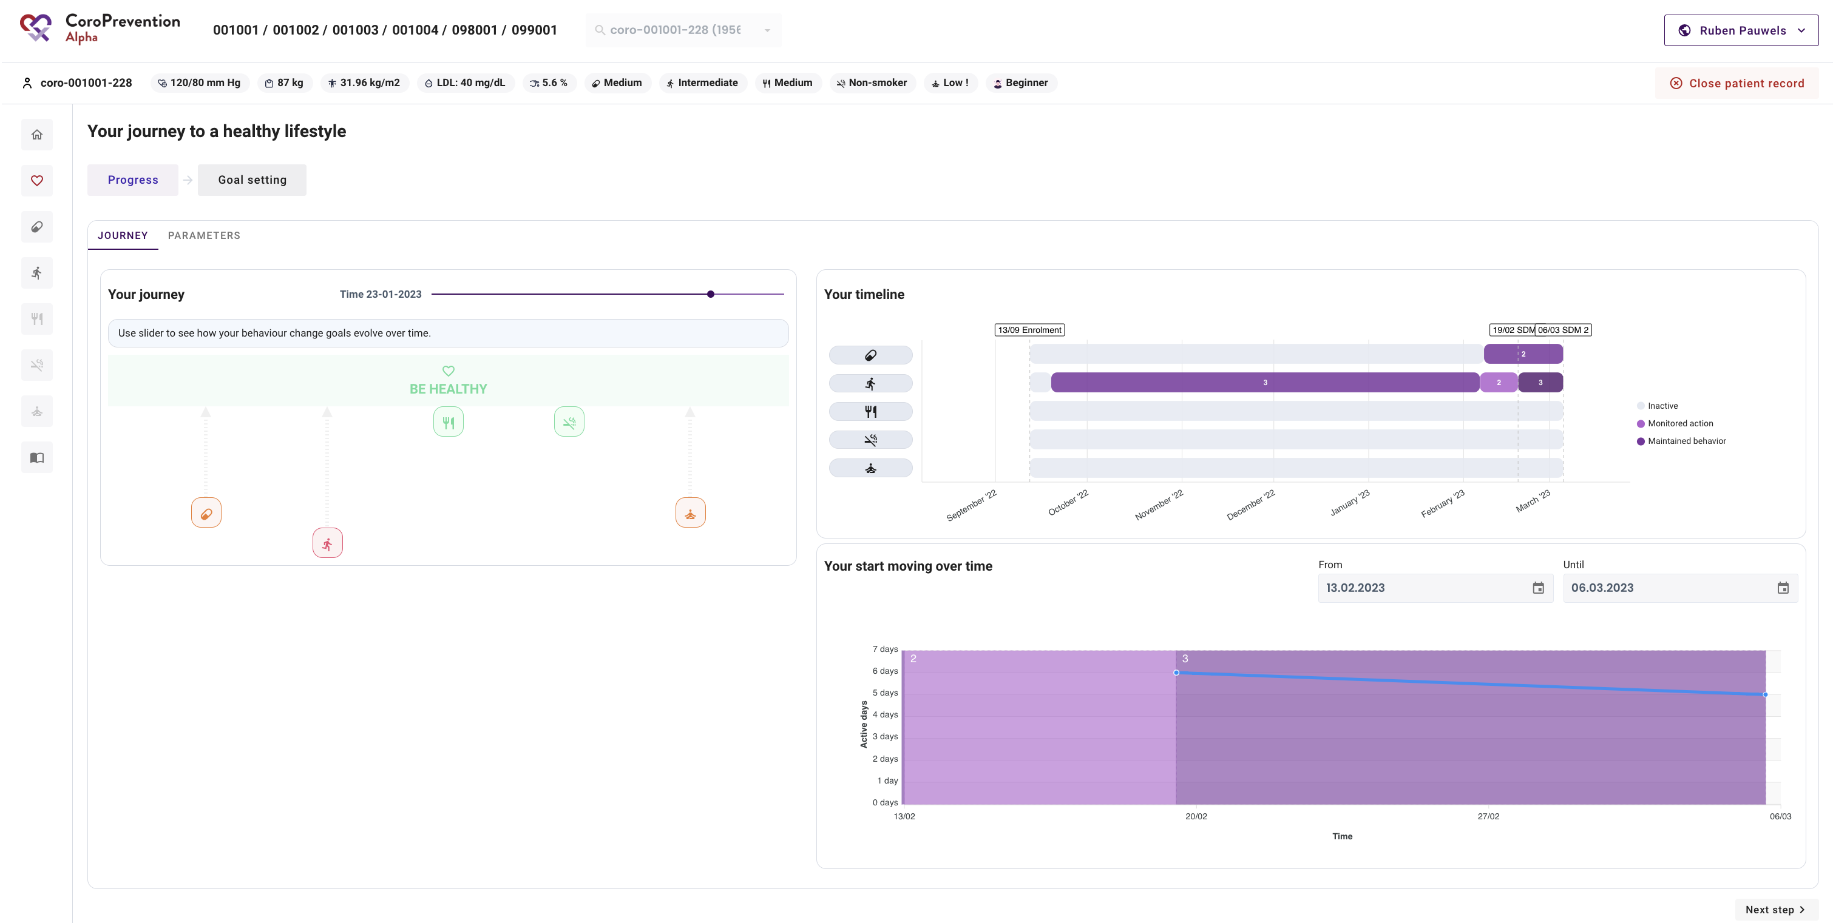
Journey – Status
View how the patient’s status for the behavioural goals evolved
View how the patient switched in level of guidance for the behavioural goals
View details about the status for the behavioural goals over time

Slide 23
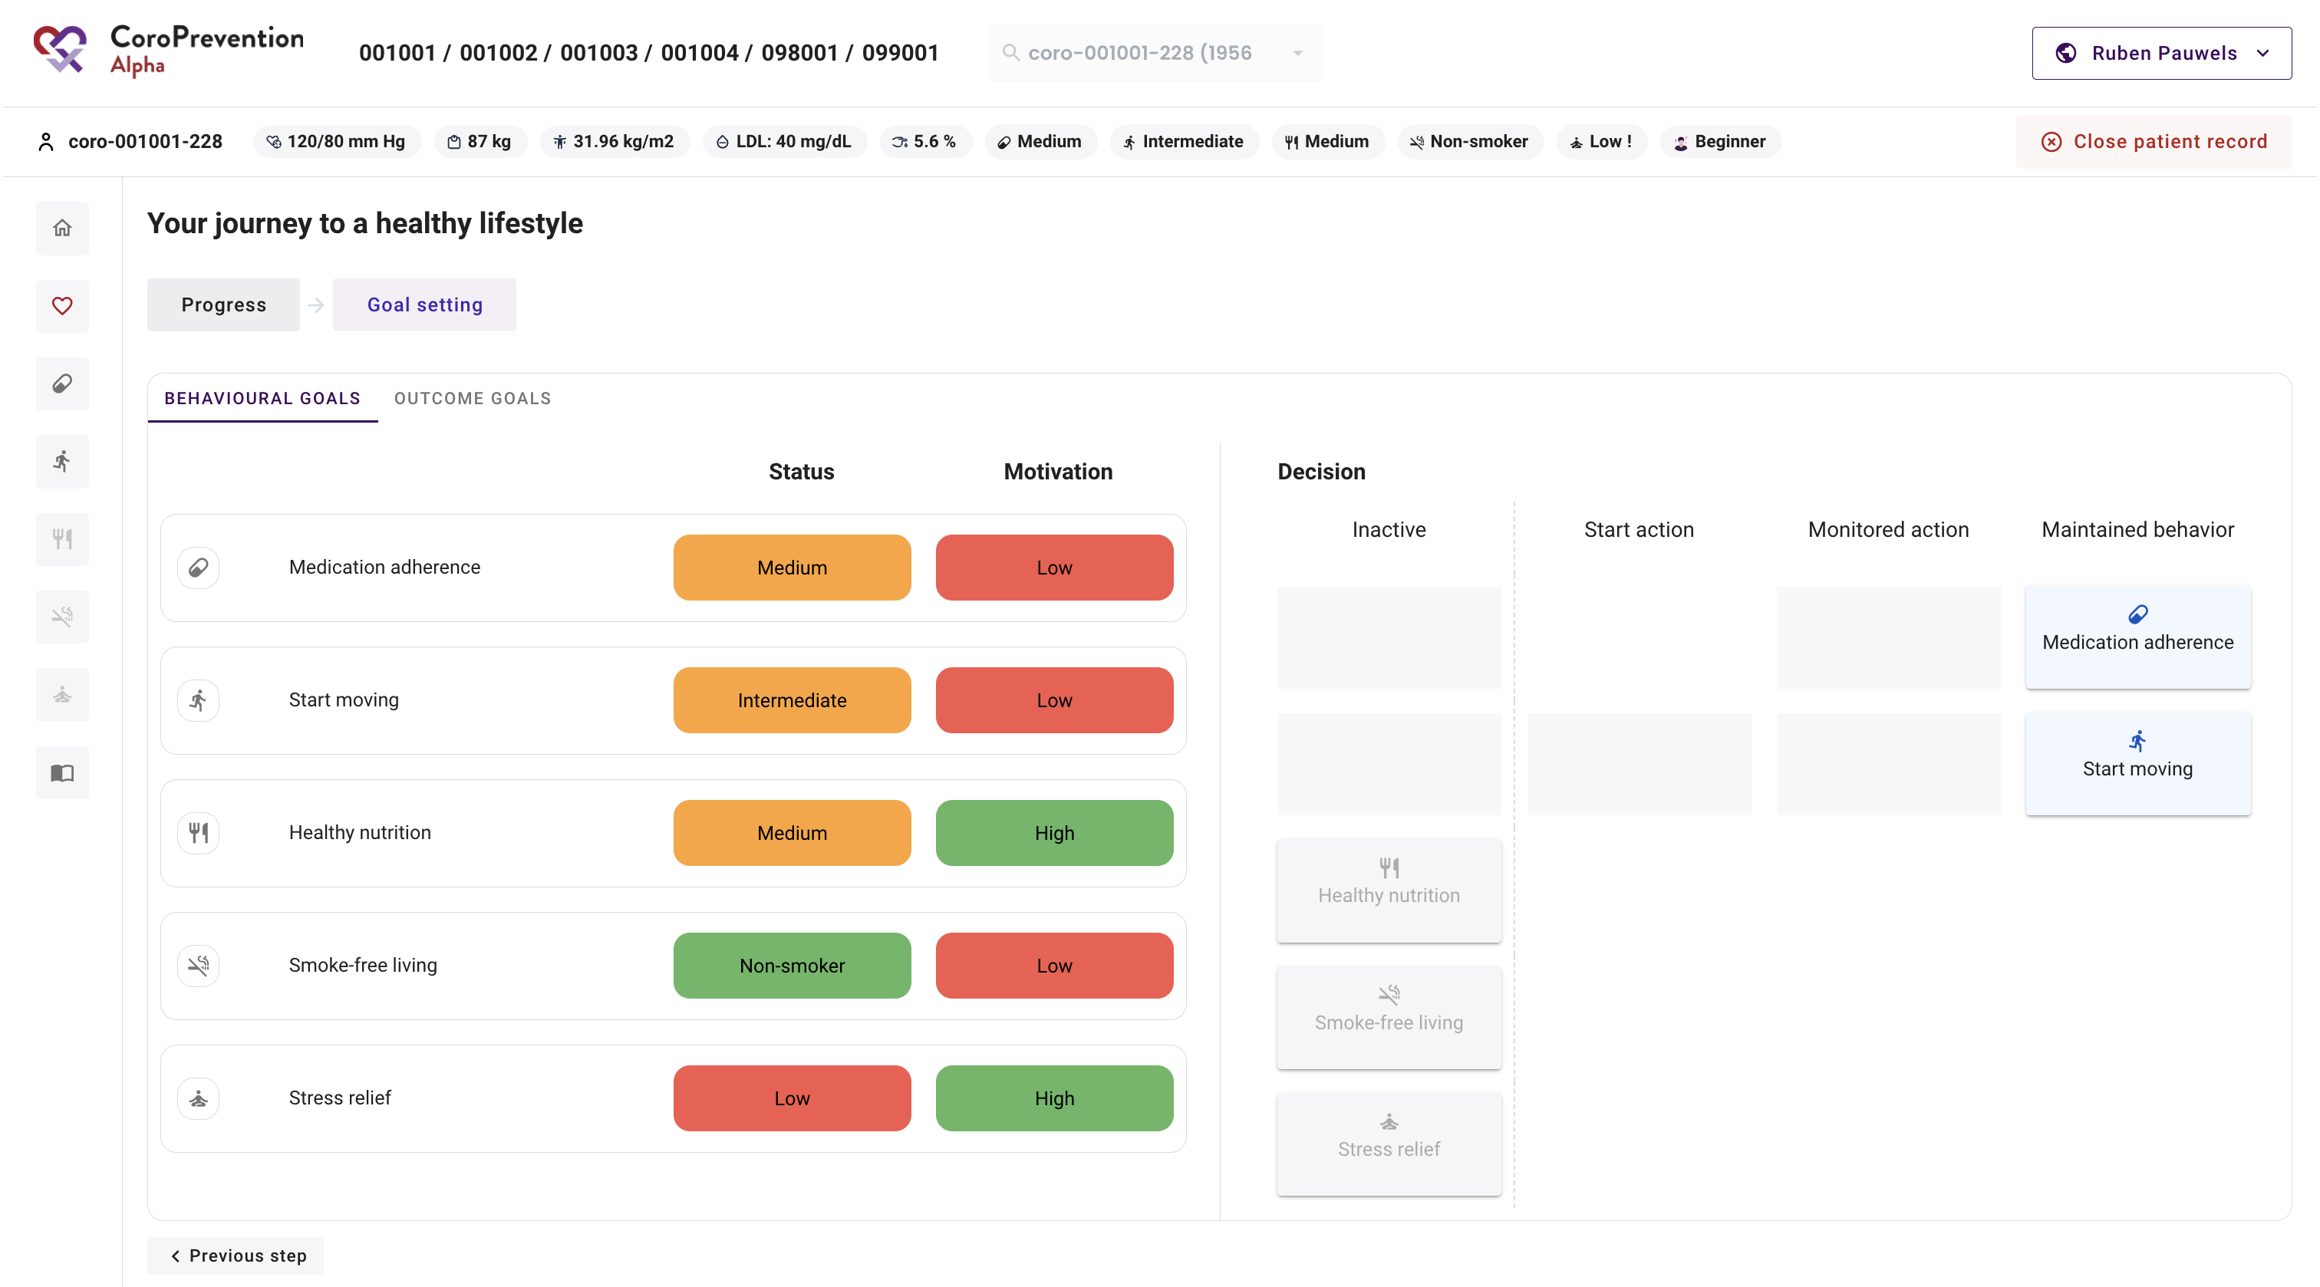
Journey – Goal setting
View the patient’s status for the behavioural goals
View the patient’s motivation for the behavioural goals
View the patient’s configuration of levels of guidance for the behavioural goals

Slide 24
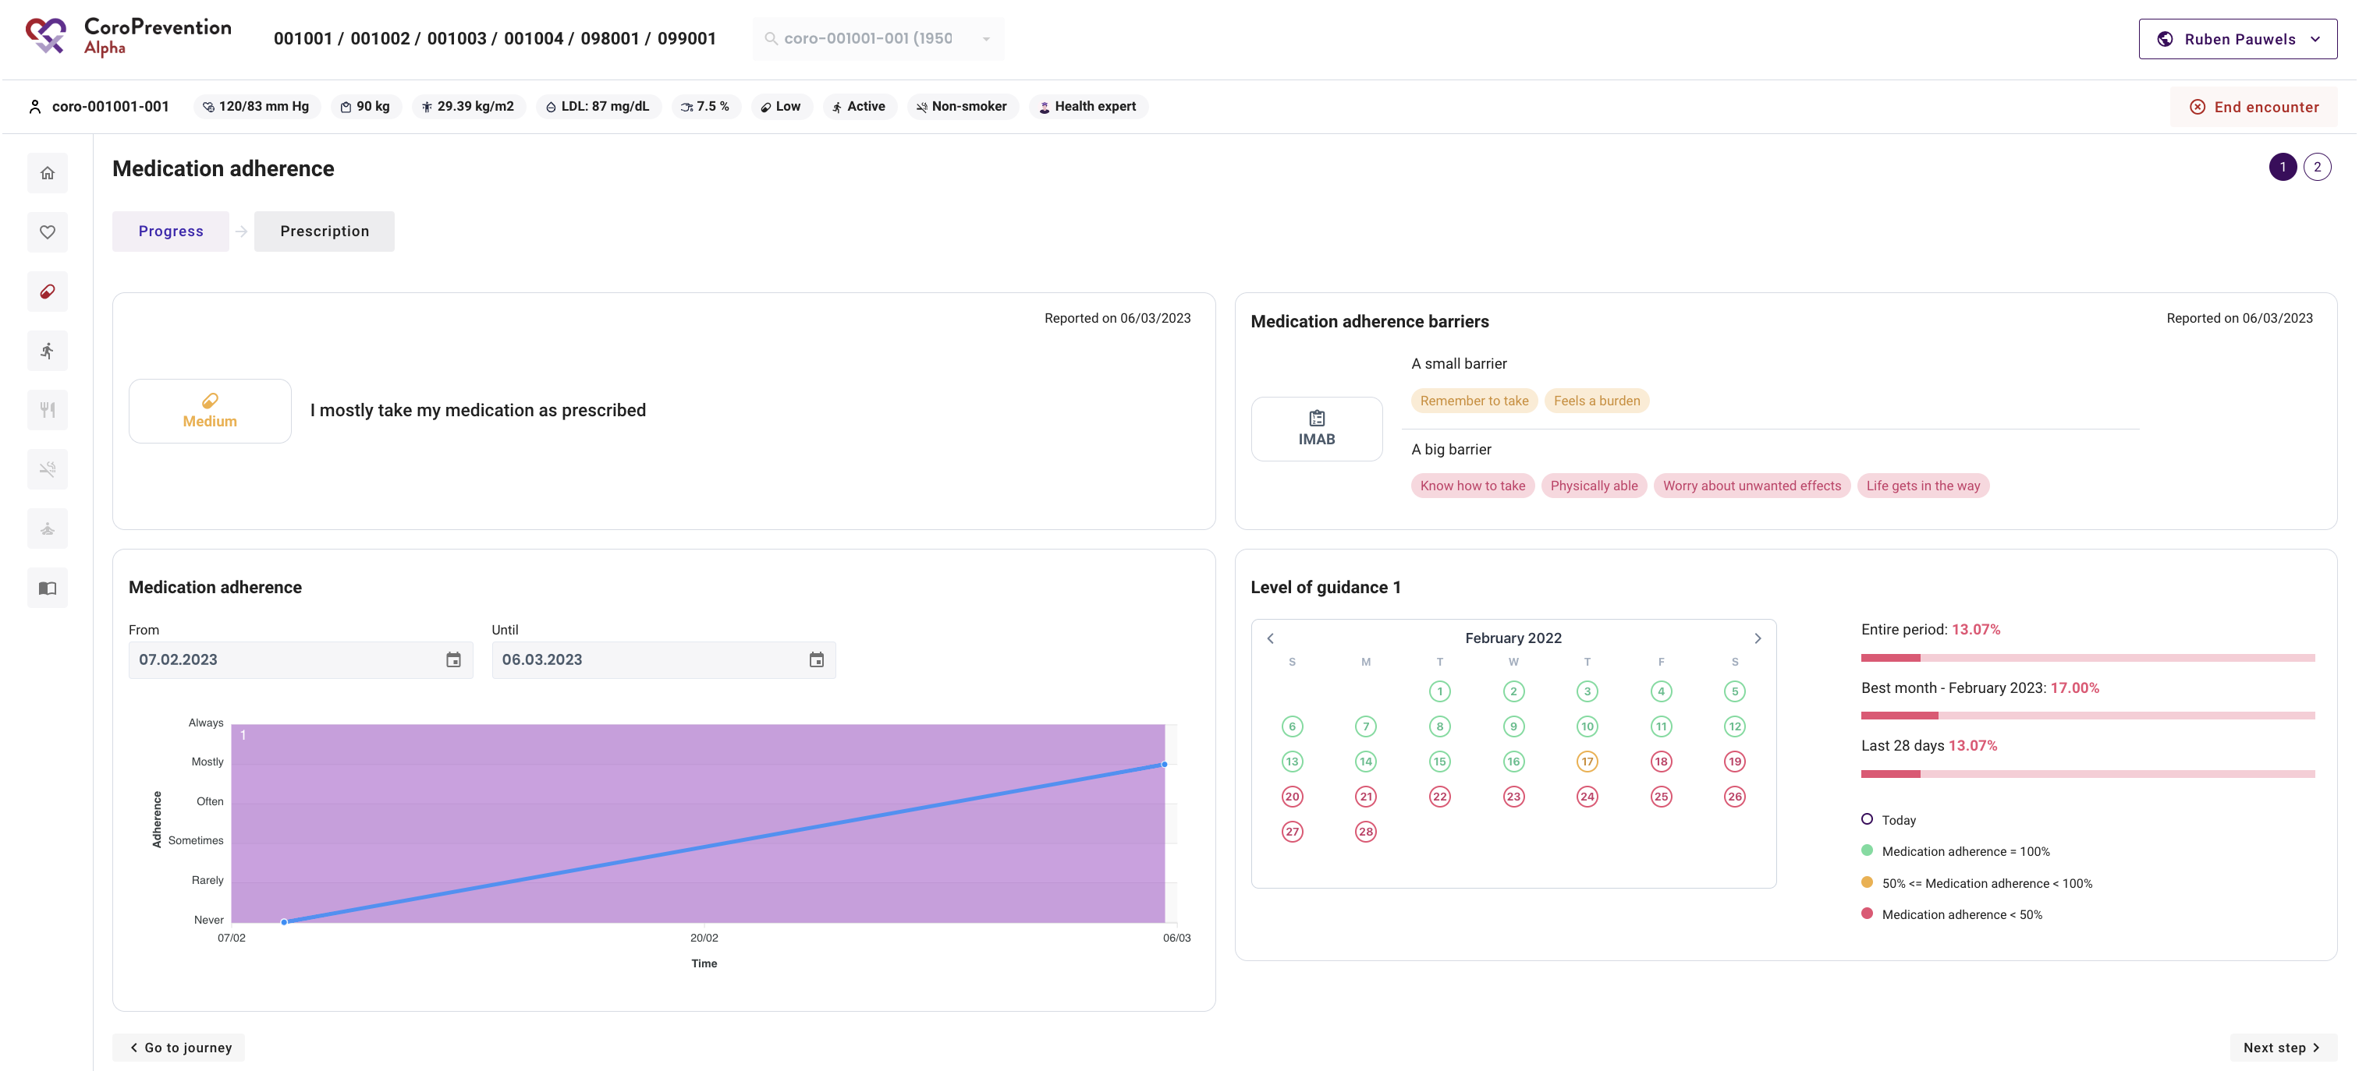
Medication adherence – Progress
View the patient’s current medication adherence
View the patient’s barriers for taking medication as prescribed
View the patient’s medication adherence over time
View the detailed medication adherence when the patient was in level of guidance 1 (“Monitored action”)

Slide 25
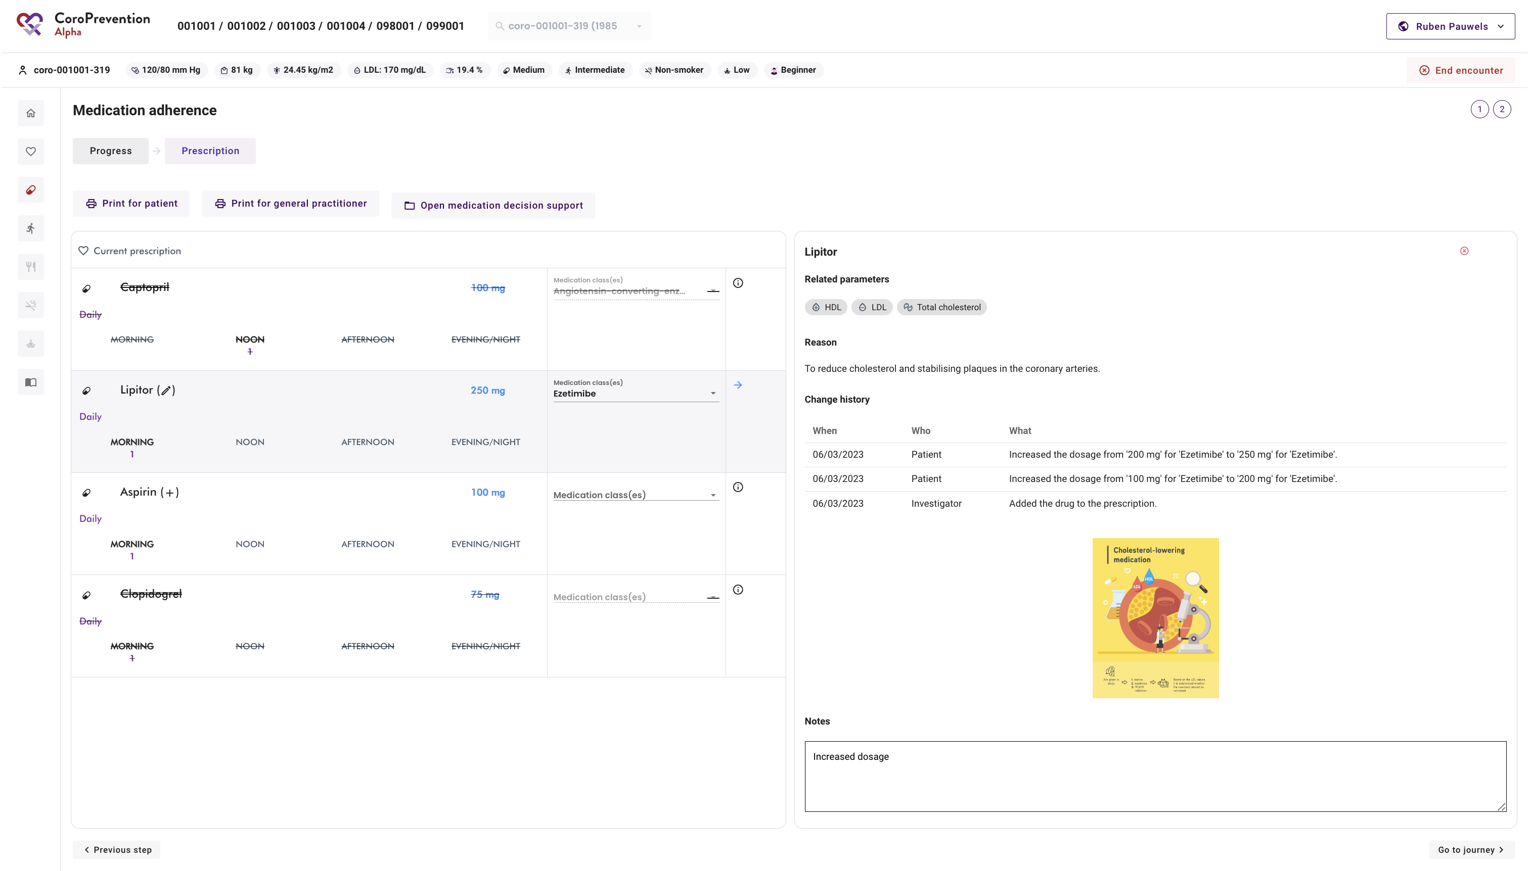
Medication adherence – Prescription
View the patient’s current medication prescription and changes compared to last visit
Select for each drug the medication class
Print medication prescription for patient and GP
View the details about a drug
View infographics to discuss the importance of the drugs
Read and take notes

Slide 26
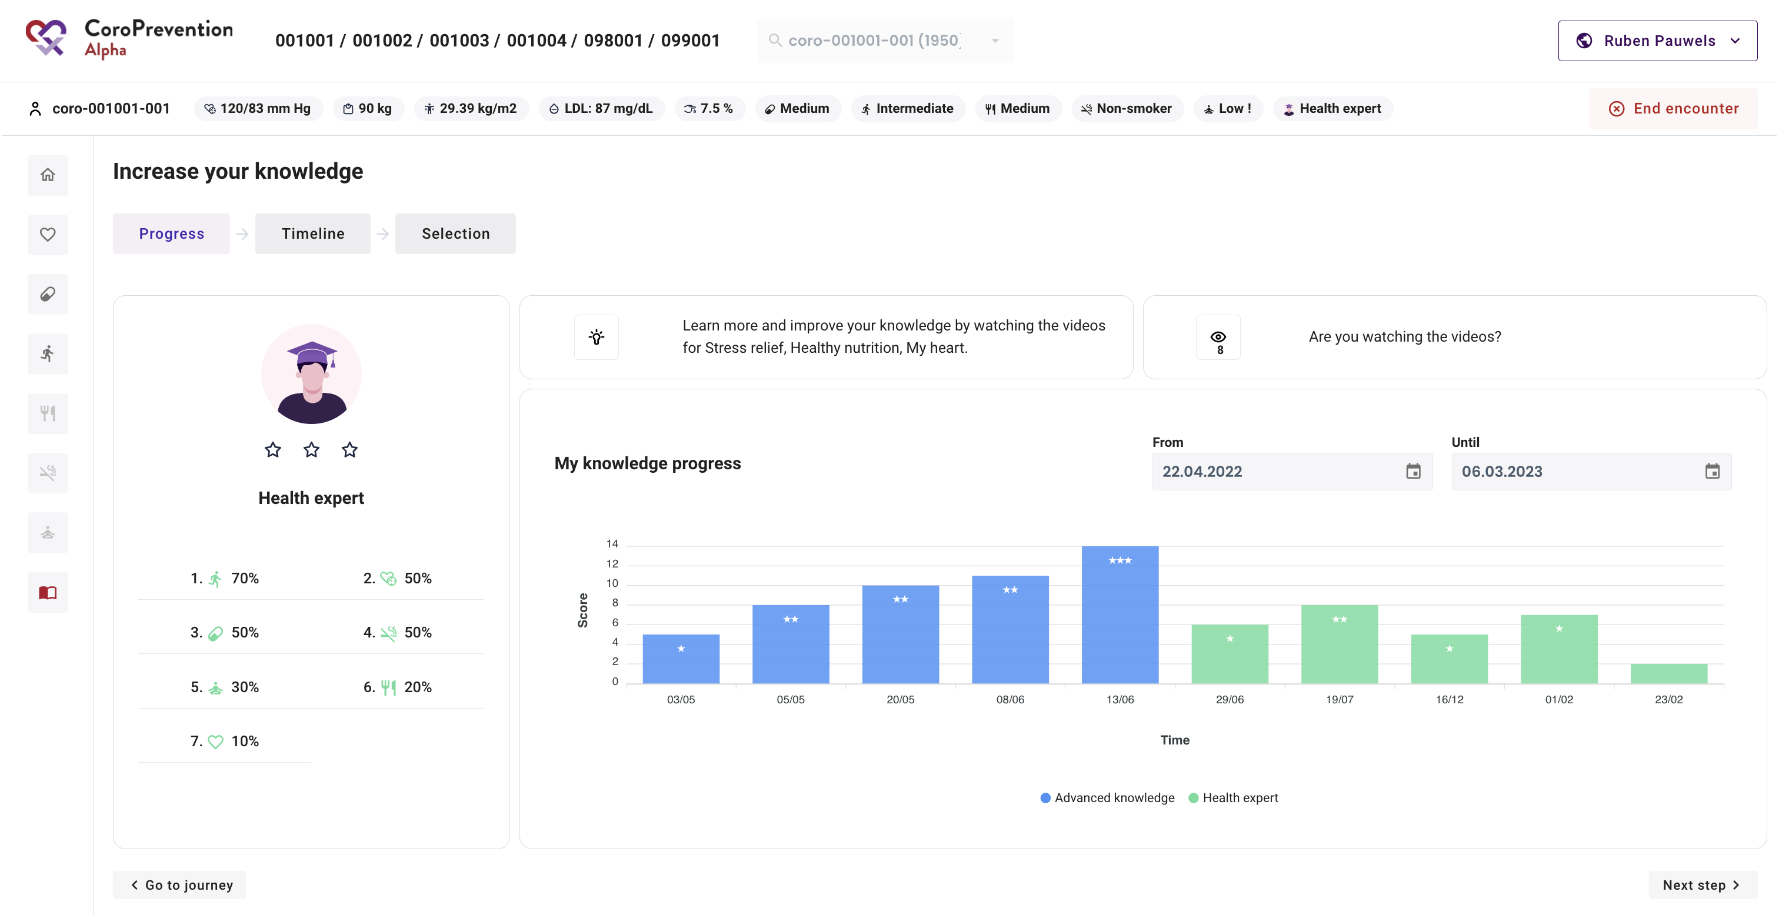
Increase your knowlege – Progress
View the patient’s current knowlegde level, performance on the last knowledge challenge and knowledge percentages
View the evolution of the patient’s knowledge over time
View about which domains the patient needs to learn more
View if the patient is watching the educational material

Slide 27
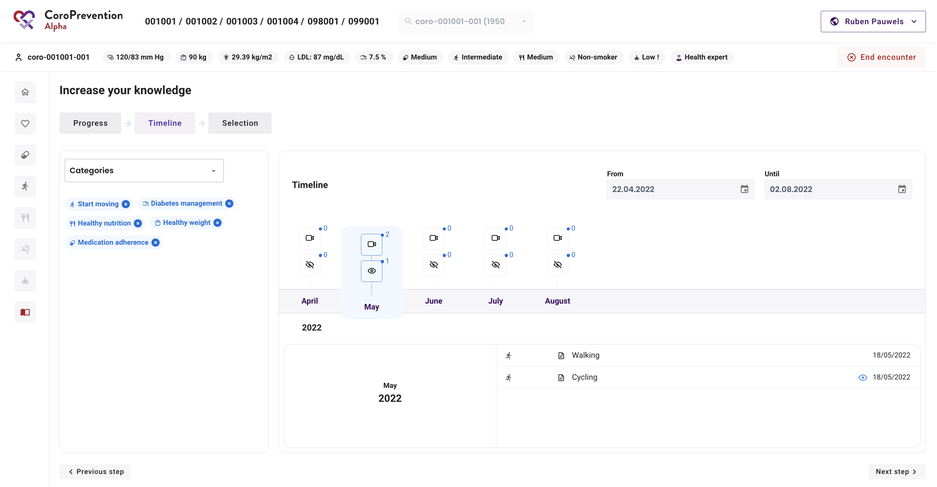
Increase your knowlege – Timeline
View the educational material that was sent to the patient
View if the patient watched the sent material

Slide 28
How can you use the Tool Suite during encounters with the patient
Cindel Bonneux, UniWeb and prof. dr. Hanne Kindermans, UHasselt

