Slide 1
EDC overview and problems + how to enroll a patient in the Tool Suite
Cindel Bonneux, UniWeb

Slide 2
Prepare for visit 1

Slide 3
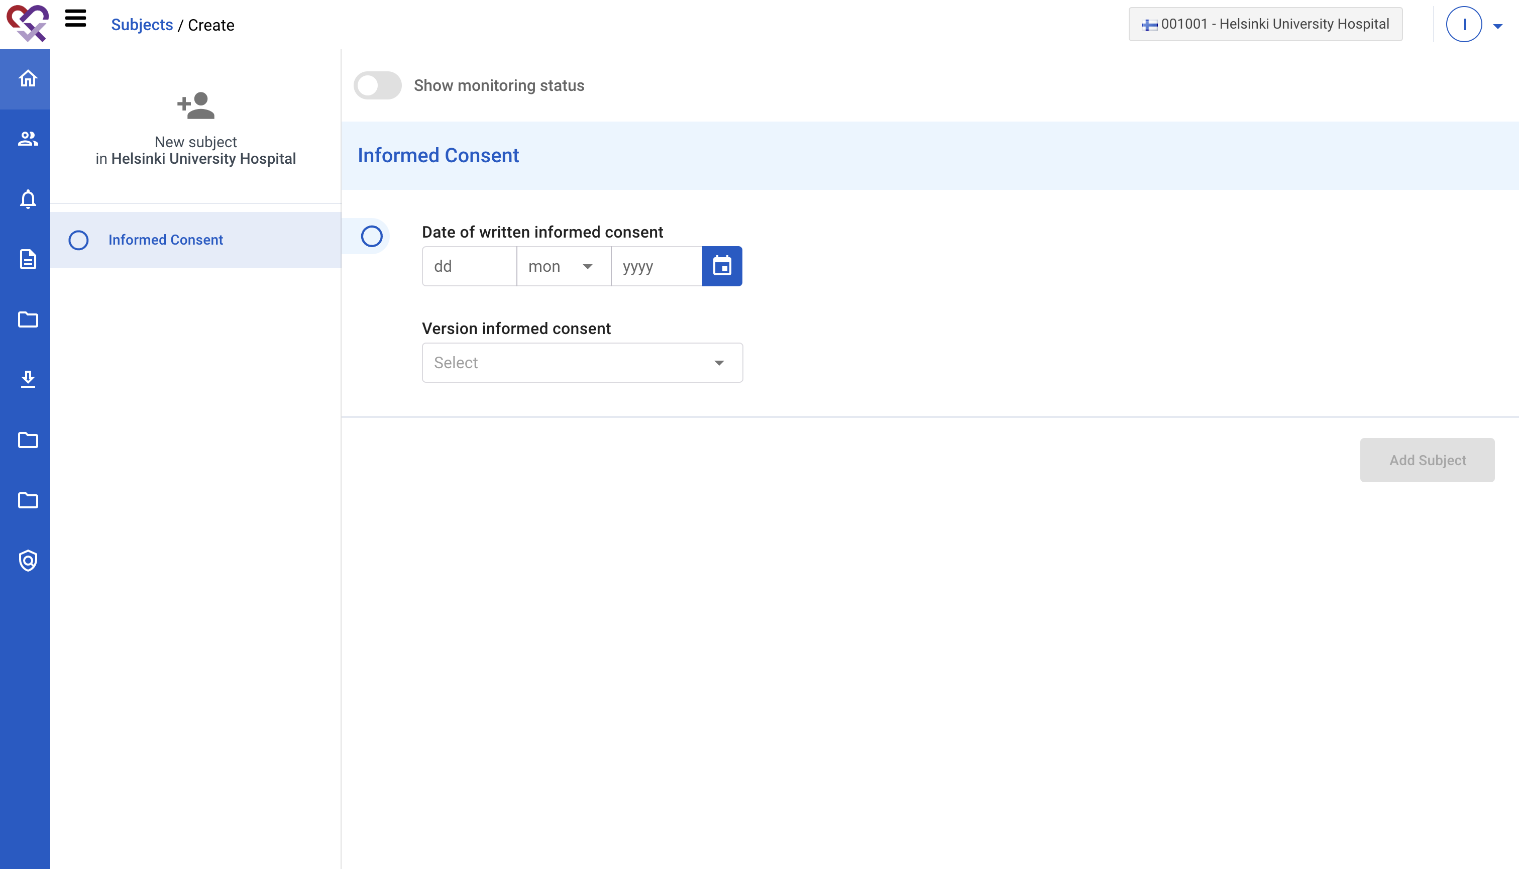
Create patient in EDC
Create a new patient in the EDC
Fill in date and version of informed consent

Slide 4
Have visit 1 with the patient

Slide 5
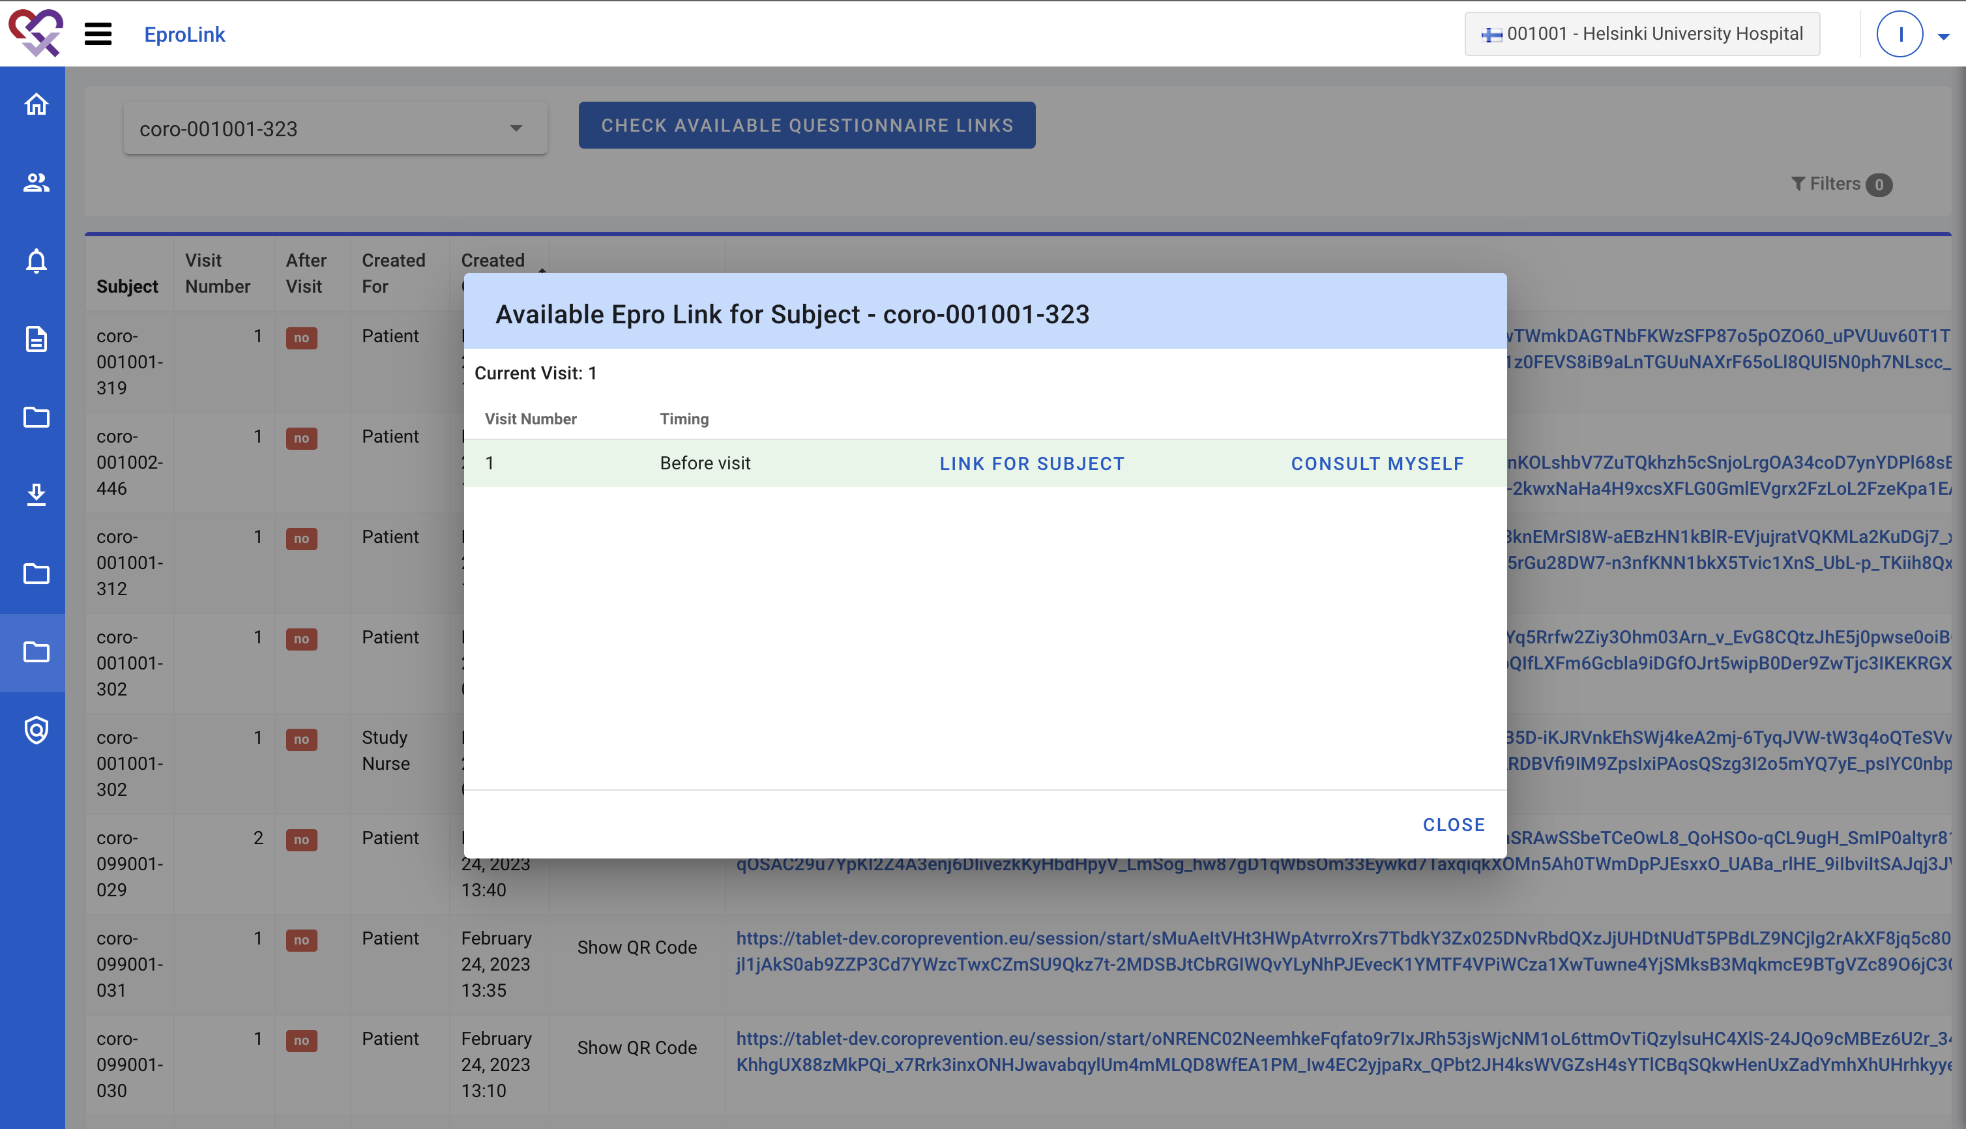
Complete ePROs for visit 1
Generate a link or QR code for the ePROs

Slide 6
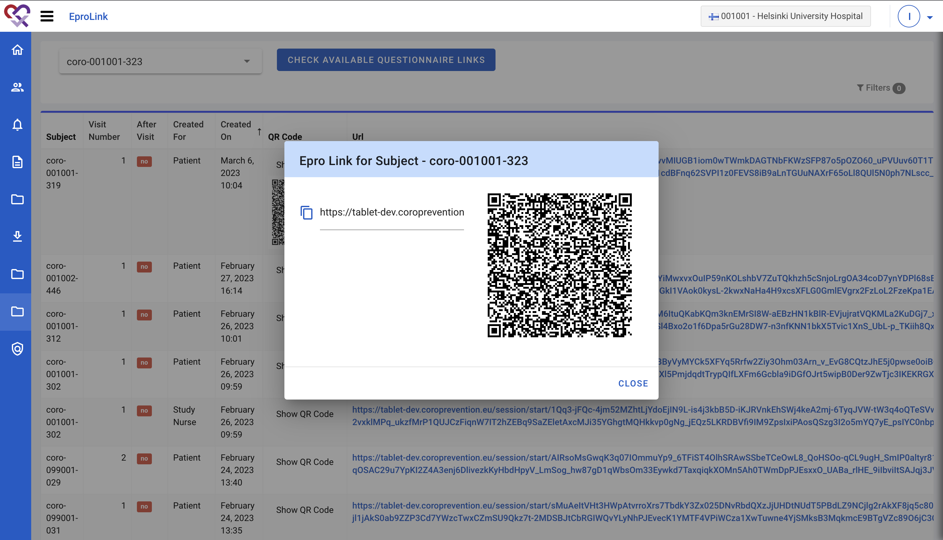
Complete ePROs for visit 1
Generate a link or QR code for the ePROs

Slide 7
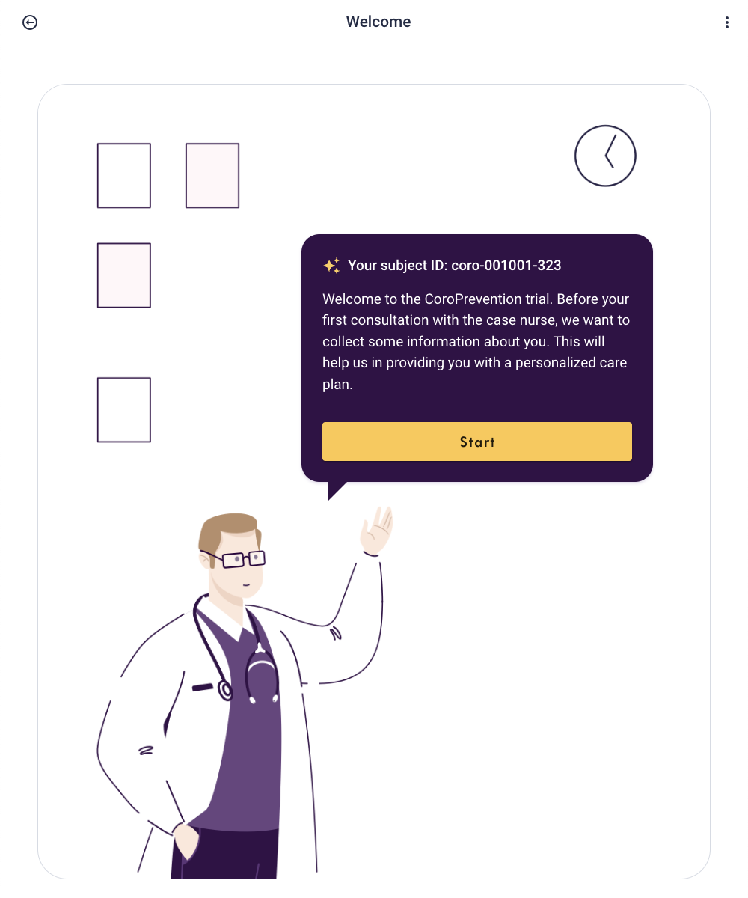
Complete ePROs for visit 1
Ask patient to complete the ePROs (custom and standardized questionnaires)

Slide 8
Prepare for visit 2

Slide 9
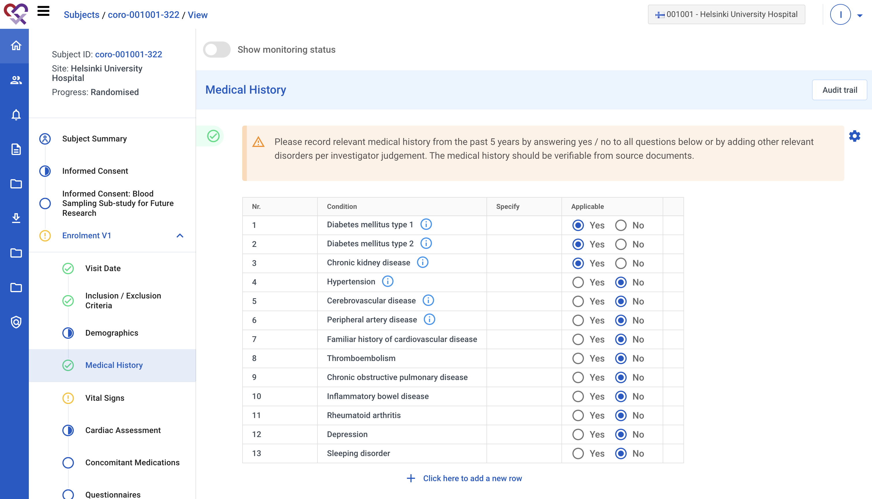
EDC – Complete visit 1 information
Registration of patient data → used for outcome analysis
Information from the EDC visit 1 can be imported to Tool Suite
Randomize subject

Slide 10
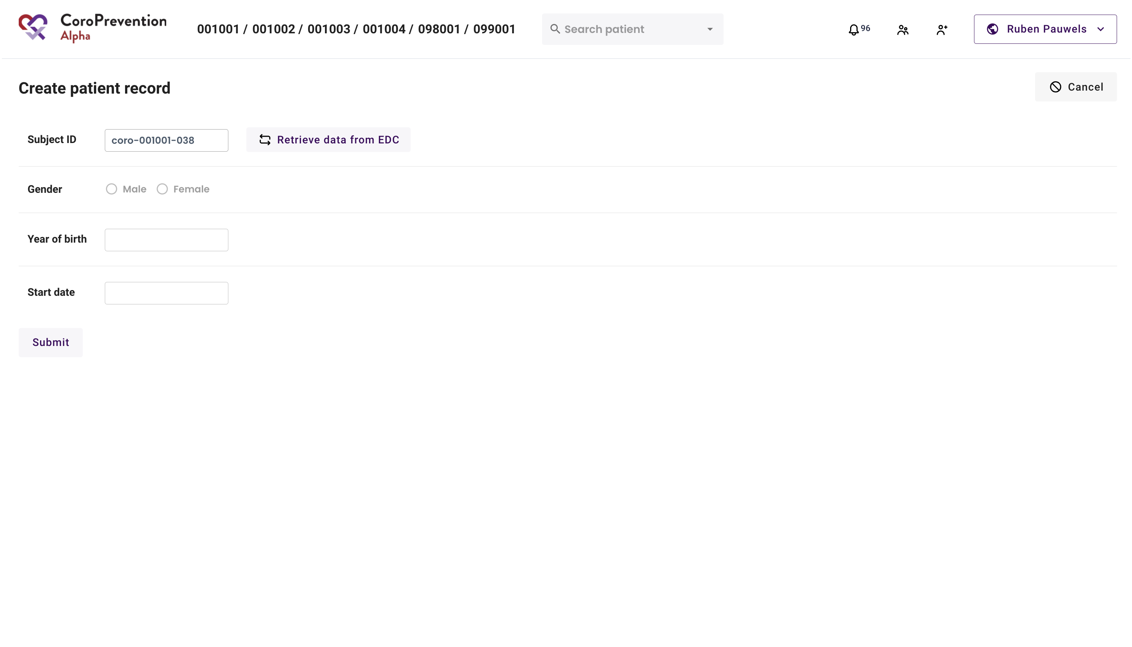
Import patient in Tool Suite
After creating the patient in the EDC, fill in the subject ID

Slide 11
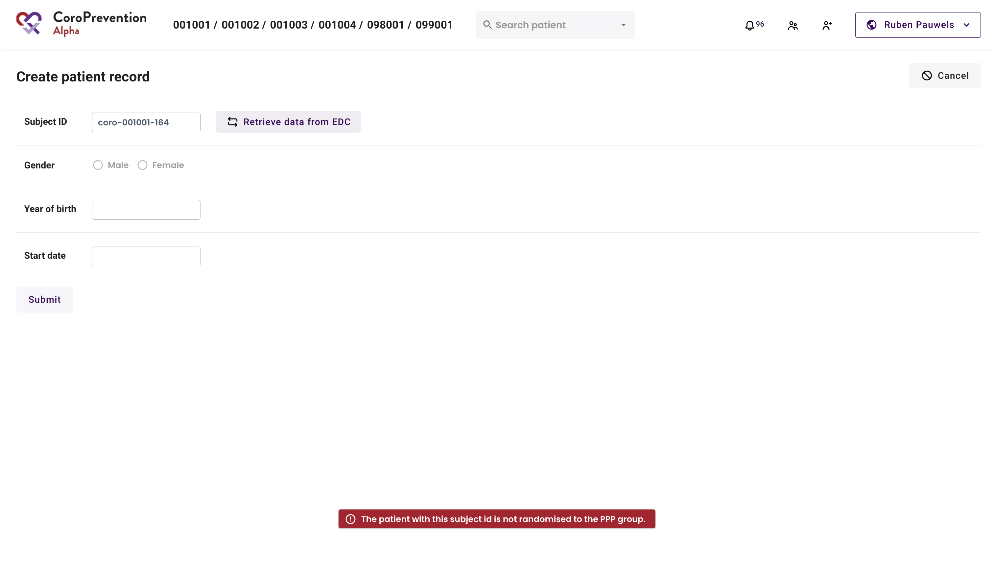
Import patient in Tool Suite
Only patients randomized into the PPP group can be imported into the Tool Suite

Slide 12
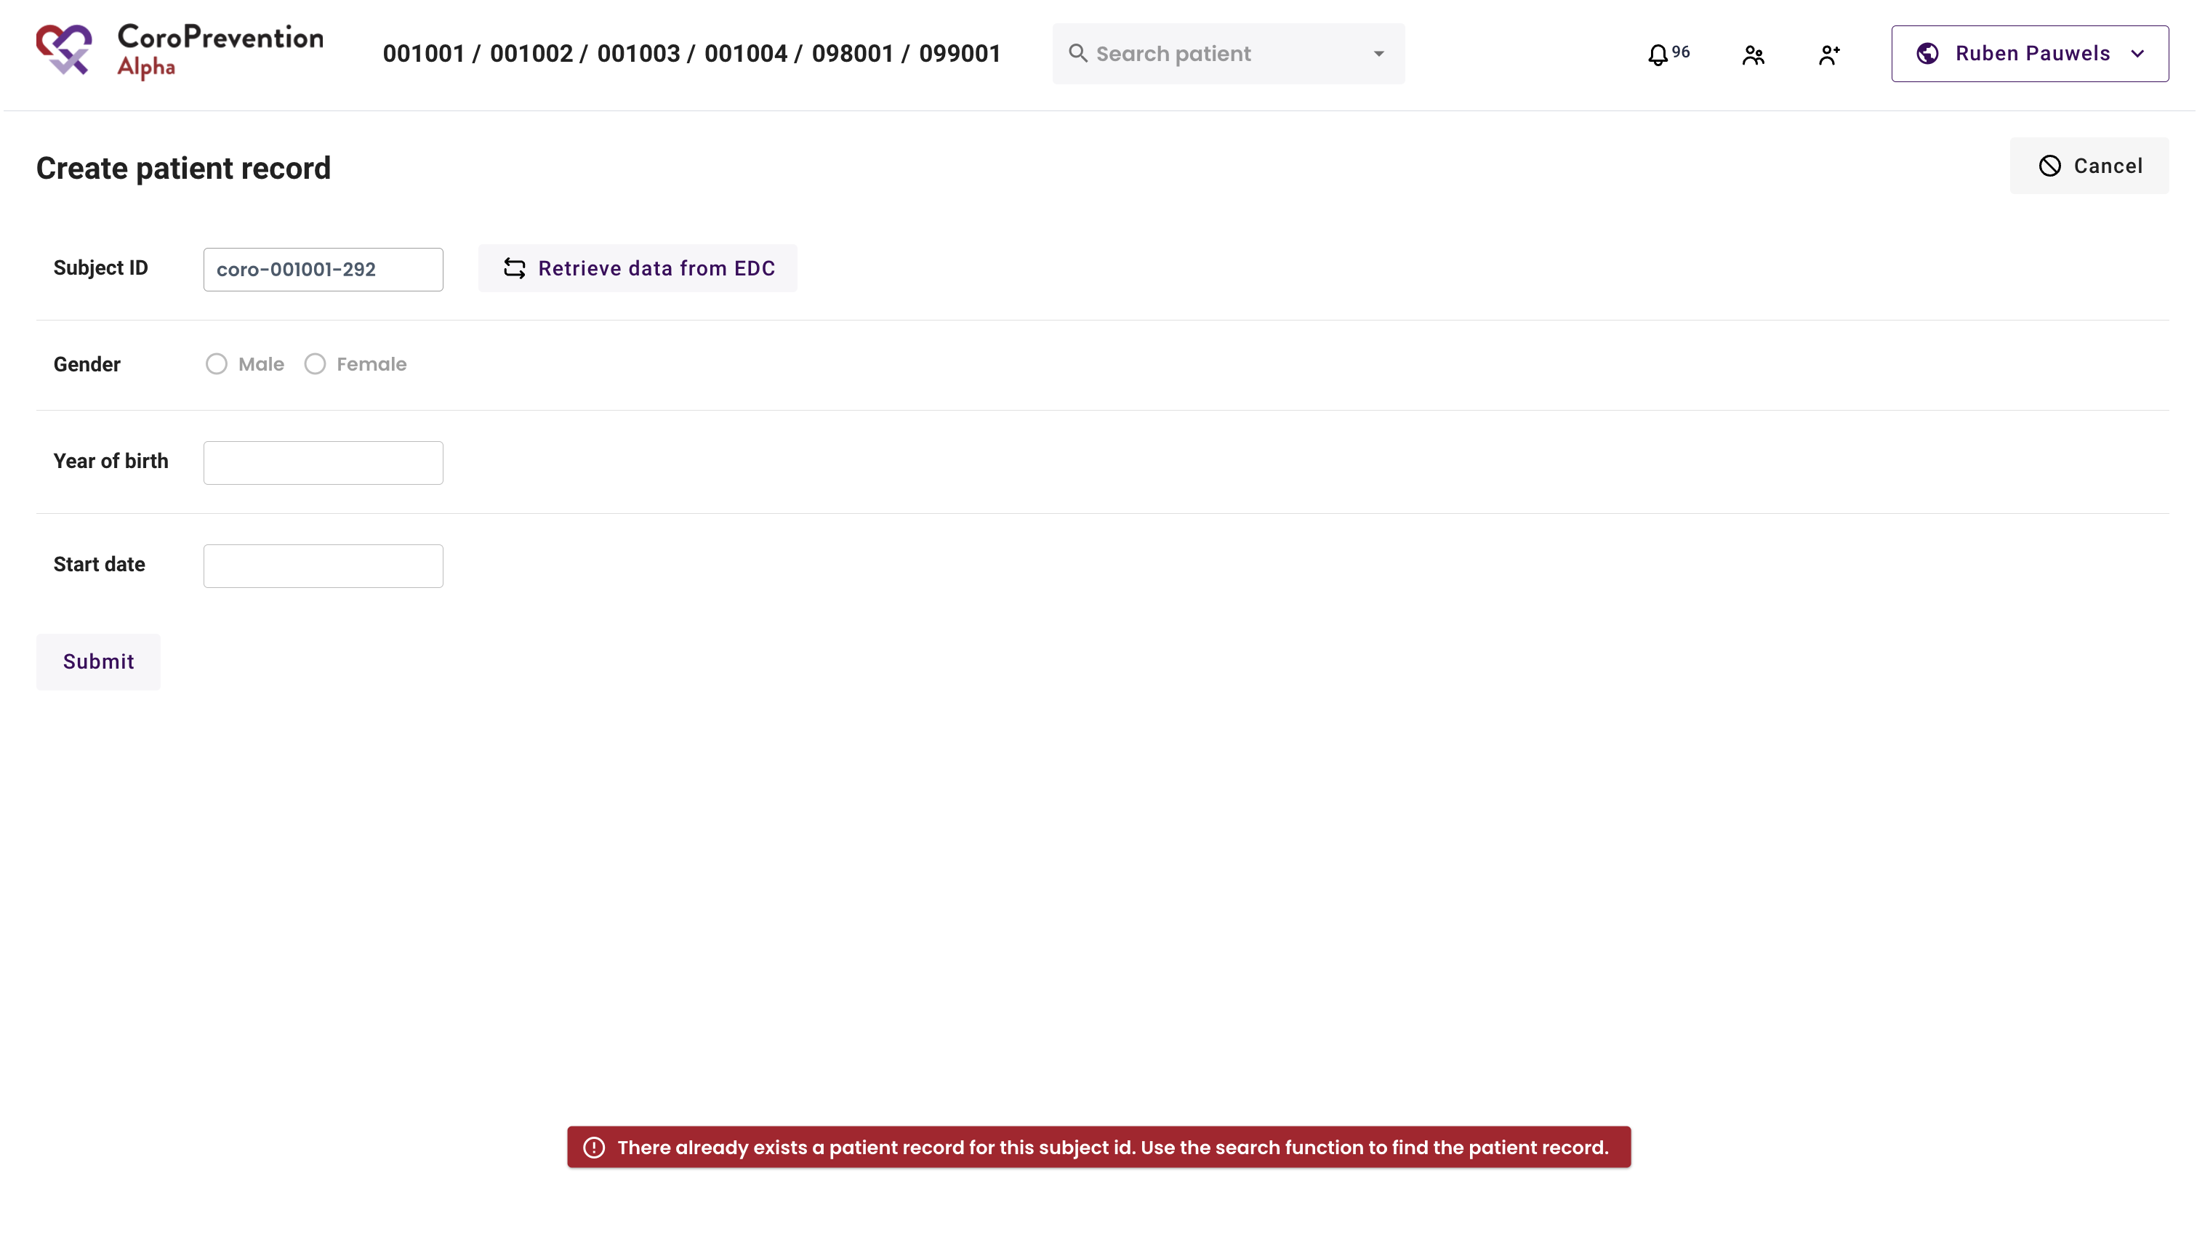
Import patient in Tool Suite
Each patient can only be imported once

Slide 13
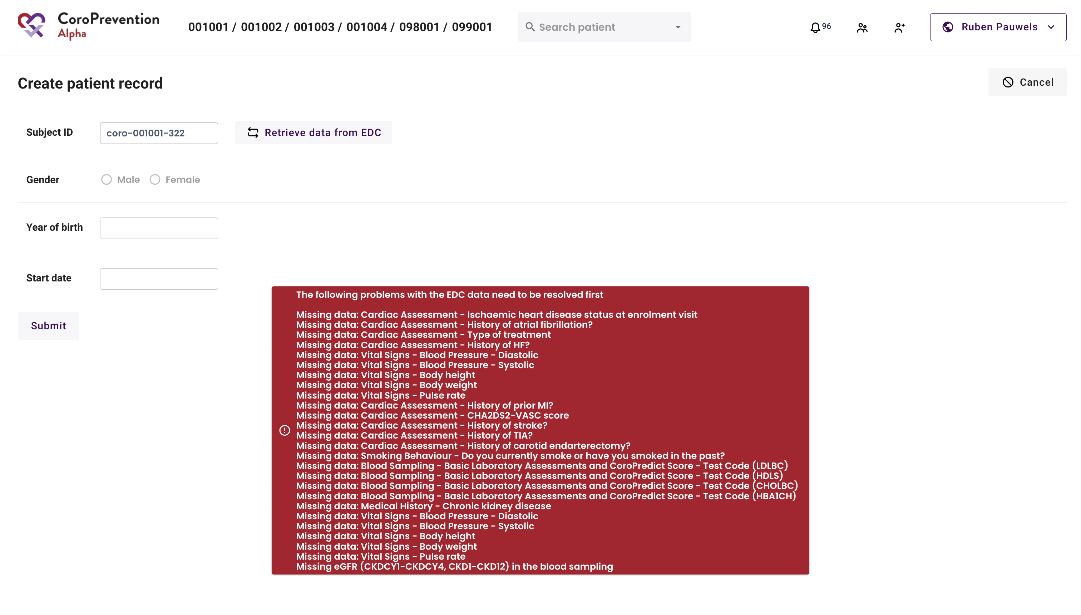
Import patient in Tool Suite
Required information for visit 1 should be completed in the EDC system

Slide 14
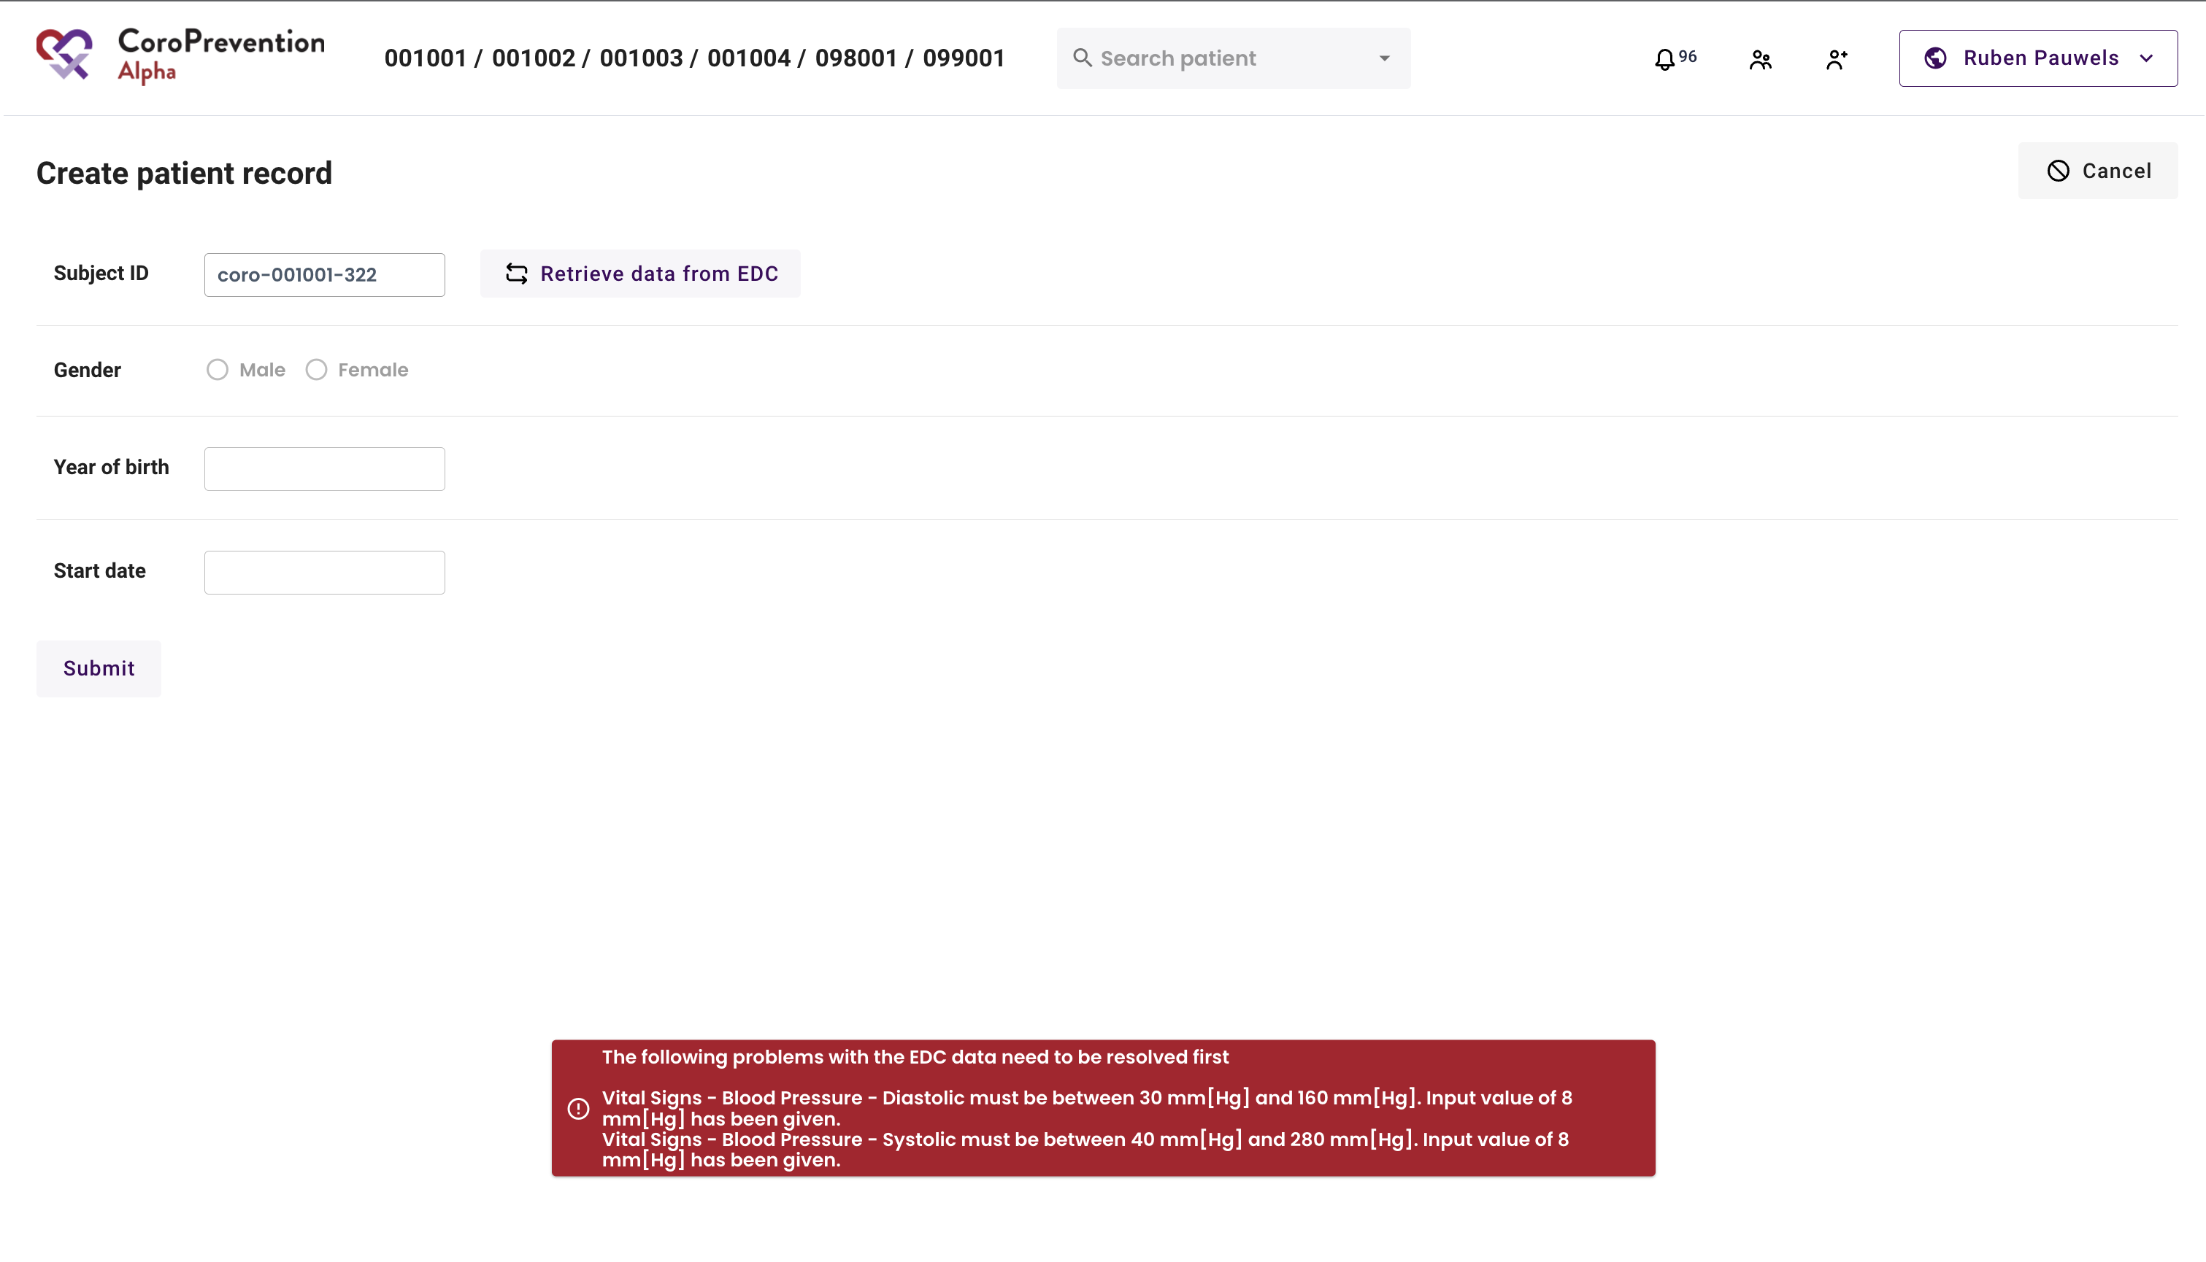
Import patient in Tool Suite
Data should be within the expected ranges

Slide 15
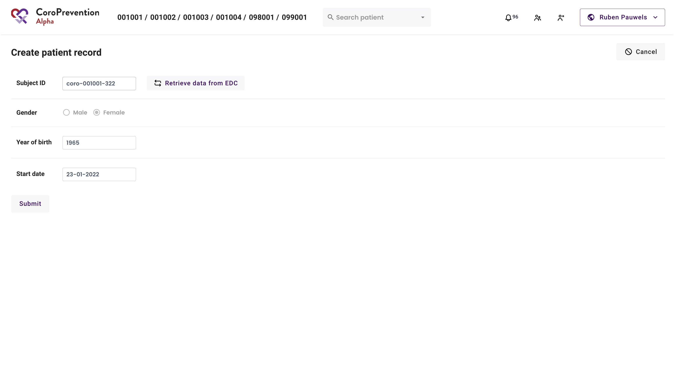
Import patient in Tool Suite
Successful retrieve of information from EDC

Slide 16
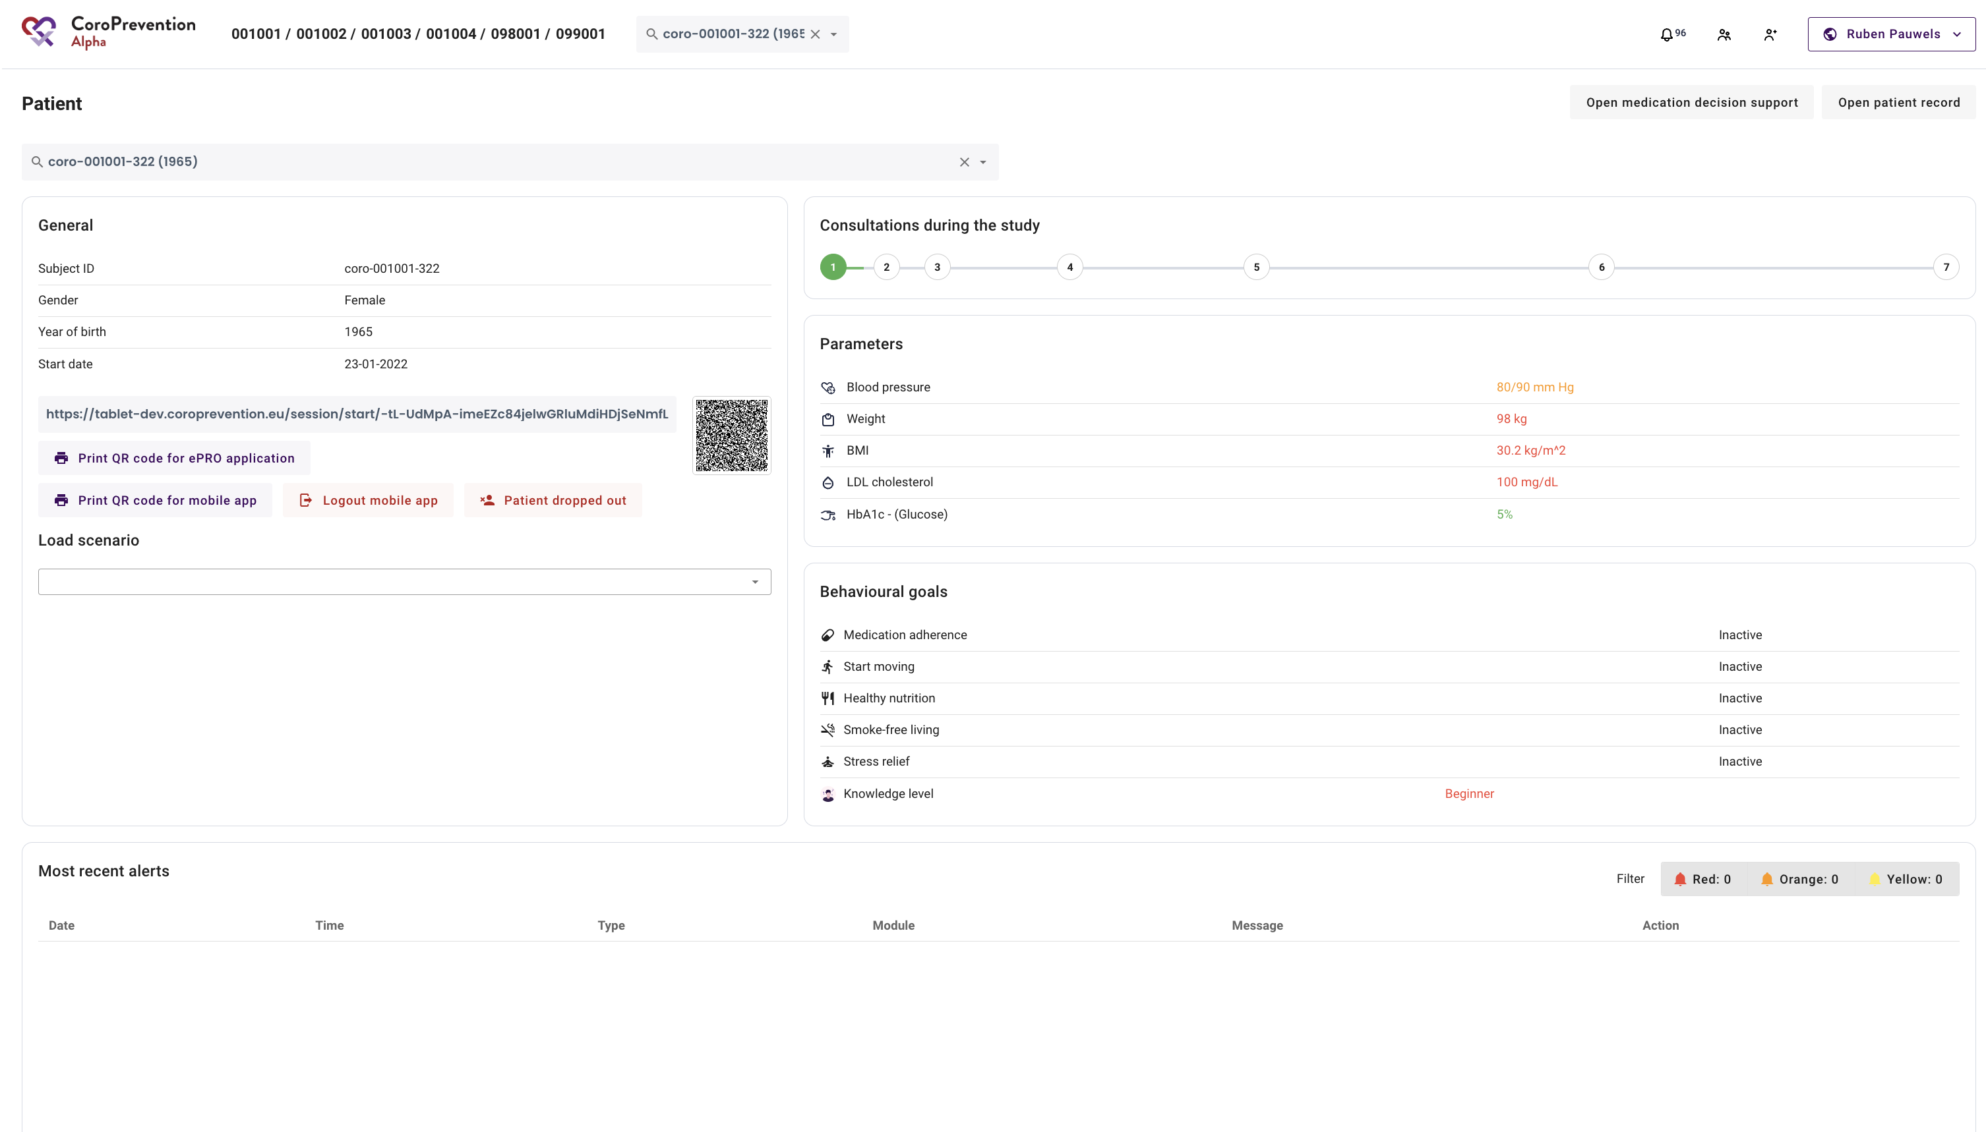
Patient overview
Patient record show after succesful import from EDC

Slide 17
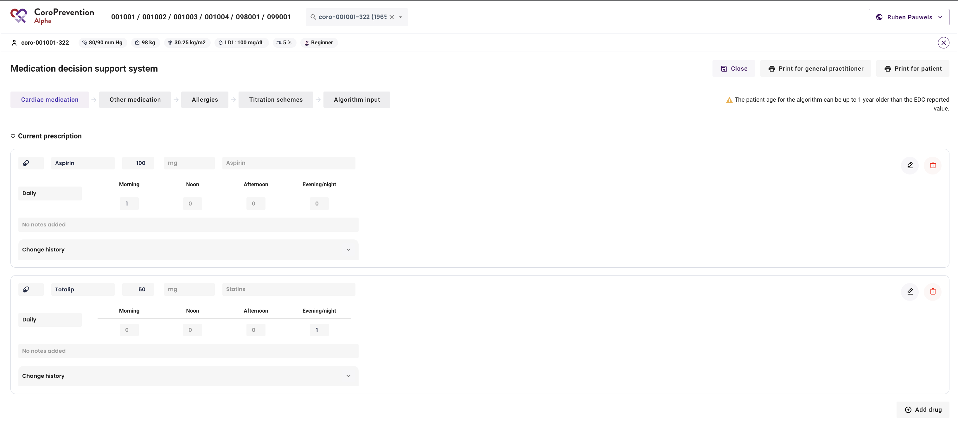
Create initial medication prescription
Create the patient’s initial medication prescription (same prescription as the one that was entered in EDC for visit 1)

Slide 18
Start visit 2

Slide 19
Open patient overview
Use the search function to find the patient record
Scan the QR code or copy the link to open the ePRO

Slide 20
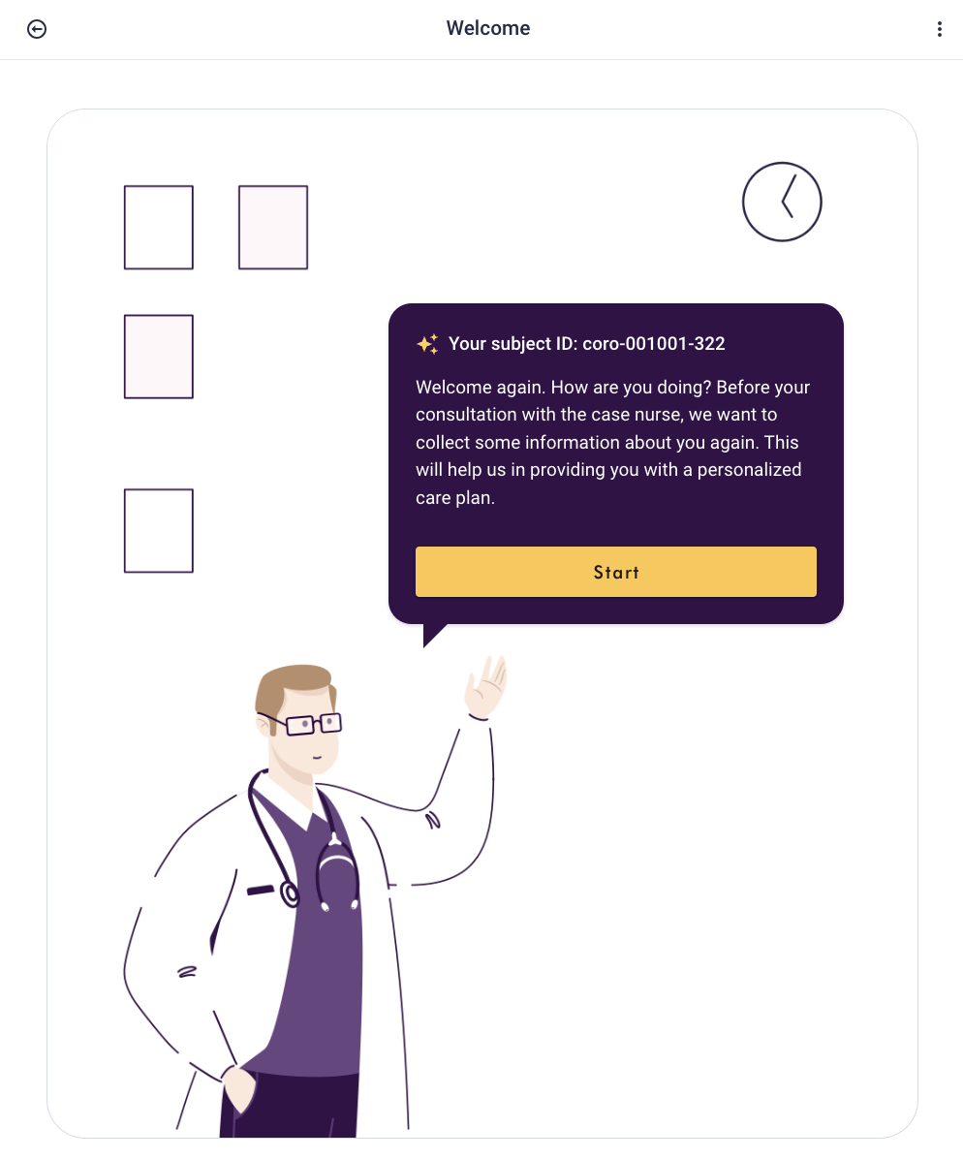
Complete ePROs for visit 2
Ask patient to complete the ePROs (custom and standardized questionnaires)

Slide 21
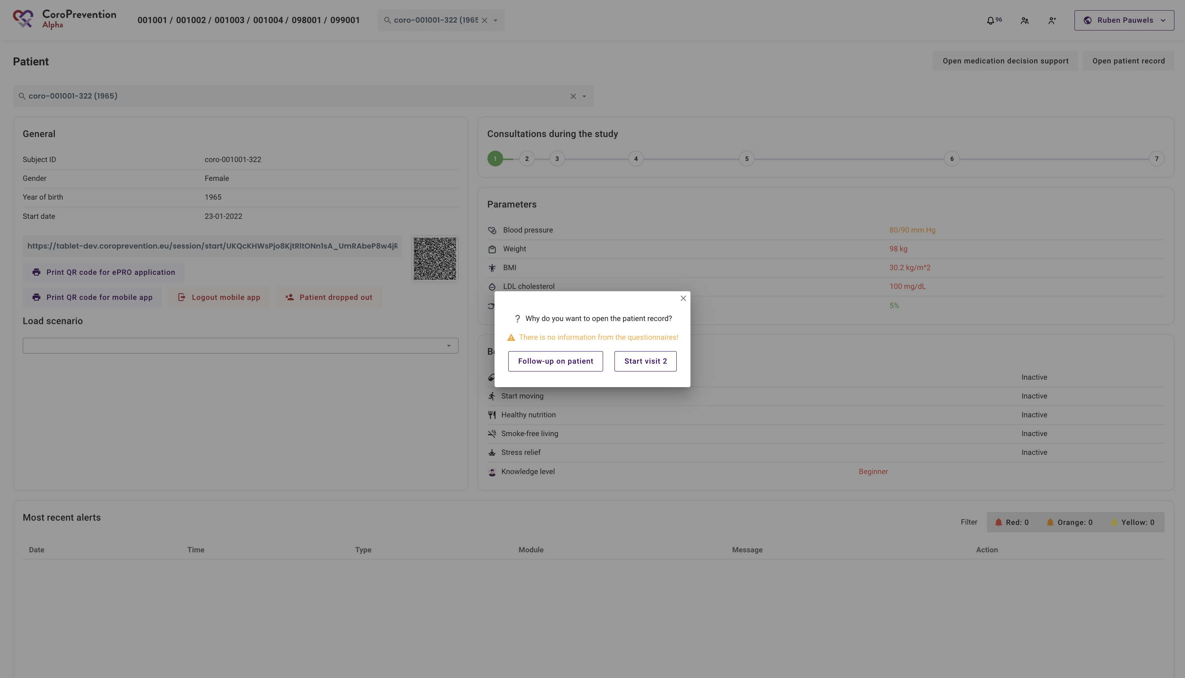
Start visit 2
Only use “Start visit X” when the patient is sitting with you
Question: What is wrong for this patient?

Slide 22
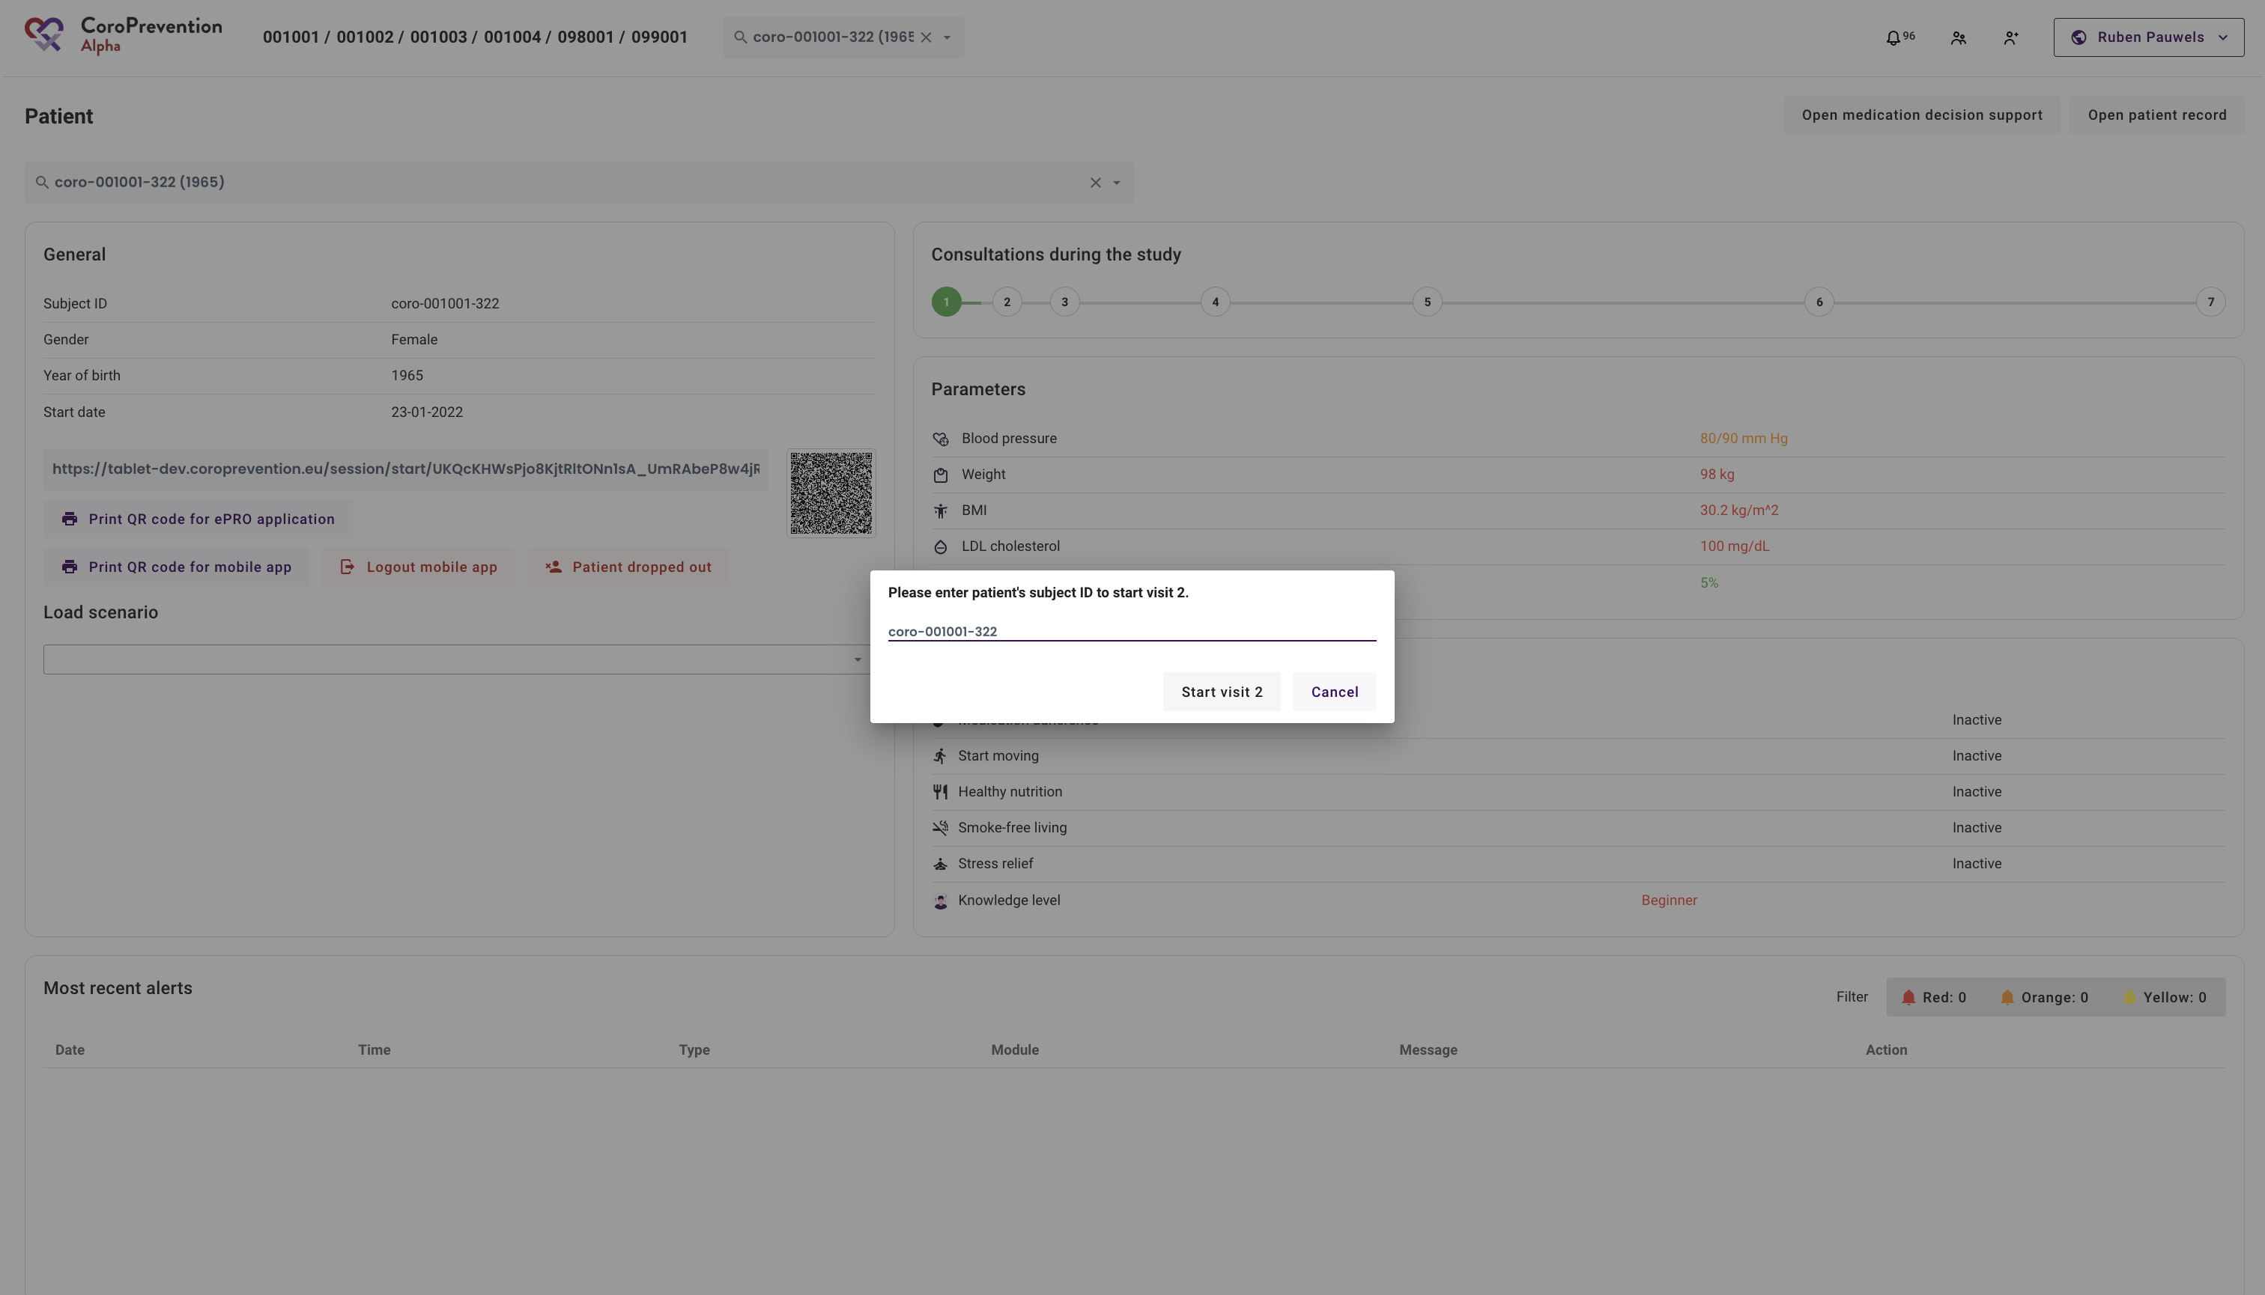
Complete subject ID
Safety feature
Complete subject ID to start a visit

Slide 23
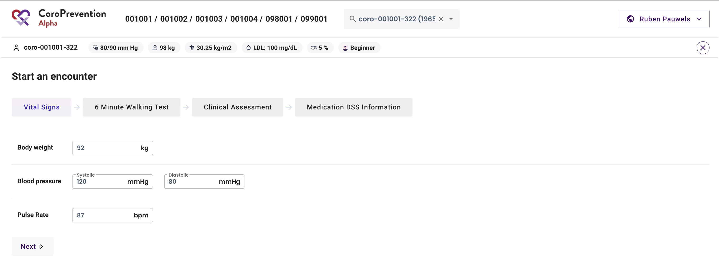
Start an encounter – Vital Signs
Vital signs screen of EDC
After the visit, this information can be imported into EDC

Slide 24
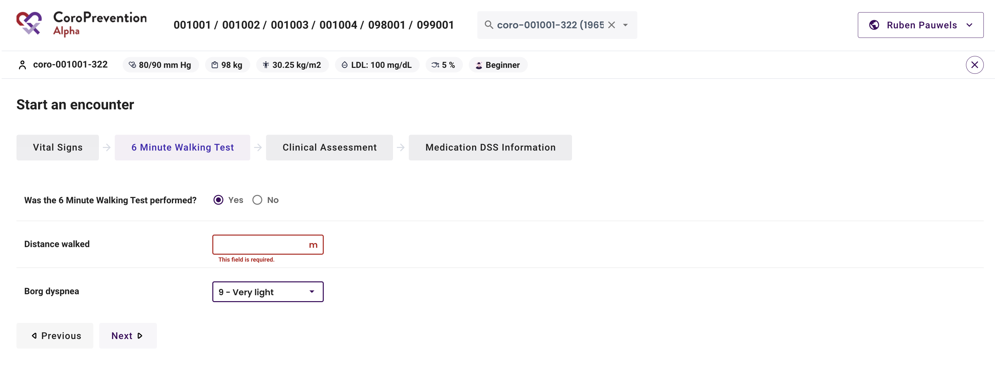
Start an encounter – 6 Minute Walking Test
6 Minute Walking Test screen of EDC
After the visit, this information can be imported into EDC

Slide 25
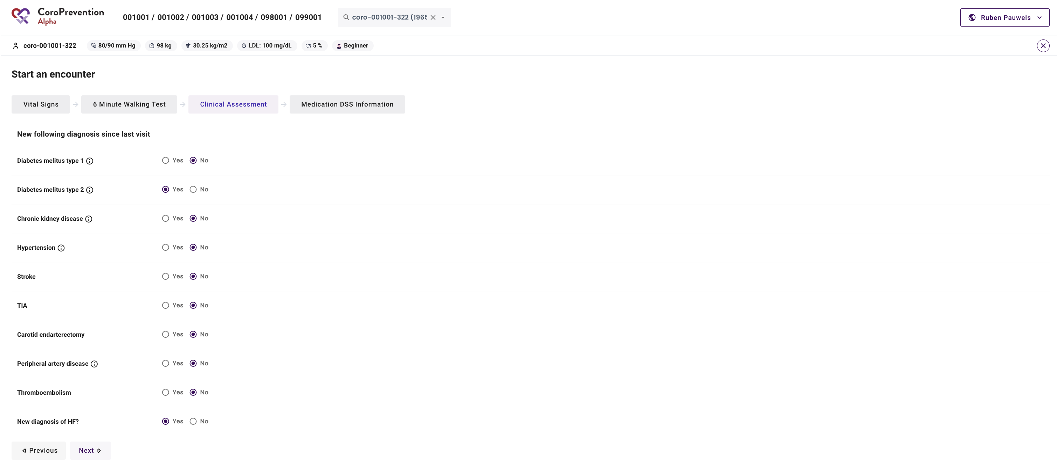
Start an encounter – Clinical Assessment
Clinical assessment screen of EDC
Indicate only NEW diagnosis since last visit
After the visit, this information can be imported into EDC

Slide 26
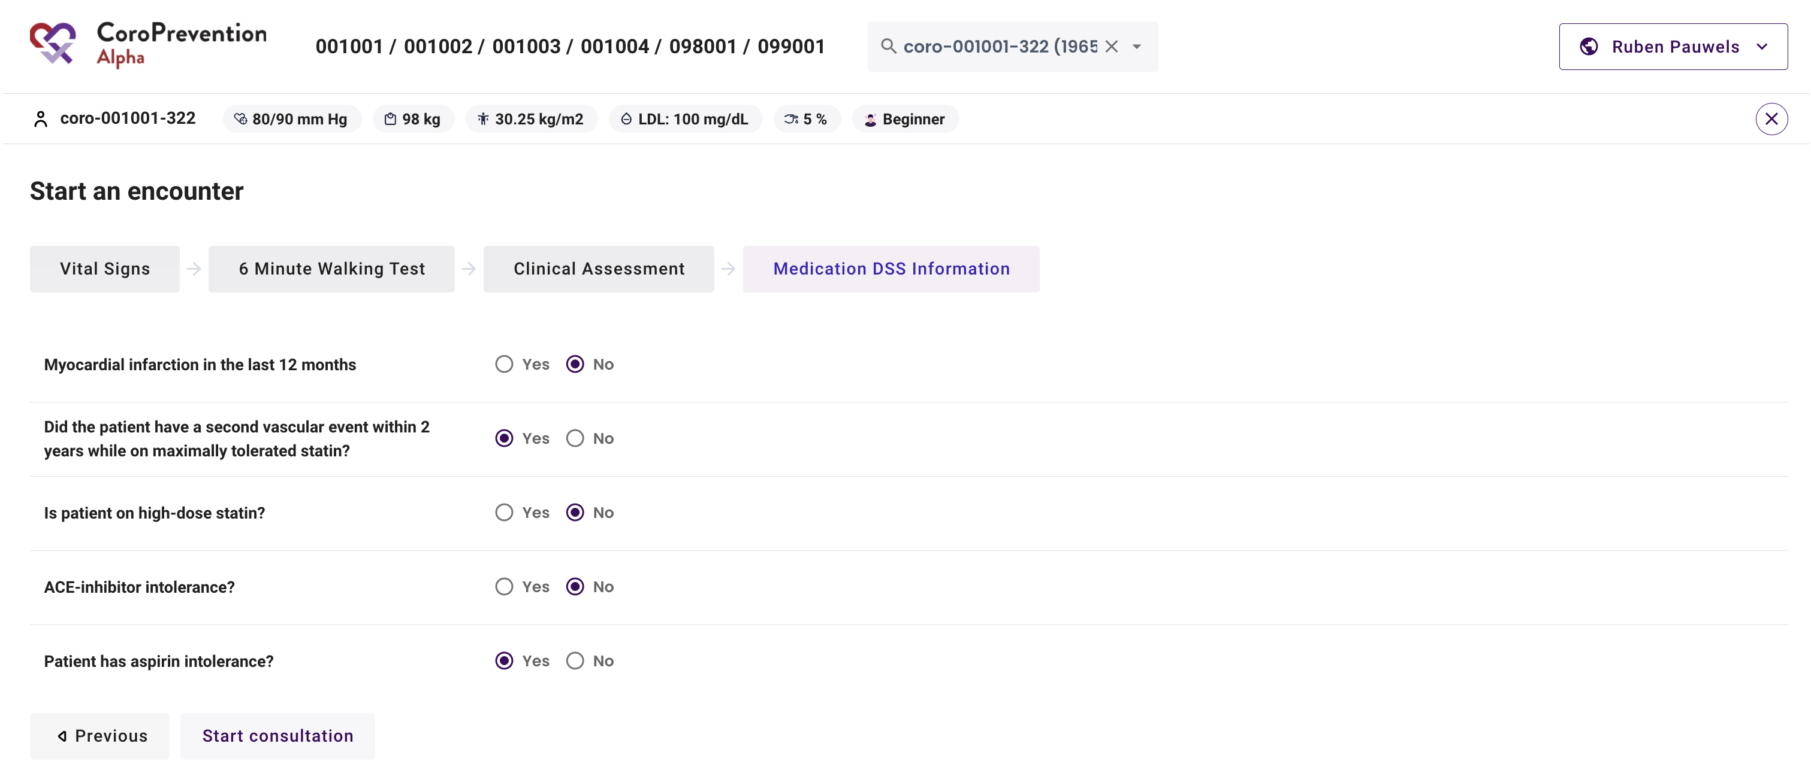
Start an encounter – Medication DSS Information
Information required for the algorithm of the medication DSS
Information can be looked up in patient medical records

Slide 27
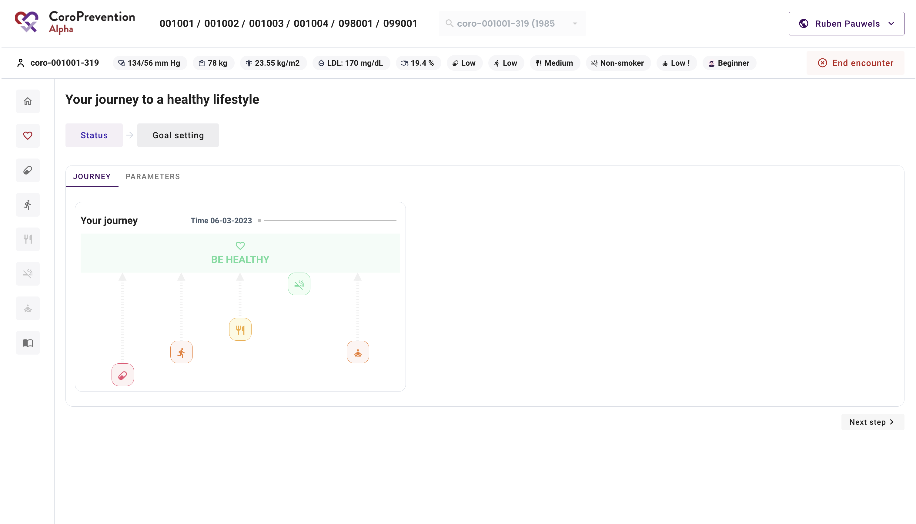
SDM discussion
Patient record is open for the visit
Start shared decision making discussion of the patient’s status, goals, etc.

Slide 28
Remote follow-up

Slide 29
Follow-up on patient
Use “Follow-up on patient” to view the patient record when the patient is not with you e.g. to view the patient’s progress or to prepare for the visit

Slide 30
Follow-up on patient progress
Patient record is open for follow-up

Slide 31
Alerts

Slide 32
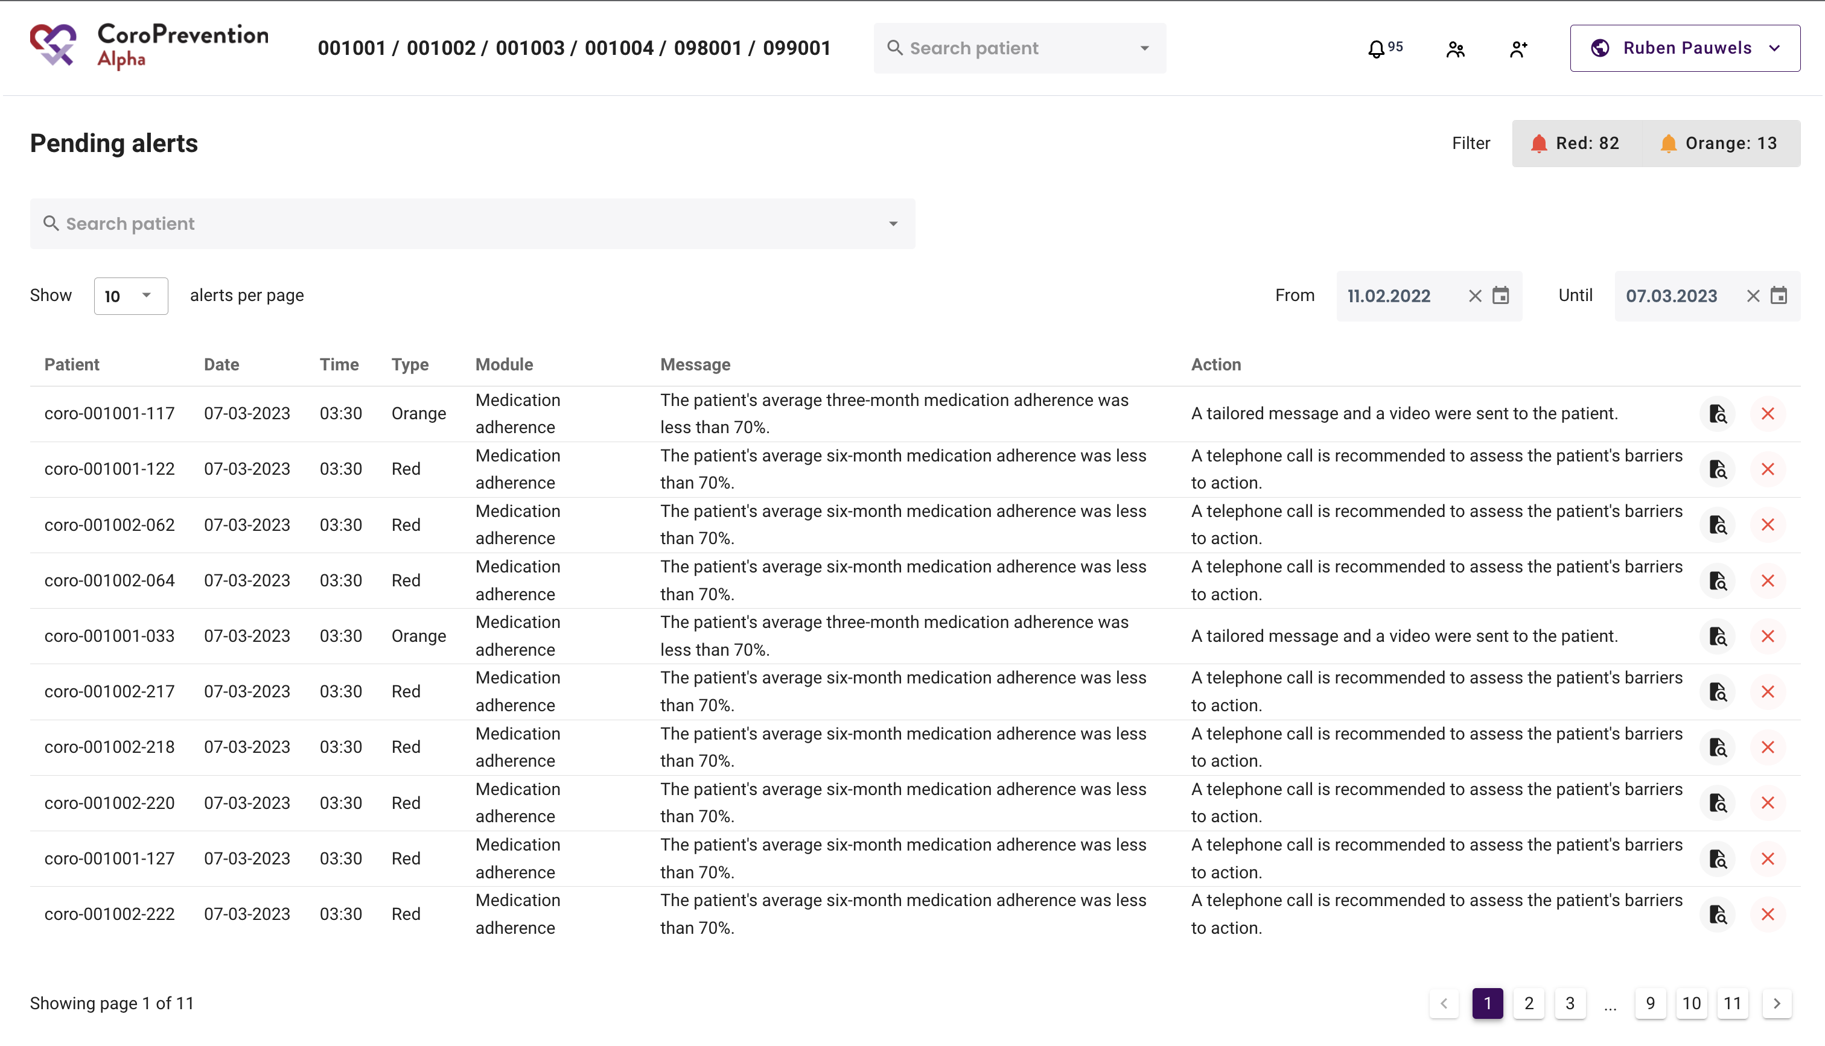
Overview of pending alerts
Alerts get triggered based on the patient’s reported behaviour (from the mobile app)
Alerts are shared between all nurses of a site
Open patient record
Dismiss alert
Required action described in alert

Slide 33
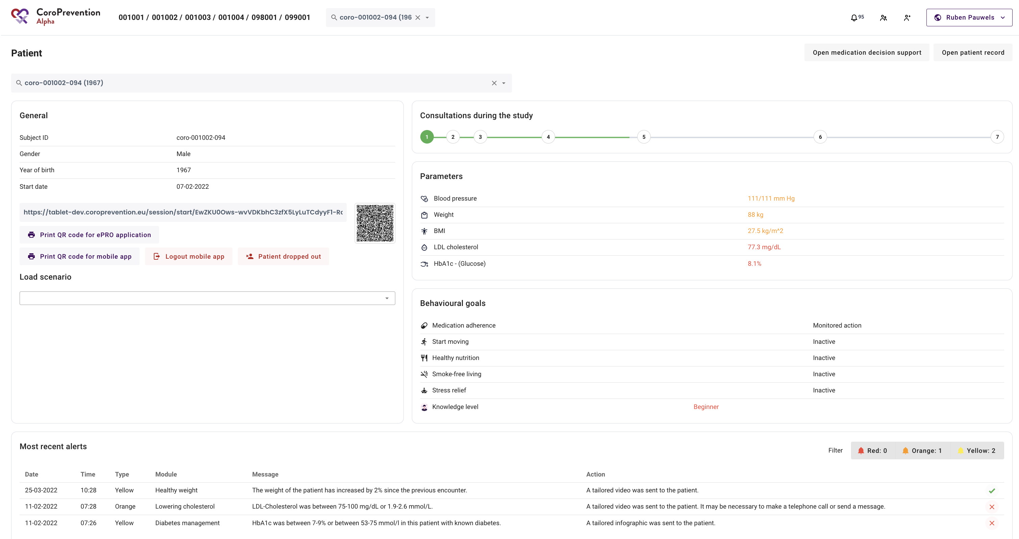
Alerts since last visit
Yellow alerts are handled automatically by the system (e.g. tailored education sent to the patient)
All alerts (handled and unhandled) that were triggered for the patient since last visit can be seen in the patient record

Slide 34
Incorrect data entered

Slide 35
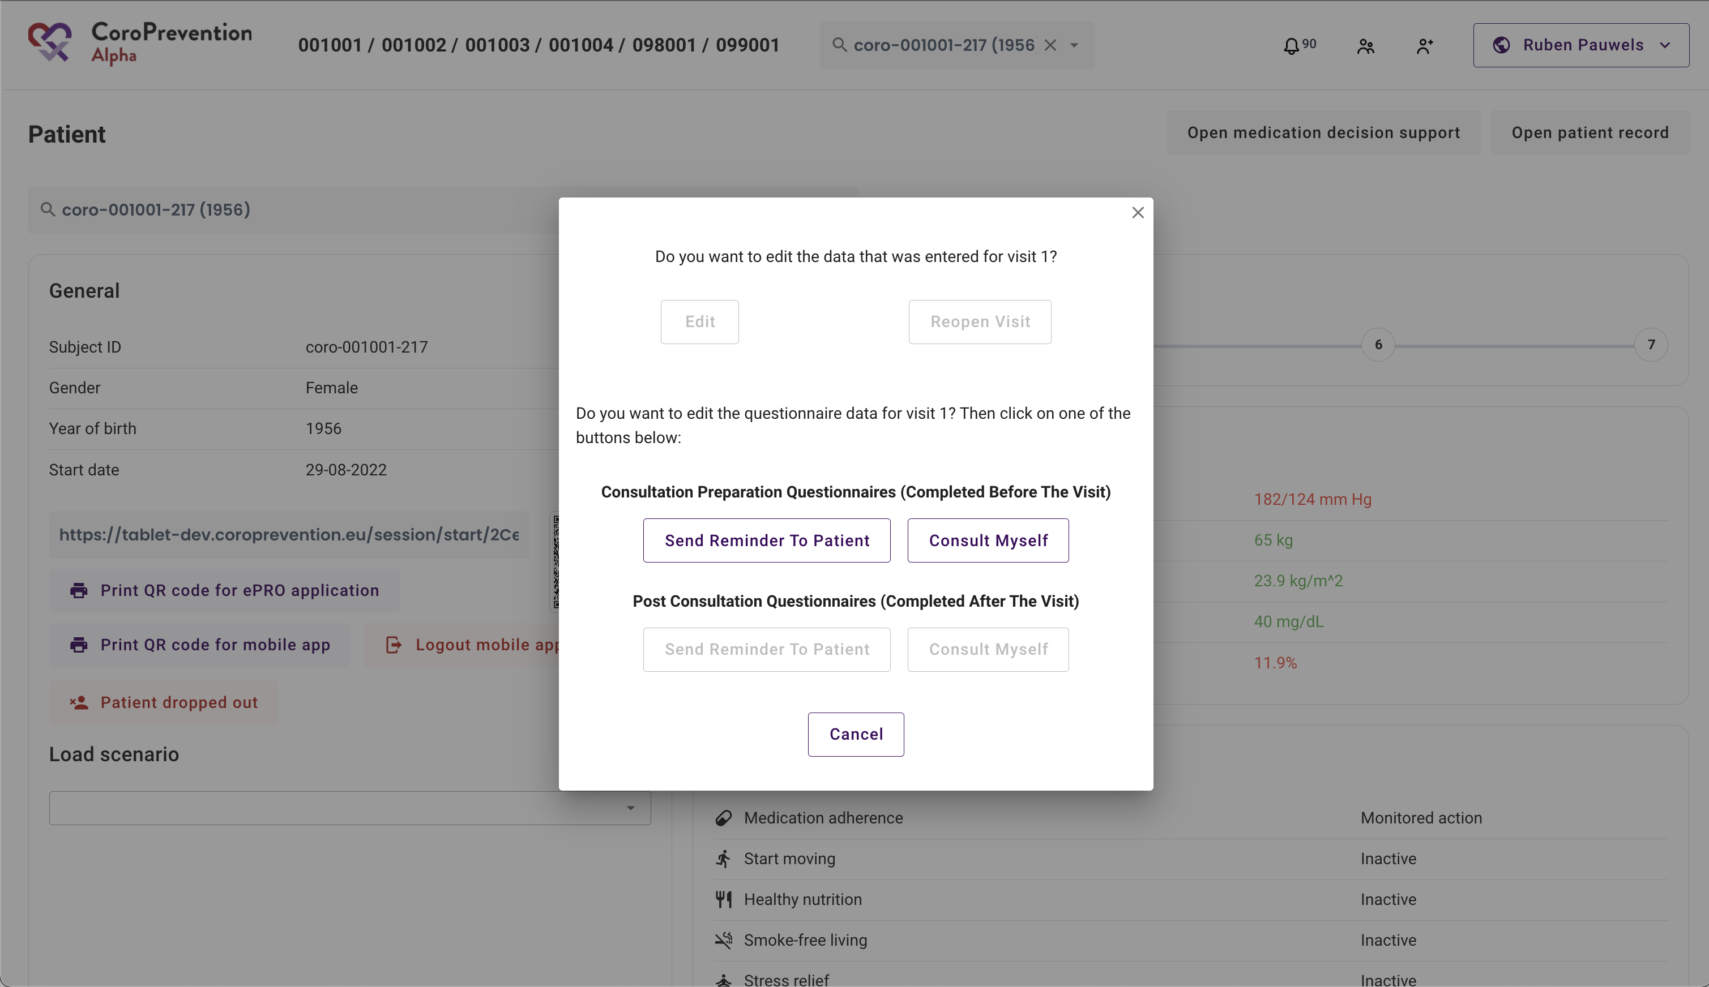
Changing visit 1 data
Visit 1 data can be edited in the EDC.
Visit 1 data cannot be edited in the Tool Suite after import. Therefore it is important to check the data thoroughly before importing!
New feature will be added to update visit 1 data such as gender, date of birth etc.

Slide 36
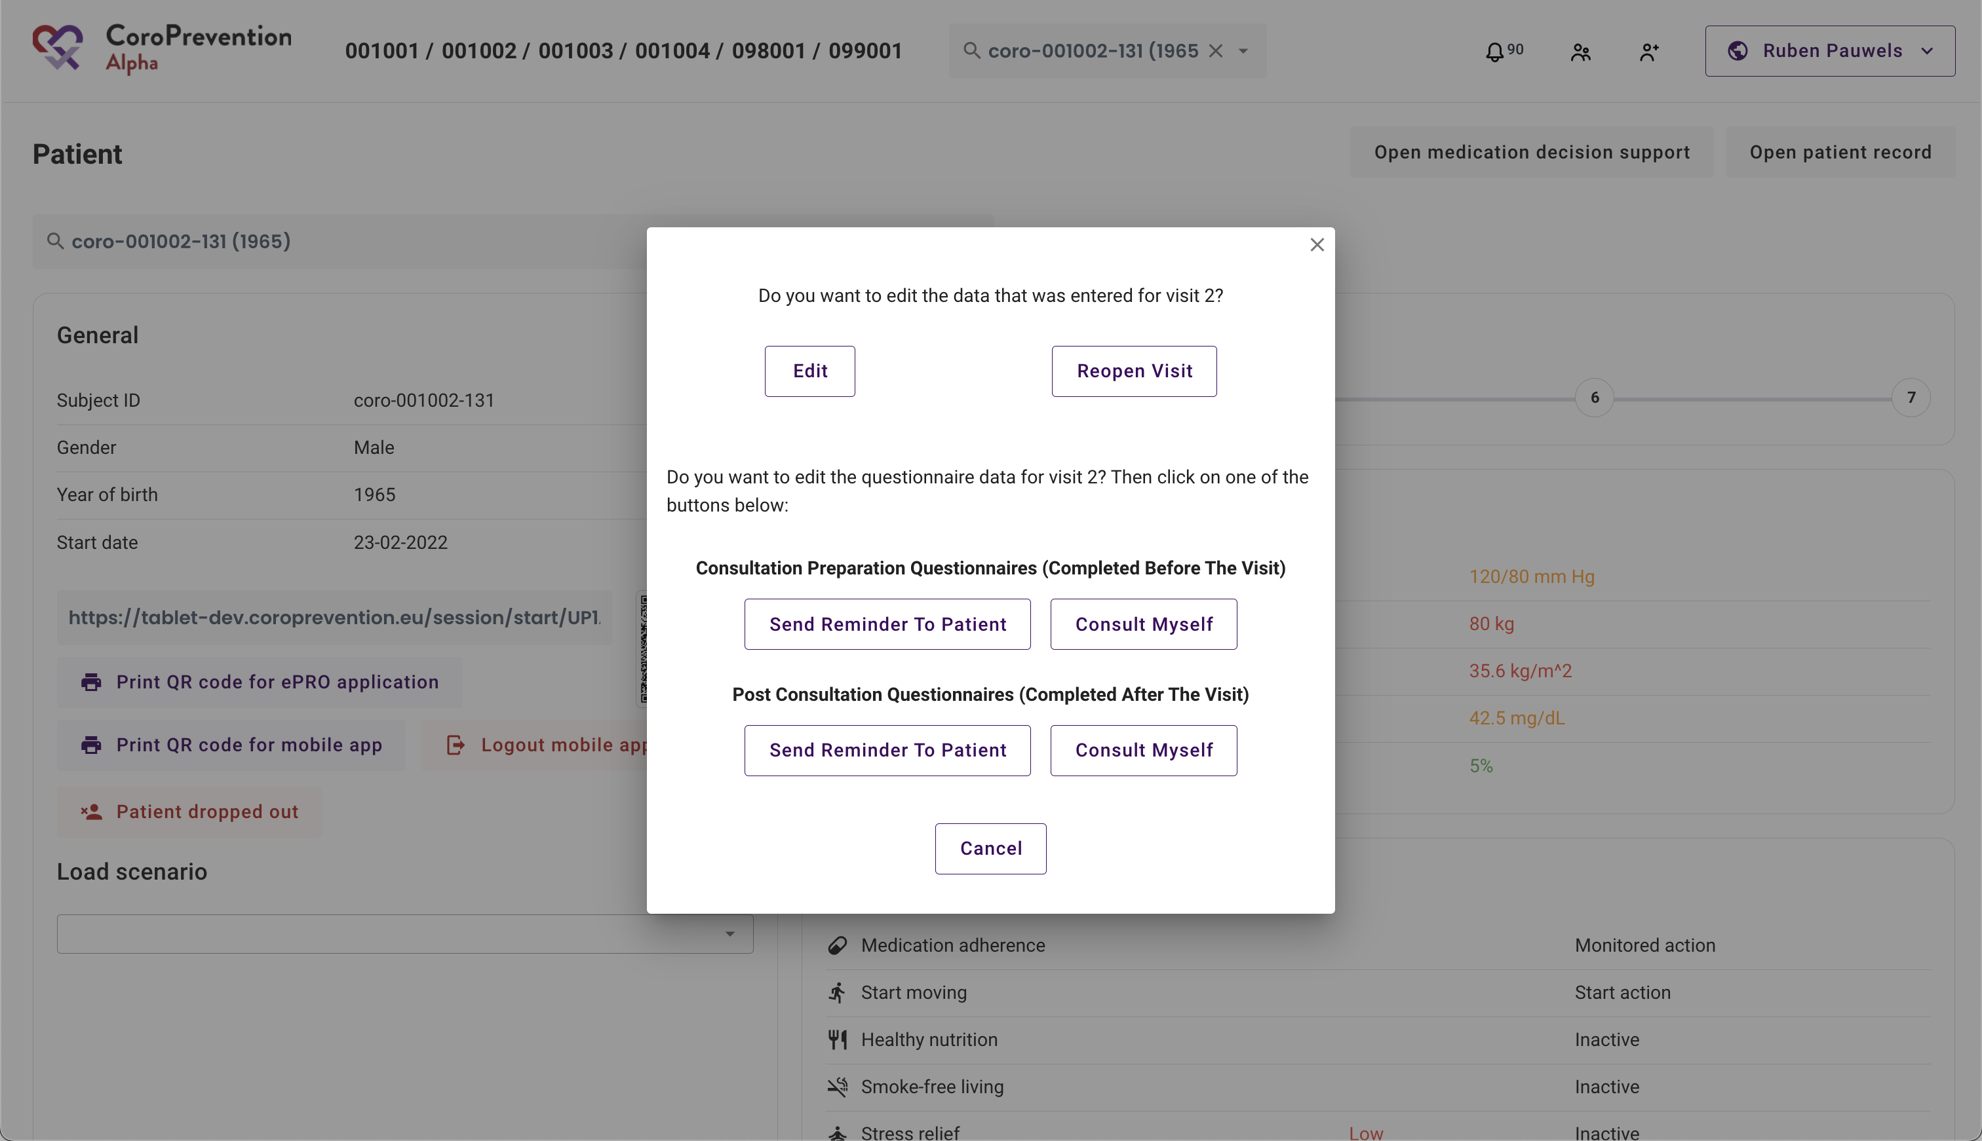
Changing visit 2 – 7 data
Visit 2-7 data of “Start an encounter” screens can be edited
Visit can be reopened
Questionnaires can be resent to the subject

Slide 37
EDC overview and problems + how to enroll a patient in the Tool Suite
Cindel Bonneux, UniWeb

