Slide 1
CoroPrevention Tool Suite Caregiver dashboard User guide
For CoroPrevention Tool Suite investigational Medical Device Release 3.1
V5.0, 20.12.2023

Slide 2
Table of contents
General information
Conduct visit 1
Information exchange between Tool Suite and EDC
About Patient record
Patient summary
How to open and close a visit
Prepare and conduct visit 2 (Tool Suite)
After visit 2 (eDC)
Conduct v3-v7
Follow-up in between the visits
Handling alerts
Correcting data (dashboard)
Patient discontinuation
General module
Journey module (follow progress)
Journey module (goal setting)
Education module
Medication adherence module
How to use the medication decision support system
Physical activity (EXPERT tool) module
Nutrition module

Slide 3
General information
The CoroPrevention Tool Suite caregiver dashboard is an investigational medical device.
Manufacturer
  Tampere University
  Medicine and Healthtech
  Arvo Ylpönkatu 34
  FIN-33520 TAMPERE
  FINLAND

Slide 4
General information
Intended users
Healthcare professionals adequately trained and delegated for the use in the CoroPrevention trial.
Precautions
The CoroPrevention Tool Suite is a digital tool which is designed to be used as part of a healthcare professional-led personalised prevention program (PPP) in the CoroPrevention trial.
Healthcare professionals using the Tool Suite should always check that recommendations by the Tool Suite are compatible with the patient’s clinical status.
Intended Clinical Benefits
The intended clinical benefits of the CoroPrevention Tool Suite, including the caregiver dashboard, are:
Improving the prescription of guideline-based medical therapy and exercise;
Improving the long-term follow-up of cardiovascular patients.

Slide 5
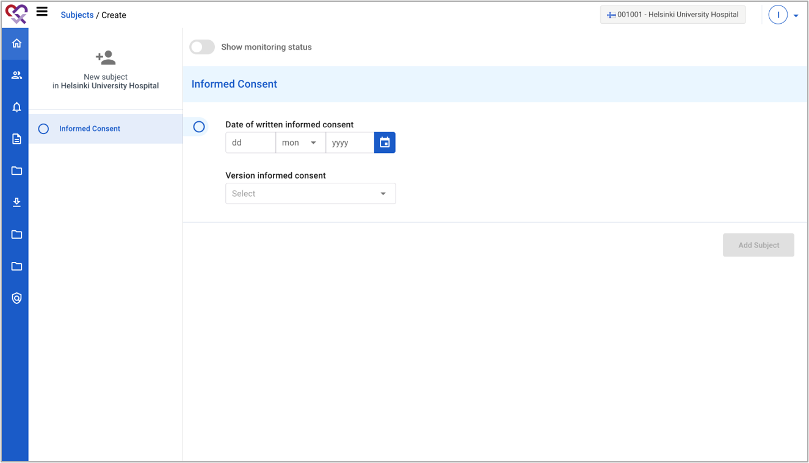
Conduct visit 1 (EDC)
1 | When a subject enrolls in the study, you start in the EDC system.
2 | To create the patient, you have to fill in the date and version of the informed consent.
1
2
For detailed instructions on how to use the EDC, please see the EDC user manual and eCRF completion guidelines in your investigator site file.
CoroPrevention Caregivver dasbhoard user guide_V5_06Oct2023

Slide 6
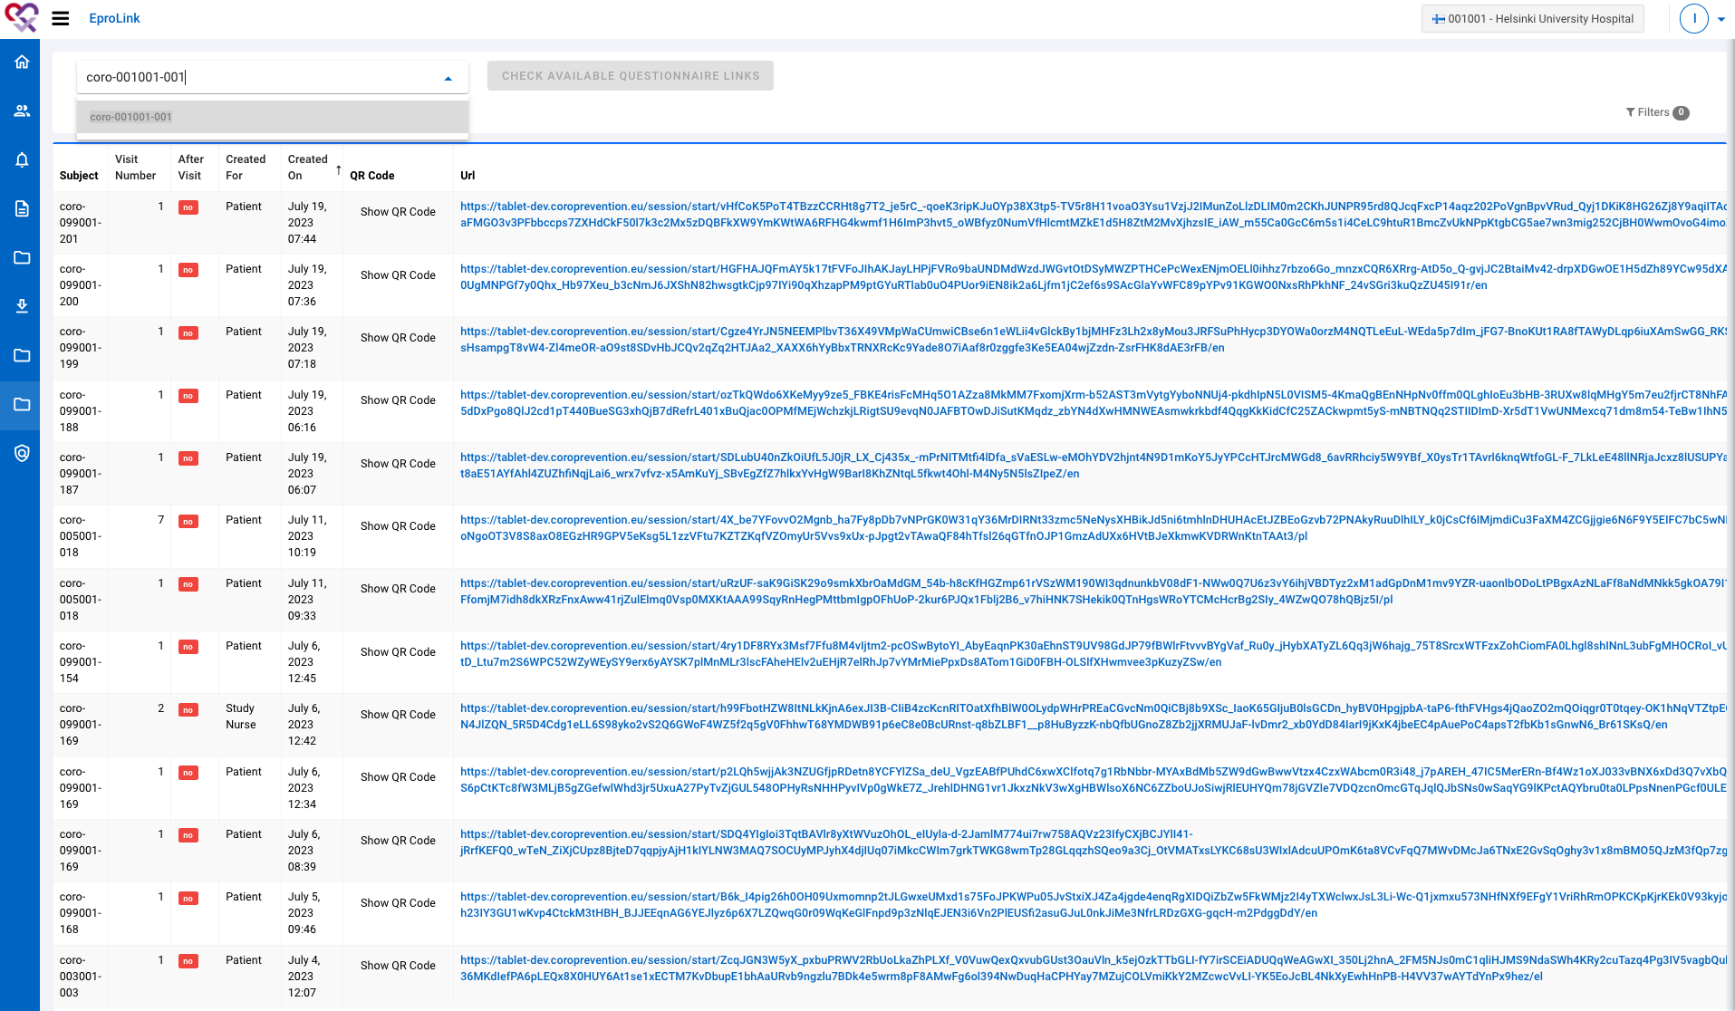
Conduct visit 1 (EDC)
1 | Ask the patient to fill in ePRO questionnaires for visit 1. You can open the ePROs by navigating to “EproLink”.
2 | Look up the patient by entering the subject ID.
3 | Click the button “Check available questionnaire links” to open the links for the ePROs.
2
3

Slide 7
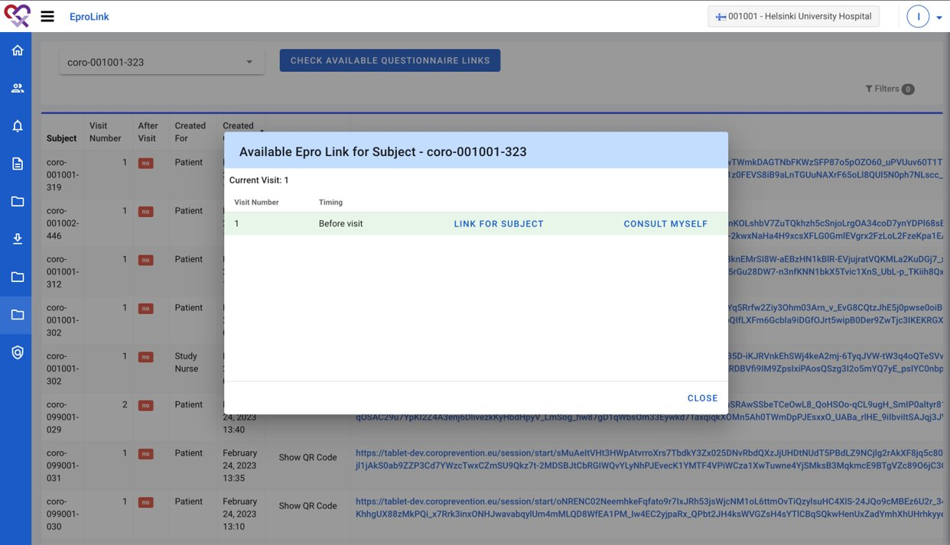
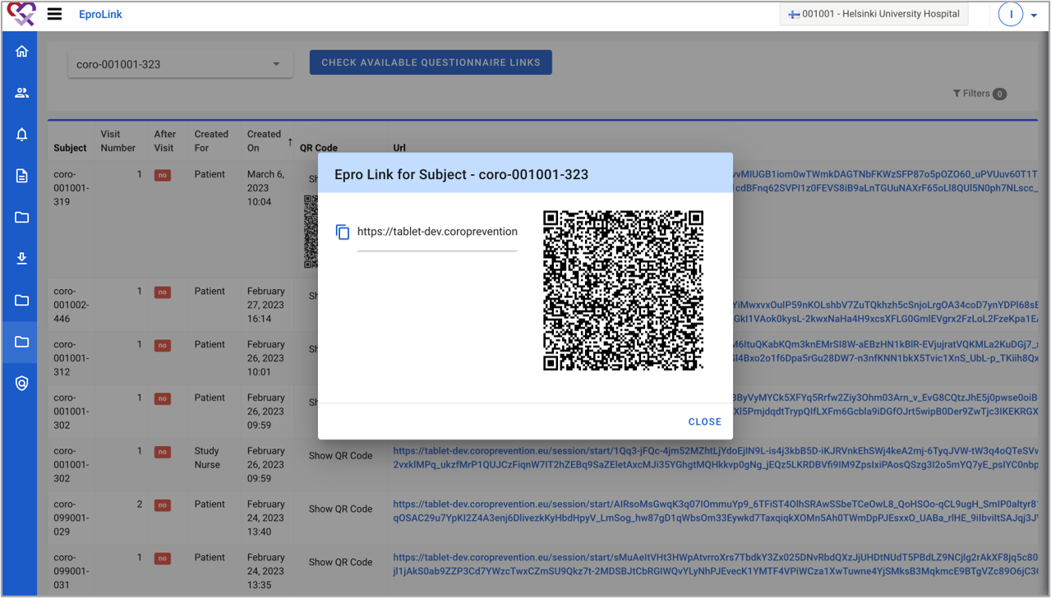
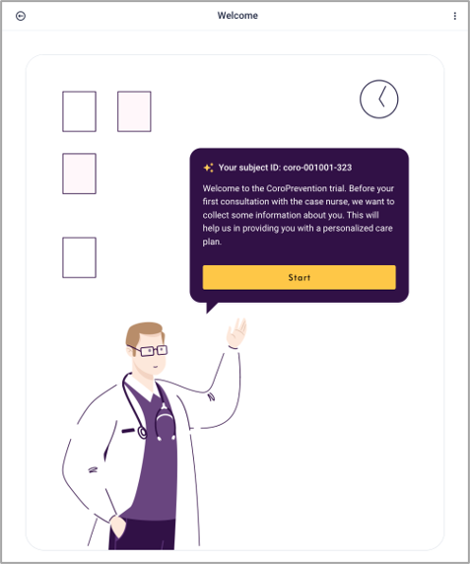
Conduct visit 1 (EDC)
4 | Click on the “Link for subject” link to generate the QR code for the ePROs for visit 1.
5 | Scan the QR code with the tablet and hand the tablet over to the patient, so the patient can complete the ePROs.
4
5
5

Slide 8
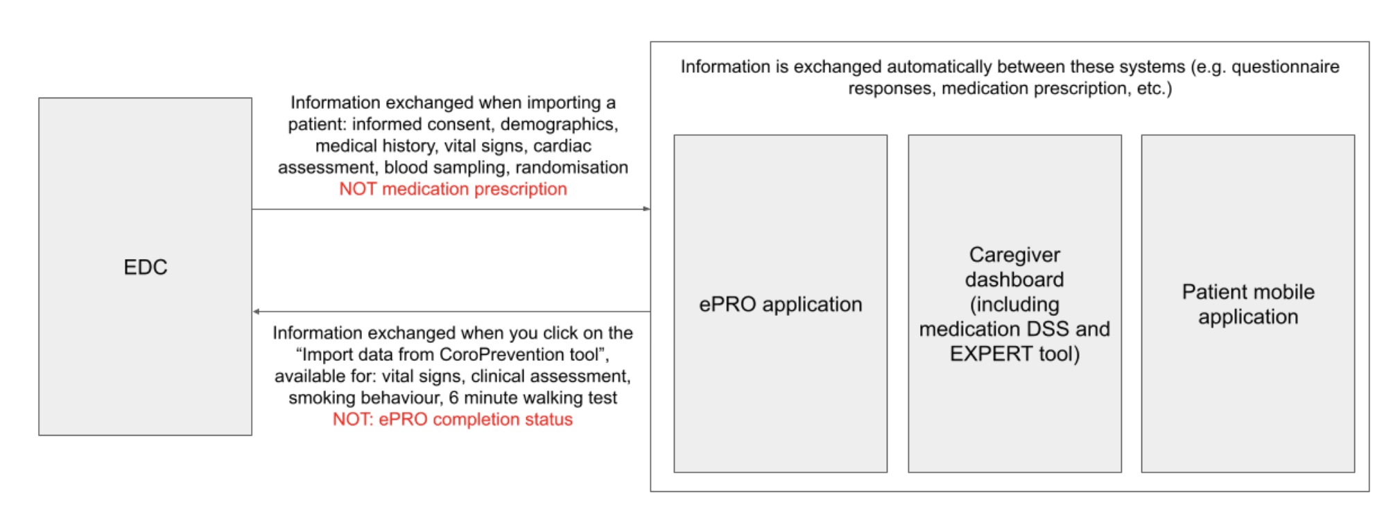
Which information is exchanged between different systems?

Slide 9
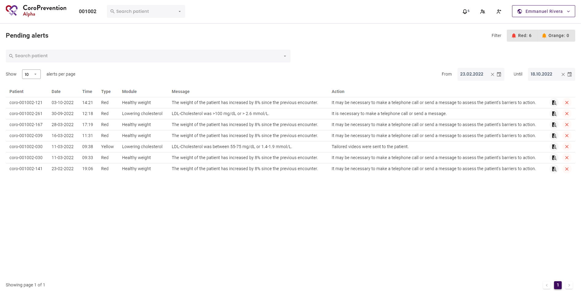
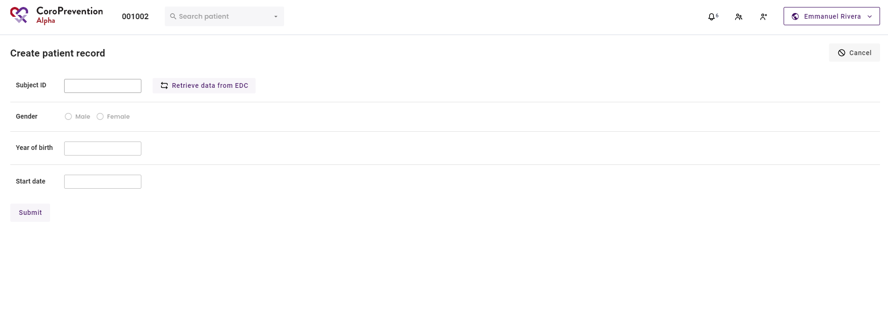
How to create a patient record?
1
1 | You can navigate to the screen to create a patient record by clicking this button. This button is only available when currently no patient record is opened.
2 | You can only create a patient record for a patient who has already been registered in the EDC system and who has been randomized into the PPP intervention group. You have to fill in the subject ID of the patient to import the patient information from the EDC system to the CoroPrevention Tool Suite.
3 | When you click this button, the patient information is retrieved from the EDC system, imported to the CoroPrevention Tool Suite, and shown below.
2
3

Slide 10
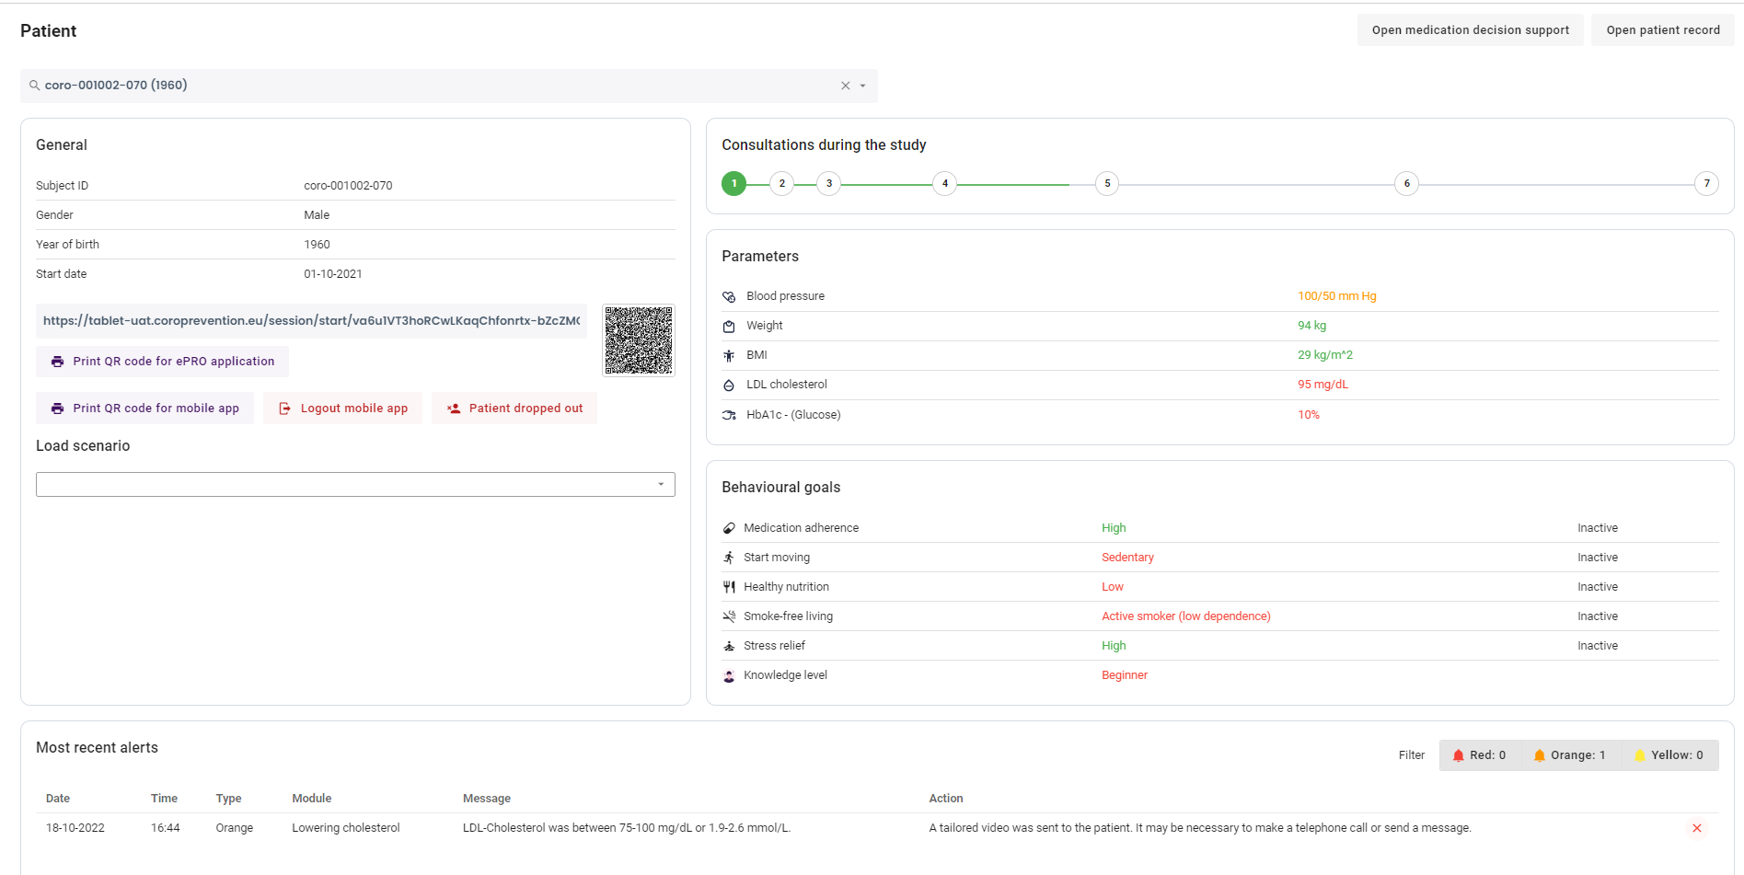
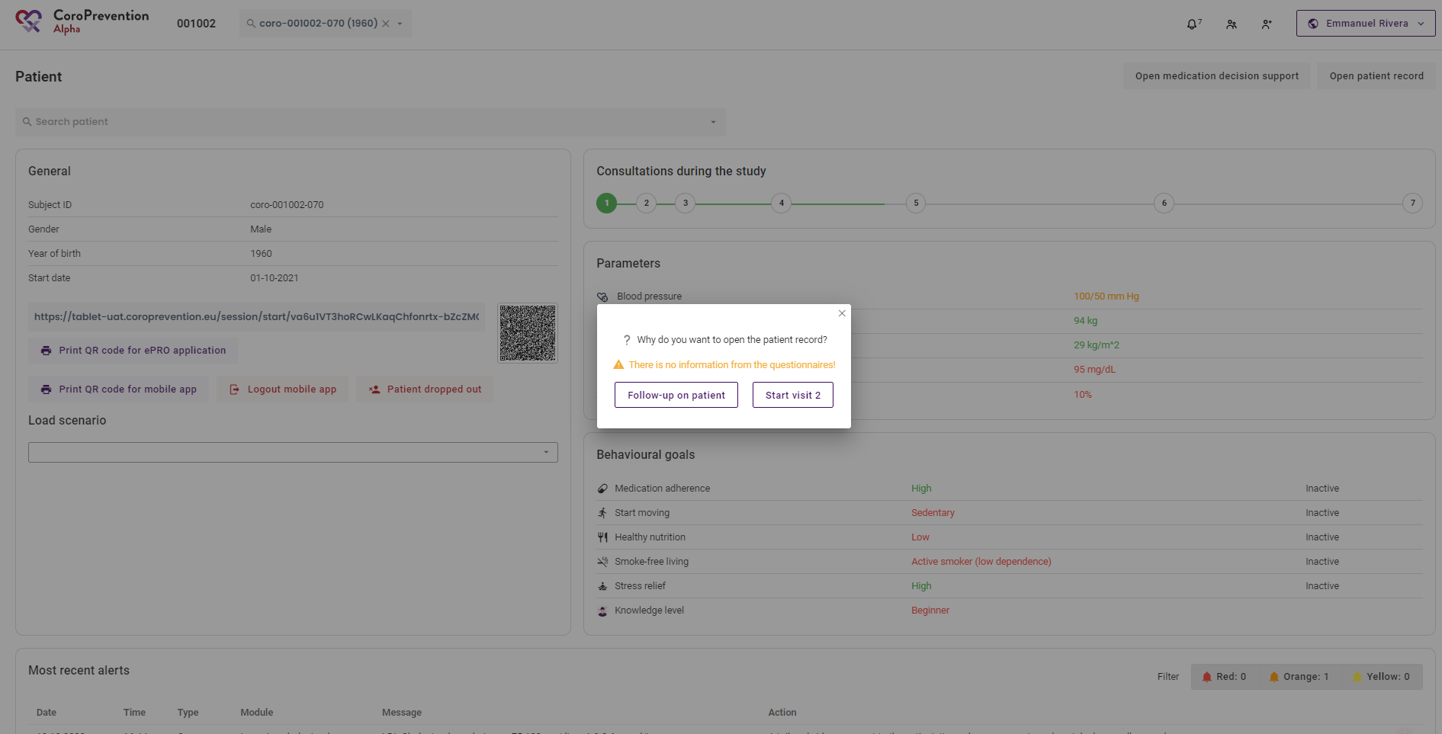
How to open the patient record?
1
1 | When you want to see more information about the patient then what is shown in the summary, you can open the patient record by clicking this button.
2 | Here it is important to choose the correct option. This way, the system keeps track of how far the patient is in his/her timeline in the study.
2 | Choose "Start visit" if the patient is sitting in front of you and this is a scheduled study visit. The number of the visit is indicated on the button.
4 | Choose "Follow-up on patient" if you are following up on the patient in between visits (e.g. because of alerts or because the patient has called you).
2
4
3

Slide 11
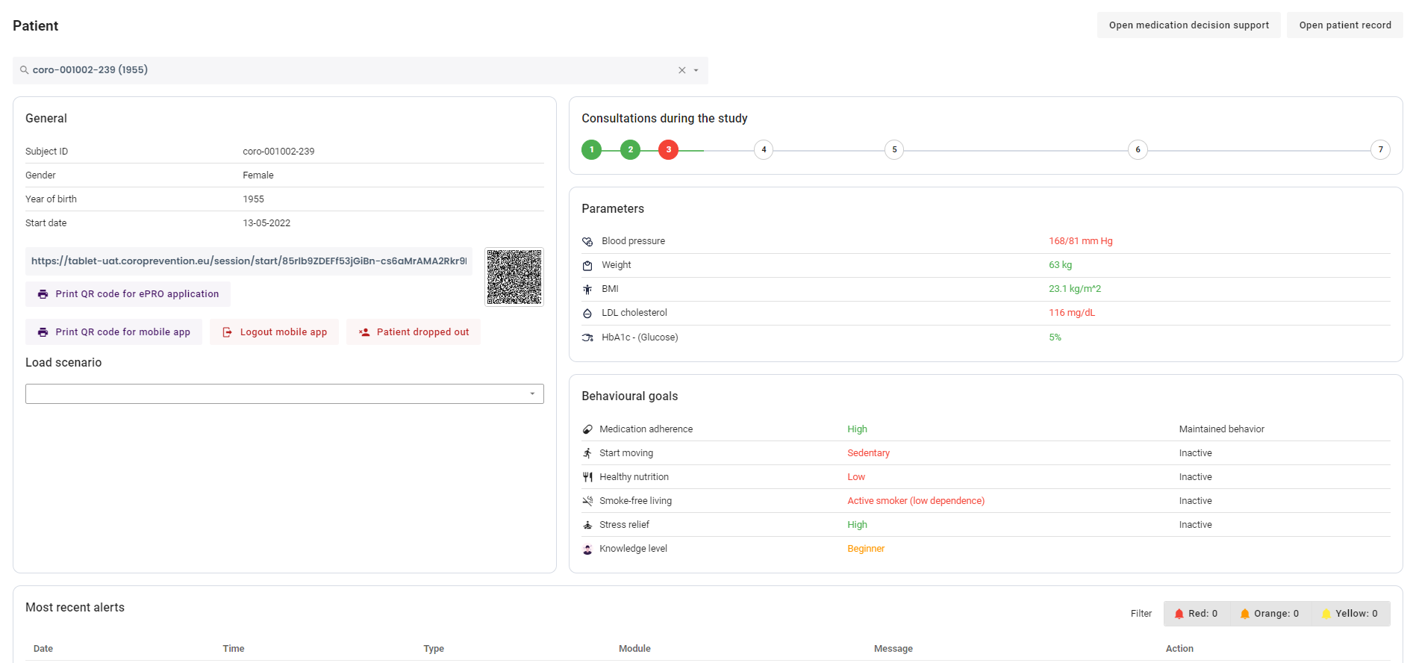

How to view a summary about a patient?
1 | This screen gives you a general overview of the most important information about the patient. The patient record is at this moment not open yet.
2 | You can view the general information about the patient, including the patient's subject ID, gender, year of birth and date of enrolment in the CoroPrevention study.
3 | You can scan the QR code with the tablet to open the consultation preparation questionnaire for the patient. Alternatively, you can type the URL in the browser of the tablet. You can also print this code to give it to the patient on paper.
4 | To login to the patient mobile application, the patient can also use a QR code, instead of his/her login credentials. You can print the QR code by clicking this button. When you print a new QR code for the patient, the patient's login credentials are reset.
5 | In the caregiver dashboard, you can indicate that the patient dropped out of the study by clicking this button.
6 | If the patient lost his/her smartphone (e.g. the smartphone is stolen), you can remotely log out the patient mobile application on the patient's smartphone. This ensures that the person that finds the patient's smartphone cannot view the personal, medical information about the patient.
7 | When the visit was already completed, the circle is green. When the visit was skipped/cancelled, the circle is red. When the visit is not yet completed, the circle is white.
8 | You can indicate that a visit was skipped by clicking on the circle of a not yet completed visit.
9 | You can view or edit the data that was entered before the encounter, consult the questionnaire results and send the patient a reminder in the mobile app to fill in the questionnaires, by clicking on the circle of an already completed visit.
10 | You can view the patient's most recently reported parameter values. The color-coding indicates if the patient's parameters are in the target ranges.
11 | For each behavioural goal, you can view how the patient is doing and in which level of guidance the patient is currently. The color-coding indicates how good the patient is doing for the behavioural goal. Furthermore, you can view the patient's current knowledge level. The color-coding indicates the patient's performance on his/her most recent knowledge challenge.
12 | You have an overview of all alerts that were triggered for this patient since last visit.
13 | There is a filter for each type of alert. You can click on a filter to enable or disable it.
14 | You can mark an alert as handled by clicking on the "cross" icon. The cross will then be updated to a checkmark.
1
2
7
8
9
10
3
4
6
5
11
13
12
14

Slide 12
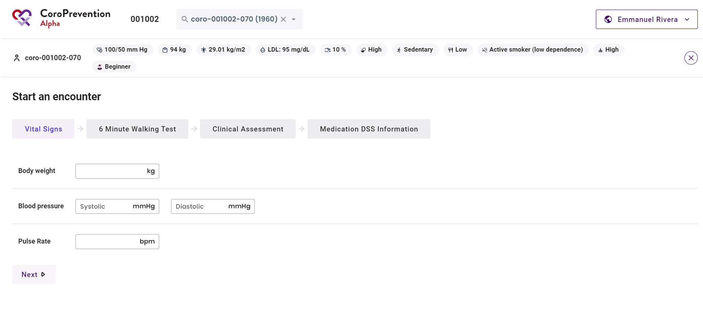
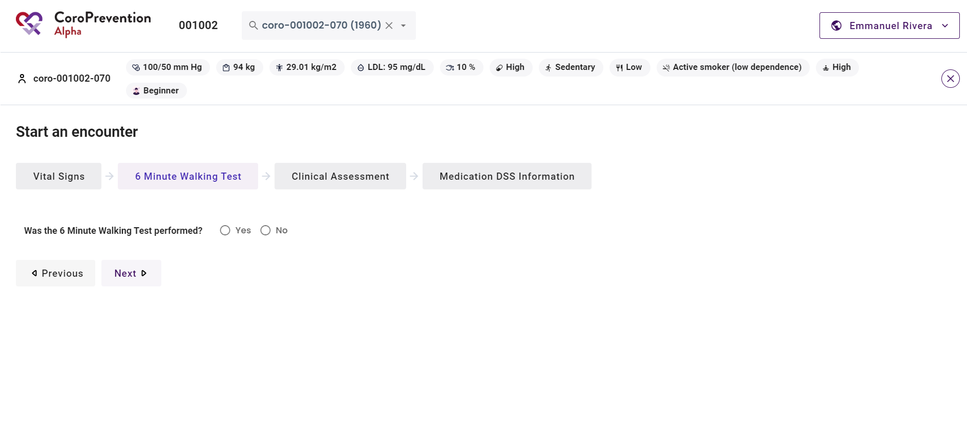
How to start a visit with the patient?
1
2
1 | Complete some information about the patient. The system will guide you through these different steps.
2 | Vital signs: First, you have to measure the patient's vital signs and record these. You can later import this information into the EDC system.
3 | 6 Minute Walking Test: In visit 2 and 6, the patient has to perform the Six-Minute Walk Test. You have to record the results in this screen. You can later import this information into the EDC system.
3

Slide 13
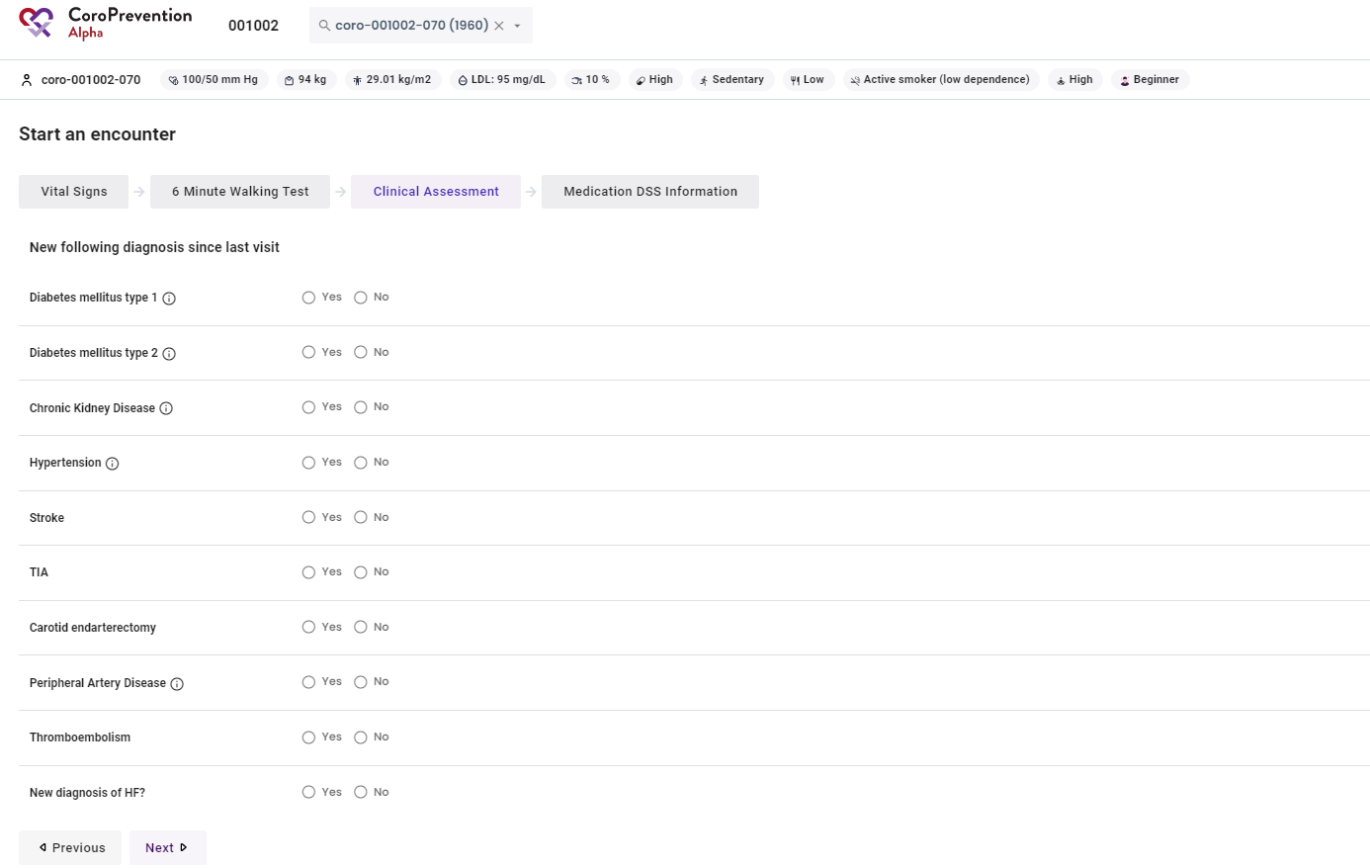
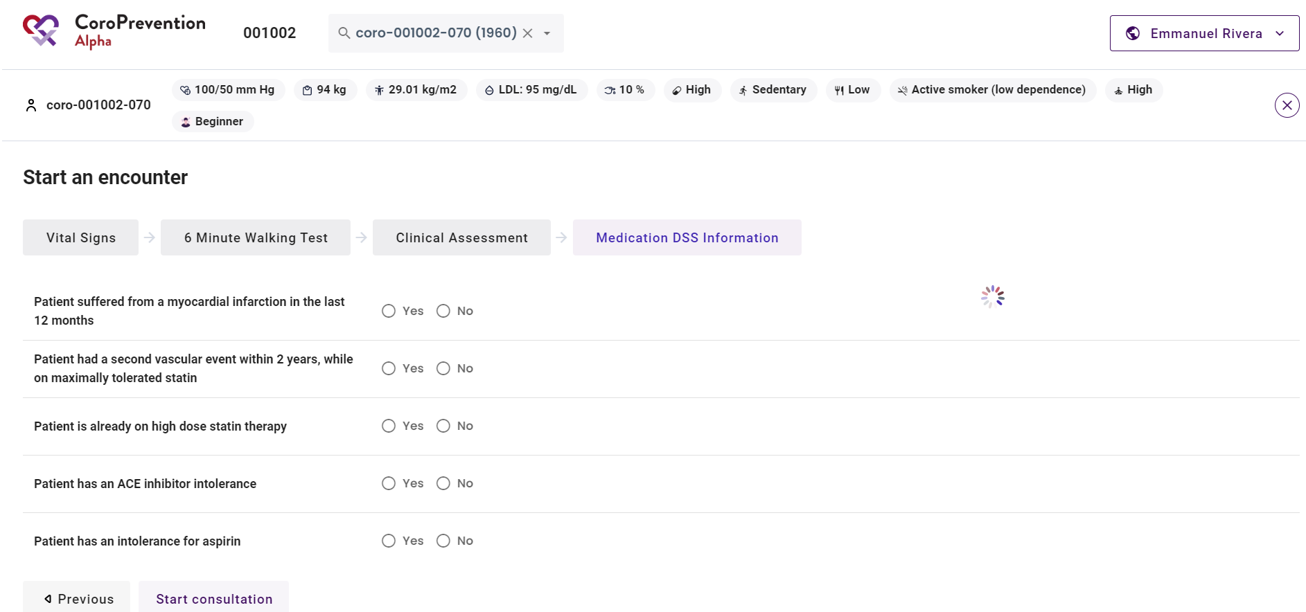
How to start a visit with the patient?
4 | Clinical assessment: Next, you have to complete the clinical assessment. You can later import this information in the EDC system.
5 | Medication DSS information: In visit 2 and visit 6, the investigator will use the medication decision support system to review and if needed update the patient's medication prescription. For the medication decision support algorithm to work, you need to enter information on whether patient has any new clinical diagnosis as well as background information about patient's cardiac treatment history.
6 | After completing the questions, you can start the visit by clicking this button. The patient record will then be opened for the study visit.
4
5
6

Slide 14
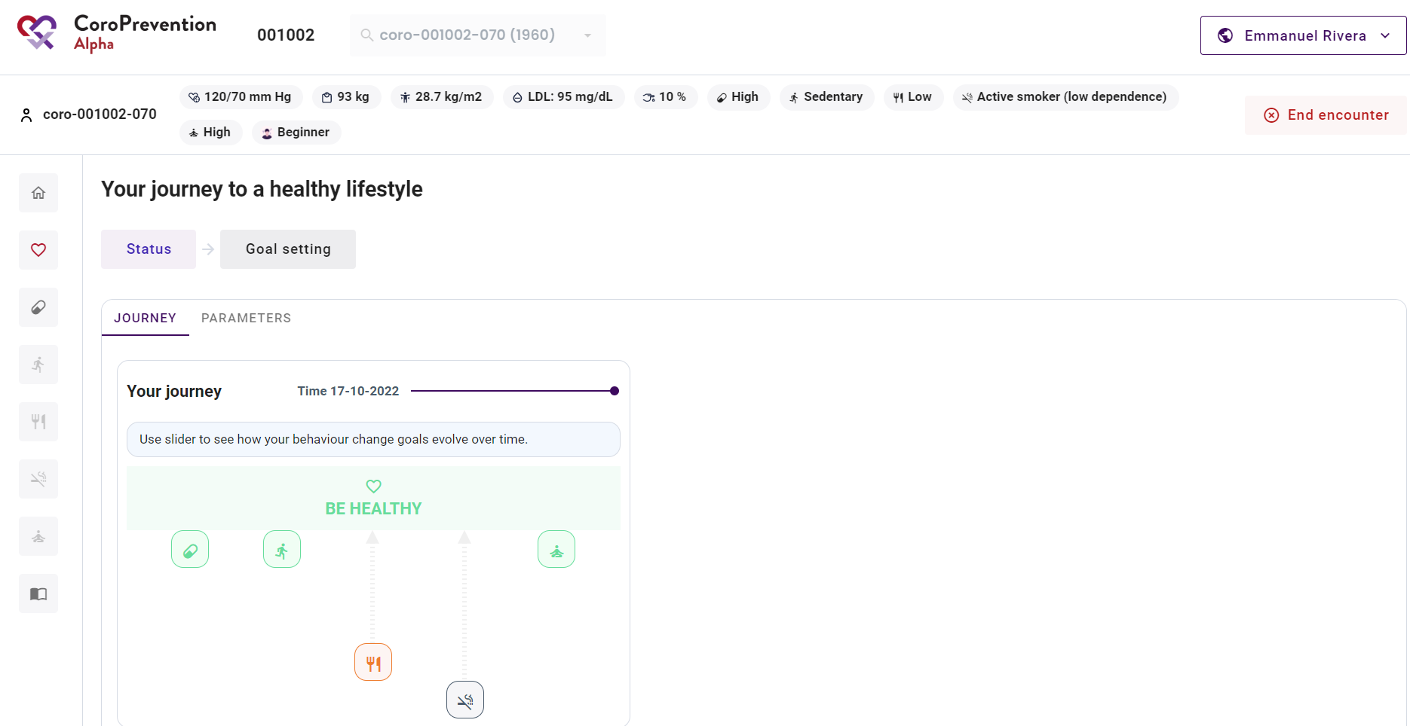
How to end a visit and close the patient record?
1
1 Click on "End encounter" if you want to end the patient visit.

Slide 15
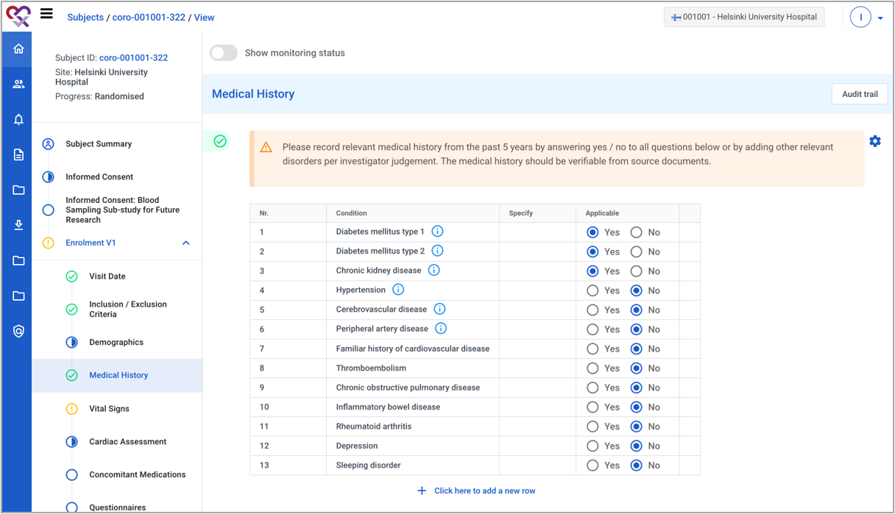
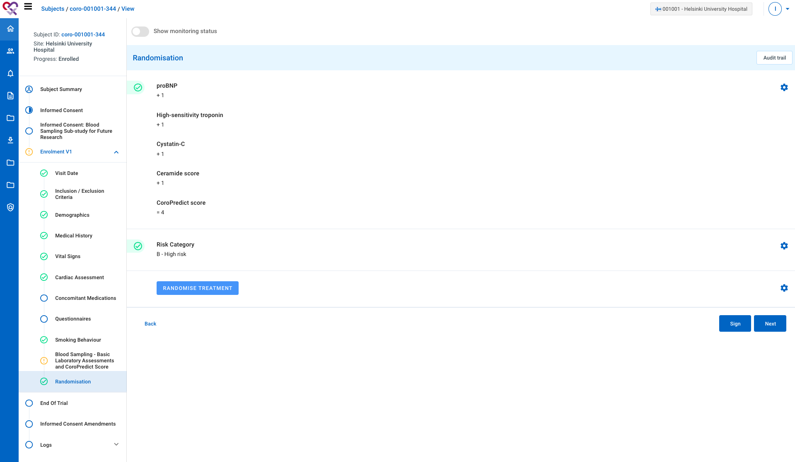
Prepare for visit 2 (EDC)
1 | In the EDC, complete the information of visit 1. The following information has to be completed to be able to import the patient into the Tool Suite: Demographics Medical History: at minimum Diabetes mellitus type 1, Diabetes mellitus type 2 information Vital Signs: Cardiac Assessment: Blood sampling: At minimum results for NT-PROBNP, Cystatin C, high-sensitive troponin, CERT2, eGFR, CKD, LDL, HDL, Total Cholesterol and HbA1c
2 | Randomize the patient.
1
2

Slide 16
Prepare for visit 2 (EDC)
To be able to import the patient into the Tool Suite the patient’s values are to be within these ranges.
Parameter | Allowed ranges
Body weight | BMI: 12 kg/m^2 – 60 kg/m^2 Body weight: using the formula and range for BMI and the patient’s height
Blood pressure | Systolic: 40 mmHg – 280 mmHg Diastolic: 30 mmHg – 160 mmHg
Pulse rate | Pulse rate: 35 – 140 bpm
HBA1CH | HbA1c: 2.15% - 20%
CHOLBC | Total cholesterol: 50 mg/dl– 500 mg/dl
LDLBC | LDL: 10 mg/dl – 450 mg/dl
HDLS | HDL: 10 mg/dl – 200 mg/dl.

Slide 17
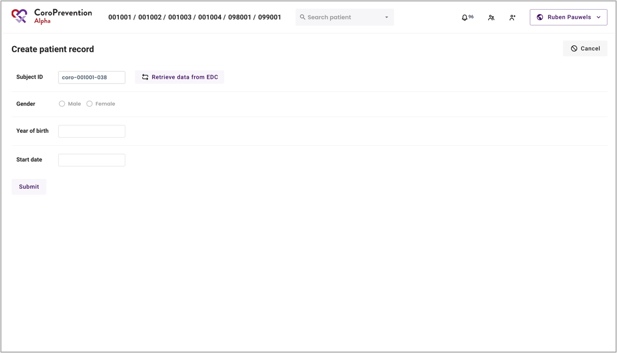
Prepare for visit 2 (caregiver dashboard)
1 | If the patient is randomised into the PPP group, the patient has to be imported into the Tool Suite. This is done by logging in to the caregiver dashboard and navigating to the “Create patient record” screen. Note: patients that are not in the PPP group cannot be imported into the Tool Suite.
2 | Fill in the subject ID.
3 | Click the button ”Retrieve data from EDC” to fetch the data from the EDC.
4 | Check if the data shown in the screen is correct for the patient. If the data is not correct, go to the EDC to correct the data and repeat the steps above.
5 | If the data is correct, click the “Submit” button to initiate the actual import of the patient from the EDC. Note: each patient can only be imported once into the Tool Suite.
1
2
3
4
5

Slide 18
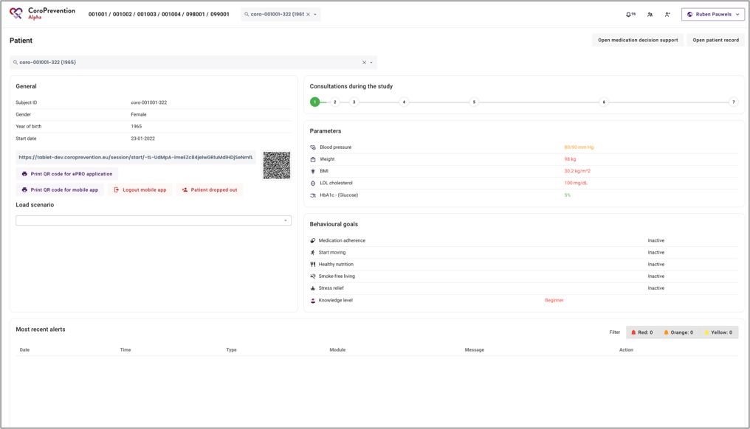
Prepare for visit 2 (caregiver dashboard)
1 | Patient record succesfully imported into the Tool Suite.
1

Slide 19
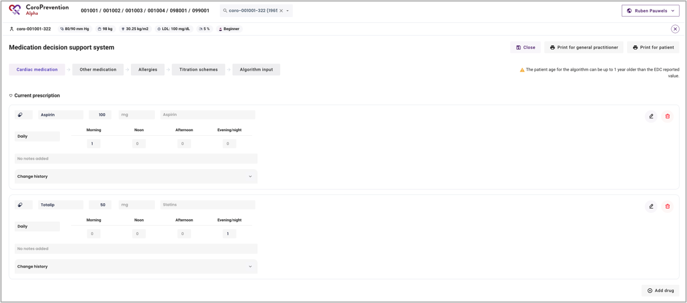
Prepare for visit 2 (caregiver dashboard)
1
MEDICATION PRESCRIPTION
1 | NOTE: The medication prescription of the patient is not automatically imported from the EDC to the Tool Suite (caregiver dashboard). Therefore, you have to manually register the patient’s medication prescription. Click the “Open medication decision support” button to open the medication DSS in which you can add / modify the patient’s medication prescription.
2 | Register the patient’s medication prescription. This is the same medication list as the one that was entered in EDC for visit 1.
2

Slide 20
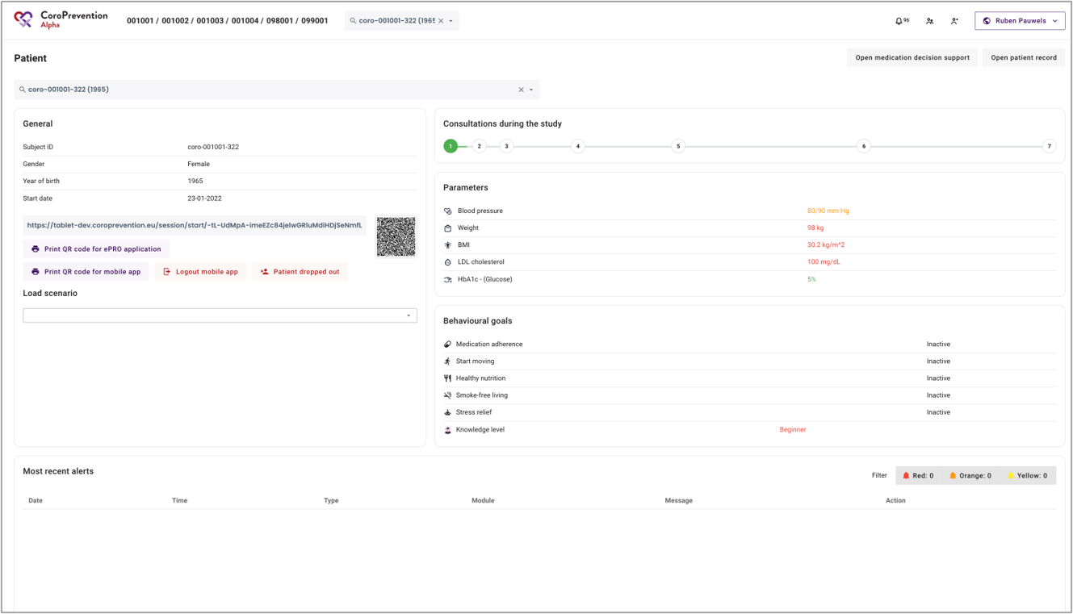
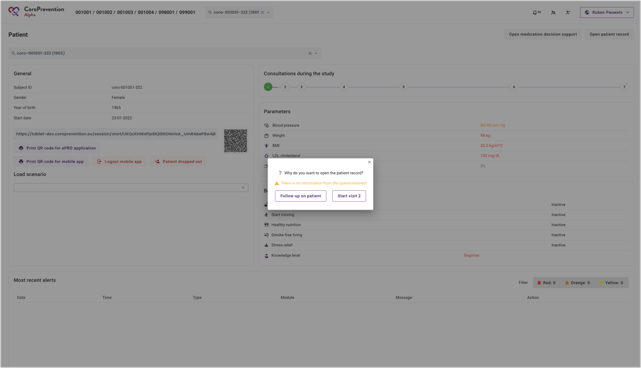
Prepare for visit 2 (caregiver dashboard)
 | EXERCISE PRESCRIPTION
1 | During the visit, you will discuss the exercise goals with the patient. To set a weekly sports goal (exercise prescription). Click on the button “Open patient record” Note: alternatively, you can also set the weekly sports goal during the visit with the patient.
2 | Open the patient record by clicking on the “Follow-up on patient” button.
1
2

Slide 21
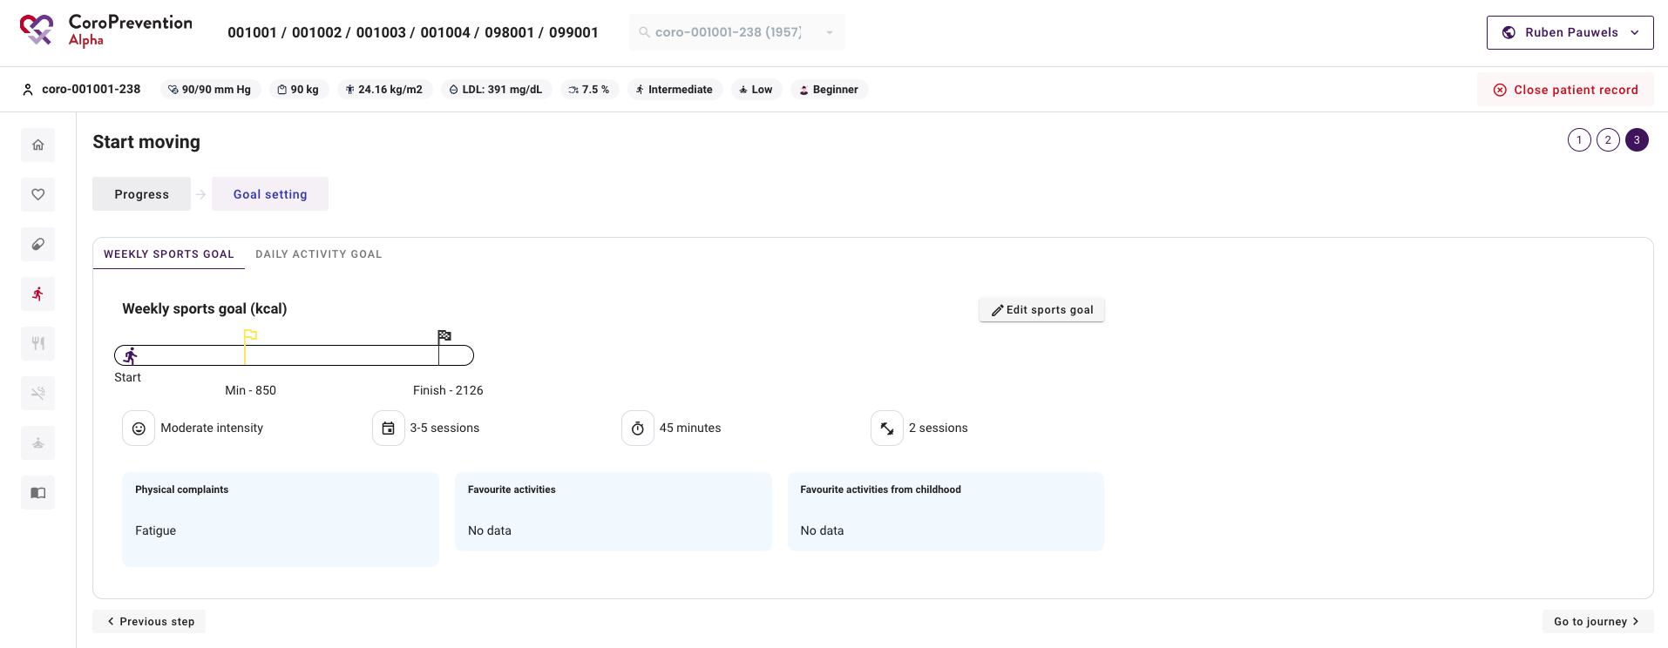
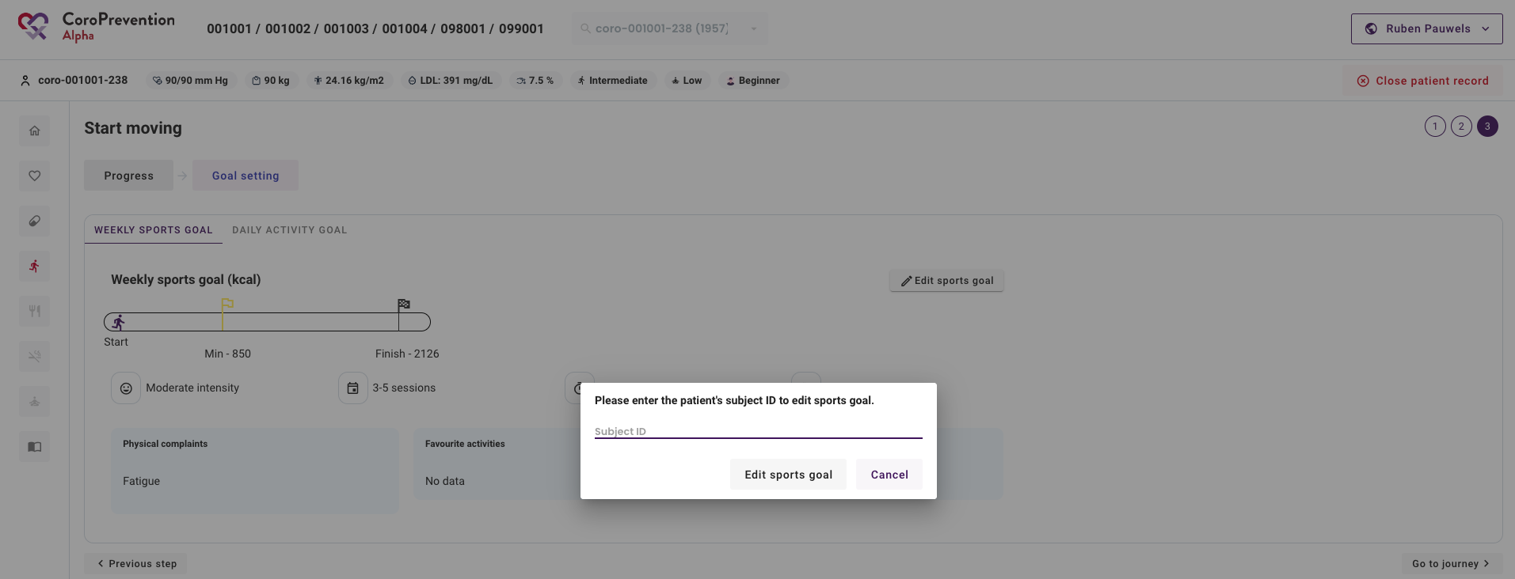
Prepare for visit 2 (caregiver dashboard)
EXERCISE PRESCRIPTION
3 | Navigate to the “Start moving” module by clicking the icon of the running man.
4 | Click on the ”Goal setting” tab.
5 | In the “Weekly sports goal” tab, click on the “Edit sports goal” button.
6 | Enter the patient’s subject ID and click the “Edit sports goal” button to open the EXPERT tool.
4
3
5
6

Slide 22
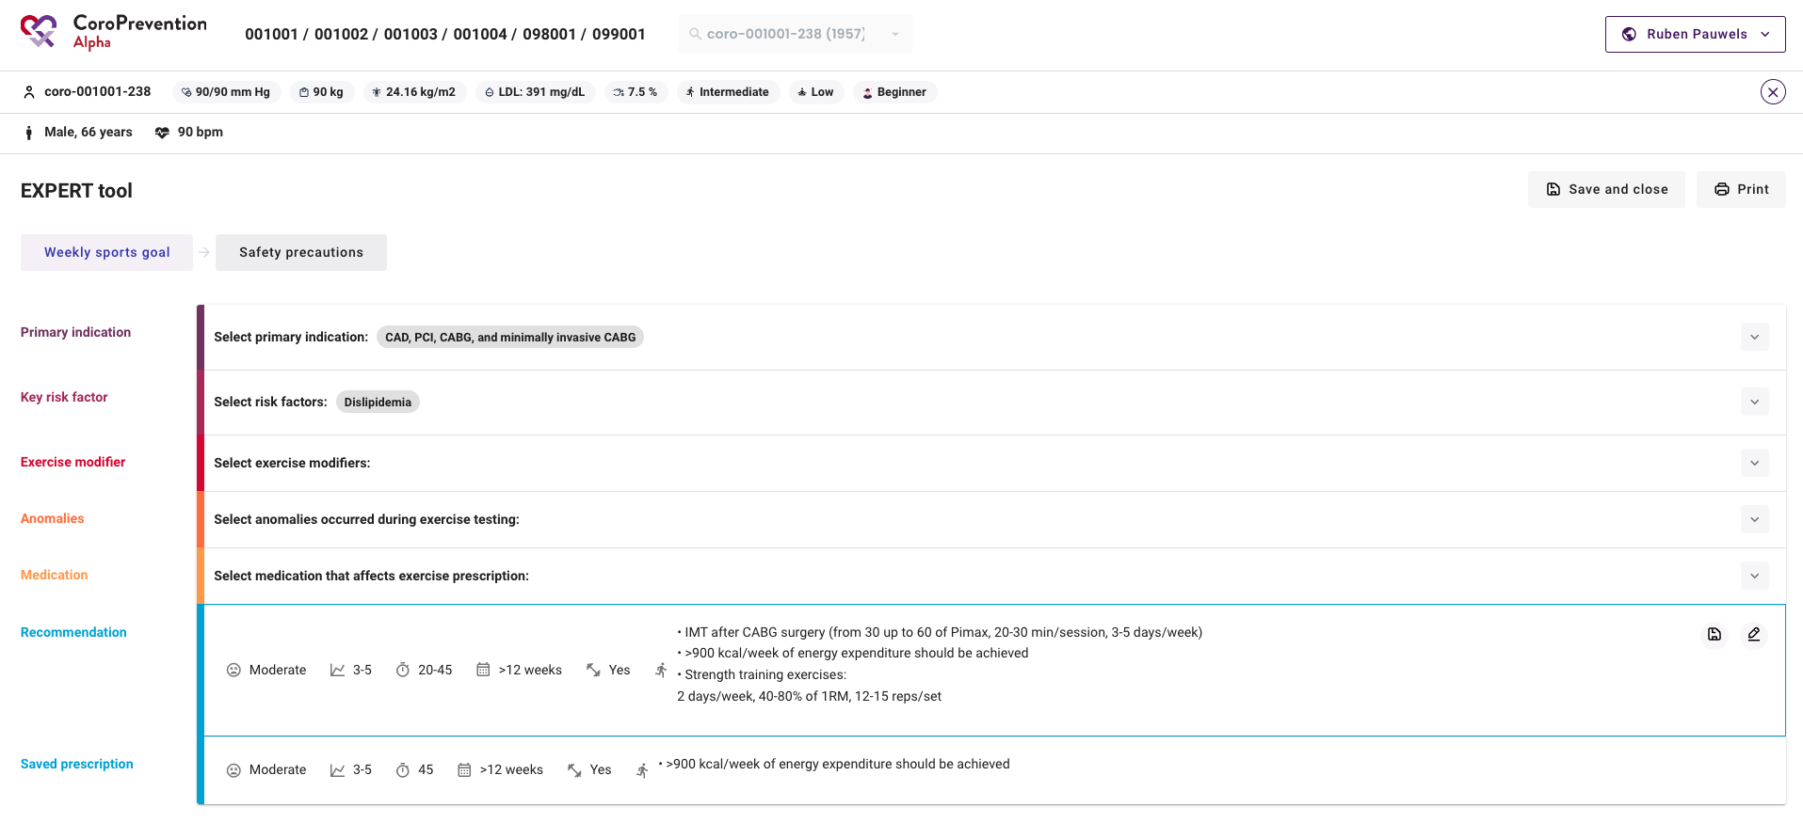
Prepare for visit 2 (caregiver dashboard)
EXERCISE PRESCRIPTION
7 | Set a weekly sports goal (exercise prescription) for the patient by selecting the relevant primary indications, key risk factors, exercise modifiers, anomalies and medication. Note: filling in this information might require you to look at the patient’s electronic health record.
8 | When you have created the weekly sports goal for the patient, you can close the EXPERT tool by clicking the “Save and close” button.
8
7

Slide 23
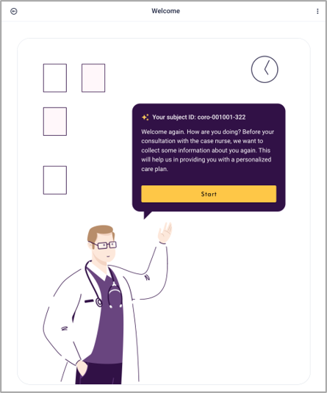
Conduct visit 2 with the patient (caregiver dashboard)
1 | Use the search function to find the patient record.
2 | Take the tablet and scan the QR code (or copy the link) to open the ePRO for the patient.
3 | Give the tablet to the patient so he/she can complete the questionnaires.
1
2
3

Slide 24
Conduct visit 2 with the patient (caregiver dashboard)
4
4 | Click the button “Open patient record” to open the patient record for a visit.
5 | In the pop-up, click the button "Start visit 2” to start the visit. Note: only use "Start visit X" when patient is sitting with you.
5

Slide 25
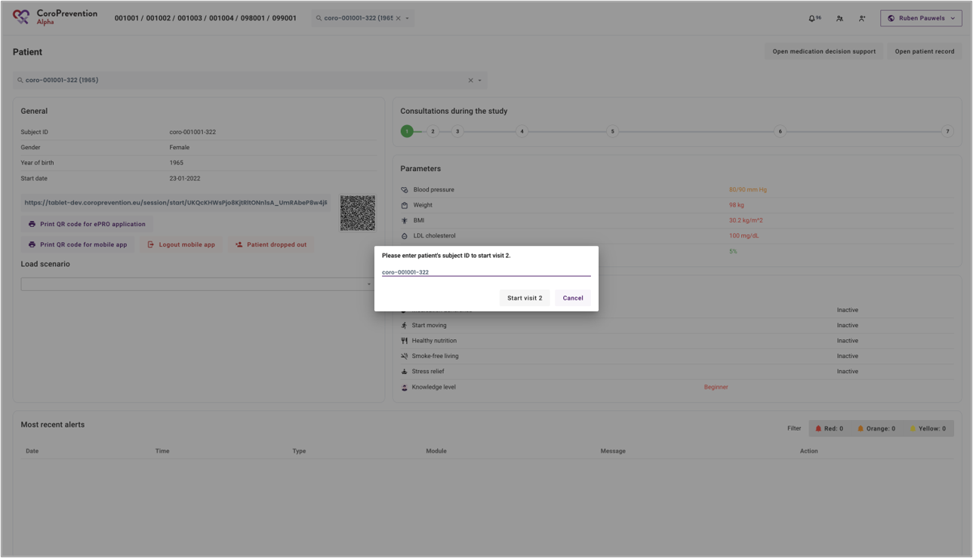
Conduct visit 2 with the patient (caregiver dashboard)
6 | Fill in the subject ID to make sure you are opening the patient record of the correct patient.
7 | Click the “Start visit 2” button to start the visit.
6
7

Slide 26
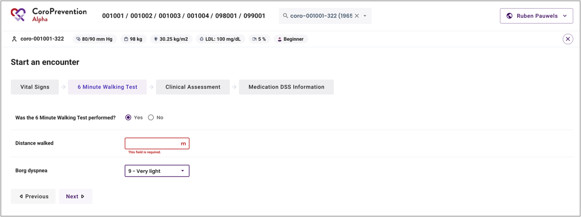
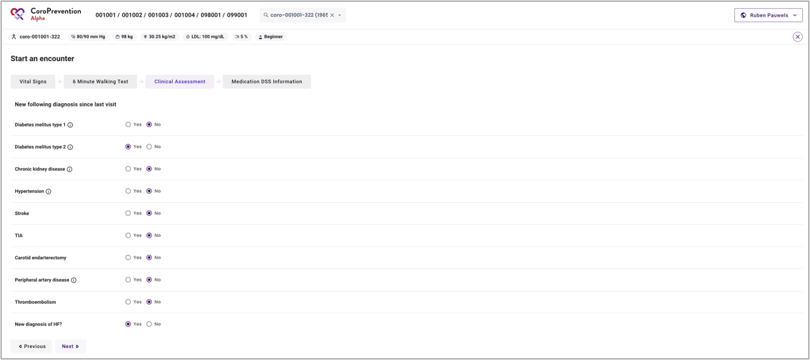
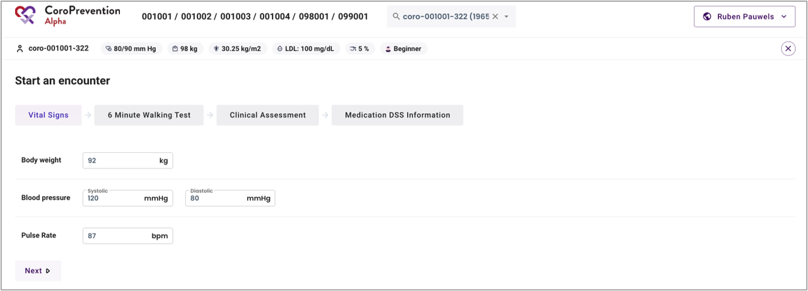
Conduct visit 2 with the patient (caregiver dashboard)
8 | When you start the visit, you have to measure and fill in the vital signs information in the caregiver dashboard. Note: after the visit, you can import this information in the EDC.
9 | During visit 2, and also 6 , the patient has to perform the 6 Minute Walking Test. You have to record the results in the caregiver dashboard. Note: after the visit, you can import this information in the EDC.
10 | Fill in the information regarding the clinical assessment (based on information in the medical records or questions asked to the patient). Indicate only NEW diagnosis since last visit. Note: after the visit, you can import this information in the EDC.
9
10
8

Slide 27
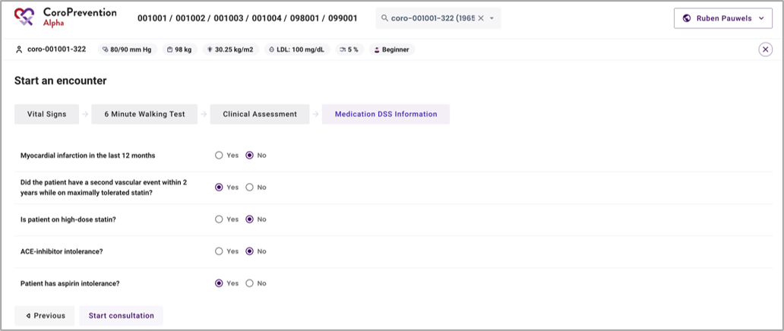
Conduct visit 2 with the patient (caregiver dashboard)
11 | Fill in the information that is required for the algorithm of the medication DSS to make personalized medication recommendations for the patient. This information can be filled in based on information that you can find in the medical records.
11

Slide 28
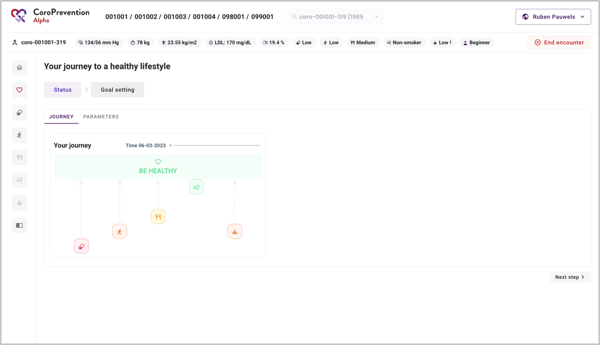
Conduct visit 2 with the patient (caregiver dashboard)
12 | The patient record is open for visit. From now on, you can have the shared decision making discussion with the patient about his/her status and goals.
12
During visit 2, you will also help to install the CoroPrevention mobile application on the patient’s smartphone.

Slide 29
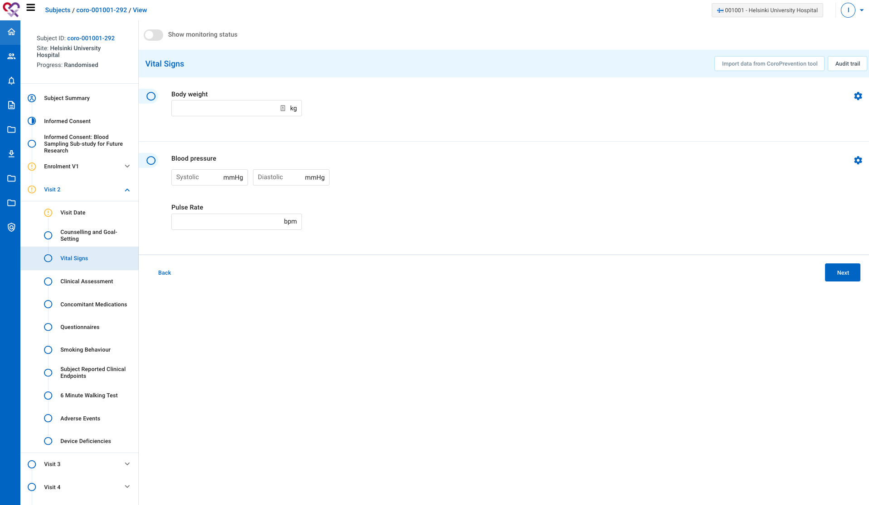
After visit 2 with the patient (EDC)
1 | Short after visit 2, all missing information for visit 2 has to be completed in the EDC.
2 | You can also use the “Import data from CoroPrevention tool” to import data that you already registered in the caregiver dashboard.
2
1

Slide 30
Conduct visit 3 - 7
Visit 3: ePRO questionnaires + shared decision making conversation with case nurse (see slide 24->)
Visit 4: ePRO questionnaires + shared decision making conversation with case nurse (see slide 24->)
Visit 5: ePRO questionnaires + shared decision making conversation with case nurse (see slide 24->)
Visit 6: ePRO questionnaires + shared decision making conversation with case nurse (see slide 24->) + appointment with investigator
Visit 7: ePRO questionnaires + shared decision making conversation with case nurse (see slide 24->) + uninstall patient mobile app
At V3-V7 you can open the PPP patient ePRO via eCRF or via Tool Suite.
Note that for high-risk UC patients you can only open the V6 and V7 ePRO via eCRF.
At the end of each visit, view the patient's disease related knowledge and the patient's usage of the educational module.
Configure relevant educational content for the patient.

Slide 31
Remote follow-up on patient between visits
(caregiver dashboard)
1
Note: use “Follow-up on patient” to view the patient record when the patient is not with you e.g. to view the patient’s progress or to prepare for the visit.
1 | Click the button “Open patient record” to open the patient record for a follow-up.
2 | In the pop-up, click the button ”Follow-up on patient” to start the follow-up.
2

Slide 32
Remote follow-up on patient between visits (caregiver dashboard)
3 | The patient record is open for follow-up.
3

Slide 33
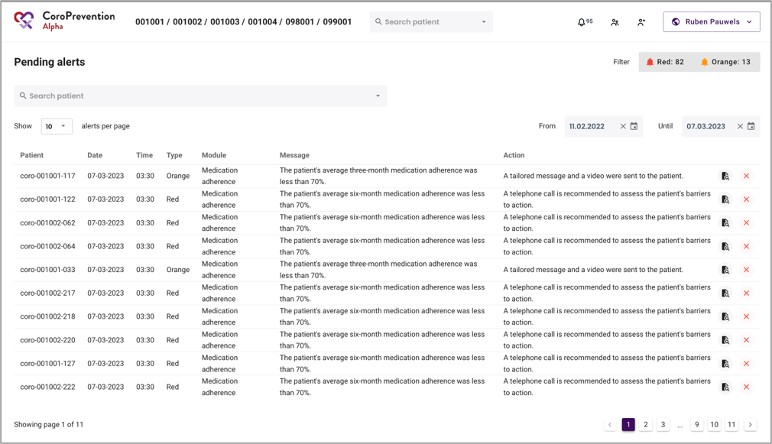
Handling alerts (caregiver dashboard)
1 | Click the “Bell” icon to view the list of pending alerts. Alerts get triggered based on the patient’s reported behaviour (from the mobile app)​. Note: alerts are shared between all nurses of a site​.
2 | The required action is described in the alert.
3 | Click the “File lookup” icon to open the patient record​.
4 | Click the “Cross” icon to mark the alert as handled
1
2
3
4

Slide 34
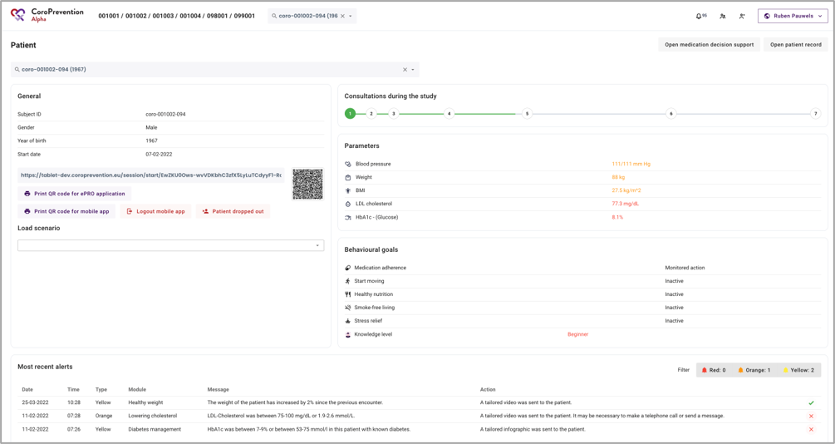
Handling alerts (caregiver dashboard)
4 | In the patient overview, there is a section “Most recent alerts”. This section shows all alerts (handled and unhandled) that were triggered for the patient since last visit. Note: yellow alerts are handled automatically by the system (e.g. tailored education sent to the patient)​.
Red alert: high priority alert, requiring intervention from the case nurse
Orange alert: medium priority alert, requiring some action from the case nurse
Yellow alert: low priority alert, requiring no action from the case nurse since an automatic action was already performed by the system
4

Slide 35
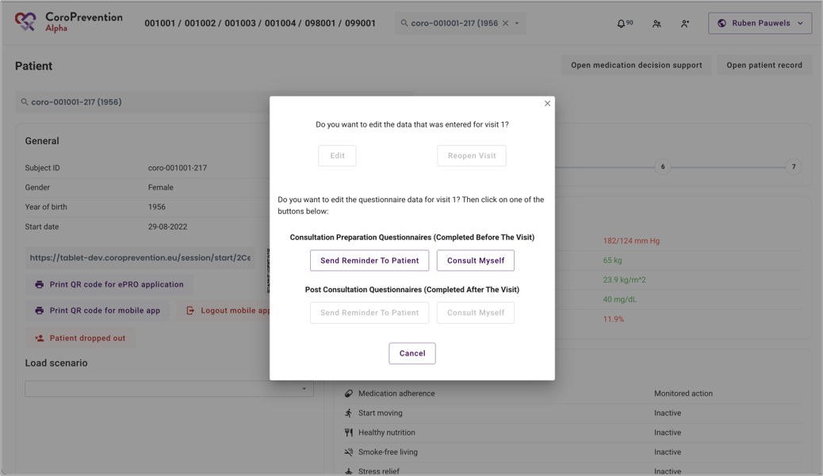
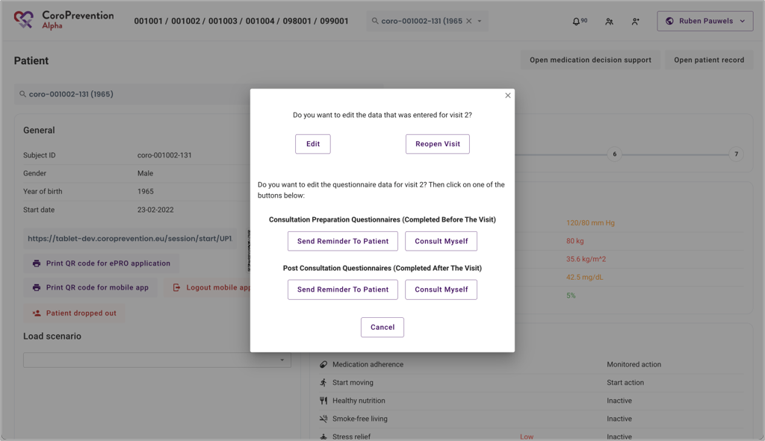
Correcting data entry (caregiver dashboard)
1 | Visit 1 data can be edited (corrected) in the EDC.​ Visit 1 data cannot be edited in the Tool Suite after import. Therefore it is important to check the data thoroughly before importing!​
2 | Visit 2-7 data of “Start an encounter” screens can be edited​ (corrected) in the caregiver dashboard. If data is corrected, remember to make corrections also in the EDC. A visit can also be reopened​ and links for ePRO questionnaires can be resent to the patient.
1
2

Slide 36
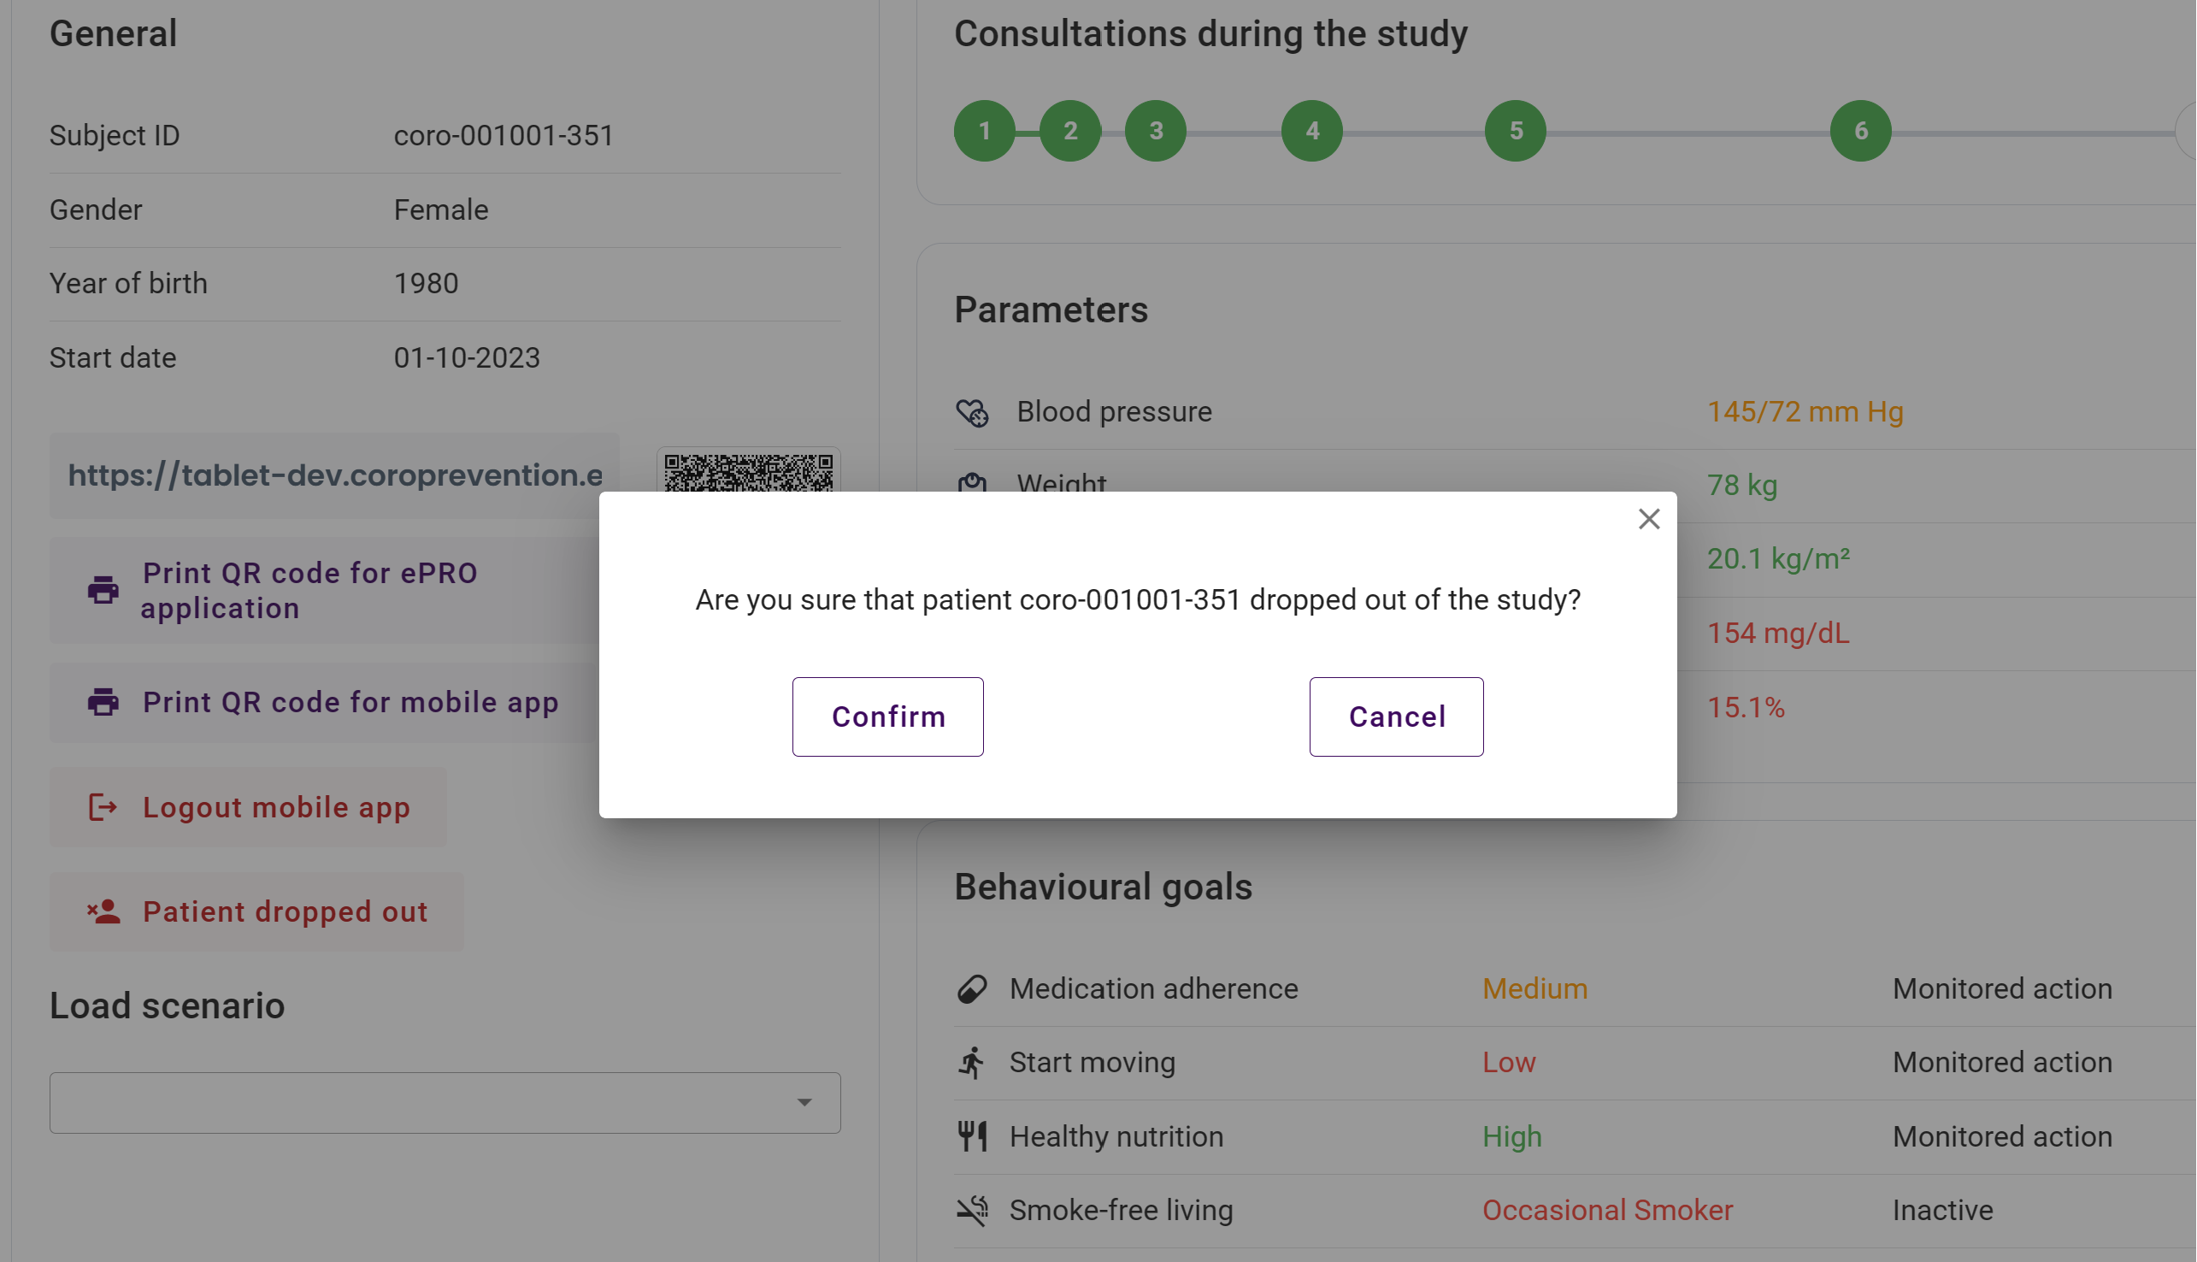
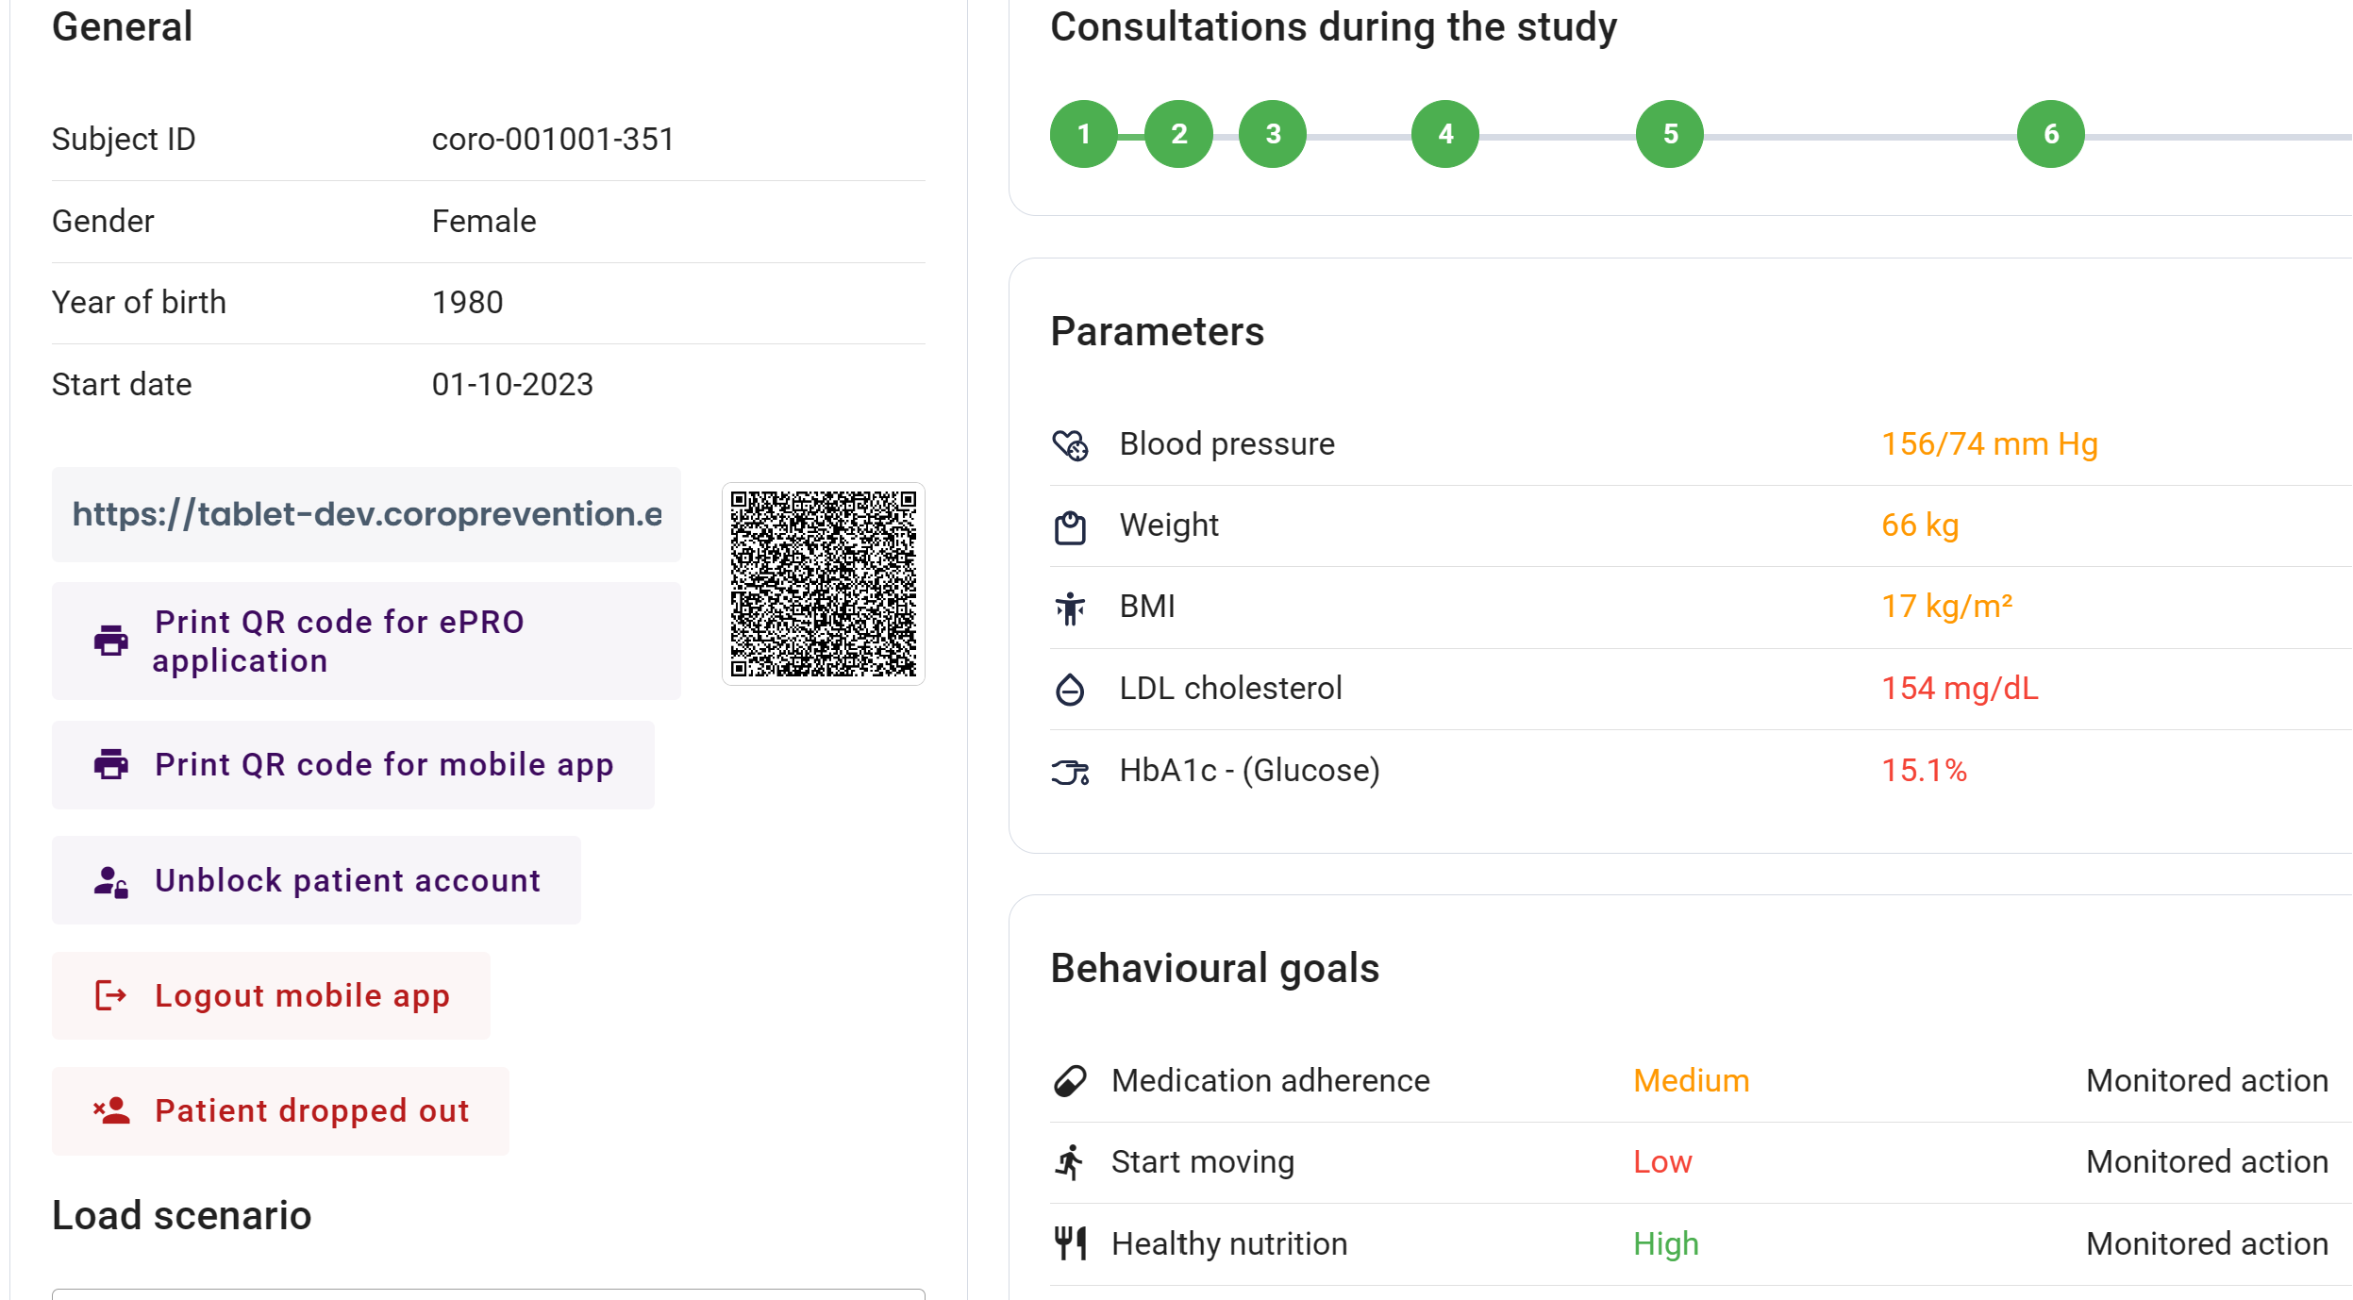
Patient discontinuation (dashboard)
1 | If a patient discontinues the trial click on the “patient dropped out button”.
2 | Check and click confirm to proceed with discontinuation.
2
Patients who complete the trial per protocol will automatically lose access to the CoroPrevention mobile app upon completion of the visit 7.
1

Slide 37
Case nurse manual caregiver dashboard - general module
V5.0, 20.12.2023

Slide 38
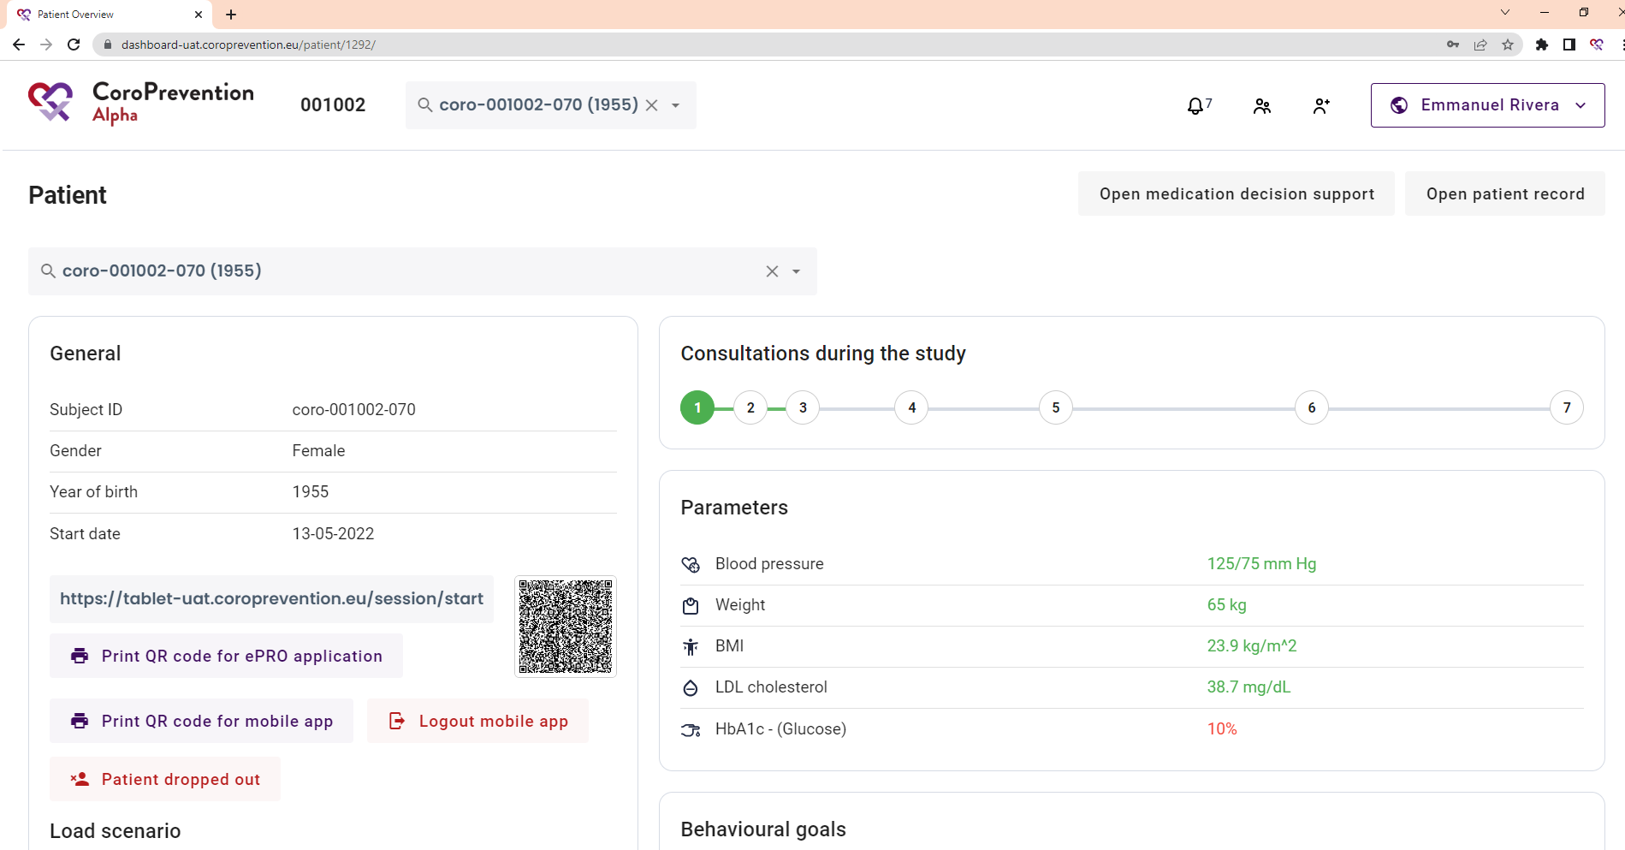
What can I find in the top navigation bar?
1 | In the search bar, you can type the subject ID of a patient. The system gives suggestions for patients that match with your search criteria.
2 | You can view the alerts by clicking this button. There is an indication of how many pending alerts you have.
3 | You can open the screen to search a patient in your trial centre by clicking this button.
4 | You can create a patient record by clicking this button.
5 | You can view who is logged in in the caregiver dashboard. In the account menu, open the about page, access settings and log out of the caregiver dashboard.
2
3
4
1
5

Slide 39
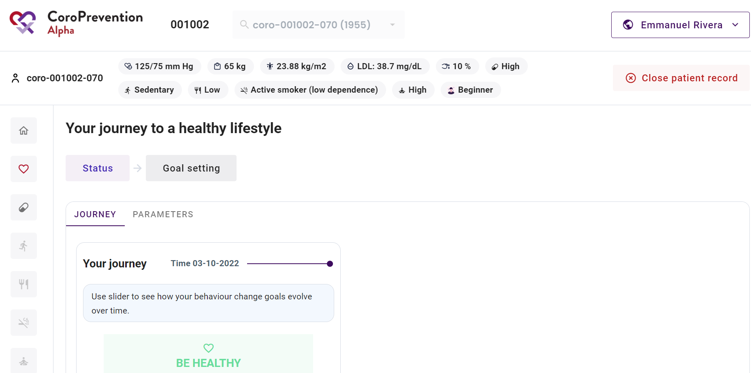

Where can I see the patient's risk profile?
1
2
3
5
6
7
8
9
10
4
11
12
13
14
15
16

Slide 40
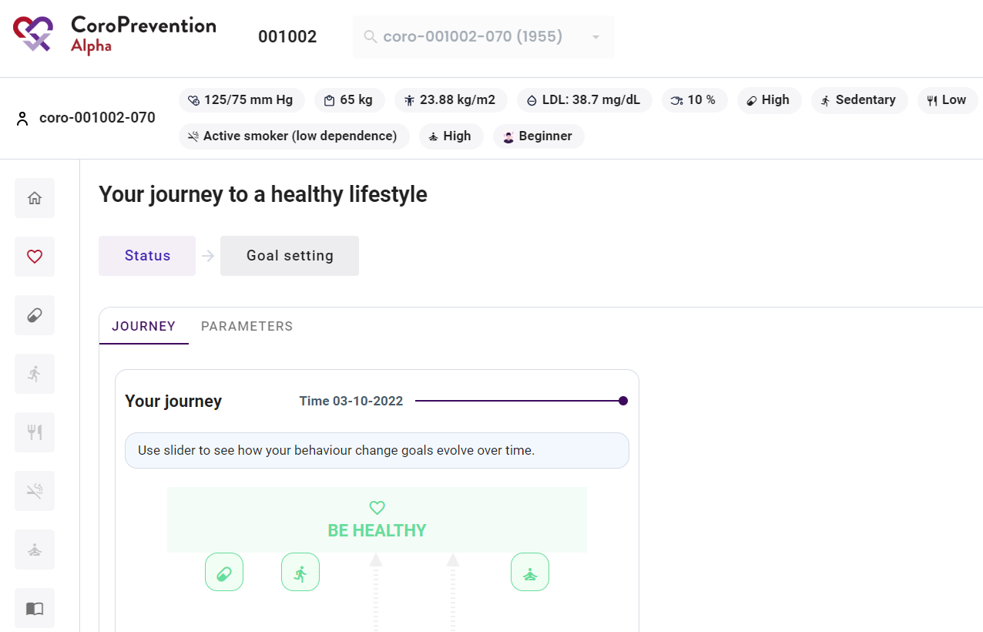
What can I do in the menu on the left?
1 | The navigation menu on the left allows you to switch between different modules or behavioral goals. The house icon takes you back to the main page of the patient profile.
2 | In the “heart” menu item, view the patient's progress for parameters and his/her journey to a healthy lifestyle. Also, you can select the outcome and behavioural goals for the patient.
3 | In the “pill” menu item, view the patient's progress and set goals for "Medication adherence".
4 | In the “running man” menu item, view the patient's progress and set goals for "Start moving".
5 | In the “cutlery” menu item, view the patient's progress and set goals for "Healthy nutrition".
6 | In the “smoking” menu item, view the patient's progress and set goals for "Smoke-free living". Feature available in mid 2024.
7 | In the “yoga” menu item, view the patient's progress and set goals for "Stress relief". Feature available in mid 2024.
8 | In the “book” menu item, view the patient's disease related knowledge and the patient's usage of the educational module or configure relevant educational content for the patient.
1
2
3
4
5
6
7
8

Slide 41
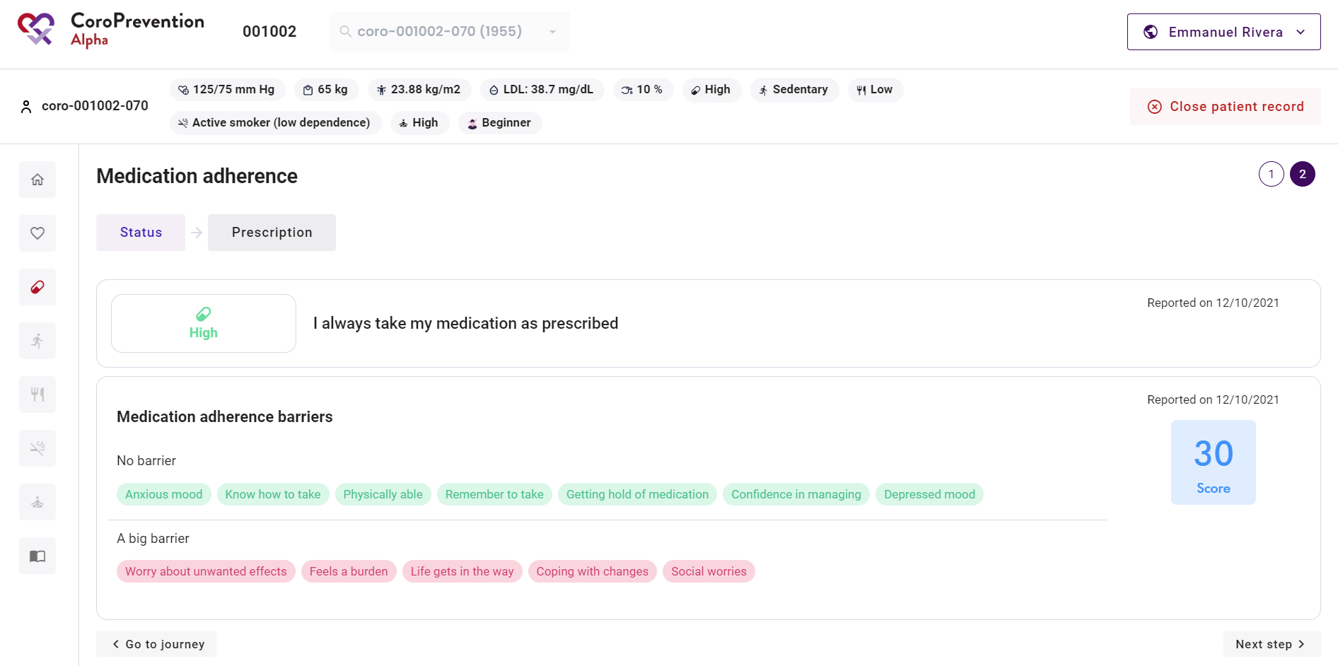
How to know the patient's level of guidance for a behavioral goal?
1 When you have opened the details about a behavioral goal, you can view the patient's level of guidance for the behavioral goal by looking at the circles.
The circle of the patient's current level of guidance for the behavioral goal is highlighted. If there is no circle highlighted, the patient is in inactive mode (level of guidance 0) for the behavioral goal.
1

Slide 42
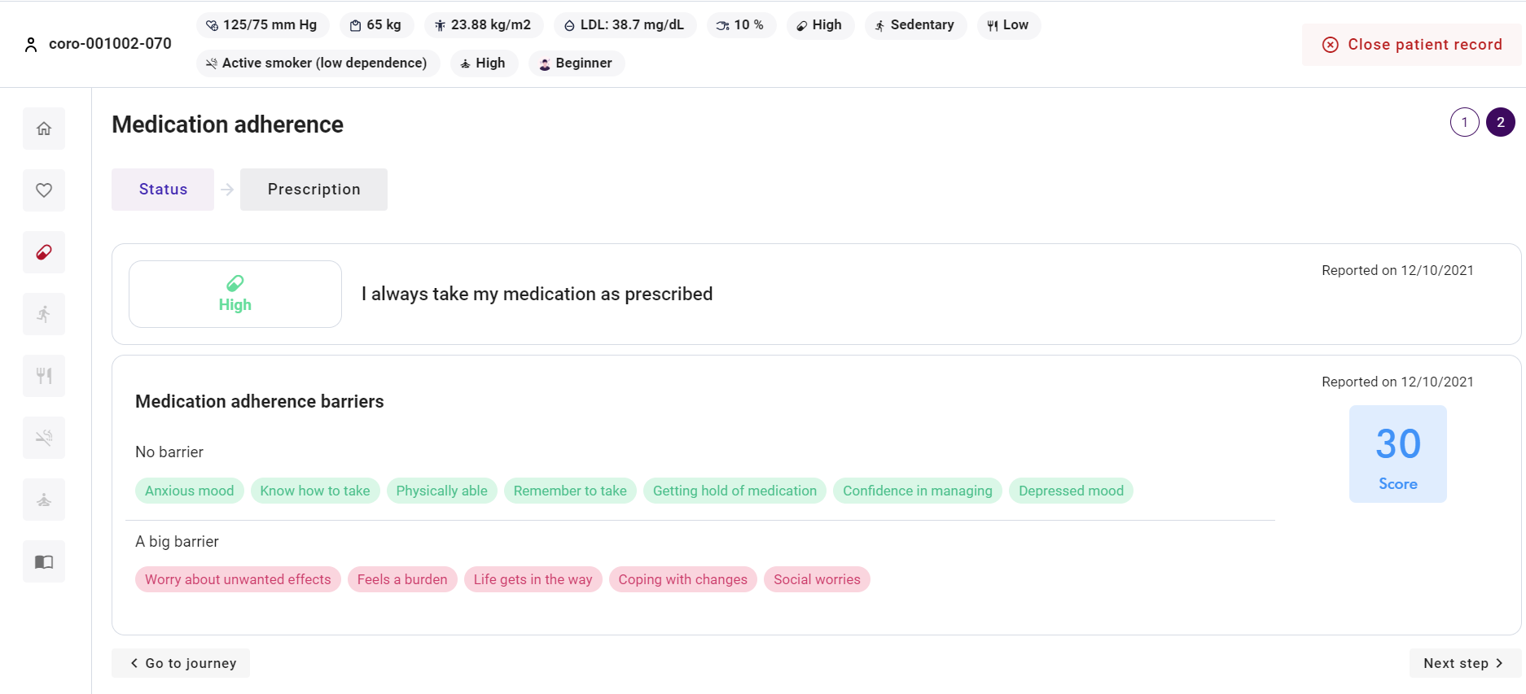
How to structure the conversation about a behavioral goal?
1 | For each menu item on the left (i.e. module or behavioral goal), there are several discussion steps. The currently selected discussion step is highlighted. You can click on a discussion step to view the related screen.
2 | You can go to the next discussion step by clicking this button.
1
2

Slide 43
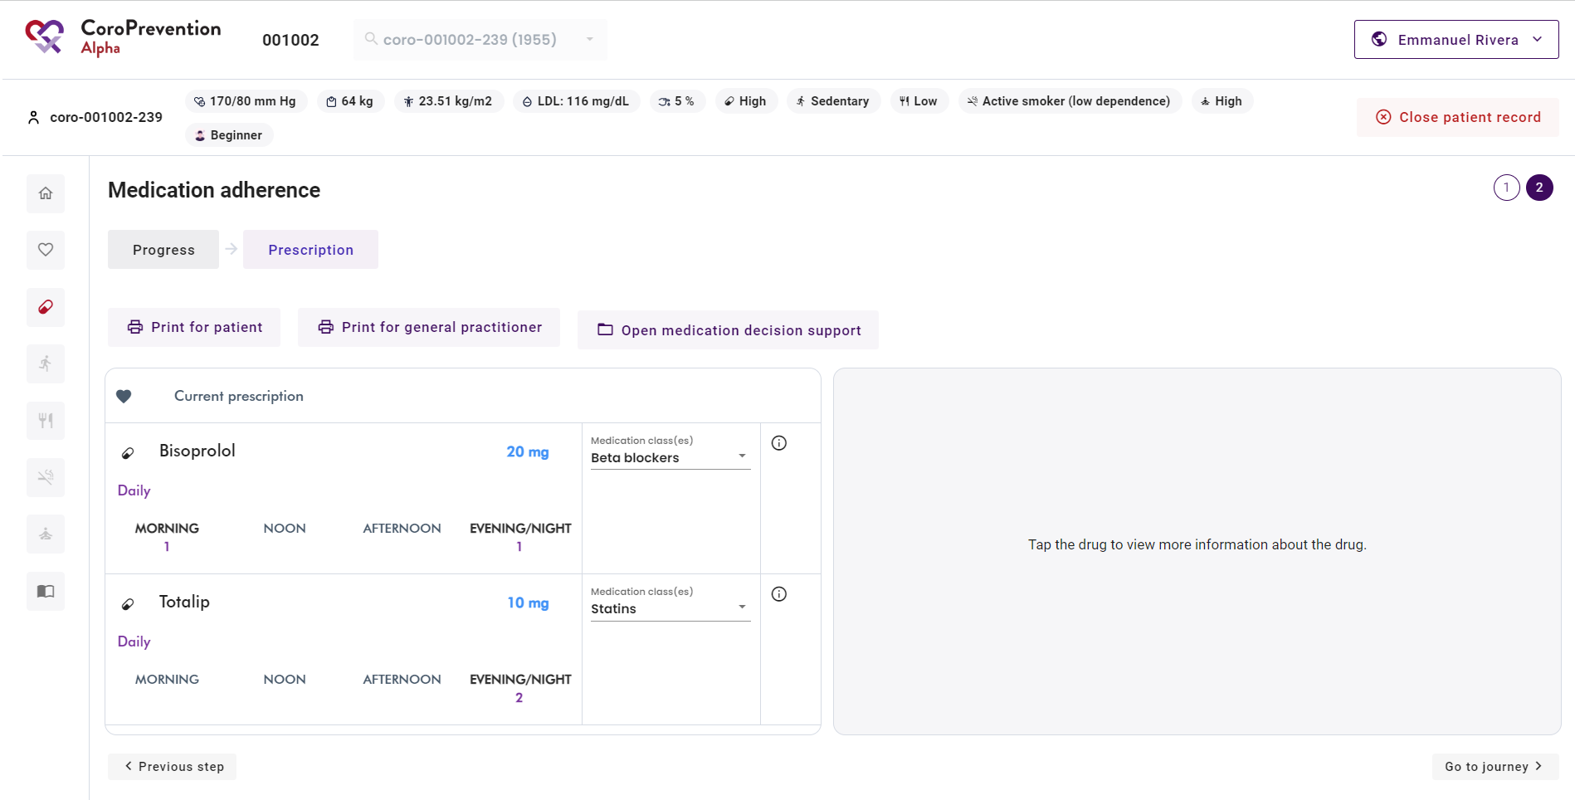
How to structure the conversation about a behavioural goal?
3 | You can go to the previous discussion step by clicking this button.
4 | After going through all discussion steps for a module or behavioral goal, you can return to the patient's journey by clicking this button.
 | Repeat the same steps for each behavioral goal as applicable.
3
4

Slide 44
Case nurse manual caregiver dashboard - journey module
V5.0, 20.12.2023

Slide 45
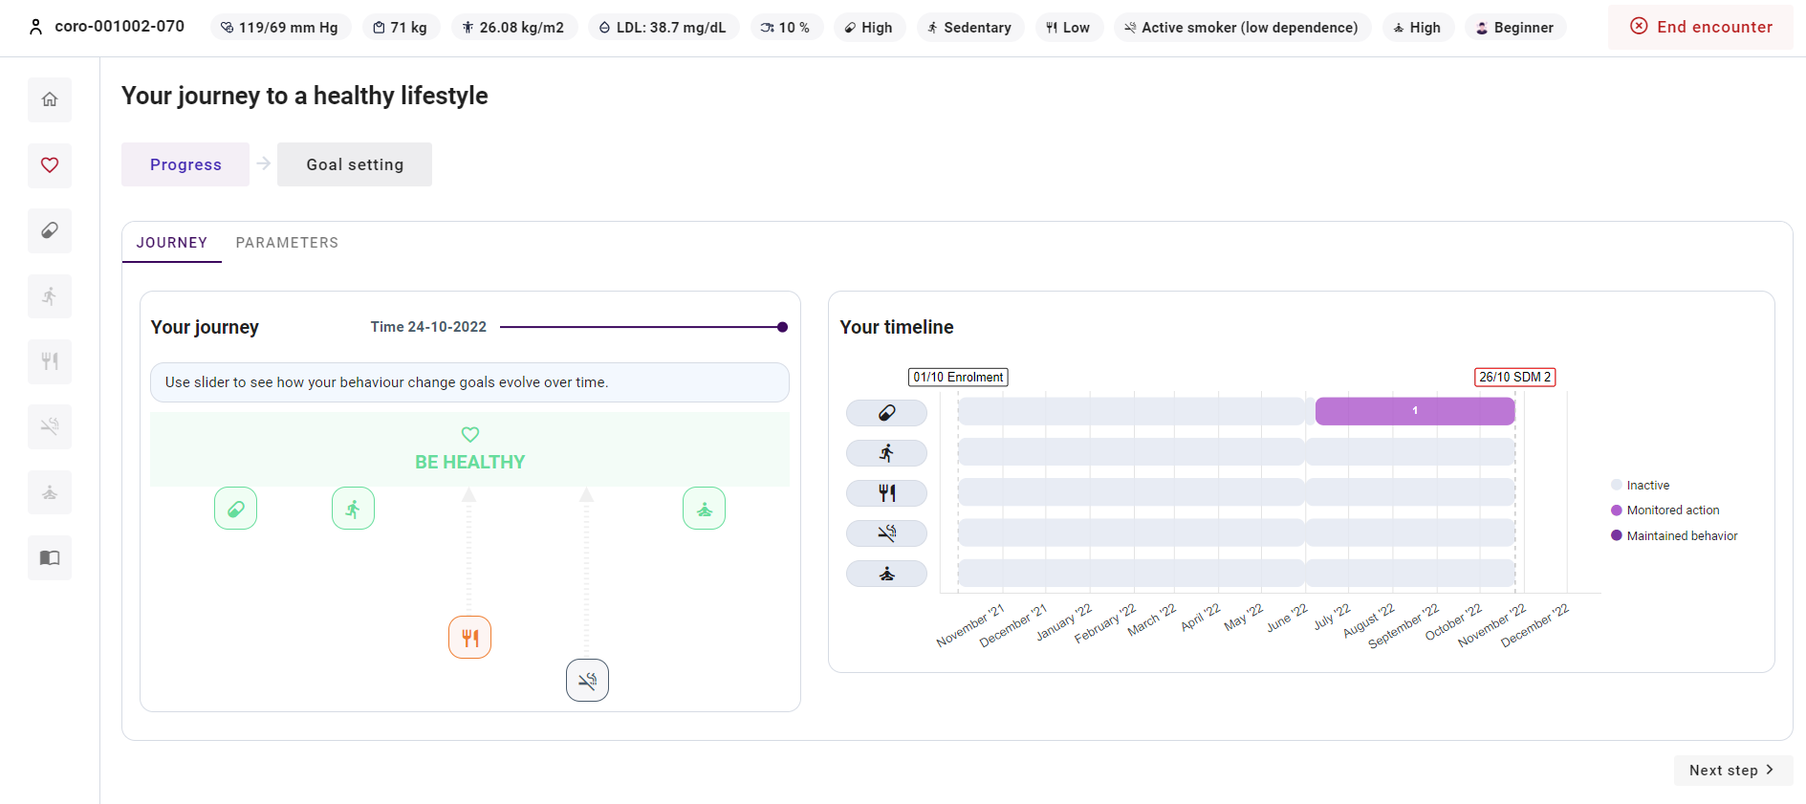
How to follow up on the patient's progress for the journey?
1
1 | In "Progress", you can view the patient's progress for his/her journey towards a healthy lifestyle. You can view the patient's progress for a) the behavioural goals and b) the parameters.
a
b

Slide 46
How to follow up on the patient's progress for the behavioral goals?
1 | The "Journey" tab in "Progress", shows an overview of the patient's progress for the five behavioural goals.
2 | The closer the behavioural goal is to the "Be healthy", the better the related risk factor is under control. In the example, you can see that "Healthy nutrition" and "Smoke-free living" are far from the "Be healthy", so these risk factors need most improvement. "Medication adherence”, “Start moving” and "Stress relief" are near to the "Be healthy", so these risk factors are well under control.
3 | You can explore the patient's progress towards a healthy lifestyle over time by moving the slider.
1
3
2
5

Slide 47
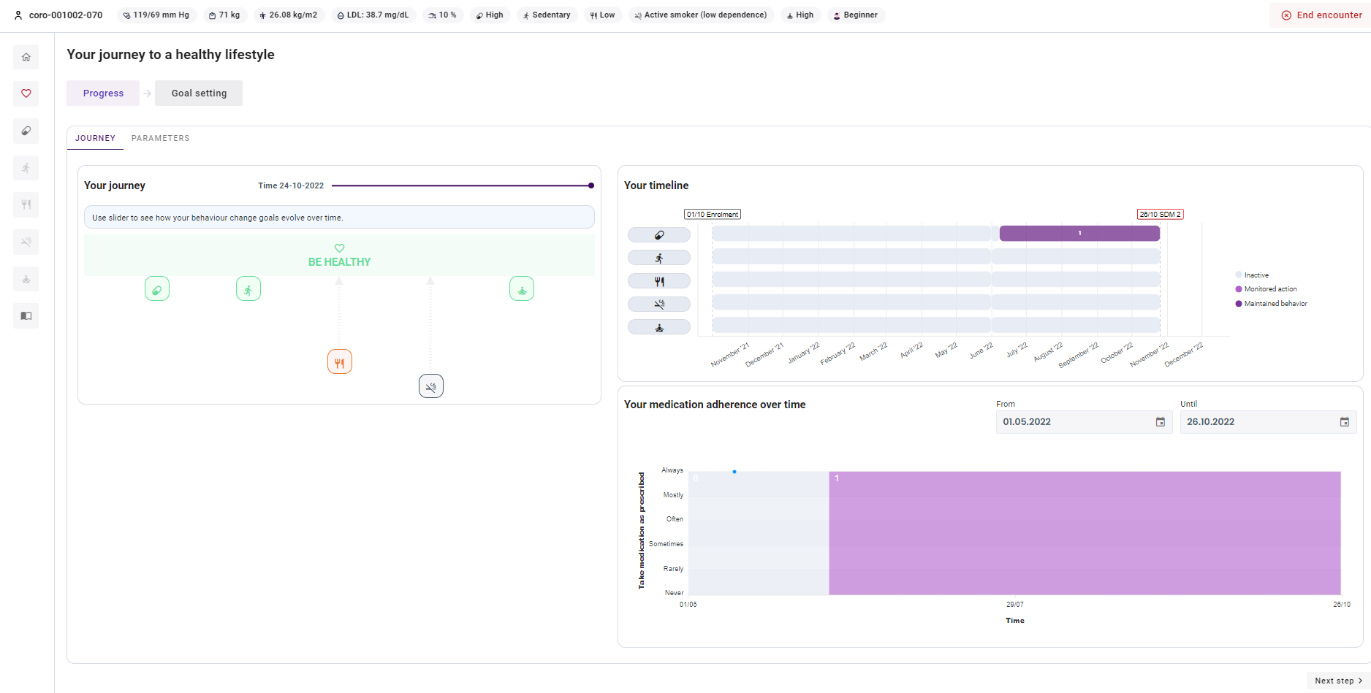
How to follow up on the patient's progress for the behavioural goals?
4 | The number on the timeline indicates which level of guidance the patient was for the behavioral goal in the specified period. If no number is indicated, the patient was in inactive mode for the behavioural goal.
5 | Click an icon of one of the behavioural goals or a period in the timeline, to see a detailed overview of the patient's self-reported behavior for that behavioural goal (reported in the ePRO application or in the mobile app). Select the period from the date picker.
6 | The numbers in the chart indicate the level of guidance that the patient was in at that moment for the behavioural goal.
4
5
6

Slide 48
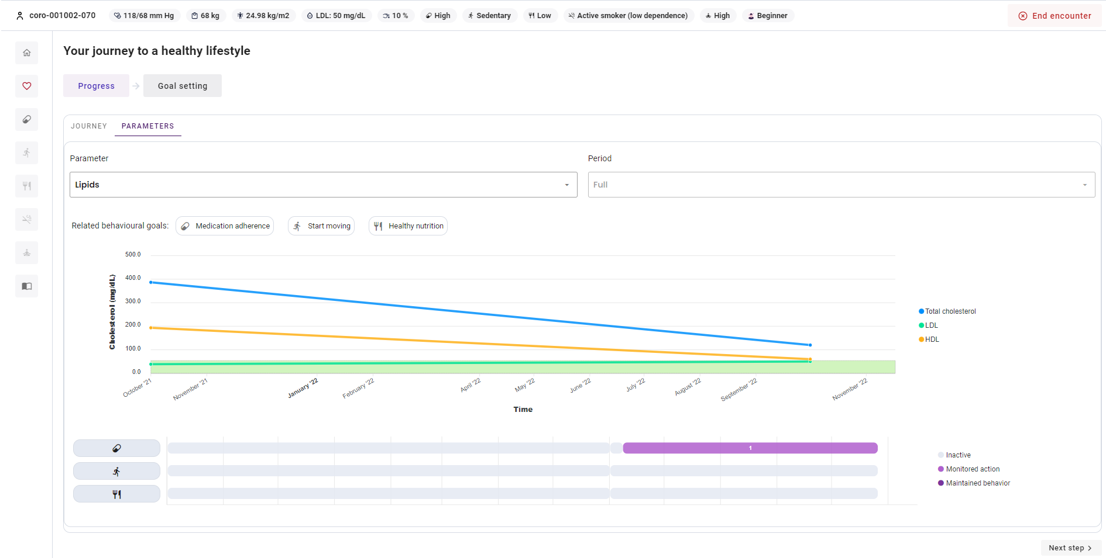
How to follow up on the patient's progress for parameters?
1 | The "Parameters" tab in "Progress", shows an overview of the patient's progress for his/her parameters. The available parameters are blood pressure, weight, lipids, and glucose.
2 | The chart depicts the evolution of the parameter over time. You can hover over a dot to see the exact value for a certain date or the average for a certain period.
3 | The green area is the personalized target zone that the patient should strive to achieve.
4 | You can choose which parameter you want to visualise.
5 | You can choose the timeframe that you want to visualise.
6 | There is an overview of the behavioural goals that are related to the selected parameter.
7 | For each related behavioral goal, you can view in which level of guidance the patient was for that behavioral goal over time.
1
5
4
6
2
3
7

Slide 49
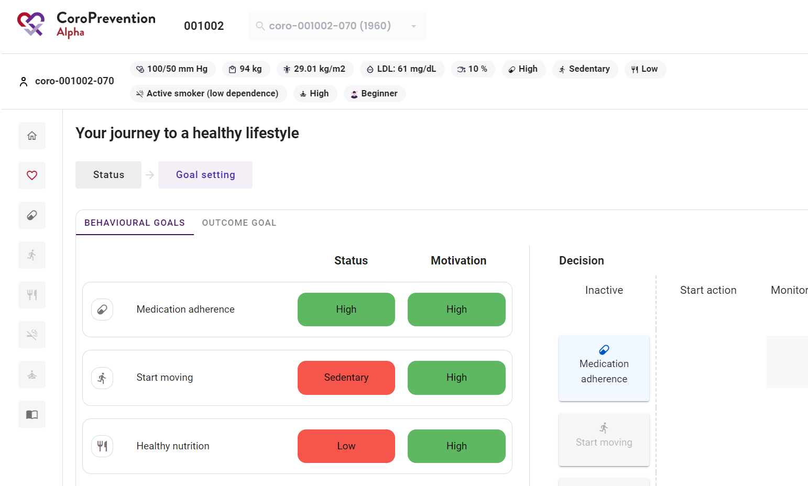
How to set the patient's behavioural and outcome goals?
In "Goal setting", you can set the patient’s
behavioural goals and
outcome goals. The patient should aim to achieve the outcome goals by working on the behavioural goals.
1
a
b

Slide 50
How to change the configuration of the levels of guidance for the patient's behavioural goals?
1 | In the "Behavioural goals" tab in "Goal setting", select together with the patient for each behavioural goal its level of guidance.
2 | View the current status, i.e., how well the patient is doing in terms of outcomes. This is the same as the information depicted in the risk profile bar (at the top in the caregiver dashboard). You can use this information when determining the patient's level of guidance for a behavioural goal.
3 | View how motivated the patient is to work on the behavioural goal. You can use this information when determining the patient's level of guidance for a behavioural goal.
4 | For each behavioural goal, the goal is to discuss and decide together with the patient in which level of guidance the patient will be. There are three levels of guidance: "start action", "monitored action", and "maintained behavior". Change the level of guidance of a behavioural goal by dragging the behavioural goal to the desired level of guidance. If the patient doesn't want to work on a behavioural goal, leave that goal at inactive. Changes to level of guidance done in the caregiver dashboard, will be automatically applied in the patient mobile application.
1
2
3
4
Note: For the behavioural goal "Medication adherence", only "inactive", "monitored action" and "maintained behaviour" are available.
Note: "Smoke-free living" and "Stress relief“ will be made available mid 2024 hence these are currently set on "inactive".

Slide 51


How to set the patient's outcome goals?
1 | In the "Outcome goals" tab in "Goal setting", you can select the outcome goals for the patient. In contrast to the behavioural goals, here direct measured outcomes are given.
2 | You can view how well the patient is doing for each outcome goal. This is directly linked to the patient's current parameter values.
3 | The outcome goals are automatically updated by the system based on the patient's reported parameter values. However, if desired, you can adjust this. Note: If a patient reports a not optimal parameter value (e.g. high blood pressure) in the mobile app or the nurse reports a not optimal parameter value in the “Start an encounter” screen in the dashboard, the related outcome goal (e.g. “Lowering blood pressure“) is enabled automatically. The same applies for other parameters/outcome goals."
1
1
2
2
3
3
5

Slide 52

How to set the patient's outcome goals?
4 | You can, together with the patient, set a target weight. When you add a target weight and the patient’s current BMI is more than 25 kg/m^2, the recommended target weight is set automatically to a 5 percent weight reduction. If the patient's BMI is already 25 kg/m^2 or lower, it is recommended to maintain the same weight
5 | You can, together with the patient, remove the target weight.
4
5

Slide 53
Case nurse manual caregiver dashboard - education module
V5.0, 20.12.2023

Slide 54



How to follow up on the patient's disease-related knowledge?
1
4
5
2
There is an overview of how well the patient’s knowledge is for different categories. The categories are respectively: stress relief, medication adherence, healthy nutrition, smoke-free living, my heart, start moving, and health parameters. The percentage indicates how well the patient scored on this category in his/her current knowledge level.
6
3
The graph depicts the evolution of the patient’s score on the knowledge challenge over time. The different colors indicate the patient’s knowledge level at that moment. The stars in the bar depict the patient’s score on the knowledge challenge. In the upper right corner, you can adjust the time period shown in the chart.

Slide 55


How to follow up on the personalized educational material sent to the patient?
1 | In "Timeline", you can follow up on how many of the personalized educational items (e.g. video, article, image) that you sent to the patient were viewed by the patient.
2 | You can select the categories (multiple) that you want to include in the timeline.
3 | Categories that are currently selected are displayed. These can be removed by clicking on the "cross" icon.
4 | You can change the time period that you want to see in the timeline.
5 | The timeline shows per month how many educational items were sent to the patient ("camera" symbol) and how many of these items were viewed by the patient ("eye" symbol).
6 | You can click on a month to view more detailed information about the educational items that were sent to the patient.
1
2
4
3
5
6

Slide 56


How to select personalized educational material for the patient?
1 | In "Selection", you can select the educational content that is relevant for the patient.
2 | Overview of action related educational material that is available in the CoroPrevention Tool Suite. For each educational item, there is an icon representing the type of education (i.e. text, image or video), the category and if the patient already viewed this educational item or not.
3 | You can search educational content by using the search function. You can also apply filters to look for specific educational content based on the category or who selected the educational content.
4 | You can view the filters for the category and choice of that are currently applied. You can remove any of these filters by clicking on the "cross" icon.
5 | Based on the patient's current outcome and behavioural goals, a set of recommended educational content is automatically selected for the patient. As a caregiver, you can also update this set of recommended educational content. Educational content that is selected by the algorithm or by you, has a "caregiver" symbol.
6 | Educational content that is selected by the patient has a "patient" symbol.
1
3
3
3
4
4
5
2
6

Slide 57

How to select personalized educational material for the patient?
7 | You can remove an educational item from the patient's or caregiver's choice by clicking on the "patient" or "caregiver" symbol respectively.
8 | You can click on the educational item to view more information (i.e. title, content type, number of related questions of the knowledge challenge that the patient answered wrong, how many times the educational item was sent to the patient, and how many times the educational item was viewed by the patient).
9 | You can add the educational item to the patient's favourites by clicking this button.
10 | You can send the educational item to the patient as a notification (i.e. in an application reminder) by clicking this button.
11 | You can also send the educational item to the patient (i.e. in an application reminder) by clicking on the “share" icon.
7
4
11
8
8
7
9
10

Slide 58
Case nurse manual caregiver dashboard - medication adherence module
V5.0, 20.12.2023

Slide 59


How to view the patient's status for medication adherence?
1 | In "Status", you have an overview of the patient's status for medication adherence.
2 | You can see how the patient describes his/her medication adherence in general. Note: The "Status" button is available until the end of visit 2. After that, see "Progress" button on next page of this manual.
3 | You can see an overview of the patient's barriers for medication adherence (only V2). The barriers are based on the patient's answers on the Identification of Medication Adherence Barriers (IMAB) questionnaire that was completed in the ePRO application at V1. Higher IMAB scores are indicative of the greater barriers for medication adherence.
4 | The elements indicated in green are no barriers for the patient.
5 | The elements indicated in orange are small barriers for the patient.
6 | The elements indicated in red are major barriers for the patient. These are the elements that the patient has limited knowledge about, or that go wrong on a regular basis. These are the patient's main points for improvement and should be the focus of the shared decision making discussion.
1
2
3
4
5
6

Slide 60


How to follow up on the patient's progress for medication adherence?
1 | In "Progress", you have an overview of the patient's progress for medication adherence.
2 | You can see how the patient describes his/her medication adherence in general.
3 | The patient's small (orange) and major (red) barriers for medication adherence are depicted. The barriers are based on the patient's answers on the Identification of Medication Adherence Barriers (IMAB) questionnaire that was completed in the ePRO application. The IMAB questionnaire assesses the patient's difficulties with taking medication.
4 | The chart depicts how the patient's medication adherence evolved over time. The medication adherence was reported by the patient in the mobile application or the ePRO application. With date picker you can adjust the time period shown in the chart.
5 | The numbers in the chart indicate the level of guidance for "Medication adherence" that the patient was in at that moment.
1
2
3
4
5

Slide 61


How to follow up on the patient's progress for medication adherence?
6 | You can click on a period in a level of guidance to view more details about this period.
7 | You can view the medication adherence percentage over this entire period in level of guidance 1 for "Medication adherence".
8 | You can view the best month of this period in level of guidance 1 for "Medication adherence".
9 | You can view the medication adherence percentage of the last 30 days in this period in level of guidance 1 for "Medication adherence".
10 | In the calendar overview, you can view on which days the patient's medication adherence was good (green), moderate (orange), or bad (red).
6
7
10
8
9

Slide 62


How to view the patient’s medication prescription?
1 | In "Prescription", you have an overview of the patient's medication prescription.
2 | The patient's current medication prescription is shown. There is also an indication of the changes that were made since last encounter. These changes are especially relevant to discuss with the patient.
3 | Drugs that were added since last visit are indicated by a "plus" icon.
4 | Drugs that were edited since last visit are indicated by a "pencil" icon.
5 | Drugs that were deleted since last visit are scratched through.
6 | Pills are indicated by a "pill" icon, while injections are indicated by a "syringe" icon.
7 | You can click on a row in the medication prescription to view more information about the drug.
8 | You can view the parameters that the medication is related to, the reason why the patient has to take the medication, the date that it was prescribed and by whom it was prescribed, and which changes were made to this drug over time. There is also an infographic that you can use in the discussion with the patient to explain the mechanisms that the drug works on and the reason why the patient has to take the drug.
9 | To be able to view the additional information about a drug, the medication class of the drug should be selected.
10 | You can record additional notes for the drug.
11 | If you have an investigator role in the study / in dashboard, you can open the medication decision support system by clicking this button.
12 | You can print the medication prescription for the patient and the recommendations for the patient's general practitioner by clicking these buttons.
1
12
11
2
3
9
8
7
5
6
4
10

Slide 63
Case nurse manual caregiver dashboard - medication DSS
V5.0, 20.12.2023

Slide 64


How to open the medication decision support system
(medication DSS)?
1
 | There are three ways to open the medication DSS.
1 2 | In the patient summary, you can open the medication DSS by clicking this button. Open the patient record, click the “House” menu item to open the medication DSS by clicking the “Open medication decision support” button.
3 | In the "Medication adherence" module, you can go to "Prescription" and click on this button to open the medication DSS.
2
3
Note: The nurse role can open and add/edit the medication DSS until the visit 2 is closed in the dashboard. Nurse cannot run the medication DSS algorithm.

Slide 65

How to navigate in the medication DSS?
1 | There are four tabs in the medication DSS: a) cardiac medication, b) other medication, c) allergies, and d) titration schemes.
2 | You can save the medication prescription by clicking this button. After saving the medication prescription, the changes are automatically made to the patient's medication prescription on his/her smartphone.
3 | You can print the medication prescription by clicking any of these buttons.
4 | If the patient has a low renal function, there is a warning indicating this.
5 | You can close the medication DSS by clicking this button. You cannot leave the medication DSS when the medication prescription is incomplete.
5
1
2
3
a
b
c
d
4

Slide 66


How to prescribe cardiac medication following the guidelines using the medication DSS?
12 If the drug was added to the medication prescription by the patient since last encounter, there is an icon indicating this.
12

Slide 67

How to prescribe cardiac medication following the guidelines using the medication DSS?
1 | In the "Cardiac medication" tab, you find an overview of all cardiac medication entered into the prescription.
2 | If the drug has a green background color, it means that the drug is already correctly prescribed, as recommended by the ESC guidelines. If the drug has a yellow background color, it means that the drug was added by the algorithm of the medication DSS because it is recommended according to the guidelines. You have to check if you want to follow this recommendation and if that is the case, complete the missing information for the drug. After completing the missing information, the background color for the drug changes from yellow to green. If the drug has a white background color, it means that the drug is not recommended according to the guidelines. It is also possible that a drug is a combination drug of which some components are recommended by the guidelines and some others are not. This is indicated by a white row with a recommendation icon for the recommended medication classes. Note: The color-codes and recommendation algorithm are visible for investigators only.
3 | View the route of administration (i.e. oral/pill or injection medication), the name and the dosage (dose and unit) of the drug.
4 | View the medication class(es) of the drug. If it is a combination drug, multiple medication classes are indicated.
1
2
4
3
2

Slide 68
How to prescribe cardiac medication following the guidelines using the medication DSS?
5 | View the frequency and at what time(s) the that the patient is prescribed to take the drug.
6 | View the notes about the drug.
7 | Edit the drug by clicking this button.
8 | You can delete the drug from the medication prescription by clicking this button. If you delete a drug that is recommended according to the guidelines, you will be asked to state the reason why you rejected the recommendation. Immediately after deleting one of the drugs the action can be undone by clicking the "Undo" button in the confirmation message. If you delete a recommended drug, it is only deleted from the prescription but still shown in the recommendations.
9 | You can view more information about the drug by clicking this button. The detailed information includes: the class of recommendation, the level of evidence, the guideline information, the guideline source, and the changes that were made to this drug in the past.
10 | You can add a drug to the patient's medication prescription by clicking this button. When prescribing the same medication class twice, a warning will be displayed.
11 | You can view the change history for the drug.
5
7
8
6
9
11
10

Slide 69


How to make changes to the patient's medication prescription?
1
1 | Save the changes to the patient's medication prescription by clicking this button.
2 | After you clicked the "Save and close" button, you have an overview of the patient's medication prescription (cardiac and other medication) and the titration schemes.
3 | Return to the medication DSS to edit the patient's prescription by clicking this button.
2
3
Note: You cannot exit the medication DSS if there are "open recommendations“ (i.e., recommendations that are were not accepted or rejected by the caregiver.

Slide 70

How to make changes to the patient's medication prescription?
4 You can return to the CoroPrevention caregiver dashboard by clicking this button.
4

Slide 71

How to view the patient's other (non-cardiac) drugs in the medication DSS?
Note: It is not mandatory to enter other medication to the Tool Suite. No medication decision support system algorithm is applied on the other medication.
1 | In the "Other medication" tab, view the non-cardiac medication entered.
2 | You can view the way of administration (i.e. oral/pill or injection medication) of the drug.
3 | You can view the name of the drug.
4 | You can view the dosage of the drug (dose and unit).
5 | You can view the frequency that the patient has to take the drug.
6 | You can view at what time(s) the patient has to take the drug.
1
3
4
2
5
6

Slide 72

How to view the patient's allergies in the medication DSS?
1 In the "Allergies" tab, the medication allergies entered for the patient are shown. This includes notes about aspirin and ACE inhibitor intolerance.
1

Slide 73

How to view and edit the patient's titration schemes in the medication DSS?
1 | In the tab "Titration schemes", define the titration schemes for medication that should be up-titrated. You can create two types of titration schemes: dosage titration schemes and drug addition titration schemes.
2 | Create a new dosage titration scheme by clicking this button. A dosage titration scheme defines for a certain drug the start and target dosage.
3 | Create a new drug addition titration scheme by clicking this button. A drug addition titration scheme defines a start medication class and medication classes that should be added based on the patient's parameter values.
4 | Edit the titration scheme by clicking this button.
5 | Delete the titration scheme by clicking this button.
1
4
5
2
3

Slide 74
Case nurse manual caregiver dashboard – Physical activity module (including EXPERT tool)
V5.0, 20.12.2023

Slide 75

How to view the patient's current status for physical activity?
1
In “Status” / "Progress", you have an overview of the patient’s current physical activity, as reported in the ePRO application.
Note: The "Status" button is available until the end of visit 2. After that you will see "Progress“ button.
You can view how much the patient is moving globally.
You have an overview of the results of the Rapid Assessment of Physical Activity (RAPA) questionnaire. This includes how active the patient is, if the patient performs strength exercises, and if the patient performs flexibility exercises.
1
2
2
3
3

Slide 76

Which types of physical activity goals can be set for the patient?
1
In "Goal setting", you can set the patient's goals for physical activity. Two types of physical activity goals can be set: a) a weekly sports goal and b) a daily activity goal.
Note:
- If no existing goals are yet set for the “monitored action” (level of guidance 2) for “Start moving”, the goal becomes applicable from the moment that you save the goal.
- When you edit the physical activity goals for the patient and the patient already has a goal for the ongoing week, the updated goal becomes applicable as of Monday (i.e., start of the new week).
1
a
b

Slide 77
How to set and edit the patient’s weekly sports goal?
1 | In the "Weekly sports goal" tab in "Goal setting", view the patient's weekly sports goal for next week.
2 | An overview of the patient's weekly sports goal is shown, expressed in kcal. The flags denote the minimal and optimal goal for the weekly sports goal. The patient should strive to achieve at least the yellow flag but aim for the finish flag.
3 | There is an overview of the exercise prescription, consisting of: the recommended exercise intensity, the recommended number of exercise sessions, the recommended session duration, and the recommended number of strength training sessions.
4 | The physical complaints that the patient indicated (in the ePRO application) that he/she suffers from are depicted. This information can be taken into account when setting the weekly sports goal.
5 | The patient's current favourite activities are depicted. This information can be taken into account when discussing how to achieve the weekly sports goal.
6 | The patient's favourite activities from childhood are depicted. These can be used to motivate the patient to possibly restart this activity.
7 | You can edit the patient's weekly sports goal (i.e., exercise prescription) in the EXPERT tool. You can open the EXPERT tool by clicking this button.
1
2
7
3
4
5
6

Slide 78

How to set the patient's daily activity goal?
Note: if patient reports a sports activity (e.g. between 10h and 11h) the steps taken during that time are not taken into for the daily activity goal. The patients receives a credit for the registered activity.
1 | In the "Daily activity goal" tab in "Goal setting", you can set the patient's personalized daily activity goal for next week. The daily activity goal is expressed in steps.
2 | You can view the patient's current level for the daily activity goal. There are four levels of step goals: inactive (< 2500 steps), beginner (2500-4999 steps), intermediate (5000-7500 steps) and advanced (> 7500 steps).
3 | You can edit the patient's level for the daily activity goal by clicking this button.
4 | Based on the patient's achievement of the daily activity goal last week, there is a proposed daily activity goal no sport* for next week. If the patient achieved the daily activity goal for that day on at least 5 out of the 7 days and the daily activity goal is not yet at least 7500 steps, the system proposes to increase the daily activity goal no sport by 10 percent. Otherwise, the system recommends that you keep the daily activity goal no sport the same as last week. You can discuss this proposal with the patient.
5 | You can edit the patient's daily activity goal no sport for next week.
6 | The patient's daily activity goal is different depending on whether the patient performs sports or not. When the patient performs a sports activity, the patient needs to do fewer steps during the day. Therefore, the patient's daily activity goal is lowered automatically on days that he/she reports sports.
1
2
3
4
5
6
*No sport goal is the step goal that the patient should aim to achieve on days that he/she does not perform structured sports activities.

Slide 79

How to navigate in the EXPERT tool?
The EAPC EXPERT tool is an interactive training and decision support system for exercise prescription in patients with cardiovascular disease. The EXPERT tool is implemented in the CoroPrevention Tool Suite.
1 | There are two tabs in the EXPERT tool: a) weekly sports goal and b) safety precautions.
2 | You can save the weekly sports goal and close the EXPERT tool by clicking this button. After saving the weekly sports goal, the changes are automatically made to the patient's weekly sports goal on his/her smartphone. Note: You cannot leave the EXPERT tool when the weekly sports goal is incomplete or when you did not save the exercise prescription (i.e., accept/reject/change the recommendation).
3 | You can print the weekly sports goal or safety precautions by clicking this button. Depending on the tab where you click this button, the weekly sports goal (i.e., exercise prescription) or safety precautions are printed. Note: The Printout is intended for professionals e.g., an exercise physiologist or physiotherapist if used for creating a detailed exercise program for the patient. The recommendation contains medical terms which might not be understood by the patient hence the printout is not intended to be given to the patients.
1
2
3
a
b

Slide 80
How to define the patient's weekly sports goal (or exercise prescription)?
1
1 | In the "Weekly sports goal" tab, view and edit the patient's weekly sports goal. The patient's weekly sports goal is represented as the exercise prescription.
2 | View the boxes with all the parameters related to cardiovascular diseases. There are five boxes, one for each of the categories included in the EXPERT tool algorithm: primary indications, key risk factors, exercise modifier, anomalies, and medication. You can open each box by clicking on the box.
2
2
2
2
2

Slide 81

How to define the patient's weekly sports goal (or exercise prescription)?
3 | Within each category, you should select all the conditions that are applicable for the patient by clicking on the corresponding checkmark. The EXPERT tool also automatically selects some risk factors based on the patient’s information, e.g., when the patient’s BMI is too high, the system will select obesity. Anomalies and medication do not have an individual exercise recommendation, but choices made in these two lists are considered in the final exercise recommendation. For some cases in the "Anomalies" category, you have to define the heart rate at which the patient experienced the anomaly.
3

Slide 82
How to define the patient's weekly sports goal (or exercise prescription)?
4 | When you open the EXPERT tool, it automatically suggests a recommendation (indicated by a thick border around the box). Every time you change the disease-related selections, the recommendation is updated automatically. Make sure you check that this recommendation is suited for the patient.
5 | If you agree with the automatically generated recommendation, you can accept the recommendation and save it to the patient record by clicking this button.
6 | If you wish to modify the generated recommendation, you can click this button.
4
5
6

Slide 83

How to define the patient's weekly sports goal (or exercise prescription)?
6 | You may choose to modify either some or all the fields in the generated recommendation. We advise you to formulate the reason why you have changed the recommendation. This extra information can serve as a future reference when analysing the data of the patient or for other members of the team when accessing the patient’s record.
7 | You can click the undo button if you want to undo your changes in the recommendation.
8 | You can save the modified recommendation by clicking this button. From the second time onwards, when you save a recommendation for a certain patient, you will have to choose between starting a new training program or a follow up recommendation that is considered part of the last (ongoing) training program. This decision will not have any influence on the exercise training recommendation as such. Considering a recommendation as the beginning of a training program or not has only informative purposes.
9 | You can go back to the initial recommendation and collapse the recommendation box by clicking this button.
7
8
9
6

Slide 84

How to define the patient's weekly sports goal (or exercise prescription)?
10 | When starting the trial for the patient, you only see the "Recommendation" box as there is no "Saved prescription" yet. After you click the "Save" button for the first time, you get a "Saved prescription" and a "Recommendation" (i.e., two boxes).
10°
10°

Slide 85

How to view the safety precautions for the patient?
1 | In the "Safety precautions" tab, you can consult the list of safety precautions according to the patient’s most recently saved exercise recommendation.
2 | You can click on each of the boxes to read more information on each one of the categories. Note: The Printout is intended for professionals e.g., an exercise physiologist or physiotherapist if used for creating a detailed exercise program for the patient. The recommendation contains medical terms which might not be understood by the patient hence the printout is not intended to be given to the patients. Inform the patient verbally about the safety precautions as applicable.
1
2
2
2

Slide 86
Abbreviations (EXPERT tool)
CAD | Coronary artery disease
PCI | Percutaneous coronary intervention
CABG | Coronary artery bypass graft
LVEF | Left ventricular ejection fraction
CMP | Cardiomyopathy
CRT | Cardiac resynchronization therapy
ICD | implantable cardioverter-defibrillator
TIA | Transient ischemic attack
CRT | Cardiac resynchronization therapy
ICD | implantable cardioverter-defibrillator
COPD | Chronic obstructive pulmonary disease
VO2peak | peak oxygen uptake
VT | ventilatory threshold
IMT | Maximal inspiratory muscle training with PImax (maximal inspiratory pressure)
HRR | heart rate reserve
1RM | 1 repetition maximum (maximal muscle strength)

Slide 87
Case nurse manual caregiver dashboard – Nutrition module
V5.0, 20.12.2023

Slide 88
What is the Nutrition-score?
The MedDietScore assesses how adherent a person is to the Mediterranean dietary pattern. It assesses the person’s nutrition intake for 11 food groups: non-refined cereals, fruit, vegetables, legumes, potatoes, fish, meat and meat products, poultry, full fat dairy products, olive oil and alcohol intake.
For CoroPrevention, we developed the Nutrition-score (based on the MedDietScore). The Nutrition-score indicates how heart-healthy a person is eating. The key updates made to the MedDietScore to arrive at the Nutrition-score are the following:
  Update of the scoring protocol for alcohol intake. In the MedDietScore, drinking 0 alcohol is regarded as bad, but in the Nutrition-score this is regarded as good.
  Update of the food groups to also cover alternatives that are more available in Nordic countries (ref. Nordic diet).
  Addition of salt and sugar as two extra food groups.
The Nutrition-score is calculated by looking at how much the person consumes of each of the food groups.​
A Nutrition-score of 100% is the best a person can achieve. However, it is not feasible for everyone to get to this 100%. The patient should aim to get as close as possible to 100%.​
Note that at the visits with the case nurse, the patient completes the MedDietScore questionnaire and two extra questions for sugar and salt in the ePRO application. The scoring protocol from the MedDietScore is used there. Whereas, in the mobile app, the patient completes the Nutrition-score questionnaire, which is a similar questionnaire in the ePRO but the phrasing is adapted so it is easier for the patient to fill in the questions and the scoring protocol is updated.
3

Slide 89

How to follow up on the patient's progress for healthy nutrition?
1
In "Progress", there is an overview of the patient’s current nutrition, as reported in the ePRO application and in the patient mobile app.
The overall rating of the patient’s diet (self-reported by the patient) is depicted.
The Nutrition-score is shown, expressed as a percentage.
You can see which challenges the patient reported as hindering him/her in eating healthy.
1
2
3
3
2
4
3
4
3

Slide 90

Which types of healthy nutrition goals can be set for the patient?
In "Goal setting", you can discuss the patient's goals for a healthy nutrition. Instruct the patient to update the goals in the mobile app on a weekly basis when actively working on healthy nutrition (in level of guidance 2).
The text gives a brief explanation of the Mediterranean and Nordic diet.
1
1
2
2
3

Slide 91

Which types of healthy nutrition goals can be set for the patient?
The table on the left provides detailed information about the goals to adhere to the Mediterranean or Nordic diet, where the focus in on having a heart-healthy lifestyle.
3
3
3

Slide 92


